Slide 1

KAGGLE BOT ACCOUNT PREDICTION
CS 513 –B
KNOWLEDGE DISCOVERY AND DATA MINING
GROUP 18

Slide 2

Team Members
Shrey Shah
Brinda Nathvani
Saumil Trivedi
Pratiksha Naik
Namra Patel

Slide 3
Abstract
The objective of this project is to predict the Kaggle Bot Accounts dataset to predict that the user is bot or human.
The dataset can be used for research in detecting and preventing bot activity on online platforms, which is a common problem in many online communities.

Slide 4
Data Set Explanation
The "Kaggle Bot Account Detection" dataset is a collection of information on user accounts on the Kaggle platform
The dataset contains 1,321,188 user accounts, labeled as either "bot" or "human."
The data includes features such as the user's name, profile picture, number of followers, number of notebooks created, and number of scripts created.

Slide 5
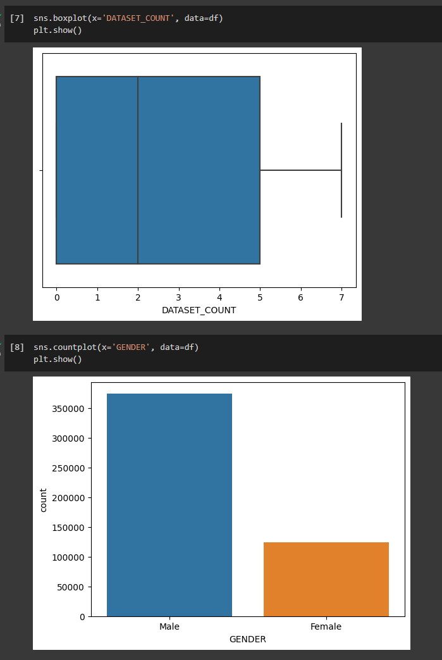
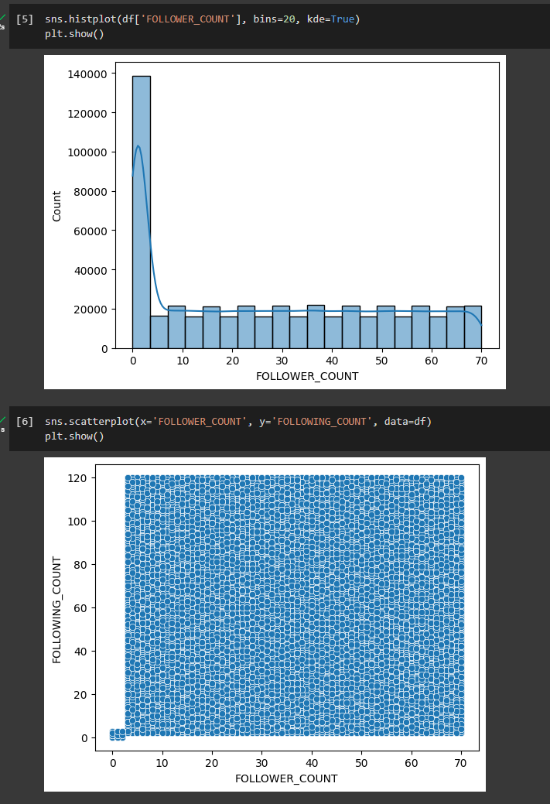
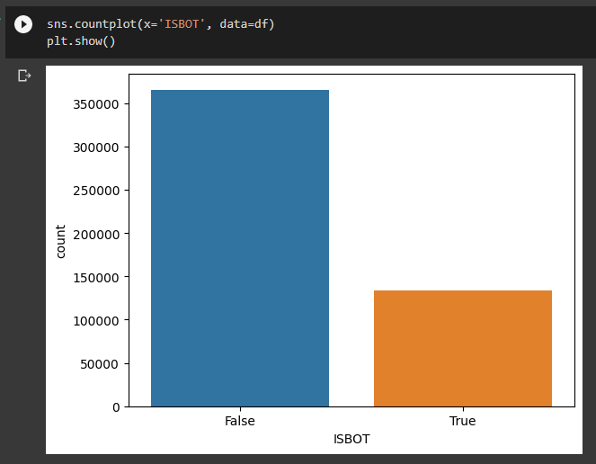
Pre-PROCESSING

Slide 6
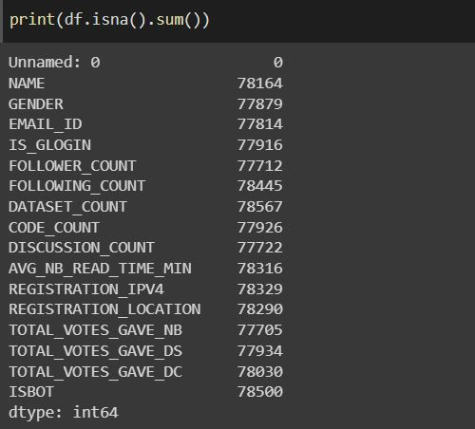
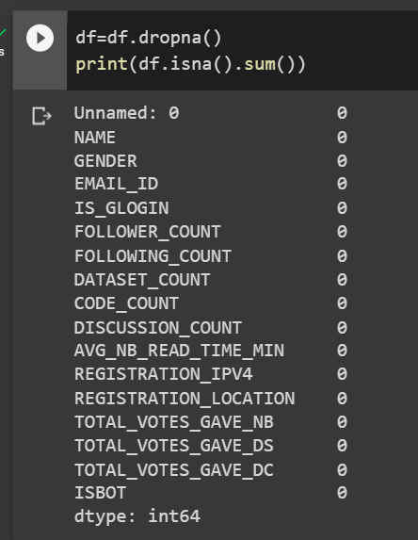
Missing values per columN

Slide 7
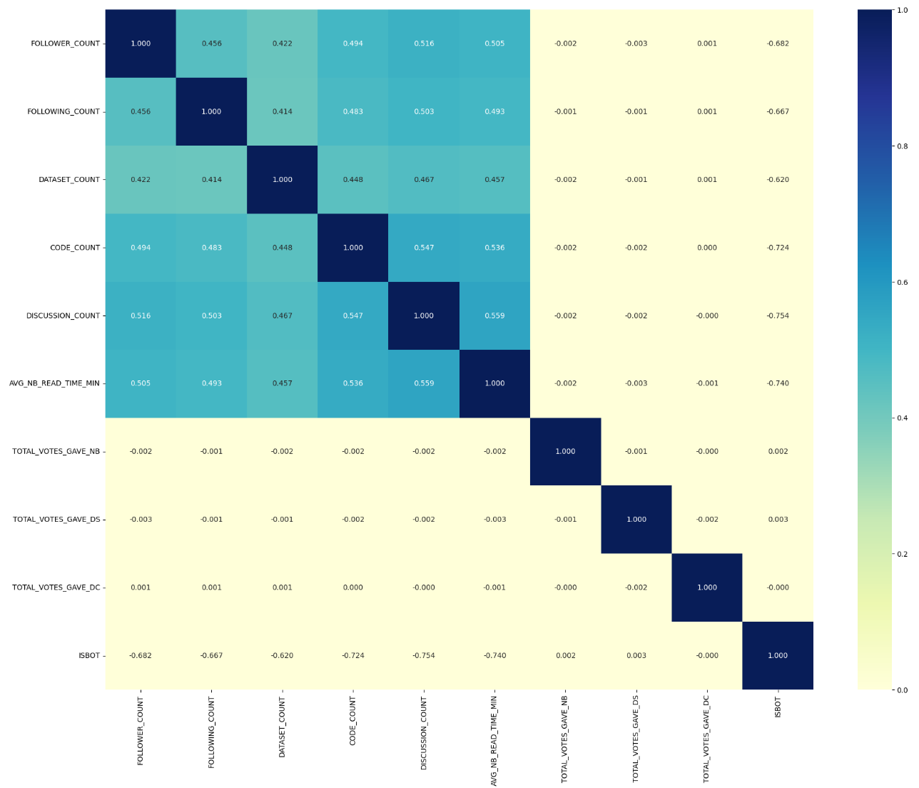
Correlation Heatmap
The correlation heat map displays the level of correlation between various features and their importance relative to each other.

Slide 8
ALGORITHMS USED
K-NEAREST NEIGHBOR NAÏVE BAYES XGBOOST SVM DECISION TREES RANDOM FOREST NN(TENTATIVE)

Slide 9
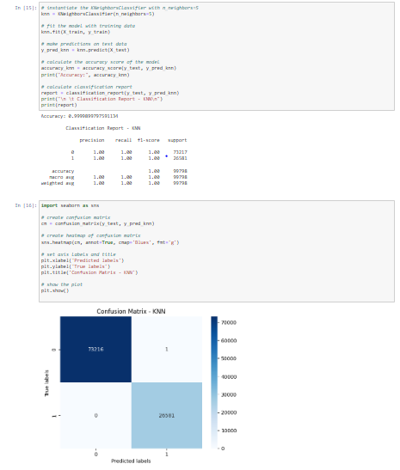
K-NEAREST NEIGHBOR
KNN (K-Nearest Neighbors) is a simple and effective machine learning algorithm used for classification and regression tasks. It works by identifying the K closest training examples to a given query point and using their labels or values to make a prediction.

Slide 10
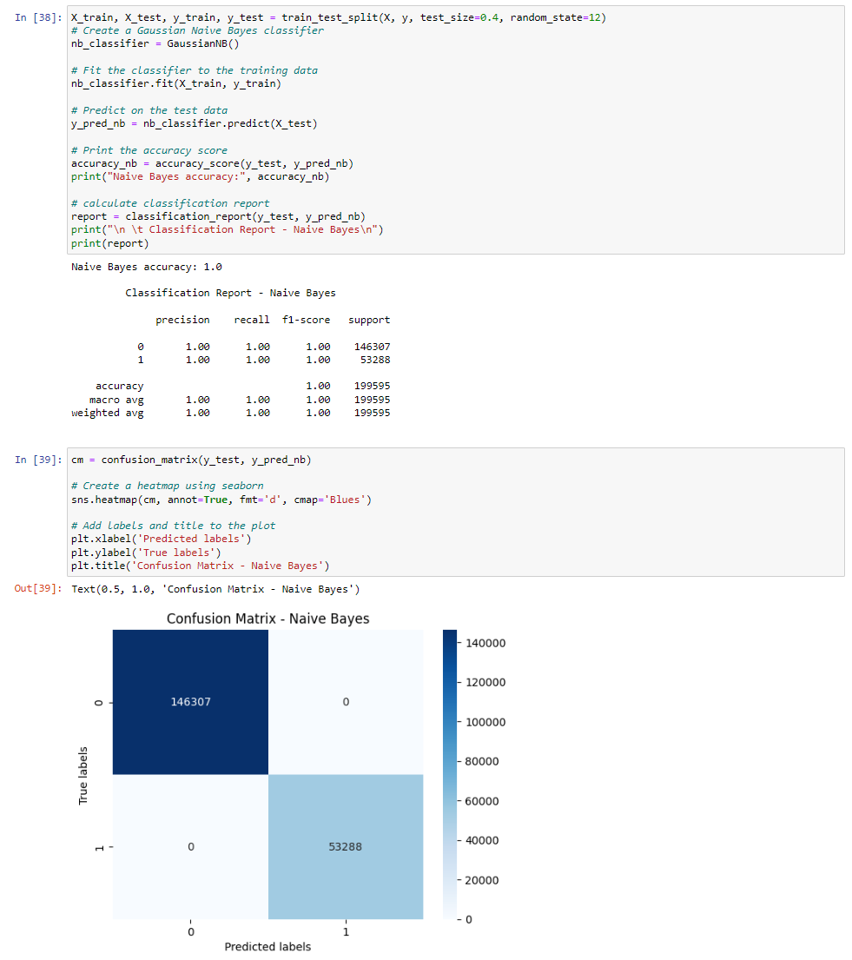
NAÏVE BAYES
Naïve Bayes is a classification algorithm that is based on Bayes' theorem. It assumes that all features in a dataset are independent of each other and calculates the probability of each class based on the probability of each feature occurring in that class. It is a simple but effective algorithm that is widely used in text classification and spam filtering.

Slide 11
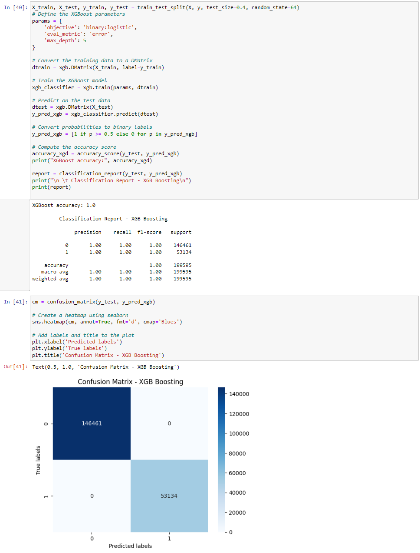
XGBOOST
XGBoost is a popular and powerful gradient boosting algorithm used for supervised learning problems. It is designed to handle large-scale, high-dimensional data and can be used for classification, regression, and ranking tasks. XGBoost builds a sequence of decision trees that are optimized using gradient descent to minimize a given loss function.

Slide 12
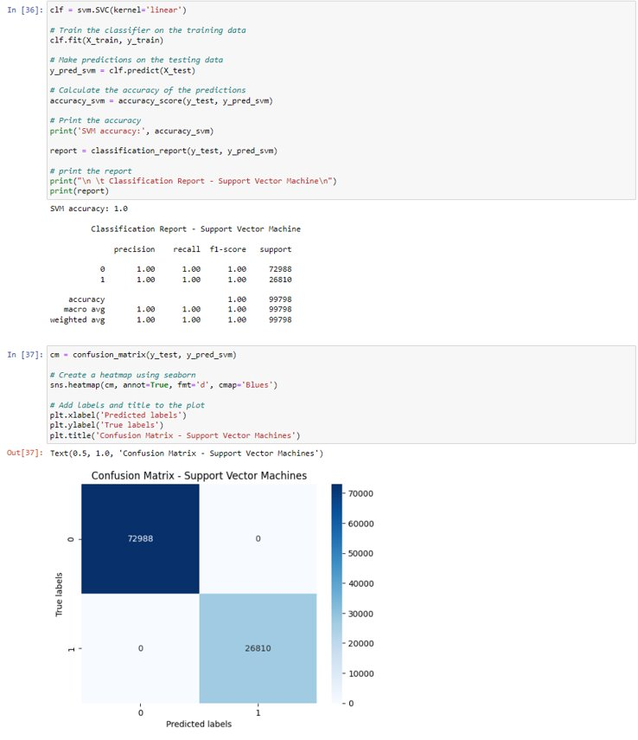
svm
Support Vector Machine (SVM) is a powerful machine learning algorithm used for both classification and regression tasks. It works by finding the best hyperplane that separates the data into different classes while maximizing the margin between the classes.

Slide 13
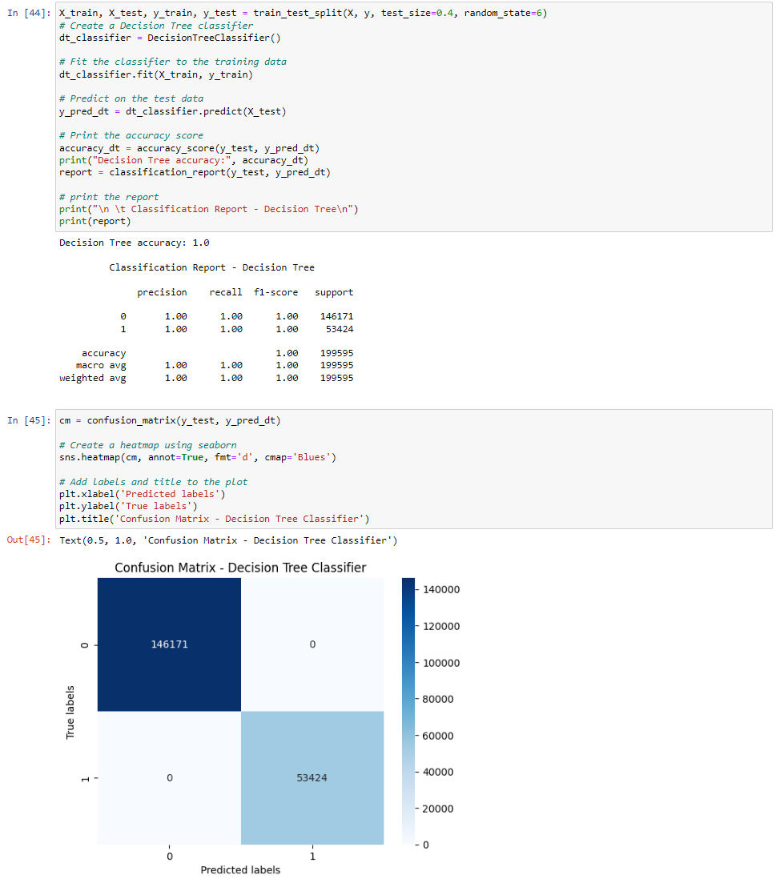
DeCESION TREES
Decision trees are a type of machine learning model that uses a tree-like graph to represent decisions and their possible consequences. They are often used for classification and regression tasks and can handle both categorical and numerical data.

Slide 14
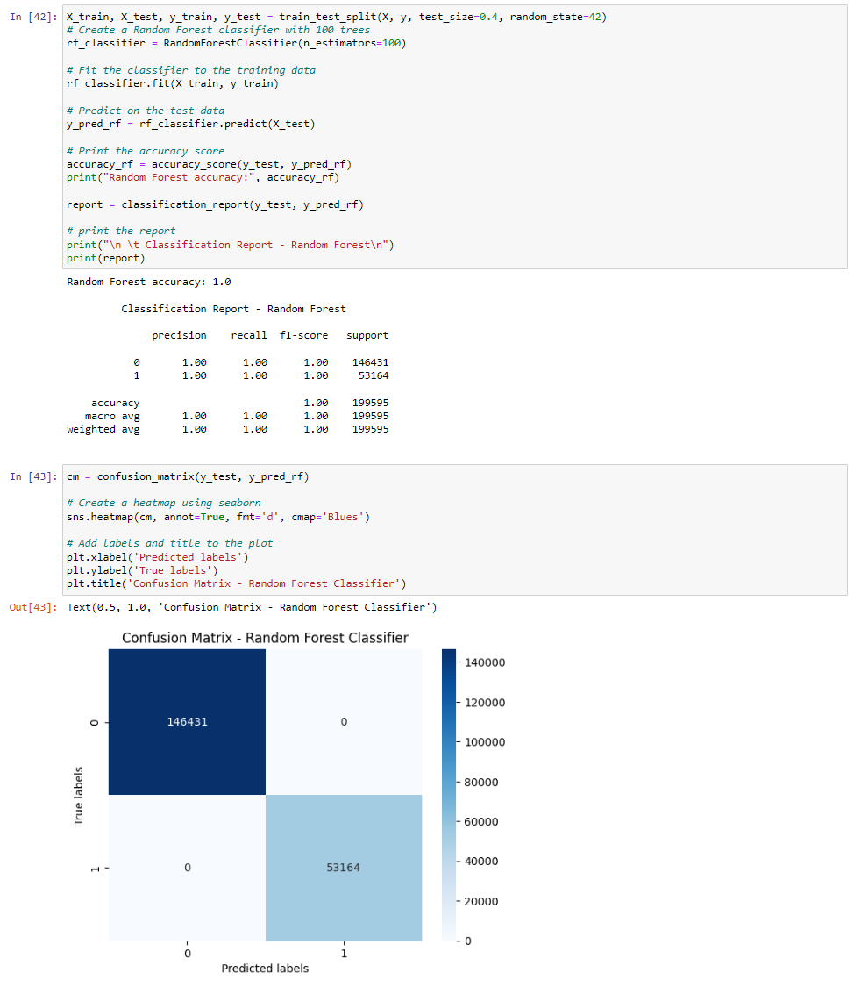
RANDOM FOREST
Random Forest is a machine learning algorithm that combines multiple decision trees to make a more accurate prediction. It randomly selects a subset of features for each tree and aggregates the predictions of all trees to make the final decision. It is widely used for classification and regression tasks in various domains.

Slide 15
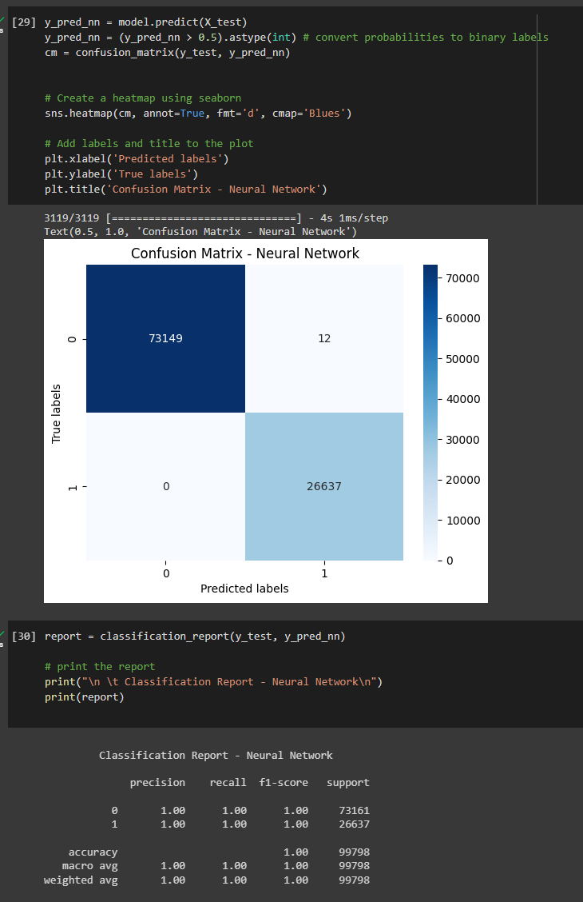
Neural Network
A neural network (NN) is a type of machine learning model that is designed to simulate the function of the human brain. It consists of layers of interconnected nodes, or neurons, that process and analyze input data to produce output predictions or classifications. NNs are widely used in various fields, including computer vision, natural language processing, and speech recognition

Slide 16
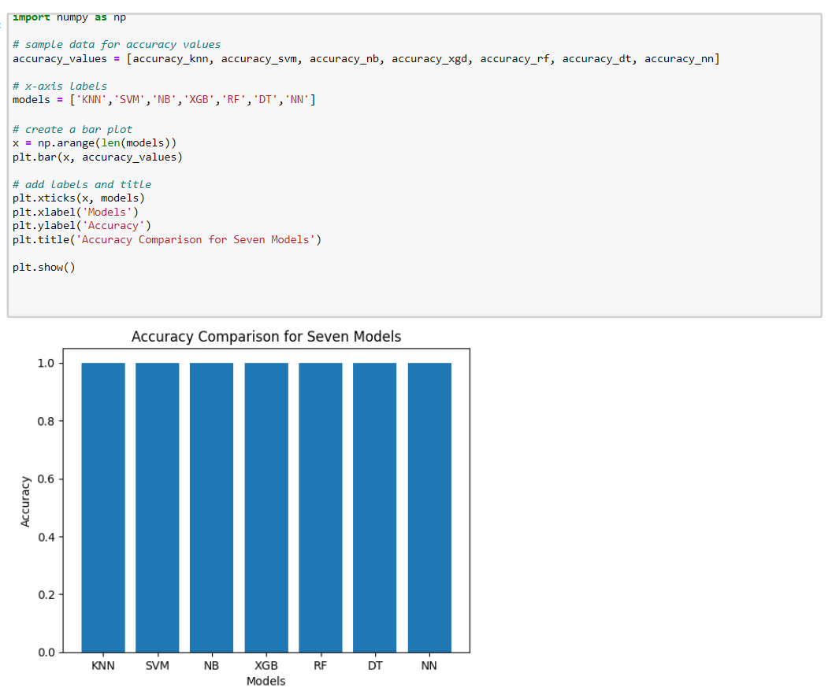
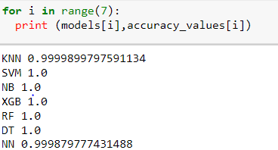
Comparison and conclusion

Slide 17
Thank you

