Slide 1
KLARO
A Private, Offline Assistant for Reading Tender Documents (RFPs)
Major Project Part-1 · B.Tech CSE · Jaypee Institute of Information Technology, Noida
Yasharth Singh
9923103059
Nikunj Sethi
9923103069
Shrey Sircar
9923103072
Supervisor: Prof. Shikha Mehta, HOD-CSE

Slide 2
THE PROBLEM
Reading an RFP by hand is slow and error-prone
A Request for Proposal (RFP) is a document a company publishes when it wants bidders. Before a team can bid, someone has to read the whole thing and find the points that matter.
50–100
0
Pages in a typical RFP
RFPs you can safely upload to a public chatbot
Deadlines, payment terms, eligibility and penalty clauses are scattered across many sections.
Tenders are confidential. Sending one to an online AI service is usually against company policy.
Klaro — Project Overview
2

Slide 3
OUR SOLUTION
Klaro reads the RFP for you — on your own laptop
Klaro is a desktop app. It reads a tender PDF and writes a short, organised summary — using a small AI model that runs entirely on the user's machine. Nothing is uploaded, ever.
01
02
03
Fully Offline
Small, Focused Model
Nine-Heading Summary
The AI model runs locally via Ollama. The document never leaves your laptop.
Qwen3.5 (4B) — light enough for an ordinary laptop, chosen after testing three models.
Scope, eligibility, dates, money, duration and conditions — every point links to its page.
Klaro — Project Overview
3

Slide 4
HOW IT WORKS
From a raw PDF to a checked summary, in six steps
EVERYTHING BELOW RUNS ON YOUR OWN LAPTOP — NOTHING IS UPLOADED
1
2
3
4
5
6
Upload the
RFP PDF
Split into
readable parts
Local AI reads
each part twice
Combine &
organise facts
AI writes the
9-heading summary
Quality check,
then shown to you
Step 3 & 5 use the AI model (dark boxes) — everything else is plain, deterministic code.
Every point in the final summary carries the page number it came from — clicking it opens the original PDF at that page.
Klaro — Pipeline
4

Slide 5
MODEL SELECTION
We tested three small AI models before picking one
Each model listed requirements from the same 20 RFP parts, checked against 47 hand-marked answers.
Gemma 4 (e4b)
SELECTED
Phi-4-mini
8.0B params · 9.6 GB
Qwen3.5 (4B)
3.8B params · 2.5 GB
60%
precision
70%
recall
4.7B params · 3.4 GB
44%
precision
15%
recall
74%
precision
49%
recall
Found the most, but nearly 3× the download size.
Fastest, but missed most requirements and invented one.
Fewest wrong claims and the smallest download — chosen.
Klaro — Model Selection
5

Slide 6
RESULTS
Tested end to end on real government and bank RFPs
Three full runs on an ordinary laptop: an 84-page government RFP, and a 54-page bank RFP run twice.
22–25 min
100%
0
3 / 3
Time for a 54–84 page RFP
Points backed by facts & page numbers
Made-up (hallucinated) facts, in any run
Runs completed with no failed parts
What we also learned
For long RFPs, the last step currently copies the collected facts instead of truly shortening them. Every point still carries a correct page number — this is the first fix planned for the next phase.
Klaro — Experimental Results
6

Slide 7
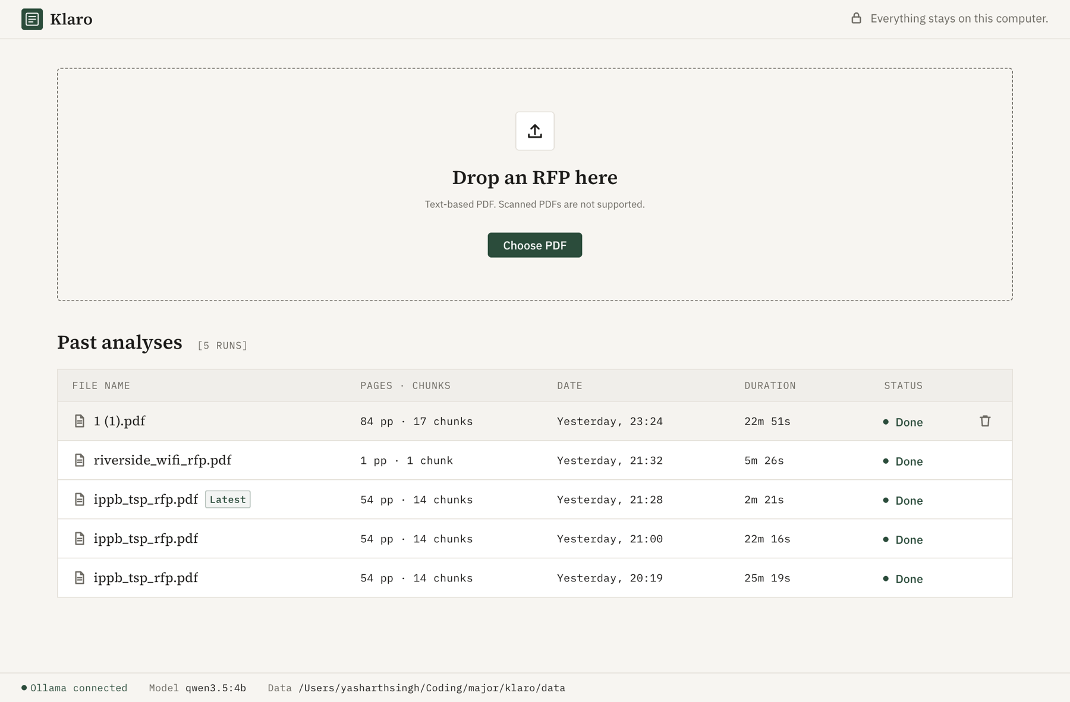
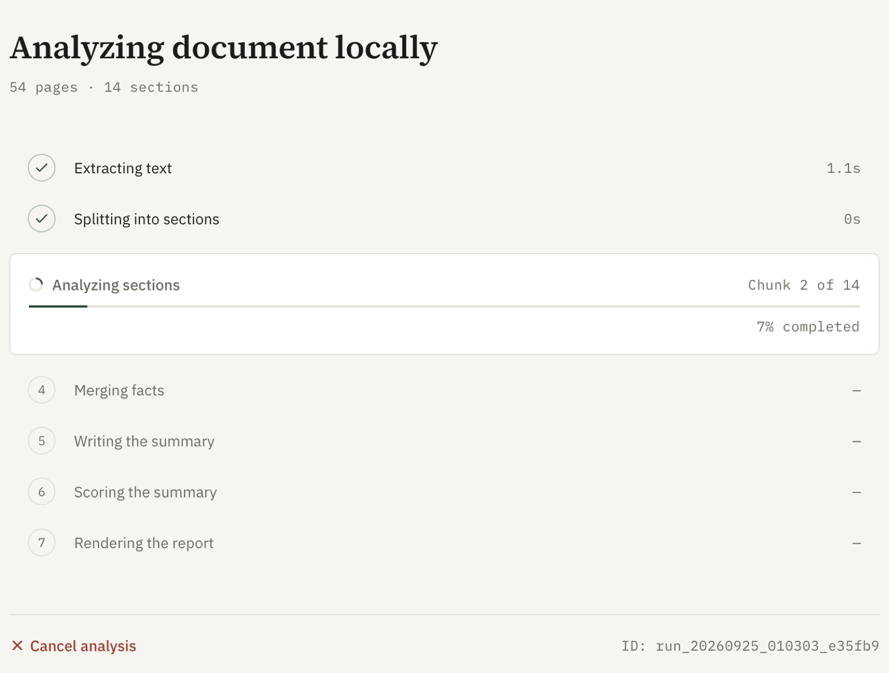
THE DESKTOP APP
A simple screen to watch, and a summary you can trust
Home screen — add an RFP or reopen a past run
Progress screen — live status while the AI reads
Klaro — Desktop App
7

Slide 8
HONEST LIMITS, AND WHAT'S NEXT
We know what's missing — here's the plan
CURRENT LIMITATIONS
PLANNED NEXT
Only a handful of RFPs tested so far
Long RFPs aren't shortened yet, only copied
English, text-based PDFs only — no scans
The AI can give slightly different answers on different runs
Fix long-summary copying
Let the model read more at once and write one heading at a time.
German support
Read German RFPs and reply in German or English — first added language.
Fine-tune the model
30–40 real RFPs, human-checked golden summaries, LoRA fine-tuning.
Proposal Assistant
Turn the summary into a first draft proposal, with a requirements checklist.
Klaro — Roadmap
8

Slide 9
Thank You
Questions on Klaro — the private, offline RFP reading assistant?
Yasharth Singh (9923103059) · Nikunj Sethi (9923103069) · Shrey Sircar (9923103072)
Supervisor: Prof. Shikha Mehta, HOD-CSE · Jaypee Institute of Information Technology, Noida

