Slide 1
Amazon Reviews Product Categorization & Sentiment Analysis
Abhijit Kannepalli & Shrey Shah

Slide 2
Aim
Dataset
The aim of this project is to classify the amazon product reviews into appropriate product categories and further perform sentiment analysis on the reviews. Our goal is to perform multilingual product classification for two languages - English and German and find the most appropriate model for the product classification.
The dataset contains reviews in English and German collected between November 1, 2015 and November 1, 2019. Each record in the dataset contains the review text, the review title, the star rating, an anonymized reviewer ID, an anonymized product ID and the product category (e.g. ‘books’, ‘appliances’, etc.) The corpus is balanced across stars.
For each language, there are 200,000 and 5,000 reviews in the training and test sets respectively. All reviews are truncated after 2,000 characters, and all reviews are at least 20 characters long.

Slide 3
Product Categorization

Slide 4
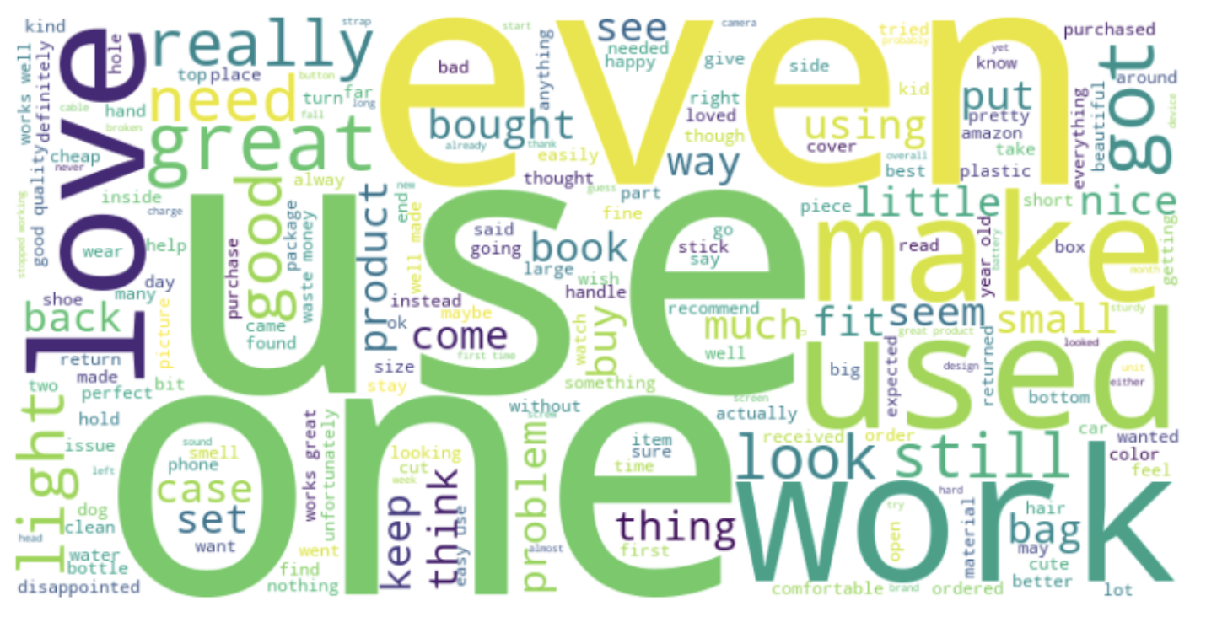
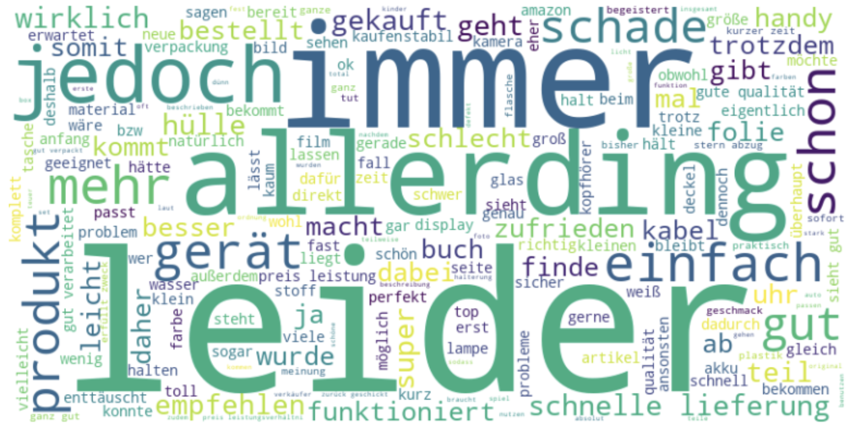
Descriptive Statistics
Parameters | English | German
Minimum Review Words | 15 | 16
Maximum Review Words | 3908 | 3869
Average Review Words | 178.846 | 207.919

Slide 5
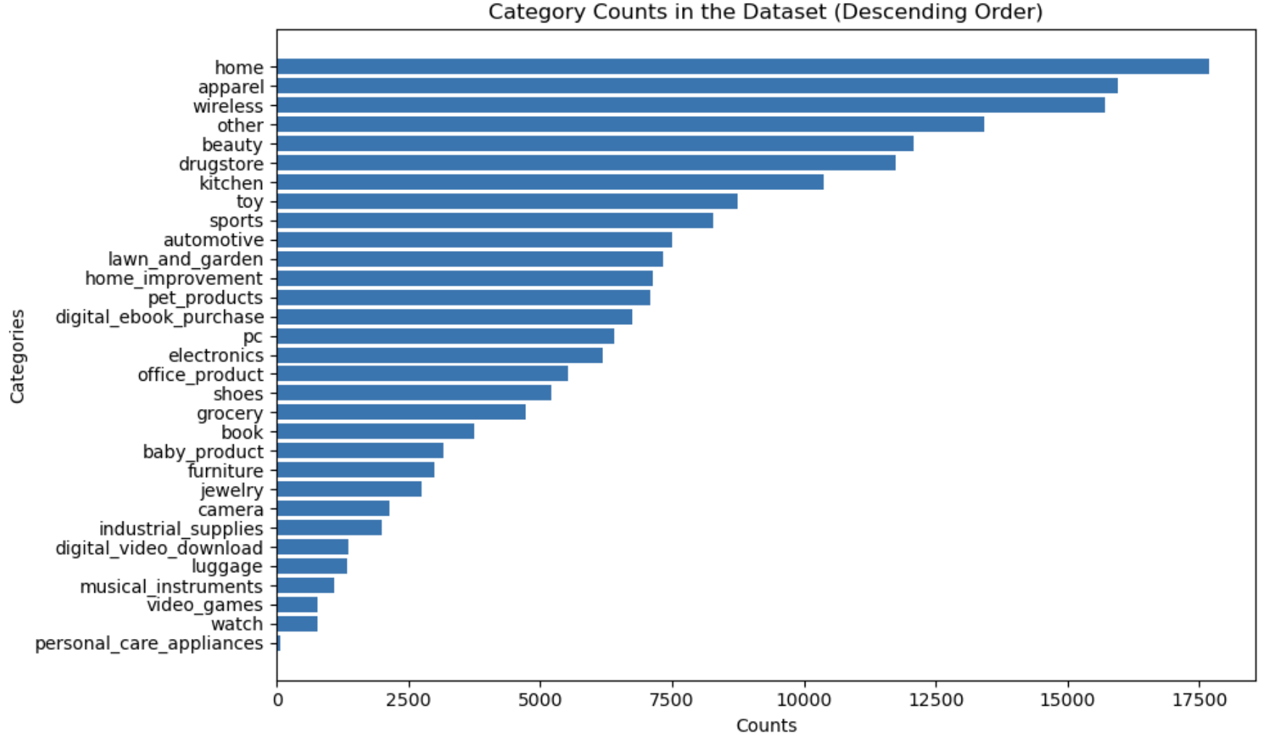
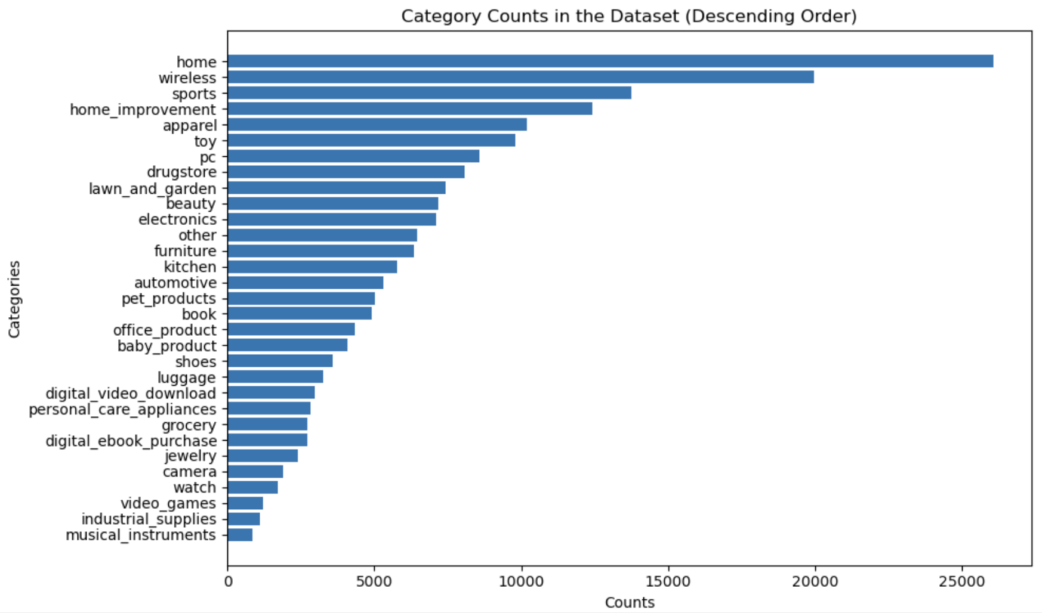
Category Counts
English German

Slide 6
Text Pre-processing Steps
Removing whitespace, HTML Tags and punctuation
Performed Tokenization
Stopwords removal for English and German languages separately
The list of tokens had numbers such as ‘’00”, “000” etc which did not add any meaning to our task of classifying reviews into product categories and we removed the numerical formats

Slide 7
Feature Engineering
For feature extraction we used two methods: CountVectorizer and TF-IDF vectorizer, and went ahead with CountVectorizer as it gave better preliminary results.
We tested the models with different k values on chi2 and mutual_info_classifier using SelectKBest and got the best results using chi2 on k = 5000 features.

Slide 8
Baseline Models
Linear classifiers serve as effective baseline models as suggested by (Lin et al., 2023).
Hence we have tried performing Linear SVC, Logistic Regression and Multinomial Naive Bayes.
To assess the quality of classification, we decided to use metrics like precision, recall and F1 score with weighted averages as each class’s contribution to the average is weighted by its support.
Model | Number of categories | Precision | Recall | F1 Score
Linear SVC | 31 | 0.433 | 0.445 | 0.434
Logistic Regression | 31 | 0.458 | 0.46 | 0.45
Multinomial Naive Bayes | 31 | 0.489 | 0.486 | 0.475

Slide 9
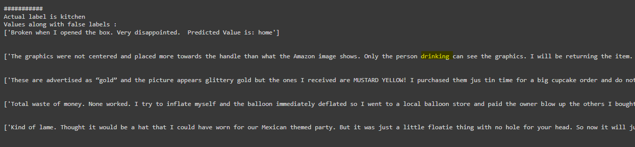
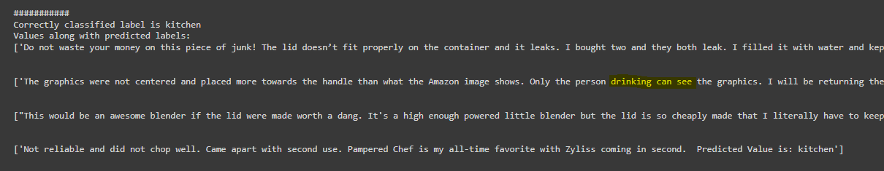
Insights
Misclassified review
Review Category after correction

Slide 10
Insights
Ambiguous Reviews - (Related to return, failed delivery )
Actual label is ‘drugstore’
Values along with false labels :
['Amazon never deliver the items. Horrible customer service. Considering new purchase choices. Predicted Value is: home']
Actual label is ‘apparel’
Values along with false labels :
['The hot glued parts are falling off. Predicted Value is: home']
['ordered product in MARCH has not arrived as of MAY 11. Attempt to contact seller and NO response! Predicted Value is: home']
Actual label is ‘wireless’
Values along with false labels :
['Nothing like the photo. Boo. Predicted Value is: home']

Slide 11
Dataset Filtering based on review counts
The metrics are not good enough owing to 31 classes. The dataset was highly imbalanced, with a ratio of 235:1 of the majority class to the minority class.
To address this issue, we filtered the data retaining only those categories for which the data consisted of more than 10000 reviews.
Based on this filtering, we had the 6 and 5 categories in English and German datasets respectively:
English - home, kitchen, apparel, beauty, drugstore, wireless
German - home, home_improvement, apparel, wireless, sports
We experimented ensemble and pretrained models.

Slide 12
Model Performance Evaluation and Comparison
The results for the filtered dataset and models are as follows:
Language | Model | Number of categories | Accuracy | Precision | Recall | F1 Score
English | Multinomial Naive Bayes | 6 | 0.674 | 0.67 | 0.674 | 0.668
 | MNB (k = 5000 features) |  | 0.676 | 0.672 | 0.676 | 0.672
German | Multinomial Naive Bayes | 5 | 0.679 | 0.686 | 0.679 | 0.668
 | MNB (k = 5000 features) |  | 0.683 | 0.69 | 0.683 | 0.673

Slide 13
Model Performance Evaluation and Comparison
Language | Model | Number of categories | Accuracy | Precision | Recall | F1 Score
English | Ensemble Model (LR + MNB, on 5000 features) | 6 | 0.631 | 0.627 | 0.631 | 0.623
 | BERT Pretrained (bert-base-uncased) |  | 0.705 | 0.705 | 0.705 | 0.702
German | Ensemble Model (LR + MNB, on 5000 features) | 5 | 0.683 | 0.689 | 0.683 | 0.674
 | BERT Pretrained (dbmdz/bert-base-german-uncased) |  | 0.688 | 0.694 | 0.688 | 0.683

Slide 14
Model Performance Evaluation and Comparison
Language | Model | Number of categories | Accuracy | Precision | Recall | F1 Score
English | CNN | 6 | 0.703 | 0.68 | 0.70 | 0.68
 | LSTM |  | 0.621 | 0.618 | 0.621 | 0.62
German | CNN | 5 | 0.721 | 0.717 | 0.711 | 0.719
 | LSTM |  | 0.587 | 0.58 | 0.587 | 0.569

Slide 15
Sentiment Analysis

Slide 16
Feature Engineering
For sentiment analysis, we used the ‘review_body’ and ‘review_title’ columns fas the input features and ‘stars’ as the star rating for the reviews.
We employed the CountVectorizer with unigrams to engineer the top 5000 features using Chi-Square thresholding.
We have also experimented by incorporating contextual information using word embeddings like word2vec and GloVe.

Slide 17


Insights
Incorrect classification:
The above review does not have much negative words and hence it has been misclassified as a 4 star review. Additionally the word ‘very’ has been misspelled from ‘vary’. Hence the classifier might have confused it with a positive sentiment giving it a 4.
The review has a positive tone even though it does not have strong positive terms. There are some negative terms but the meaning is opposite. The actual label is 3 but our model does a good job at predicting the better star rating.

Slide 18
Sentiment Analysis Classes
Based on our initial baseline models, we performed the 5-class sentiment analysis where the ratings ranges from 1 to 5.
The dataset was balanced across the different ratings with 40000 training instances for each rating level.
Classes 2,3,4 suffered from lower precision, recall and F1 score values as the model is unable capture significant complex sentence meaning and context.
Hence, we performed 3-class sentiment analysis by:
1,2 -> ‘negative’ reviews
3 -> ‘neutral’ reviews
4, 5 -> ‘positive’ reviews

Slide 19
Model Performance Evaluation and Comparison
The results for the filtered dataset and models are as follows:
Language | Model | Number of categories | Accuracy | Precision | Recall | F1 Score
English | Multinomial Naive Bayes with 5000 features | 5 | 0.498 | 0.485 | 0.498 | 0.489
 |  | 3 | 0.668 | 0.664 | 0.668 | 0.666
German | Multinomial Naive Bayes with 5000 features | 5 | 0.534 | 0.525 | 0.534 | 0.527
 |  | 3 | 0.709 | 0.709 | 0.708 | 0.709

Slide 20
Insights
The base model showed an improvement from 5 classes to 3 classes.
But even then only the positive and negative classes enjoyed high accuracy. The neutral sentiment was hard to classify due to its very simple nature.
To address this, we added contextual information using word embeddings like word2vec and GloVe with a Convolutional Neural Network (CNN)
CNN model specifications:
Sequential model with input layer for 5000 features
2 Dense layers with 64, 128 neurons respectively & ReLU activation function
1 output layer with softmax activation function
Categorical cross entropy loss with Adam optimiser

Slide 21
Model Performance Evaluation and Comparison
The results for the filtered dataset and models are as follows:
Language | Model | Number of categories | Accuracy | Precision | Recall | F1 Score
English | CNN with word2vec | 3 | 0.712 | 0.715 | 0.712 | 0.714
 | CNN with GloVe | 3 | 0.708 | 0.709 | 0.714 | 0.712
German | CNN with word2vec | 3 | 0.74 | 0.743 | 0.739 | 0.74
 | CNN with GloVe | 3 | 0.738 | 0.745 | 0.738 | 0.742

Slide 22
Learnings

Slide 23
What we learned
Information about the review cannot be determined without key words that are helpful in identifying the product class.
Sampling to balance the dataset may improve the accuracy by certain amount but does not give enough contextual information to for the model to train on varying data.
BERT is efficient in capturing contextual information.
For an ideal model, more resources are needed and more hyperparameter tuning is required with varying epochs, which is difficult to achieve on standard machines.

Slide 24
Summary
Product categorization based on customer reviews is a challenging use-case considering the large number of target categories and thin line of distinction between the properties of different categories.
Linear classification models like SVM sometimes outperform the pre-trained models.
Sentiment Analysis differs from Product Categorization in the sense that we need to factor in contextual information. Sometimes, a review may just use simple words and have a neutral tone but the model may misclassify it as positive review.

Slide 25
References
Esmaeilzadeh, A., & Taghva, K. (2021). Text classification using neural network language model (NNLM) and Bert: An empirical comparison. Lecture Notes in Networks and Systems, 175–189. https://doi.org/10.1007/978-3-030-82199-9_12
Lin, Y.-C., Chen, S.-A., Liu, J.-J., & Lin, C.-J. (2023a). Linear classifier: An often-forgotten baseline for text classification. Proceedings of the 61st Annual Meeting of the Association for Computational Linguistics (Volume 2: Short Papers). https://doi.org/10.18653/v1/2023.acl-short.160
Sharma, P., & Parwekar, P. (2023). Multiclass classification of online reviews using NLP & Machine Learning for Non-english language. Intelligent Human Computer Interaction, 85–94. https://doi.org/10.1007/978-3-031-27199-1_9
https://www.nltk.org/book/
https://huggingface.co/dbmdz/bert-base-german-uncased
https://huggingface.co/transformers/v3.0.2/model_doc/bert.html
https://scikit-learn.org/
https://pytorch.org/docs/stable/data.html#torch.utils.data.DataLoader

Slide 26
Thank You

