Slide 1



BIG DATA ANALYTICS ENGAGEMENT
Prepared for Starbucks Autumn 2026 Campaign
MAY 2026

Slide 2

PROBLEM STATEMENT
Our current program has a one-size-fits-all approach, regardless of whether you transact once a year or once a day.
Tressie Lieberman · Global Chief Brand Officer, Starbucks,
StarbucksInvestor Day · 29 January 2026

Slide 3
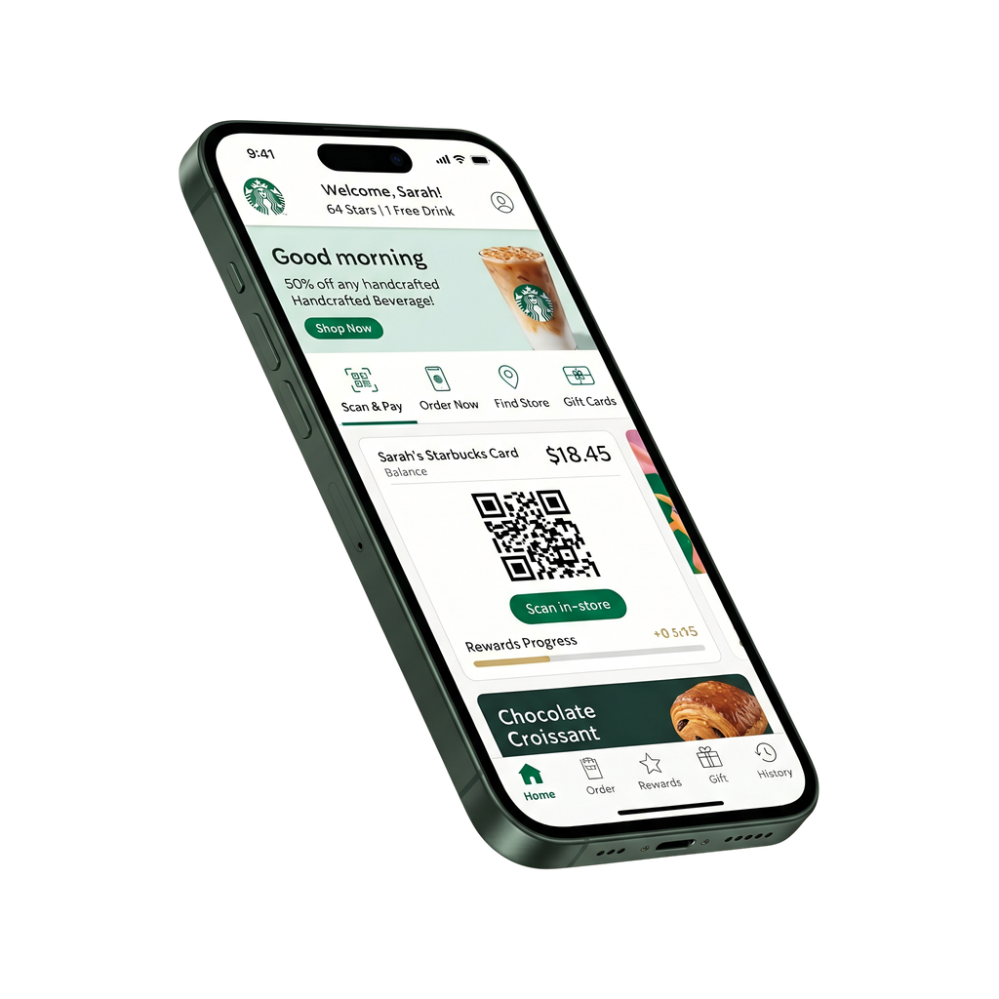
KEY OBJECTIVES
Tiers personalise the rewards. The next layer personalises the relationship, so each member, not each tier, gets the offer, the cadence, and the channel calibrated to who they actually are.
+$50M
revenue / per year
“If half of active rewards members transact one more time each year, it would deliver an extra $50 million in revenue.”

Slide 4

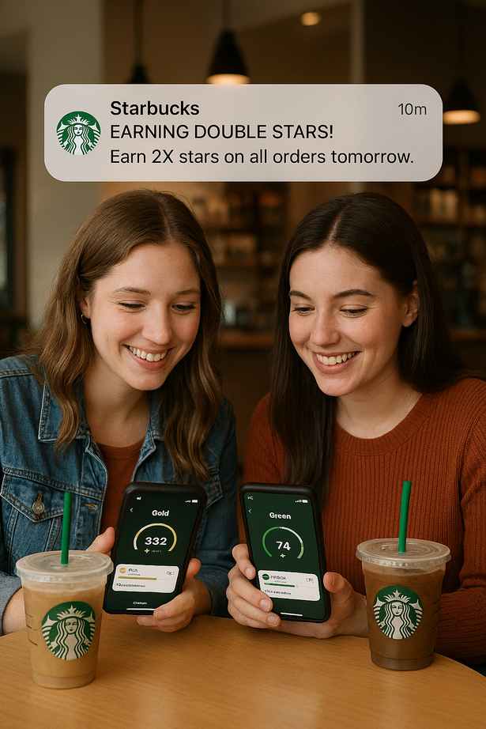


THE CURRENT STATE OF STARBUCKS LOYALTY
Programme Structure
Green / Gold / Reserve
Earn rates 1× / 1.2× / 1.7× stars per dollar
Deep Brew AI drives in-app recommendations and operational forecasting
Data Assets
5 years of transaction history, member-linked
35.5M Rewards 90-day active members (Q1 FY26)
10,000-member psychographic survey + 5 years of marketing campaign data
Marketing Layer
Broad-reach strategy since Q4 FY24 shift
Mix: paid search, paid social, email, in-app push, broad-reach TV
Cadence and message largely common across audiences

Slide 5
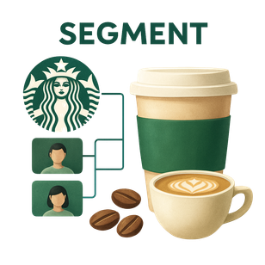
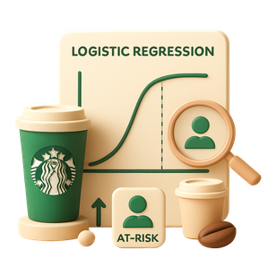
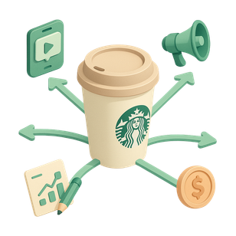
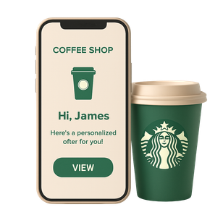
PROPOSED SOLUTION
MEMBER INTELLIGENCE AT SCALE
SEGMENT
PREDICT
ALLOCATE
CAMPAIGN
RFM clustering groups members by behaviour, then validated against the survey to ensure the segments hold.
Logistic regression flags members at risk of leaving so retention spend reaches the right people.
Multiple regression reveals where every marketing dollar earns most, by channel and by segment.
Segment-aware offers, cadence, and budget allocation delivered to inform Autumn 2026 campaign decisions.
Smith, A., Lukinova, E., Harvey, J., Smith, G., Mansilla, R., Goulding, J. and Nica-Avram, G. Consumer Decision-Making, Analytics and AI. Routledge.

Slide 6

METHODOLOGY
THREE TECHNIQUES CHOSEN FOR INTERPRETABILITY, SCALE, AND SEGMENT FIDELITY
CLUSTERING
CLASSIFICATION
REGRESSION
5 years of RFM features & 10,000-member psychographic survey overlay.
RFM, tier movement, app engagement, mobile order completion, segment membership.
5 years of marketing campaign data with channel allocation and spend, transaction outcomes, controls.
K-means with silhouette validation on RFM data. Chosen over hierarchical clustering because k-means scales cleanly to 35.5M members and the optimal segment count is selected by silhouette scoring.
Logistic regression at member level. Chosen over gradient boosting because GDPR Article 22 requires meaningful information about model logic, and weekly retraining at 35.5M scale rewards stability over marginal accuracy gains.
Hierarchical multiple regression with channel and segment interaction terms. Chosen over aggregate marketing mix modelling because aggregates flatten the very gap our work is meant to surface.
Channel × segment ROI heatmap with sensitivity ranges, refreshed monthly.
Five behavioural segments with tier overlay.
Weekly Power BI segment with feature-level explanations per flag.
Wang, T. (2016) 'Why Big Data Needs Thick Data', Ethnography Matters [Blog]. Available at: medium.com/ethnography-matters

Slide 7
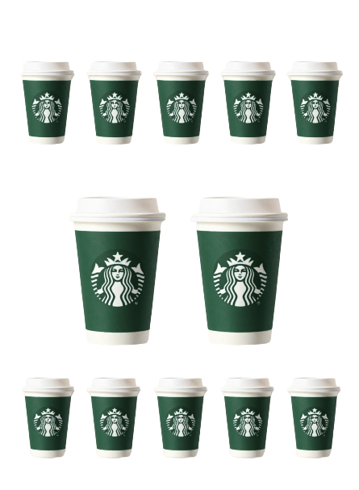
STP AT SCALE
S
SEGMENTATION
Anchor Loyalists - High frequency, high spend, low promotional response
Habitual Routines - Stable cadence, predictable patterns
Value Seekers - Promotion-driven, frequency follows offers
Lapsing Members - Declining frequency, churn risk window open
Occasional Visitors - Sporadic, low engagement, low cost-to-serve
T
TARGETING
Lapsing Members - Retention focus. Highest-impact 30-day intervention window.
Habitual Routines - Frequency lift focus. Dormant frequency capacity most easily activated.
Anchor Loyalists already maximised. Value Seekers and Occasional Visitors handled at lower priority.
P
POSITIONING
Anchor Loyalists - Recognise loyalty. Reinforce ritual.
Habitual Routines - Make the routine more valuable.
Value Seekers - Lead with offer relevance.
Lapsing Members - Recognise the gap. Curate a return reason.
Occasional Visitors - Reach efficiently. Paid acquisition only.
Smith, A. (2019) Consumer Behaviour and Analytics. Routledge.

Slide 8








7 Ps MARKETING MIX
THREE Ps WHERE MEMBER INTELLIGENCE SHARPENS DECISIONS
PRODUCT
PLACE
Premium beverages and food. Deep Brew handles in-app product personalisation.
38,000+ stores globally plus mobile-order across app, web, and in-store.
PRICE
PHYSICAL EVIDENCE
Premium pricing with tier-based earn rates. Owned in-house.
Store ambience, packaging, mobile app interface, Siren brand mark.
PROMOTION
PROCESS
Per-segment cadence, channel mix, and message. The MMM and segmentation outputs land here.
PEOPLE
Weekly model refresh, monthly campaign cycle, quarterly review. Analytics embedded into your operating rhythm.
Marketing team trained on live dashboards in week 16. Analytics they own, not analytics they receive.
Smith, A. (2019) Consumer Behaviour and Analytics. Routledge.

Slide 9
THE RACE FRAMEWORK
REACH
ACT
CONVERT
ENGAGE
Pre-Acquisition/Awareness
Pre-Purchase/Engagement
Purchase Decision
Post-Purchase/Retention
SIGNAL
MMM identifies which paid channels reach Occasional Visitors most efficiently
Churn model flags Lapsing Members hitting 30 days no-visit
Behavioural rules detect Value Seekers responding to offer cues
Segmentation distinguishes Anchor Loyalists from Habitual Routines
ACTION
Reactivation budget allocated to those channels and not to the broader media mix
Personalised win-back deploys before behaviour locks in as lapse
Trigger-based offer fires, calibrated to their typical basket value
Anchors get exclusive previews; Habituals get cadence-controlled email
SEGMENT
Occasional Visitors
Lapsing Members
Value Seekers
Anchor Loyalists + Habitual Routines
Chaffey, D. and Ellis-Chadwick, F. (2022) Digital Marketing: Strategy, Implementation and Practice. 7th edn. Pearson.

Slide 10
MONITORING & KPIs
PRE-ENGAGEMENT BASELINE
IN-FLIGHT MEASUREMENT
POST-LAUNCH VALIDATION
Per-tier churn rate (Green / Gold / Reserve)
Per-channel marketing ROI at current allocation
Per-segment engagement rate (cadence opt-out, offer redemption)
Revenue per active member, current run rate
Segment response rate to win-back messaging (week 6)
Offer redemption lift across segment cohorts (week 8)
Churn flag accuracy: actual lapse vs predicted (week 10)
Per-segment campaign response monitored live (week 12)
Incremental visit lift per segment vs baseline
Retention rate of churn-flagged lapsing members vs control
Cost per re-acquisition vs current baseline
Channel ROI shift after segment-aware allocation

Slide 11
DATA TYPES
VOLUNTEERED & DECLARED
OBSERVED
What members chose to share
• Member sign-up data (name, postcode, date of birth, communication preferences, date joined Rewards)
• 10,000-member psychographic survey
• Marketing consent records (per CNIL precedent)
What members actually do.
• 5 years of transaction data (member-linked)
• App engagement signals (push opens, offer redemptions, cadence response)
• Mobile order incompletion data
INFERRED
EXTERNAL
What your existing systems already produce.
• Tier transition history (Green ↔ Gold ↔ Reserve, since March 2026 launch)
• Mobile order incompletion flags at member level
• Customer satisfaction / NPS scores at member level (where collected)
Recommended additions to enrich your view.
• Weather data (already a Deep Brew input can extend to segmentation)
• Regional economic indicators (relevant to international market variation)
• Social listening signals (relevant to brand discourse and programme launch reaction)
Smith, A. (2019) Consumer Behaviour and Analytics. Routledge.

Slide 12

TECHNOLOGY REQUIREMENTS
01. INGESTION - EDAP
Member-linked transactions, app engagement signals, mobile incompletion flags, marketing campaign logs.
02. STORAGE - AZURE DATA LAKE
5 years of transaction history and segment outputs. Member-linked, partitioned by segment.
03 PROCESSING - DATABRICKS
Feature engineering pipeline. RFM features for clustering, churn features (recency, frequency, app engagement, lapse signals), MMM features (channel × segment exposure matrix).
04. ANALYSIS - AZURE ML
Model training, scoring, and deployment at scale. K-means clustering, logistic regression for churn, hierarchical multiple regression for MMM. Weekly retraining cadence.
05. VISUALISATION - POWER BI
Live segment dashboards for the marketing team - segment views, churn flags, MMM allocation. Outputs feed campaign deployment via your existing marketing automation platform.
06. GOVERNANCE - MICROSOFT PURVIEW
Data lineage, sensitivity labels, audit trails. Privacy by Design controls per Cavoukian (2009).
Smith, A., Lukinova, E., Harvey, J., Smith, G., Mansilla, R., Goulding, J. and Nica-Avram, G. Consumer Decision-Making, Analytics and AI. Routledge.

Slide 13
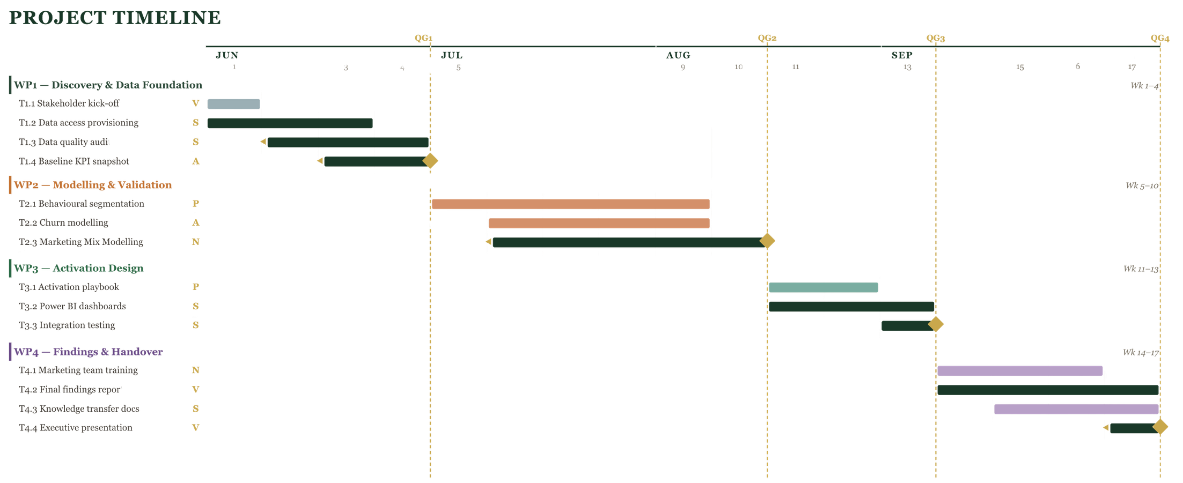
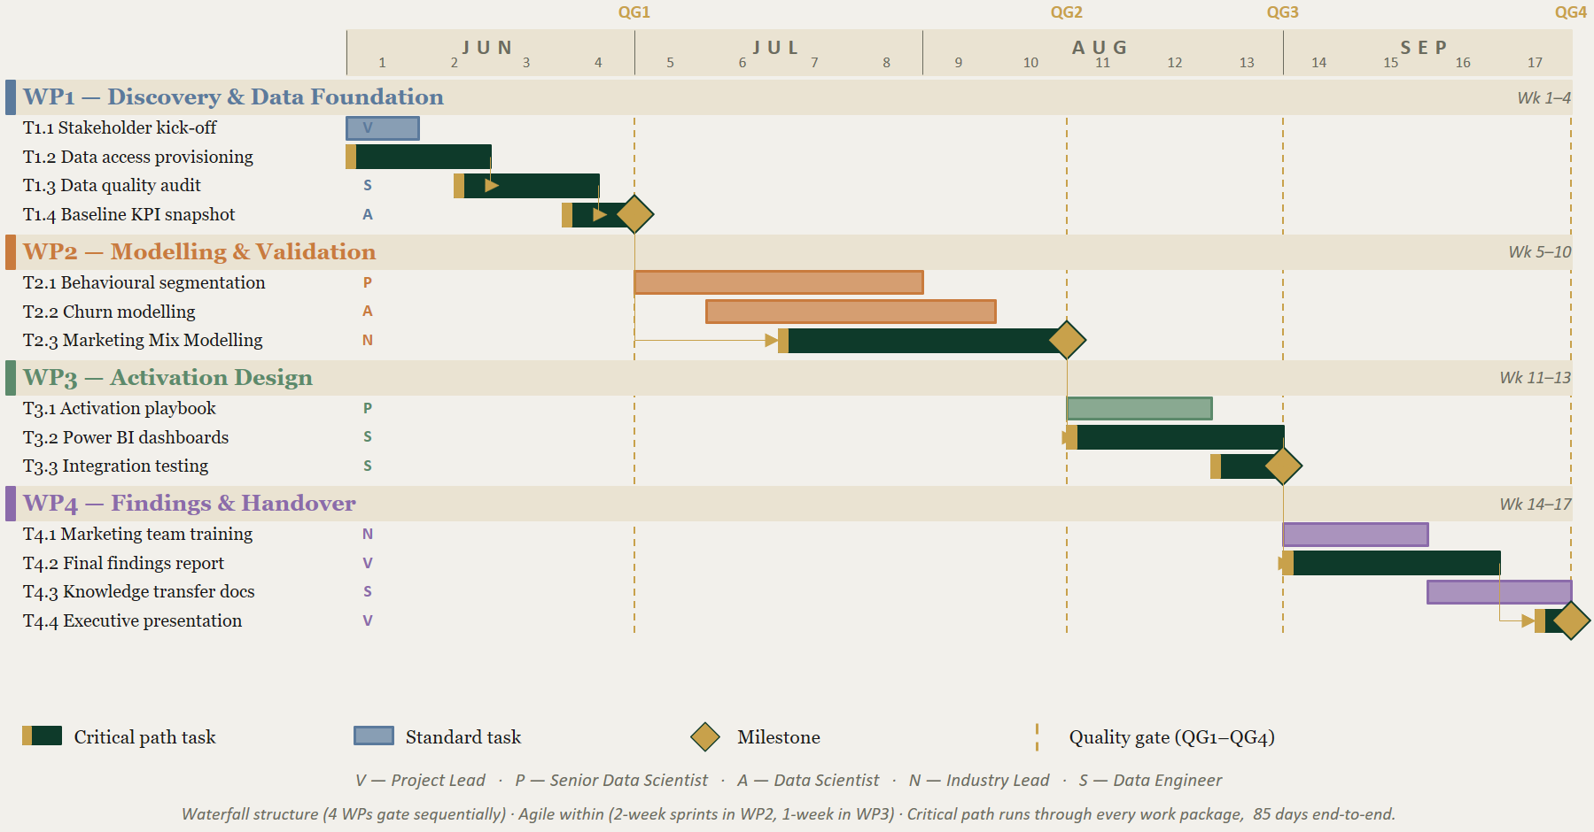
PROJECT TIMELINE
Wysocki, R.K. (2019) Effective Project Management. 8th edn. Wiley.

Slide 14
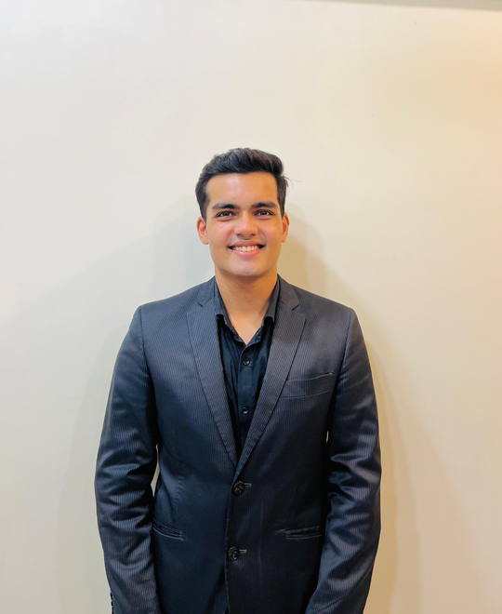




THE TEAM
Vallabh Joshi
Project Lead
Ashutosh Shinde
Data Scientist
Shreyash Meshram
Data Engineer
Paras Yadav
Senior Data Scientist
Noor Bhatti
Industry Lead
“Turning Data into Decisions, and Decisions into Growth.”

Slide 15

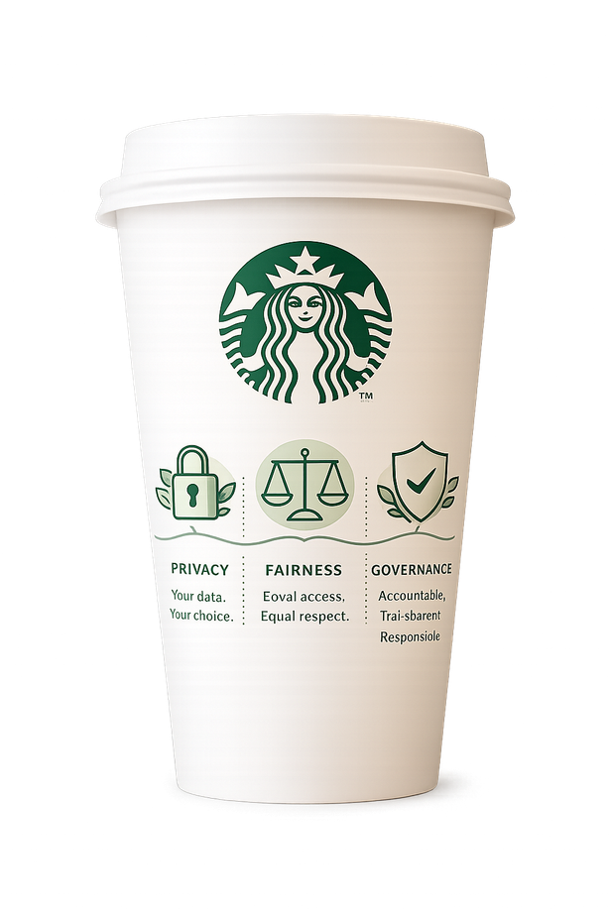


PRIVACY
ETHICS & PRIVACY
Per Cavoukian (2009)
Lawful basis documented per data category
Purpose limitation: data used only for stated objectives
Data minimisation across model inputs
Member opt-out one tap away in app
FAIRNESS
Per FAccT principles
Fairness audits across age, postcode, gender, tenure
Logistic regression for GDPR Article 22 compliance
Human-in-the-loop before retention spend triggers
No features that proxy sensitive attributes
GOVERNANCE
Per CNIL Deliberation
Microsoft Purview sensitivity labels and audit trails
Consent management at the ingestion layer
Quarterly ethics review with Privacy & Compliance
Sensitivity-driven feature engineering
Cavoukian, A. (2009) Privacy by Design: The 7 Foundational Principles. IPC Ontario. (already in your script)
Barocas, S., Hardt, M. and Narayanan, A. (2023) Fairness and Machine Learning. MIT Press.

Slide 16
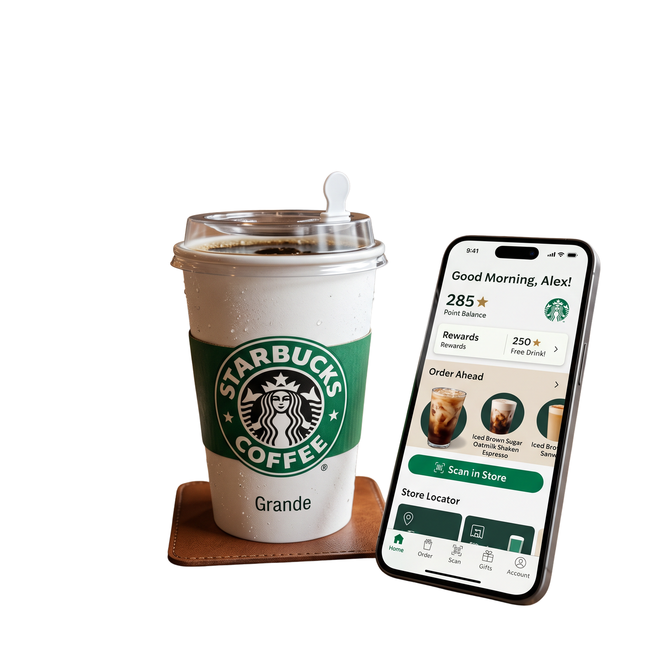
FROM INSIGHT TO OUTCOME
17 weeks to the first per-segment campaign - a foundation that compounds toward the $50M opportunity
YEAR 1 DELIVERABLES
What you have at engagement end
Five validated behavioural segments
Live churn-flag cohort in Power BI
Per-segment marketing mix model
Marketing team trained and operating
Autumn 2026 campaign brief, segment-aware
BEYOND YEAR 1
Where this compounds
Real-time personalisation as data volume grows
Loyalty programme evolution: segment-aware tier upgrades
Long-term partnership: segmentation underneath every campaign

