Slide 1

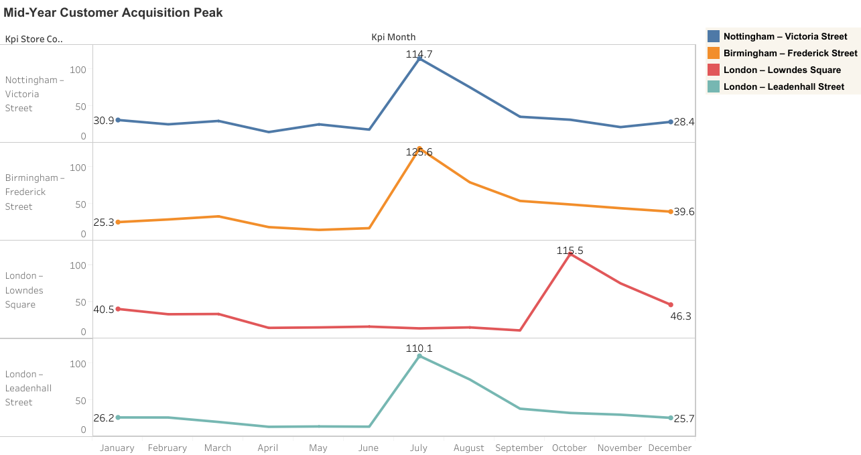
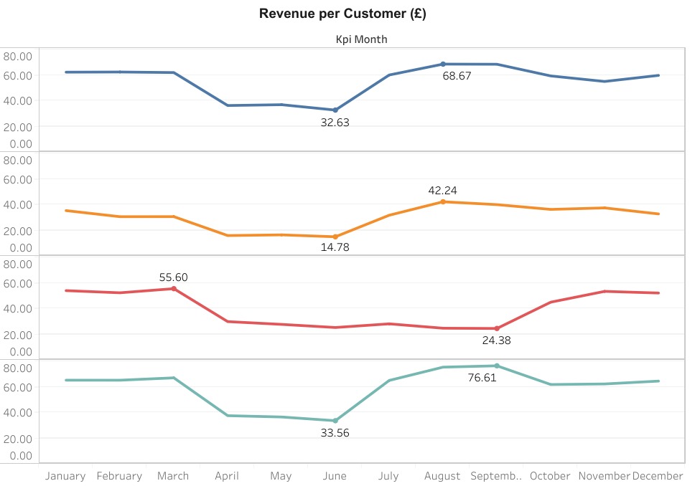
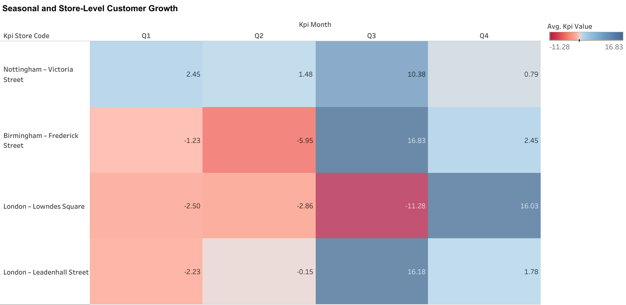
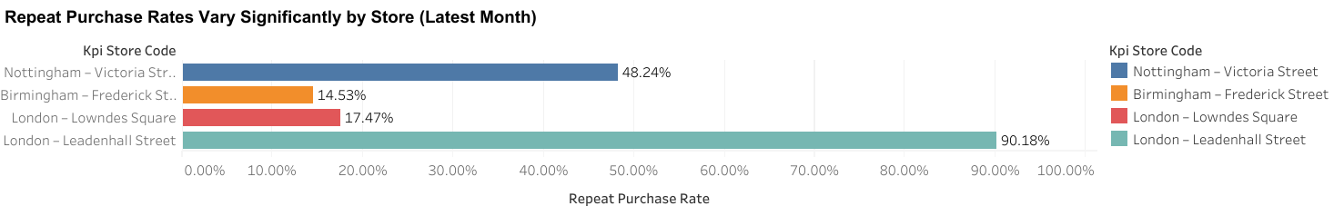
FoodCorp Store Performance Analysis
Key Insights:
Customer acquisition peaks mid-year across all stores.
London – Leadenhall Street shows the strongest growth and retention.
Birmingham lags in repeat purchase despite acquisition spikes.
Total Revenue: £1,291,690.23
nottingham.ac.uk/

