Slide 1
COMPILER DESIGN · PROJECT REVIEW
Regex Matching
Engine V2
From Thompson NFA to lazy DFA, symbolic minimization, and measured evidence
117
branch feature/v2-regex-engine
verified at d09673e
V2 tests passed
Review package · 28 October 2026
Notes:
Open with the review outcome: V2 is functionally broader and verified, but the fair benchmark also exposed a real matching-speed regression.
Sources:
- git log in /Users/shrey/Documents/compiler/project
- local pytest run on commit d09673e

Slide 2
EXECUTIVE RESULT
What changed — and what the measurements say
117
8 → 4
3.45–4.55×
V2 tests passed independently
Complete DFA states in the live demo
Slower V2 median matching on shared syntax
Capability
Fairness
Character classes, ranges, negation, numeric quantifiers, deterministic simulation, minimization, structured errors, and reproducible analysis.
V1/V2 ratios use only shared syntax, identical inputs, fresh processes, alternating order, warmups, and the same interpreter.
Bottom line: broader semantics are verified; matching performance is the next optimization target.
02
Notes:
Do not present V2 as faster. The comparison shows equal automaton state counts and nearly flat RSS, but materially higher per-character matching cost.
Sources:
- benchmarks/review_2026_10_27/v1_v2_comparison.json
- docs/V2_SEMANTICS.md

Slide 3
ARCHITECTURE
One engine, two deliberate execution paths
Regex
NFA
Lazy DFA
MATCH
parser + AST
Thompson
on demand
full string
Complete DFA → partition refinement
optional · bounded · visualization + analysis
Simulation and diagnostics observe both paths without changing matching semantics.
03
Notes:
Explain that normal matching never needs complete determinization. The complete DFA exists for minimization and analysis, and its budgets are intentionally tighter.
Sources:
- regex_engine/parser.py
- regex_engine/nfa.py
- regex_engine/dfa.py
- regex_engine/matcher.py
- regex_engine/simulation.py

Slide 4
V2 SEMANTICS
The parser now expresses richer regular languages
[A-Za-z]
positive class + ranges
one code point from the union
[^0-9]
negated class
one code point outside the class
x{3}
exact repetition
three concatenated copies
x{2,5}
bounded repetition
two required, three optional
x{2,}
open upper bound
two required, then Kleene star
Exact boundary
Full-string matching only; no anchors, captures, lookaround, backreferences, flags, or substring search.
04
Notes:
Use the right-hand column to explain implementation semantics, not just syntax examples. Numeric quantifiers expand into Thompson fragments and are protected by state budgets.
Sources:
- docs/V2_SEMANTICS.md
- regex_engine/parser.py
- regex_engine/nfa.py

Slide 5
ALGORITHMS
V2 generalizes the transition alphabet
01
Thompson construction
AST nodes become ε-NFA fragments with one start and one accept interface.
02
Lazy subset construction
Only DFA subsets reached by the actual input are created and cached.
03
Symbolic equivalence classes
Characters with identical transition signatures share one compact input class.
04
Partition refinement
Accepting and non-accepting groups split until every class has stable destinations.
Performance clue: V2 recomputes a generalized character signature on every match step; V1 uses a cheaper literal-or-wildcard key.
05
Notes:
Connect the final callout to the benchmark result. The language and algorithms are correct; the generalized signature path is where an optimization should be evaluated.
Sources:
- regex_engine/dfa.py
- benchmarks/review_2026_10_27/v1_v2_comparison.json

Slide 6
MEASUREMENT
Fair V1/V2 protocol — same language, same machine
Isolation
Ordering
Timing
Memory
Fresh process for every version, workload, and round
5 rounds; V1-first and V2-first order alternated
10 warmups + 40 matches per round = 200 samples
tracemalloc peak + process maximum RSS
Shared-syntax workloads
(a|b)*abb
4,003 chars
suffix language
a.*z
4,002 chars
wildcard scan
(ab|ac|db|dc)*
4,000 chars
alternation loop
Excluded from ratios: [A-Za-z0-9_]{4,32} and [^,]{1,1000} because V1 cannot parse them.
06
Notes:
Stress that shared syntax prevents an apples-to-oranges comparison. V2-only workloads are reported separately as feature evidence.
Sources:
- scripts/review_benchmark.py
- benchmarks/review_2026_10_27/v1_v2_comparison.json
- benchmarks/review_2026_10_27/v2_feature_workloads.json

Slide 7
MEASURED RESULT
V2 matching is slower on all shared workloads
3.45×
suffix language
4.55×
wildcard scan
4.01×
alternation loop
Lower is better · medians from 200 samples per version/workload
07
Notes:
Read the ratios directly. Then explain that the measured penalty is on a warm lazy-DFA core path, not HTTP or trace formatting.
Sources:
- benchmarks/review_2026_10_27/v1_v2_comparison.json

Slide 8
MEASURED RESULT
State counts are equal; process memory is effectively flat
RSS differences are below 0.3%; equal state counts isolate the slowdown to per-character work, not state growth.
08
Notes:
RSS is a coarse peak measure that includes the interpreter and imports. The strongest conclusion is that V2 does not inflate the automaton state count on the shared workloads.
Sources:
- benchmarks/review_2026_10_27/v1_v2_comparison.json

Slide 9
LIVE DEMONSTRATION
Equivalent complete-DFA states collapse into four partitions
Complete DFA · 8 reachable states
Minimized DFA · 4 states
D4
D1
D0
M0
M1
D5
D0 · start
D1 + D3
D3
D6
partition
refinement
D2
M2
M3
D7
D2 · dead
D4 + D5 + D6 + D7 · accept
Why it works: after a or d, the machine accepts the same suffix set — b or c.
09
Notes:
Walk through the partitions. D1 and D3 are indistinguishable; all four accepting states are indistinguishable; the dead state remains separate.
Sources:
- scripts/dfa_minimization_demo.py
- review/DFA_MINIMIZATION_LIVE_DEMO.md

Slide 10
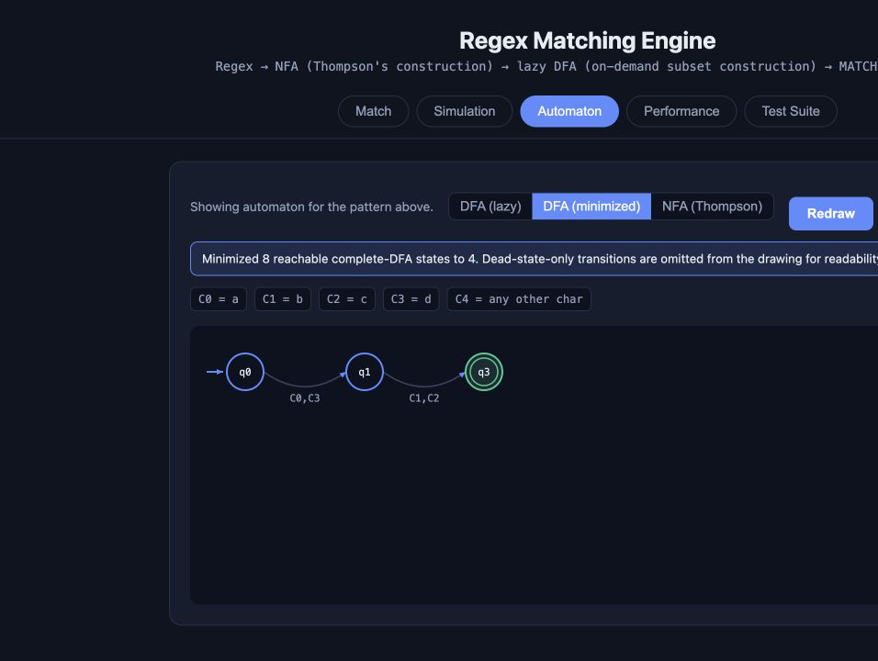
LIVE DEMONSTRATION
Run the script, then switch the dashboard view
cd /Users/shrey/Documents/compiler/project
./.venv/bin/python scripts/dfa_minimization_demo.py
Expected
8 complete states → 4 minimized states
50.0% reduction · 5 symbolic classes
Inputs
MATCH ab · ac · db · dc
NO MATCH aa · cb · abc · empty
Fallback evidence captured from the local dashboard
10
Notes:
If the server is already running, open the Automaton tab, enter (ab|ac|db|dc), select DFA (lazy), then DFA (minimized). The drawing omits the dead state for readability but the count remains four.
Sources:
- review/assets/dashboard_lazy_dfa.jpg
- review/assets/dashboard_minimized_dfa.jpg
- review/DFA_MINIMIZATION_LIVE_DEMO.md

Slide 11
ENGINEERING LIMITS
Budgets bound expansion; limitations remain explicit
50,000
20,000
5,000
expanded NFA states
lazy-DFA states
minimization input states
2,048
2,000,000
500
symbolic input classes
input code points
simulation display steps
Language boundary
Operational boundary
Full-string matching only; no anchors, captures, lookaround, backreferences, flags, or substring search.
The local FastAPI dashboard has no authentication or rate limiting; the repository has no configured CI workflow.
Optimization candidate: cache signatures by symbolic input class or add a literal fast path, then rerun the identical protocol.
11
Notes:
These budgets are part of the semantics, not emergency afterthoughts. Large bounded quantifiers can expand the NFA substantially, while ordinary matching remains lazy.
Sources:
- docs/V2_SEMANTICS.md
- regex_engine/errors.py

Slide 12
REVIEW CLOSE
Evidence, commands, and the next decision
82
117
50%
V1 tests at 09de2a6
V2 tests at d09673e
state reduction in live demo
Reproduce
PYTHONDONTWRITEBYTECODE=1 ./.venv/bin/python -m pytest -q -p no:cacheprovider
./.venv/bin/python scripts/dfa_minimization_demo.py
./.venv/bin/python -m uvicorn server.main:app --reload --port 8008
Decision for the next iteration
Keep V2 semantics; optimize the character-signature hot path; rerun the frozen comparison before making any speed claim.
12
Notes:
End with a precise decision: preserve the V2 feature set and tests, optimize the hot path, and use the same comparison script as the acceptance test.
Sources:
- review/Compiler_Design_Project_Review_Report.pdf
- benchmarks/review_2026_10_27/v1_v2_comparison.json
- review/DFA_MINIMIZATION_LIVE_DEMO.md

