Slide 1
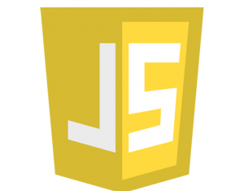

Javascript Execution Model
Staring:
the main (UI) thread
Asynchronous actions

Slide 2


Execution model - Visual Representation
Stack
Heap
Web APIs
DOM (document)
foo()
setTimeout, setInterval
bar()
AJAX (XMLHttpRequest)
onload()
Event loop
Callback Queue:
onClick
Interval
Data ready

Slide 3
The Call-Stack
JS (similar to many programming languages) uses a call-stack to manage the execution
function foo(b) { var a = 10 return a + b + 11 } function bar(x) { var y = 3 return foo(x * y) } function onload() { return bar(7) }
The Call-Stack
foo() b=21 a=10
bar() x=7 y=3
onload()

Slide 4
The Heap
Objects are allocated in the heap
which is large mostly unstructured region of memory.
Stack
Heap
foo() return {name: ‘P’}
bar() arr = [1, 2, 3]
Global scope

Slide 5
Messages Queue / Callback Queue
The JS engine contains a message queue, which is a list of messages to be processed.
A function is associated with each message.
When the stack is empty, a message is taken out of the queue and the function is processed.
The processing ends when the stack becomes empty again.
Stack
Heap
Web APIs
DOM (document)
Event loop
AJAX (XMLHttpRequest)
setTimeout, setInterval
Callback Queue:
onLoad
onClick
Interval cb
Data ready

Slide 6
Run to completion & Never blocking
Run to completion
Each message is processed completely before any other message is processed.
This is the single threaded nature of javascript
This means our processing should be kept short and sweet
Never Blocking
Javascript never blocks!
Besides:
the native popups: alert, prompt, confirm
There is a synchronous option (hardly used) for I/O such as in XMLHttpRequest

Slide 7
Javascript Execution Model

