Slide 1
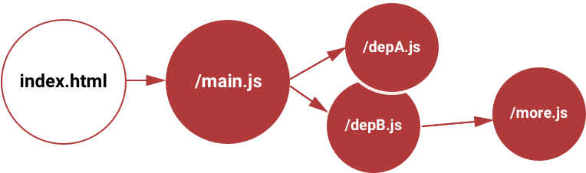
Switching to modules
Let the app grow
misterBIT.co.il

Slide 2
Javascript modules
When coding modern javascript we use modules
Lets review

Slide 3
type="module"
<!DOCTYPE html>
<html>
<head>
<meta charset="UTF-8" />
<title>JS Samples</title>
</head>
<body>
<h1>JS Modules</h1>
<button class="btn-foo" onclick="onFoo()">Foo</button>
<script type="module" src="js/main.js"></script>
</body>
</html>

Slide 4
strict mode
When working with modules, we are automatically in strict mode
bye bye 'use strict'
bla=0 // Uncaught ReferenceError: bla is not defined

Slide 5
No globals
When working with modules, variables are not global
We can define global variable by accessing the window object
var gNotGlobal = 'Nope' // I'm known in the file only
window.gGlobal = 'Yep' // I am a global

Slide 6
No global event handlers
When working with modules, functions are not global
Here is a simple workaround:
<button class="btn-foo" onclick="onFoo()">Foo</button>
window.onFoo = onFoo
function onFoo() {
console.log('Foo!')
}

Slide 7
Named imports and exports
Here is how
// in file: util.service.js
export const utilService = {
saveToStorage,
loadFromStorage,
makeId
}
// some other file:
import { utilService } from './util.service.js'

Slide 8

CRUDL
As we've seen before, when building apps, we usually have some entities that the application manages:
We usually need to:
Create – add a new entity
Read – read the entire details of the entity
Update – update the entity
Delete – remove the entity
List – Read a list of the entity preview
(filtered / ordered / paging)

Slide 9

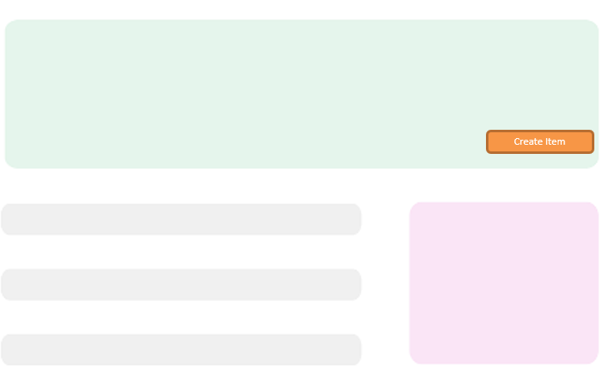
Back to our MVC
<View Layer>
petController
render
onSomething
petService
CRUDL
storageService
save, load
localStorage

Slide 10
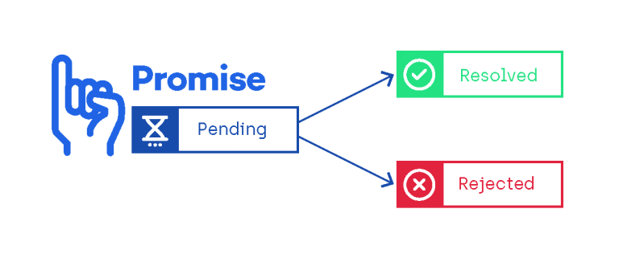
Switching our CRUDL service to work with promises
In our frontend, our the services will later use AJAX to call the server and perform the CRUDL on the database
So the response will come as a promise

Slide 11
Meet the async-storage service
This service implements functions for our CRUDL with a Promise API
export const storageService = {
post, // Create
get, // Read
put, // Update
remove, // Delete
query // List
}
storageService
localStorage

Slide 12
Meet the async-storage service
The query function is used by the other functions:
function query(entityType, delay = 500) {
var entities = JSON.parse(localStorage.getItem(entityType)) || []
return new Promise(resolve => setTimeout(() => resolve(entities), delay))
}
function get(entityType, entityId) {
return query(entityType).then(entities => {
const entity = entities.find(entity => entity.id === entityId)
return entity
})
}
function remove(entityType, entityId) {
return query(entityType).then(entities => {
const idx = entities.findIndex(entity => entity.id === entityId)
entities.splice(idx, 1)
_save(entityType, entities)
})
}

Slide 13
Pet service
This service uses the async-storage-service to provide CRUDL on cars:
function get(petId) {
return storageService.get(PET_KEY, petId)
}
function remove(petId) {
return storageService.remove(PET_KEY, petId)
}
function save(pet) {
if (pet.id) {
return storageService.put(PET_KEY, pet)
} else {
return storageService.post(PET_KEY, pet)
}
}

Slide 14
Pet service filtering support
Our service supports filtering:
var gFilterBy = {txt: '', minScore : 0}
function query() {
return storageService.query(PET_KEY)
.then(pets => {
if (gFilterBy.txt) {
const regex = new RegExp(gFilterBy.txt, 'i')
pets = pets.filter(pet => regex.test(pet.name))
}
if (gFilterBy.minScore) {
pets = pets.filter(pet => pet.score >= gFilterBy.minScore)
}
return pets
})
}

Slide 15
Pet service demo data
Our service demonstrates creating demo data
function _createDemoPets() {
const petNames = ['Bobi', 'Charli', 'Pinchi']
const petDescs = ['Bobi is an amazing dog', 'Charli is a curious cat', 'Just one look at Pinchi']
const pets = petNames.map((petName, i) => {
const pet = _createPet(petName)
pet.desc = petDescs[i]
return pet
})
utilService.saveToStorage(PET_KEY, pets)
}
function _createPet(name) {
const pet = getEmptyPet()
pet.id = utilService.makeId()
pet.type = utilService.randomPetType()
pet.name = name || utilService.randomPetName(pet.type)
pet.birth = utilService.randomPastTime()
return pet
}

Slide 16

We are Ready
Switching to modules
Done

