Slide 1
Sales Analysis for Pratibha Syntex
-Ankur Shrivastava

Slide 2
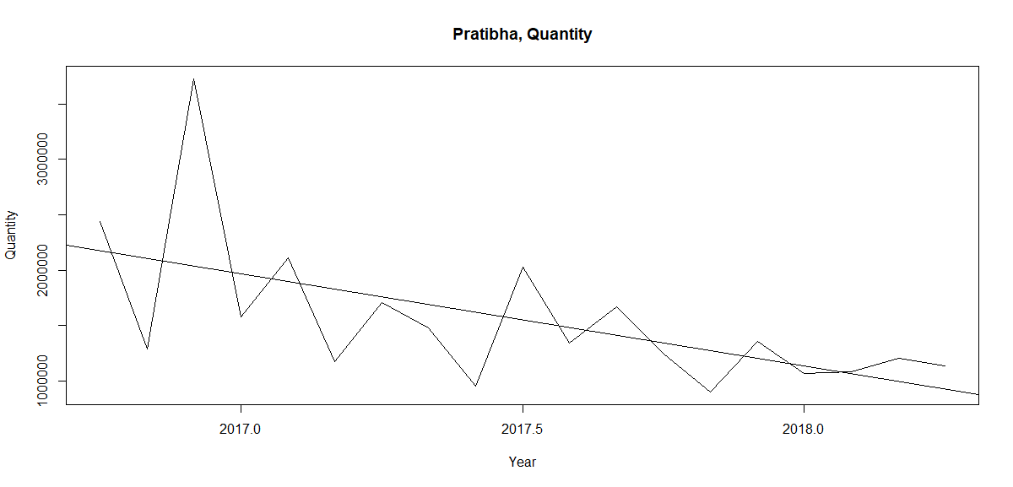

Trend in Quantity

Slide 3
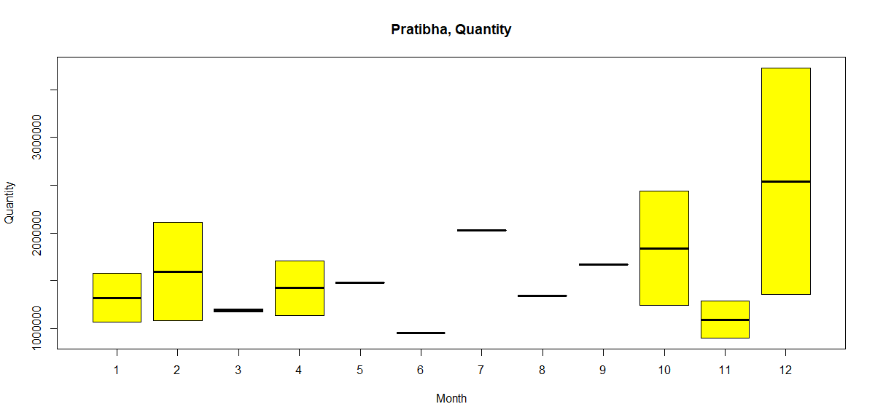
Seasonal effect in Quantity
Notes:
A seasonal effect can be seen as quantity increases during months of July, Oct and Dec and also during Feb while they dip in March, June and November.

Slide 4
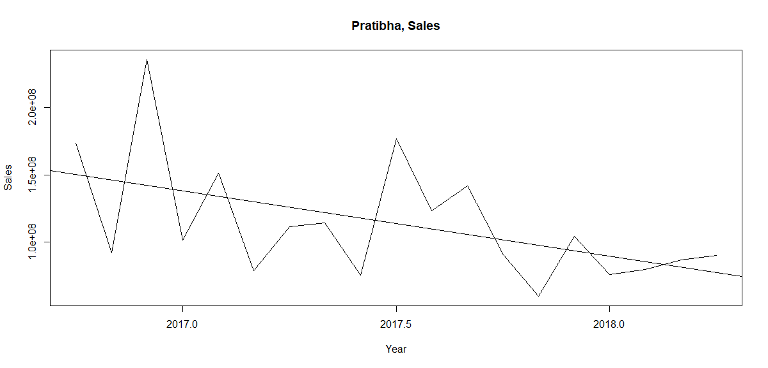
Trend in Sales

Slide 5
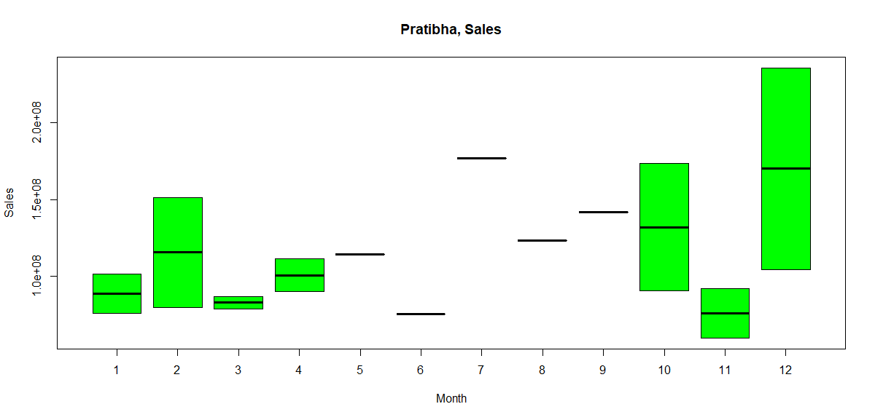
Seasonal effect in Sales
Same seasonal effect can be seen as sales increase during months of July, Oct and Dec and also during Feb while they dip in March, June and November.
Notes:
Same seasonal effect can be seen as sales increase during months of July, Oct and Dec and also during Feb while they dip in March, June and November.

Slide 6
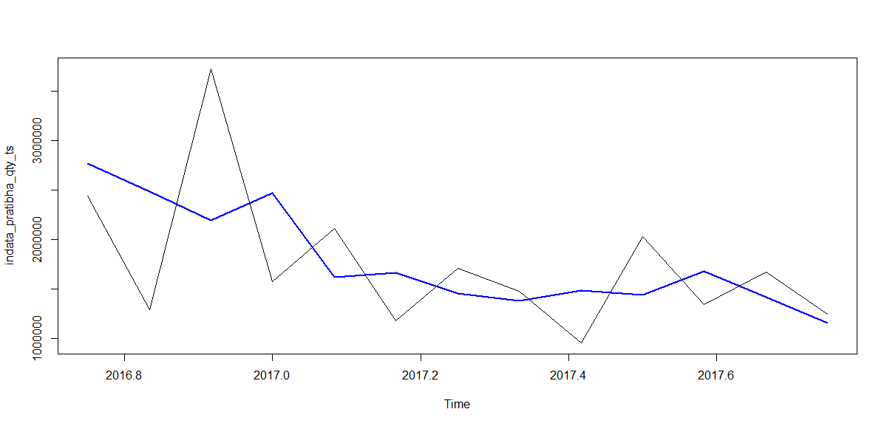
Original with smoothed time-series
Notes:
Smoothing window of 1

Slide 7
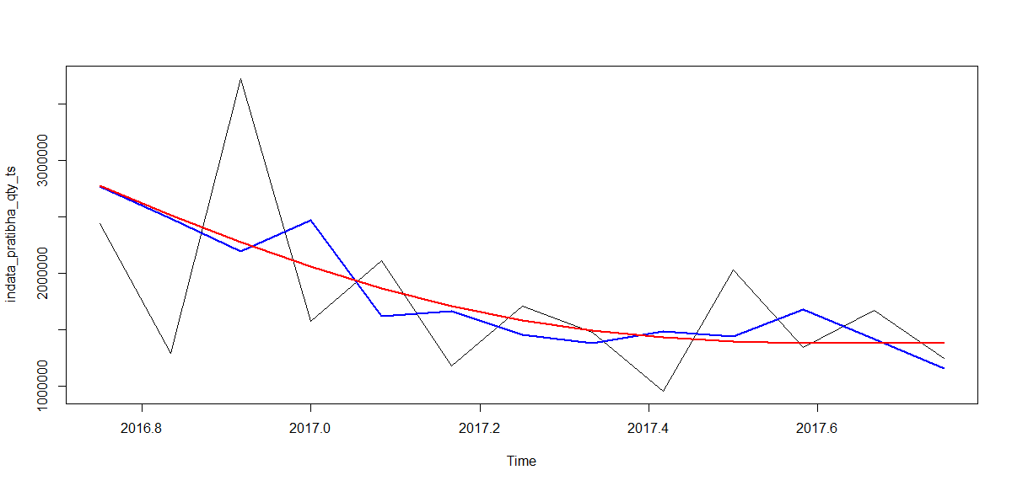
Fitted time series

Slide 8
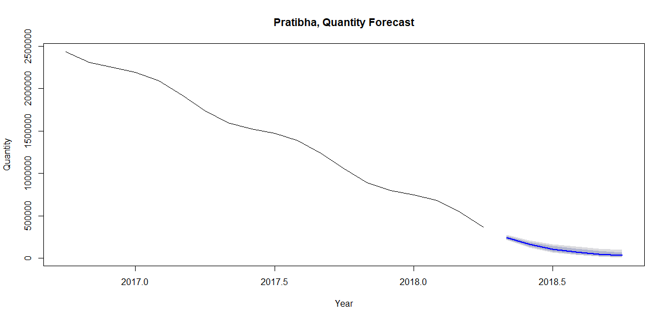
Pratibha Quantity Forecast
Quantity shows a downward trend and so does the forecast.

Slide 9
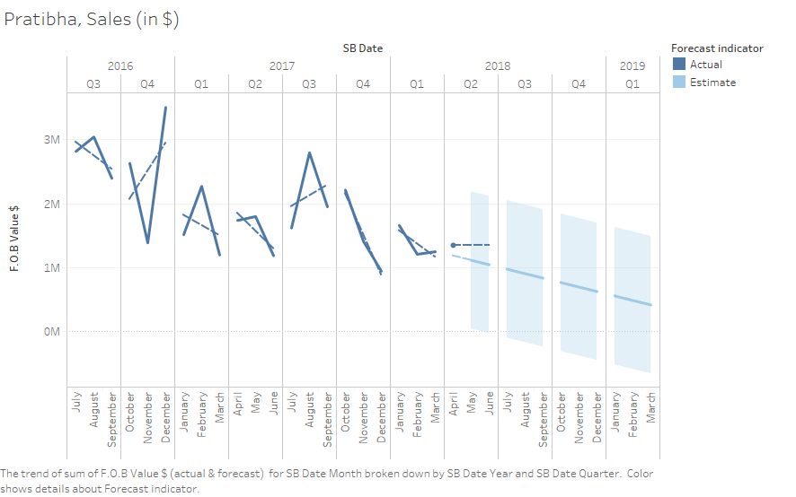
Pratibha Sales Time series & Forecast (Quarter-wise)
Sales show a downward trend from last 3 quarters

Slide 10
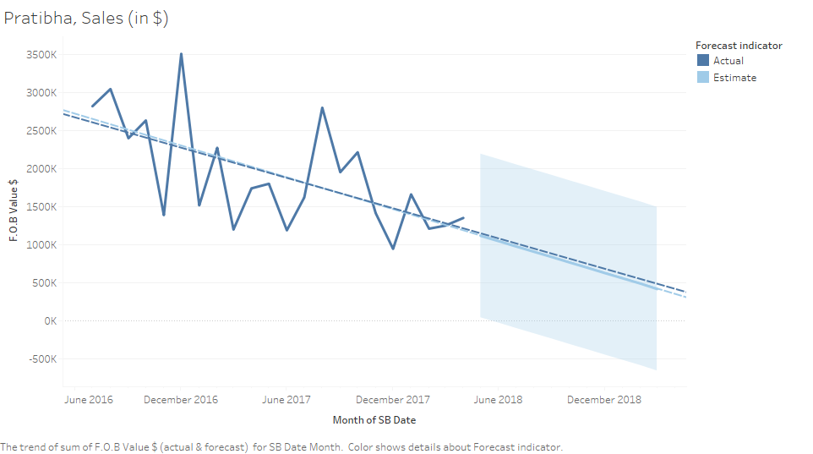
Pratibha Sales Time series & Forecast (Overall)
Overall Sales show a very prominent downward trend

Slide 11
Recommendations/Insights
1) The reasons for downward trends in Pratibha’s sales and quantity needs to be investigated.
2) Sales need to be given a boost by providing incentives to existing customers or acquiring new customers.
3) MEN and BOYS category make the most of the sales. Other categories sales also need to be boosted.

Slide 12
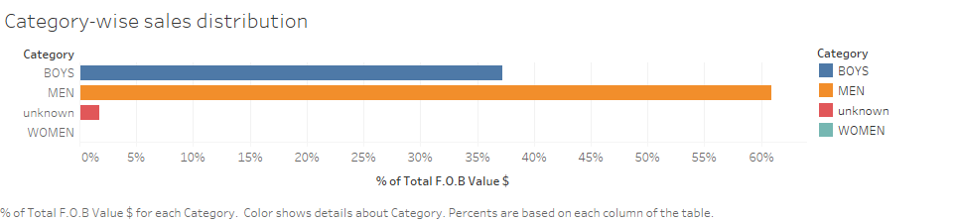
Category wise breakup of sales
Approximately 61% of exports are in men’s category while around 37% exports are in boy’s category

Slide 13
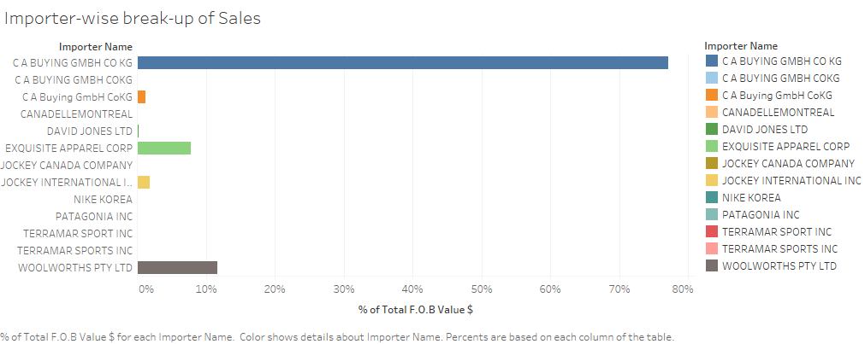
Importer wise break-up of Pratibha’s Sales
Almost 80% of Pratibha’s exports are to C A Buying GmbH

Slide 14
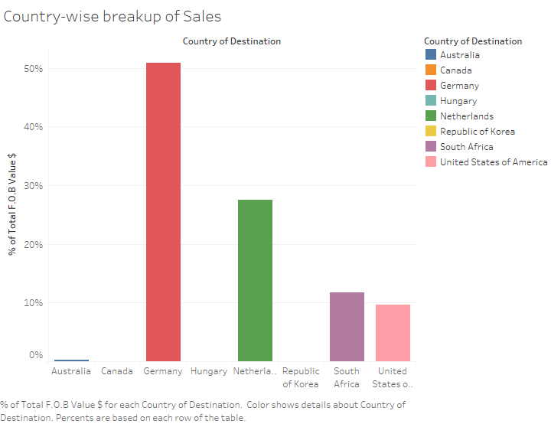
Country wise breakup of Pratibha’s sales in Percentage terms
Nearly 79% of the sales come from Germany and Netherlands.

Slide 15
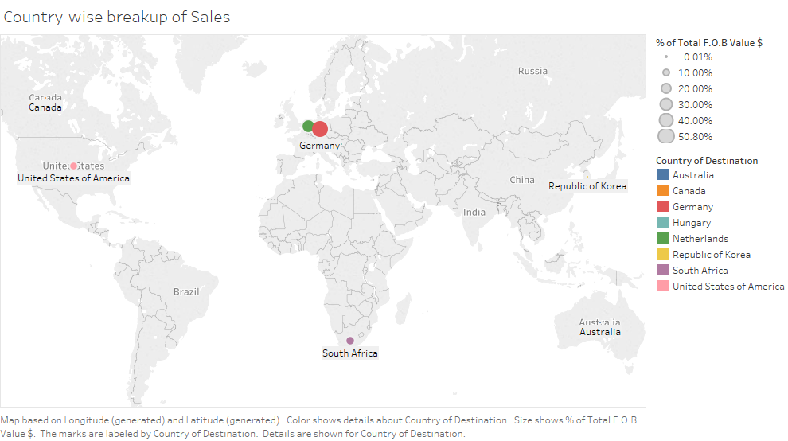
Country-wise breakup of Pratibha’s sales

Slide 16
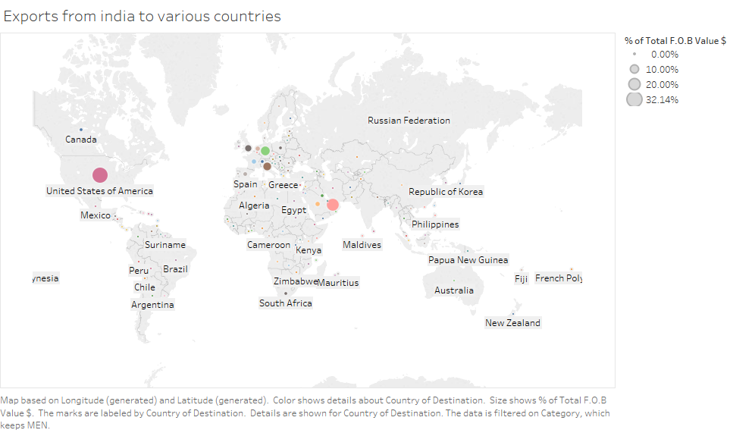
Country-wise distribution of sales from India
US accounts for the most sales at 32% followed by UAE at 20%, Germany (11%), Italy (8.5%) and UK (5.5%)

Slide 17
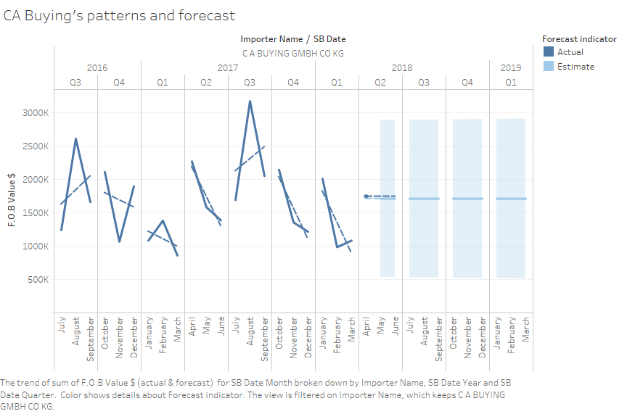
CA BUYING’s India buying patterns analysis
CA ‘s buying patterns show a downward trend from last quarter of 2017.

Slide 18
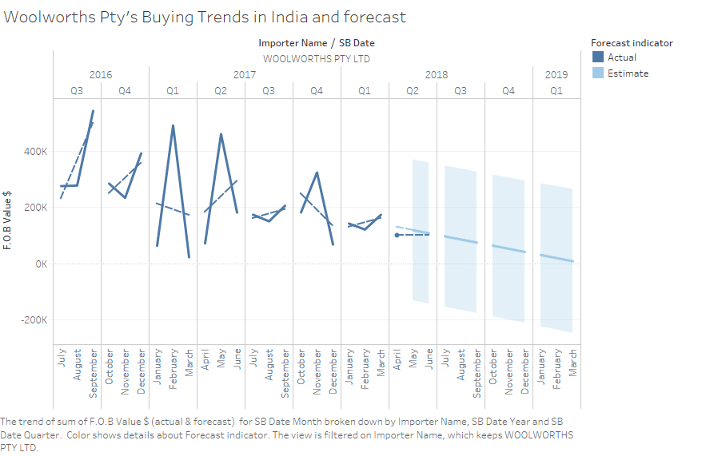
Woolworth Pty’s India Buying patterns analysis
Woolworth Pty’s buying patterns in India show a downward trend.

Slide 19
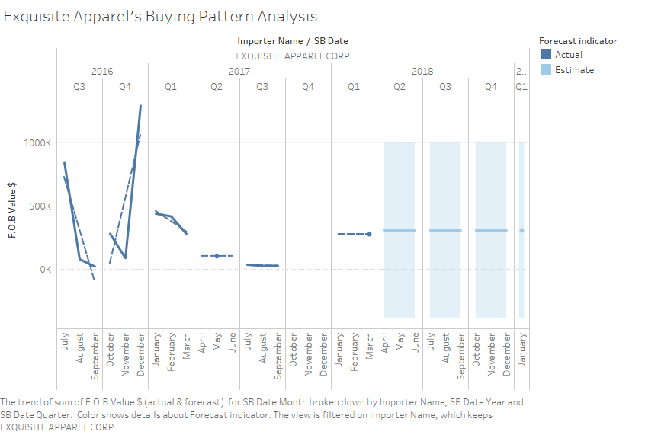
Exquisite apparel’s buying pattern analysis
Exquisite’s Buying pattern shows a flattish trend since last quarter.

Slide 20
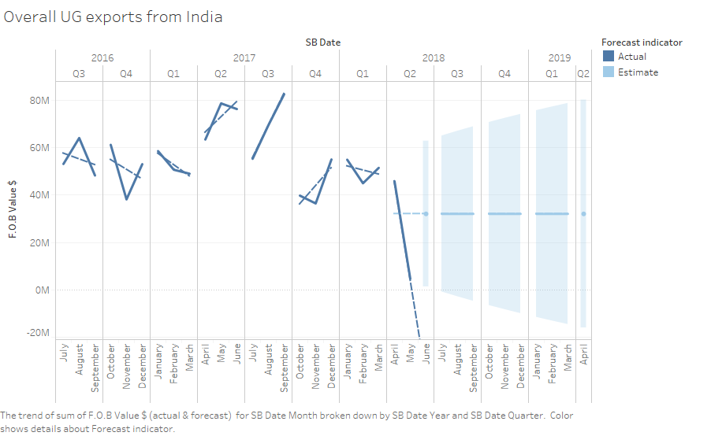
Pattern of total exports from India
Pattern of overall UG exports from India also show a downward trend and a flattish forecast.

Slide 21
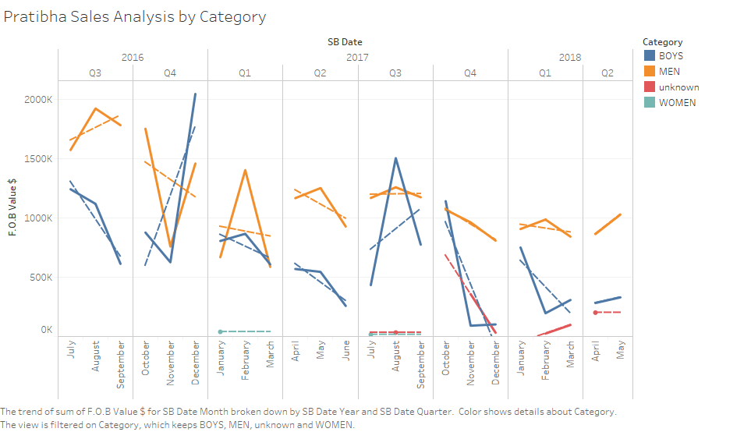
Pratibha Sales Analysis by Category
There is downward trend for both BOYS and MEN category in last 2 quarters but an upward trend this quarter.

Slide 22
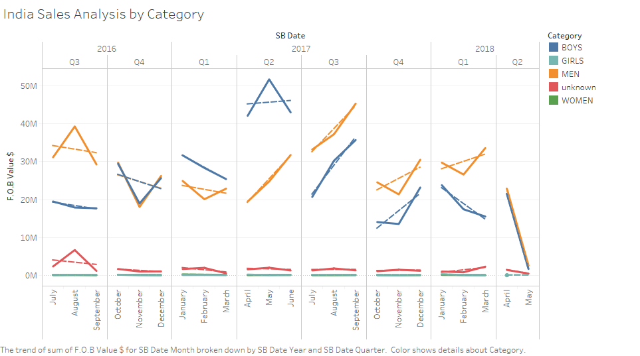
UG India Sales Analysis by category
In the last 2 quarters, there has been increasing trend for MEN category for exports from India.

Slide 23
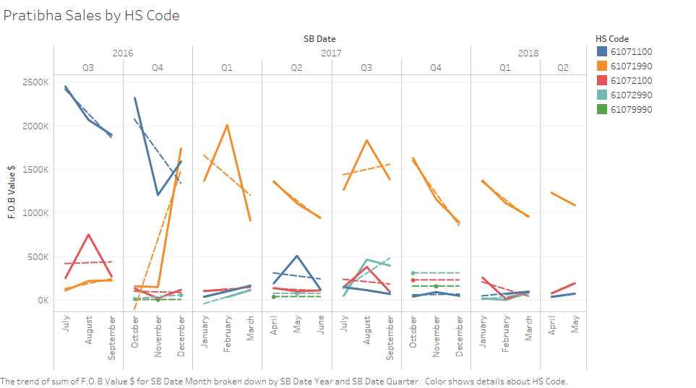
Pratibha Sales by HS Code
HS code 61071990 is showing negative trend for last 3 quarters. HS Code 61071100 sales haven’t picked up after the high of 2016 Q4.

Slide 24
Insights
1) There is an overall decreasing trend for exports from India in the last 2 quarters and Pratibha’s sales are also reflective of that. This needs to be analyzed further if there are some larger macro economic factors responsible or there is weak global demand or there are some policy actions responsible at governments level.

Slide 25
Insights
2) Almost 80% of Pratibha’s sales comes from 1 importer (CA Buying) and 2 countries ( Germany and Netherlands. Pratibha should reduce its dependence on only 1 importer and expand into other countries as well (such as UAE, UK, Italy, US etc.)
3) Pratibha should try to increase sales in other categories besides ‘MEN’ and ‘BOYS’ in order to offset weak sales n these categories.

Slide 26
Insights
4) Pratibha should try to counter drop in sales during the months on march, June and November by offering incentives to customers.
5) Pratibha currently manufactures 5 of the 15 HS codes. It should explore manufacturing in remaining 10 HS codes as well.

