Slide 1
Smart Gym Monitoring System using Fog and Cloud Computing
Name: Shridharan Muniyandi
Student ID: 24232327
Module: Fog and Edge Computing
Deployed URL: http://32.193.150.49/

Slide 2
Project Overview
Problem: - Traditional systems depend only on cloud - Delay in response - Not suitable for real-time alerts Solution: - Use Fog + Cloud - Fast alert detection - Efficient data processing

Slide 3
Threshold Set for each sensors
Temperature Sensor:
- Warning: < 18°C or > 30°C
- Critical: < 16°C or > 35°C
Heart Rate Sensor:
- Warning: > 150 bpm
- Critical: > 170 bpm
Equipment Usage:
- Warning: > 30 minutes
- Critical: > 45 minutes
Occupancy Sensor:
- Warning: > 45 people
- Critical: > 60 people

Slide 4
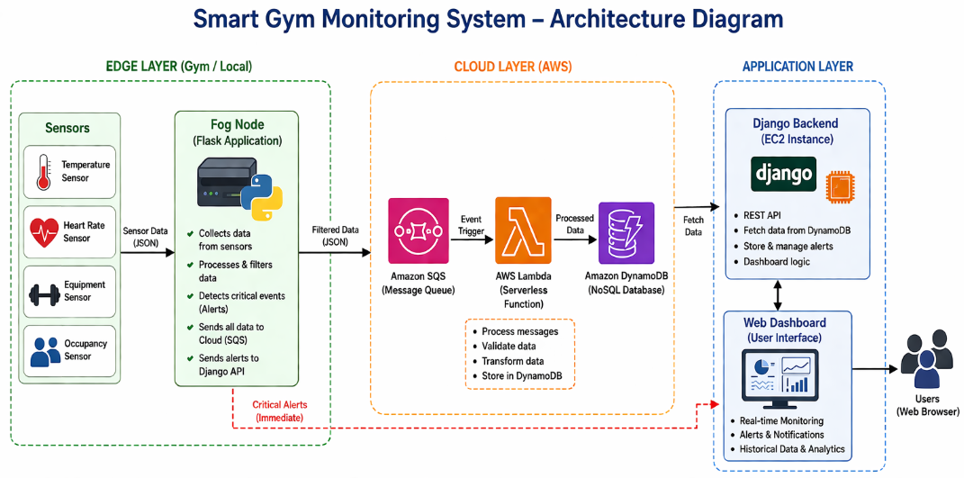
Architecture
Flow:
Sensors → Fog Node → SQS → Lambda → DynamoDB → Django Dashboard

Slide 5
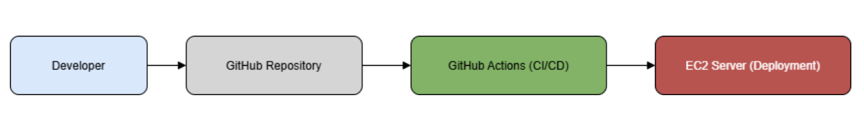
CI/CD Pipeline Workflow
GitHub Actions used for automating the process of deploying the application
When the Code changes are pushed to GitHub it triggers deployment
Application deployed to AWS EC2
All the Services restarted automatically as configured in the pipeline file.

