Slide 1
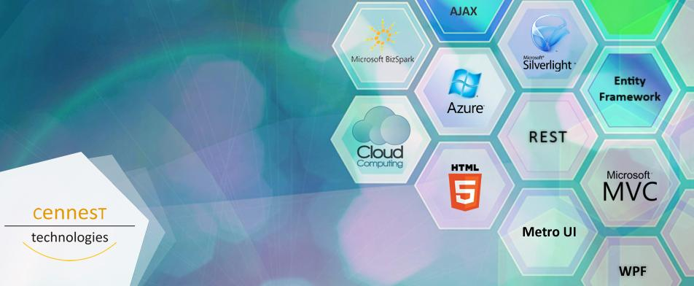
MODULE 4 – Database Entities and LINQ
Last Updated 27 November 2020
http://www.cennest.com/

Slide 2
Objective
At the end of this module, you would have grasped the following concepts:
Tiered Architecture Importance
LINQ & SQL
WCF Communication

Slide 3
Contents
Creating a Database
Data Layer and LINQ
Exercise in LINQ queries
Business Layer
Exercise in Business Layer
Service Layer
Exercise in WCF
UI Layer

Slide 4
Section 1 Creating a Database

Slide 5
Consider the following scenario and create a database for a Company
A Company has many clients.
A Client has many Projects.
A Project belongs to only one Client.
A Project has many Tasks.
A Task can be in more than one Project.

Slide 6
A Company also has many Departments.
A Department has many Employees.
A Department has a DepartmentHead (Employee).
An Employee can belong to only one Department.
A Department has many Projects.
Each Project belongs to only one Department.

Slide 7
A Project maybe assigned to many Employees
An Employee can also work on many Projects.
A Task maybe assigned to many Employees
An Employee can also work on many Tasks.

Slide 8
A Project can use many Technologies.
A Technology can be used in many Projects.
A Task can use many Technologies.
A Technology can be used in many Tasks.
A Project has a Status (Not Started, Started etc).
A Task also has a Status.

Slide 9
Points to be followed while creating tables
Create tables(relations) based on rules of mapping.
Create Master tables for Department, Technology, Status.
(i.e. add ‘Master’ after at the end of each table’s name e.g. DepartmentMaster).
Use Pascal casing for naming attributes and relations(tables).
(Pascal Casing E.g. EmployeeName)

Slide 10
Points to be followed while creating tables
The data types of the Primary Keys must be integers and they must be set to auto increment.
Avoid creating Composite Primary Keys on tables.
Also consider which columns in a table can have null values and those that cannot.

Slide 11
Section 2 Data Layer using LINQ

Slide 12
Introduction to LINQ
Language-Integrated Query (LINQ) is a feature introduced .NET Framework 3.5 that extends powerful query capabilities to the language syntax of C#.
LINQ provider assemblies enable the use of LINQ with .NET Framework collections, SQL Server databases, ADO.NET Datasets, and XML documents.

Slide 13
LINQ Advantages
Unified data access
Single syntax to learn and remember
Strongly typed
Catch errors during compilation
IntelliSense
Prompt for syntax and attributes
Bindable result sets(IEnumerable)

Slide 14
LINQ DataSources
LINQ allows multiple datasources such as:
LINQ to XML
LINQ to Dataset
LINQ to SQL
LINQ to Objects

Slide 15
LINQ Queries
All LINQ query operations consist of three distinct actions:
Obtain the data source.
Create the query.
Execute the query.
For Example:
var queryCustomersByCity = from cust in customers select cust

Slide 16
Deferred Execution
In LINQ execution of the query is deferred until you iterate over the query variable in a foreach statement.
Since the query variable itself never holds the query results, you can execute it as often as you like and get updated results.
To force immediate execution of query and you can call the Count method.

Slide 17
Join Clause
In LINQ the join clause always works against object collections instead of database tables directly.
Foreign keys in LINQ are represented in the object model as properties that hold a collection of items.
For example, a Customer object contains a collection of Order objects. Rather than performing a join, you access the orders by using dot notation:
from order in Customer.Orders...

Slide 18
LINQ to SQL
LINQ to SQL is used to manage relational data as objects.
Object-relational mapping
Records become strongly-typed objects
Data context is the controller mechanism
Facilitates update, delete & insert
Translates LINQ queries behind the scenes

Slide 19
Navigation Properties
Navigation properties in the Entity Framework are shortcut properties used to locate the entities at the ends of an association. Navigation properties allow a user to navigate from one entity to another, or from one entity to related entities through an association set.
Eg :
List<Project> project = (select projects in db.Projects
Where projects.StatusMaster.StatusDescription == Status.Delayed.ToString() select projects ).ToList();

Slide 20
IEnumerable<T>
IEnumerable<T> is the interface that enables generic collection classes to be enumerated by using the foreach statement.
When a query variable is typed as IEnumerable<Customer>, it means that the query, when executed, will return a list of zero or more Customer objects.

Slide 21
IEnumerable Example
For Example:
IEnumerable<Customer> customerQuery = from cust in customers where cust.City == "London" select cust;

Slide 22
FirstOrDefault
First will throw an exception when there are no results. FirstOrDefault won't, it will simply return either null (reference types) or the default value of the value type. (e.g like '0' for an int.)

Slide 23
IsNullOrEmpty
To check whether a string parameter contains null values use IsNullOrEmpty
Example:
if (string.IsNullOrEmpty(task.TaskName))
return Resource.TaskNameMissing;

Slide 24
Creating Data Layer
Create a new ‘Class Library Project’ in Visual Studio
Name the project as ‘CompanyManagementDataLayer’ and name the solution as ‘CompanyManagement’
Add a new Console Application project to the Solution to pass parameters to class library class methods and check the results.

Slide 25
Check Compulsory Columns
Before each insert operation check whether all necessary values are present.
Create separate methods to check for compulsory fields for each insert function.
Check next slide for example.

Slide 26
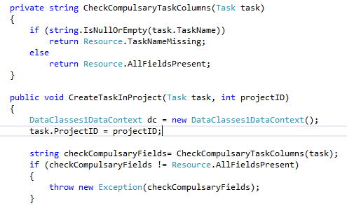
Check Compulsory Columns

Slide 27
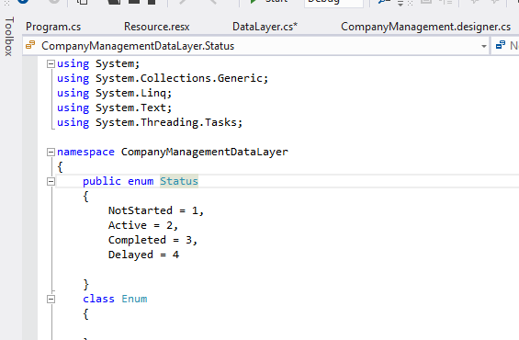
Enum File
Add a new class file to the project and create a Enum for values of StatusMaster table.

Slide 28
Enum File
Use the values in this file for comparisons in queries.
Instead of using string values such as : StatusMaster.StatusText == “Delayed”
Use the following
StatusMaster.StatusID == (int)Status.Delayed

Slide 29
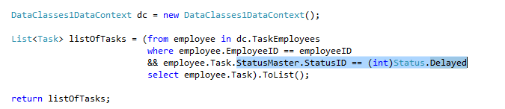
Enum File Example

Slide 30
Resource File
Add a new Resource file to project
Use this file to return error values in case of some missing or invalid values supplied as parameters to methods of Data Layer class instead of returning string values such as :
return “Task ID Missing”.
Check next slide for example

Slide 31
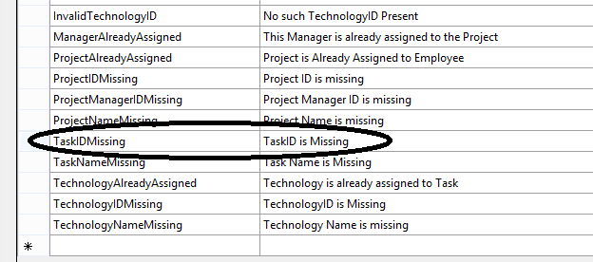
Resource File

Slide 32
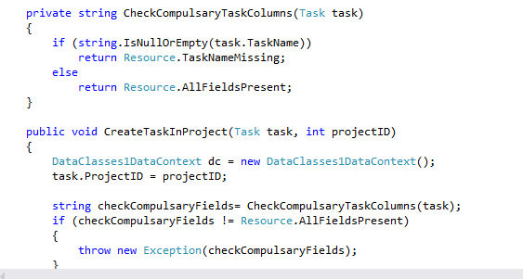
How to use Resource File?

Slide 33
Exercise 2-A
Implement the following methods in the Data Layer using LINQ.
Use Resources and Enum where it is required.
GetAllProjects();
GetAllTechnologies();
GetEmployeeCountForProject(int projectID)
GetAllEmployeesForProject(int projectID)
GetAllDelayedProjects();
GetAllProjectsForEmployee(int employeeID)
GetAllTasksForEmployee(int employeeID)
GetAllTechnologyTasksForEmployee(int technologyID, int employeeID)
GetAllTechnologyProjects(int technologyID)
GetAllActiveTasksForProject(int projectID)
GetAllTechnologiesForEmployee(int employeeID)
GetProjectCountForEmployee(int employeeID)
GetAllActiveProjectsManagedByEmployee(int employeeID)
GetAllDelayedTasksForEmployee(int employeeID)

Slide 34
Exercise 2-B
AddProject(Project project)
AddTechnology(Technology technology)
AddEmployee(Employee employee)
AssignEmployeeToProject(int employeeID, int projectID)
CreateTaskInProject(Task task, int projectID)
AssignTechnologyToTask(int technologyID, int taskID)
UpdateTechnologiesForTask(List<int>technologyIDs, int taskID)
DeleteEmployeeFromSystem(int employeeID)
DeleteTechnology(int technology)
DeleteTask(int taskID)
DeleteProject(int projectID)

Slide 35
Section 3 Business Layer

Slide 36
Business Layer
Business Layer is part of the program which uses real world business logic
Business Layer is used in an N-tier architecture of an application
Business Layer also defines business entities that are used by the business logic

Slide 37
Business Logic
Models real life business objects (such as products, sales)
Prescribes how business objects interact with one another
Enforces the routes and the methods by which business objects are accessed and updated

Slide 38
Creating Business Layer
Add another class library called CompanyManagementBL
Add reference of the DataLayer to the BL
Connect your console app to the Business Layer instead of the data layer
Implement all the previously defined DataLayer methods in the BL .
BL should call DataLayer to get the required data from the Database

Slide 39
Business Objects
Create a separate folder named “Entities” and add a class file for each entity to be returned by the Business Layer.
The class must contain variables corresponding to the attributes of data entities.
Create business objects for the entities that have to be returned to the UI Layer since you cannot return DataLayer objects.

Slide 40
Business Objects
The class file must be named as:
“BO<Entity>”
For example: “Employee” entity’s business object would be named as “BOEmployee”.

Slide 41
Exercise 3
Implement the following functionalities in the Business Layer.
Add additional methods in DataLayer to support below functionality if needed:
Cannot delete technology used in more than 2 projects( max number of projects may change as per client requirement)
Cannot assign technology to task if it is not assigned to the task’s project
Cannot assign more than 4 technologies to a task( again number should be variable)
One PM can only manage max 3 projects( max number of projects may change as per client requirement)
Employee cannot work in more than 2 projects( though he can be PM of upto 3 projects) ( max number of projects may change as per client requirement)
An already started task cannot be deleted
An already started Project cannot be deleted
Task cannot be created to a “Completed” project

Slide 42
Section 4 Service Layer using WCF

Slide 43
WCF
Windows Communication Foundation (WCF) is a framework for building service-oriented applications.
Using WCF, you can send data as asynchronous messages from one service endpoint to another.

Slide 44
WCF Fundamentals
Messaging and Endpoints
WCF is based on the notion of message-based communication, and anything that can be modelled as a message
Messages are sent between endpoints. Endpoints are places where messages are sent or received (or both), and they define all the information required for the message exchange.

Slide 45
ABC of Endpoint in WCF
Address(A)
Address specifies where the service is residing.
This is an URL( Uniform Resource Locator)
Address URL identifies , location of the service.

Slide 46
ABC of Endpoint in WCF
Binding(B)
Binding says , how the service could be used.
Binding specifies
Which protocol to be used
Which encoding to be used.
What type of security requirement to be used like SSL or SOAP message security.

Slide 47
ABC of Endpoint in WCF
Contract(C)
Contracts: The contract outlines what functionality the endpoint exposes to the client.
A contract specifies:
What operations can be called by a client.
The form of the message.
The type of input parameters or data required to call the operation.
What type of processing or response message the client can expect.

Slide 48
Types of Contract
Service Contracts: It is the API the service consumer invokes on your service. It's the method signature that will go into the WSDL.
Data Contracts: It is your data that would travel from the service consumer and the service. It's the data structure. This can be found in the schema of your service.

Slide 49
Creating A WCF Web Service
Add a new WCF Service Project.
Name it as CompanyManagementWCF.
After Adding the project you get 2 Files:
An Interface File
A Class File
Add a reference to the Business Layer in your web service

Slide 50
Interface File
Include all the function definitions in this File.
Each Function Definition that should be accessible to the client should be preceded by [OperationContract].
Example:
[OperationContract]
List<BOEmployee> GetAllEmployees();

Slide 51
Class File
The Class in Class File must implement the Interface.
All the functions must be implemented in the class.
Depending on the functions you will be returning either a list of Business Objects or boolean values.

Slide 52
App.config File
The App.Config file contains all the configuration details of your Web Service.
You may change the base address
E.g. <add baseAddress = "http://localhost:8080/CompanyManagement"/>
Specify the address in the endpoint that is already present.
E.g. <endpoint address="home" binding="basicHttpBinding" contract="CompanyManagementWCF.ICompanyManagement">

Slide 53
Testing your WCF Service
Change your Start-up project to your WCF project.
Double Click on the Method and click on Invoke button to call it from your Web Service.
Pass the parameters in Value Column if a method requires parameters.

Slide 54
Section 5 UI Layer

Slide 55
UI Layer
Create a Windows Application or Web Form Application.
Add Service Reference of the WCF Service to the client.
Call the methods of the Web Service using Web Service client object.

Slide 56
Revision History
Date | Author | Comments
03-10-2013 | Cennest Technologies | Newly created.
04-10-2013 | Cennest Technologies | Data Layer and LINQ added.
10-10-2013 | Cennest Technologies | Business Layer and WCF Added.
11-11-2013 | Cennest Technologies | UI Layer Added.
27-11-2013 | Cennest Technologies | Business Layer Exercise Added

Slide 57
More Information
Official site - MSDN LINQ Page
CodeProject LINQ article
PluralSight WCF Tutorial

