Slide 1



Internship Project
Time Series Analysis
Submitted by
SHRINIKET DIXIT
AKASH HARIPRIYA
Student of B-Tech (Seventh Semester)

Slide 2

Presentation Outline
Title of the project
Introduction
Objective
Project Scope
Time series forecasting applications
Factors affecting time series analysis
Disadvantages of Time series forecasting
Future of Time series forecasting
Technical Requirements
Project Screenshots
Bibliography
Websites
Project Link

Slide 3

Introduction
Predicting the data using Time series forecasting algorithm
Time series forecasting is the process of analysing time series data using statistics and modelling to make predictions and inform strategic decision-making.
Time series forecasting means to forecast or to predict the future value over a period of time. It entails developing models based on previous data and applying them to make observations and guide future strategic decisions.
Time series forecasting is one of the most applied data science techniques in business, finance, supply chain management, production and inventory planning. Many prediction problems involve a time component and thus require extrapolation of time series data, or time series forecasting.

Slide 4

These four components are:
Secular trend, which describe the movement along the term
Seasonal variations, which represent seasonal changes
Cyclical fluctuations, which correspond to periodical but not seasonal variations
Irregular variations, which are other non-random sources of variations of series.
Autoregressive integrated moving average, or ARIMA, models are another time series forecasting method. They are among the most widely used time series forecasting techniques — as widely used as exponential smoothing methods. While exponential smoothing methods generate forecasts based on historical components of the data, ARIMA models take advantage of autocorrelation to produce forecasts. Autocorrelation is when a time series displays correlation between the time series and a lagged version
of the time series.

Slide 5
ARIMA stands for Auto-Regressive Integrated Moving Average. There are three integers (p, d, q) that are used to parametrize ARIMA models. Because of that, a nonseasonal ARIMA model is denoted with ARIMA(p, d, q):
p is the number of autoregressive terms (AR part). It allows to incorporate the effect of past values into our model. Intuitively, this would be similar to stating that it is likely to be warm tomorrow if it has been warm the past 3 days.
d is the number of nonseasonal differences needed for stationarity. Intuitively, this would be similar to stating that it is likely to be same temperature tomorrow if the difference in temperature in the last three days has been very small.
q is the number of lagged forecast errors in the prediction equation (MA part). This allows us to set the error of our model as a linear combination of the error values observed at previous time points in the past.
When dealing with seasonal effects, as in our example, seasonal ARIMA is used, which is denoted as ARIMA (p,d,q) (P,D,Q)s. Here, (p, d, q) are the nonseasonal parameters described above, (P, D, Q) follow the same definition but are applied to the seasonal component of the time series.

Slide 6


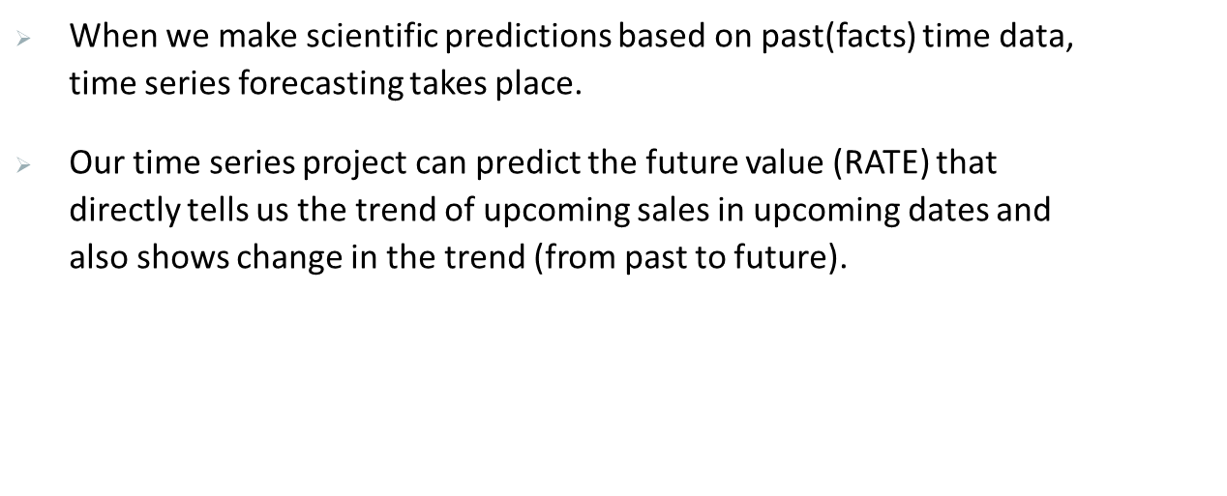
Objective
In this we are presenting the future prediction values of a particular date using the given dataset (BHEL material code pricing indices) implementing Time series forecasting algorithm.

Slide 7
Time series forecasting applications
Forecasting power demand to decide whether to build another power generation plant in the next five years.
Forecasting call volumes to schedule staff in a call centre next week
Forecasting inventory requirements to stock inventory to meet demand
Forecasting supply and demand to optimize fleet management and other aspects of the supply chain
Predicting equipment failures and maintenance requirements to minimize downtime and uphold safety standards
Forecasting infection rates to optimize disease control and outbreak programs
Predicting customer ratings through to forecasting product sales

Slide 8
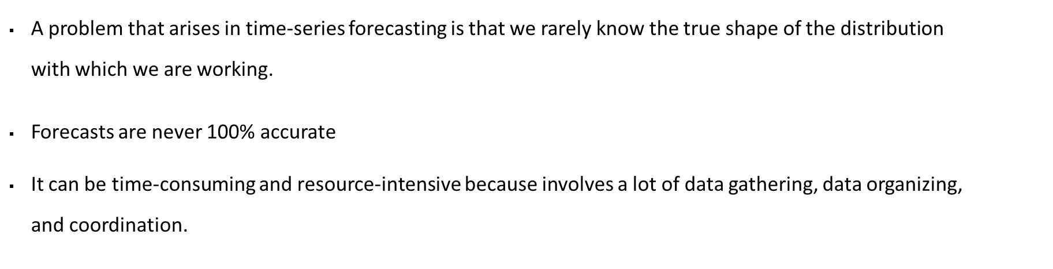
Factors affecting time series analysis
Stationarity: The degree to which the mean and variance of a time series remain stable over time is known as stationarity.
Auto-relocation: The propensity of data observations and patterns to repeat themselves in a time series is known as autocorrelation.
Seasonality: Seasonality, is the periodic repetition of observations and patterns.

Slide 9

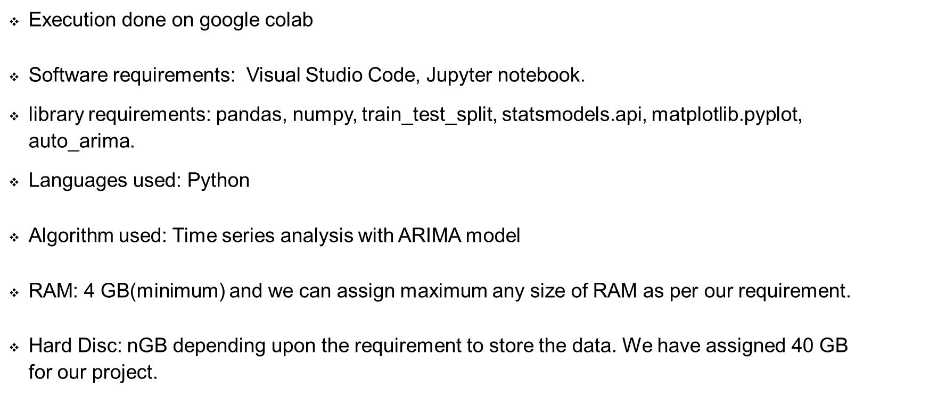
Future of Time series forecasting
We can create Android or iOS for this project.
In future, the work can be enhanced by developing a web application based on the Time Series algorithms as well as using a larger dataset as compared to the one used in this analysis which will help to provide better results and help health professionals in predicting the expected results effectively and efficiently.

Slide 10
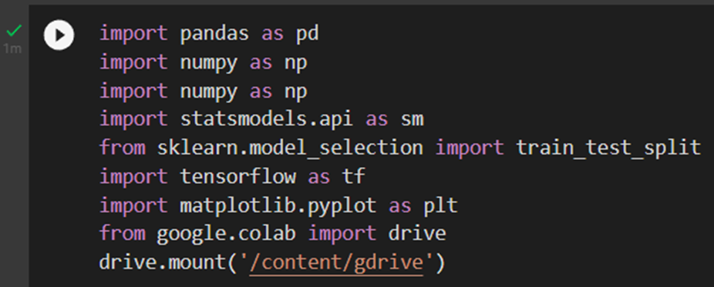
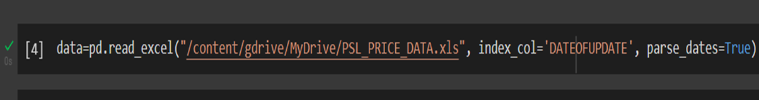
Project Screenshots
First, we import all the libraries which we needed.
Then we imported our dataset

Slide 11
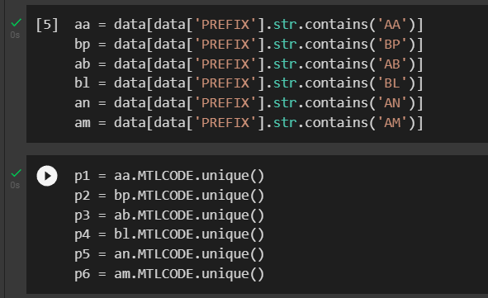
Then we took out each of the MLT codes that are linked to each prefix.

Slide 12
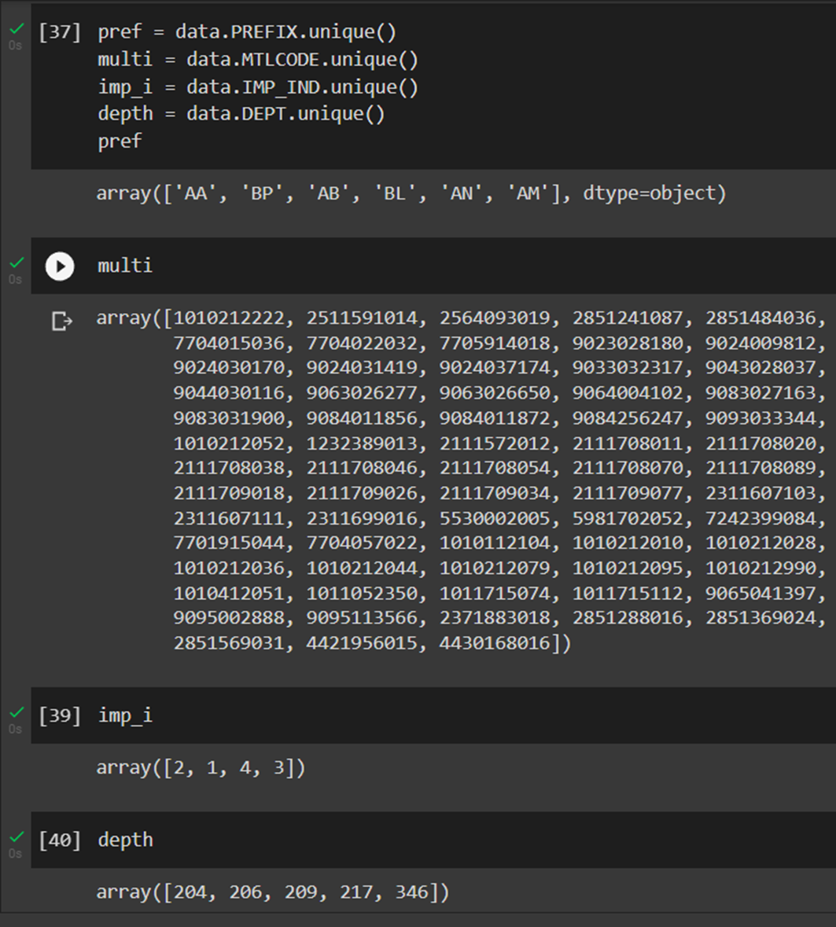
Now, we want to see the unique values in each column, which can be done using Pandas unique() function.

Slide 13
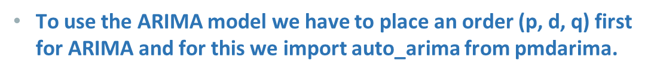
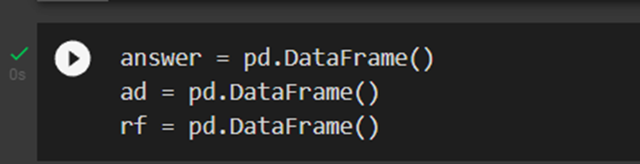
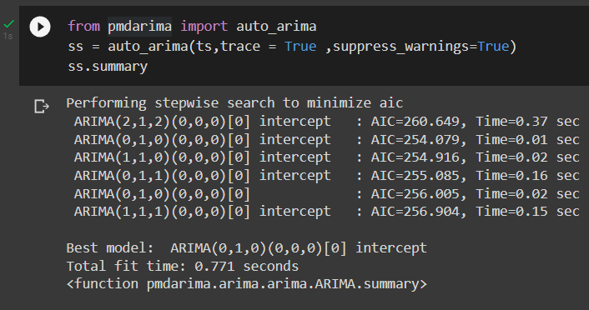
Pandas DataFrame ‘pd.DataFrame()’ consists of three principal components, the data, rows, and columns.

Slide 14
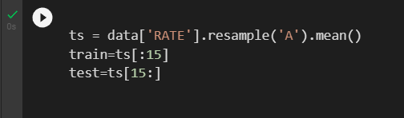
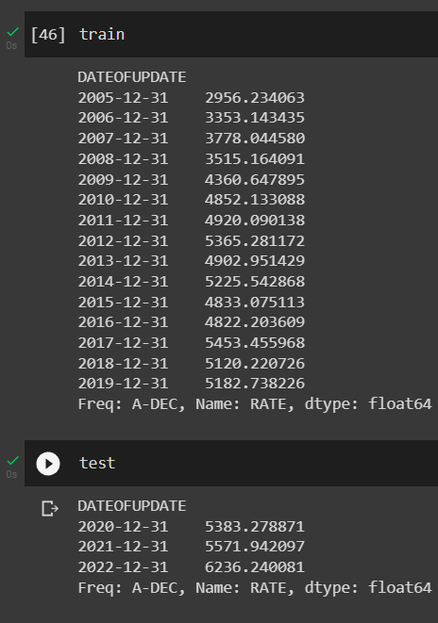
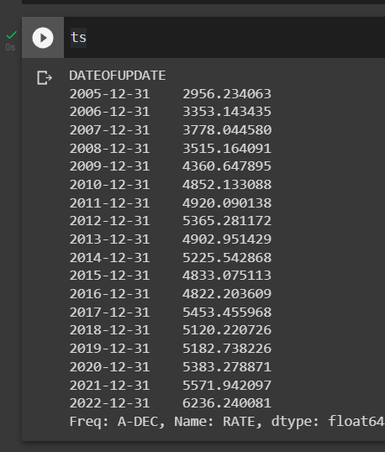
Introducing mean() function, we select a subset of the data series as training data and remaining as test data.

Slide 15
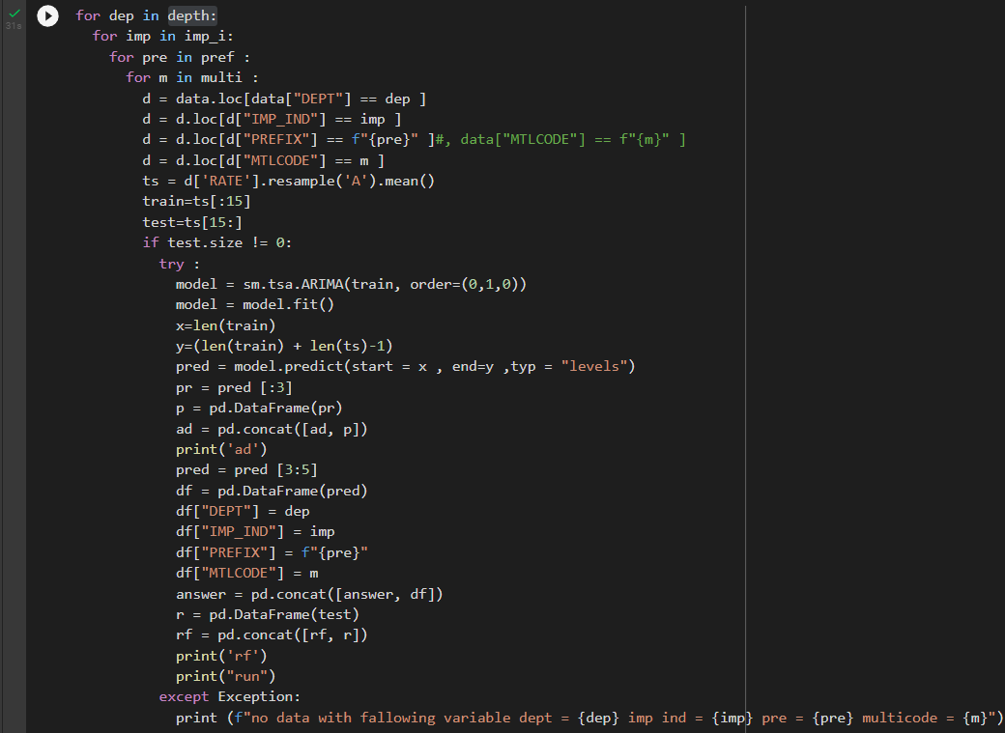
When we use “for loop” function given below, doing the prediction work for us along with ARIMA model fitting (Time series forecasting algorithm). The above loop is trying to find the prediction of the given DATEOFUPDATE (2023 and 2024).

Slide 16

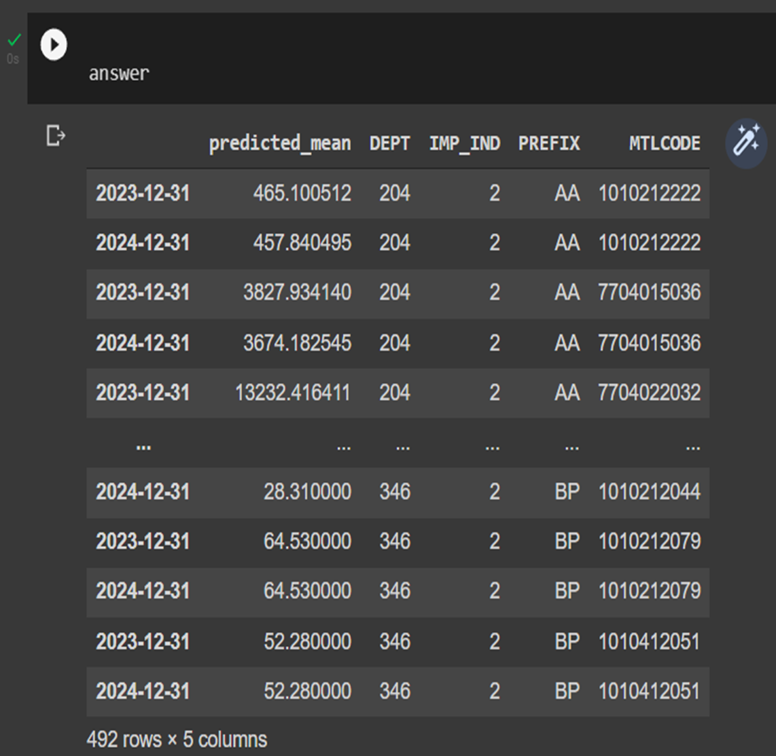
With the help of ARIMA model fitting, we can fit each of the predictions (DEPT, PREFIX, RATE, MLT CODE, IMP_IND) to the given date of update.
Prediction Table:

Slide 17
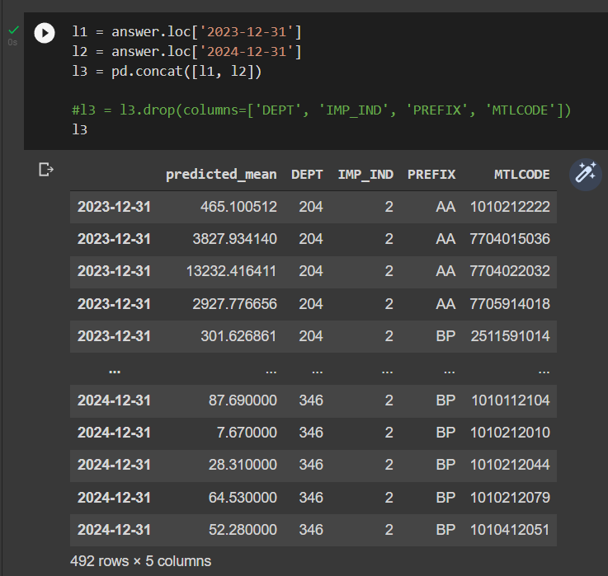
Arranging the rows according to date.

Slide 18
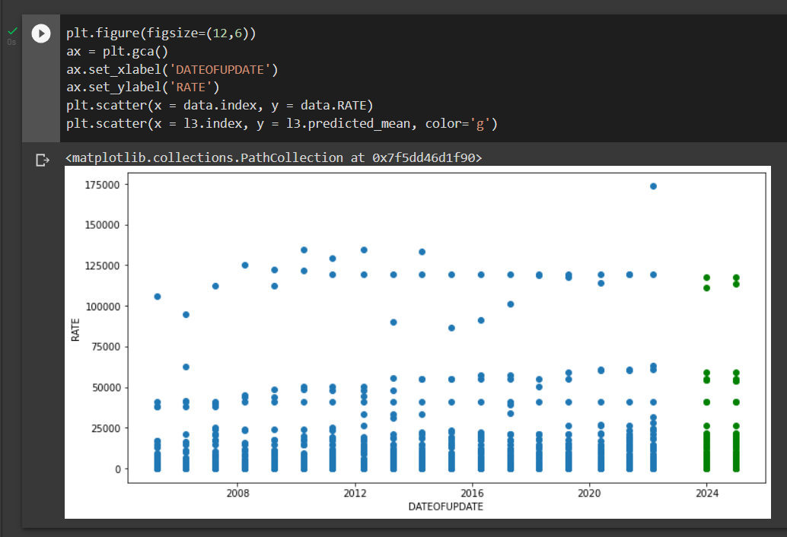
After that we plot the graph of the given dataset and predicted data set.

Slide 19
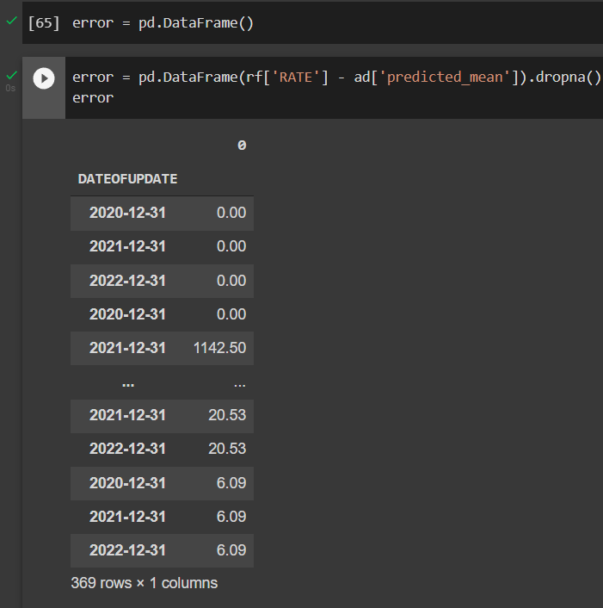
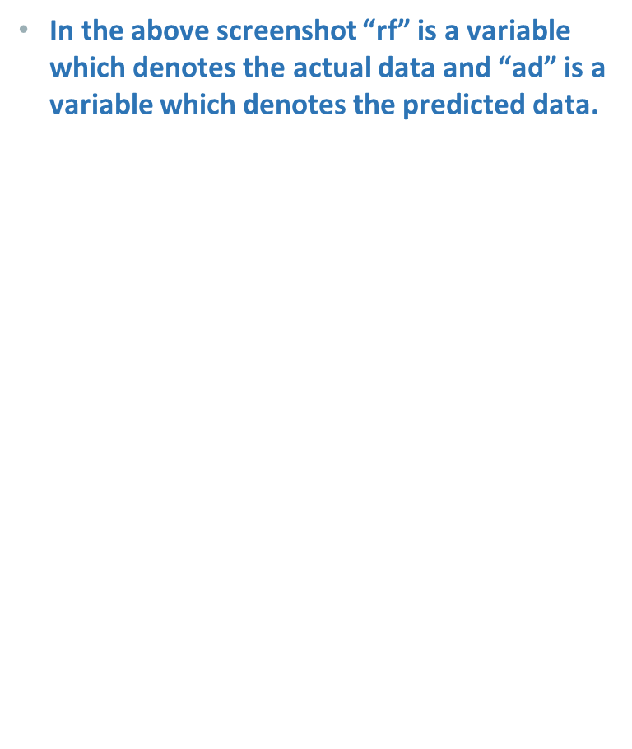
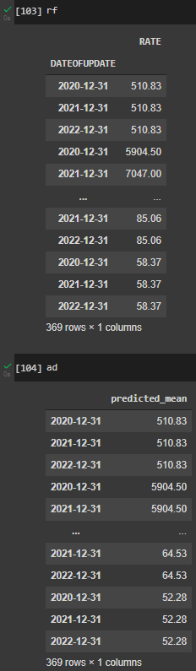
After this we found the percentage error to compare between the actual data and the predicted data.

Slide 20
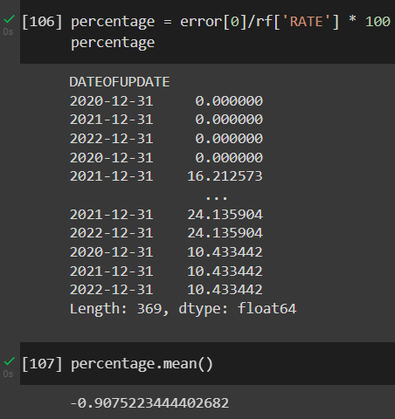
Percentage error: Percentage error shows the difference between actual data and predicted data.

Slide 21
Summary:
With the help of the trends of earlier years, we were able to predict the data of coming years. The ARIMA (0,1,0) capture(predict) the overall trend of 2023 and 2024 from the given dataset with the Absolute Percentage Error of 0.90%.

Slide 22
Bibliography
Websites
Following websites has been referred to create this project report:
▪ https://medium.com/oreillymedia/the-future-of-time-series-forecasting-bd83c2aca9a8
▪ https://www.infoworld.com/article/3622246/an-introduction-to-time-series-forecasting.html
▪ https://www.analyticsvidhya.com/blog/2021/07/time-series-forecasting-complete-tutorial-part-1/
▪ https://philosophy-question.com/library/lecture/read/30434-what-are-the-limitations-of-time-series#7
▪ https://www.infoworld.com/article/3622246/an-introduction-to-time-series-forecasting.html#:~:text=Time%20series%20forecasting%20is%20a,data%20to%20predict%20future%20values
▪ https://johngalt.com/learn/blog/3-advantages-disadvantages-of-forecasting

