Slide 1

Hospital Bed Booking Management System
Submitted in partial fulfillment of the Requirements
For the award of Master of Computer Application Degree
DR. HARISINGH GOUR A CENTRAL UNIVERSITY
SAGAR (M.P.)
MAJOR PROJECT PRESENTATION
Submitted by:
Shrikant Dwivedi
(Y18271032)
Under the Guidance of
Prof. DIWAKAR SHUKLA
MASTER OF COMPUTER APPLICATION
DR. HARI SINGH GOUR CENTRAL UNIVERSITY (MCA),
SAGAR
2021 – 2022

Slide 2
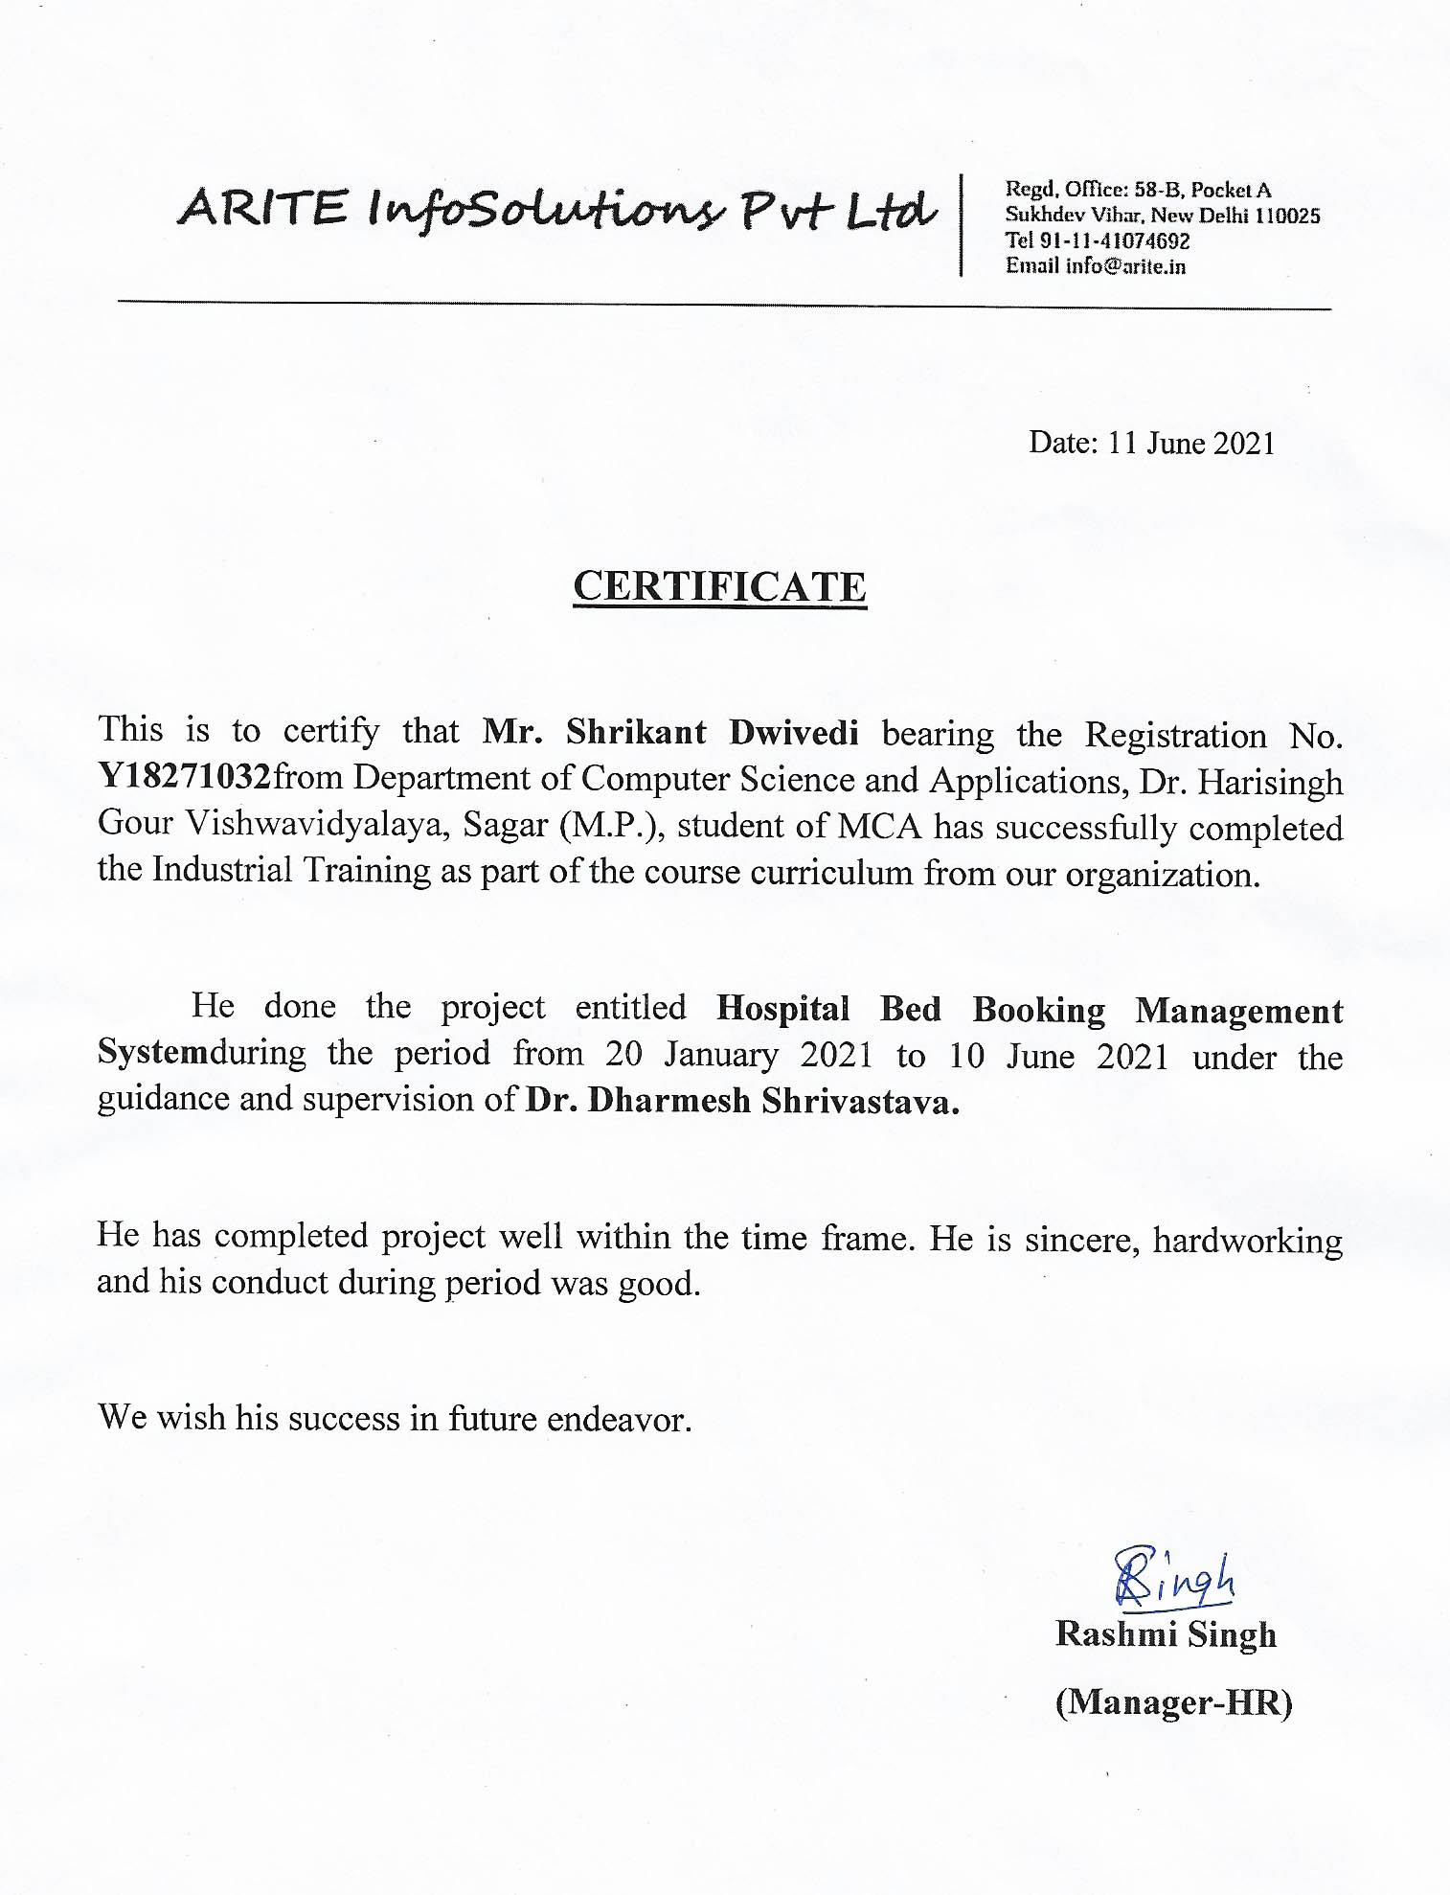
COMPANY CERTIFICATE

Slide 3

DECLARATION
I hereby declare that the work contained in this project entitled “Hospital Bed Booking System” towards the partial fulfillment of the requirements for the award of the Degree of Master of Computer Applications in Department of Computer Science and Application, Dr. Harisingh Gour Vishwavidyalaya, Sagar (M.P.), of my own work and performed by me. It is an original and authentic record.
I have not submitted the matter embodied in the project for the award of any other degree or diploma to any other institute or University.
Name: Shrikant Dwivedi
Registration No: Y18271032

Slide 4
Content
Introduction
Technology Used
Hardware & Software Requirements
Flow Diagram
ER Diagram
Screenshots
Conclusion
References

Slide 5
Introduction

Slide 6
Introduction
“Hospital Bed Booking System” Hospital bed management systems became a pivotal practice after the National Health Service’s statement rule on patient’s emergency trolly waiting hours
After an accident, inconvenient waiting hours in hospital waiting halls due to improper operational capacity planning and control over managing, allotting, and maintaining beds may turn frustrating when emergency care is required.
This is the system where the patient/user book their bed for the patient. In Hospital lots of people gets treatment, they need beds for the rest so need to book the bed for the patient.

Slide 7
Technology Used

Slide 8
ReactJS
ReactJS is JavaScript library used for building reusable UI components. According to React official documentation, following is the definition −
React is a library for building composable user interfaces. It encourages the creation of reusable UI components, which present data that changes over time. Lots of people use React as the V in MVC. React abstracts away the DOM from you, offering a simpler programming model and better performance. React can also render on the server using Node, and it can power native apps using React Native. React implements one-way reactive data flow, which reduces the boilerplate and is easier to reason about than traditional data binding.

Slide 9
GraphQL
GraphQL is an open-source data query and manipulation language for APIs, and a runtime for fulfilling queries with existing data.
It provides an approach to developing web APIs and has been compared and contrasted with REST and other web service architectures. It allows clients to define the structure of the data required, and the same structure of the data is returned from the server, therefore preventing excessively large amounts of data from being returned

Slide 10
Leaflet
Leaflet is the leading open-source JavaScript library for mobile-friendly interactive maps. Weighing just about 39 KB of JS, it has all the mapping features most developers ever need.
Leaflet is designed with simplicity, performance and usability in mind. It works efficiently across all major desktop and mobile platforms, can be extended with lots of plugins, has a beautiful, easy to use and well-documented API and a simple, readable source code that is a joy to contribute to.

Slide 11
Json Web Token (JWT)
JSON Web Token (JWT) is an open standard (RFC 7519) that defines a compact and self-contained way for securely transmitting information between parties as a JSON object. This information can be verified and trusted because it is digitally signed. JWTs can be signed using a secret (with the HMAC algorithm) or a public/private key pair using RSA or ECDSA.
Although JWTs can be encrypted to also provide secrecy between parties, we will focus on signed tokens. Signed tokens can verify the integrity of the claims contained within it, while encrypted tokens hide those claims from other parties. When tokens are signed using public/private key pairs, the signature also certifies that only the party holding the private key is the one that signed it.

Slide 12
Software & Hardware
Requirements

Slide 13
Hardware Requirements
Windows 7 or above
RAM 512GB (Minimum)
GPU (optional)

Slide 14
Software Requirements
Visual Studio or other IDE
Nodejs
MongoDB Compass / Mongodb Atlas
ReactJS
GraphQL

Slide 15
Flow Diagram

Slide 16
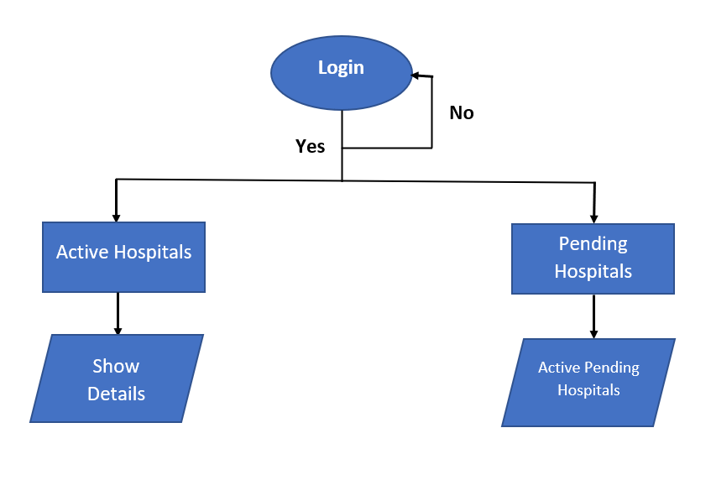
Admin Flow

Slide 17
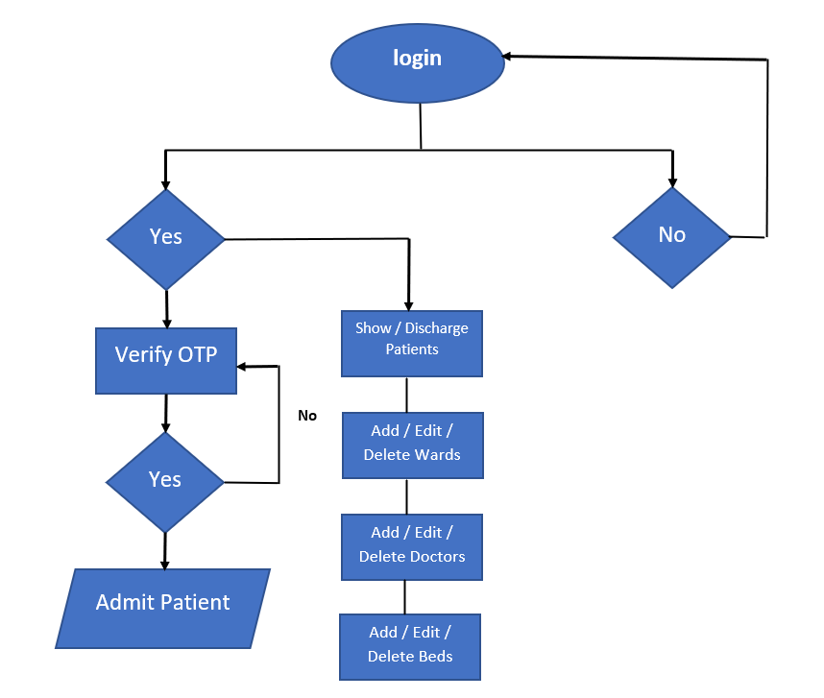
Hospital Flow

Slide 18
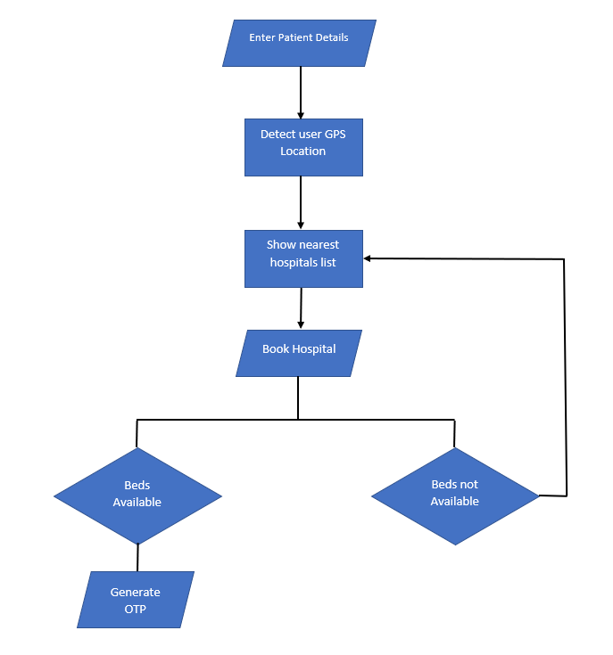
Patient/User Flow

Slide 19
ER Diagram

Slide 20
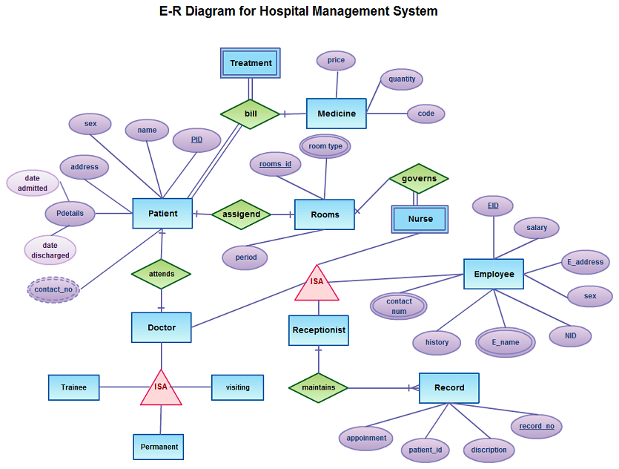
ER Diagram

Slide 21
Screenshots
&
Output Screen

Slide 22
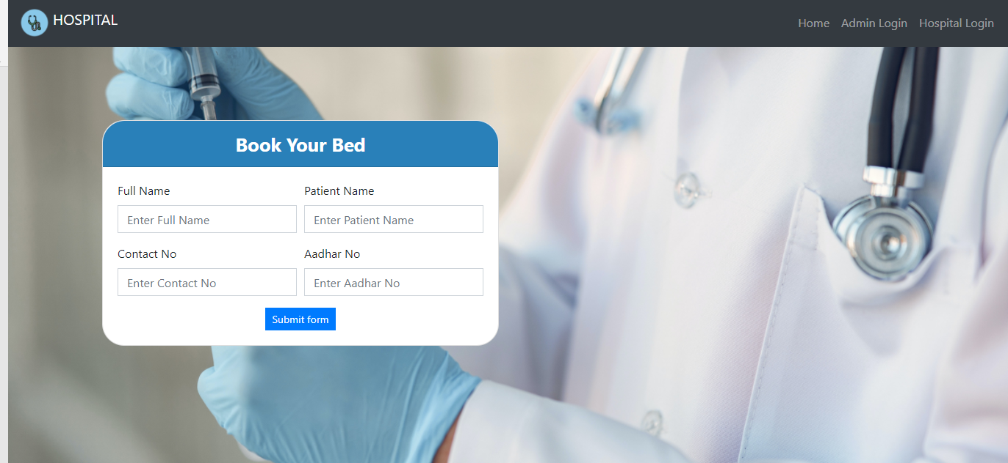
Home Page

Slide 23
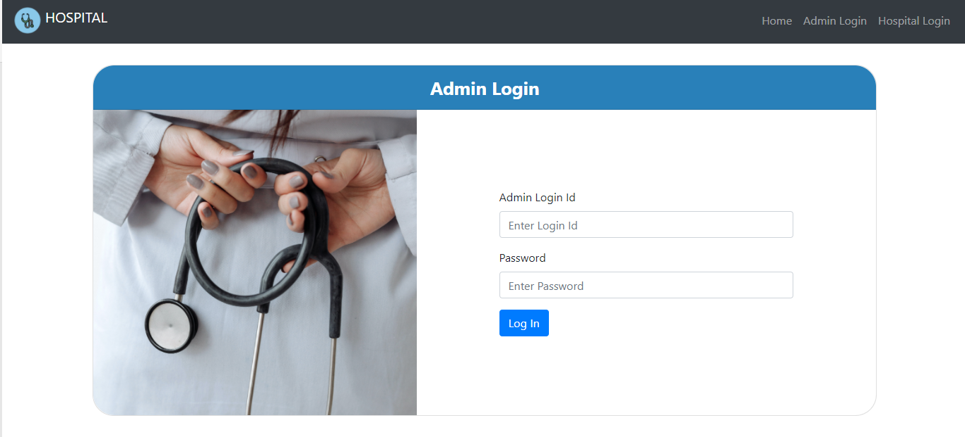
Admin Login Page

Slide 24
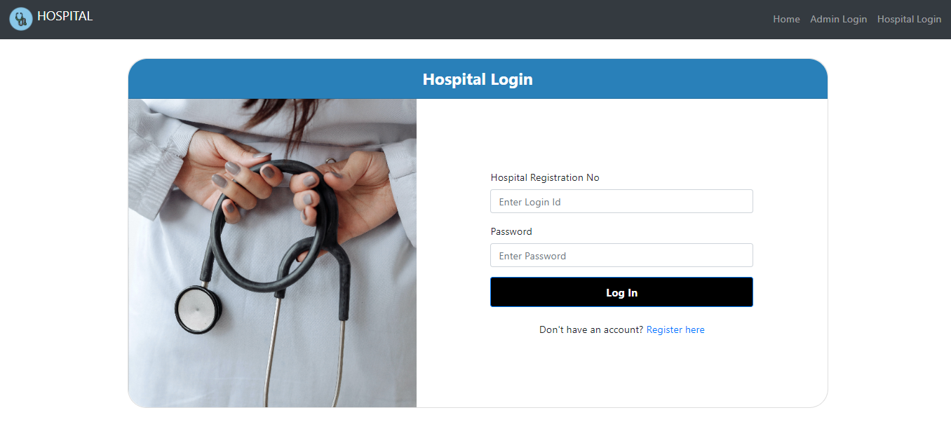
Hospital Login Page

Slide 25
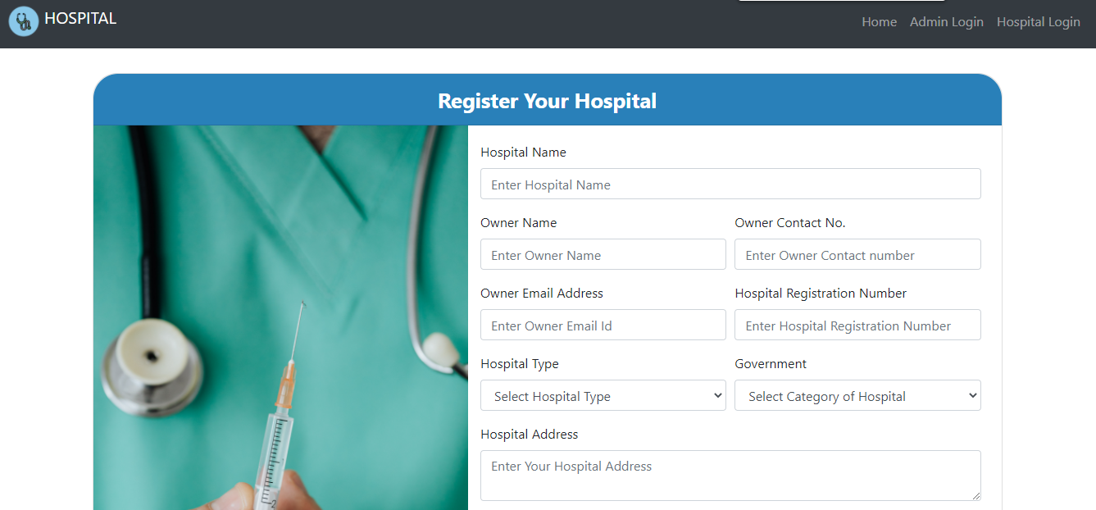
Hospital Registration Page

Slide 26
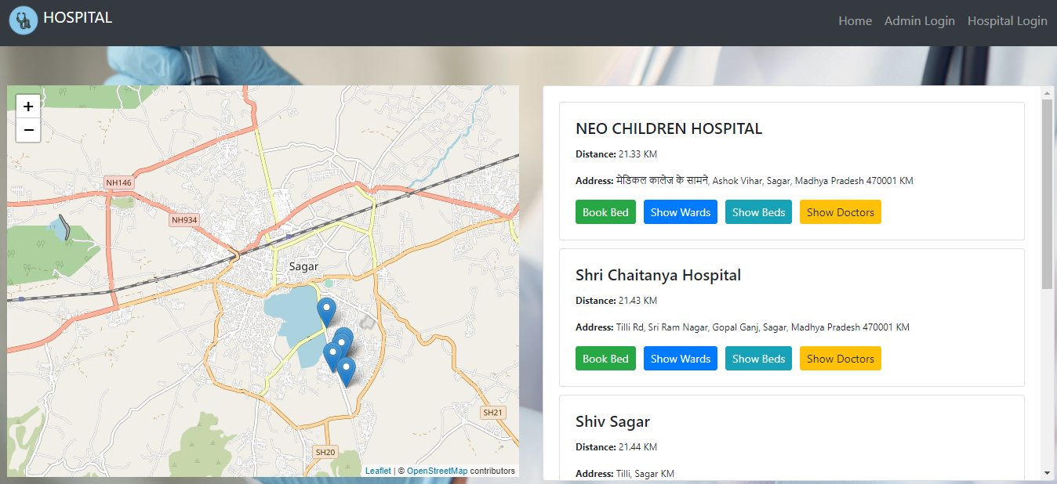
Nearest Hospital Page

Slide 27
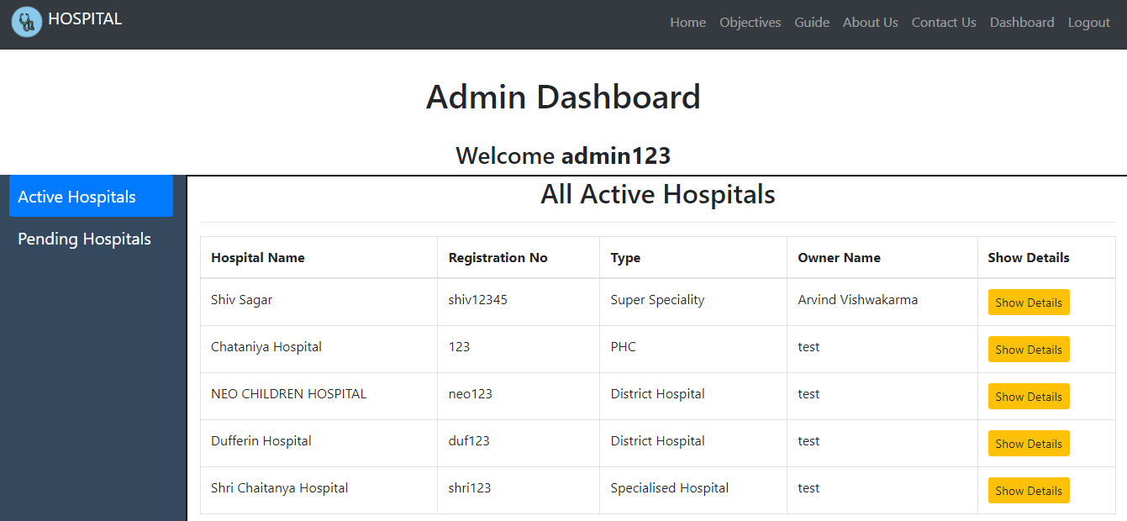
Admin Dashboard

Slide 28
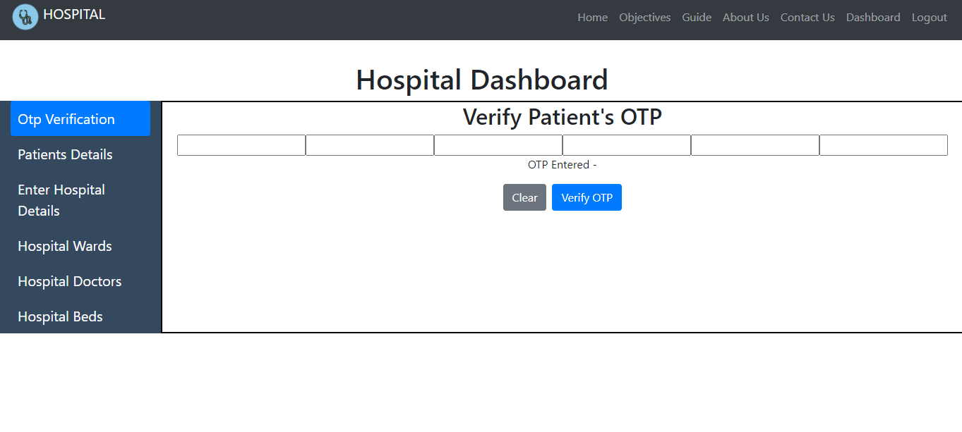
Hospital Dashboard

Slide 29
Conclusion

Slide 30
Conclusion
According to the HIS function requirement as well as combining the intrinsic HIS preferably, our research has designed and realized a set of safe, stable and easy-to handle beds resource management information system aiming at the problems of “difficult to be hospitalized”, which provide the hospital beds centralized management with comprehensive information solutions
The research highlighted a very complex and difficult issue of hospital bed allocation experienced by most major hospitals. The current systems have vast amount of written information located in a variety of computer and hardcopy file areas which require specific targeted searching. E-Beds has integrated these existing information systems and formats and provides a level of visualization which allows health care professionals to make informed and more accurate decisions for patient administration.

Slide 31
References

Slide 32
Conclusion
Australian Institute of Health and Welfare (2003). Australian Hospital Statistics 2003-04. Australian Institute of Health and Welfare (2003), Health Services Series No. 23.
Richardson, Drew B. (2003) Reducing patient in the emergency department. The Medical Journal of Australia, 170 (10), p.516-517
Walsh, M. (1998) What is a Bed? – Beds as a Measure of Resource Usage and Demand. Better Outcomes Health Newsletter, V4 N3
Ward, Dr Michael (2004). Bed Management Collaborative. Queensland Health Quality and Safety Improvement Program, Queensland. Wikipedia 2006. The Free Dictionary. www.wikipedia.org.
Pinggen,W., and Yunsuo,G. (2012)Preliminary Study on the Distribution Plan of Hospital Beds in Large General Hospital.Chinese Journal of Hospital Statistics,13,7-8.
Microsoft Corporation, ASP.NET MVC: The Official Microsoft ASP.NET Site[EB/OL], http://www.asp.net/mvc2012-2.
Nguyen,J.M.,Six,P.and Antonioli,D.(2015)A simple method to optimize hospital beds capacity.Journal of Health Geographies,74,39-49.
Jun,Y. and Cheng,C.(2014) Design of system architecture based on J2EE workflow platform.Electronic technology and software engineering, 11,59-60.

Slide 33
Thank You

