Slide 1

Recipe Application
RNS INSTITUTE OF TECHNOLOGY
BENGALURU - 98
DEPARTMENT OF INFORMATION SCIENCE & ENGINEERING
Presentation on Internship
Srishti Srivastava
USN: 1RN18IS109
Enmaz Engineering Services pvt. ltd
Internal Guide
Mrs. Chandan Rani
Asst. Prof, Dept of ISE, RNSIT
External Guide
Mr. Akshay DR
Co-founder and CEO

Slide 2
AGENDA
Abstract
About the Company
Introduction
Literature Survey
Requirements
System Design
Detailed Design
Implementation
Testing
Conclusion and Future Enhancements
References
Q & A

Slide 3
ABSTRACT
The use of mobile devices such as, smartphone or tablets have increased significantly in the past decade. All these devices use applications that are created for them.
These applications can provide many different services including, social media, music streaming, video streaming, ride sharing, online shopping, and video games. Some of these apps need to be constantly connected to the internet to function properly, while others can work offline.
This application helps users find and view different food recipes based on different categories, as well as allowing them to add their own recipes to the database. The app aspires to run efficiently, while having an intuitive a simple design that provides the user all the necessary functionalities.

Slide 4
About the Company
Enmaz has a simple yet robust solution that helps any industry /factory digitise their workfloor in no time. The products offered will help in remote monitoring, controlling and also analysing any machine parameter or process.
Enmaz provides end to end solution development services for industrial requirements which is specializes in embedded hardware development, embedded firmware development, cloud support, big data analysis and reporting, dashboard UX/UI design and model analysis.

Slide 5
INTRODUCTION
Food recipe is an Android application that helps users find and view different food recipes based on different categories, as well as allowing them to add their own recipes to the database. The users can filter the list of recipes based on the ingredients used in the recipe, the prep time, cook time, ready time, and the number of servings. The app aspires to run efficiently, while having an intuitive a simple design that provides the user all the necessary functionalities.
The era of technology today has become a bridge that connects humans with all the ease. Technology has made the life of humans easy. And the same is the objective of this applications.

Slide 6
LITERATURE SURVEY
Android Studio:- Android Studio is an integrated development environment (IDE) for Google Android Operating System. It is built based on JetBrains’ IntelliJ IDEA Community Edition, and it specifically designed for creating applications on Android devices.
Flutter Sdk:- Flutter is a open source UI development kit created by google. It is used to develop cross platform application for Android, ios, Mac, Linux, Windows, Google Fuschia, Web platform and the web from a single codebase. Flutter was released in may 2017.

Slide 7
LITERATURE SURVEY
Dart(Programming Language):- Dart is a programming language designed for client development. Dart is an open-source general-purpose programming language. It is originally developed by Google and later approved as a standard by ECMA. Dart is a new programming language meant for the server as well as the browser. Introduced by Google, the Dart SDK ships with its compiler – the Dart VM. The SDK also includes a utility -dart2js, a transpiler that generates JavaScript equivalent of a Dart Script. This tutorial provides a basic level understanding of the Dart programming language.

Slide 8
LITERATURE SURVEY
VS Code:- Visual Studio Code is an streamlined code editor with support for development operation like debugging, task running and version control. It aims to provide just a tool developer needs for a quick code-build-debug cycle and leaves more complex workflows to fuller feature IDEs such as Visual Studio IDE.

Slide 9
Requirements
Hardware Requirements
Processor Intel 5i or more
Ram 8GB or more
Cache 512kb
Hard disk 16gb
Monitor 1024x720 display
Software Requirements
Operating system: Windows 7/8/10/11 or Linux
Modern web browser with internet access
Flutter 3.0
Android 12
VS Code

Slide 10
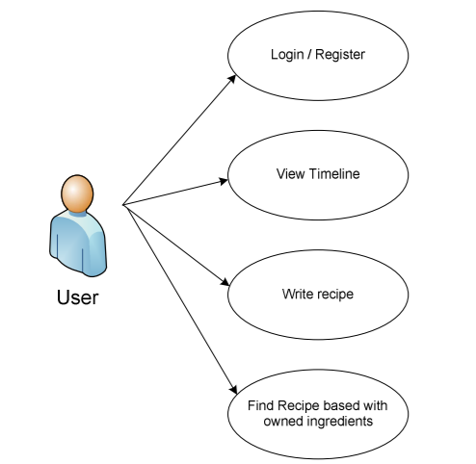
System Design
The adjacent figure shows the brief system design of the recipe app application. Here the user can perform multiple operations like searching for recipes based on particular keyword. Viewing the timeline which includes popular recipes. And writing own recipe.

Slide 11
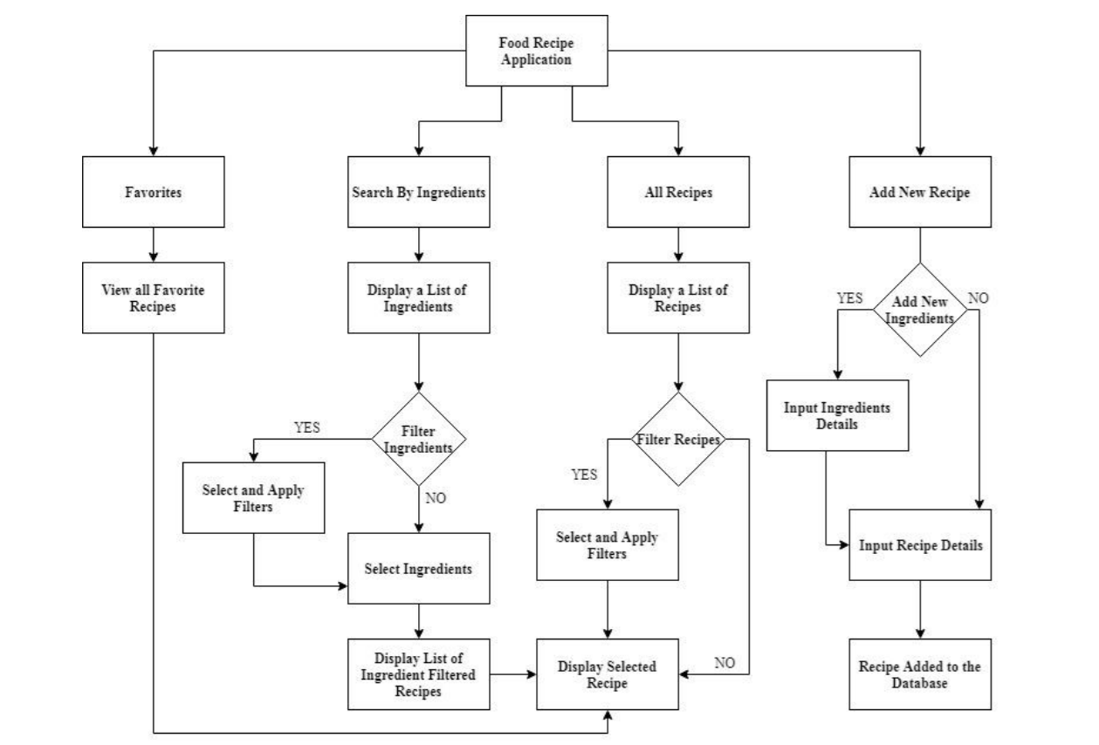
Detailed Design

Slide 12
Implementation / Coding
Search_Screen.dart :
This displays the main page of the application where one can select the calorie according to their health and the type of meal they are looking for. The main page allows the user to choose to see sub menus for courses, cuisines, and types of food. The application also provides a search bar where the user can input the wanted ingredient instead of scrolling down to it.
The main page is itself designed in diet conscious way but makes sure that the taste goes nowhere.

Slide 13
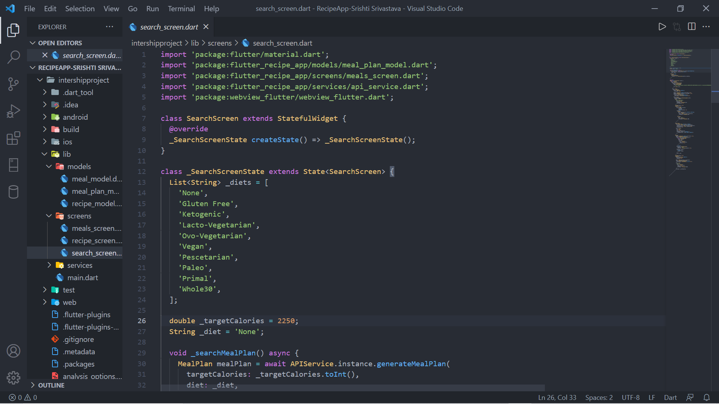
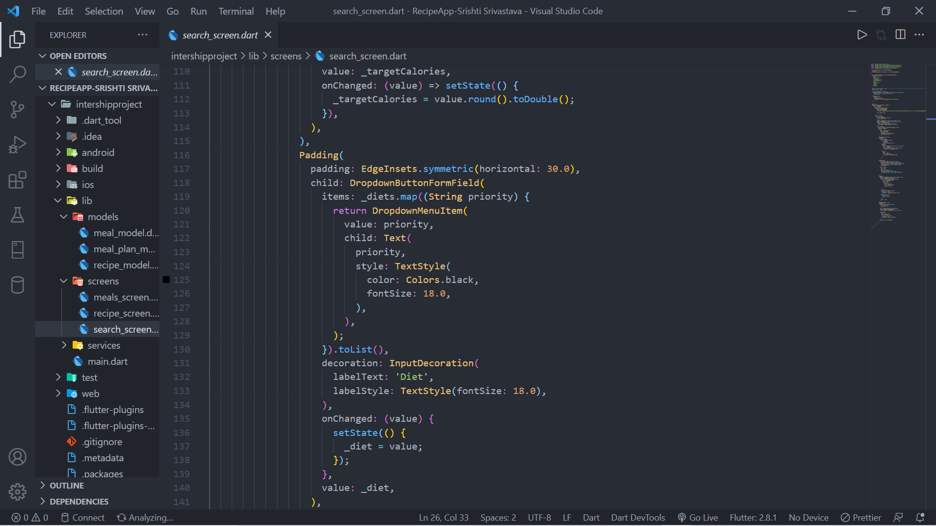
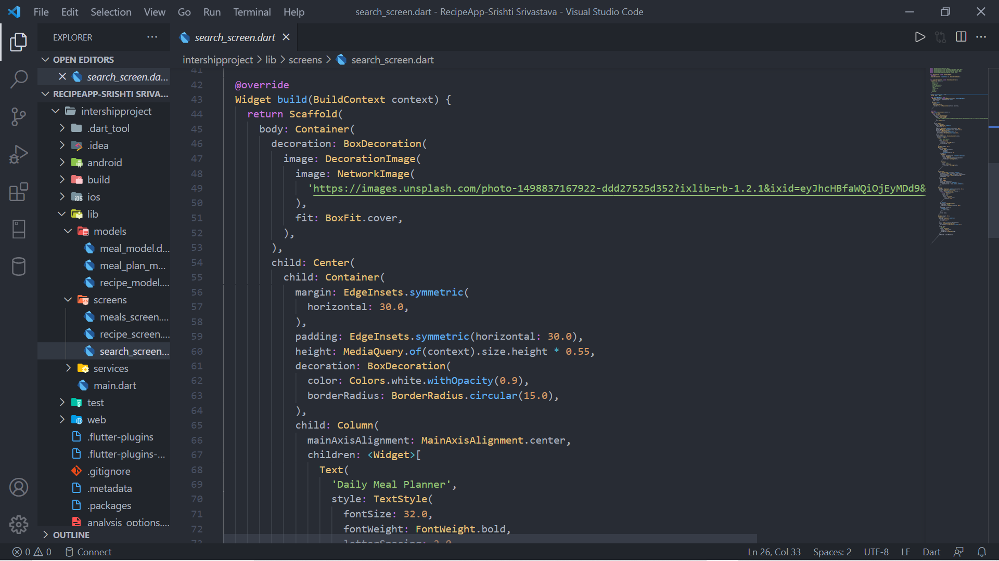
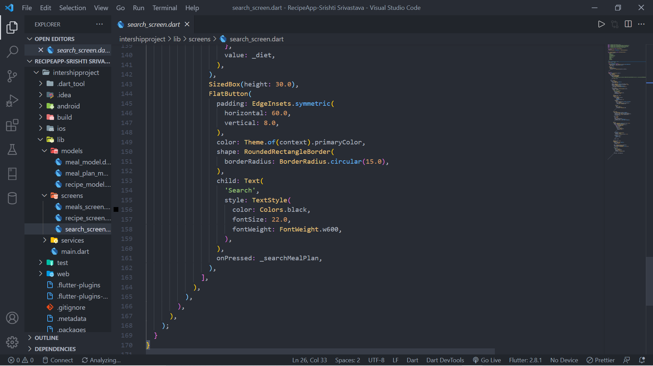

Slide 14
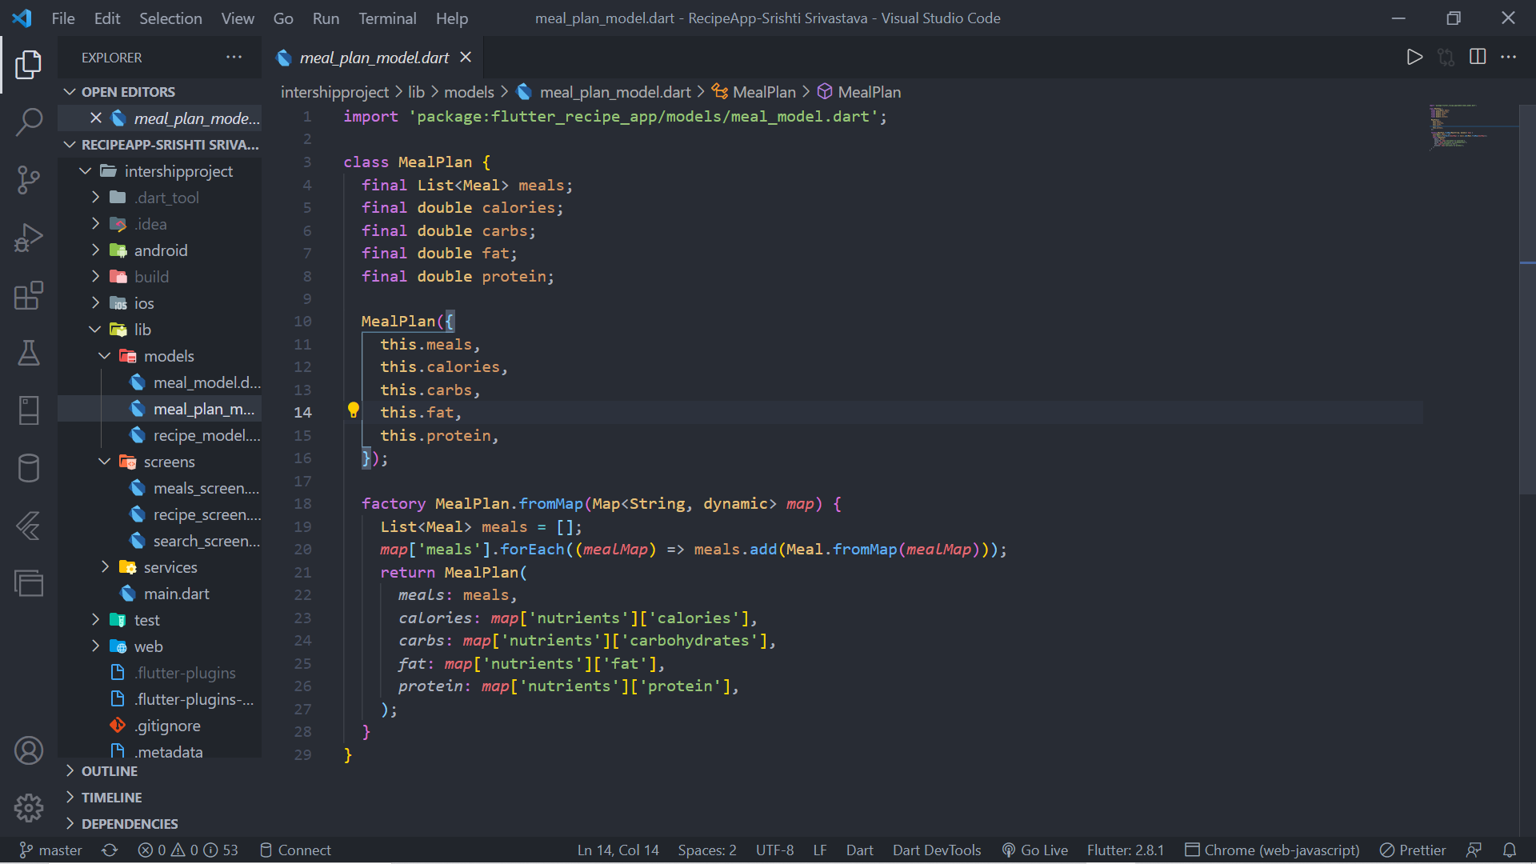
Meals_Screen.dart :
This displays the recommended meals for breakfast, lunch and dinner. It also predicts the calory intake of the day if we follow the recommended system.
We can click on any meal and that will provide us the recipe of that meal.

Slide 15
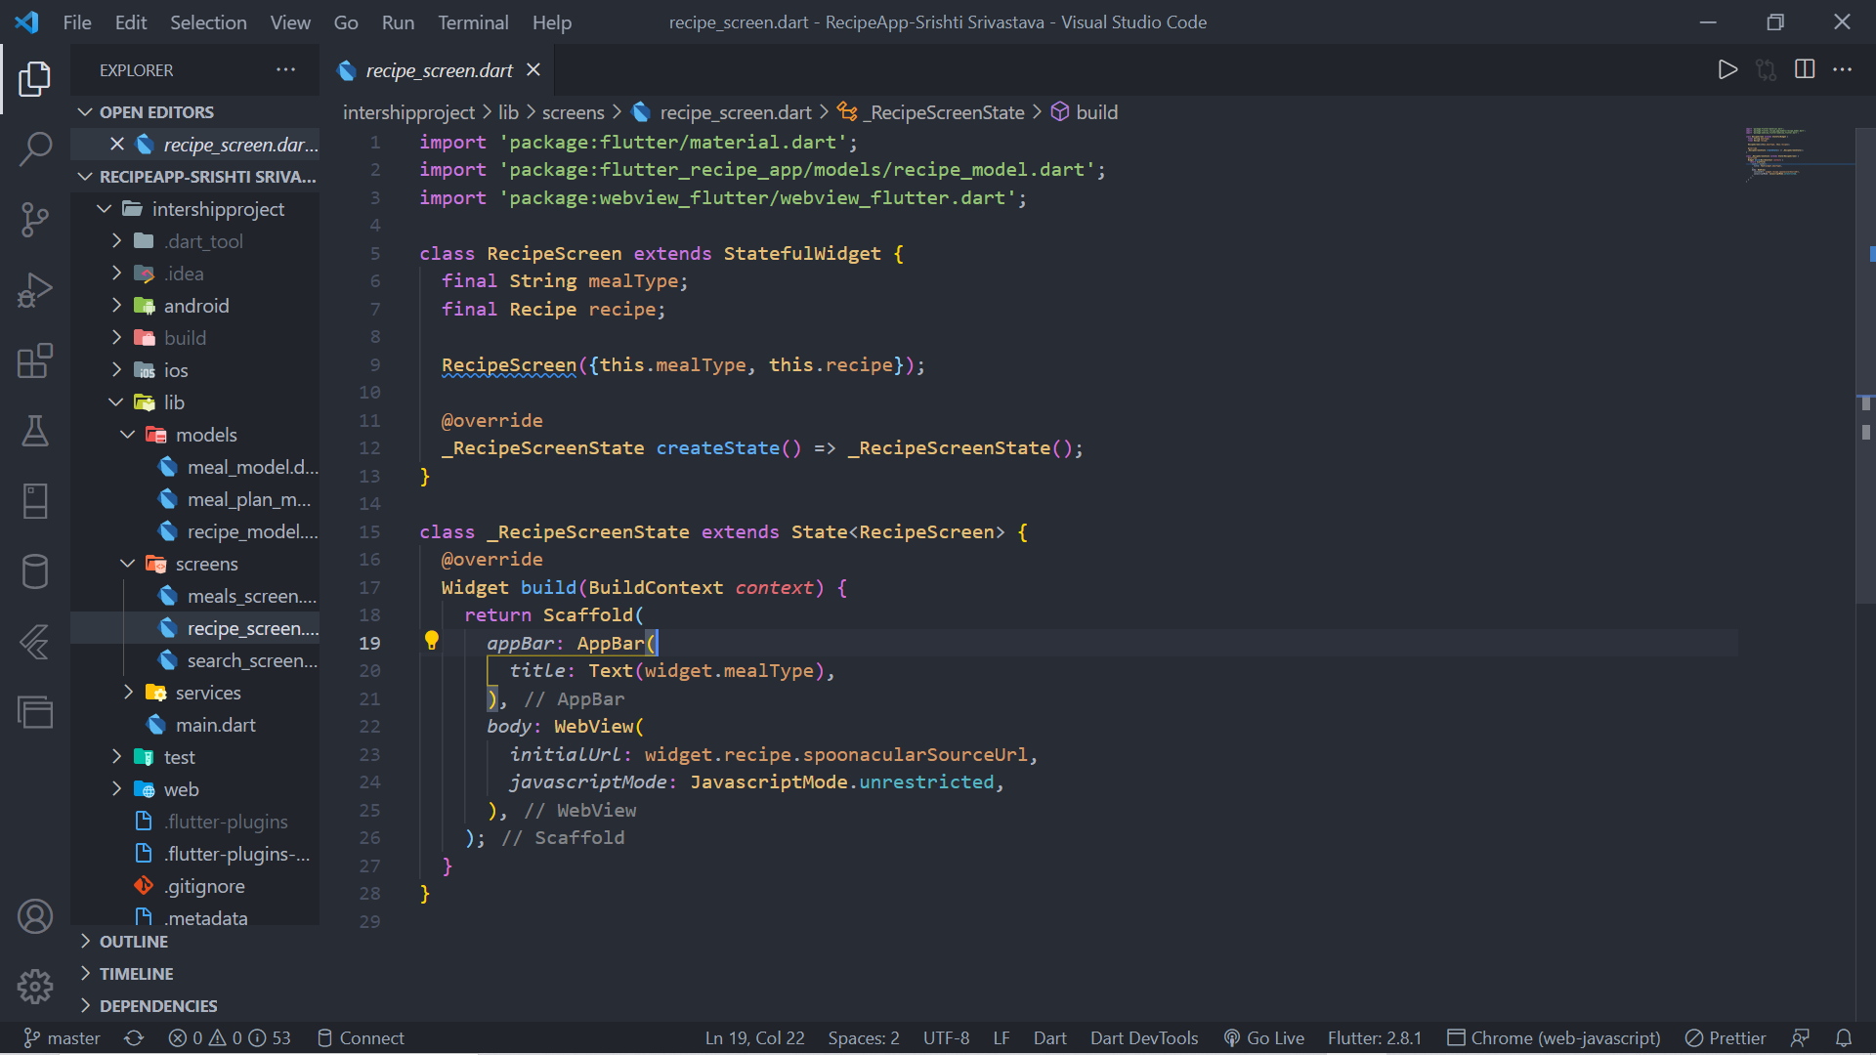
Recipe_Screen.dart :
This displays the recipe of any food item selected by the user. It takes us to the original webpage of the recipe from where user can explore more such recipe of its interest.

Slide 16
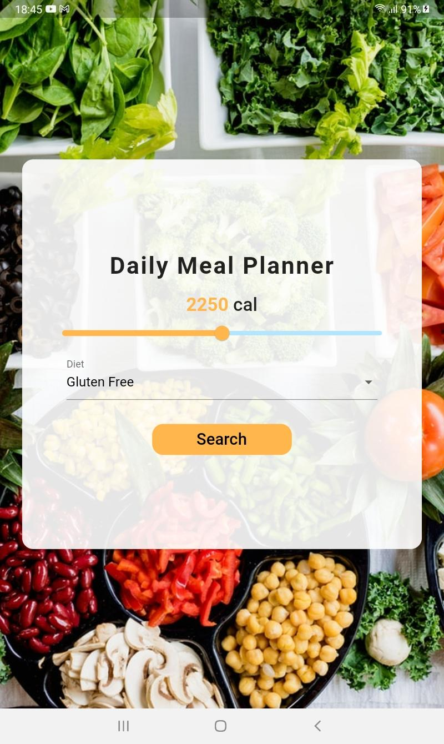
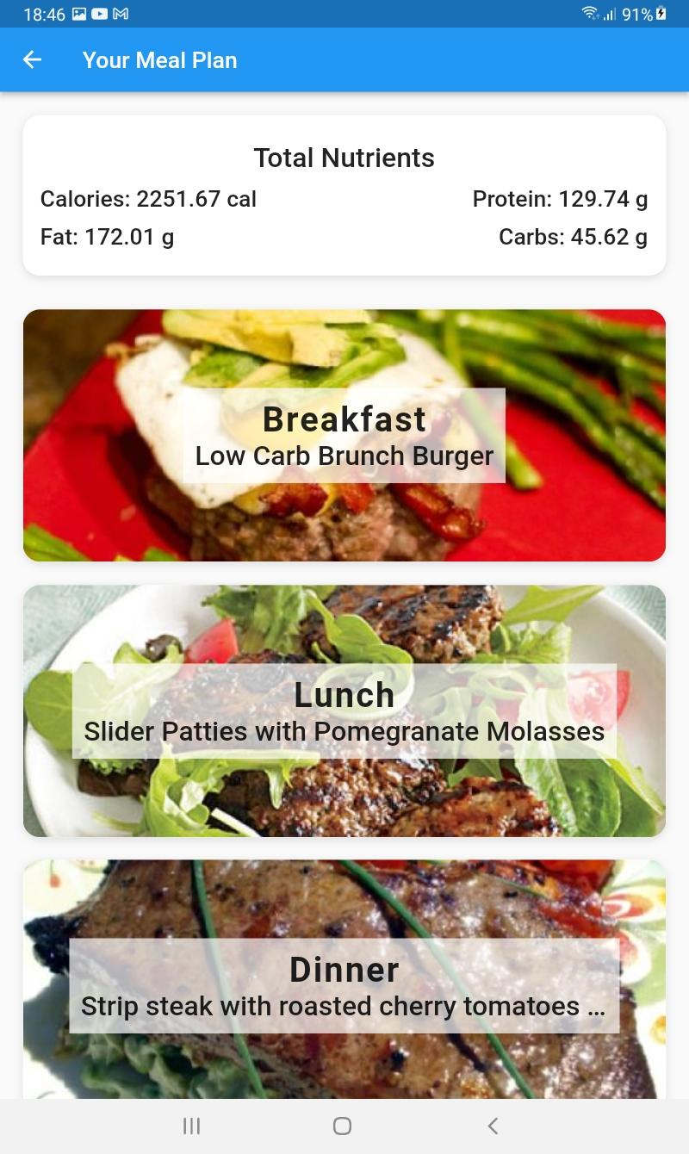
Results

Slide 17
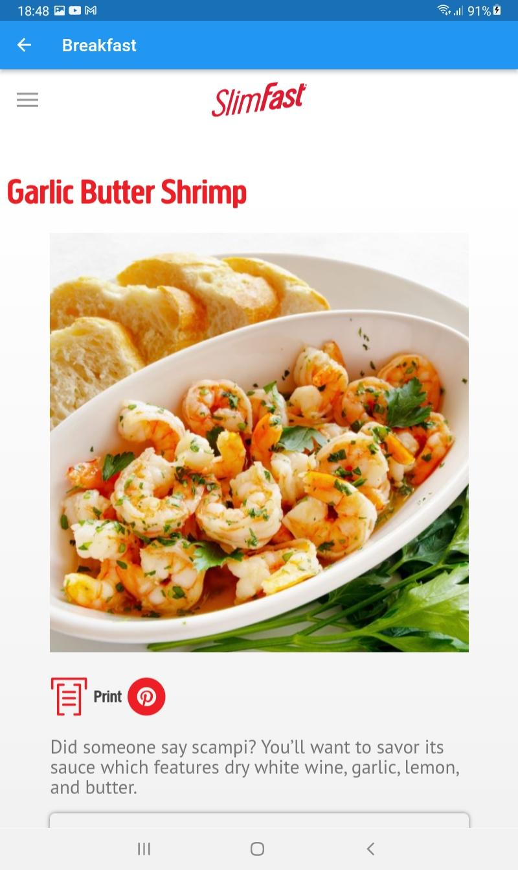
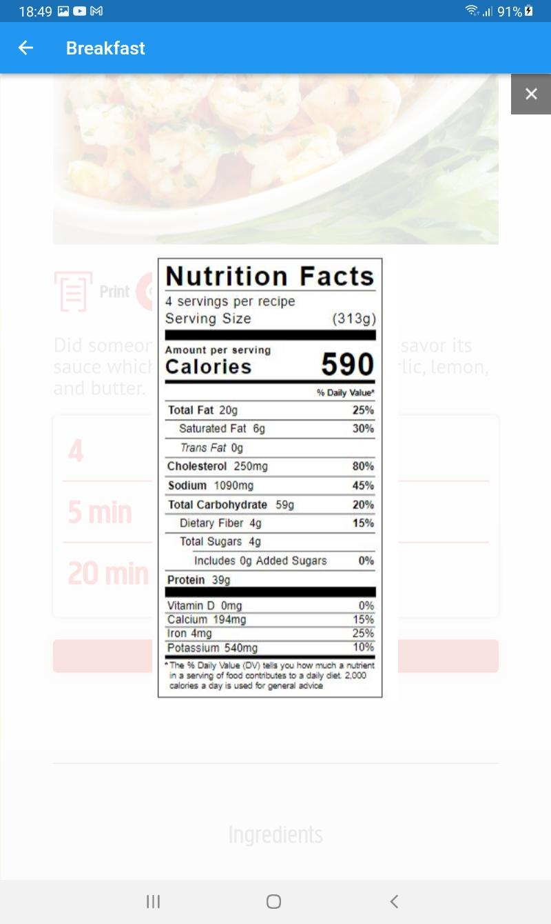

Slide 18
Testing
Serial No. | Description | User Input | Expected Output | Actual output
1. | Select the type of recipe the user is looking to cook for that day. | User selects the menu. | Desired meal type is selected. | Desired meal type is selected.
2. | The user clicks on the search button in order to look for diet plan. | User performs click event on the search button. | Navigated to the meals page. | Navigated to the meals page.
3. | The user clicks on the breakfast, lunch or dinner meal to navigate to its recipe. | User clicks the meal. | Recipe Page is displayed. | Recipe Page is displayed.

Slide 19
CONCLUSIONS
This project was developed to allow users to add and find food recipes using an intuitive and simple to use mobile application. The app allows the users to find recipes based on different criteria such as, course, cuisine, and type of food.
It also provides a filtering system that can be used to filter the list of recipes based on the ingredients used in each recipe, the time it takes to make the food, and the number of servings. The app also allows the users to add their own recipes using the interface provided.
In the end, the final goal of this mobile application is to provide a platform that allows anyone to share and find food recipes conveniently.

Slide 20
Future Enhancements
A feature that I would like to implement is some sort of moderation system for recipe addition. Using this system recipes added by the users will be checked for validity, as well as any inappropriate remarks or words.
If a recipe does not pass the check it will not be added to the database, and users will be provided an explanation as to why the recipe was not added. A set of guidelines will then be shown to users to help them add their recipes to the database.

Slide 21
Another feature that I would like to implement in the app is a user system. This system would allow the users to create an account using an email address. This would then allow the recipes to be added only by the register users, instead of anyone using the app. This would make the moderation of the app users much easier, since a user can be banned if he or she attempts to add bogus or inappropriate information to the database constantly. This system would also allow the users to update the recipes that they have already added to the database.

Slide 22
REFERENCES
[1] https://docs.flutter.dev/
[2] https://www.tutorialspoint.com/flutter/
[3] https://www.javatpoint.com/flutter
[4] https://www.geeksforgeeks.org/flutter-tutorial/
[5] https://ieeexplore.ieee.org/Xplore/home.jsp

Slide 23
Question and Answer

Slide 24
THANK YOU

