Slide 1
PREDICTIVE ANALYSIS FOR DIABETES DETECTION AND GLUCOSE MONITORING

Slide 2
Team Members
Shreeya Sharma (BTAI-544)
Parth Chavan (BTAI-536)
Shradha Misal (BTAI-549)
Rathik Shetty (BTAI-546)
Jonel Mathew (BTAI-531)
Kingshuk Sarmah (BTAI-527)

Slide 3
Table of Contents
1)Introduction
PROBLEM STATEMENT
AIM OF THE PROJECT
LITERATURE REVIEW
2)PROPOSED METHODOLOGY
Overview
Predictive Analytics in Healthcare
Predictive Analytics in Diabetes Management
Model Building
3)Existing approaches
4)Previous STUDIES
5)PROJECT CONTIBUTORS
6)RESULTS
7)CONCLUSION
8)THANK YOU NOTE

Slide 4
INTRODUCTION

Slide 5
Introduction
Rising Prevalence of Diabetes Mellitus Worldwide: Diabetes mellitus has emerged as a global health concern, affecting millions of individuals. The prevalence of this metabolic disorder continues to escalate, placing significant burdens on healthcare systems.
Challenges of Diabetes Management: Managing diabetes is a multifaceted endeavor that involves monitoring blood sugar levels, adhering to medications, making dietary adjustments, and adopting lifestyle changes. These complexities can lead to suboptimal outcomes if not addressed with precision.
Need for Glucose Monitoring: Glucose monitoring is essential for managing diabetes as it allows individuals to track their blood sugar levels, enabling timely adjustments to medication, diet, and lifestyle to prevent complications and maintain optimal health. Regular monitoring helps in achieving and maintaining target glucose levels, promoting effective diabetes management.

Slide 6
Problem Statement
Diabetes management entails intricate tasks such as continuous monitoring of blood sugar levels, making lifestyle adjustments, and mitigating potential complications. The multifaceted nature of these requirements poses challenges for effective patient care.
Despite advancements in Continuous Glucose Monitoring (CGM) technology, there exists a critical knowledge gap regarding its effectiveness in improving diabetes care. This study bridges a critical knowledge gap in Continuous Glucose Monitoring (CGM) effectiveness for diabetes care. Utilizing data from a randomized experiment, we employ advanced AI models to predict hypoglycemia and hyperglycemic events, aiming to enhance patient care and optimize CGM-assisted diabetes treatment.

Slide 7
Aim of the Project
Developing a predictive analysis framework to enhance early detection of diabetes and real-time glucose monitoring, this project aims to leverage advanced analytics for proactive healthcare intervention. The goal is to create a robust system that provides timely insights, contributing to improved diabetes management and overall patient well-being.

Slide 8
Literature Review
Study | Focus
Sugandh, F. N. U., Chandio (2023). Advances in the management of diabetes mellitus: A focus on personalized medicine. | A future where personalized medicine transforms diabetes management globally, enhancing patient outcomes and promoting patient-centric care.
Hornborg Svensson, C., Henriksen, (2022). Assessment of the Advanced Technologies and Treatments for Diabetes Consensus Definition of CGM-Recorded Hypoglycemia | Continuous glucose monitoring (CGM) readings during patient-reported symptomatic hypoglycaemia: Assessment of the advanced technologies and treatments for diabetes consensus definition of CGM-recorded hypoglycaemia.
Cappon, G., Vettoretti, M., Sparacino, G., & Facchinetti, A. (2019). Continuous glucose monitoring sensors for diabetes management: A review of technologies and applications. Diabetes & Metabolism Journal, 43(4), 383. | Specifying the multifaceted aspects of modern day CGM
Ryali, S., & Menon, V. (2009). Feature Selection and Classification of fMRI data using Logistic Regression with L1 norm regularization. NeuroImage, 47, S57. | Feature selection using Lasso Regularization

Slide 9
Literature Review
Study | Focus
Hajian-Tilaki, K. (2013). Receiver operating characteristic (ROC) curve analysis for medical diagnostic test evaluation. Caspian Journal of Internal Medicine, 4(2), 627. | Focusing on ROC-AUC (Receiver Operating Characteristic - Area Under the Curve) techniques
Aldughayfiq, B., Ashfaq, F., Jhanjhi, N. Z., & Humayun, M. (2023). Explainable AI for retinoblastoma diagnosis: Interpreting deep learning models with LIME and SHAP. Diagnostics (Basel, Switzerland), 13(11), 1932. | Focusing on AI techniques such as SHAP and LIME
(N.d.-c). Ieee.org. Retrieved December 21, 2023 | Focusing on SAGA (Stochastic Average Gradient Accelerated Method).

Slide 10
PROPOSED METHODOLOGY

Slide 11
Overview of CGM
Comprehensive Diabetes Monitoring to Prevent Complications: Effective diabetes management encompasses a holistic approach aimed at averting potential complications. The goal is to maintain stable blood sugar levels and prevent adverse health outcomes.
Components of Management: Diabetes care involves a range of components, including regular blood glucose monitoring, adherence to prescribed medications, adjustments in dietary habits, and incorporation of suitable lifestyle changes. These facets collectively contribute to the maintenance of overall health.
Importance of Early Detection: Early detection of glucose abnormalities and diabetes is crucial for timely intervention and effective management, preventing complications and improving overall health outcomes. Identifying elevated blood glucose levels in the pre-diabetic stage allows for lifestyle modifications, reducing the risk of progression to full-blown diabetes. Early diagnosis enables prompt initiation of treatment, including medication and behavioral interventions, to maintain optimal blood sugar levels. This proactive approach not only enhances individual well-being but also alleviates the societal and economic burdens associated with diabetes-related healthcare costs and complications.

Slide 12
Predictive Analytics in Healthcare
Overarching Impact in Healthcare: Predictive analytics and machine learning have revolutionized healthcare by enabling data-driven decision-making. These technologies harness vast datasets to uncover insights that shape diagnostics, treatment strategies, and patient outcomes.
Roles in Early Detection and Risk Stratification: A pivotal role of predictive analytics and machine learning lies in early detection. By identifying subtle trends and deviations in patient data, these tools aid in the timely diagnosis of conditions like diabetes. Additionally, risk stratification allows healthcare providers to prioritize interventions for individuals with higher susceptibility.
Individualized Care through Pattern Recognition: Machine learning's ability to discern intricate patterns empowers healthcare providers to offer personalized interventions. These algorithms can uncover correlations and trends that human perception may miss, thus optimizing treatment plans based on individual attributes.

Slide 13
Predictive Analytics in Diabetes Detection
Potent Tool for Anticipating Patient Outcomes: Predictive analytics emerges as a powerful tool in diabetes management, enabling healthcare providers to foresee patient outcomes with remarkable accuracy. By analyzing historical and real-time data, these techniques equip professionals to make proactive decisions.
Key Patient Data Variables: Machine learning algorithms analyze a myriad of patient data variables, including blood glucose levels, insulin sensitivity, lifestyle factors, medical history, and more. This comprehensive approach allows for a holistic understanding of individual patient profiles.
Efficacy of Models Gradient Boosting and Random Forest: Notably, models like Gradient Boosting and Random Forest have demonstrated exceptional efficacy in forecasting diabetes likelihood and potential complications. These algorithms harness intricate relationships within patient data to generate reliable predictions, offering invaluable insights for personalized interventions.

Slide 14
Model Building And Precision Monitoring
1. Logistic Regression as a Baseline Model:
The purpose of the Logistic Regression serves as a starting point to establish a simple yet effective model before exploring more complex algorithms. The Logistic Regression model is instantiated without any regularization initially, using parameters like solver and penalty in it’s through the implementation
2. Regularization Techniques:
Lasso (L1 Regularization): Purpose: Lasso Regularization shrinks less important coefficients to zero, effectively performing feature selection by eliminating irrelevant features
•The Logistic Regression model is instantiated with the penalty="l1" parameter, indicating Lasso regularization in its implementation factor. The model is fitted to the training data (X_class_train, y_class_train) using the fit method. C=1 is set to control the regularization strength (inverse of regularization strength, where smaller values specify stronger regularization).

Slide 15
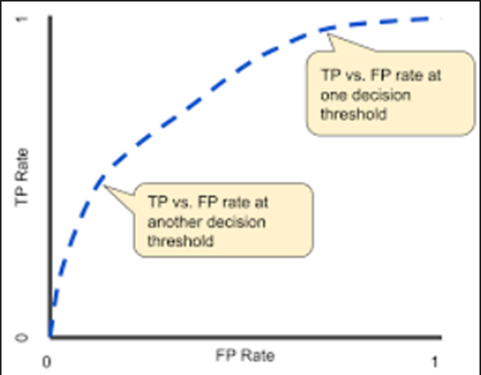
3.Ridge (L2 Regularization): Ridge Regularization shrinks coefficients close to zero but doesn't set them exactly to zero, maintaining all features while reducing their impact on the model.
4.Recursive Feature Elimination (RFE): Applied to simplify the model while retaining optimal performance. RFE is utilized to identify and select the most informative features from the dataset, eliminating less important ones
Recursive Feature Elimination: RFE proceeds as follows:
•Stepwise Selection: It starts by training the model on the full set of features.
•Feature Importance Ranking: The model’s coefficients or feature importance are used to rank the features based on their importance.
•Feature Pruning: It iteratively eliminates the least important features, selecting a subset of features that contribute most to the model's predictive ability.

Slide 16
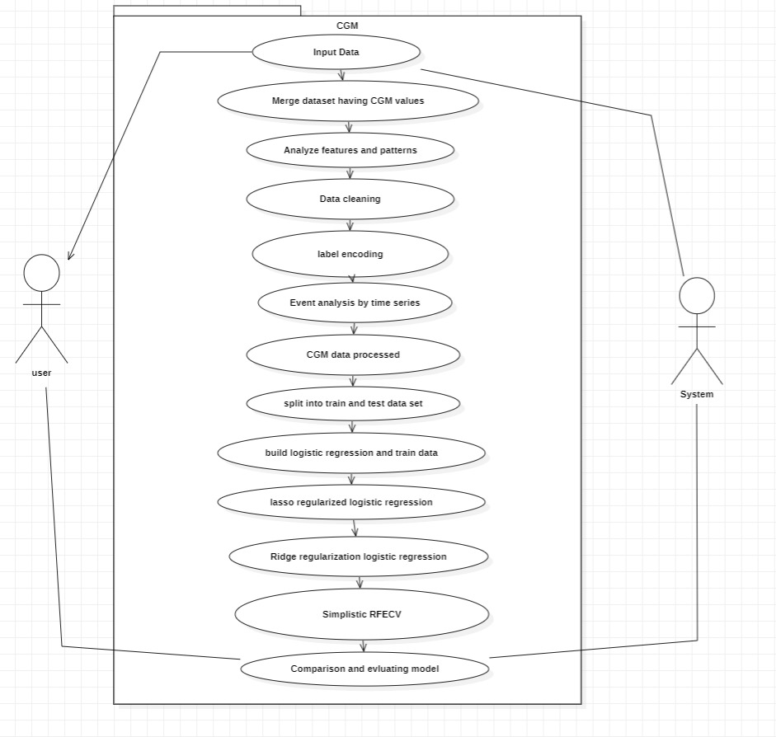
Fig. Use Case Diagram

Slide 17
Existing Approaches to Diabetes Prediction
Contrasting Traditional Approaches and Digital Health Technologies: The landscape of diabetes prediction and management has witnessed a transformative shift from traditional methods to innovative digital health technologies. This transition marks a departure from periodic monitoring towards real-time, data-driven interventions.
Real-Time Monitoring : The advent of continuous glucose monitoring systems and mobile applications has ushered in a new era of diabetes care. These technologies enable patients to monitor their blood sugar levels in real-time, providing immediate insights into fluctuations. Moreover, early detection and real-time monitoring can empower healthcare providers to deliver personalized interventions tailored to real-time data, facilitating timely adjustments to treatment plans.

Slide 18
Previous Studies and Research
Exploring Similar Domains: Research in similar domains has yielded valuable insights into the intersection of technology and diabetes care. These studies provide a foundation for our project's objectives and underscore the potential of innovative approaches.
Effectiveness of Continuous Glucose Monitoring Systems: A study by Robard’s et al. (2020) showcased the effectiveness of continuous glucose monitoring systems in intensive care settings. This technology allows for real-time tracking of glucose levels, enabling proactive interventions.
Predictive Analytics Optimizing Diabetes Care: Bootsma (2018) highlighted the potential of predictive analytics in optimizing diabetes care. The study emphasized the role of data-driven insights in personalizing treatment strategies and enhancing patient outcomes.

Slide 19
RESULT
Logistic Regression Baseline: Initially, a logistic regression model served as a baseline.
Regularization Techniques: Lasso (L1) and Ridge (L2) regularization were employed. Lasso was used for feature selection by shrinking less important coefficients to zero, while Ridge reduced coefficients close to zero but not to zero itself, preserving all features.
Feature Selection: Recursive Feature Elimination (RFE) simplified the model while maintaining optimal performance.

Slide 20
LIMITATIONS
While Continuous Glucose Monitoring (CGM) and Artificial Intelligence (AI) offer a comprehensive approach to diabetes management, several limitations require acknowledgment:
The use of a dataset from a randomized trial lacks explicit consideration of potential limitations, such as sample size and representativeness. Concerns arise over the generalizability of findings due to the absence of information on the diversity of the study population. Data collection relying on surveys and interviews introduces the possibility of response bias.
The use of AI models raises concerns about algorithmic bias if training data lacks representativity. The abstract implies a causal relationship between CGM usage and improved outcomes but falls short in addressing challenges related to establishing causation and potential confounding variables.
Long-term assessments of CGM technology's impact on diabetes management and considerations for socioeconomic factors are overlooked, potentially affecting the study's generalizability across diverse population groups.
Addressing these limitations is crucial to enhance the robustness and applicability of the study's findings and recommendations.

Slide 21
Project Contributions
Aligning with Evolving Trends: By leveraging predictive analytics and machine learning, our project aligns with the industry's shift towards precision medicine and personalized interventions.
Development and Evaluation of Predictive Models: A key contribution of our project lies in the development and rigorous evaluation of advanced predictive models. Specifically, models like Gradient Boosting and Random Forest are being harnessed to provide accurate diabetes predictions and anticipate potential complications.
Integration of Personalized Treatment Recommendation Algorithms: We take a holistic approach by integrating personalized treatment recommendation algorithms into our project. These algorithms offer healthcare providers tailored insights to guide patient interventions, merging data-driven insights with clinical expertise.

Slide 22
Conclusion and Future Directions
Recap of Main Goals and Contributions: In closing, CGM will stand as a beacon of innovation in diabetes management. Our project's central goals include predictive models for accurate diabetes prediction, personalized treatment recommendations, and the integration of data-driven insights into clinical practice.
AI-Driven Diabetes Care: As we conclude, we envision a future where AI-driven diabetes care becomes the cornerstone of precision medicine. The synergy between machine learning and medical expertise holds the promise of improved patient outcomes, enhanced healthcare decision-making, and resource optimization.
Engagement and Discussion: We invite you to engage in discussions and pose questions about our research methodology. Your insights and feedback are invaluable as we collectively shape the future of diabetes management through innovative technologies.

Slide 23
References
Sugandh, F. N. U., Chandio, M., Raveena, F. N. U., Kumar, L., Karishma, F. N. U., Khuwaja, S., Memon, U. A., Bai, K., Kashif, M., Varrassi, G., Khatri, M., & Kumar, S. (2023). Advances in the management of diabetes mellitus: A focus on personalized medicine. Cureus, 15(8). https://doi.org/10.7759/cureus.43697
Hornborg Svensson, C., Henriksen, M. M., Thorsteinsson, B., & Pedersen-Bjergaard, U. (2022). Continuous glucose monitoring (CGM) readings during patient-reported symptomatic hypoglycemia: Assessment of the advanced technologies and treatments for diabetes consensus definition of CGM-recorded hypoglycemia. Diabetes Technology & Therapeutics, 24(2), 130–135. https://doi.org/10.1089/dia.2021.0216
van Oss, C. J. (1995). Transfusion Immunology and Medicine (1st Edition). CRC Press.
Sugandh, F. N. U., Chandio, M., Raveena, F. N. U., Kumar, L., Karishma, F. N. U., Khuwaja, S., Memon, U. A., Bai, K., Kashif, M., Varrassi, G., Khatri, M., & Kumar, S. (2023). Advances in the management of diabetes mellitus: A focus on personalized medicine. Cureus, 15(8). https://doi.org/10.7759/cureus.43697
Anunaya, S. (2021, August 10). Data preprocessing in data mining - A hands on guide (updated 2023). Analytics Vidhya. https://www.analyticsvidhya.com/blog/2021/08/data-preprocessing-in-data-mining-a-hands-on-guide/
Nefs, G., Bazelmans, E., Marsman, D., Snellen, N., Tack, C. J., & de Galan, B. E. (2019). RT-CGM in adults with type 1 diabetes improves both glycaemic and patient-reported outcomes, but independent of each other. Diabetes Research and Clinical Practice, 158(107910), 107910. https://doi.org/10.1016/j.diabres.2019.107910

Slide 24
Thank You
Gratitude: We extend our heartfelt gratitude to each of you for your time and attention during this presentation. Your interest in our CGM and its potential impact on diabetes management is truly appreciated.
Thank you once again for being a part of this journey towards revolutionizing diabetes care through predictive analytics and machine learning.

