Slide 1
Missing Scoop
By
Anushri Srinath Aithal, Mojdeh Keykhanzadeh, Ashwini Shankar Narayan

Slide 2
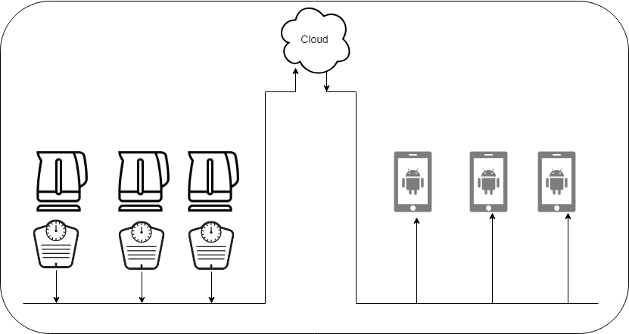
Introduction
Busy Lifestyle makes it hard to stock grocery
Lack of proper planning and appropriate nutrition consumption
Elder people living by themselves make multiple errands
Refill Inventory with real time visualization of kitchen containers from any place at any time
Notes:
Anushri

Slide 3
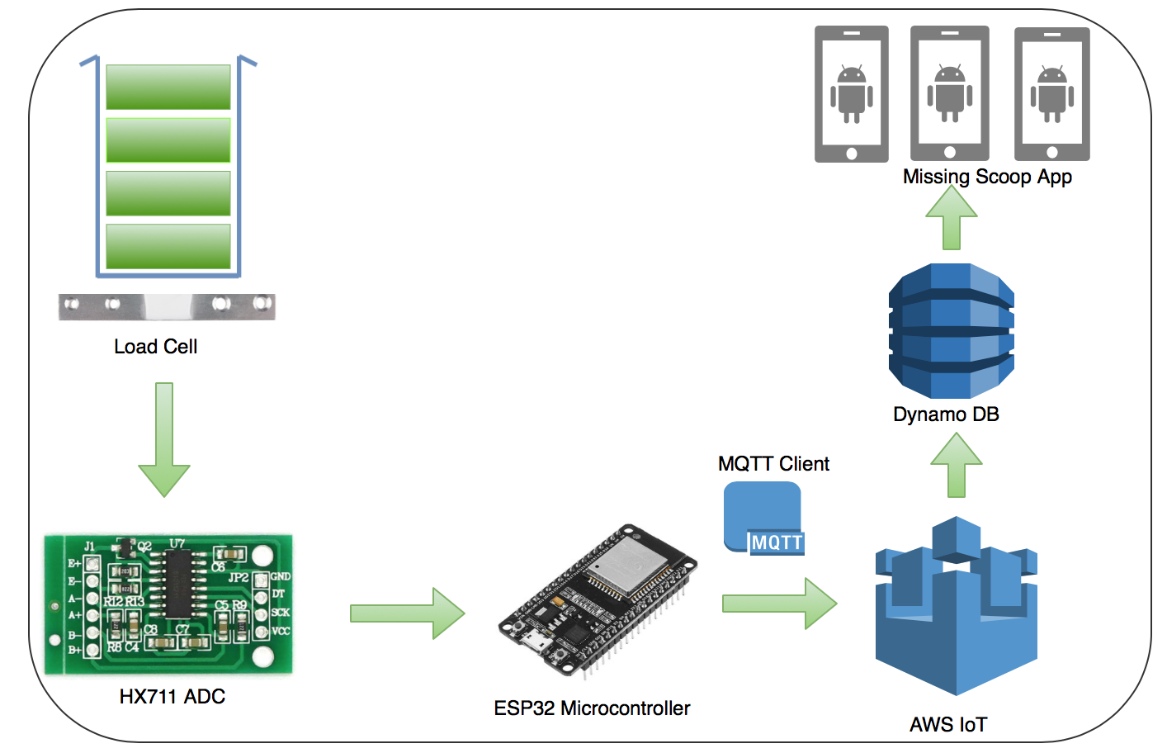
Hardware Architecture
Notes:
Ashwini

Slide 4
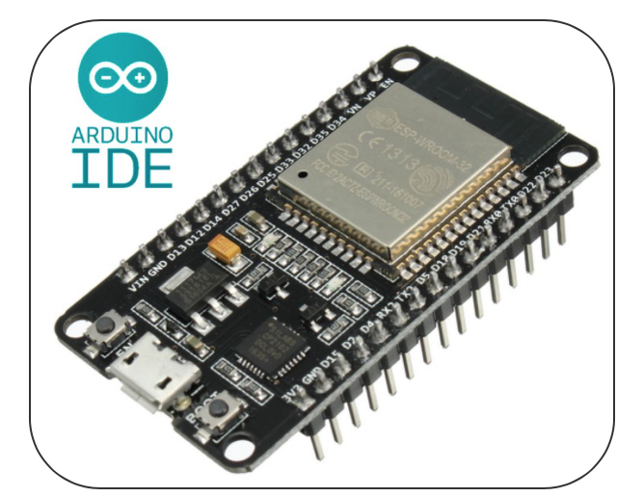
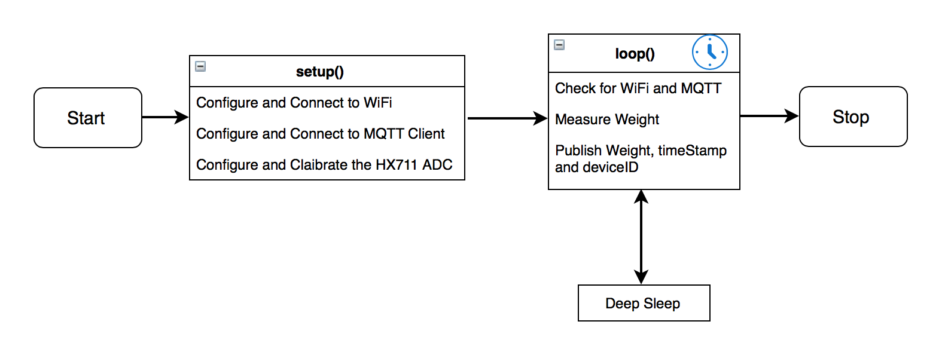
Hardware Program Flow
Notes:
Ashwini

Slide 5
Demo

Slide 6
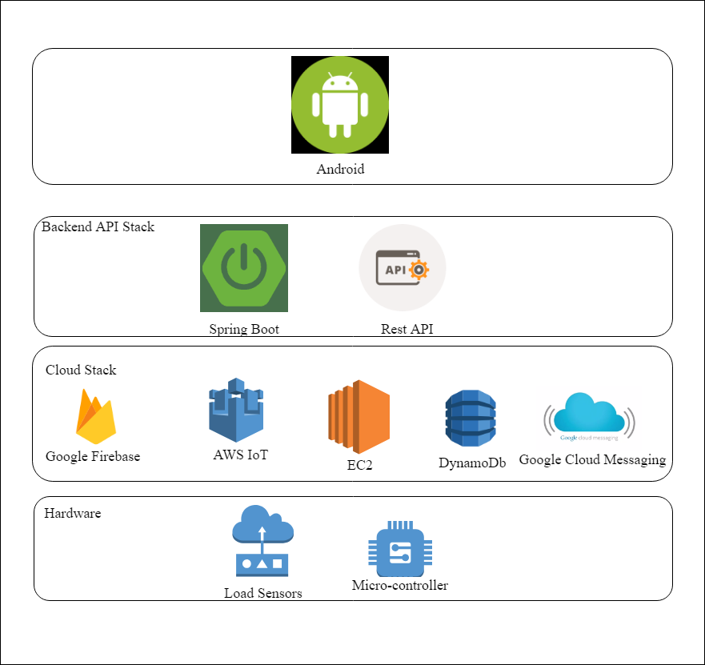
Architectural Diagram
Notes:
Anushri /Ashwini

Slide 7
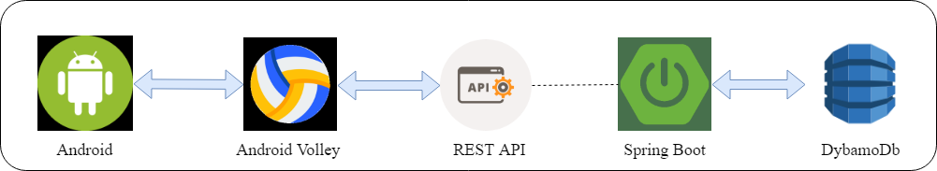
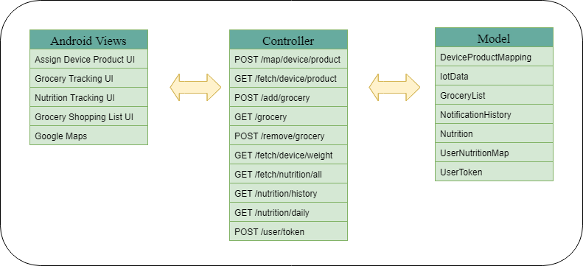
Design Pattern

Slide 8
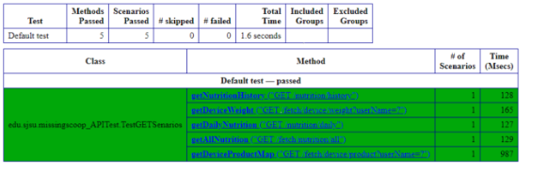
Testing Frameworks
Selenium Test with TestNG
Notes:
Mojdeh

Slide 9
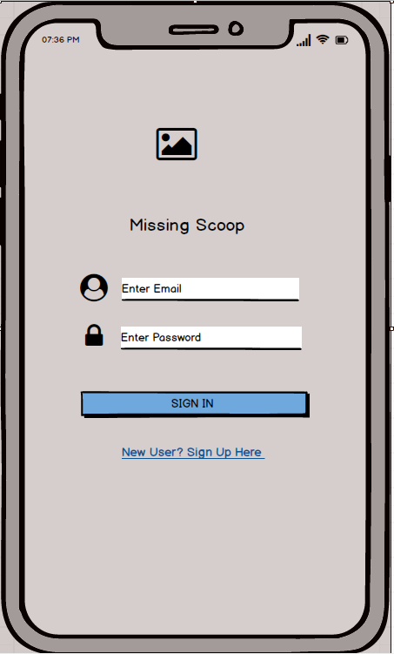
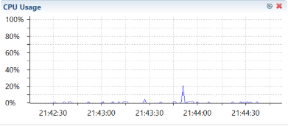
Profiling Mockups

Slide 10
Future Work
Integration with Google Fit
Provide Recommendation on Healthy eating
Supply Chain Management

