Slide 1
Retention Rate for TV Shows on Netflix
Group 9:
Aatir Cheema, Shrirang Annasaheb Bhadgaonkar, Temitope Oluyomi

Slide 2
Why This Matters
Investment at Stake
Streaming platforms spend heavily on additional seasons
Streaming platforms invest heavily in producing additional seasons of a show
Season-to-season viewership is shaped by factors such as Season 1 rating, directors, viewership, show duration, viewership slope, and the time gap between seasons
Some shows gain viewers in later seasons through positive reception, publicity, and growing popularity
Other shows lose viewers due to declining interest, longer time gaps, or drops in quality
Predicting the direction of viewership change can help streaming platforms, producers, and analysts better understand audience retention
$
Viewership Can Shift
Audiences grow or shrink season to season
↕
Predictive Value
Direction of change informs renewal decisions
→

Slide 3
Project Scope
Problem Statement:
Predict whether a TV show's next-season viewership will decrease relative to the preceding season, based on information available from the current and previous seasons
Focus: the direction of season-to-season viewership change (increase vs. decrease)
Applies to the Season 1 → Season 2 transition, with the same approach extending to Season 2 → Season 3
Confirmed with real data (n=3,418): 72% High Retention vs. 28% Low Retention — validating this as a meaningful, moderately imbalanced classification problem
Class balance in modeling dataset (n = 3,418)

Slide 4
Data Sources
Netflix Movie & TV Engagement Reports (2023–2026)
32,576 entries covering global viewing engagement across four years
Includes runtime, type (Movie/TV), hours viewed, views per period, and total views
Source: whats-on-netflix.com
Search Netflix's Movie & TV Engagement Reports (2023-2026) - What's on Netflix
IMDb Non-Commercial Datasets
title.basics — runtime, genre, start/end year
title.episode — season structure, episodes per season, season gaps
title.ratings — ratings and votes, key for determining viewership direction
title.crew — season-wise directors and writers, enabling director popularity analysis
title.principals — cast and crew roles
title.akas — alternate titles, languages, and regions
Source - IMDb Data Files Download
Both datasets are publicly available for non-commercial use

Slide 5
Data Exploration
Data Quality Strengths:
Directly measures global Netflix engagement
Includes both popular and less-popular titles
Covers multiple reporting periods (2023–2026)
Contains quantitative variables usable for prediction
Aggregated title-level data — no personally identifiable viewer information

Slide 6
Exploratory Data Analysis
 | feature | missing_count | non_missing_count | missing_percent
1 | imdb_age_at_netflix_year | 3112 | 306 | 91.0474
2 | netflix_imdb_year_gap | 3112 | 306 | 91.0474
3 | netflix_reference_year | 3112 | 306 | 91.0474
4 | prev_view_change_absolute | 2126 | 1292 | 62.2001
5 | prev_view_change_percent | 2126 | 1292 | 62.2001
6 | prev_hours_change_absolute | 2102 | 1316 | 61.498
7 | prev_hours_change_percent | 2102 | 1316 | 61.498
8 | prev_season_views | 1390 | 2028 | 40.6671
9 | prev_season_rating | 1370 | 2048 | 40.0819
10 | prev_season_hours | 1369 | 2049 | 40.0527
Missing Data Analysis
While we were able to merge the two (Netflix and IMDB) dataset , some key feature for rows were missing. Here is a list of Top 10 missing features.

Slide 7
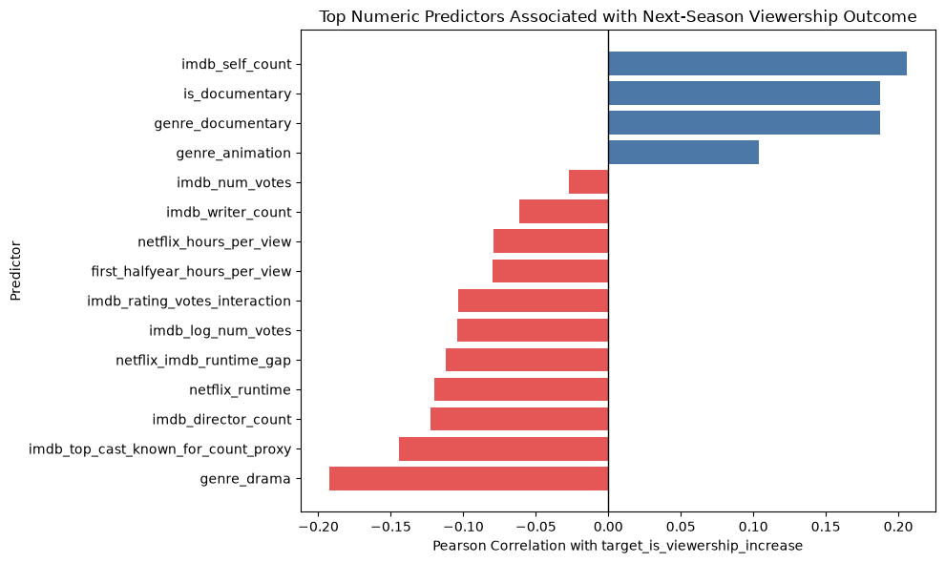
Correlation Analysis
Our Target is to determine if viewership is increased or next season viewership did not increase.
This Correlation shows
+1 ➔ Perfect Positive Relationship
+0.5 ➔ Moderate +ve Relationship
0 ➔ No Relationship
-0.5 ➔ Moderate –ve relationship
-1 ➔ Perfect –ve relationship

Slide 8
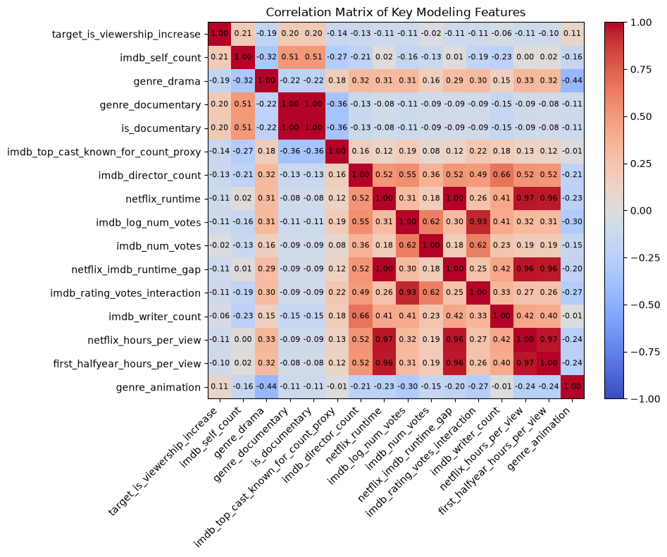
Feature Correlation
Key Observation correlation matrix:
1) No single predictor strongly explains next-season viewership increase. Largest correlation is 0.21
2) Documentary appears positively associated with viewership growth.
3) Drama shows the strongest negative association among the displayed genres.
4) IMDb vote-related engineered features are also redundant

Slide 9
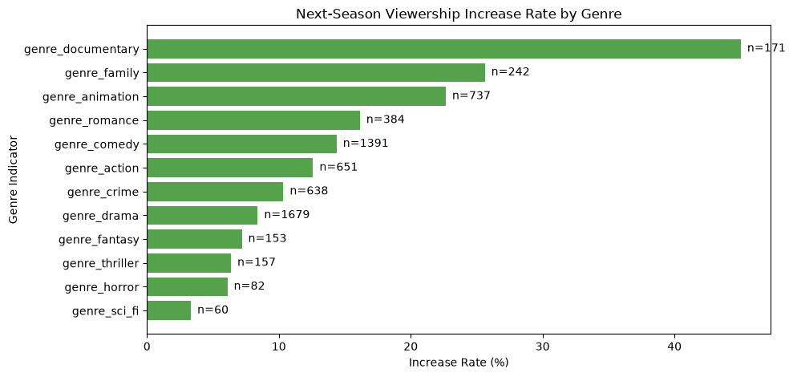
Relationship between Viewership change and Genre
This is a descriptive analysis.
Genre appears to have meaningful association with next-season performance
Documentary, family, and animation have substantially higher observed increase rates than drama, fantasy, thriller, horror, and sci-fi.
Documentary shows roughly a 44–45% increase rate from 171 observations.

Slide 10
Modeling and Evaluation

Slide 11
Workflow
Data (Netflix and IMDb)
Filter and Pair Seasons
Retention Model
Train / Test split 70% and 30%
Model and Evaluate

Slide 12
Planned Implementation vs Final Implementation
Planned
Final
Retention metric over a similar window
Predictors
IMDb rating
Time between seasons
Cast Continuity
Planned 80/20 split
Used total season 2 views / season 1 views
Predictors
IMDb average rating
IMDb vote count (used for gauging viewer engagement)
Other variables were not available reliably
70 / 30 split implemented
The primary issue ended up being data availability. The data didn't provide the season specific information we needed as we needed it. Rather than changing the entire proposal, we wanted to continue to use our model and evaluation methods but shift it so we could use the data we do have.

Slide 13
Prediction and Classification
Multiple Linear Regression
Decision Tree
Predicting retention using multiple linear regression.
Evaluate based on MAE, RMSE, median baseline
How close are predictions to the real retention ratio?
Output retention classification
Greater than or equal to 70%
Less than 70%
Does the prediction retention fall below or above 70%.
Retention = Season 2 Total Views ÷ Season 1 Total views

Slide 14
Multiple Linear Regression
1295 season 1 to 2 observations made
Average retention: 78.68%
Median: 71.05%
Standard Deviation: 51.79%
High Retention Cases:
157 over 100%
25 over 200%

Slide 15
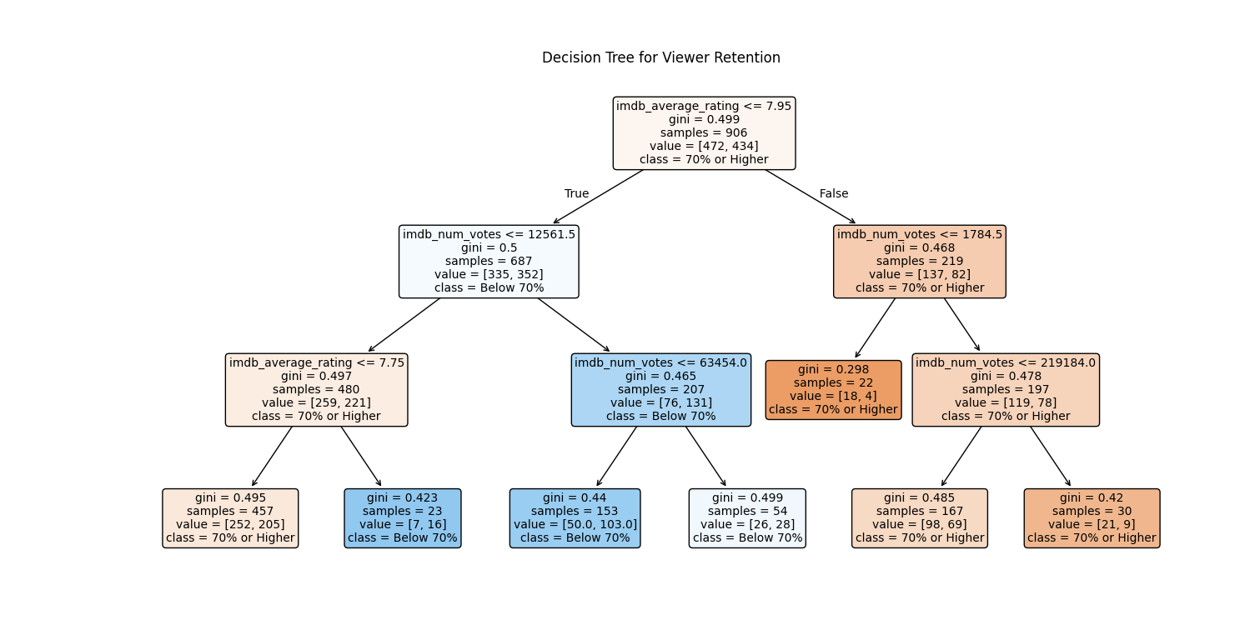
Decision Tree
Breakdown
674 (52.05%) greater than or equal to 70%
621 (47.94%) less than 70%
0: =>70% retention
1: <70% retention
Evaluation results
Balanced Accuracy 50.27%
Baseline Balanced Accuracy 50%
F1 Score for Low Retention: 34.93%
Baseline F1 Score: 0%

Slide 16
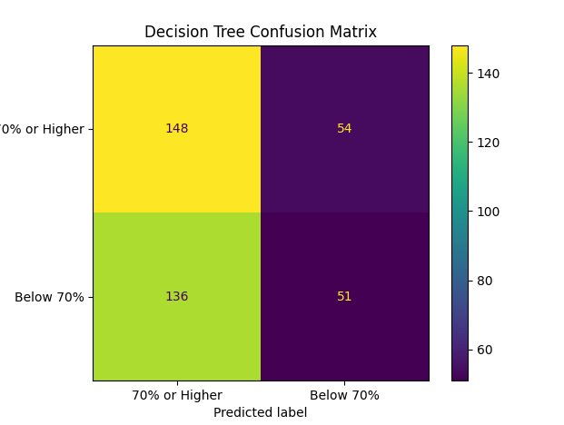
Results
Results for both models were weak
136 low retention shows were incorrectly classified as 70% or higher.
Regression did not beat the simple median-retention guess either.
IMDb average rating and vote count alone did not reliably predict our retention metric
The implementation worked, but stronger predictors are needed.

Slide 17
Limitations and methods for improvement
Comparing equal release windows
Alternatively knowing exact release date
We had to adjust retention metric, and we couldn't use season gaps as a predictor
Ideally having data beyond just 2023 to 2026
Data for series that debuted outside of Netflix would go a long way
Many series on Netflix's report didn't launch there so there's a lot of information that we ideally wouldn't use
More predictors
Season specific cast continuity instead of series specific cast data
Maybe should have focused on director, producer, and/or primary actors as opposed overall casting changes
The current models establish a decent baseline however we need more season specific data to improve the output

Slide 18
Thank you
Data Manager – Shrirang
Multiple Linear Regression Modeling and Evaluation - Aatir
Decision Tree Evaluation Modeling and Evaluation - Temitope

