Slide 1
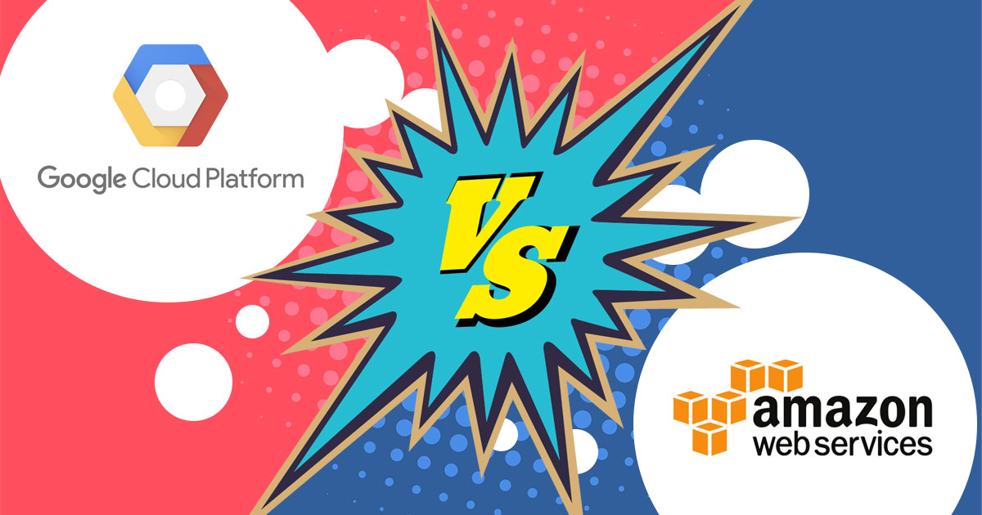

Slide 2
GCP VS AWS CSYE6225- NETWORK STRUCTURES AND CLOUD COMPUTING
Varsha Bhanushali, 001234580, bhanushali.v@husky.neu.edu
Shrikant Mudholkar, 001284732, mudholkar.s@husky.neu.edu
Rahul Chandra, 01225683, chandra.ra@husky.neu.edu
Manish Patil, 001228956, patil.man@husky.neu.edu

Slide 3
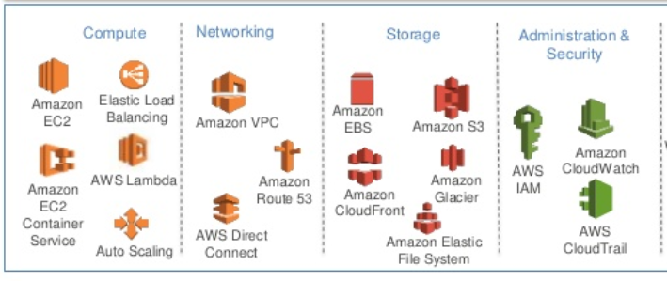
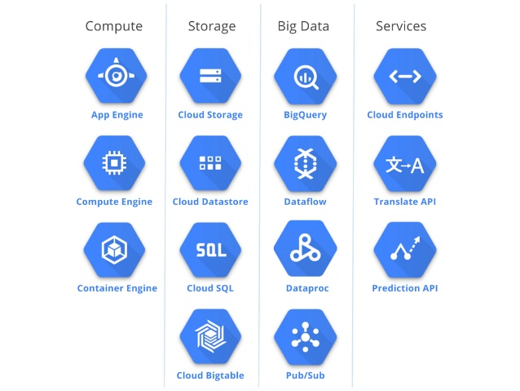
SERVICES
From Service point of view AWS is clear winner as the quality and quantity (200+) as extremely broad and wide which build huge set opportunities for many needs
On the other hand GCP product’s list is quite small (50+) which are based on classic IaaS and PaaS services

Slide 4
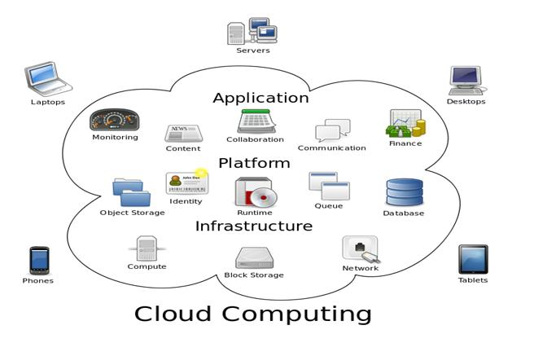
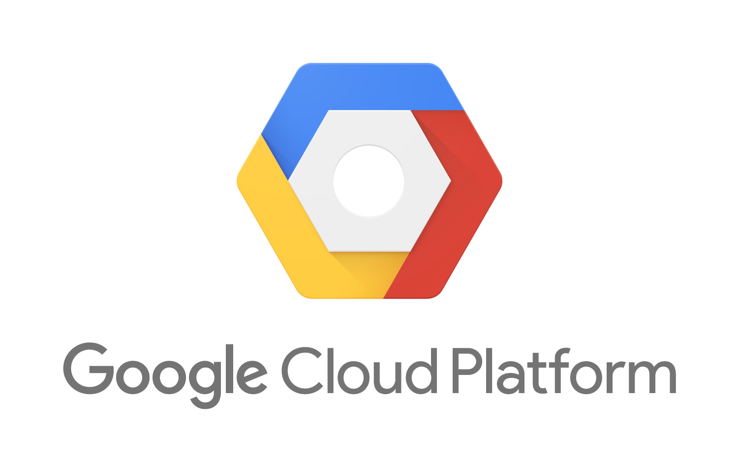

COMPUTE
Infrastructure as a service | Google Compute Engine | EC2
Platform as a service | Google App Engine | AWS Elastic Beanstalk
Functions as a service | Cloud Functions | AWS Lambda
Containers as a service | Kubernetes Engine | Amazon ECS
Machine/Instance Type | Google Compute Engine | AWS EC2
Technology | KVM (Kernel-based Virtual Machine) | Xen
Shared | f1-micro g1-small | t2.nano – t2.2xlarge
Custom Instance types | Google Cloud Preemptible VMs | AWS EC2 Spot Instances

Slide 5
BLOCK STORAGE
High throughput (IO), max IOPs per volume/instance, ability to burst capacity for short times
Block Storage | Google Cloud Platform (persistent disks) | AWS (EBS)
Service | SSD | General and Provisioned IOPS SSD
Volume Sizes | 1 GB to 64 TB | 1 GB to 16 TB 4GB to 16 TB Provisioned IOPS
Max IOPs per volume | 40,000 read, 30,000 write | 10,000 (20,000 for Provisioned IOPS) Max IOPS of 75,000/instance
Max Throughput per volume (MB/s) | 800 read, 400 write | 160 (320 for Provisioned IOPS)
Magnetic Pricing (per GB/month) | $0.040 (standard disk) | $0.045
SSD Pricing (per GB/month) | $0.170 | $0.10

Slide 6
OBJECT STORAGE
Both allow users to use disks that are locally attached to the physical machine running the instanceBlock Storage
Local storage offers superior performance, very high input/output operations per second (IOPS), and very low latency compared to persistent disks.
Object Storage | Google Cloud Platform | AWS
Service | Google Cloud Storage | Amazon S3
Locally Attached Disks | Local SSDs | Instance Store Volumes
Hot Multi-Region Pricing (per GB/month) | $0.0260 Includes transfer | S3 Standard(x2) $0.0460 Transfer $0.0100
Hot Single Region Pricing (per GB/month) | $0.0200 | $0.0230

Slide 7
DYNAMODB VS GOOGLE CLOUD DATASTORE
Name | Google Cloud Platform | AWS
Description | Hosted, scalable database service | Automatically scaling NoSQL Database as a Service
SQL | no | SQL-like query language (GQL)
Server-side scripts | no | using Google App Engine
Triggers | yes | Callbacks using the Google Apps Engine
Foreign keys | no | yes
Transaction concepts | no | ACID
MapReduce | no | yes
User concepts | Access rights for users and roles can be defined via the AWS Identity and Access Management (IAM) | no

Slide 8
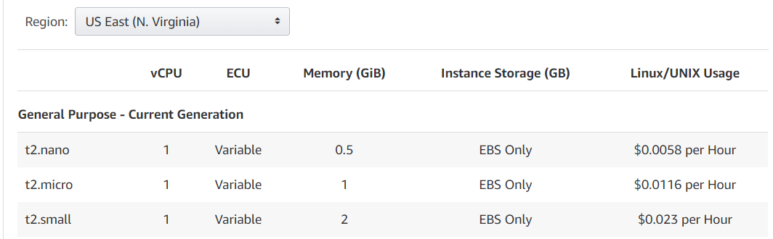
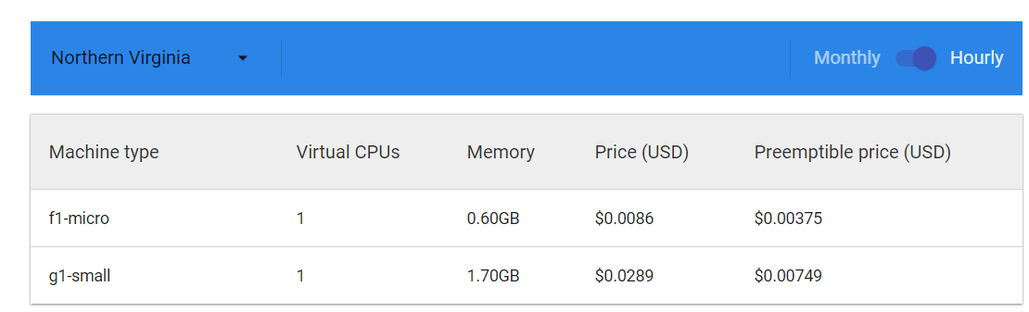
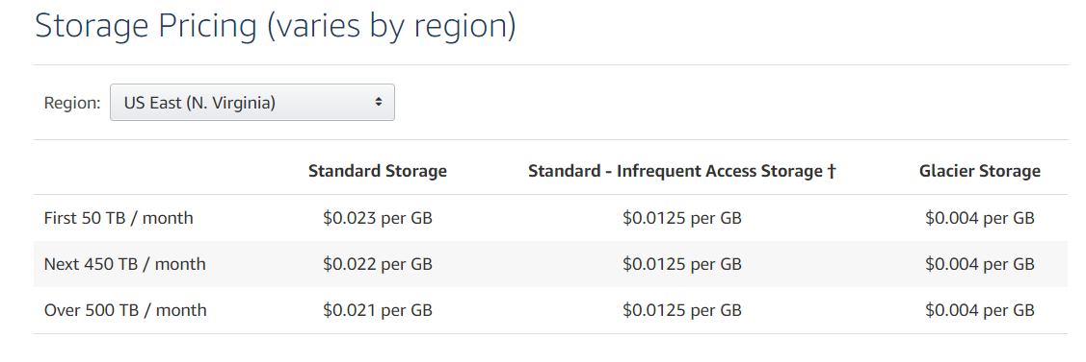
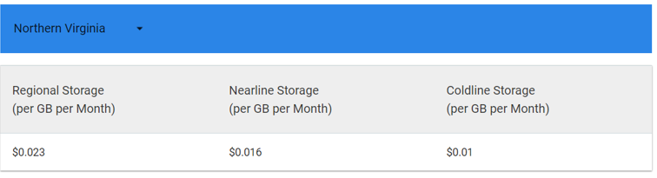
PRICING
In the huge competitive market of cloud vendor there has been a great cuts in pricing which is providing benefit to the customers
Estimating monthly spend with both of these cloud providers can be a challenge.
Compute Pricing:
Cloud Storage Pricing:

Slide 9
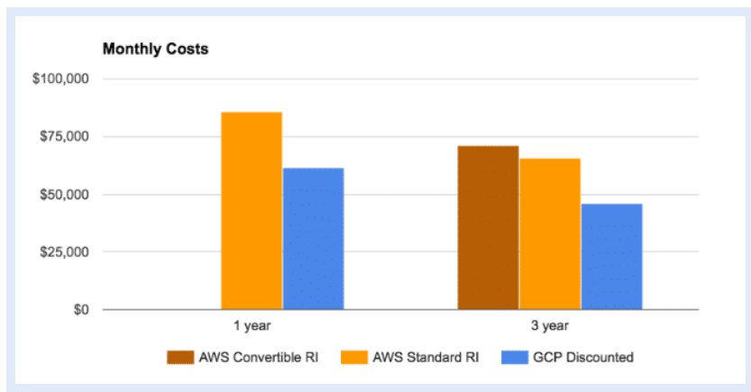
AWS EC2 offers Reserved Instance, which provide a significant discount (up to 75%) compared to on-demand pricing and provide a capacity reservation when used in a specific availability zone
Google Cloud has Committed Use Discounts, which provide the ability to purchase committed use contracts in return for deeply discounted prices for VM usage
Google Cloud offers automatic discounts on longer use of the instance, unlike with AWS where you have to reserve the instance for a long period of time

Slide 10
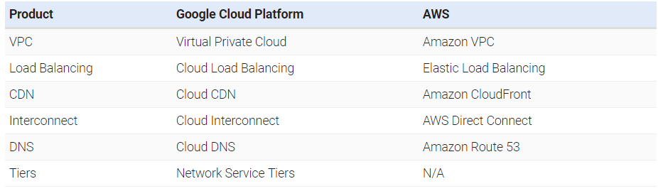
NETWORK
Google Cloud and AWS both utilize different networks and partners to interconnect their data centers across the globe and deliver content via ISPs to end users.
Google firewall does not have outgoing rules
Google subnets can span multiple regions
No IP on Load balancer in Amazon, while Google has static IP

Slide 11
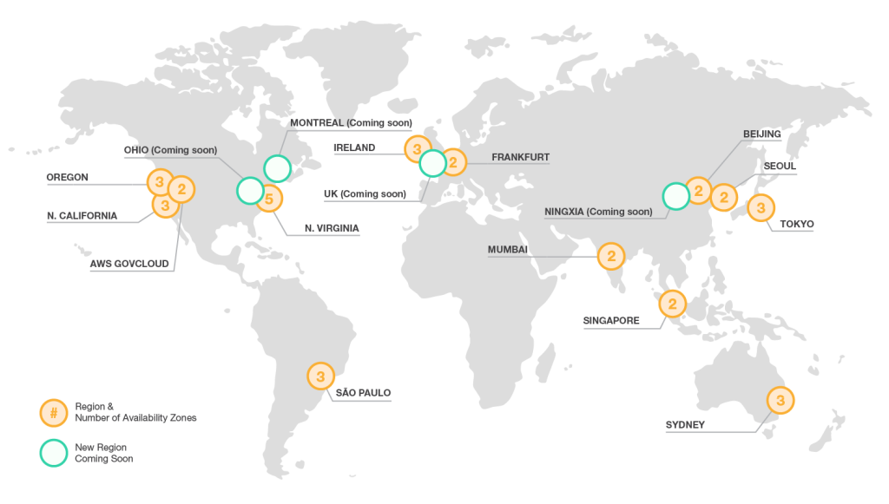
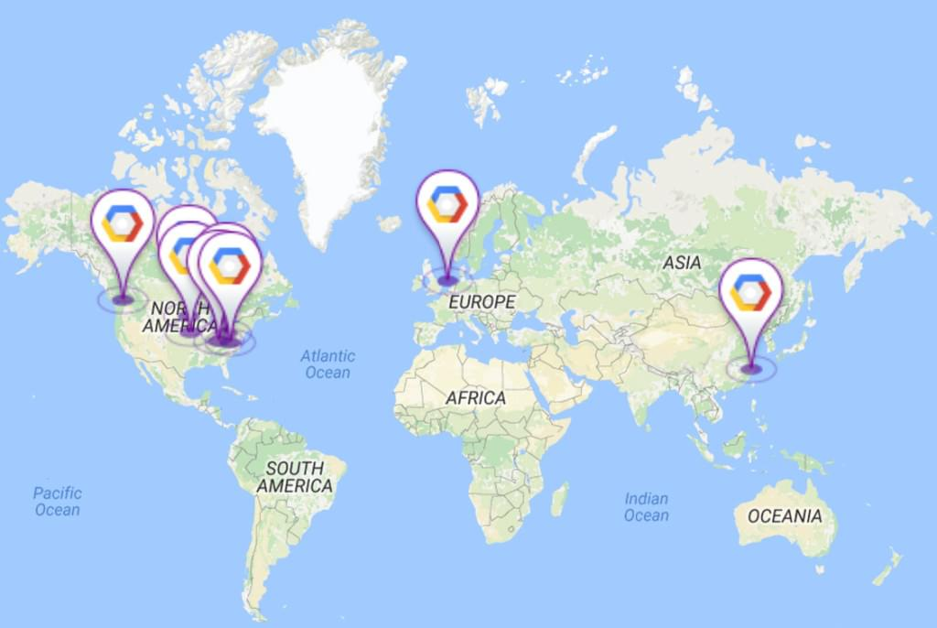
Availability
The AWS Cloud operates 46 Availability Zones within 17 geographic Regions around the world, Whereas GCP cloud operates 39 Availability zones within 13 Regions.

Slide 12
DEVELOPMENT TOOL
Description | AWS | GCP
Store Code in Private Git Repositories | AWS CodeCommit | Cloud Source Repositories
Release Software using Continuous Integration & Delivery | AWS CodePipeline | Maven App Engine Plugin, Gradle App Engine Plugin
Build and Test Code | AWS CodeBuild | Cloud Tools for Android Studio, Cloud Tools for IntelliJ, Cloud Tools for Eclipse, Cloud Tools for PowerShell, Cloud Tools for Visual Studio
Automate Code Deployments | AWS CodeDeploy, AWS CloudFormation | Cloud Launcher, Cloud Deployment Manager

Slide 13
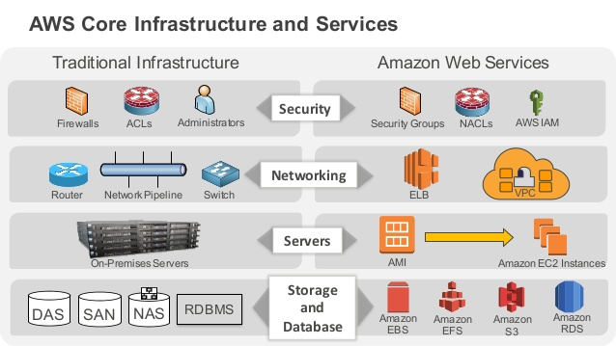
MIGRATION
On AWS, the user must manually migrate their affected instances from these host machines, either by rebooting the instances or recreating them using instance snapshots
Cloud Platform features live migration, in which Cloud Platform automatically and transparently migrates instances when their host hardware needs maintenance or replacement

Slide 14

CLOUD SERVICES SUPPORT AND UPTIME
Google Cloud Premium Support
Cheapest support plan starts at $150/month minimum
The next level support plan starts at $400/month minimum, but with bill of minimum of 9% of product usage fees
AWS Support
Cheapest paid support plan starts at $29/month or 3% of monthly AWS usage
The next level support plan starts at $100/month minimum, but with bill of minimum of 10% of product usage fees
Google Cloud Uptime
SLO will provide a Monthly Uptime Percentage to Customer of at least 99.95%
With Google Cloud instances might be on the same machine per region
Provides unique feature with their ability to live migrate virtual machines
AWS Uptime
Monthly Uptime Percentage of at least 99.99%, during any monthly billing cycle as the Service Commitment
Provides ability to get different machines within their multiple availability zones per region.

Slide 15
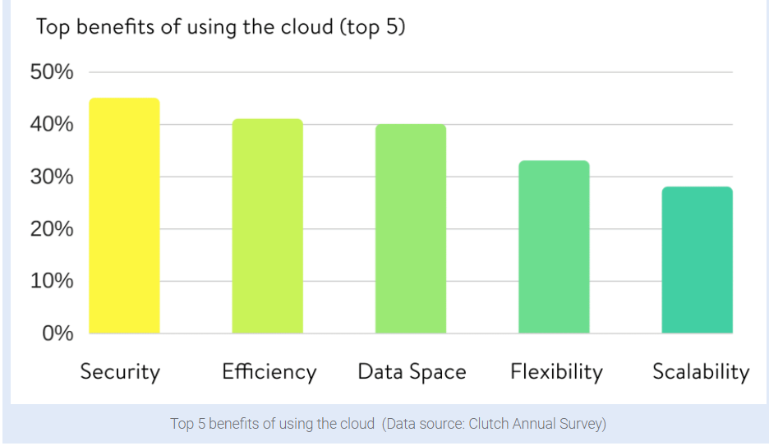


SECURITY
Google Cloud Security Features
Data stored on persistent disks is encrypted under 256-bit AES
Cloud IAM provide predefined roles that give granular access to specific Google Cloud Platform resources
The layers of the Google application and storage stack require that requests coming from other components are authenticated and authorized.
AWS Security Features
data stored on EC2 instances is encrypted under 256-bit AES
AWS IAM, Multi-Factor Authentication, and Directory Services allow for defining, enforcing, and managing user access policies.
Network firewalls built into Amazon VPC, and web application firewall capabilities in AWS to create private networks, and control access to your instances and applications.

Slide 16
CONCLUSION
AWS clearly wins in market share and offerings
AWS definitely has better documentation and resources
Google Cloud offers better pricing
Google Cloud has easier and faster instance configuration
Google Cloud wins on the Big Data and Analytics front
Google Cloud gives continuous Migration of Virtual Machines
Google Cloud has Better Security
Google Cloud provides Redundant Backups

Slide 17
Thank You!

