Slide 1
Crack Behavior of High Plastic Soil
A Comparative Study with and without Biopolymer Reinforcement
Submitted by: Akshat Aren(210104012)
Under the Supervision of: Prof. T.V. Bharat
Department of Civil Engineering, IIT Guwahati
November 2024

Slide 2
Objective
The experiment aims to evaluate the effectiveness of biopolymers (xanthan gum and guar gum) in reducing desiccation cracking in high-plastic soils. Specifically, it seeks to:
Investigate the mechanisms of cracking in untreated high-plastic soils.
Assess the impact of biopolymers on crack reduction, soil strength, and permeability improvement.

Slide 3
Introduction
Characteristics of High-Plastic Soils:
Rich in clay minerals like montmorillonite, with high shrink-swell potential.
Impact of Moisture Changes:
Drying causes shrinkage and cracks, reducing shear strength and increasing permeability.
Wet periods lead to swelling, structural instability, and higher maintenance costs.
Cracking in Untreated Soils:
Uneven moisture, temperature variations, and particle arrangement cause cracks up to 2.6 mm wide, impacting load-bearing capacity.
Limitations of Traditional Stabilizers:
Lime and cement stabilizers have environmental drawbacks, such as high carbon emissions.
Emergence of Biopolymers:
Eco-friendly xanthan gum and guar gum reduce cracks by forming hydrogels, cutting crack width by 65% and density by 46%.
Scope of the Study:
Explore crack formation mechanisms, biopolymer treatment impact, and methodologies for analyzing soil behavior.

Slide 4
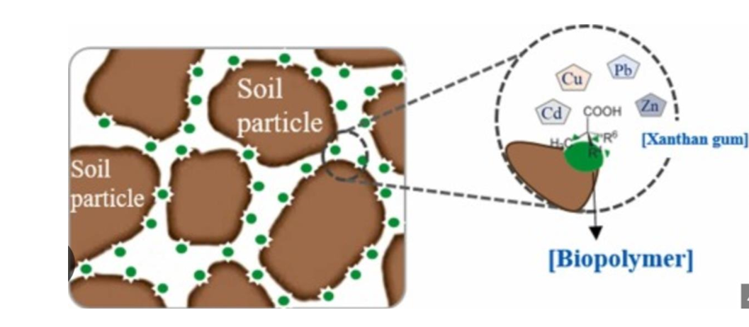

Slide 5
Literature Review
Cracking in High-Plastic Soils: High-plastic soils, rich in minerals like montmorillonite and illite, experience shrinkage-induced cracks during drying and swelling-induced stresses during wetting. These phenomena lead to structural damage, instability, and challenges in geotechnical engineering.
1. Mechanisms of Cracking:
Shrinkage Behavior:
Moisture loss creates tensile stresses, causing cracks.
Dispersed particle structures and swelling minerals exacerbate shrinkage.
Geotechnical Challenges:
Increased permeability destabilizes structures.
Reduced shear strength compromises load-bearing capacity.

Slide 6
Literature Review
2. Mitigation Using Biopolymers: Biopolymers like xanthan gum and guar gum form hydrogels, enhancing cohesion and reducing shrinkage.
Benefits:
Crack density reduced by 46%, width by 65%.
UCS(Unconfined Compressive Strength) improvement up to 630%.
Lower permeability and better moisture retention.
3. Experimental Studies:
Laboratory Findings:
Untreated soils exhibit large cracks (>2.6 mm).
Biopolymers consistently reduce crack widths and improve soil strength.
Case Studies:
Roads and landfill liners in India and Indonesia show improved stability with biopolymers.

Slide 7
Literature Review
4. Analytical Approaches:
Simulations: ABAQUS models crack propagation and optimizes biopolymer dosages.
Microstructural Analysis: SEM and XRD reveal hydrogel networks and improved cohesion.
5. Comparison of Soils:
Untreated Soil: Crack width >2.6 mm, high permeability, and low strength.
Biopolymer-Treated Soil: Crack width ~0.9 mm, strength improved by up to 630%.
6. Limitations and Gaps:
Biodegradation reduces long-term performance.
Lack of standardization and large-scale trials limits adoption.

Slide 8
Literature Review
7. Future Directions:
Develop durable biopolymers.
Conduct large-scale trials in diverse conditions.
Standardize protocols for soil stabilization.

Slide 9
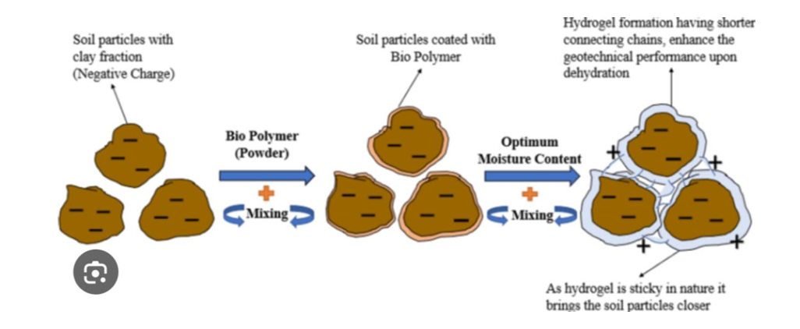

Slide 10
Methodology
1. Materials and Sample Preparation
Soil Selection:
High-plastic expansive soils from regions like Gujarat, Andhra Pradesh (India), and Regina (Canada).
Characterized using Atterberg limits, grain size, free swell index, and XRD analysis for clay minerals.
Biopolymer Selection:
Xanthan gum and guar gum were chosen for their hydrophilic and gel-forming properties.
Concentrations used: 0.5%, 1.5%, and 2% by dry soil weight.
Sample Preparation:
Untreated Samples: Oven-dried, sieved, and compacted soils.
Treated Samples: Biopolymers mixed uniformly with soils and aged for up to 60 days for hydrogel formation.

Slide 11
2. Experimental Program
Crack Formation Analysis:
Shrinkage tests under ambient and accelerated drying.
Crack width and density measured using ImageJ software.
Thermal imaging to analyze moisture distribution.
Mechanical and Hydraulic Properties:
UCS Tests: Evaluated strength improvement with biopolymer stabilization.
Hydraulic Conductivity: Assessed permeability changes via falling head tests.
SEM Analysis: Observed micro-cracks and hydrogel networks.
Field Trials:
Conducted on roads in Indonesia and soils in Karnataka, India.
Metrics: Crack density reduction and UCS improvement.

Slide 12
. 3. Cracks in Untreated High-Plastic Soils
Moisture Loss: Causes shrinkage and tensile stress, leading to cracking.
Thermal Variations: Fluctuations accelerate drying and widen cracks.
Particle Arrangement: Dispersed particles exacerbate cracking.
Impact of Cracks: Increased permeability and reduced shear strength.
4. How Biopolymers Mitigate Cracking
Hydrogel Formation: Binds particles, reduces voids, and minimizes shrinkage.
Cohesion and Strength: Enhances tensile strength and UCS by up to 630%.
Water Retention: Slows drying, maintaining moisture and mitigating cracks.
Environmental Resistance: Reduces crack widths even under cyclic conditions.

Slide 13
5. Visualization and Analysis
Image Analysis: Crack density and width significantly reduced post-treatment.
SEM Micrographs: Show hydrogel networks sealing voids and bridging particles.
Thermal Imaging: Uniform moisture distribution in treated soils.
Simulations: ABAQUS models show reduced crack propagation with biopolymer treatment.

Slide 14
Methodology Experiment Setup
Materials: Expansive clay and black cotton soil were treated with xanthan gum at varying concentrations.
Sample Preparation: Biopolymers (xanthan gum) were mixed with the soil, and control (untreated) samples were prepared for comparison.
Environmental Simulations: The samples underwent controlled rainfall, drying cycles, and temperature conditions to replicate real-world environmental scenarios.

Slide 15
Testing Parameters:
Water Retention: Measured over time to assess moisture-holding capacity of the soils.
Crack Resistance: Monitored for crack formation using image analysis techniques.
Shear Strength: Tested to evaluate the mechanical stability of the treated and untreated soils.
Vegetation Growth: Germination rates, plant growth, and drought resistance were tracked to assess the impact on vegetation.
Data Analysis: Statistical tools were used to compare the performance of treated vs. untreated samples.

Slide 16
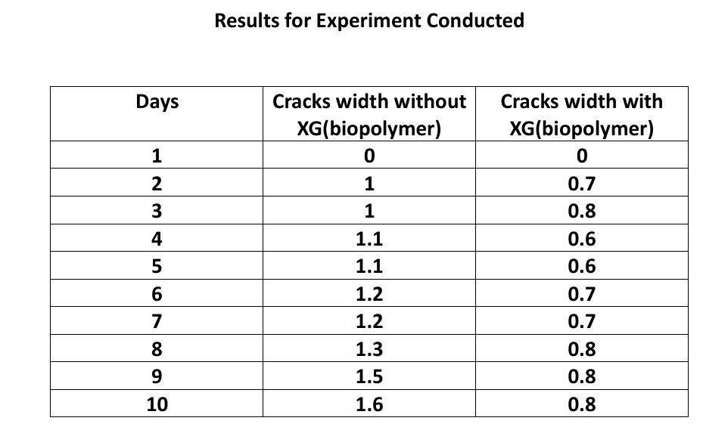

Slide 17
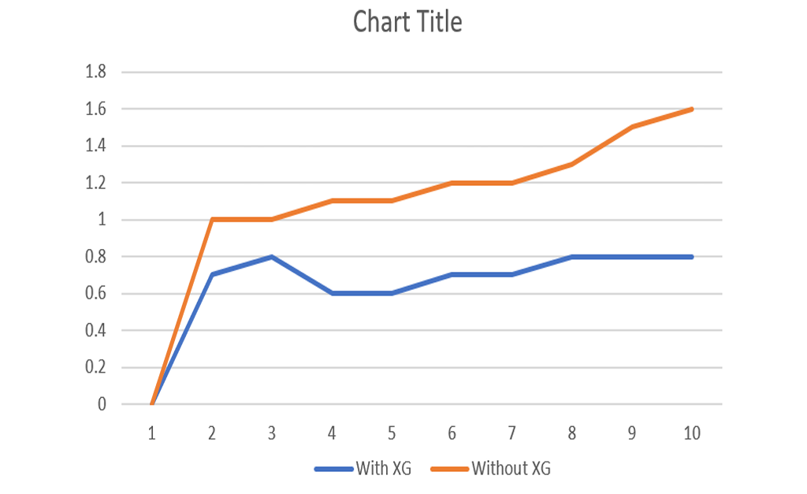

Slide 18
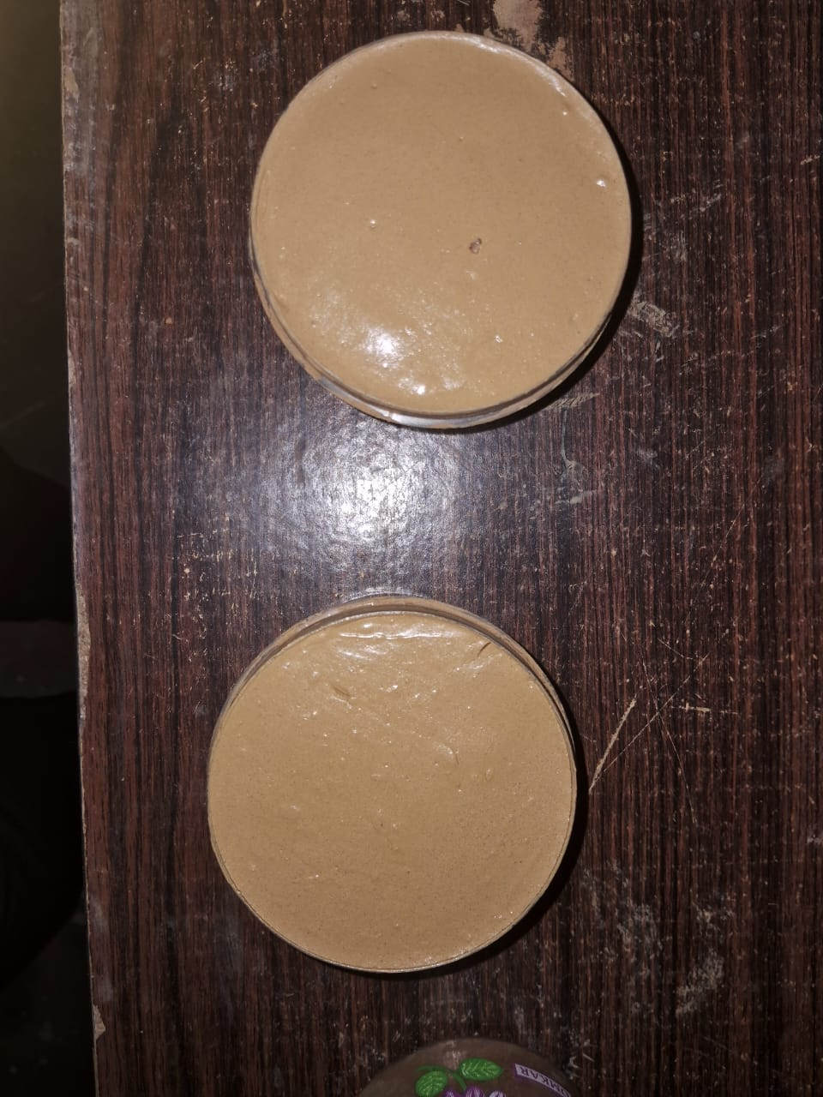
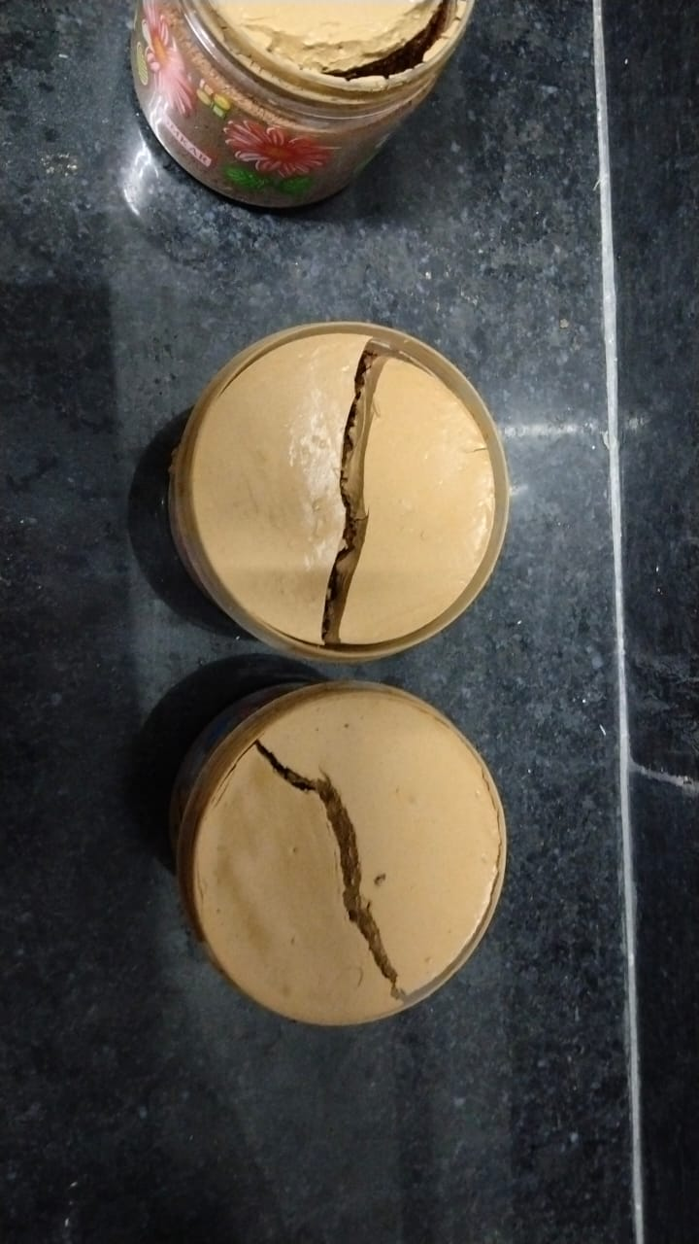
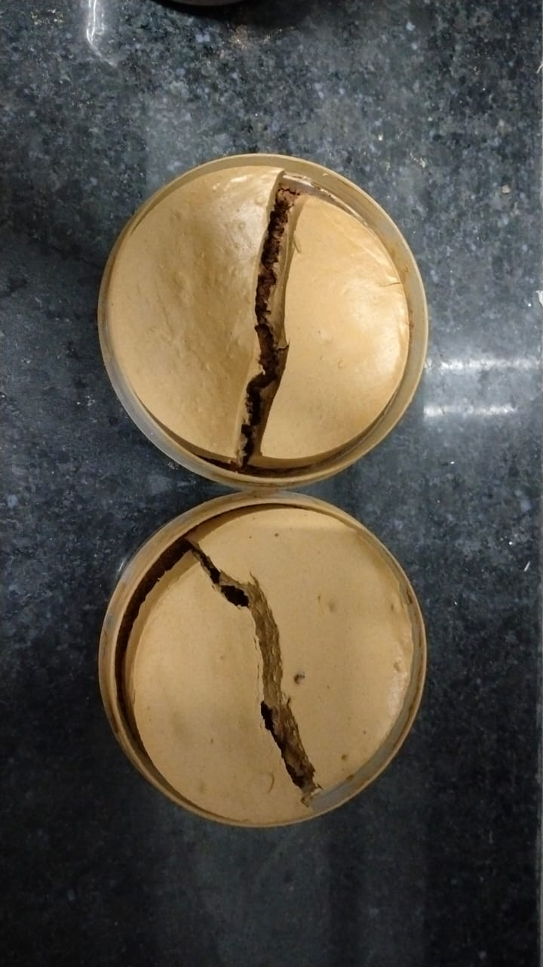
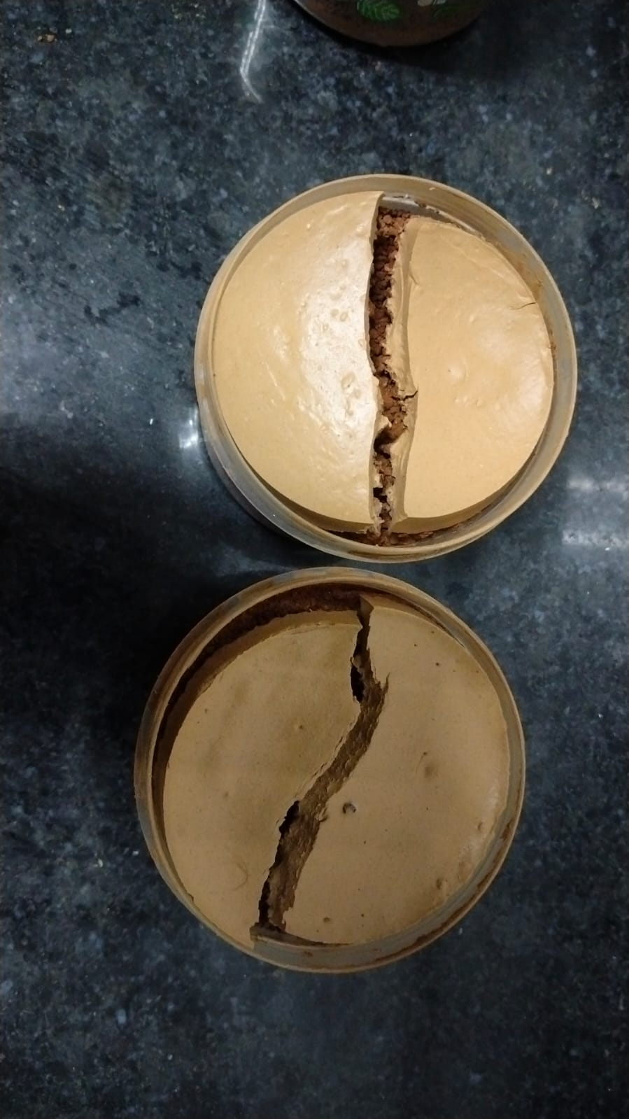
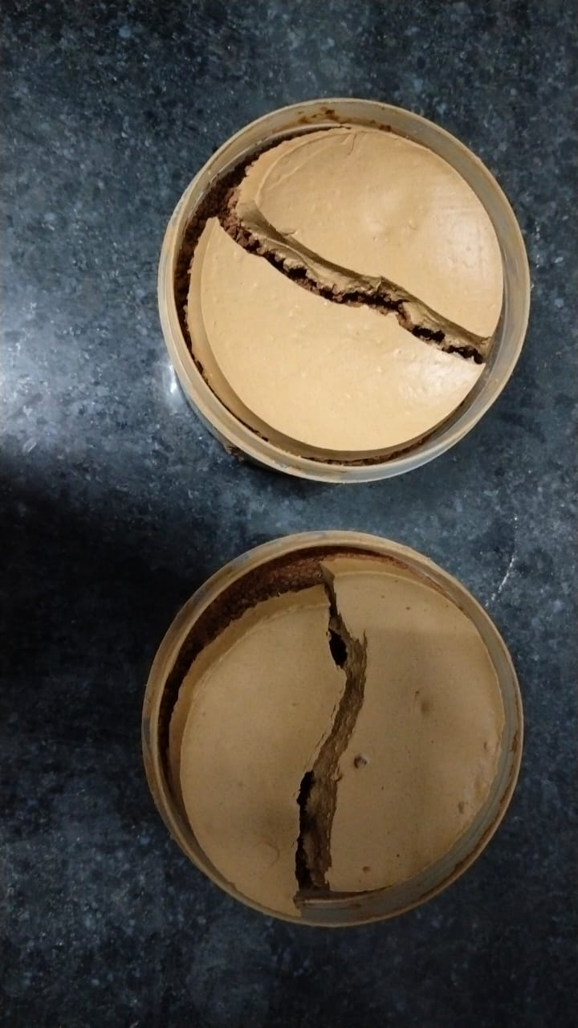

Slide 19
Conclusion
Biopolymers like xanthan gum effectively reduce desiccation cracking in high-plastic soils, such as black cotton soil. Key findings include:
Crack Reduction: Crack width reduced to 0.9 mm, with a 46% reduction in crack density.
Strength Improvement: Unconfined compressive strength (UCS) increased by 630%, enhancing soil stability.
Hydraulic Benefits: Lower permeability reduces water infiltration and swelling risks.
Sustainability: Biopolymers offer an eco-friendly alternative to traditional stabilizers like lime and cement.
Overall, biopolymers provide a sustainable and effective solution for improving the stability of high-plastic soils in geotechnical applications.

Slide 20
References
1. Smith & Jones (2018): Expansive soil behavior.
2. Gupta & Sharma (2021): Desiccation cracking analysis.
3. Indian Road Congress (2018): Guidelines on expansive soils.
4. Geological Survey of India (2020): Soil properties report.

