Slide 1
DevOps
Bridging the Gap Between Development and Operations
- Shridhar Pandey

Slide 2
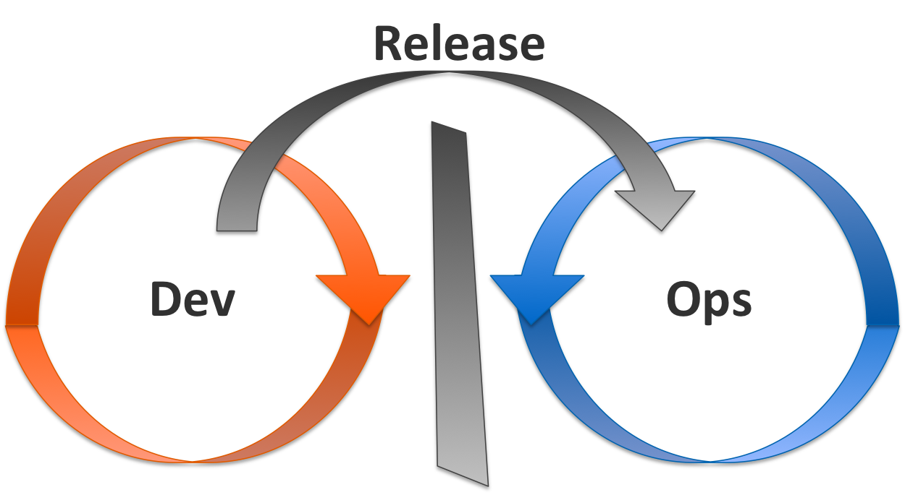
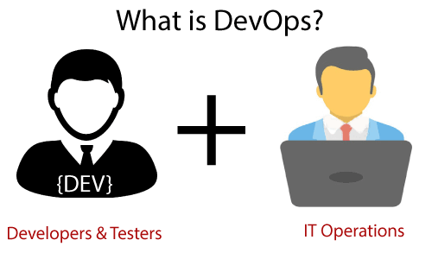
Introduction to DevOps
What is DevOps?
A combination of "Development" and "Operations“.
A cultural and technical movement.
Focuses on collaboration, automation, and continuous delivery.

Slide 3
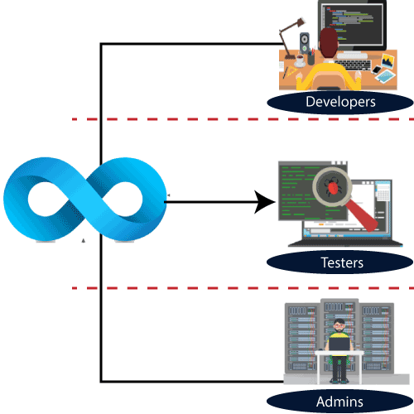
The Need of DevOps
Traditional Challenges
Isolated teams (Development vs. Operations)
Long development cycles
Delayed feedback and release cycles
DevOps Solutions
Integration of teams
Automation of processes
Continuous feedback and improvement

Slide 4
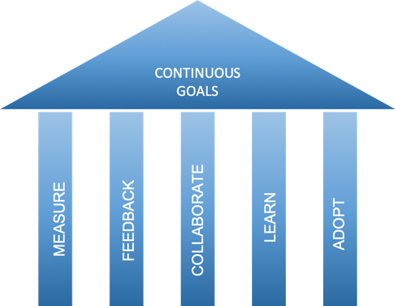
Core Principles of DevOps
CAMS Model:
Culture: Collaboration between teams.
Automation: Automating repetitive tasks.
Measurement: Metrics to measure success.
Sharing: Knowledge and tools.

Slide 5
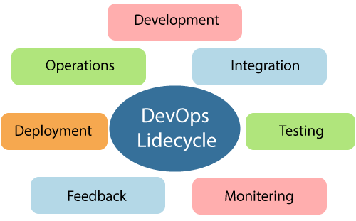
DevOps Lifecycle
Phases of DevOps:
Plan: Define and plan the project
Code: Writing and managing code
Build: Continuous integration and building of code
Test: Automated testing to ensure quality
Release: Deploying code to production
Deploy: Releasing to users
Operate: Monitoring and logging in production
Monitor: Feedback loop to improve the next cycle

Slide 6
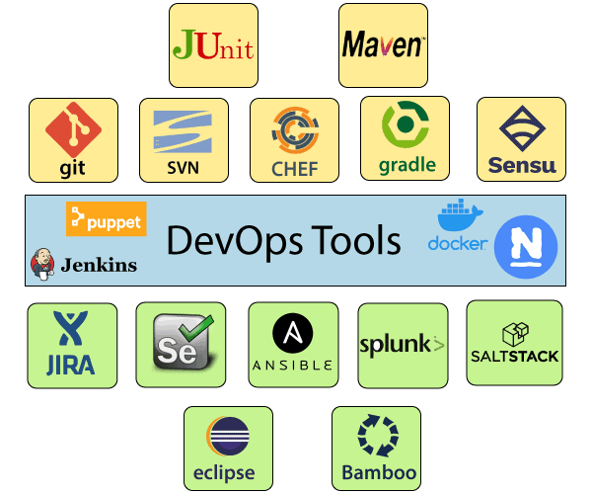
DevOps Tools
Categories of Tools:
Version Control: Git, GitHub
CI/CD: Jenkins, GitLab CI
Configuration Management: Ansible, Chef, Puppet
Containerization: Docker, Kubernetes
Monitoring: Prometheus, Nagios
Collaboration: Slack, Jira

Slide 7
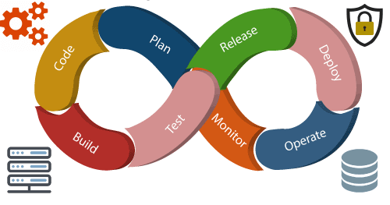
Continuous Integration & Continuous Delivery (CI/CD)
What is CI/CD?
CI: Integrating code frequently with automated testing
CD: Automatically deploying code changes
Benefits:
Faster time to market
Reduced risk of deployment failures
Enhanced product quality

Slide 8
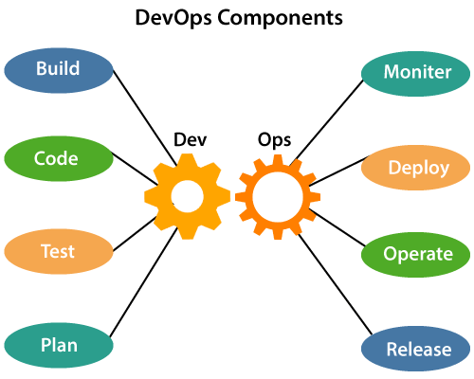
DevOps Culture
Key Aspects:
Collaboration: Between Dev and Ops teams
Ownership: Everyone is responsible for the success
Agility: Adapting quickly to changes
Continuous Learning: Always improving

Slide 9

Real-World Examples of DevOps
Companies Successfully Using DevOps:
Amazon: Reduced deployment time to every 11.7 seconds
Netflix: Streamlined deployment with microservices architecture
Etsy: From fragile, infrequent releases to continuous delivery

Slide 10

Challenges in Adopting DevOps
Common Challenges:
Cultural shift within the organization
Choosing the right tools
Ensuring security and compliance
Integrating with legacy systems

Slide 11
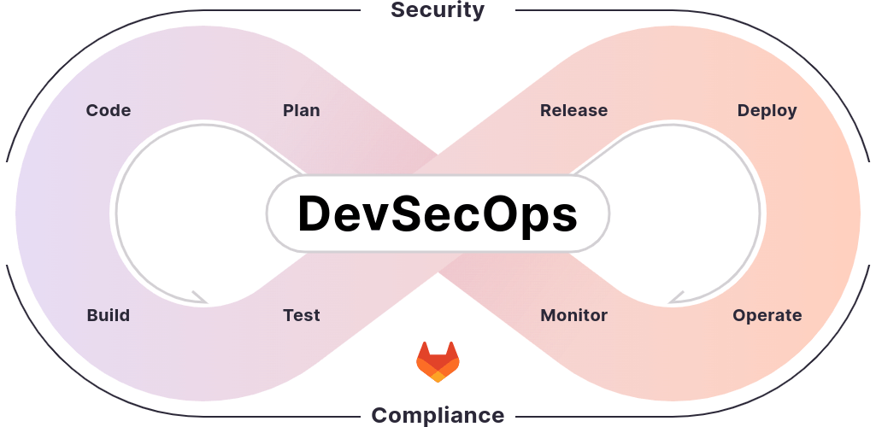
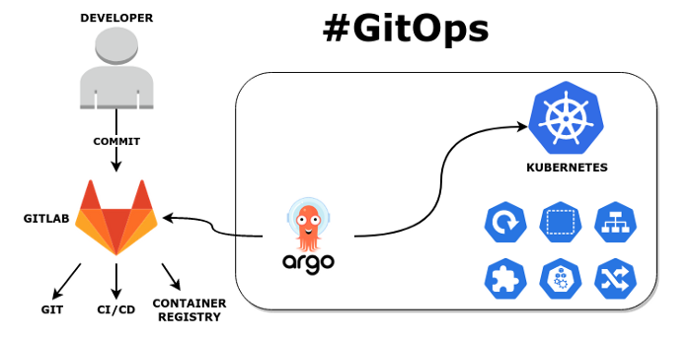
Future of DevOps
Trends:
AI and Machine Learning: Enhancing automation and decision-making
DevSecOps: Integrating security into DevOps practices
GitOps: Using Git as a source of truth for infrastructure

Slide 12
Conclusion
Key Takeaways:
DevOps is about collaboration, automation, and continuous improvement
It transforms the way teams work together
The future of DevOps is bright, with evolving practices and tools

Slide 13
Thank You!
Under the Guidance of Indrakka Mam
(Edubridge * Capgemini)

