Slide 1

Accelerating the pace of your growth
Mobile Trends, 2013 and Beyond, Intensifying in the Mainstream
CONFIDENTIAL

Slide 2
Agenda
Introduction
Mobile Trends
  Mobile Evolution
  Top Ten Trends
  Mobile Ecosystem
  Smartphone Trends
Mobile Application Testing
  Application Option
  Approach to QA
  Challenges
  Implementation

Slide 3
Introduction
14 years of experience working in the IT industry providing solutions and outsourcing services focused in the areas of application development, quality assurance, mobile application development, and business intelligence.
8 years working with iSpace, Inc. serving in a variety of capacities including current position as Projects Solutions Manager
Experience working with clients to identify major challenges faced within their organization and implementing customized business solutions that are cost effective and centered around increasing productivity, company revenue, and streamlining processes.
Bachelor's Degree in Chemical Engineering along with a Degree in Computer Science
Active member of PMI, HIMMS, Mobile Apps User Groups, and Hadoop User Group

Slide 4
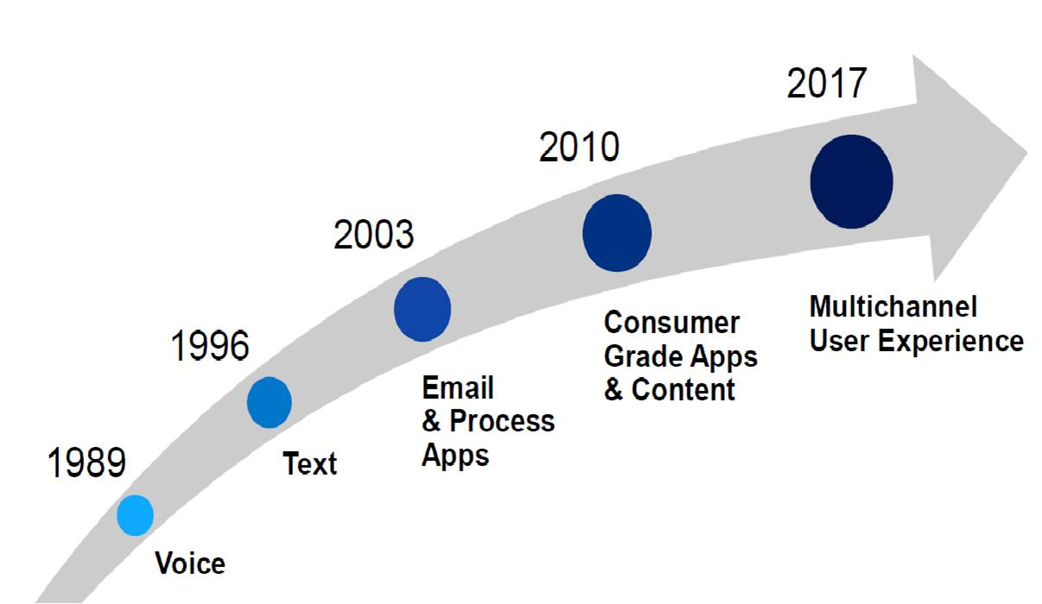
Mobile Evolution
An average consumer spends 127 minutes a day on the mobile phone
There are 4.5 times as many mobile devices in use as there are PCs
49% of mobile users in the US now have smart phones and this number is going up at a very rapid rate

Slide 5

Mobile viewpoint: Top Ten Trends

Slide 6
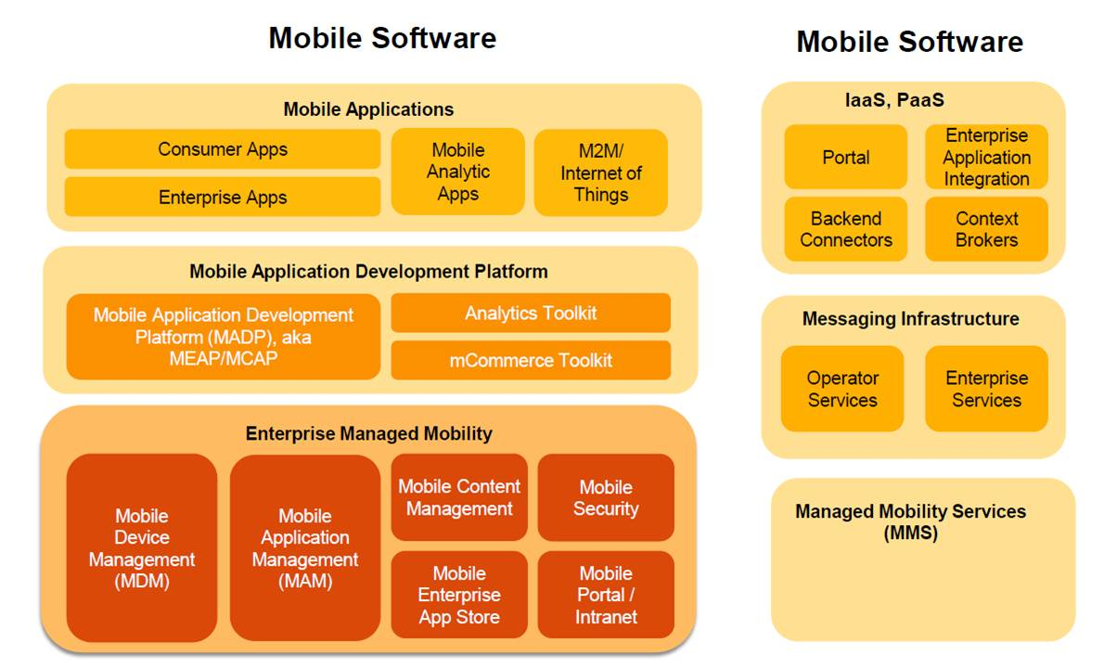
Mobile Ecosystem Framework

Slide 7
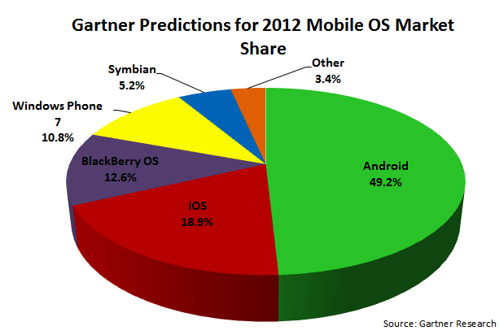
Smartphone OS Marketshare

Slide 8




Mobile Application Options
On Device
    Rich, fast client
    Best UX
    Offline capabilities
    Development challenge
    Platform fragmentation
    Resource intensive to develop, test and maintain
Mobile Web 3.0
Mobile web
Standardization issues
Varying form factors
Needs continuous connectivity
Inconsistent implementations
Low Development Complexity High
SMS/Text
Simple functionality
Does not support complex interactions
Ubiquitous access
Weak User Experience Superior

Slide 9
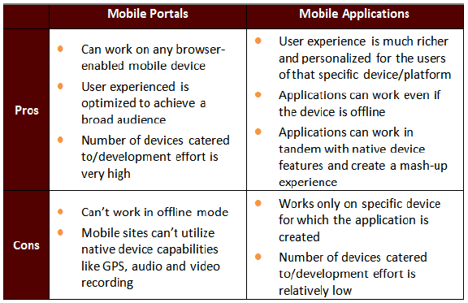
Mobile Portals Vs Native Applications

Slide 10
Approach to QA
Requirement Compatibility Analysis (RCA)
  RCA is the most important step for mobile application testing, as it gives supported networks, media content types, file transfer ports, supported file sizes, accessibility of file structure of devices, memory limitation for the application available in the devices, etc.

Slide 11
Approach to QA – Challenges
iPhone/iOS:
  The testing matrix is a bit simpler as there is only one device manufacturer - The challenge is still to make sure the iPhone applications work across iOS versions.
  This challenge, along with Apple's strict limitation on UDIDs, has made testing a major hassle for developers
Android:
  Is more complex in terms of its testing matrix - Each new app - and each new app version – has to function as expected on multiple device models from various manufacturers.
  Functionality on mobile devices with touch screens vs. physical keyboards.
  Performance on various Android OS versions - .
  BlackBerry:
  Even more complex in terms of its testing matrix as applications need to be tested on various devices.
  Functionality on mobile devices with touch screens vs. physical keyboards ; and a number of OS versions
  Note - BB & Android allow running multiple applications in background
Notes:
iPhone/iOS:
The testing matrix is a bit simpler as there is only one device manufacturer - The challenge is still to make sure the iPhone applications work across iOS 3G, 3GS and 4.
This challenge, along with Apple's strict limitation on UDIDs, has made testing a major hassle for developers
Android:
The fastest growing mobile operating system, is also the most complex in terms of its testing matrix. Android developers must ensure that each new app - and each new app version - function as expected on multiple device models from LG, Motorola, HTC and others manufacturers.
And then there's functionality on mobile devices with touchscreens vs. physical keyboards. UI rendering on tablets like the Samsung Galaxy and Acer Iconia. Performance on various carriers, as well as the multiple Android OS versions. The list of challenges goes on and on.
Blackberry
While BlackBerry apps have evolved rapidly over the past several years in terms of functionality and ease-of-use, the same cannot be said of BlackBerry testing methodologies.
As RIM developers increasingly rely on emulators and simulators for testing, the frequency of device-specific bugs multiplies - making it more important than ever to test your applications on Touch, Curve, Storm and other devices.
Windows Mobile
WinMo app developers are thrilled with the early returns of Windows Phone 7 – but in order to take advantage of this exciting new platform, many applications will have to be updated or re-written entirely. And this means a lot of new testing across device makers, device models and carriers and locations
While Microsoft has added private beta group support to the Windows Phone 7 Marketplace, many developers are finding that it's a limited solution to a much more comprehensive problem.

Slide 12
Approach to QA – Test Planning and Strategy
Test Plan and Strategy
  Devised custom mobile test strategy based upon the business requirements.
  Based on the requirements of the mobile application, finalized the best applicable approach out of Full Automation, Partial Automation or manual testing to test the mobile application and also develop a suitable framework for the automation testing
  Test strategy specifies the test approach and the best framework.
    Unit and Integration Testing ; Functional and System Testing ; Compatibility Testing ; Network Connectivity Testing ; Performance Testing; Security Testing ; UI Specifications in Cross-mobile OS ; Acceptance Testing.

Slide 13
Mobile App Testing - Areas of Focus
Application Launch
User Interface
Functionality
Stability
Security
Connectivity
Personal Information Management
External incoming communication
Voice Call Handling
Performance
Notes:
Application Characteristics – Information about the application is provided to help the testing team in the testing work.
b. Stability – Focusing on the application being stable on the device.
c. Application Launch – Once an application is loaded it must start (launch) and stop correctly in relation to the device and other applications on the device.
d. User Interface - Application Logo, Resolution, Usability testing.
e. Functionality – Documented features are implemented in the application and work as expected. Sources for the information are user manuals, formatted application specification documents and online documentation.
f. Connectivity – The application must demonstrate its ability to communicate over a network correctly. It must be capable of dealing with both network problems and server-side problems.
g. Personal Information Management – The application accessing user information needs to be able to do it in an appropriate manner and not to destroy the information.
h. Security - Application Side Effects, Vulnerabilities, Network Testing, Application crashes
i. External incoming communication - Infrared, Bluetooth, wifi
j. Voice Call Handling - Call Accept, Call Rejection, Call Establish, SMS handling
k. Performance - Visual Feedback, Charger Effect, Application Start/ Restart, Battery Consumption, Low Battery, Removal of Battery, Low Memory

Slide 14
Mobile Apps – Manual & Automated Testing
Approach | Types of Testing | Manual Testing |  | Automation Testing
 |  | Devices | Emulators
Standard Testing
 | Integration Testing | No | Yes | No
 | System Testing | Yes | No | No
 | Regression Testing | Yes | No | Yes
Special Type of Testing To Address Specific Challenges | Compatibility Testing | Yes | No | Yes
 | GUI Testing | Yes | No | No
Types Of Testing More Relevant for enterprise Mobile Applications | Performance Testing | Yes | No | Yes
 | Security Testing | Yes | No | Yes
 | Synchronization Testing | Yes | No | No

Slide 15
Mobile App Testing
  Usability testing: Usability testing should happen as soon as the basic stable for the application is ready. This is also true in order to test whether the application UI is user-friendly or not, or whether some part/functionality of the application is easily discoverable or not. Also, usability studies should be done for the different types of devices, such as touch screen devices, since the user has different experience for the same application on these devices.
  Some Key Criteria:
    Device specific UI guidelines
    Text entry
    Finger sized targets
    Well organized work flow
    Consistency
    Call handling
    Response times

Slide 16
Mobile App Testing
  Performance testing: Performance testing is key criteria for the application success on the market. It may happen that application testing is carried though wi-fi network under which application might perform well, but it also happens that application has the poor performance for the end-user who are accessing site through the mobile carries. Application must be tested with different devices + carries wise mix depending on the county and region.
  Some Key Criteria
    Network
    Battery
    Volume
    Rendering

Slide 17
Mobile App Testing
Compatibility testing: Compatibility testing assures that a given application works as intended with selected devices with different screen sizes, resolutions, and internal hardware (memory size, processor speed, and button/input differences).It defines the feasible compatibility combinations of devices and interfaces for a specific testing assignment, in concurrence with the customer’s requirement.
    OS
    Device
    Screen resolution
Synchronization testing: This testing focuses on data exchange and synchronization among different mobile devices, PDAs, and PCs using infrared frequency and USB ports.

Slide 18
Mobile App Testing
Security testing - All the tests relevant to a thick client application can be applicable to mobile applications.
  Authentication checks
  Input Validation checks
  Session Management checks
  Encryption checks
  Application checks
  SQL injection checks
  LDAP injection checks
  XPATH injection checks

Slide 19
Testing Process
Ensure functionality of the site is stable – Test mobile applications on the desktop browser
Test on device emulator to get the browser/platform coverage
Test on the device itself to find the device specific bugs
Notes:
Ensure functionality of the site is stable – Test mobile applications on the desktop browser
Using Plug-in mobile user agent string within Firefox browsers to test mobile sites.
The solution might highlight a problem the site would have with that mobile device, but it does not diagnose it.
Mobile browser compatibility tool - will not only provide a visual inspection, it will also give detailed feedback on how a mobile website can be improved for optimal compatibility.
Test on device emulator to get the browser/platform coverage
Used to find the browser/platform specific bugs before the actual device is available.
Cannot rely entirely when we test on an emulator as we are using a mouse to perform the operations and interact with the application’s UI, which could be much different on the actual device.
Testing on Emulators/Simulators is a cost effective and much quicker method of mobile testing. But it is also true that they do not behave same as actual device for the following reasons:
- Resource availability
Simulators may have access to more or less resources, and the speed at which those resources become available is liable to be very different.
- Program performance
The simulator may run at very different speeds to the device, thus hiding potential performance bottlenecks, or introducing ghost bottlenecks.
- Communications availability
If you're app communicates over 3g/GPRS/WAN/Bluetooth or similar, simulators tend to simulate these links in such a way that they always work, whereas in the real world you get outages, performance drops, etc... and a very necessary part of your testing is to see how your program deals with these issues
- Hardware exceptions –
It’s difficult to identify how your code does handle low battery, power-offs, insufficient memory, etc...
Test on the device itself to find the device specific bugs
Testing at an early stage for the priority devices from the metrics: When the application is in the development phase and is testable, perform a quick test on the top priority devices of the metrics in order to find any rendering or any functional issues in early stage.
Usability testing: Usability testing should happen as soon as the basic stable for the application is ready. This is also true in order to test whether the application UI is user-friendly or not, or whether some part/functionality of the application is easily discoverable or not. Also, usability studies should be done for the different types of devices, such as touch screen devices, since the user has different experience for the same application on these devices.

Slide 20
Tools and Resources Used
  Test Automation
  Mobile Interactive Testing Environment (MITE)
  SQUISH (http://www.froglogic.com/)
  3rd Party Testing Labs
  Perfecto Mobile (http://www.perfectomobile.com/)
  Device Anywhere (http://www.deviceanywhere.com/)
Crowd Testing
Challenges:
  There is no one automation testing tool to cover all the mobile devices
  GPS can't be tested on ALL the targeted devices in 3rd party test labs
  3rd party testing at test labs is very slow compared to physical testing

Slide 21
Conclusion
Scope Definition
  Device/OS selection, keeping track of ever-changing trends
  Requirements Compatibility Assessment
Investment to build expertise in specific areas of expertise in Mobile space
  Areas of Focus/Critical to Quality Areas
  Tools and Technologies and Resources
Comprehensive Test Strategy - judicious mix of manual and automated testing

Slide 22
Thank you!
Pankaj Khurana
Project Solutions Manager
iSpace, Inc.
310.563.3839
pankaj.khurana@ispace.com

