Slide 1

Usability Testing For Mobile Applications
Presentation By
Ganapathi M
© 2006-11 Rails Factory | www.railsfactory.com

Slide 2

Agenda
Mobile World – Quick Overview
What is Usability
Why Usability
Usability Test Guidelines
Miscellaneous Examples

Slide 3
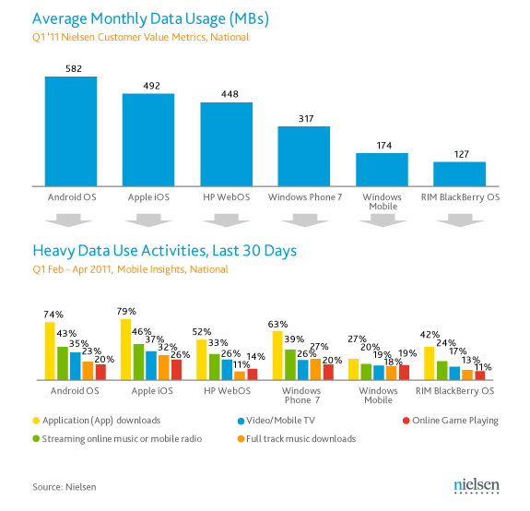
Mobile App Usage - Facts

Slide 4

Mobile App Market- Facts
17.7 billion downloads in 2011(117% increase)
By 2014, over 185 billion applications downloads
Mobile app store revenue $15.1 billion in 2011
90% increase from 2010 revenue of $5.2 billion
Gartner, Inc.
Mobile App Testing
Min 15.4 percent annual growth rate through 2015
$9.4 Billion – 2010

Slide 5
Top 10 Consumer App - 2012
Money Transfer
Location-Based Services
Mobile Search
Mobile Browsing
Mobile Health Monitoring
Mobile Payment
NFC Services
Mobile Advertising
Mobile IM
Mobile Music
Gartner, Inc
“We predict that most users will use no more than five mobile applications at a time and most future opportunities will come from niche market ‘Killer Applications’.”

Slide 6
Mobile App QA - Challenges
QA Status quo is not sufficient
Complex testing matrix & getting worse
Simpler Apps & Time-to-market critical
Tighter margins & Manage costs

Slide 7
What is Usability
Usability Professionals Association
Is an approach that incorporates direct user feedback throughout the development cycle in order to reduce costs and create products and tools that meet user needs
Steve Krug, author of Don’t Make Me Think
“..making sure that something works well: that a person of average (or even below average) ability and experience can use the thing --- for it’s intended purpose without getting hopelessly frustrated”

Slide 8

Importance of Usability
Save Time
Save Money
Precondition for:
Market Survival
Customer Base
Market Share

Slide 9

Usability Test – Mobile Vs Web
Target User Group
Target Devices
Test Environment

Slide 10
Why Usability Testing
Earlier….
People with access to technology tended to be experts
“Great Scientists” expected to fiddle with technology and read manuals
Now ….
Rapid advances in technology; less time to fiddle
All types of users – novice to expert
No time to spare
No desire to learn
Increased competition

Slide 11

User Centric Design

Slide 12


Usability - Dimensions
Intelligence
Easy to Learn
Usability
Response Time
Satisfaction
No (Small) Errors
Less Fatigue

Slide 13

Evaluation Type
Formative Evaluation
During design & dev
Summative Evaluation
After design is deployed

Slide 14
Formative Evaluation
During the development of a product
To mould or improve the product
Iterative Process
Output
Usability problems and suggested fixes
Highlight videos

Slide 15
Summative Evaluation
End development of a product
Measure or validate the usability of a product Compare against competitor or usability metrics
Output
Statistical measures of usability
Reports or white papers

Slide 16


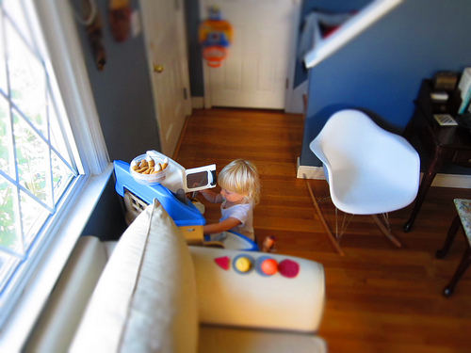


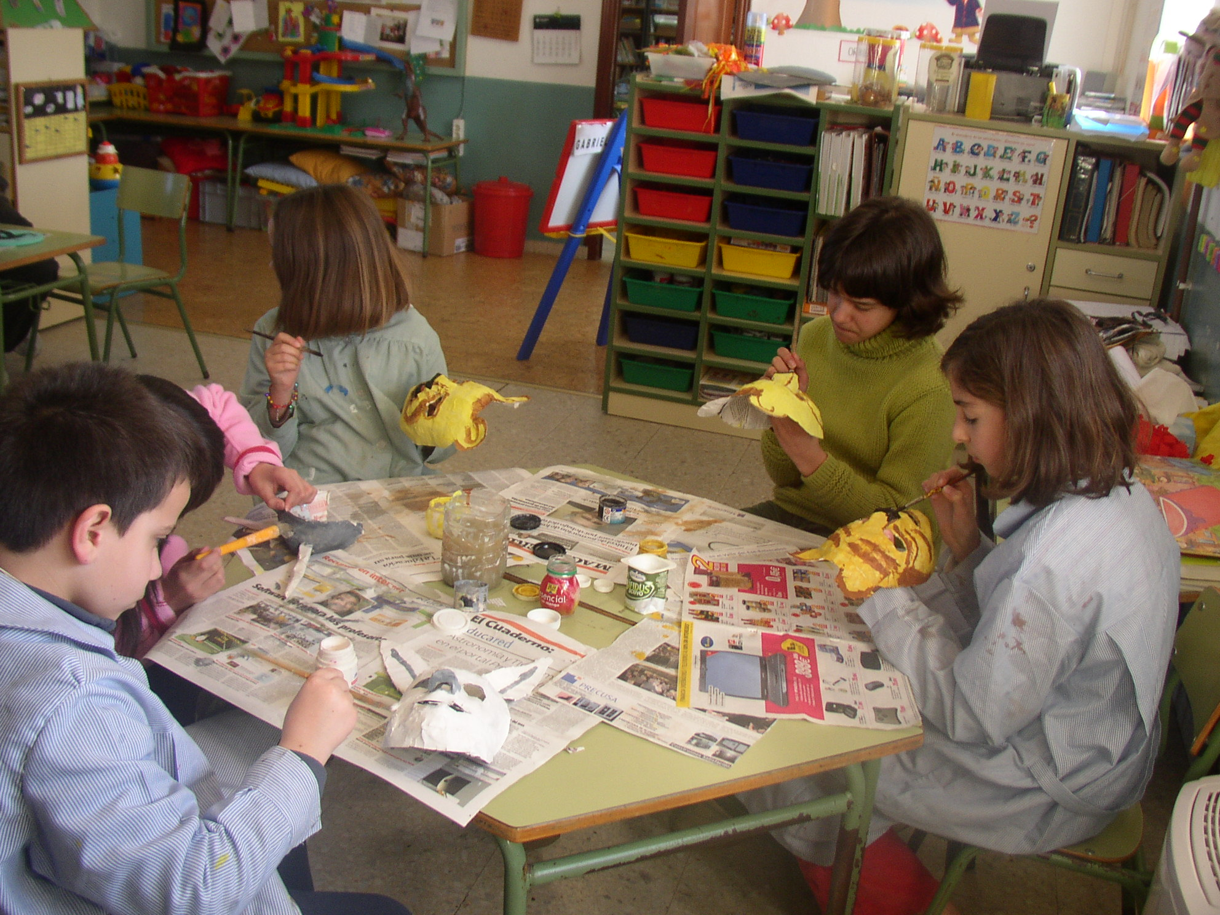

Usability Test - Guidelines

Slide 17

How many people
5-8 people provide sufficient test results and feedback
Group 1 (benchmarks)
5 novice users
5 more experienced users
Group 2
5-8 novice users after induction

Slide 18
Measuring Usability
The product is usable if participants performed most of the tasks
Benchmarking (Group 1):
Quantitative: n% testers took x minutes to perform task 2
Qualitative: comments/discussion, e.g., if everyone had problem with a task, to highlight design flaws. Or positive feedback.

Slide 19

Metrics - Usability
Task success
Task time
Errors
Efficiency
Self-reported metrics

Slide 20

HEAR - Usability
Heuristics
Eye Rollout
Aesthetics
Remote

Slide 21
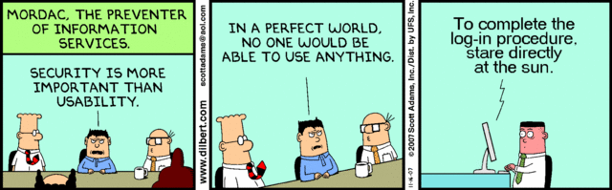
Usability - Important

Slide 22
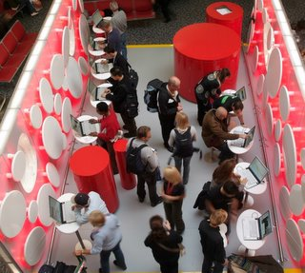
Google Usability lab

Slide 23



Know more about us
ganapathi@railsfactory.org
www.railsfactory.com
www.facebook.com/RailsFactory
Email: info@railsfactory.com
blog.railsfactory.com
RailsFactory, No.1, Kamakshipuram II Street, West Mambalam, Chennai, TN, India -600033

