Slide 1
Counter-UAS Radar Tracker
Technical Design Documentation (TDD) — architecture, UML, sequences, and design principles
Repo: workspace • Output: CounterUAS_RadarTracker_TDD.pptx

Slide 2
System overview
Purpose: ingest radar detections (per dwell) and output stabilized 3D tracks for downstream display / C2.
Inputs: UDP SPDetectionMessage (range/azimuth/elevation + SNR/RCS/strength).
Outputs: UDP TrackTableMessage (TrackUpdateMessage list) + optional binary logs.
Primary concerns: real-time throughput, association correctness under clutter, track lifecycle management.

Slide 3
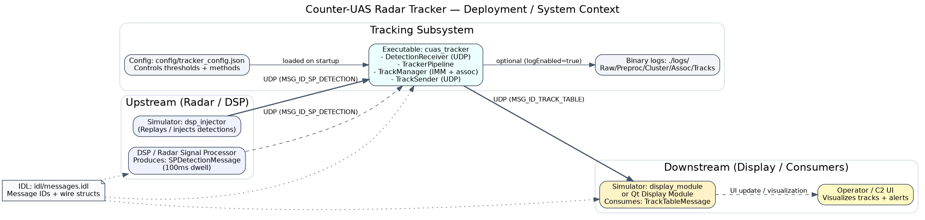
Deployment / system context
UDP protocol and message structures are defined in `idl/messages.idl`.

Slide 4
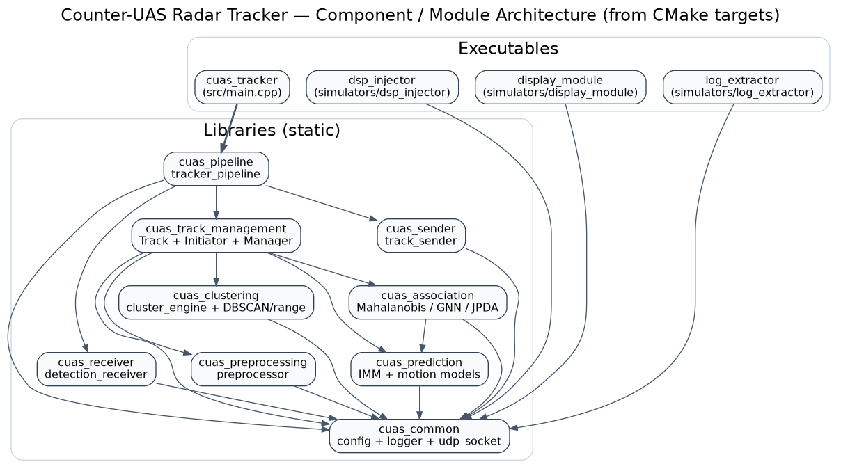
Component architecture (CMake targets)
Modules are linked as static libraries and composed by `cuas_pipeline` / `cuas_tracker`.

Slide 5
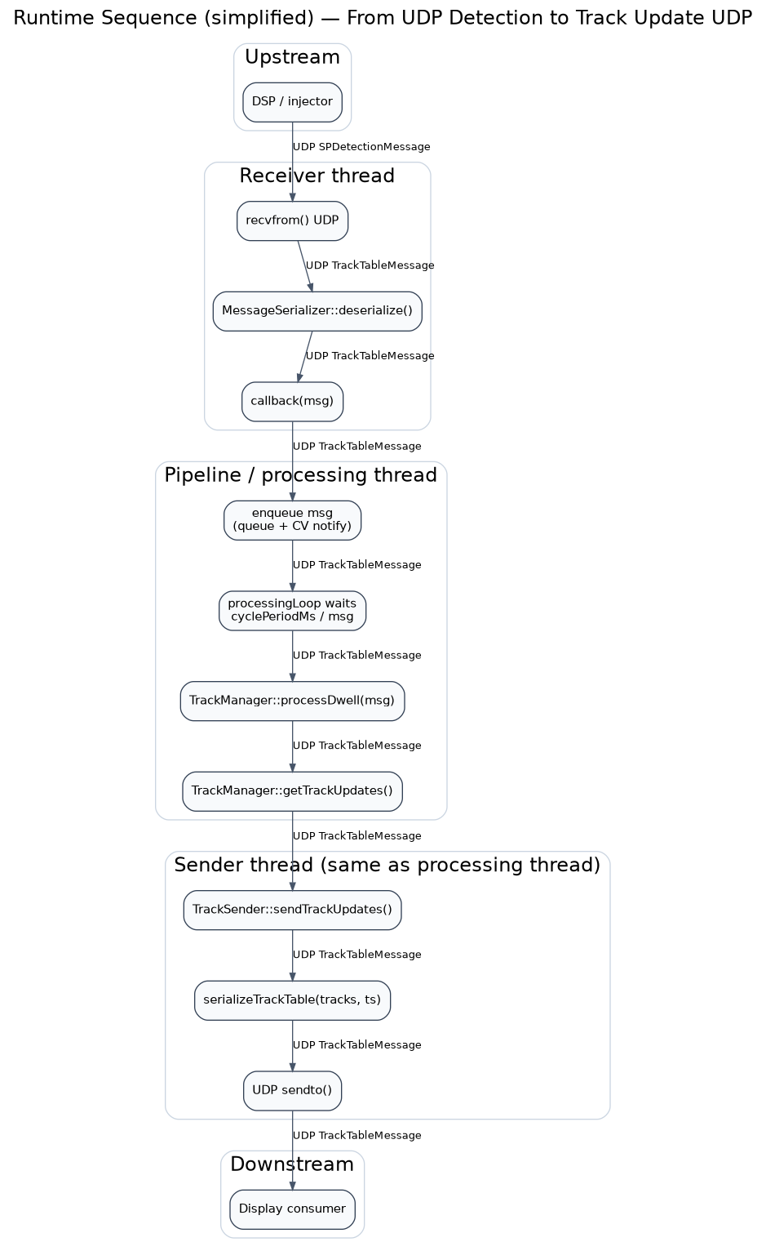
Runtime sequence (threads and message handoff)
Receiver runs in its own thread; processing runs in a separate thread and is paced by `cyclePeriodMs`.

Slide 6
Per-dwell data flow (processing pipeline)

Slide 7
Core data model (wire + internal)
Detection: spherical measurement (range/az/el) plus features (strength/noise/SNR/RCS/microDoppler).
Cluster: strength-weighted centroid of detections, converted to Cartesian (x,y,z) for filtering.
Track state: 9D Cartesian IMM state [x,vx,ax,y,vy,ay,z,vz,az] with merged covariance and mode probabilities.
TrackUpdateMessage: status + classification + spherical + Cartesian + quality/hits/misses/age.

Slide 8
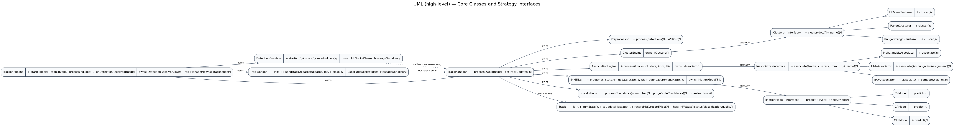
UML (high-level) — core classes and strategy interfaces
Clustering and association are runtime-selectable via configuration (Strategy pattern).

Slide 9
Preprocessing & clustering design
Preprocessor: hard-gate out-of-bounds detections (range, azimuth, elevation, SNR, RCS, strength).
Clustering: groups detections into centroided targets to reduce association complexity.
DBSCAN: distance in normalized (range,az,el) space using epsilons; noise points become singleton clusters.
ClusterEngine assigns monotonically increasing clusterId and computes Cartesian centroid.

Slide 10
Prediction — IMM filter
IMM models: CV, CA1, CA2, CTR1, CTR2 (all 9D Cartesian).
Interaction (mixing) step uses transition matrix and current mode probabilities.
Each model predicts its own (x,P); estimates are merged by mode probabilities.
Config: numModels=5 • initialModeProbabilities=[0.4, 0.15, 0.15, 0.15, 0.15]

Slide 11
Association — measurement gating + assignment
Measurement space: Cartesian position (x,y,z) with H selecting position from the 9D state.
Gating: Mahalanobis distance computed with innovation covariance S = HPHᵀ + R.
Methods:
- Mahalanobis NN: greedy nearest-neighbor with distanceThreshold=9.21
- GNN: global assignment (reduced-cost greedy/Hungarian-like) with costThreshold=16.0
- JPDA: probabilistic association using clutterDensity=1e-06 and Pd=0.9

Slide 12
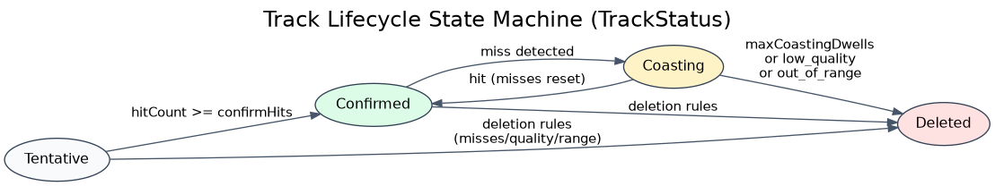
Track lifecycle (status transitions)
Rules are defined by `trackManagement.maintenance` and `trackManagement.deletion` in the config.

Slide 13
Track initiation, maintenance, deletion, classification
Initiation: M-of-N candidates (m=3, n=5) on unmatched clusters; optional initial velocity from two-point differencing.
Maintenance: confirmHits=5 and quality update (boost=0.1, decay=0.95).
Deletion: maxCoastingDwells=15, minQuality=0.05, maxRange=25000.0.
Classification: simple heuristics using speed + IMM mode probabilities (clutter/drone/bird/unknown).

Slide 14
Configuration (tracker_config.json) — key knobs
System: cyclePeriodMs=100 maxDetectionsPerDwell=256 maxTracks=200
Network: receiver=0.0.0.0:50000 sender=127.0.0.1:50001
Clustering: method=dbscan • DBSCAN eps(range/az/el)={'epsilonRange': 50.0, 'epsilonAzimuth': 0.02, 'epsilonElevation': 0.02, 'minPoints': 2}
Association: method=gnn gatingThreshold=16.0
Operational practice: keep config under version control; changes should be validated with simulators/log replay.

Slide 15
Reliability, performance, and real-time behavior
Concurrency: receiver thread deserializes UDP messages and pushes them into a guarded queue; processing thread consumes messages.
Back-pressure risk: if input rate exceeds processing, the queue grows; consider bounded queues + drop/merge policy for production.
Timing: receiver uses socket receive timeout; processing loop uses `cyclePeriodMs` wait-for pacing.
Numerics: IMM update uses simplified covariance update for performance (Joseph form is noted as alternative).
Logging: binary logs can be enabled for offline analysis; ensure disk I/O budget is acceptable in real-time runs.

Slide 16
Software design principles & patterns applied
Separation of concerns: UDP transport (`UdpSocket`/`MessageSerializer`) is isolated from tracking algorithms.
Single Responsibility: each class has a focused scope (receive, preprocess, cluster, associate, predict, manage tracks, send).
Strategy pattern: `IClusterer` and `IAssociator` select behavior via configuration without changing call sites.
Composition over inheritance: engines own strategy instances; pipeline composes subsystems.
Configurability: algorithm choice and thresholds are externalized to `tracker_config.json`.

Slide 17
Extensibility guide (how to add new algorithms)
New clusterer: implement `IClusterer::cluster()`, add to `ClusterEngine` switch, extend config parsing if needed.
New associator: implement `IAssociator::associate()`, add to `AssociationEngine` switch, add config knobs.
New motion model: implement `IMotionModel`, register in `IMMFilter` models_ array, extend transition matrix sizing if expanded.
Add telemetry: extend `BinaryLogger` record types and emit at stage boundaries (raw/preproc/cluster/assoc/update).

Slide 18
Build / run / verify
Build (Linux): mkdir -p build && cd build && cmake .. && cmake --build . -j
Run tracker: ./build/cuas_tracker [config/tracker_config.json]
Simulators: dsp_injector (inject/replay detections), display_module (receive/display tracks), log_extractor (analyze logs).
Integration test idea: replay a known detection log and assert stable track count / state transitions / message throughput.

