Slide 1

SDM COLLEGE OF ENGINEERING AND TECHNOLOGY, DHARWAD
Department of Information Science and Engineering
MINI PROJECT-II
“Insurance Policy Recommender System”
Team Members:
Shridhardatt Shetti 2SD16IS047
Supreet Joshi 2SD16IS052
Prasanna Katigar 2SD16IS037
Under the guidance of:
Dr. Anita Dixit

Slide 2
INSURANCE POLICY RECOMMENDER SYSTEM
Create a machine learning model to recommend a suitable insurance policy to the customer based on customer’s information.

Slide 3
Solution
In response to the problem definition, we have developed a model which recommends an insurance policy based on customer’s age and average monthly savings.

Slide 4
Methodology
The methodology of this project involved creating a dataset with appropriate values.
This model has been implemented using a decision tree algorithm which helps to find a suitable insurance policy for the customer.

Slide 5
-
START
READ INPUT
(Customer Information)
Decision Tree
Recommend Insurance
Policy

Slide 6
Requirements
Platform: Anaconda
Python development environment: Spyder or Jupyter
Web Browser: Chrome
Operating System : Windows 8

Slide 7
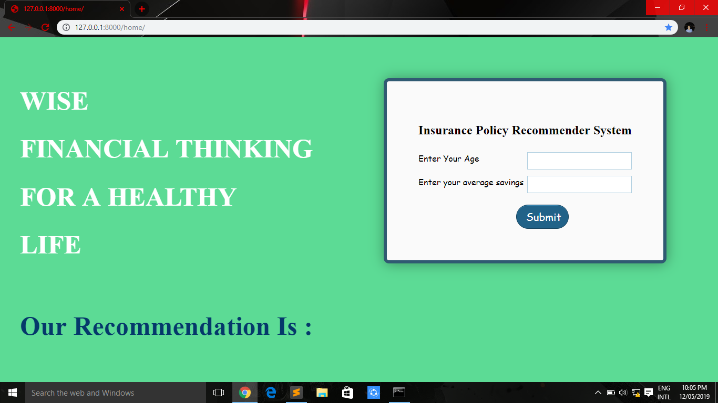
THIS IS HOW OUR WEBSITE LOOKS LIKE !!!..
DESIGN
Place your screenshot here

Slide 8
IMPLEMENTATION
Importing Libraries
Importing csv file
Separating dependent and independent variables
Separating training and testing data
Fitting appropriate algorithm
Calculating accuracy
Recommending an Insurance Policy

Slide 9
Importing Libraries
The libraries used for this project are
Numpy
Pandas

Slide 10
Importing csv file
We created a dummy dataset policy.csv referring to policy bazzar website.
Dataset consists age, average monthly savings and insurance policy

Slide 11
Separating independent and dependent variables
In policy dataset
Age and Average monthly savings are considered as independent variables
Insurance policy is considered as dependent variable.

Slide 12
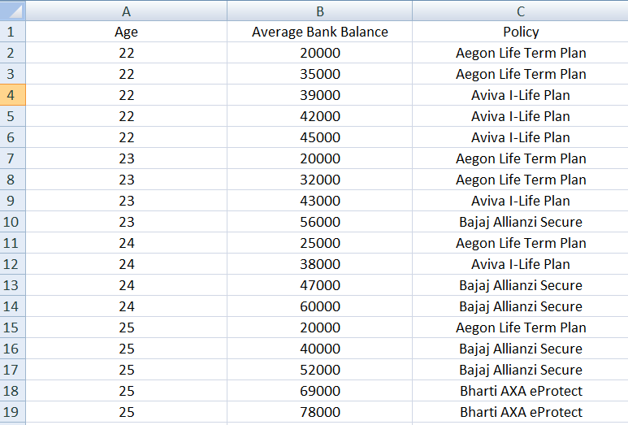
Policy.csv

Slide 13
Separating Test and Train data
For this model the data have been split with the ration 75:25.

Slide 14
Fitting appropriate algorithm
For this project we chose Decision Tree algorithm

Slide 15
Why Decision Tree Algorithm???
Decision trees require relatively little effort from users for data preparation.
As we had to design a sample dataset for the model, it was in our best interest to go with Decision Tree Algorithm.

Slide 16

Calculating Accuracy
The accuracy of the model turned out to be near 80%.

Slide 17
Recommending an Insurance Policy
The model takes age and average monthly savings as input and recommends a suitable insurance policy to the customer.

Slide 18
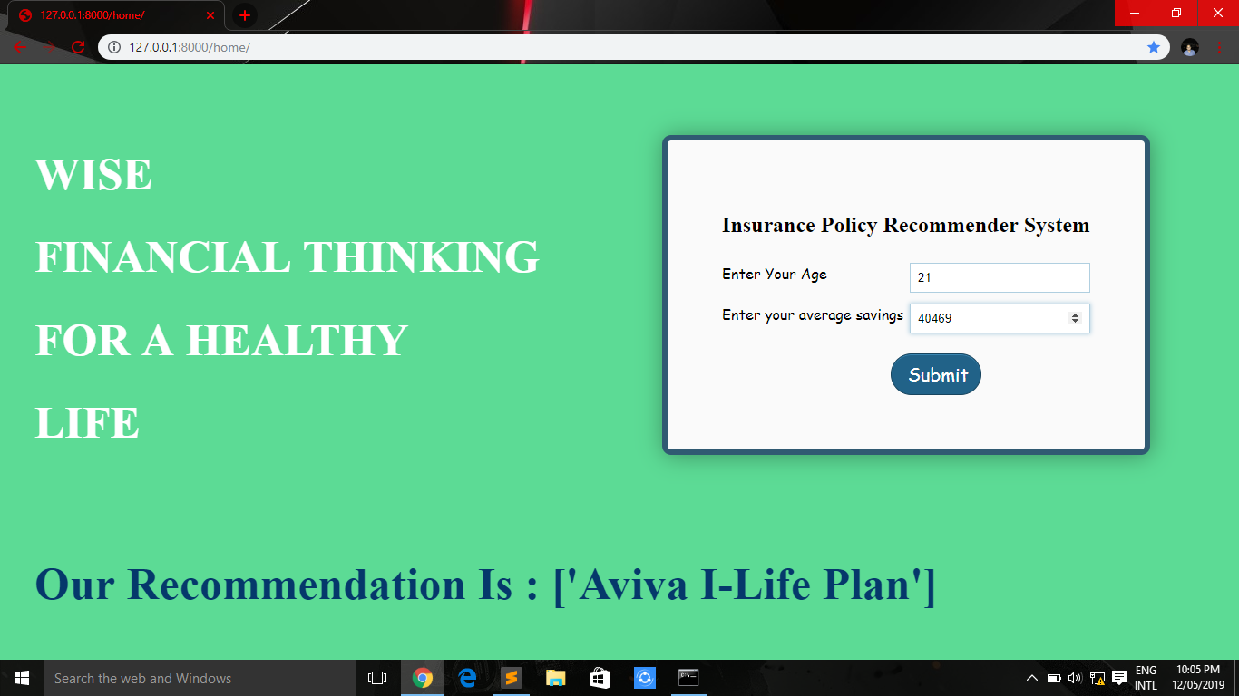

Slide 19
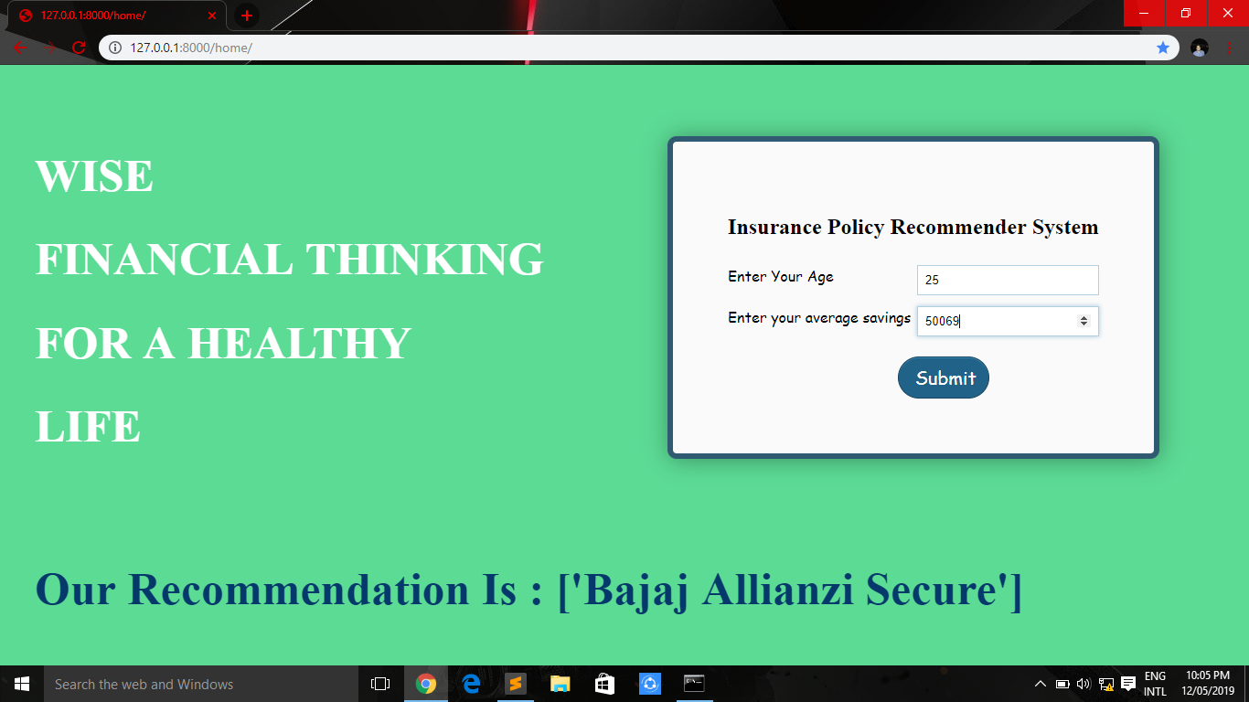

Slide 20
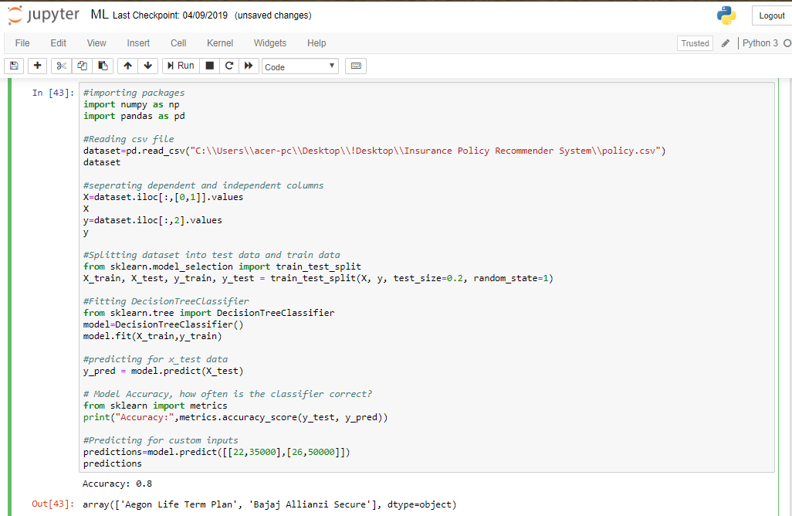

Slide 21
Conclusion
The project Insurance Policy Recommender System overall simplifies the process of the recommendation of appropriate insurance policies to the customer. Customers can easily access the website and get a recommendation based on their age and their average bank balance.

Slide 22
Limitations
Some of the limitations of this model are:
The model recommends insurance policy using only two attributes. Hence making it a little less reliable.
The model is not designed to provide multiple recommendations to the customer.

Slide 23
Future Scope
The model can be implemented on a large scale if the dataset is improved.
The model mainly finds its place in the banking system as the banks have tie-ups with insurance policy companies and also have relevant data needed for this model for a reliable prediction.
The model can be used in any insurance policy e-commerce website to recommend suitable insurance policy to its users.

Slide 24
THANKS!;
By:
Shridhar Shetti 2SD16IS047;
Supreet Joshi 2SD16IS052;
Prasanna Katigar 2SD16IS037;
Under the Guidance of
Dr. Anita Dixit

