Slide 1
Bike Share Data Analysis Report
Prepared by: Shridhar H. Kottappanavar
Date: March 2025

Slide 2
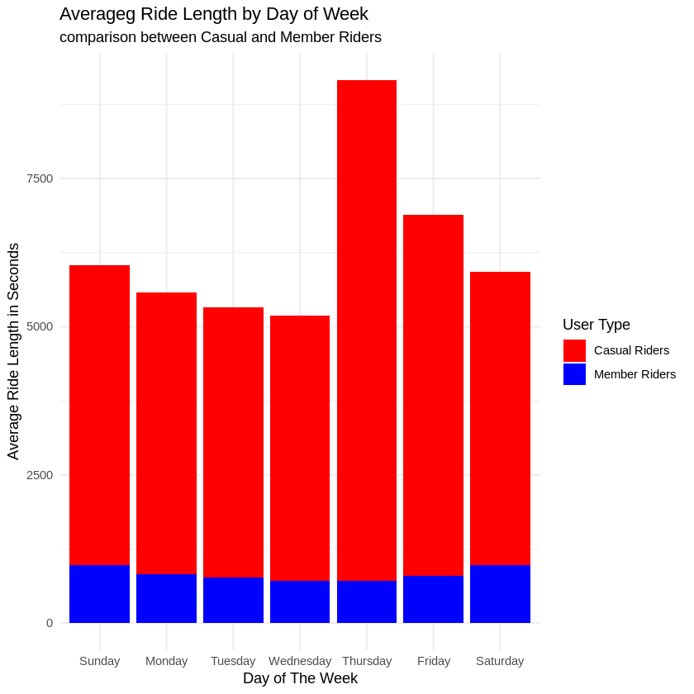
Average Ride Length by Day of Week
Insight: Casual riders have significantly longer ride durations compared to members, especially on weekends.

Slide 3
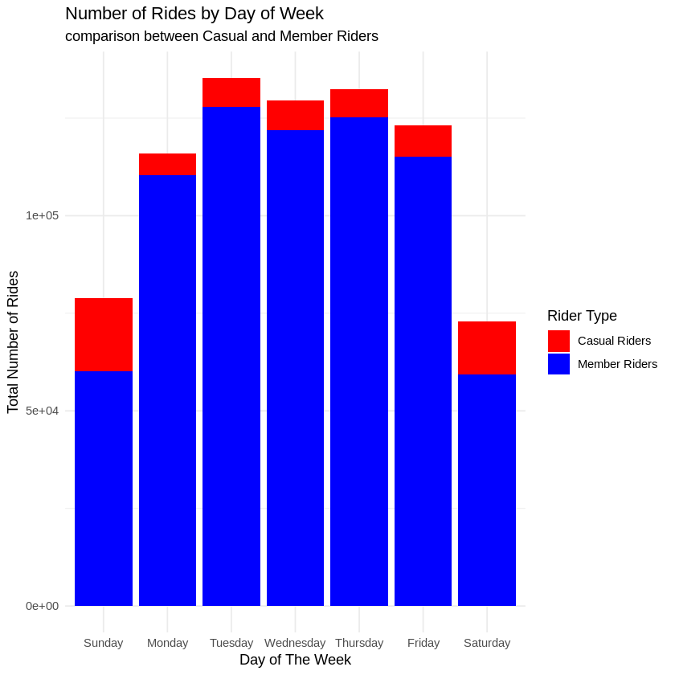
Number of Rides by Day of Week
Insight: Annual members consistently take more rides throughout the week, while casual riders are more active on weekends.

Slide 4
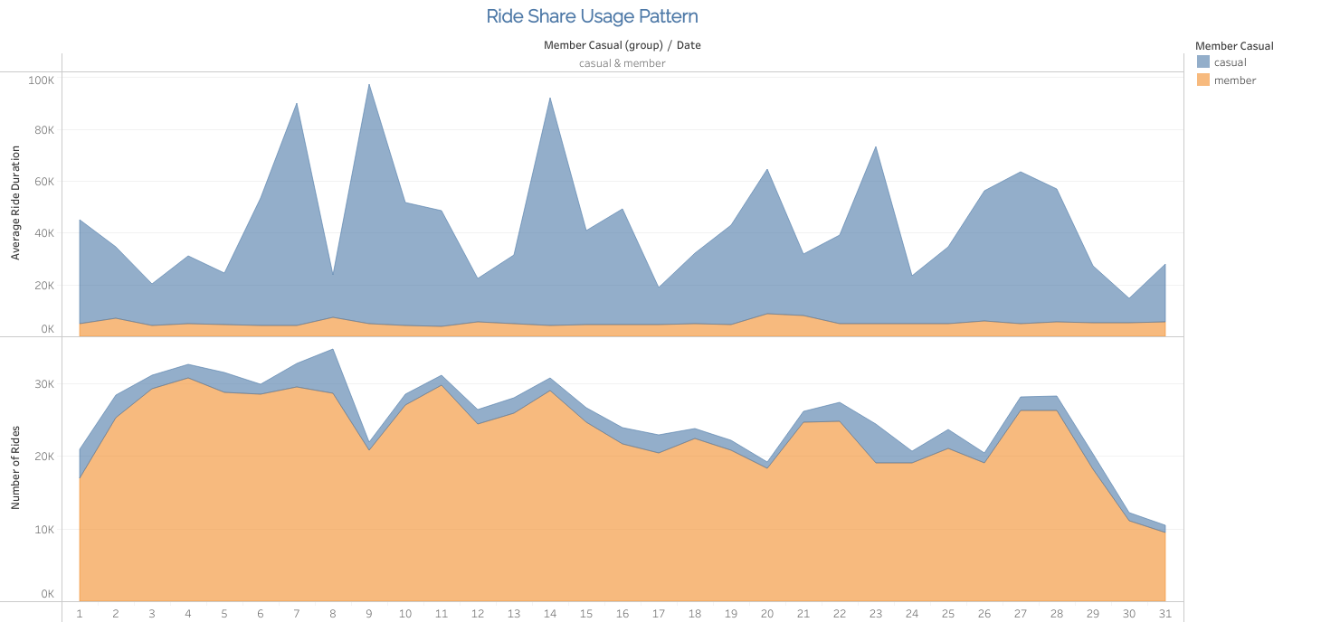
Ride Share Usage Pattern
Insight: Casual riders exhibit sporadic usage patterns, while members display consistent daily usage.

Slide 5
Recommendations
• Marketing: Convert casual riders into members through promotions.
• Service Optimization: Adjust bike availability for different demand patterns.
• Pricing Adjustments: Introduce flexible membership plans.

Slide 6
Conclusions
✅ Casual riders have longer, irregular ride durations, mostly on weekends.
✅ Annual members have shorter, consistent rides, primarily for commuting.
✅ To boost revenue, focus on converting casual riders to members.
✅ Optimize bike availability during peak casual rider times.
✅ Introduce flexible membership plans.

