Slide 1

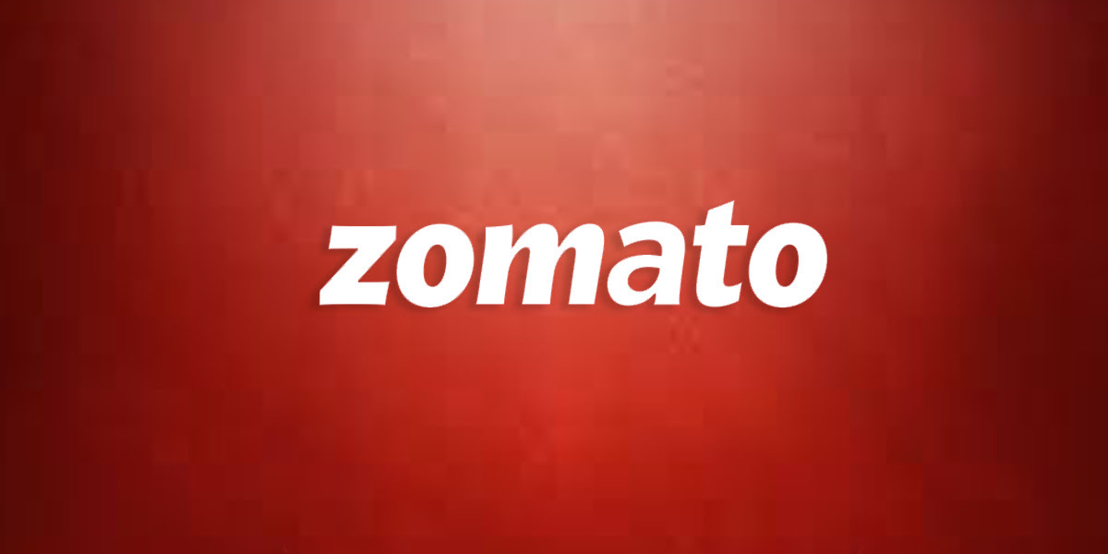
Product Strategy to Integrate a food truck locator into:

Slide 2
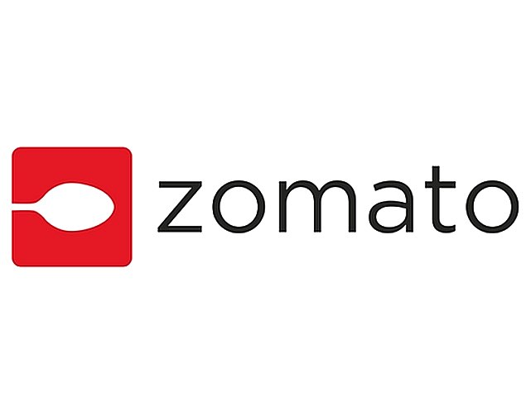
Introduction
Welcome to this presentation on integrating a food truck locator into Zomato!
Today, we'll be discussing the market opportunity for food truck locators and how we plan to leverage Zomato's platform to enhance the customer experience.
For those who may be unfamiliar, Zomato is a popular online food ordering and restaurant discovery platform that operates in over 24 countries.
Zomato's extensive network of restaurants and food-related businesses makes it the perfect platform to integrate a food truck locator and allow users to find and track their favorite food trucks in real-time.
With the growing popularity of food trucks and mobile food options, we believe that integrating a food truck locator into Zomato can enhance the platform's value proposition and drive business for both Zomato and the food trucks.

Slide 3

Market Research
Before we dive into our product strategy, let's take a look at the market opportunity for food truck locators and how they benefit both food trucks and customers in India.
The food truck industry is still in its nascent stage in India but is seeing rapid growth, with an estimated market size of INR 300 crore in 2020 and an annual growth rate of 25% (source: The Hindu Business Line).
Customers in India love food trucks for their convenience, unique food offerings, and affordable prices. However, one of the biggest challenges for customers is finding their favorite food trucks and tracking their locations.
This is where a food truck locator can provide value by allowing customers to easily find and track their favorite food trucks in real-time, saving them time and effort.

Slide 4
Food truck locators can also benefit food trucks by increasing their visibility and reach, helping them attract more customers and generate more revenue
According to a survey by the National Restaurant Association of India, street food is the most popular food segment in India, accounting for 34% of the total food service market (source: Food Service India).
Lastly, let's take a look at some competitors and their features to see how we can differentiate ourselves:
Competitors such as Food Truck India and Food Trucks Association of India offer similar features such as real-time tracking, but may not have as large of a network as Zomato.
By integrating a food truck locator into Zomato, we can leverage the platform's existing user base and extensive network of restaurants and food-related businesses to offer a more comprehensive and convenient experience for customers

Slide 5
Customer Segments
Now that we've identified the market opportunity for a food truck locator in India, let's take a closer look at the primary customer segments that would be interested in using this product.
The primary customer segments for a food truck locator in India are:
Urban millennials: This demographic is tech-savvy and enjoys trying new and unique food options. They are likely to be heavy users of food delivery apps such as Zomato and Swiggy.
Office-goers: People who work in office areas are often looking for convenient and affordable food options. Food trucks are a great fit for this segment as they are often located near office areas.
Tourists: Food trucks offer a unique and authentic food experience for tourists. A food truck locator can help tourists find the best food trucks in the city.

Slide 6
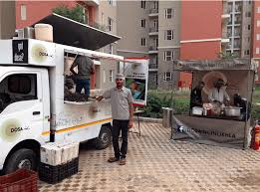
To tailor the product to meet the needs and preferences of these segments, we can consider factors such as:
Location-based search: Users can search for food trucks in their current location or any other location of their choice.
Personalized recommendations: Based on a user's search history and preferences, the app can suggest food trucks that they may be interested in.
Real-time tracking: Users can track the location of their favorite food trucks in real-time, reducing the need for unnecessary travel.
By catering to the needs of these customer segments, we can create a product that is both relevant and useful for our target audience.

Slide 7
Value Proposition
Our food truck locator will add significant value to Zomato's existing platform by offering customers a convenient and seamless way to discover and track their favorite food trucks in real-time.
By integrating this feature, we can enhance the customer experience on Zomato and provide a more comprehensive food discovery platform for our users.
Here are some of the key features and benefits of our food truck locator:
Real-time tracking: Users can track the location of their favorite food trucks in real-time, reducing the need for unnecessary travel.
Discovery: Customers can discover new and unique food options from the diverse range of food trucks in their area.
Convenience: Customers can easily find and order from food trucks without having to navigate through crowded streets or wait in long lines.

Slide 8
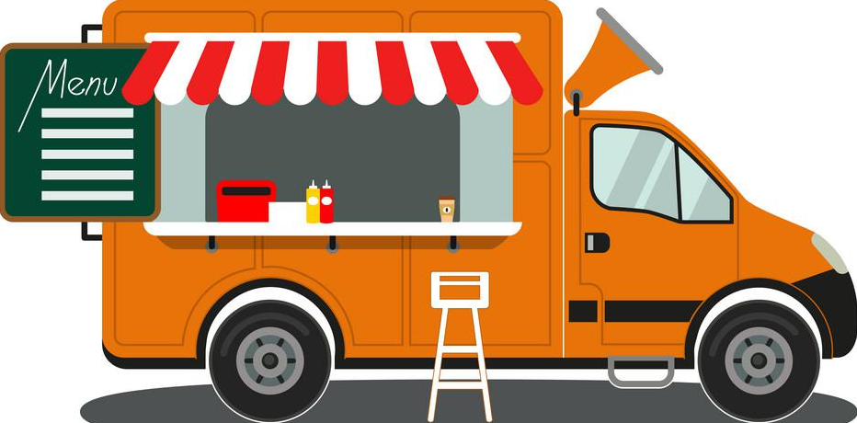
By offering these features, we can differentiate ourselves from competitors and attract more users to Zomato.
Additionally, our food truck locator can drive business for both Zomato and the food trucks themselves. By providing a platform for food trucks to showcase their offerings and reach a wider audience, we can help drive more customers and revenue to these businesses.

Slide 9

Product Design and Development
Our food truck locator will require a thorough design and development process to ensure a seamless integration with Zomato's existing platform.
The key milestones of the process include:
Planning and scoping: This involves defining the scope of the project, determining resource requirements, and establishing timelines.
User research: This includes understanding user needs and preferences to ensure the product meets their expectations.
Design and development: This involves creating wireframes, designing the user interface, developing the backend infrastructure, and testing the product.
Integration: This involves integrating the food truck locator with Zomato's existing platform and ensuring it works smoothly.
Launch: This involves rolling out the product to users and collecting feedback to improve it over time.

Slide 10
The resources required for this project include personnel with expertise in user experience design, backend development, and data management, as well as technology infrastructure to support the product's functionality.
Potential roadblocks may include technical challenges in integrating the food truck locator with Zomato's existing platform, user adoption and engagement, and regulatory compliance related to food safety and location tracking. To overcome these challenges, we will need to work closely with Zomato's development team, engage with users to ensure their needs are met, and ensure compliance with all relevant regulations.

Slide 11
Marketing and Promotion
To successfully promote our food truck locator, we plan to utilize a mix of marketing channels and tactics that are most relevant to our target audience. Some of the strategies we plan to use include:
Social media marketing: We will use Zomato's social media channels, as well as targeted advertising on platforms like Facebook and Instagram, to reach our audience where they spend the most time online.
Influencer partnerships: We will partner with popular food bloggers and influencers to promote the food truck locator to their followers, leveraging their influence and credibility to reach a wider audience.
Email marketing: We will leverage Zomato's existing customer database to send targeted email campaigns promoting the food truck locator and its benefits.
Events and activations: We will participate in relevant food events and activations, where we can showcase the food truck locator and encourage people to try it out.
Public relations: We will work with media outlets to secure coverage and write-ups about the food truck locator, as well as utilize press releases to generate buzz around its launch.
We anticipate a budget of $X for our marketing efforts, with an expected ROI of Y%. By leveraging these tactics, we believe we can effectively reach and engage our target audience, driving adoption of the food truck locator and delivering value to both Zomato and the food trucks we support.

Slide 12
Launch and Growth Strategy
We plan to launch the food truck locator feature on Zomato in three phases:
Beta testing: We will conduct beta testing in select cities with a small group of users to gather feedback and make any necessary adjustments before the official launch.
Soft launch: We will roll out the feature in a few major cities to gather user data and test the scalability of our technology.
Official launch: We will launch the food truck locator feature on Zomato in all major cities in India.

Slide 13
Expected outcomes of our launch and growth strategy include:
Increased user engagement and retention on the Zomato platform
Increased revenue from food truck advertising and partnerships
Greater visibility and growth opportunities for food trucks
We will measure the success of our food truck locator feature through the following metrics:
User engagement and retention on the Zomato platform
Number of food trucks listed on the platform and their level of activity
Revenue generated from food truck advertising and partnerships
Potential expansion opportunities include:
Partnering with other food-related platforms to cross-promote the food truck locator feature and expand our user base
Scaling to new markets outside of India where the food truck industry is growing
Integrating additional features, such as online ordering and payment, to enhance the user experience and increase revenue opportunities.

Slide 14
Conclusion
We hope this presentation has given you a clear understanding of our vision for the food truck locator and its potential to provide value to our customers and the food truck industry. We welcome any questions or feedback you may have.
Thank You!

