Slide 1
Library Management System
Presented By: Shreedharagowda B P

Slide 2
Abstract
Library Management System Library management system is a project which aims in developing a computerized system to maintain all the daily work of library .This project has many features which are generally not available in normal library
management systems like facility of user login and a facility of librarian login.

Slide 3
Introduction
Overall this project of ours is being developed to help the
students as well as librarian to maintain the library in the best way possible and also reduce the human efforts.

Slide 4
Existing System
The current system is based on manual procedures.
Student must visit library for books are exist in the library or not.

Slide 5
Problems
Some times due to some human error there may be a loss of records.
Difficult to search books.

Slide 6
Propose System
To overcome the drawbacks of Existing system and Our software is multifunctional which includes book issue details, book details and also student details.

Slide 7
Problem statement
In the Current working system maintenance is the major problem.
Librarian maintain all the information manually and keep all the records manually .

Slide 8
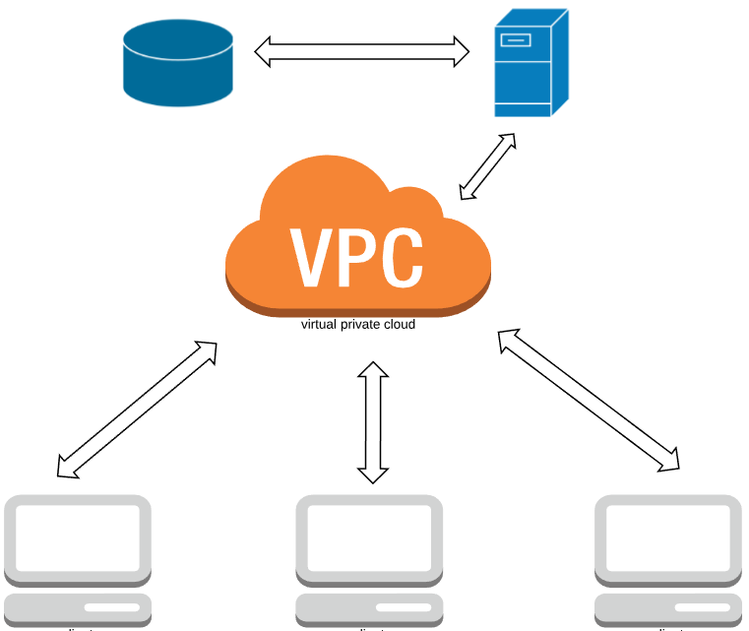
System Architecture
Web Server
Database
Admin
Librarian
Student

Slide 9



USE CASE DIAGRAM
Login
Student Register
Librarian Register
Librarian
Request Book
Admin
Issue Book
Return Book
Accept Return
Student

Slide 10
Implementation
Angular: Angular is a Typescript framework which makes you able to create reactive Single Page Applications (SPAs). This is a leading front-end development framework which is regularly updated by Angular team of Google.
Spring Rest: Spring REST has quickly become the de-facto standard for building web services on the web because they’re easy to build and easy to consume.

Slide 11
Conclusion
This website provides a computerized version of library management system which will benefits the students as well as the staff of the library. It makes entire process online where student can search books, staff can generate reports and do book transactions. It also has a facility for student login where student can login and can see status of books issued as well request for book.

Slide 12


