Slide 1


Introduction :
This assignment is part of NASA Spaceapp challenge for Covid19 solutions, May 2020.
We are trying to analyze the human factors and different trends in order to predict the hotspots of Covid19.
Data Sources and references -
. space agency data
. European Centre for Disease Prevention and Control
. WHO
. Data world etc.
Shridhar Shukla

Slide 2
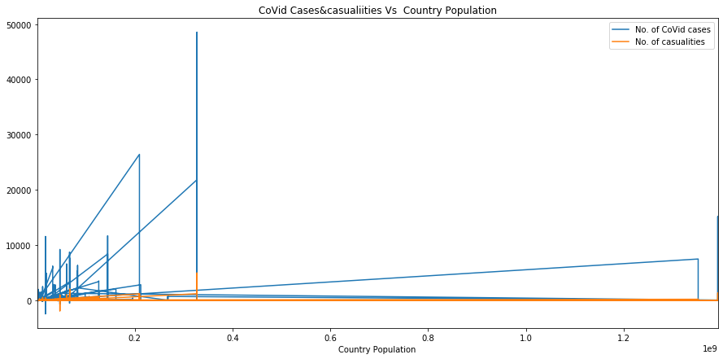
This shown us that the World's most affected countries are not with most population but with less population as well mostly. Hence we can alarm the less populous countries with certain extra measures.

Slide 3
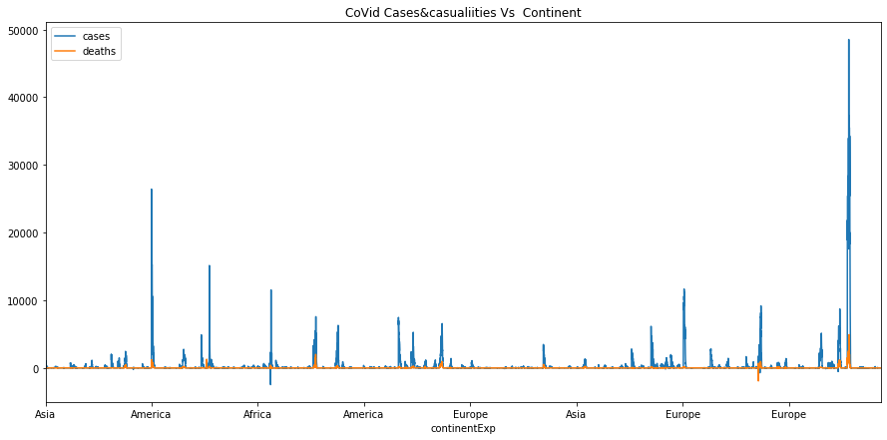
This map shows us that most chances of spreading Covid19 is on American and European countries.

Slide 4

This map alarms that the Brazil and some EU contries e.g. Switzerland are more prone to new spread.

Slide 5
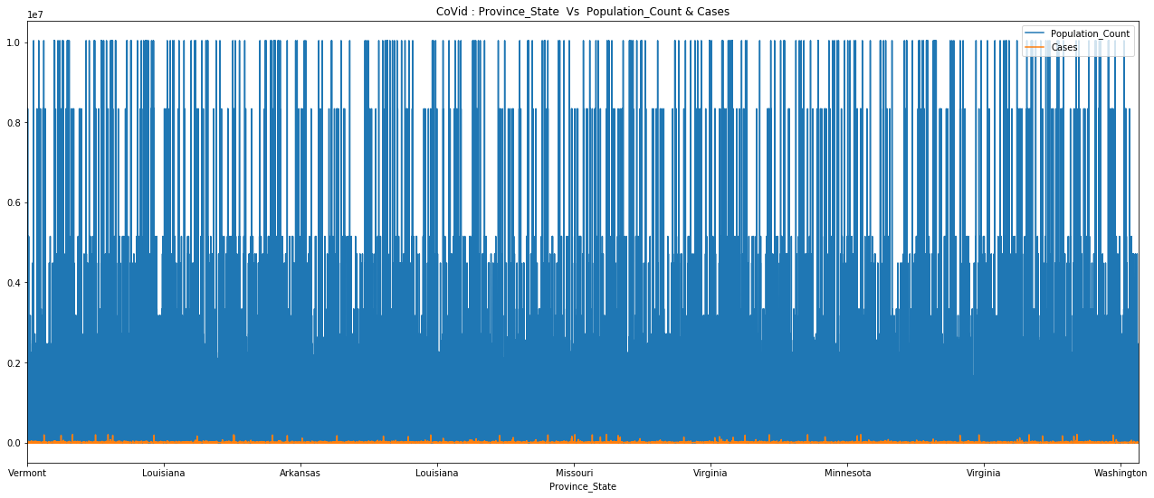
This map shows us that the Population of different states of US and the number of pandemic cases reported.

