Slide 1
BOOSTING ALGORITHM
ADA BOOST
XG BOosTING
Lg boosting

Slide 2
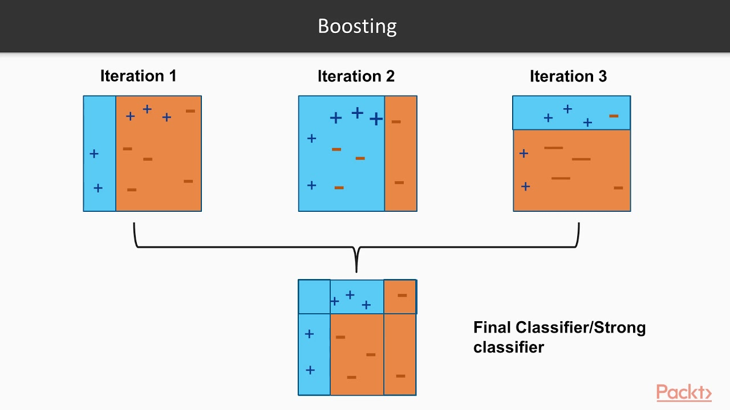
ADA BOOST
AdaBoost (short for Adaptive Boosting) is an ensemble machine learning algorithm that combines multiple "weak" learners to create a single "strong" classifier
class sklearn.ensemble.AdaBoostClassifier(estimator=None, *, n_estimators=50, learning_rate=1.0, random_state=None)

Slide 3
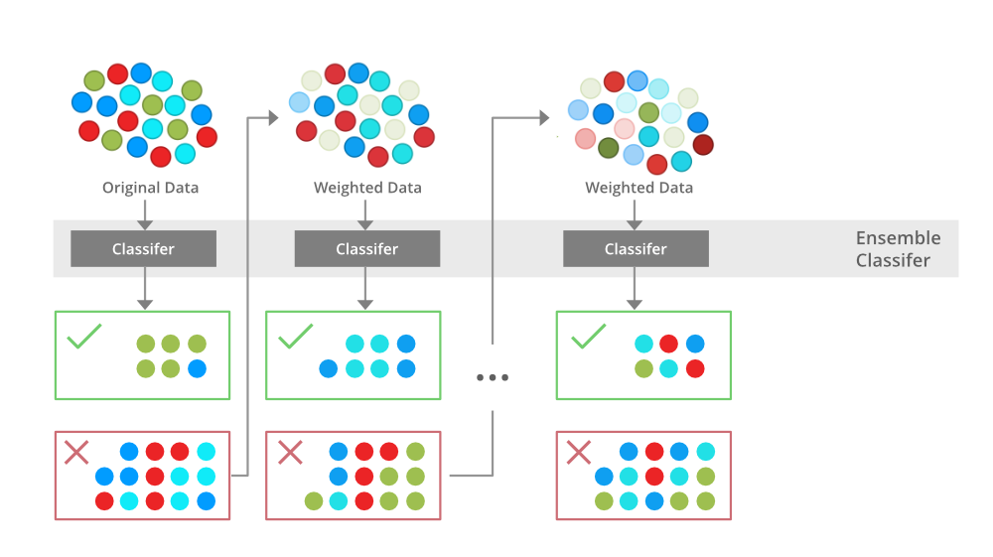
XG BOOSTING ALGORITHM
The XGBoost (eXtreme Gradient Boosting) algorithm is an optimized, scalable implementation of gradient-boosted decision trees designed for high performance and speed
class sklearn.ensemble.GradientBoostingClassifier(*, loss='log_loss', learning_rate=0.1, n_estimators=100, subsample=1.0, criterion='friedman_mse', min_samples_split=2,
min_samples_leaf=1, min_weight_fraction_leaf=0.0, max_depth=3, min_impurity_decrease=0.0, init=None, random_state=None, max_features=None, verbose=0, max_leaf_nodes=None, warm_start=False, validation_fraction=0.1, n_iter_no_change=None, tol=0.0001, ccp_alpha=0.0)[source]

Slide 4
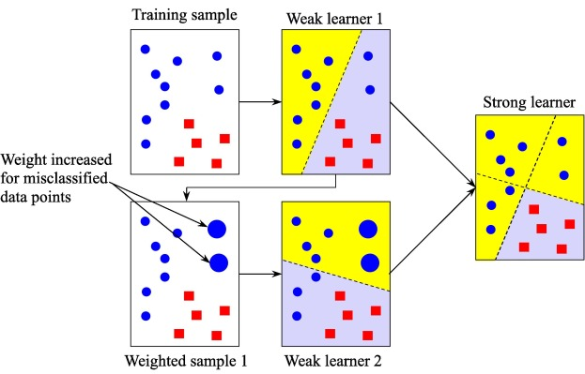
LG BOOSTING AlGORITHM
The LGBoost boosting algorithms are ensemble methods that combine several weak learners—typically small decision trees—to create a strong predictive model
class sklearn.ensemble.GradientBoostingRegressor(*, loss='squared_error', learning_rate=0.1, n_estimators=100, subsample=1.0, criterion='friedman_mse', min_samples_split=2,
min_samples_leaf=1, min_weight_fraction_leaf=0.0, max_depth=3, min_impurity_decrease=0.0, init=None, random_state=None, max_features=None, alpha=0.9, verbose=0,
max_leaf_nodes=None, warm_start=False, validation_fraction=0.1, n_iter_no_change=None, tol=0.0001, ccp_alpha=0.0)[source]

