Slide 1

FortiGate VPN Solutions: Project Overview
This presentation outlines a comprehensive 4-week project focused on implementing and optimizing VPN solutions using FortiGate firewalls. Designed for IT network engineers and technical students, this project builds foundational knowledge in VPN concepts and advanced configurations.

Slide 2

Project Goals: Secure Connectivity & Optimization
Master VPN Concepts
Gain a deep understanding of various VPN types and their practical applications in modern networks.
Hands-on Configuration
Develop practical skills in configuring both SSL and IPsec VPNs on FortiGate devices.
Optimize Traffic Flow
Learn to integrate SD-WAN with VPNs for enhanced performance and intelligent traffic routing.
Comprehensive Documentation
Produce detailed guides and reports on configurations, testing, and performance analysis.

Slide 3

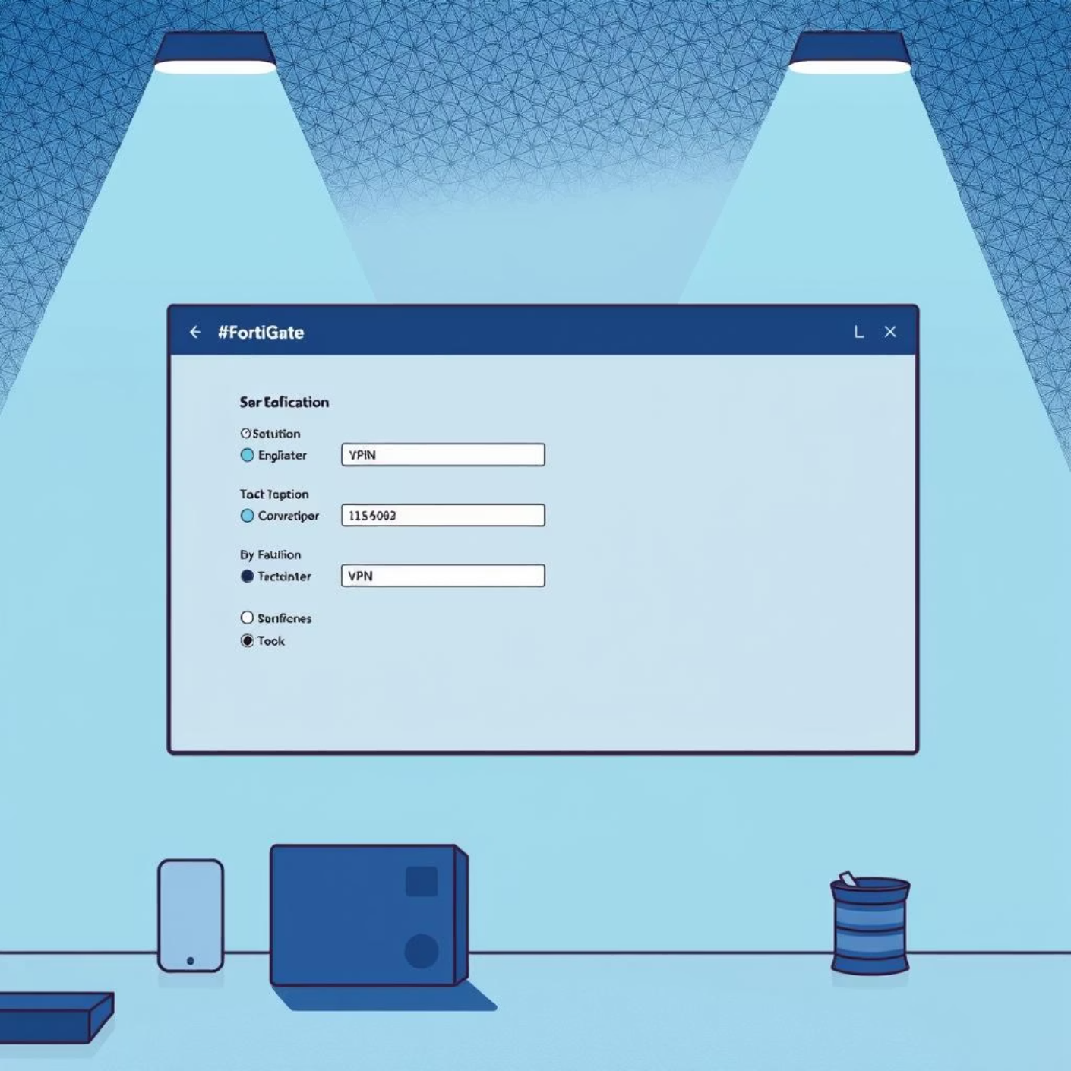
Chapter 1: VPN Fundamentals & SSL VPN
Week 1: Understanding & Configuring SSL VPN
1
VPN Concepts & Use Cases
Explore different VPN types, including site-to-site, remote access, and their respective scenarios for secure communication.
2
SSL VPN Deep Dive
Understand the architecture, authentication methods, and encryption protocols behind SSL VPNs.
3
FortiGate SSL VPN Configuration
Step-by-step guidance on setting up an SSL VPN on a FortiGate device, including user authentication and portal customization.
4
Testing & Troubleshooting
Verify SSL VPN connectivity and learn common troubleshooting techniques for resolving access issues.

Slide 4

Deliverable: Week 1 - SSL VPN Guide
Configuration Guide
Test Results
Network Diagram
A detailed document outlining the configured SSL VPN parameters and settings on the FortiGate.
Documentation of successful connection tests from remote clients, including access to internal resources.
Visual representation of the SSL VPN topology and connected components.
This deliverable serves as a comprehensive resource for future reference and replication of the SSL VPN setup.

Slide 5
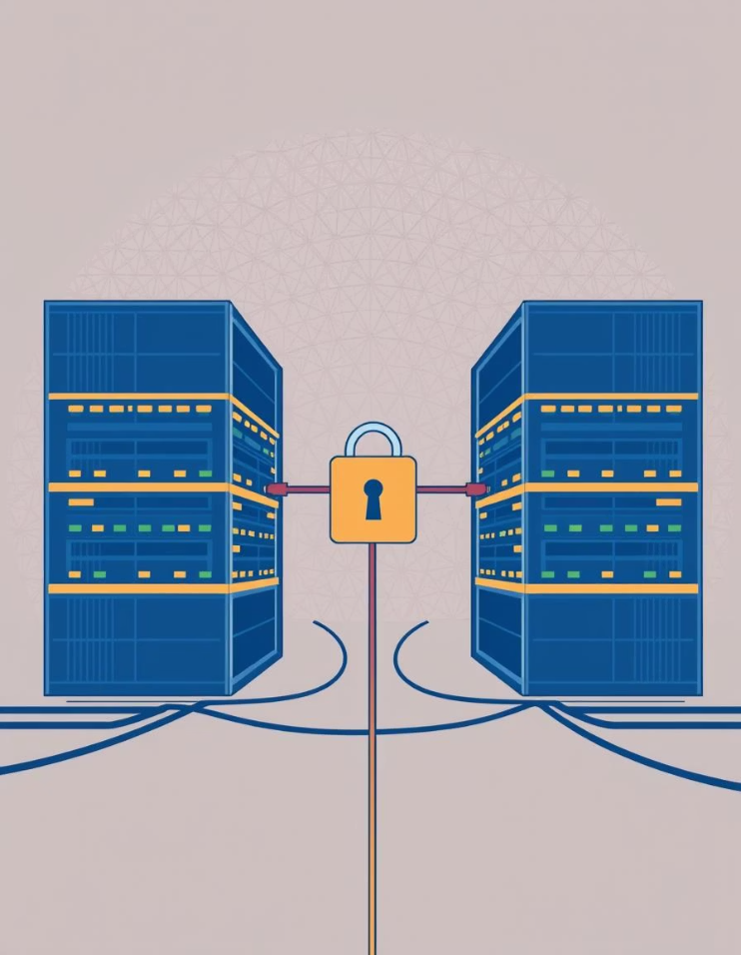
Chapter 2: Site-to-Site Connectivity
Week 2 & 3: Implementing SDWAN Over IPsec VPN Tunnels
01
SDWAN VPN
SDWAN Configured by GUI
Network→SDWAN→Create Members
02
Create 2 IPSec Tunnels
Create Phase 1 and Phase 2 with the remote IPs and configring Preshared Key
03
Phase 2 Configuration (IPsec)
Set up the IPsec tunnel to secure data transfer, defining proxies, protocols, encryption algorithms and the 2 networks.
04
Routing & Policies
Implement static routes and firewall policies to allow traffic to traverse the SDWAN IPsec VPN tunnels securely.
05
Configuring SLA & SDWAN rule
Implement static routes and firewall policies to allow traffic to traverse the SDWAN IPsec VPN tunnels securely.

Slide 6
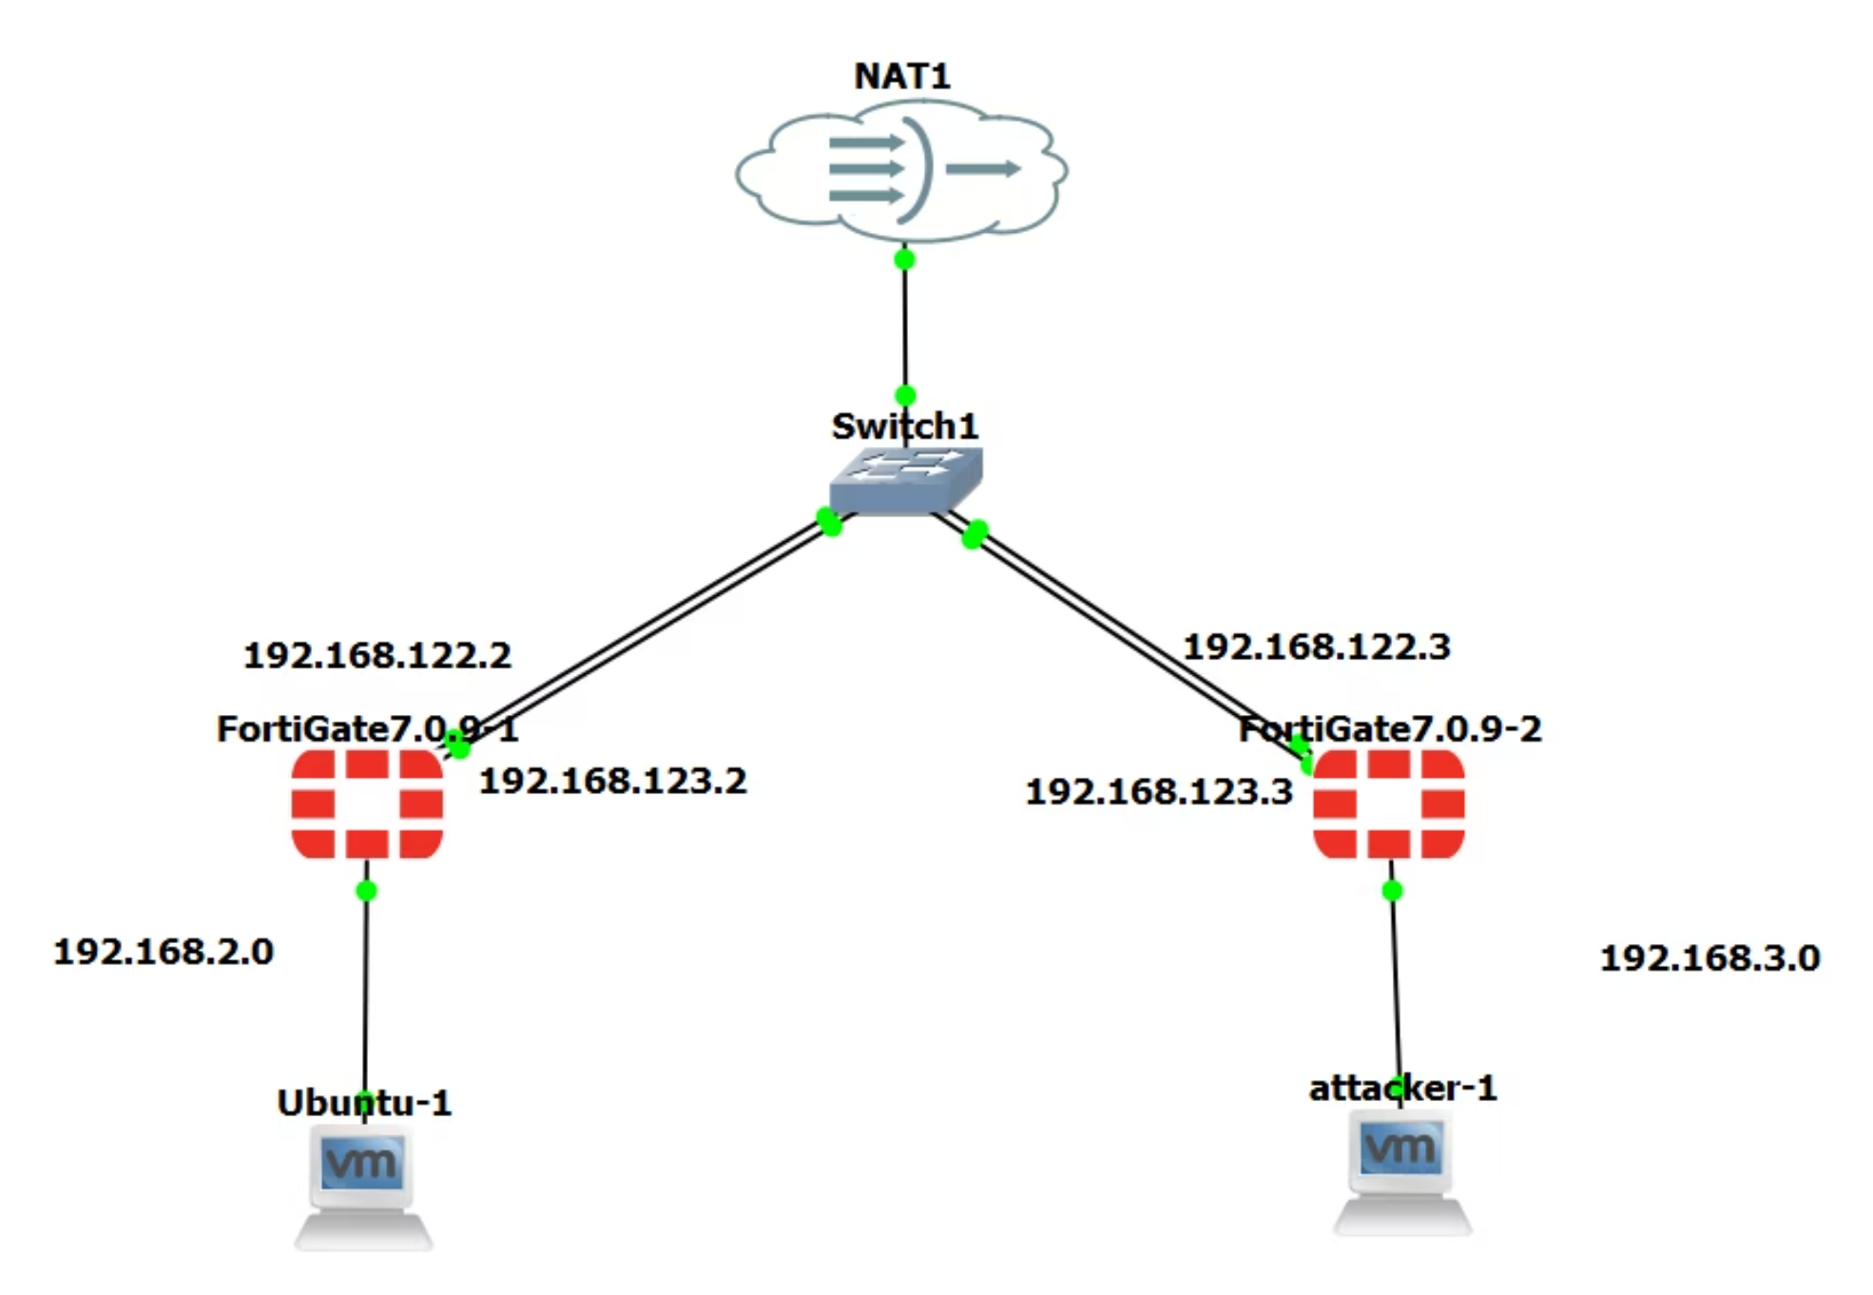
Deliverable: Week 2 & 3 - SDWAN Over IPsec VPN Documentation
→GNS3

Slide 7
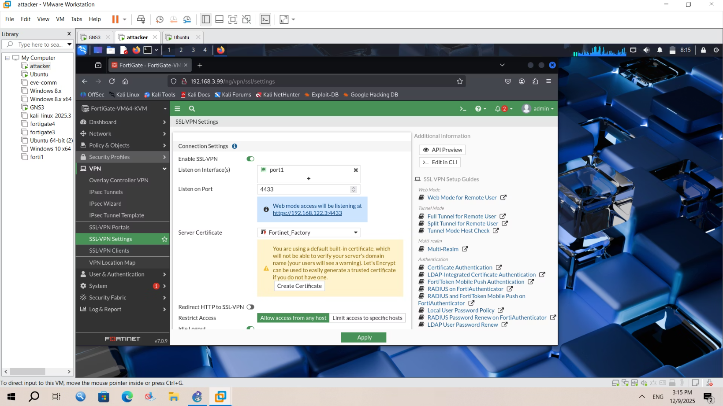
Chapter Testing
Week 1: SSLVPN settings Net LAN 192.168.3.0 (Branch)

Slide 8
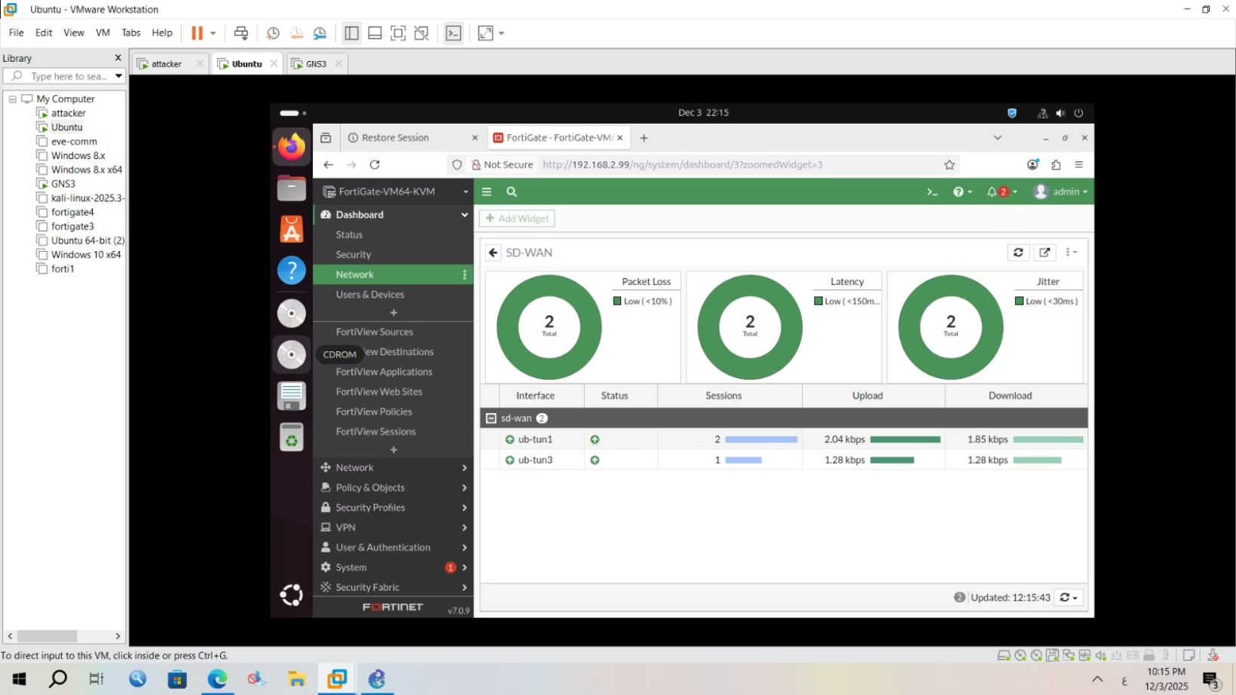
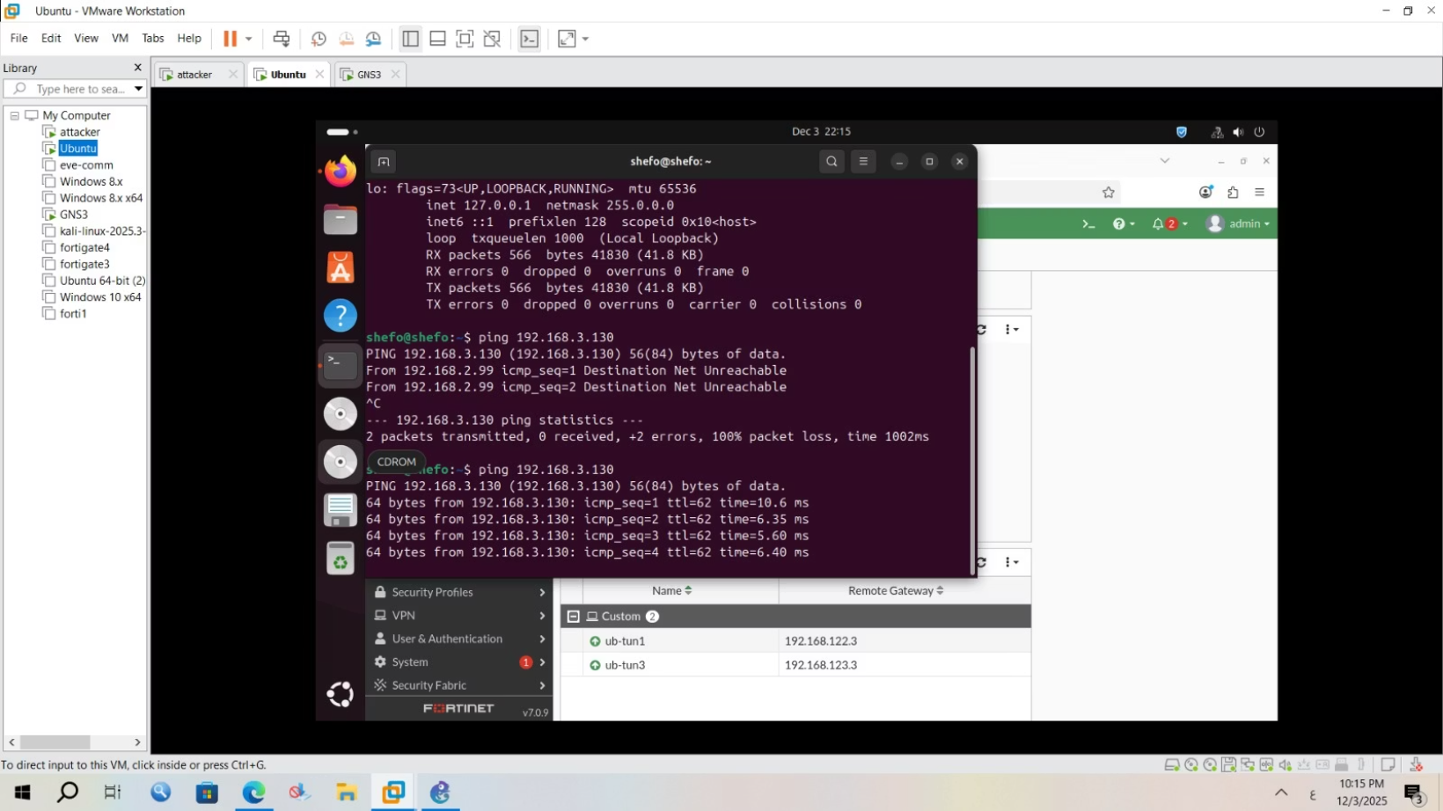
Chapter Testing
Week 2 & 3: Cont Net LAN 192.168.2.0 (HQ)

Slide 9
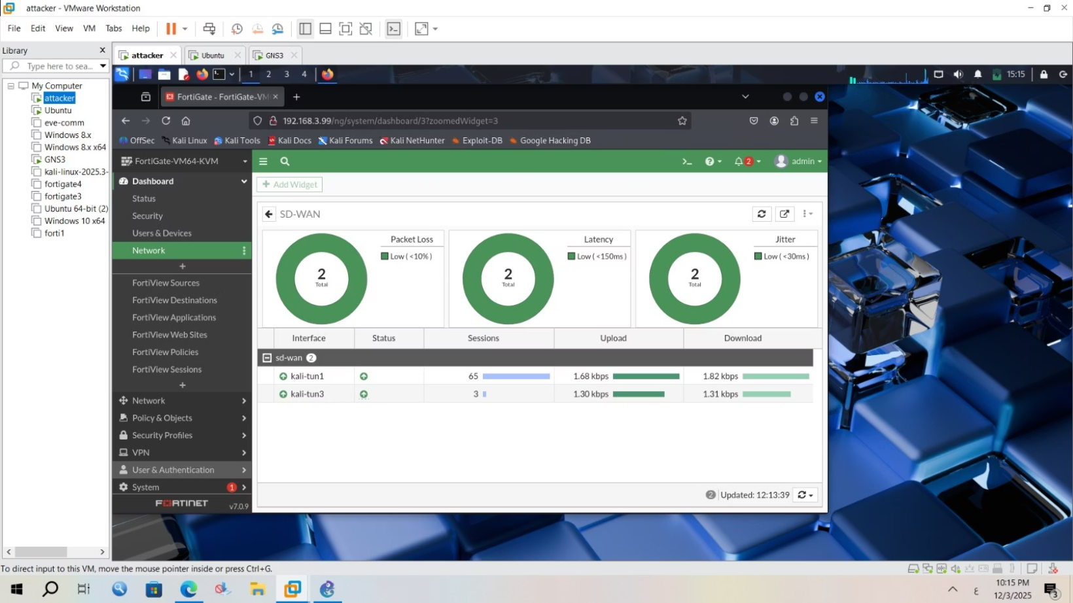
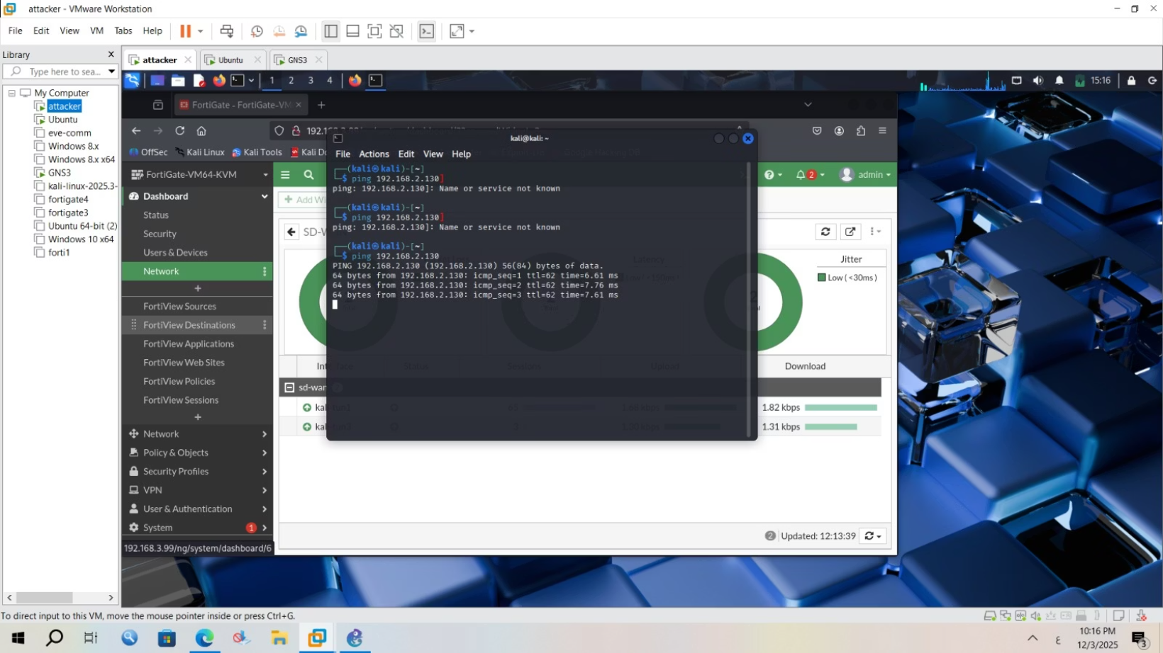
Chapter Testing
Week 2 & 3: Cont Net LAN 192.168.3.0 (Branch)

Slide 10
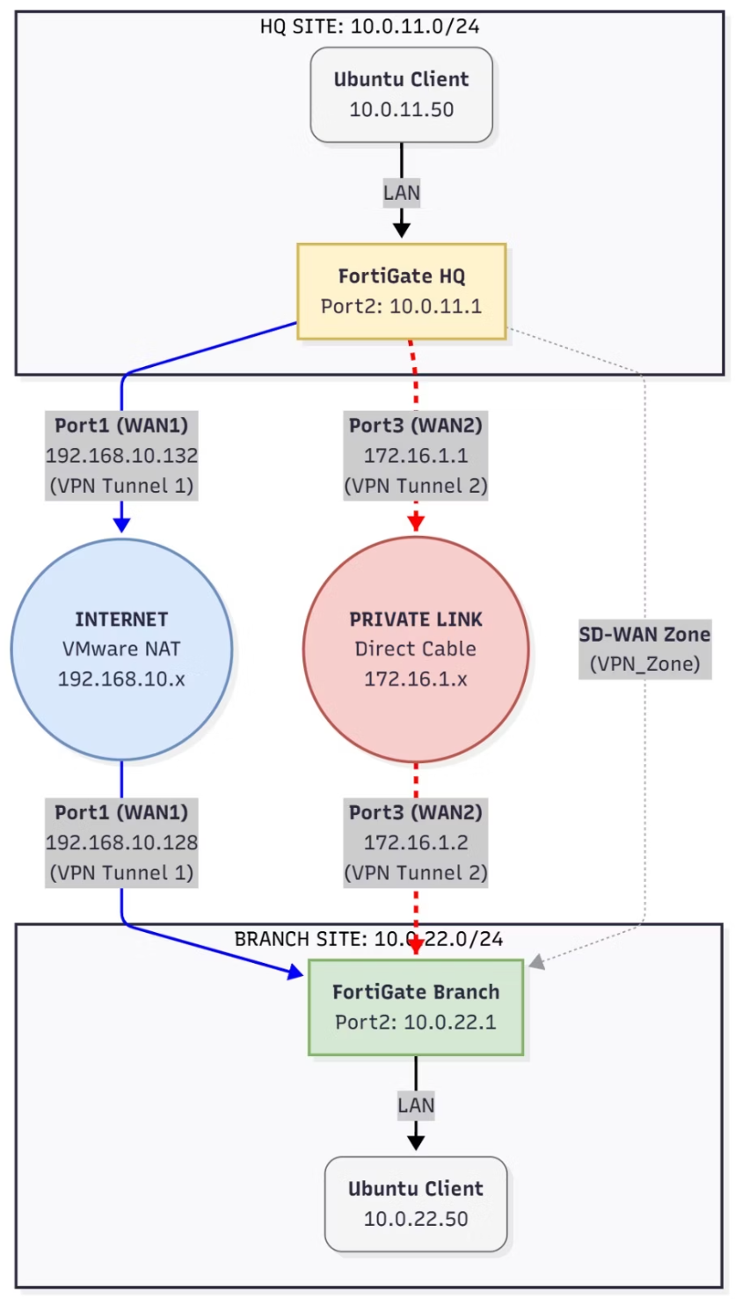
Deliverable: Week 2 & 3 Cont - SDWAN Over IPsec VPN Documentation
→VMWare WorkStation

Slide 11
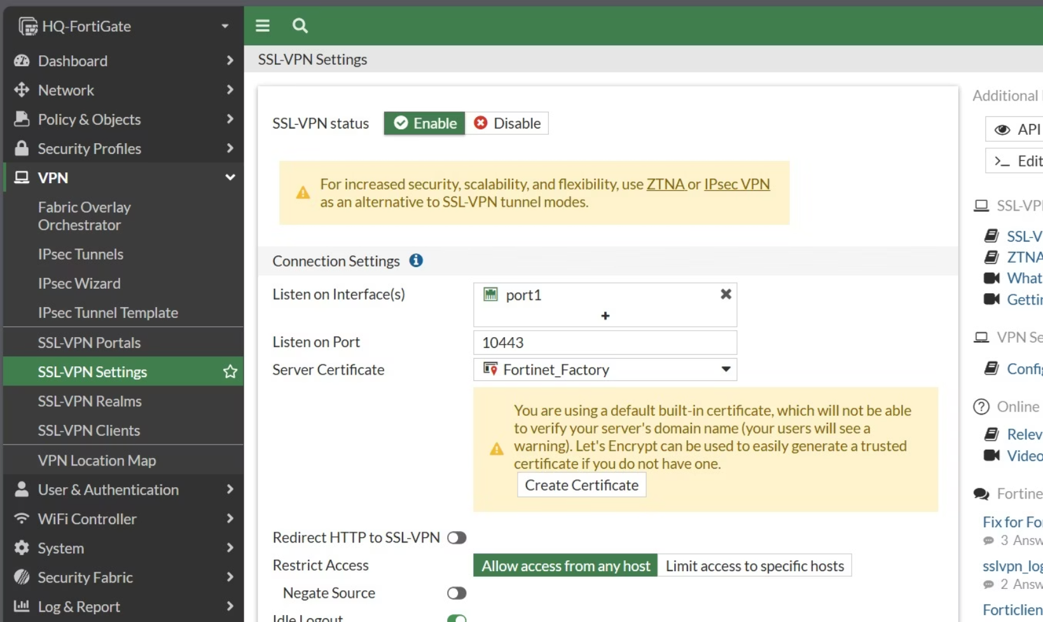
Chapter Testing
Week 1: SSLVPN Net Site HQ Firewall

Slide 12
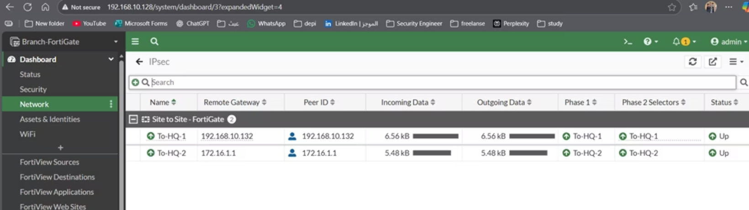
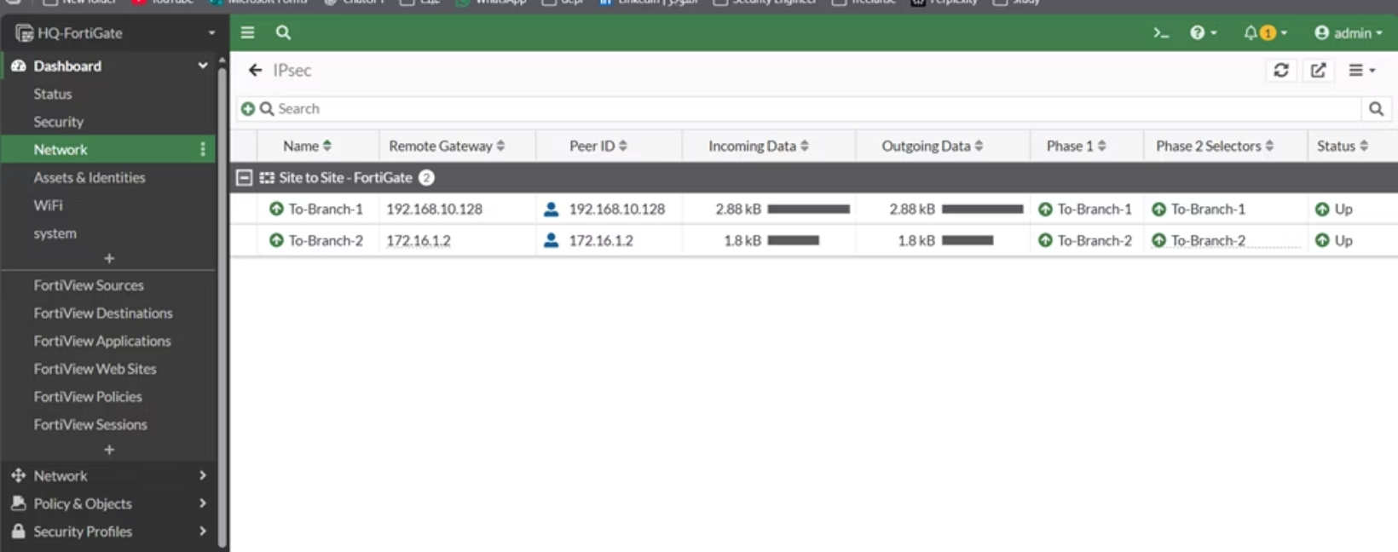
Chapter Testing
Week 2 & 3: IPSec tunnels Net Site HQ & Branch

Slide 13
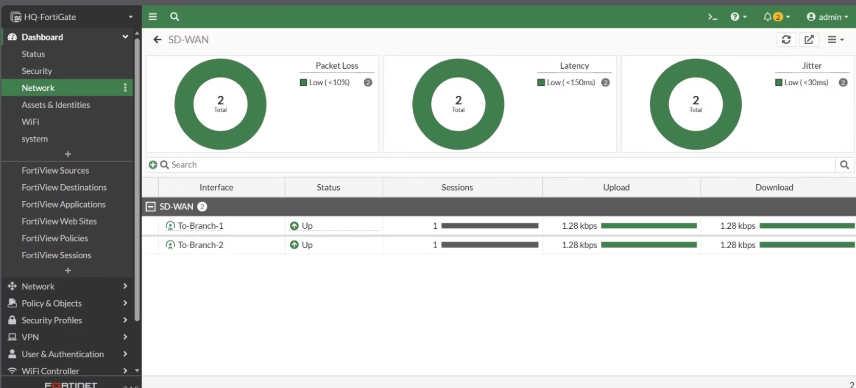
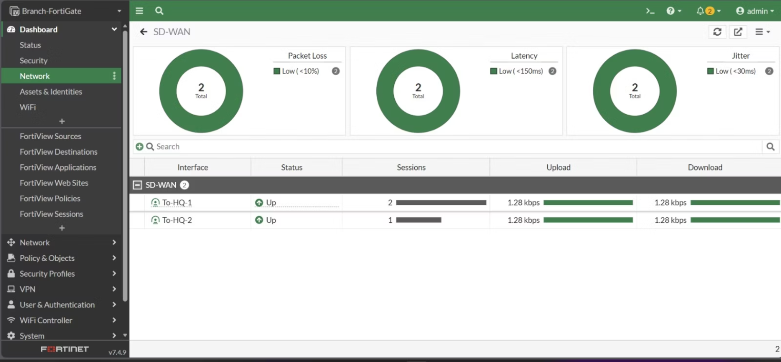
Chapter Testing
Week 2 & 3: SDWAN Over IPSec Net Site HQ & Branch

Slide 14

Chapter 4: Project Showcase
Week 4: Final Report & Presentation
1
Compile All Documentation
Integrate all weekly deliverables into a cohesive final report.
2
Executive Summary
Highlight key findings, configurations, and performance improvements.
3
Prepare Presentation
Create a clear and engaging presentation summarizing the project.
4
Demonstration
Showcase live VPN and SD-WAN functionality, if applicable.

Slide 15


Key Takeaways & Next Steps
Enhanced Security
FortiGate VPNs provide robust, encrypted communication channels.
Optimized Performance
SD-WAN integration elevates VPN efficiency and user experience.
Continuous Learning
The project offers a strong foundation for advanced network security roles.
This project equips participants with critical skills for deploying and managing secure, high-performance network infrastructures using FortiGate.

Slide 16
Meet Our Team

