Slide 1
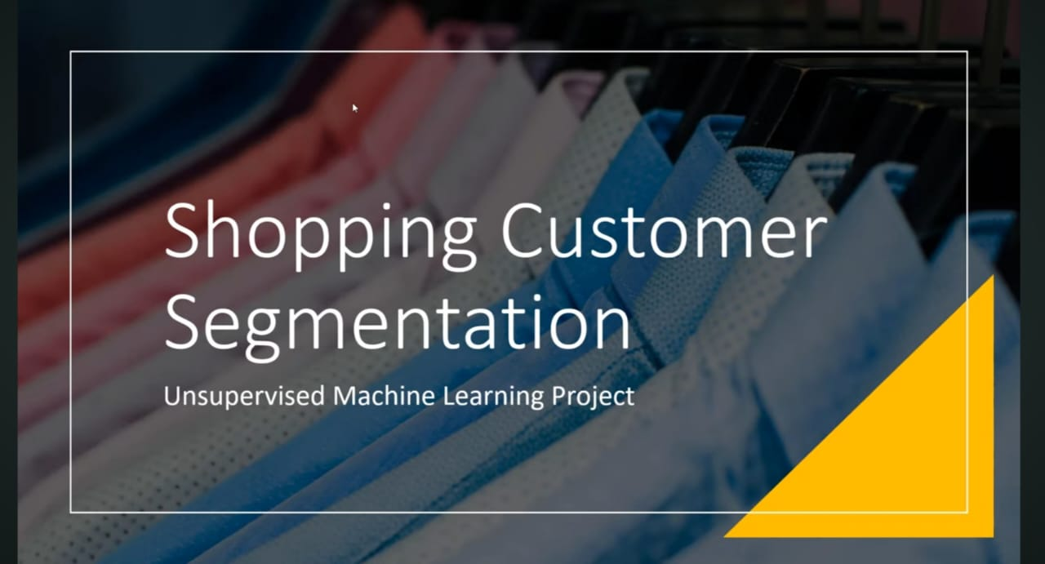
Analysis with Python

Slide 2
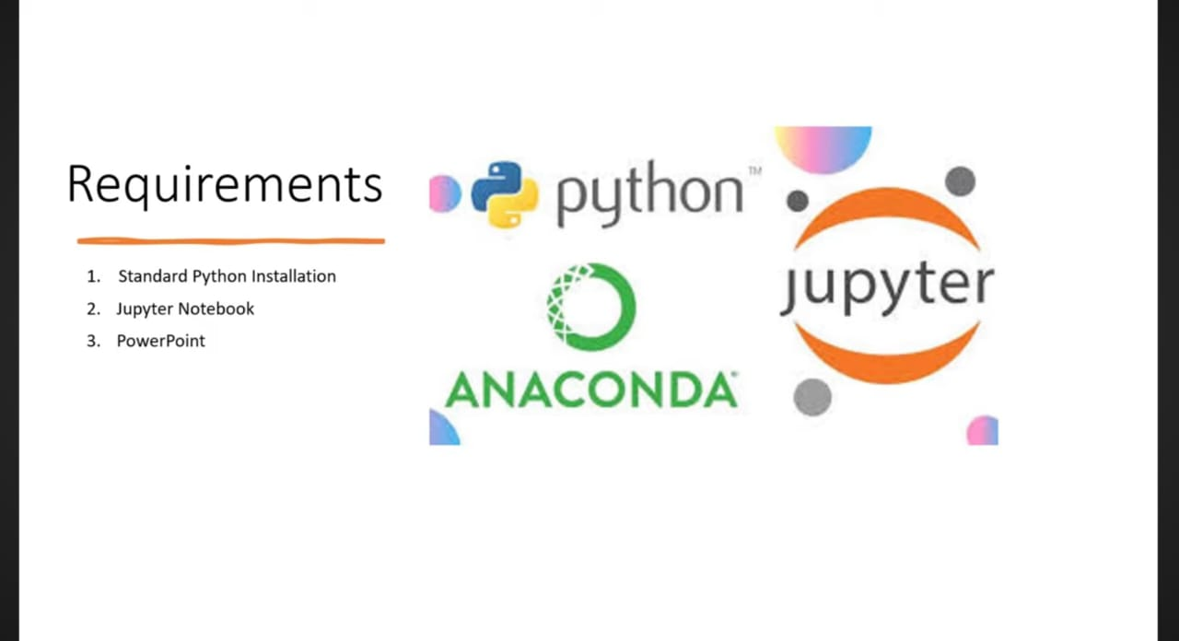

Slide 3
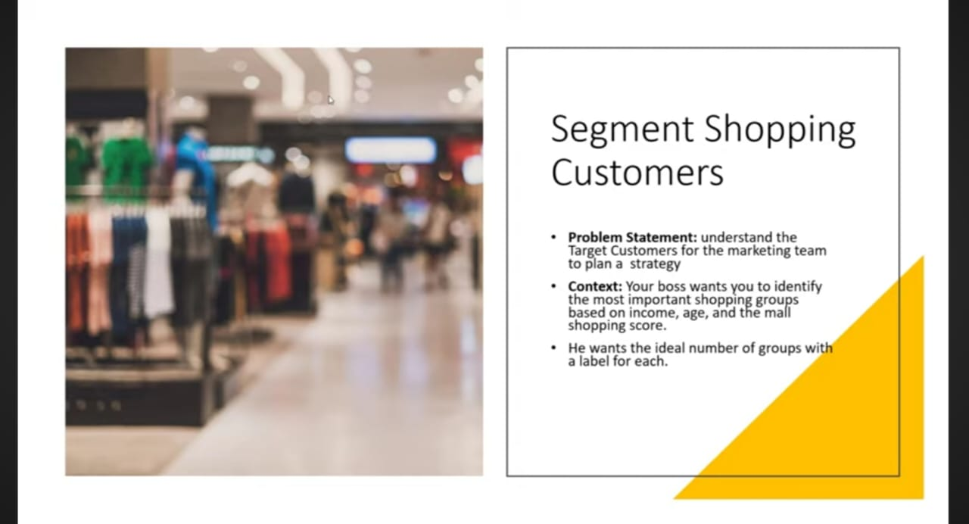

Slide 4
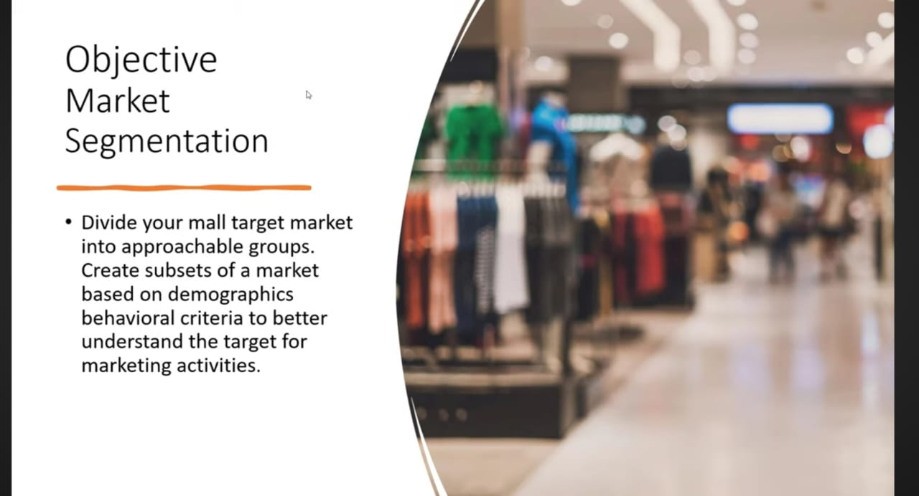

Slide 5
1. Introduction
This report presents a detailed customer segmentation study conducted using the K-Means clustering algorithm. The analysis focuses on identifying natural groupings within mall customers based on Annual Income and Spending Score.
The primary goal is to enable targeted marketing, improve resource allocation, and enhance overall customer engagement.
2. Business Objective
The mall’s management requires a data-driven segmentation strategy to:
Identify high-value customer groups
Understand spending behaviors
Improve marketing ROI
Tailor promotions to specific customer needs
3. Dataset Description
The dataset includes the following variables:
Annual Income (k$)
Spending Score (1–100)
Age
Gender
For segmentation, the most influential variables identified were Annual Income and Spending Score.

Slide 6
4. Analytical Approach
4.1 Exploratory Data Analysis (EDA)
EDA helped understand trends, distributions, and variable relationships. Key observations:
Income and spending show clear separations visually.
Spending Score varies more by age than expected.
Gender ratio: 56% Female, 44% Male.
Scatterplots suggested multiple natural groupings even before clustering.
4.2 Why K-Means Clustering?
K-Means is efficient for identifying customer groups with similar behavior.
It groups customers by minimizing the distance between each customer and the cluster’s centroid.
4.3 Selecting the Optimal Number of Clusters
The Elbow Method was used to determine the ideal number of clusters.
WCSS (inertia) was plotted against K values from 1–10.
The curve flattened after K = 5, indicating diminishing returns.
Therefore, five clusters were selected for segmentation.

Slide 7
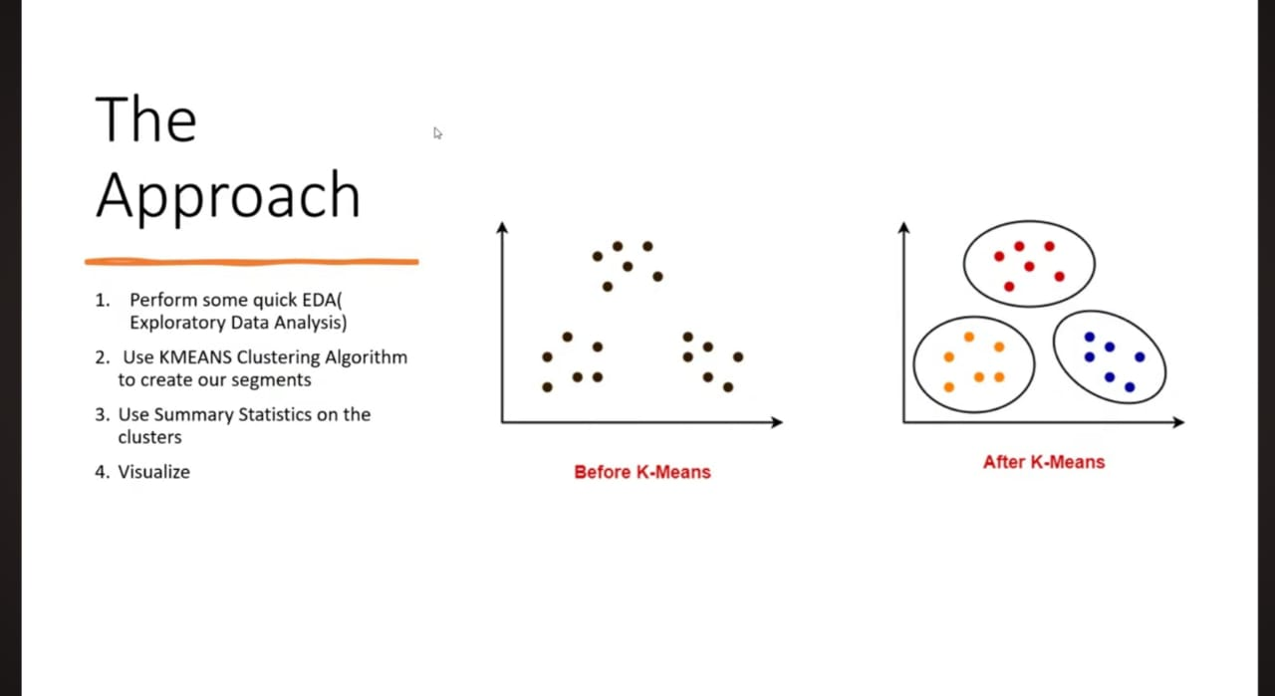

Slide 8
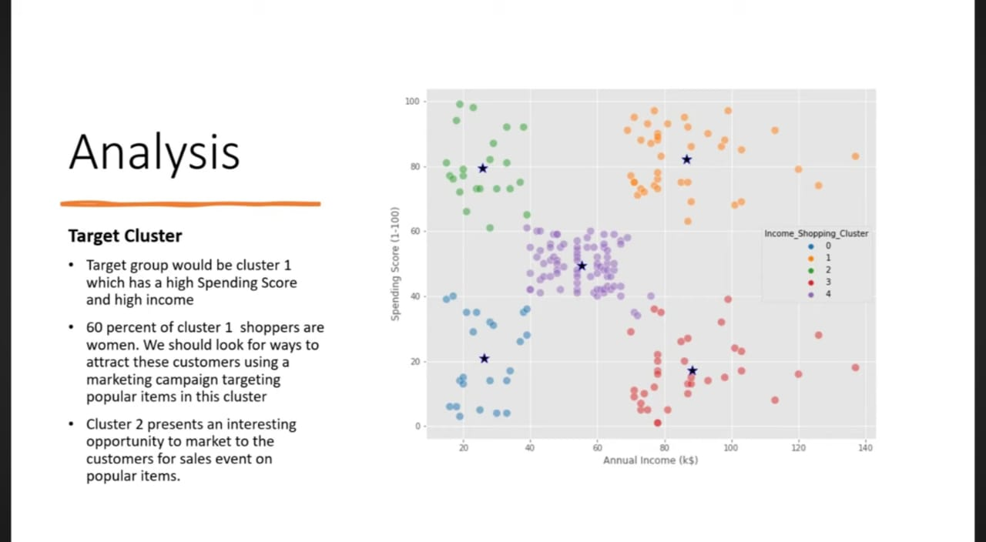

Slide 9
l5. Customer Segmentation Results
The clustering model produced five distinct customer segments, summarized below:
Cluster Profiles
Core Insight
Two clusters offer the strongest marketing opportunities:
Cluster 4: High income + high spending → Most profitable group
Cluster 2: Low income + high spending → Highest engagement potential
Pictures for references – Straight out from analysis on jyupiter notebook :

Slide 10
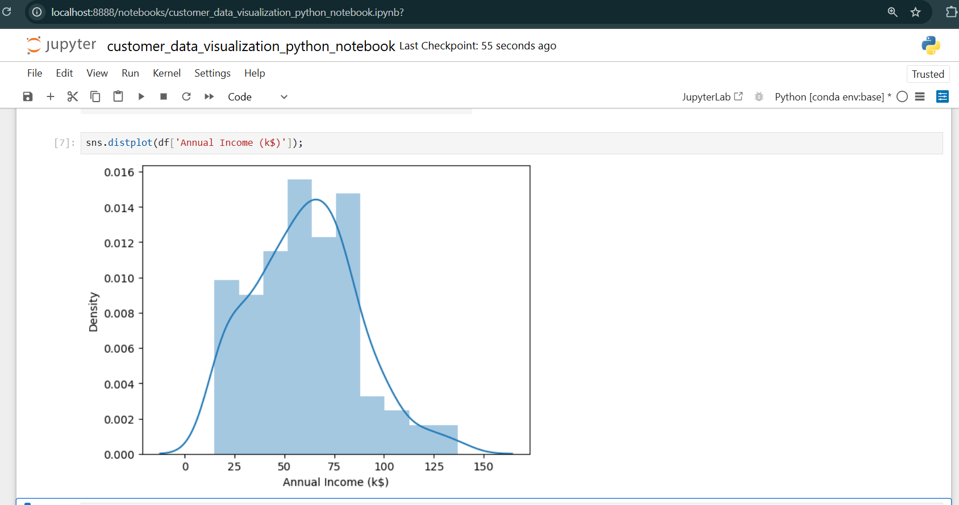

Slide 11
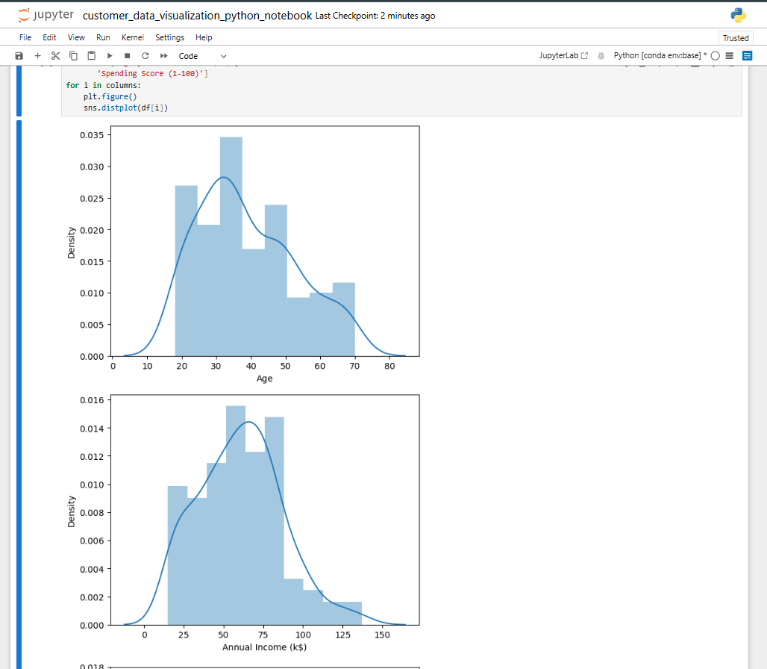

Slide 12
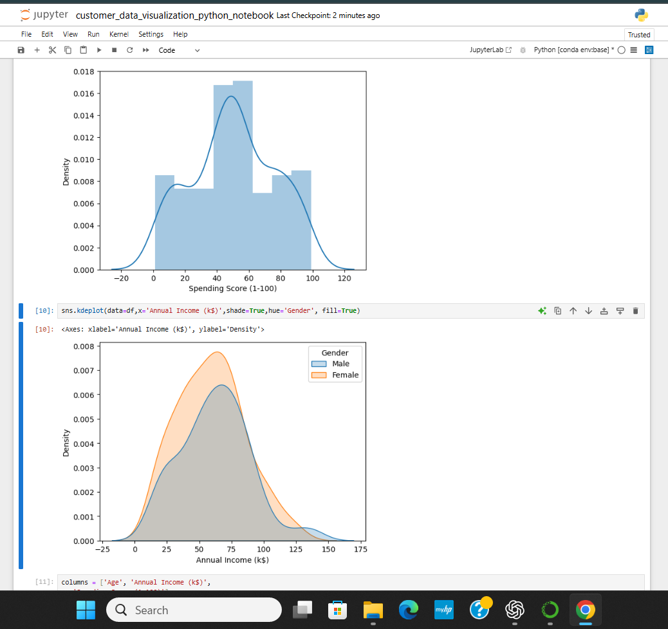

Slide 13
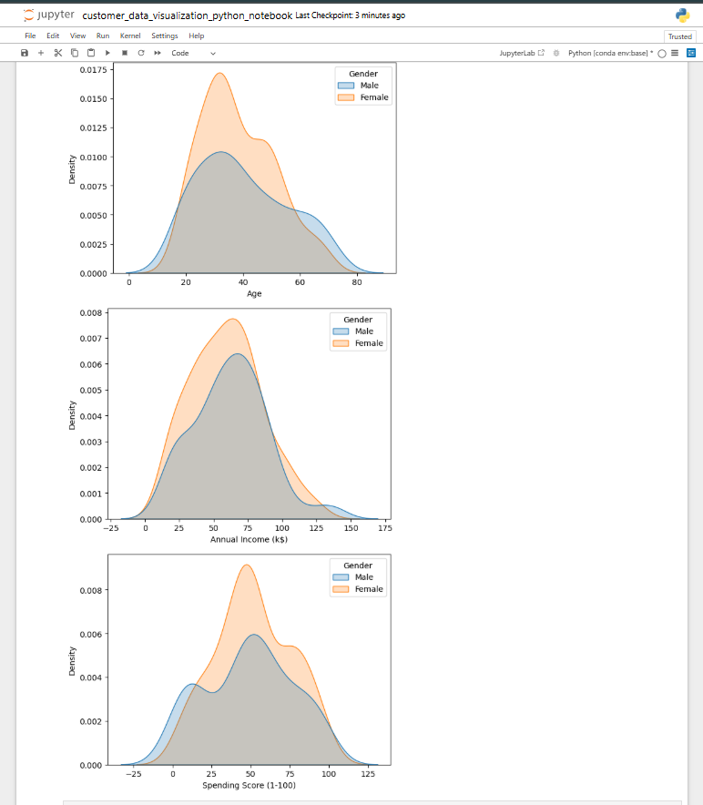

Slide 14
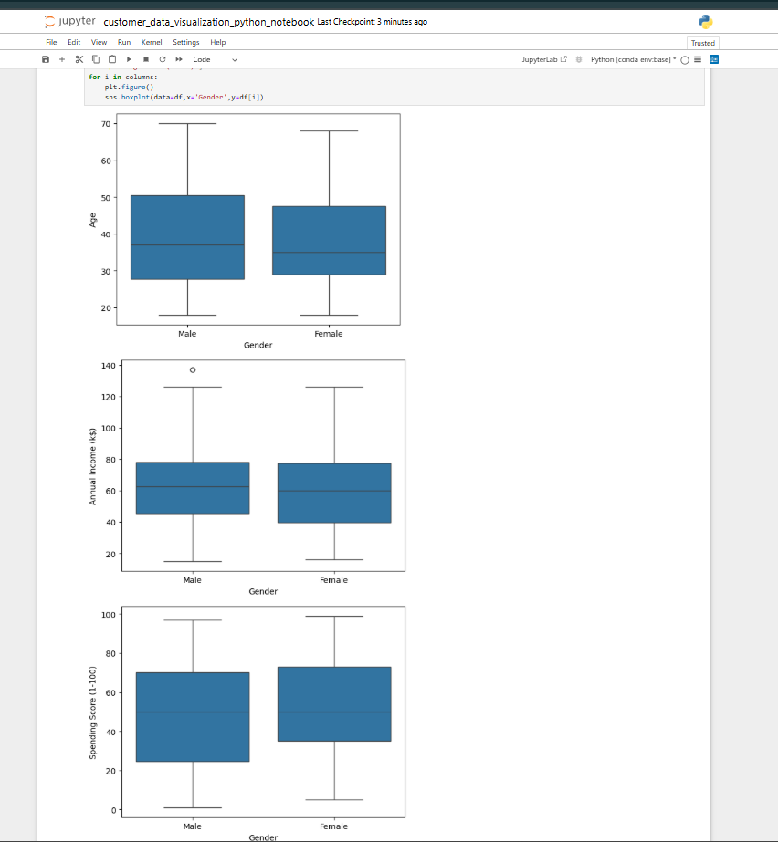

Slide 15
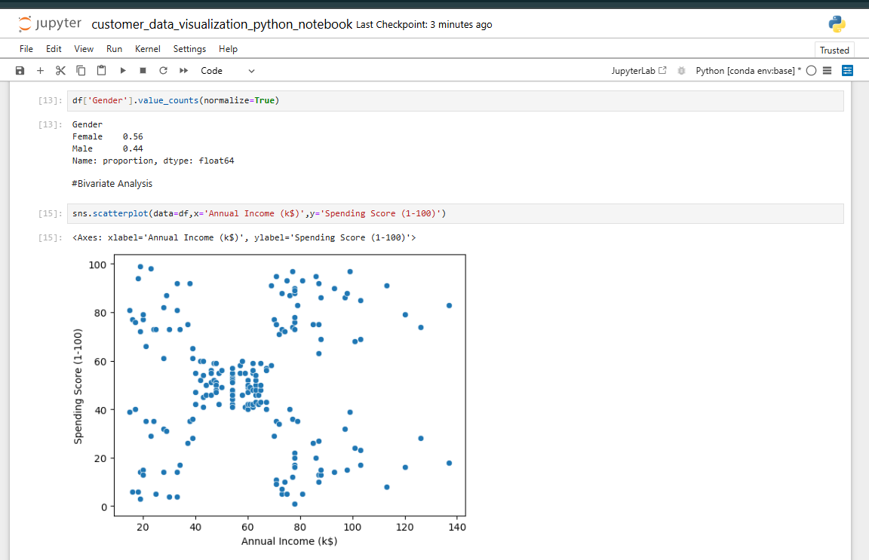

Slide 16
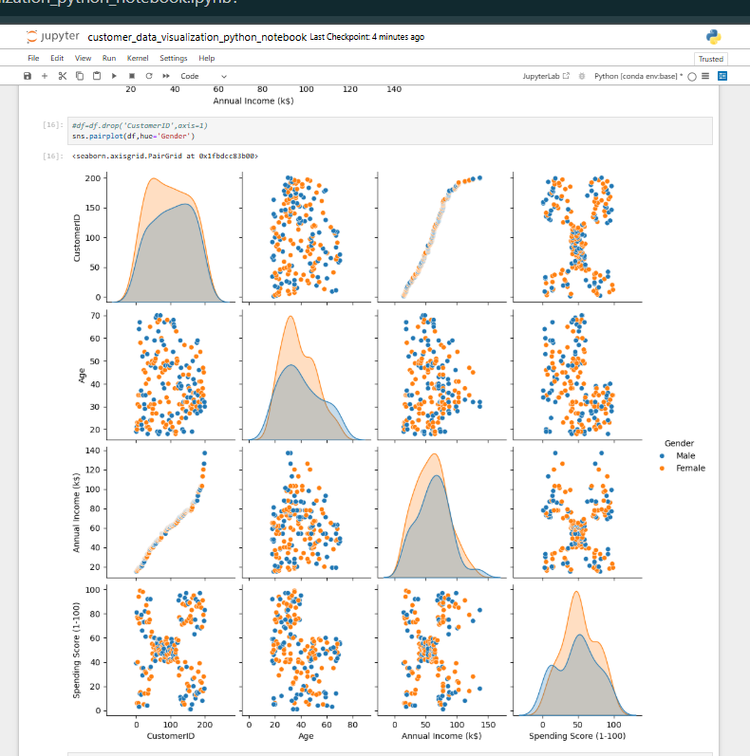

Slide 17
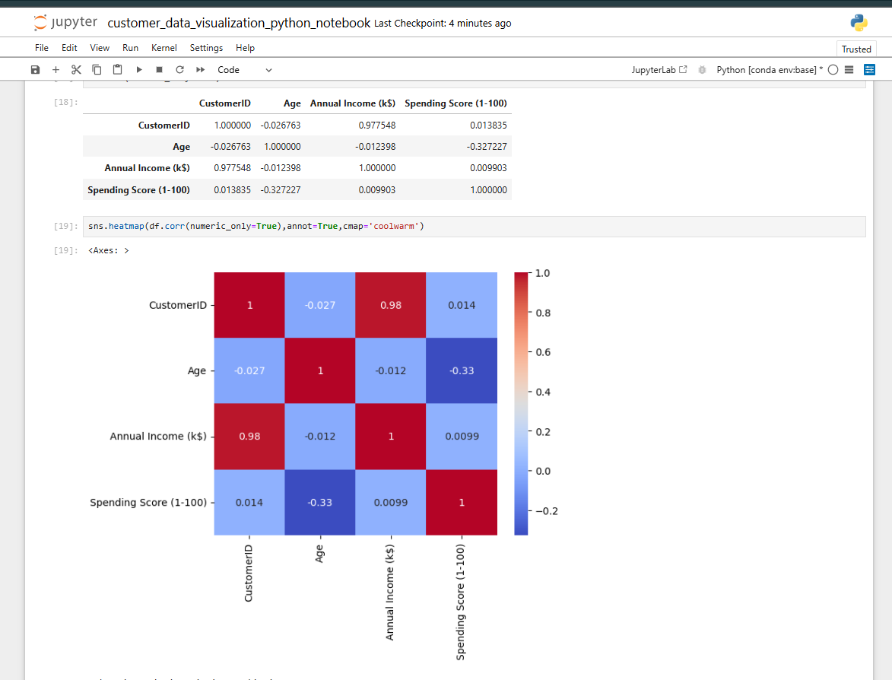

Slide 18
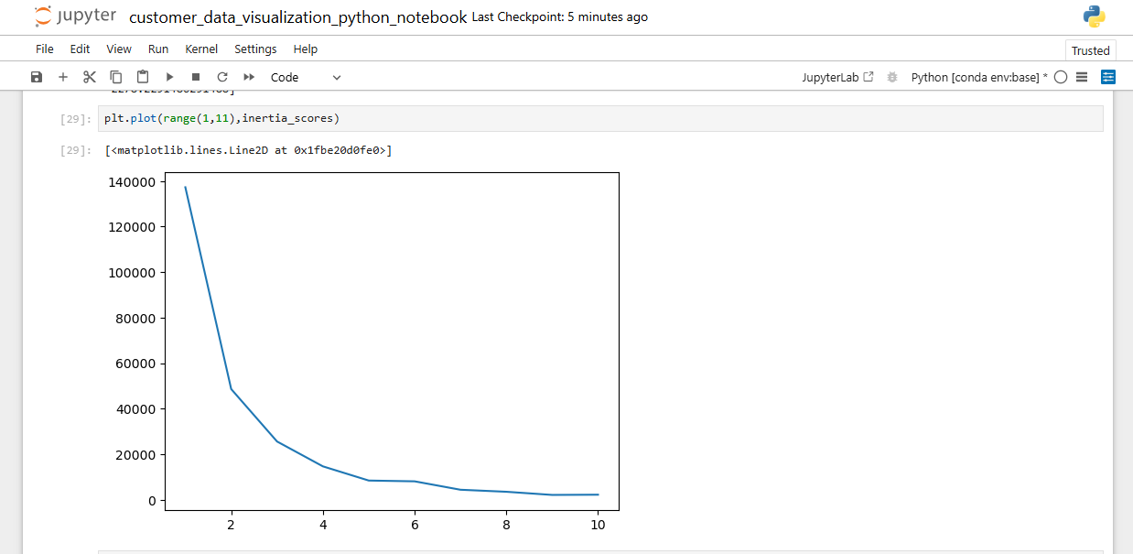

Slide 19
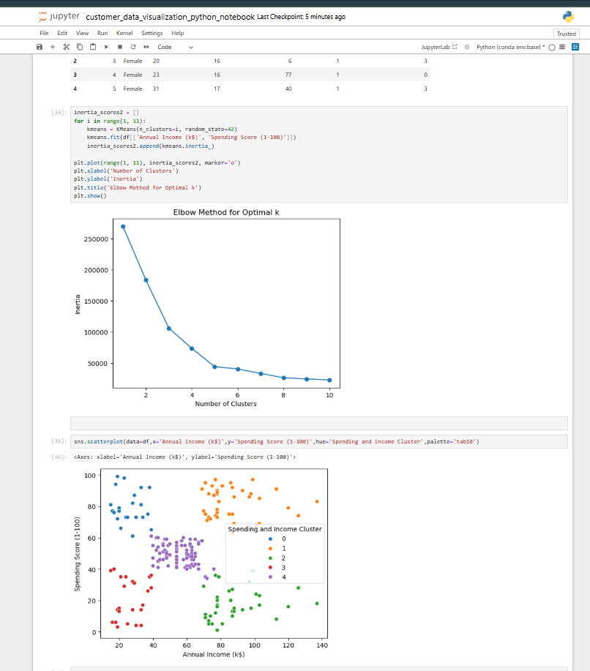

Slide 20
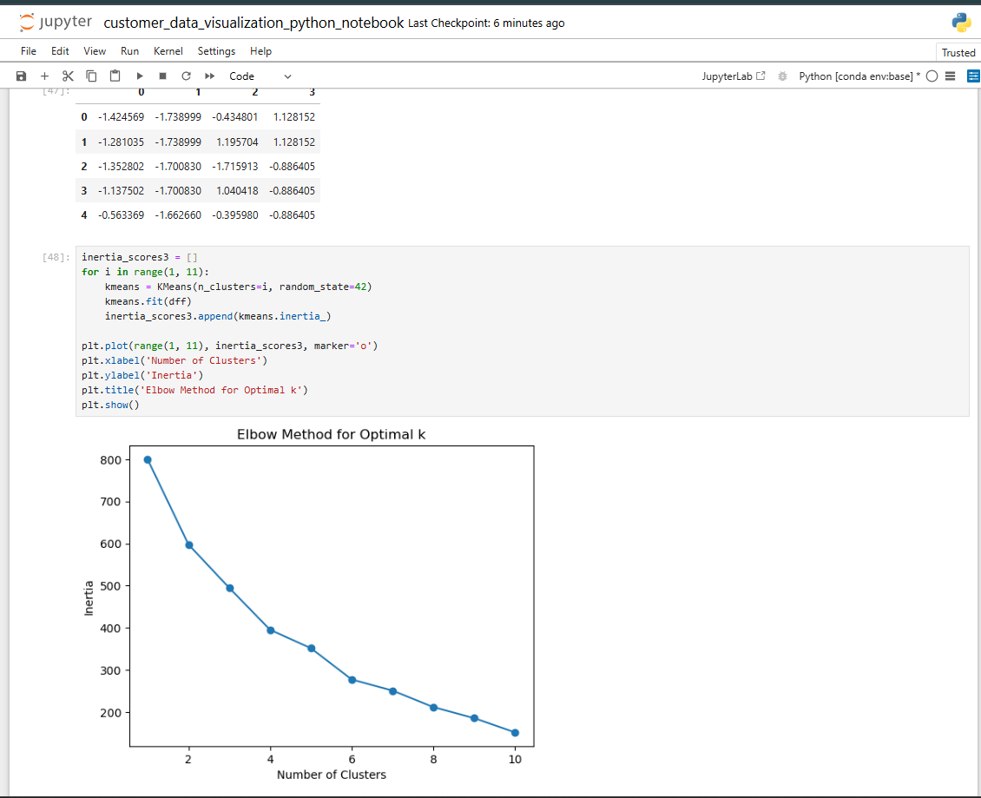

Slide 21
6. Segment-by-Segment Interpretation
Cluster 4 — High Value (The VIPs)
Income: Highest
Spending Score: Highest
Behavior: Purchases premium products regularly
Opportunity: Maximize long-term loyalty
Risk: Expect premium service and quality
Cluster 2 — Targeted Spenders (The Spenders)
Income: Low
Spending Score: Very High
Behavior: Young customers who splurge on trend-driven items
Opportunity: Influencer marketing, flash sales
Risk: Sensitive to promotions and peer influence
Cluster 0 — Standard Segment (The Middle Ground)
Income: Mid-range
Spending Score: Mid-range
Behavior: Consistent and predictable
Opportunity: Upsell into higher-value categories
Cluster 3 — Budget-Conscious (The Cautious)
Income: Low
Spending Score: Low
Behavior: Value-seeking, infrequent shoppers
Opportunity: Essentials, discount-driven marketing
Cluster 1 — Low Engagement (The Savers)
Income: High
Spending Score: Very Low
Behavior: Rarely purchases at the mall
Opportunity: Explore reasons for disengagement
Risk: Money spent in competing stores or online

Slide 22
7. Marketing Strategies — Segment Focus
Cluster 4 — High Value (VIPs)
Goal: Retain and increase loyalty
Strategies:
Exclusive loyalty tiers
Private launch events
Premium services
Personalized offers
Cluster 2 — Targeted Spenders
Goal: Maximize spending through engagement
Strategies:
Trend-based promotions
Influencer-driven ads
Flash sales & limited drops
Flexible payment options
Cluster 0 — Standard Segment
Goal: Improve visit frequency
Strategies:
Weekly deals
Seasonal campaigns
Medium-tier rewards
Additional Segment Strategies
Cluster 3 — Budget-Conscious
Goal: Increase low-ticket purchases
Strategies:
Bulk discounts
Clearance sales
Price-match guarantees
Store-brand essentials
Cluster 1 — Low Engagement
Goal: Reactivate high-income customers
Strategies:
Personalized surveys
Gift card incentives
Premium trial services
Exclusive invitations

Slide 23
8. Conclusion
The K-Means clustering model successfully identified five meaningful customer segments, each with unique characteristics and marketing needs. This segmentation enables the mall to shift from broad, uniform marketing to highly targeted, data-driven strategies.
Key insights:
Cluster 4 (High Value VIPs) delivers the strongest long-term profitability.
Cluster 2 (Targeted Spenders) offers immediate revenue potential through strategic promotions.
Other clusters require balanced marketing efforts to boost conversion and retention.
By implementing cluster-specific marketing strategies, the mall can expect:
Higher marketing ROI
Improved customer satisfaction
Increased purchase frequency
Enhanced revenue across multiple segments
This segmentation framework can be extended and refined further with additional variables such as customer visit frequency, product categories purchased, and online behavior.

Slide 24
Author and Contact :
Shreeganesh Bhat
Data Analyst
Email : shriganeshbhat0@gmail.com
Linkedin : https://www.linkedin.com/in/shreeganesh-bhat-8a8184398?utm_source=share&utm_campaign=share_via&utm_content=profile&utm_medium=android_app
Github :https://github.com/shriganeshbhat0-git

Slide 25
Thank you 💐

