Slide 1

Hotel Booking data Analysis

Slide 2
Hotel Booking Data Analysis Report (2018–2020)
Comprehensive Data Analyst Portfolio Project
Executive Summary
This project delivers a complete end-to-end analytical solution using hotel booking data from 2018 to 2020, answering core business questions related to revenue performance, parking infrastructure planning, and market trends.
Data transformation and querying were performed in Microsoft SQL Server Management Studio (SSMS), and insights were visualized in Power BI using an interactive dashboard.
Key findings include:
Strong revenue growth between 2018 and 2019
Parking utilization consistently 2%–3%, indicating no expansion needed
ADR shows a steady upward trend, supporting profitable pricing
Clear seasonality patterns, beneficial for forecasting
This report provides strategic recommendations in pricing, operations, and forecasting.

Slide 3
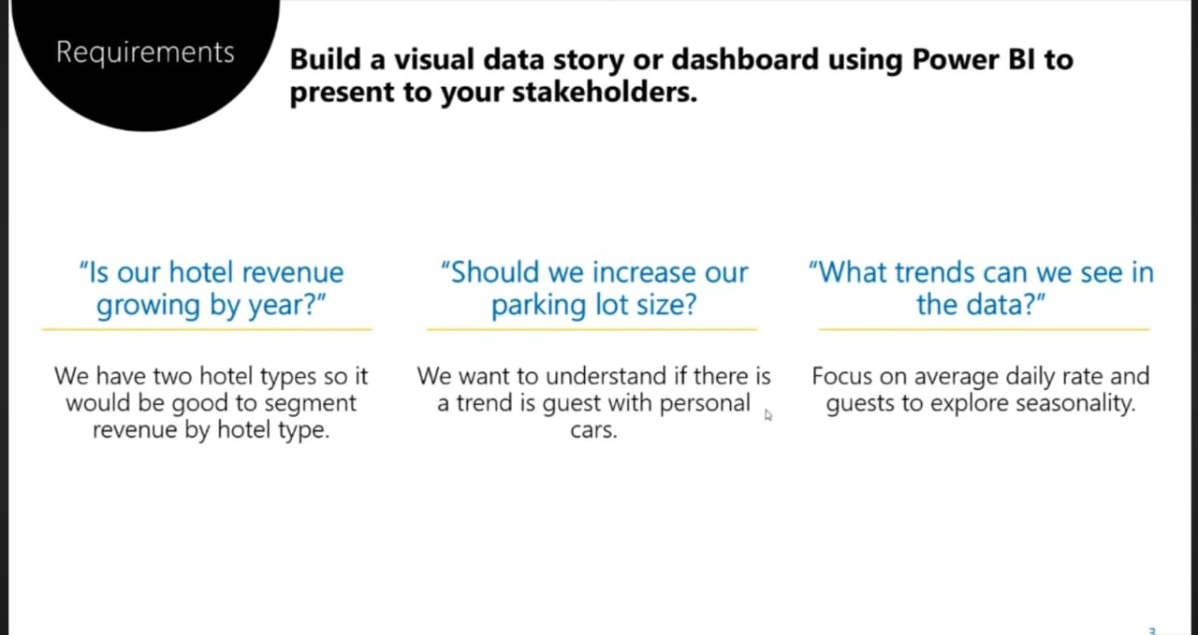

Slide 4
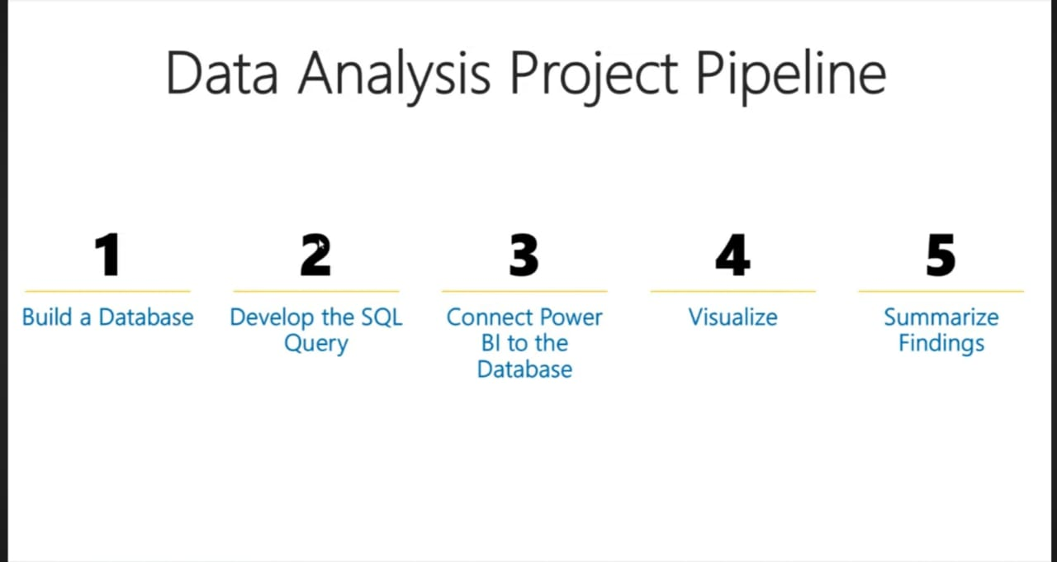

Slide 5
I. Project Scope, Objectives & Technical Execution
A. Project Objectives
Financial Performance
Measure and segment revenue by hotel type (City Hotel vs. Resort Hotel).
Infrastructure Planning
Assess the need to expand parking capacity.
Operational & Market Dynamics
Understand ADR trends and seasonality for strategic decisions.
B. Technical Pipeline & Achievements
1. SQL Database Engineering
Built project database in SSMS.
Imported raw datasets (2018–2020 bookings, meal_cost, market_segment).
Standardized data types across tables.
2. Consolidation & Structuring
Combined three years using UNION ALL (≈100k rows).
Created CTE (hotels) for unified analytical structure.
Joined:
  market_segment → discount percentage
  meals_cost → meal attributes
3. Accurate Revenue Metric
Correct Formula:
Total Room Nights = Stays in Week Nights + Stays in Weekends
Total Revenue = Σ (Total Room Nights × ADR × (1 − Discount%))
Calculated in Power BI for accuracy.
4. Power BI Dashboard
Slicers for date, hotel type, and segment
Revenue segmentation visuals
Parking trend line charts
ADR trend lines
Seasonality graphs

Slide 6
II. Analytical Findings & Business Insights
A. Revenue Performance
Yearly Revenue Summary
2018
→ ~$4M baseline revenue
2019
→ ~$20M, nearly 5x growth
2020
→ ~$14M (incomplete dataset; exclude from YoY comparisons)
Insights
Strong growth from 2018–2019 shows high pre-pandemic momentum.
City Hotel contributes the majority of total revenue.
Resort Hotel also grows but to a smaller scale.
2020 data cannot be considered for forecasting.
Interpretation
→ City Hotel is the primary revenue engine
→ Use 2018–2019 as the benchmark for performance forecasting

Slide 7
B. Parking Infrastructure Assessment
Utilization Rate = 2%–3% consistently
Findings
No increasing trend across three years
City Hotel guests rely more on taxis
Resort guests use slightly more car space but still too low
No seasonal spikes or demand surges
Conclusion
→ Parking expansion is NOT required.
→ Demand does not justify investment.

Slide 8
C. ADR & Market Trends
1. ADR Trend
Consistently increasing YoY
Indicates successful pricing and strong demand
2. Seasonality
Resort: peaks in summer
City Hotel: peaks in Q3 business season
Dips during monsoon & early Q1
3. Segment Profitability
High-discount OTA segments reduce ADR
Direct bookings & corporate segments deliver higher margins

Slide 9
III. Strategic Recommendations
A. Revenue Optimization
Increase ADR during peak seasons
Promote themed packages during low-demand months
Prioritize high-margin segments
  Direct bookings
  Corporate clients
Reduce dependency on OTA discounts
B. Operational Strategy
Invest more in City Hotel
  Strongest and most stable revenue base
Enhance Resort Hotel experiential offerings
  Family packages
  Seasonal getaway bundles
C. Do not expand parking
Convert unused parking areas into:
  EV charging stations
  Outdoor café
  Event hosting zone
  Valet drop space

Slide 10
D. Forecasting & Analytical Roadmap
Use 2018–2019 as the clean forecasting base
Build a monthly demand forecasting model
Perform ADR sensitivity testing
Run segment profitability analysis to identify weak-performing discount groups
DashBoard of the Hotel data Analysis :

Slide 11
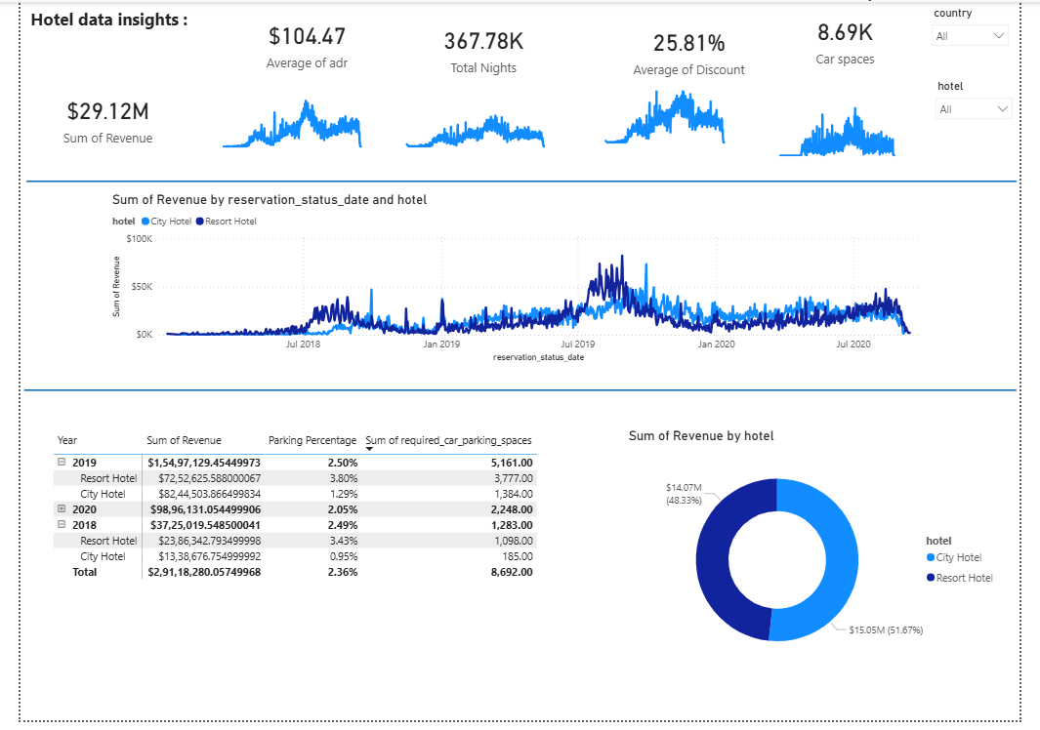

Slide 12
Conclusion :
This project gave me the opportunity to build a complete end-to-end analytics workflow — starting from raw Excel files and progressing through SQL-based data engineering, automated metric calculation, and interactive dashboard development in Power BI. Through this process, I was able to extract meaningful insights that directly support hotel business decision-making.
From my analysis, I found clear revenue patterns between hotel types, a reliable assessment of parking space utilization, and strong signals around ADR trends and seasonality. These insights helped me understand how operational data translates into strategic decisions such as pricing, infrastructure investment, and segment targeting.
Beyond the business findings, this project also strengthened several of my core data skills. I learned how to design a structured SQL pipeline, build reproducible CTE-based transformations, apply realistic revenue calculations using discount logic, and translate raw metrics into an executive-level dashboard. It also improved my ability to interpret trends, validate assumptions, and present insights in a format that supports real-world decision-making.
Overall, this work demonstrates my ability to handle the full spectrum of a data analytics project — from cleaning and modeling to visualization and strategic recommendations — while ensuring that every insight is grounded in data, clarity, and business value.

Slide 13
Author & Contact :
Shreeganesh Bhat
Linkedin - https://www.linkedin.com/in/shreeganesh-bhat-8a8184398?utm_source=share&utm_campaign=share_via&utm_content=profile&utm_medium=android_app
Github –
https://github.com/shriganeshbhat0-git

Slide 14
Thank You 💐

