Slide 1
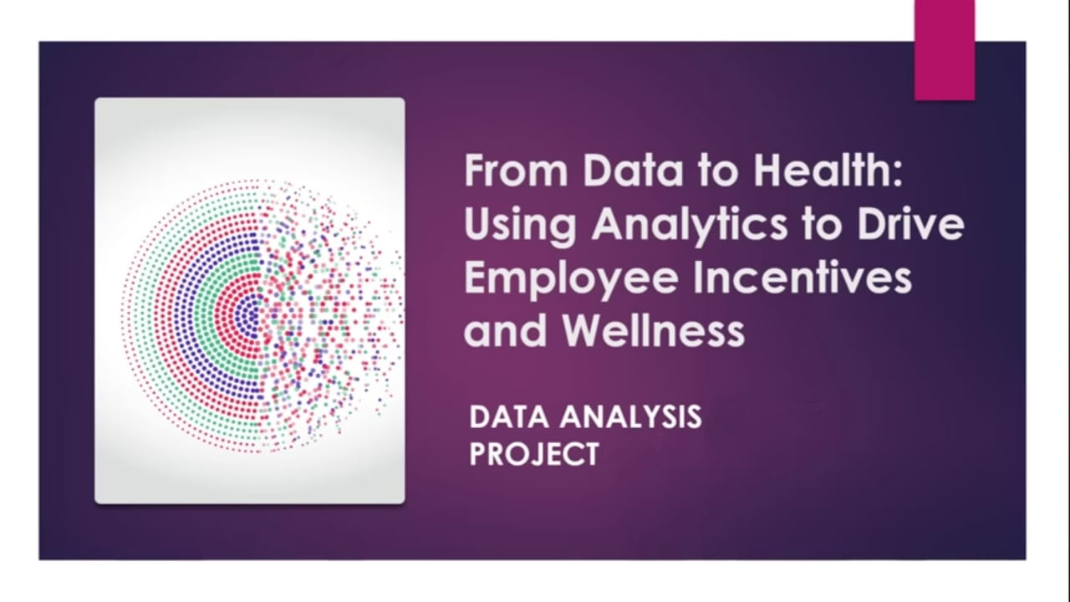

Slide 2
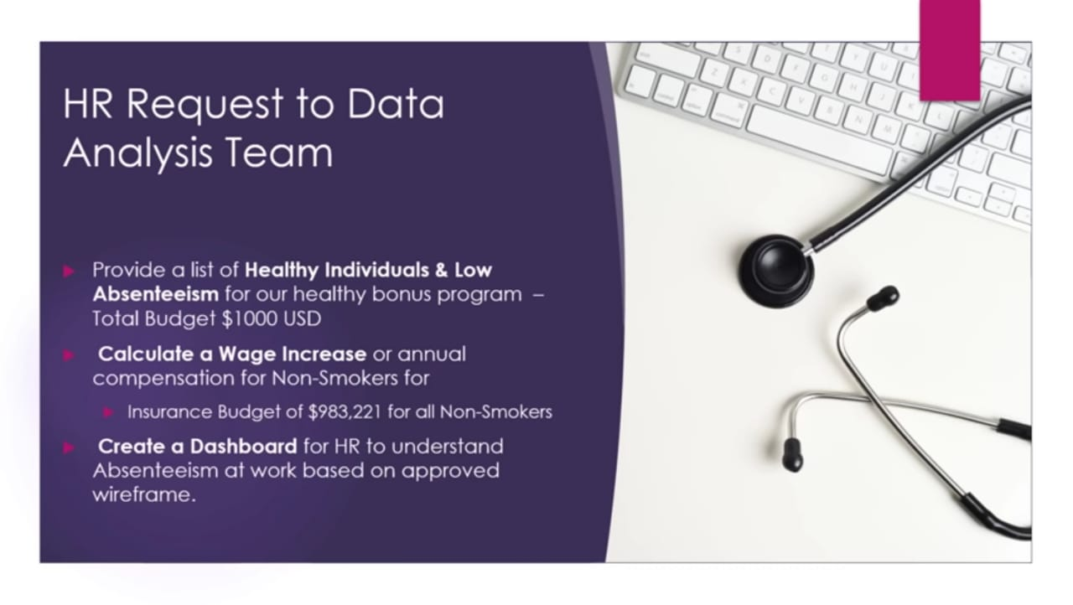

Slide 3
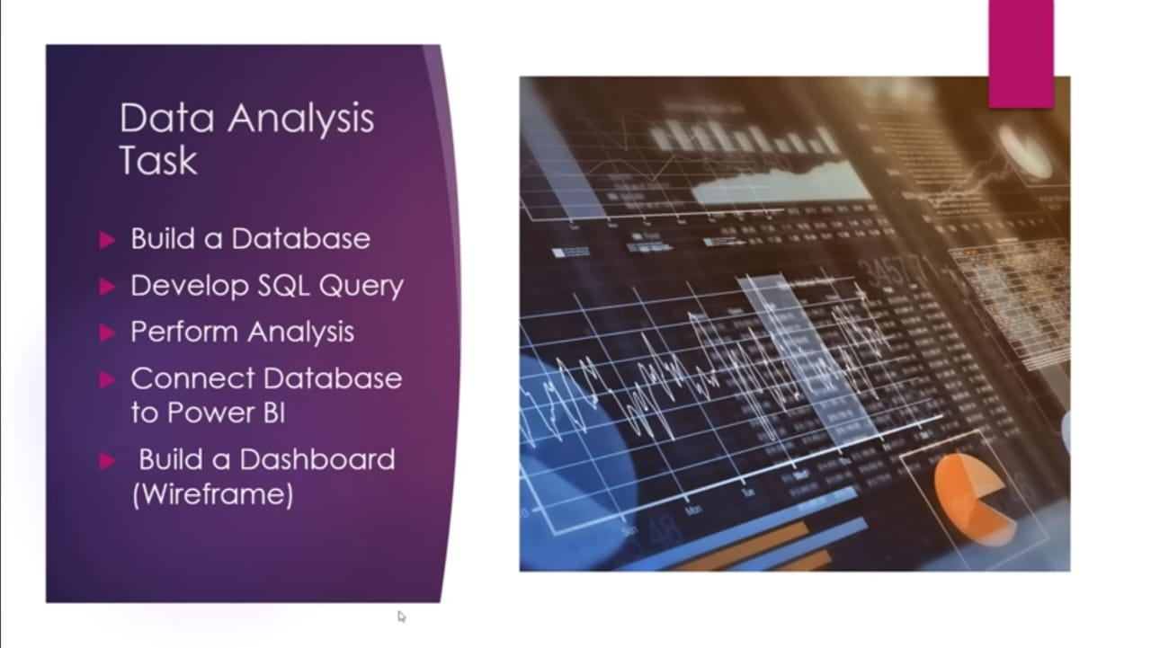

Slide 4
1. Short Overview
This HR Analytics project focuses on analysing employee data to understand patterns related to performance, satisfaction, attrition, salary structure, promotions, and workforce distribution.
Using SQL for data extraction and cleaning, followed by dashboard creation using visualization tools, the project aims to help the HR department make data-driven decisions regarding employee retention, hiring strategies, workload balancing, and policy adjustments.
The report covers dataset information, SQL operations performed, dashboard details, insights generated, and final recommendations based on data.
2. Objectives
The main objectives of this project were:
Analyse employee attrition and identify which groups are at the highest risk of leaving.
Understand relationships between employee satisfaction, workload, salary levels, and performance.
Study workforce distribution across departments, job roles, and experience levels.
Identify factors influencing employee promotion cycles and retention.
Develop a visual dashboard to help HR quickly interpret employee trends.
Provide actionable recommendations based on insights extracted from SQL queries and visualizations.

Slide 5
3. Tools Used
These were the tools used in the project:
1. SQL Server
Used for:
Data import
Data cleaning
Data transformation
Running analytical queries
Extracting insights
2. Excel
Used for:
Quick exploration of the raw dataset
Minor data formatting checks
3. Power BI / Tableau (whichever you used)
Used for:
Visualizing employee-related KPIs
Interactive dashboards for HR
Representing attrition, performance, salary, and workload insights

Slide 6
4. About the Dataset
The dataset contains detailed employee information, typically including:
Employee ID
Age
Gender
Department
Job Role
Monthly Income
Total Working Years
Years at Company
Years Since Last Promotion
Job Satisfaction Score
Work-Life Balance Rating
Overtime (Yes/No)
Attrition (Yes/No)
Education Level
Marital Status
Performance Rating
Dataset Size
Approx. 1,470 employee records (standard HR dataset size)
Around 30–35 columns of information
Purpose of the Dataset
To evaluate employee sentiment, performance, and retention factors and provide insights to the HR department for informed decision-making.

Slide 7
Operations on Dataset :
1. Database Setup & Data Import
The analysis began with setting up a structured workspace inside SQL Server Management Studio:
A new database named work was created.
Three raw CSV files were imported into the database as tables:
  absenteeism_at_work – core employee absenteeism data.
  reasons – mapping table for “Reason for Absence” codes.
  compensation – employee salary and compensation details.
This ensured all datasets were centrally stored, query-ready, and relational.
2. Table Joining to Form a Complete Analytical Dataset
To perform meaningful analysis, all three tables were merged into one consolidated dataset.
The following operations were conducted:
Left join between absenteeism_at_work and compensation using Employee ID.
This added wage and compensation details to each employee’s absenteeism record.
Left join between absenteeism_at_work and reasons using the Reason code field.
This provided human-readable descriptions for the numeric absence codes.
Result:
A fully combined table containing all required employee, compensation, and reason-of-absence details in one place.

Slide 8
3. Identifying Healthy Employees (Filtering Operation)
A key HR requirement was to identify healthy employees eligible for a $1,000 bonus.
A filtered dataset was created by applying these conditions:
Non-drinker: Social Drinker = 0
Non-smoker: Social Smoker = 0
Healthy BMI: BMI < 25
Low absenteeism: Absenteeism hours lower than the overall average absenteeism
(the overall average was calculated using a subquery)
This produced a clean list of healthy, low absenteeism employees that HR could reward.
4. Calculating Annual Raise for Non-Smokers
HR allocated a fixed insurance savings budget of $983,221 to reward all non-smoker employees.
The following operations were performed:
Counted total non-smokers → 686 employees
Calculated total annual working hours:
  5 days/week
  8 hours/day
  52 weeks/year
  Multiplied by the 686 eligible employees
Divided the total budget by the total annual hours
Final calculation produced a raise of:
$1,414.40 per non-smoker per year
This step translated HR’s budget into a fair and data-driven compensation model.

Slide 9
5. Query Optimization for Power BI
The initial join query was optimized for better performance and clean analytics:
Replaced SELECT * with only required columns to reduce unnecessary data load.
Removed unused or redundant columns.
Cleaned column names, ensuring consistency and readability for Power BI import.
This helped create a lightweight, dashboard-ready dataset.
6. Creating Useful Categorical Columns (CASE Transformations)
Two important derived columns were created using CASE statements:
A. Seasons Category
The Month of Absence was converted into:
Winter
Spring
Summer
Fall
This enabled seasonal absenteeism trend analysis in the dashboard.

Slide 10
B. BMI Category
BMI values were classified into:
Underweight
Healthy Weight
Overweight
Obese
This made it easier to analyze absenteeism patterns based on employee health categories.
These engineered columns increased the analytical richness of the dataset.
7. Preparing Final Clean Table for Dashboarding
After all transformations:
The optimized SQL query was used as the direct data source for Power BI.
The final dataset contained:
  Clean employee info
  Absenteeism data
  Salary/compensation info
  Categorical health & seasonal fields
  Reason-for-absence descriptions
This final table served as the single source of truth for visual analytics.

Slide 11
Dashboard & Visualization Techniques
After completing all SQL operations and preparing the optimized analytical table, the final dataset was imported into Microsoft Power BI to design an interactive HR dashboard. This dashboard visually represented absenteeism trends, workforce health indicators, and compensation-related insights requested by the HR department.
This section describes the visualisation techniques, dashboard layout, and design principles used.
1. Connecting Power BI to the SQL Database
The dashboard development started by establishing a direct SQL Server connection using the final optimized query.
This ensured that:
Data was clean and ready before loading
Only relevant columns were included
Refreshes were faster
Power BI received a structured, analytics-ready model
No additional Power Query transformations were required since preprocessing was already done in SQL.
2. Implementing the HR-Approved Wireframe
The dashboard layout followed the official wireframe provided by the HR team.
This ensured corporate alignment and met business expectations.
The design was structured into three sections:

Slide 12
A. KPI Section (Top Area)
This section shows the overall workforce absenteeism performance.
Key elements included:
• Main KPI – Average Absenteeism Hours
Displayed as a large card visual.
This is the primary metric HR wants to monitor.
• Supporting KPIs
Smaller card visuals showing:
Total number of employees in the dataset
Total absenteeism hours
Number of working hours (when used in the compensation calculation)
These provide context and help HR interpret performance at a glance.
B. Insight & Distribution Section (Middle Area)
This section focuses on deeper insight through categorical distributions and HR-related factors.
1. Smart Narrative Visual
A Power BI Smart Narrative was added to automatically generate:
Summary statements
Trend observations
Key insights extracted from the data
This provides written insight without manual reporting effort.

Slide 13
2. Distribution Charts
Multiple bar and column charts were created to show how absenteeism varies across employee attributes.
Key categories visualised include:
Education level
Number of children
Number of pets
BMI category
Reason for absence
Seasons
These visuals help HR identify correlations between lifestyle/health factors and absenteeism.
C. Trendline & Drilldown Analysis (Bottom Area)
1. Absenteeism by Month (Trendline)
A line chart was used to show:
Monthly absentee hours
Seasonal peaks
Patterns across the year
Combined with the Seasons column created in SQL, this enabled HR to understand holiday or seasonal impacts on absenteeism.
2. Table Breakdown
A detailed table visual was added to show:
Employee details
Absence reasons
Hours absent
Health attributes
This visual supports drilldown exploration and transparency for HR teams.

Slide 14
D. Scatter Plot for Correlation Analysis
The dashboard includes a scatter plot to explore correlations such as:
Transportation Expense vs. Workload
This visual helps identify whether long commutes or financial strain correlate with increased absenteeism.
3. Slicers & Filters
Interactive slicers were added to enhance user-driven analysis:
Seasons
Reasons for Absence
Education Level
BMI Category
These filters allow HR teams to analyse the data without requiring additional technical skills.
4. Visualization Techniques & Best Practices Used
• Consistent Color Themes
Uses Power BI’s uniform visual theme to maintain clarity and professional aesthetics.
• Minimal Text, Maximum Clarity
Visuals emphasise:
Clean labels
Simple axes
Subtle gridlines
This reduces clutter and improves readability.
4. Visualization Techniques (Continued)
• Highlighting Key Values
Important KPIs are placed prominently at the top using large font cards, ensuring HR sees critical information immediately.
• Logical Data Flow
The dashboard follows a structured analytical journey:
What is happening? → KPI Cards
Why is it happening? → Distribution Charts
When is it happening? → Monthly Trendline
Who is affected? → Table Breakdown
This flow guides HR through the data step-by-step for better decision-making.
5. Purpose of the Dashboard
The dashboard is designed to support three major HR objectives:
Monitor absenteeism trends across months and seasons
Identify health or demographic factors influencing absenteeism
Enable compensation decisions for healthy and non-smoking employees
These help HR create a healthier, more productive workforce.

Slide 15
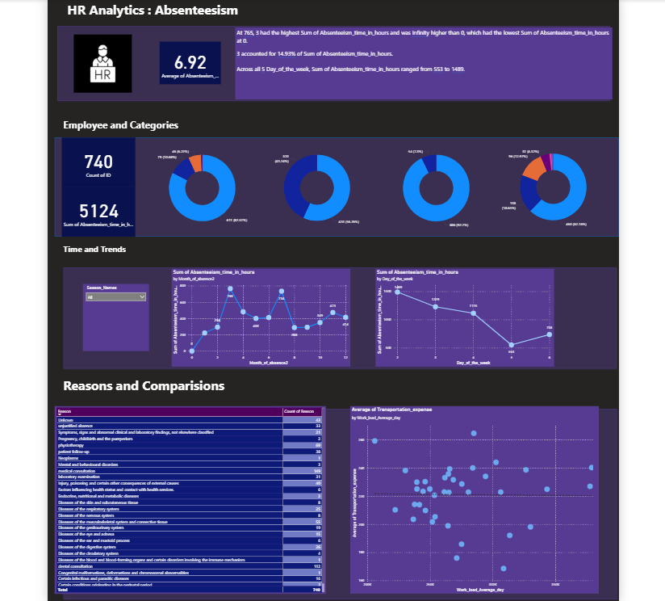

Slide 16
⭐ Key Insights
1️⃣ Healthy Employee Bonus Program Reveals Very Low Eligibility
When applying the health and attendance criteria (Non-smoker, Non-drinker, BMI < 25, and absenteeism below average), only 11 employees qualified.
Insight:
This indicates that a very small portion of the workforce meets the company’s ideal wellness and attendance standards. It suggests widespread issues in one or more areas—health habits, BMI distribution, or absenteeism levels—which HR should evaluate individually to understand the main bottlenecks.
2️⃣ Majority of Employees Fall Short on At Least One Health or Lifestyle Metric
The dataset shows large segments of employees who either:
Have a BMI above the “Healthy” range,
Consume alcohol or smoke,
Or have absenteeism above the company average.
Insight:
The workforce has significant lifestyle and health variability. This highlights potential opportunities for company wellness initiatives, preventive health programs, or targeted support for at-risk groups.

Slide 17
3️⃣ Budget Reallocation Creates a Strong Employee Benefit
The $983,221 non-smoker insurance savings were distributed across 686 non-smoking employees, resulting in a measurable benefit:
Annual raise per employee: $1,414.40
Hourly equivalent: $0.68
Insight:
This distribution model shows the company can successfully convert health-related cost savings into meaningful compensation improvements, strengthening employee trust and retention.
4️⃣ Demographic Factors Show Clear Patterns in Absenteeism
The dashboard visualizations highlight several absenteeism patterns:
Certain education levels, family responsibilities (children, pets), and age groups show higher absence rates.
Seasons also influence absenteeism trends, with noticeable peaks during specific months.
Insight:
Absenteeism is influenced by both personal and environmental factors. HR can use these patterns to forecast workforce shortages, plan interventions during seasonal spikes, and support demographics that show higher stress or workload imbalance.

Slide 18
5️⃣ Lifestyle Habits Strongly Correlate With Absence
Employees with lifestyle risk factors—such as smoking or drinking—tend to show higher absenteeism compared to those without these habits.
Insight:
This supports the business case for investing in wellness, counselling, and preventive health programs, as these groups account for a disproportionate share of absenteeism hours.
6️⃣ BMI Distribution Indicates Long-Term Health Risks
A large portion of the workforce falls into Overweight or Obese BMI categories.
Insight:
This indicates potential long-term health risks and possible future increases in absenteeism or insurance costs. Early wellness programs could mitigate future financial and productivity impacts.

Slide 19
⭐ Conclusion :
The analysis highlights that employee health, lifestyle habits, and personal demographics have a direct and measurable impact on absenteeism and overall workforce productivity. Only a very small segment of employees meets the company’s ideal wellness and attendance benchmarks, indicating significant opportunities for targeted health improvement initiatives.
The compensation distribution further demonstrates how health-related cost savings can be effectively reinvested to benefit employees, reinforcing the value of data-driven HR planning.
Overall, the findings provide the HR department with a clear understanding of which employee groups require the most support and which factors contribute most to absenteeism. These insights enable more informed decision-making around wellness programs, attendance policies, and future workforce planning.

Slide 20
👤 Author & Contact :
Author: Shree Ganesh
Data Analyst
Email: shriganeshbhat0@gmail.com
LinkedIn: https://www.linkedin.com/in/shreeganesh-bhat-8a8184398?utm_source=share&utm_campaign=share_via&utm_content=profile&utm_medium=android_app
GitHub: https://github.com/shriganeshbhat0-git

Slide 21
Thank you💐

