Slide 1
SOIL TESTING AND ANALYSIS KIT
TEAM MEMBERS
SHRIHARI KULKARNI | KSHITIJ DHAKE | ADITYA CHOUDHARY |
PICT, PUNE- 43

Slide 2
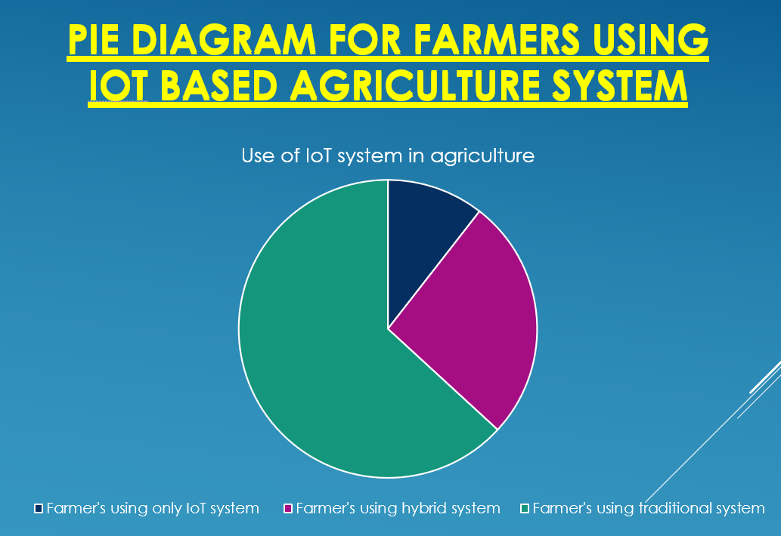
PIE DIAGRAM

Slide 3
Methodology
Step 1
To get values from sensor by inserting them in their respective places.
Step 2
Process the values and send them on farmers phone and on L.C.D
Step 3
According to values sensed by the sensor's suitable crops can be cultivated.
Step 4
During irrigation, according to moisture level of soil sensed by moisture sensor crops will be watered.
Notes:
List all of the steps used in completing your experiment.
Remember to number your steps.

Slide 4
RESULTS :
Result of test conducted on soil of potted plants
Available at home:
Results of on the spot test conducted in grapes farm
Conducted at NRCG.
Date | Pot | Moisture Level | pH +-0.2 | EC | ppm | Temperature
14/04/23 | P1 | 60% | 6.90 | 4.52 | 73.4 | 28°C
 | P2 | 65% | 7.16 | 4.81 | 75.2
16/04/23 | P1 | 70% | 7.20 | 5.32 | 76.1 | 25°C
 | P2 | 68% | 6.78 | 4.38 | 63.7
17/04/23 | P1 | 91% | 6.8 | 4.49 | 64.3 | 27.23°C
 | P2 | 95% | 7.24 | 5.77 | 79.5
SR.NO. | SAMPLE NAME | pH | EC (mS/cm) | Ppm
 |  | +- 0.2 | +- 0.1 | 0.019
1 | T1R1 | 7.53 | 4.94 | 56.4
2 | T1R2 | 7.8 | 3.92 | 66.5
3 | T2R1 | 6.88 | 4.49 | 72.1
4 | T2R2 | 7.25 | 5.77 | 63.3
5 | T3R1 | 7.57 | 4.11 | 66.5
6 | T3R2 | 7.6 | 4.95 | 55.5
7 | T4R1 | 7.75 | 4.55 | 59.6
8 | T4R2 | 7.33 | 5.40 | 63.3
T1, T2, T3, T4 – Four different places in the farm.

Slide 5
Observations
The Soil Test Result is completed by showing the Values collected by sensors which have an average range from, for pH 6.45 - 7.85, EC (Electrical Conductivity) 3.06 - 6.80, ppm 20.0 - 80.0, Humidity 40% - 69%. These values are based on the test conducted to know moderate condition in which crops can grow well.
Average value of pH, EC, ppm, moisture level, temperature and humidity at which the condition of soil i.e. concentration of micro and macro nutrients, rate of Nitrogen fixation, etc. are perfect, recpectively are 7.45, 4.76, 62.9, 75%, 53%, 28 °C.
Observation is based on the data collected from tests conducted.

Slide 6
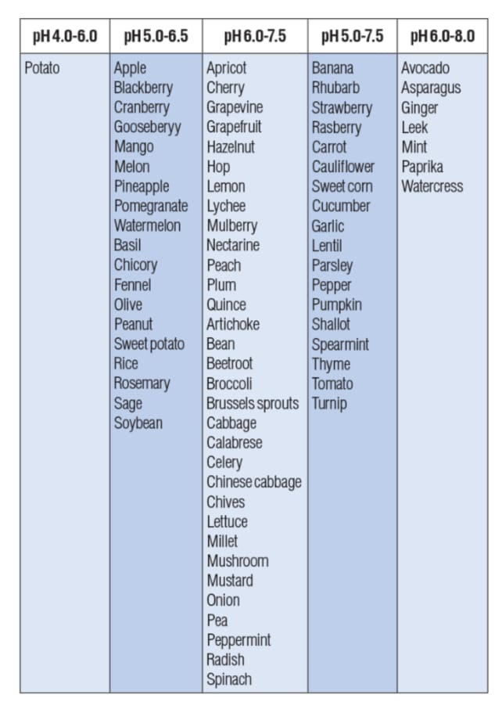
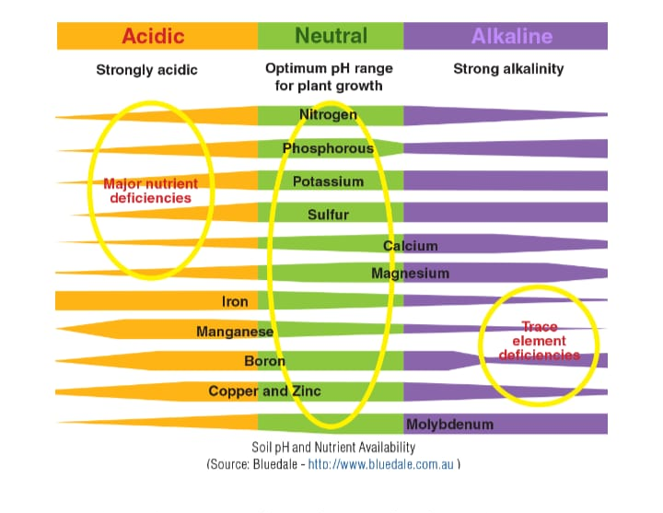

Slide 7
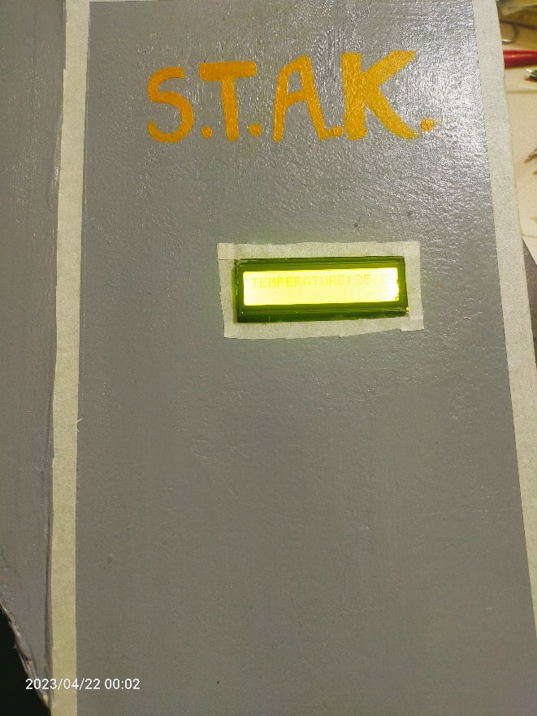
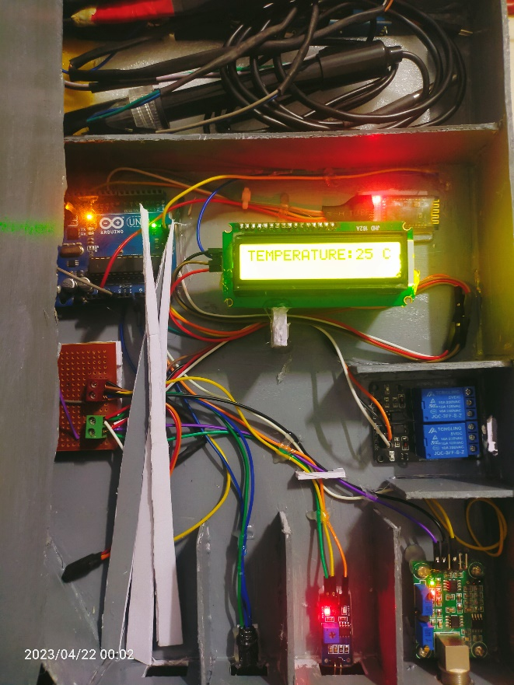
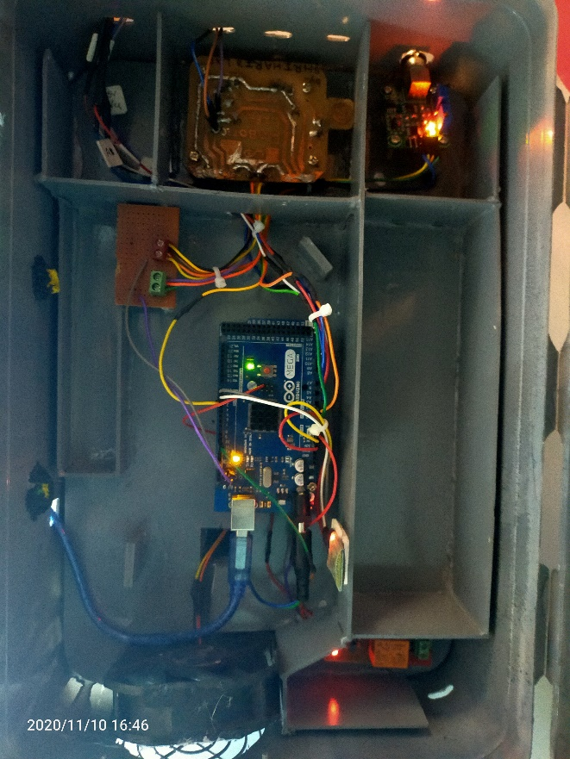
Conclusion
Taking into consideration the results obtained for tests conducted it can be concluded that, every inch of the farm land is vital to maximize crop production. To ideally use with every inch of the farmland accordingly, the use of sustainable IoT based Sensors and Communication technology for SOIL TESTING is not optional, but has become a necessity.

Slide 8
THANK YOU

