Slide 1
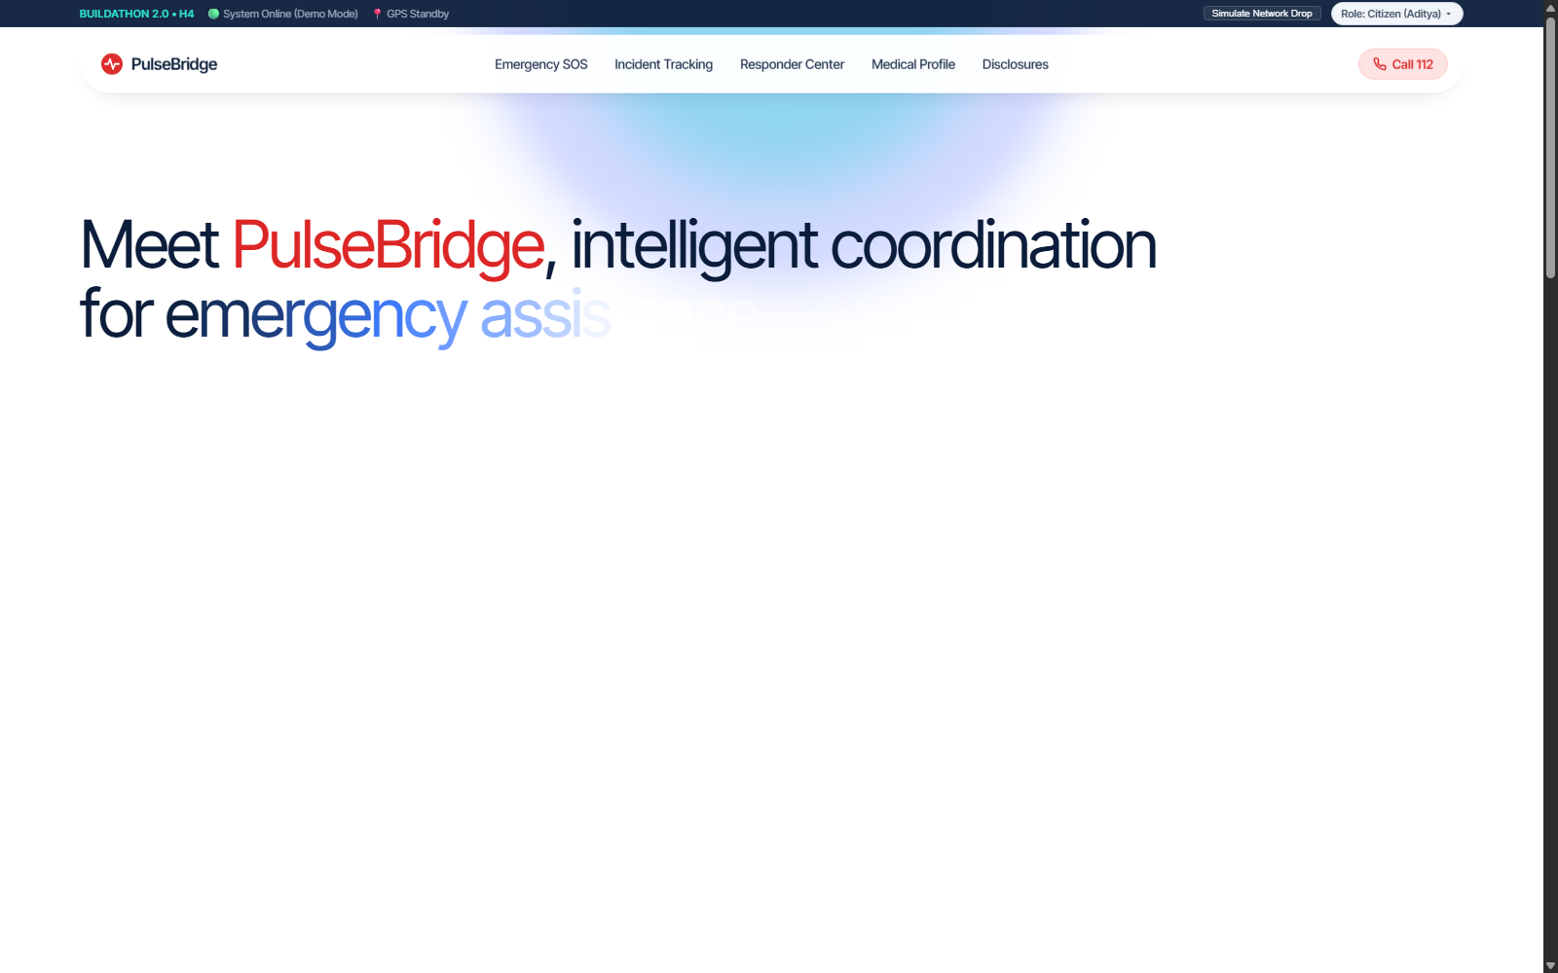
BUILDATHON 2.0 | KNEW-2K26 | PROBLEM H4: EMERGENCY HEALTH ASSISTANCE
PulseBridge
Emergency Response & Coordination Platform
Connecting emergency reporting, incident tracking, and tactical responder coordination.
PROJECT & TEAM DETAILS (EDITABLE PLACEHOLDERS)
* Team Name: [Your Team Name / Team ID]
* Presenters: [Lead Presenter, Member 2, Member 3]
* Institution: [College / University / Organization Name]
* Hackathon Track: H4 - Emergency Health Assistance
* Live Web Platform: shrihari12012007-web.github.io/Pulse-Bridge/
* GitHub Repository: github.com/shrihari12012007-web/Pulse-Bridge
* Prototype Status: Fully Functional Interactive Web & CAD Demo
INTEGRATED EMERGENCY RESPONSE SUITE
1-Tap SOS Dispatch
False-alarm buffer + 112 link
GPS & Indoor Landmark
Sensory fix + room/floor notes
Realtime Ref ID Tracking
Zero-login transparent updates
Tactical CAD Dashboard
Leaflet map & unit dispatch
PulseBridge - Emergency Response Platform | BUILDATHON 2.0 (KNEW-2K26) | Slide 1 of 8

Slide 2
PROBLEM STATEMENT & ANALYSIS
The Emergency Coordination Problem
Critical bottlenecks in campus, industrial, and community crisis response
01. Delayed Incident Reporting
CRITICAL 5-10 MIN LOSS
02. Incomplete Location Information
INDOOR LOCATION DRIFT
* Panic and shock prevent callers from finding phone numbers or explaining symptoms.
* Bystanders hesitate or assume someone else has called, losing the vital Golden Hour window.
* Phone lines are frequently busy or require lengthy manual address verification.
* GPS signals fail or drift by 50+ meters inside multi-story concrete buildings and labs.
* Responders receive vague locations ("somewhere in Block B") with no floor or room number.
* Emergency teams waste 4 to 8 minutes searching corridors instead of delivering care.
03. Difficulty Coordinating Responders
NO UNIFIED CAD CONSOLE
04. Lack of Clear Status Visibility
ANXIETY & BLIND SPOTS
* Response teams rely on uncoordinated phone calls, chat groups, or verbal shouts.
* No centralized Computer-Aided Dispatch (CAD) console to triage priority or assign units.
* Leads to duplicate dispatches to one incident while another critical patient is unattended.
* Citizens receive zero confirmation on whether their emergency alert was acknowledged.
* Lack of feedback triggers extreme anxiety and repeated duplicate emergency calls.
* No audit trail exists to evaluate response latency or responder accountability.
HACKATHON INSIGHT: Over 80% of emergency response delay occurs in the first 5 minutes due to manual reporting, lost indoor context, and uncoordinated dispatch. PulseBridge directly eliminates these failure points.
PulseBridge - Emergency Response Platform | BUILDATHON 2.0 (KNEW-2K26) | Slide 2 of 8

Slide 3
THE PULSEBRIDGE PLATFORM
Our Solution: Connected Emergency Coordination
Bridging emergency reporting, location telemetry, tracking, and tactical responders
CITIZEN REPORTING
LOCATION & TRACKING
RESPONDER DISPATCH
Rapid SOS & Hotlines
Dual Location Engine
Tactical CAD Console
* Single-Tap SOS Trigger: Large accessible button with 3s cancel buffer to prevent false alarms.
* Direct 112 Hotline: Permanent direct dial button to official emergency services, never blocked by login.
* Consented Health Snapshot: Securely attaches blood group, allergies, and emergency contacts.
* GPS Sensor Telemetry: Captures precise latitude, longitude, and accuracy radius confidence.
* Indoor Landmark Fallback: Room, floor, wing, and building notes for GPS-denied environments.
* Unique Reference Token: Issues trackable reference IDs (e.g. PB-2026-9812) for zero-barrier updates.
* Computer-Aided Dispatch: Dark Navy tactical dashboard with prioritized triage queues (Critical to Low).
* Interactive Leaflet Map: Color-coded status pins showing caller locations, accuracy, and landmark notes.
* CAD State Machine: Strict status progression: Submitted -> Acknowledged -> Assigned -> Resolved.
SIMPLE CLOSED-LOOP WORKFLOW
Citizen in Crisis
SOS Trigger
->
Incident Record
Ref ID + Telemetry
->
CAD Triage
Acknowledge
->
Responder Unit
Unit Assigned
->
Resolution
Audit Logged
PulseBridge - Emergency Response Platform | BUILDATHON 2.0 (KNEW-2K26) | Slide 3 of 8

Slide 4
USER JOURNEY
How PulseBridge Works: 4-Step Lifecycle
Seamless operational path from emergency trigger to on-site medical resolution
STEP 01
TIME: < 5 SEC
STEP 02
LOCATION FIX
STEP 03
CAD DISPATCH
STEP 04
AUDIT LOGGED
Report Emergency
Record Details
Review & Dispatch
Track & Resolve
* Citizen triggers 1-tap emergency SOS on mobile or desktop browser.
* 3-second audible cancellation buffer prevents accidental activation.
* Direct 112 hotline fallback link is permanently available.
* Browser Geolocation sensor captures latitude, longitude, and accuracy radius.
* Indoor landmark fallback allows instant entry of building, floor, or room.
* User consented medical profile (blood group, allergies) securely attached.
* Incident alerts Tactical Responder Console with immediate audio-visual cue.
* Dispatcher reviews caller severity, medical snapshot, and map coordinates.
* Dispatcher acknowledges ticket and assigns response team / paramedic unit.
* State machine updates: SUBMITTED -> ACKNOWLEDGED -> ASSIGNED -> RESOLVED.
* Citizen monitors live progress transparently via Reference ID (PB-2026-9812).
* Immutable audit log records all timestamps and responder actions to resolution.
INCIDENT LIFECYCLE STATE MACHINE
[ SUBMITTED ] ---> [ ACKNOWLEDGED by Dispatcher ] ---> [ ASSIGNED to Response Unit ] ---> [ RESOLVED with Audit Log ]
PulseBridge - Emergency Response Platform | BUILDATHON 2.0 (KNEW-2K26) | Slide 4 of 8

Slide 5
PLATFORM CAPABILITIES
Key Features: Minimal, Mission-Critical Grid
Six core capabilities designed for life-saving speed, accuracy, and operational clarity
EMERGENCY SOS
TELEMETRY
TRANSPARENCY
Emergency SOS & 112 Fallback
GPS & Manual Coordinates
Incident Tracking (Ref ID)
* Instant 1-tap activation modal with 3s cancel window.
* Direct dial-112 hotline never blocked by logins or offline errors.
* Immediate visual alert triggers across CAD network.
* HTML5 Geolocation sensor captures latitude, longitude, and accuracy.
* Manual coordinate override and indoor floor/room landmark fallback.
* Purpose-built for multi-story campus buildings where GPS drifts.
* Generates unique reference token (e.g. PB-2026-9812).
* Zero account creation required for citizens to track rescue status.
* Real-time visual badges show triage updates and responder assignments.
CAD CONSOLE
WORKFLOW
HEALTH DATA
Tactical Responder Dashboard
Acknowledge, Assign & Resolve
Consent-Based Medical Profile
* Dark Navy CAD dashboard optimized for emergency duty dispatchers.
* Interactive Leaflet OpenStreetMap with colored priority marker pins.
* Instant incident search, status filtering, and live metric cards.
* Strict role-based status transitions eliminate coordination confusion.
* One-click action to acknowledge incident and assign field responders.
* Immutable, timestamped audit log preserved for accountability.
* User-controlled blood group, severe allergies, and chronic medications.
* Encrypted and shared strictly upon active SOS dispatch.
* Empowers first responders to administer safe, informed triage on arrival.
PulseBridge - Emergency Response Platform | BUILDATHON 2.0 (KNEW-2K26) | Slide 5 of 8

Slide 6
TECHNICAL ARCHITECTURE
Technology Stack & System Architecture
Inspected repository source code: genuine technologies, zero invented integrations
REACT 19 + TS
SYSTEM DATA FLOW ARCHITECTURE
Frontend Framework & Routing
React 19 | TypeScript | Vite | React Router v7 (HashRouter for zero-config GitHub Pages hosting)
CITIZEN MOBILE & WEB CLIENT (LIGHT THEME)
* 1-Tap SOS Activation | 3s Cancel Buffer | India 112 Permanent Hotline
* Browser Geolocation Sensor Telemetry | Indoor Room/Floor Landmark Fallback
LEAFLET + OSM
Interactive Maps & Geolocation
DATA SERVICE ABSTRACTION LAYER (RESILIENCE)
* Unified Incident Service: Transparently switches between Supabase & Demo Store
* Truthful Offline Outage Detector: Alerts user to dial 112 when disconnected
* Local Draft Preservation & State Machine Validation
Leaflet 1.9 & OpenStreetMap (react-leaflet) | Custom SVG status pins | HTML5 Geolocation API
POSTGRES + RLS
SUPABASE CLOUD / LOCAL DEMO STORE (POSTGRESQL 15+)
* Incidents Table: Priority, Coordinates, Landmark, Consented Health Snapshot
* Immutable Audit Events Log | Row-Level Security (RLS) Profile Protection
* Postgres Realtime Replication Channels
Backend, Database & Storage
Supabase Client | PostgreSQL 15+ | Row-Level Security (RLS) policies | Realtime Replication | Node.js Server
RESPONDER CAD DASHBOARD (DARK NAVY THEME)
* Live Triage Queue: Critical, High, Medium, Low Filtering
* Interactive Leaflet Map with Real-time GPS Pins & Indoor Landmark Details
* Strict CAD State Transitions: Acknowledge -> Assign Unit -> Resolve
CI/CD & OFFLINE
Resilience & Deployment
Service abstraction layer | Truthful offline detection | Local draft store | GitHub Actions CI/CD | Render
Verified 100% against repository source code. No unconfigured integrations.
PulseBridge - Emergency Response Platform | BUILDATHON 2.0 (KNEW-2K26) | Slide 6 of 8

Slide 7
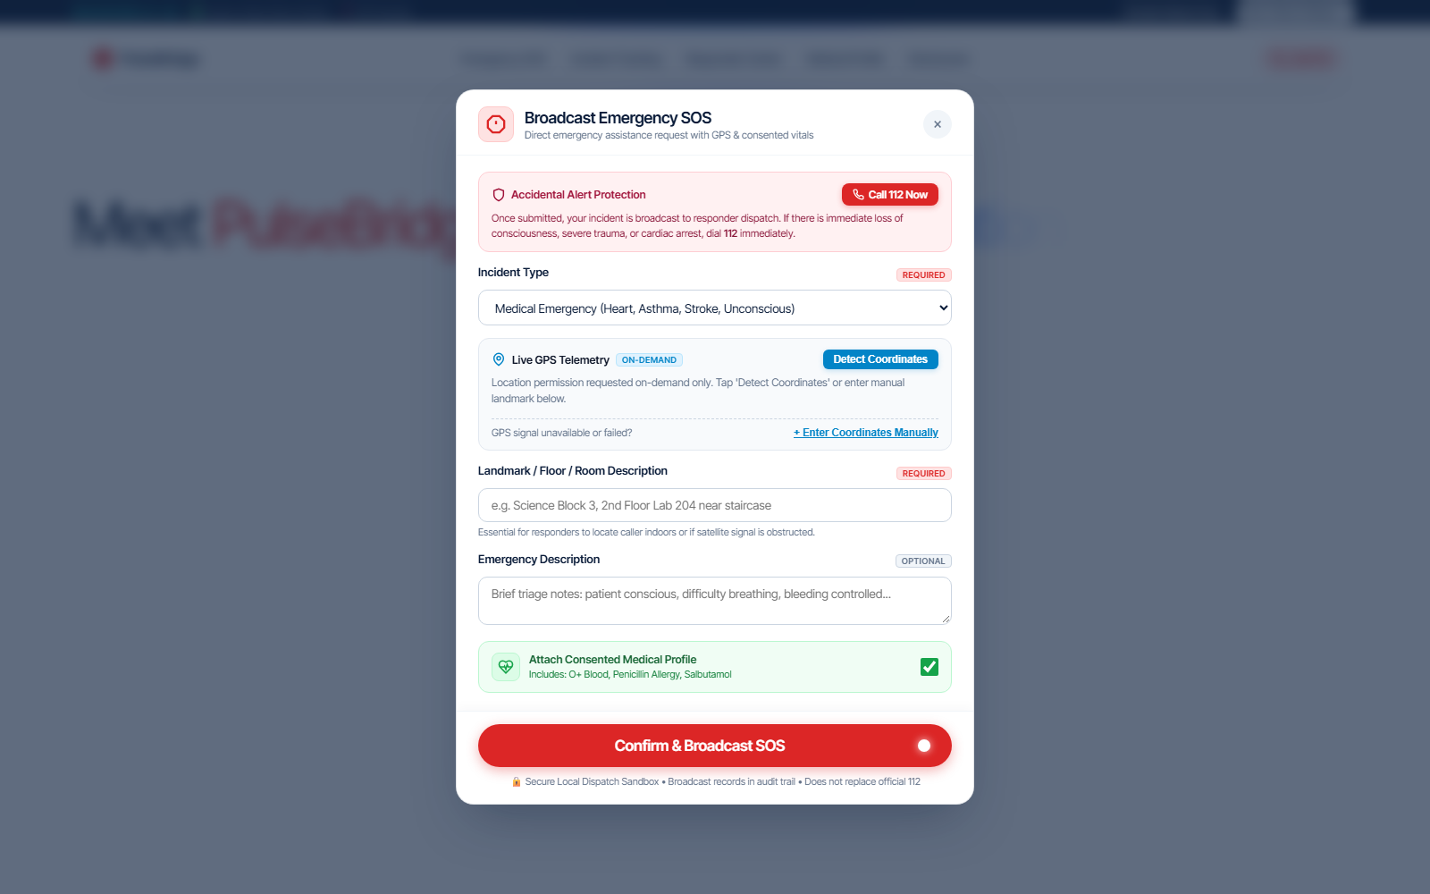
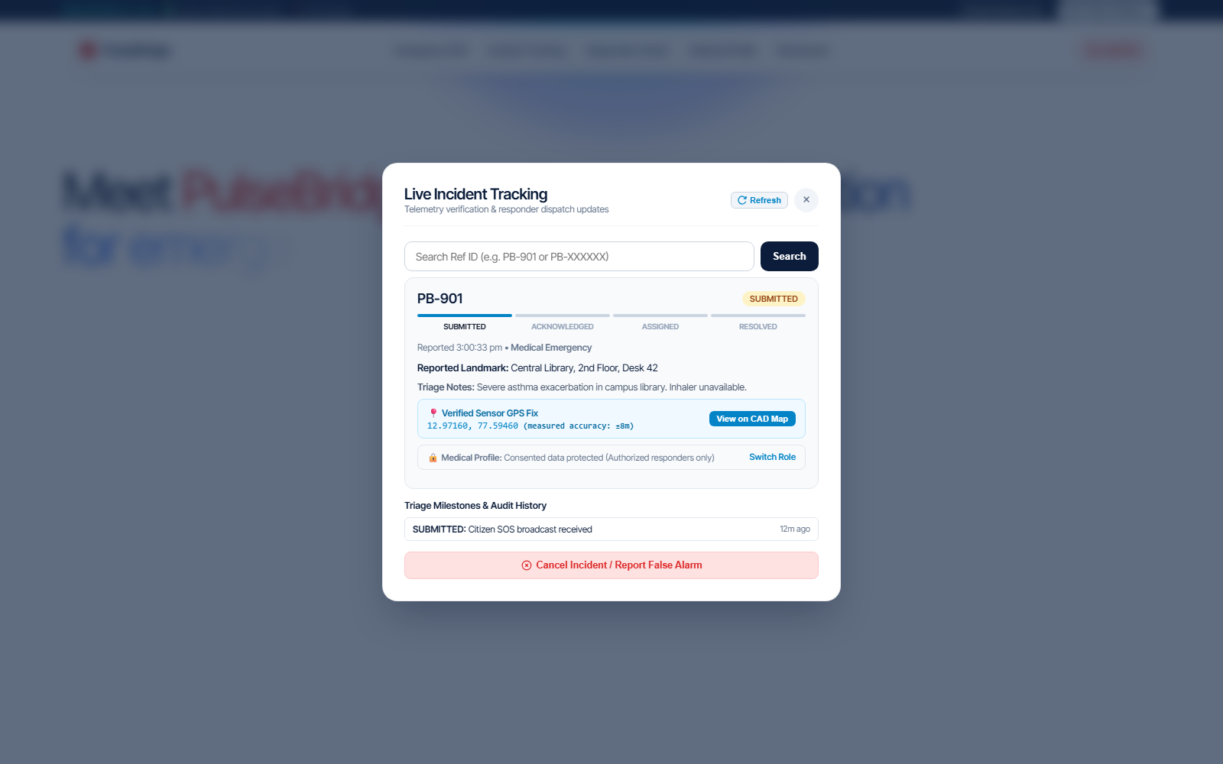
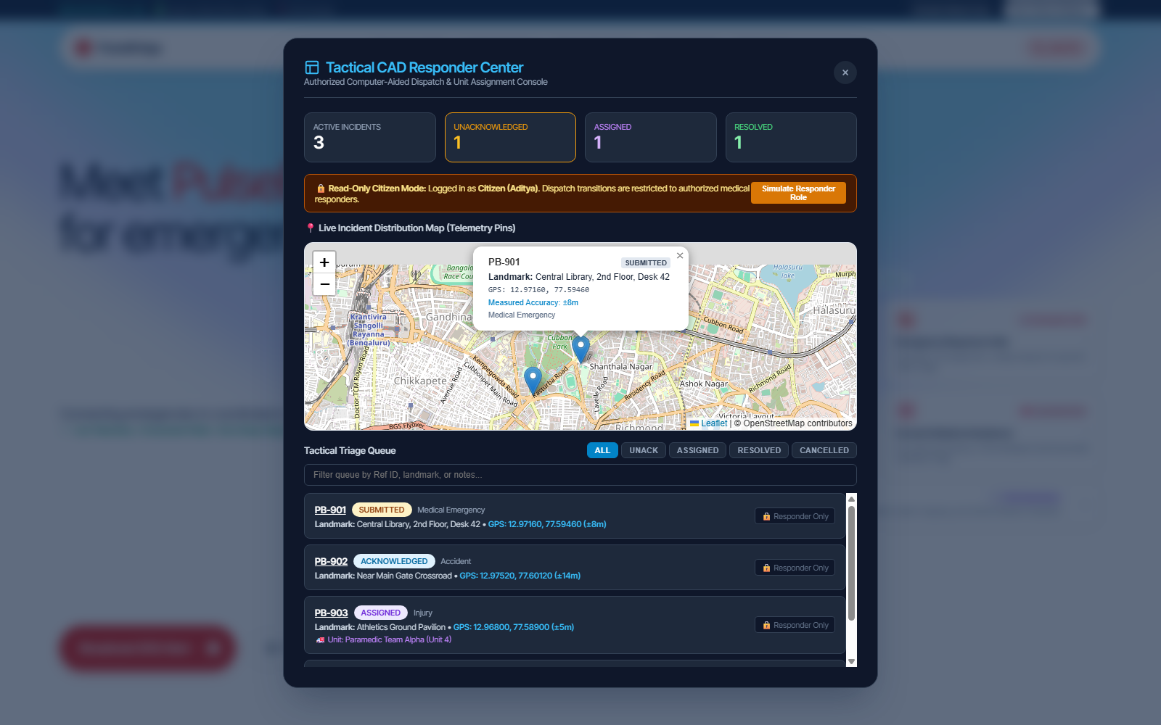
PROTOTYPE VALIDATION
Live Demo & Current Implementation
Genuine application screenshots captured directly from active PulseBridge deployment
CITIZEN LANDING
INCIDENT DISPATCH
LIVE TRACKING
CAD DASHBOARD
1. Homepage
1-Tap SOS & 112 Hotline
2. Emergency SOS Form
GPS Telemetry & Landmark
3. Incident Tracking
Ref ID & Audit Timeline
4. Responder Center
Leaflet Map & Triage Queue
IMPLEMENTED DEMO WORKFLOW (VERIFIABLE DURING LIVE DEMO)
1. SOS Submission -> 2. Reference ID Generated -> 3. Responder Queue Alert -> 4. Dispatcher Assignment -> 5. Case Resolution
MANDATORY PROTOTYPE DISCLOSURE & DEMO STATEMENT
PulseBridge is an engineering prototype built for BUILDATHON 2.0. The current workflow utilizes local demo storage and an event bus to demonstrate end-to-end responder coordination. It does NOT connect to municipal emergency dispatch or live ambulance fleets. In real life emergencies across India, dial 112 immediately.
PulseBridge - Emergency Response Platform | BUILDATHON 2.0 (KNEW-2K26) | Slide 7 of 8

Slide 8
ROADMAP & CONCLUSION
Future Scope & Platform Conclusion
Strategic pathway from hackathon prototype to enterprise emergency coordination network
STRATEGIC FUTURE IMPROVEMENTS
PulseBridge
1
Reliable GPS & Location Verification
Integrate Wi-Fi RTT, Bluetooth Low Energy (BLE) beacons, and building floorplans for sub-meter indoor positioning.
"PulseBridge - Connecting Every Emergency to a Coordinated Response."
2
Live Backend Synchronization
Deploy production WebSocket clusters and conflict-free replicated data types (CRDTs) for seamless offline-to-online sync.
3
Secure Responder Authentication
Thank You Judging Panel & Mentors!
We welcome your questions and live demonstration.
Institutional credential verification, paramedic licensing checks, and biometric authentication for dispatchers.
BUILDATHON 2.0 | KNEW-2K26
Problem Statement: H4 - Emergency Health Assistance
Team Details (Editable):
* Presenters: [Lead Presenter, Member 2, Member 3]
* Institution: [College / University / Organization Name]
* Web Demo: shrihari12012007-web.github.io/Pulse-Bridge/
* GitHub: github.com/shrihari12012007-web/Pulse-Bridge
4
Verified Emergency-Service (112) Integrations
Establish official Computer-Aided Dispatch (CAD) API bridges with municipal public safety answering points.
5
Real-Time Notifications & Communication
Automated SMS/WhatsApp family crisis alerts, WebPush notifications, and low-latency WebRTC responder voice intercom.
PulseBridge - Emergency Response Platform | BUILDATHON 2.0 (KNEW-2K26) | Slide 8 of 8

