Slide 1
INTERNSHIP PROGRESS REPORT
BVRGym: Reinforcement Learning for Missile Evasion
Project: Beyond Visual Range (BVR) Missile Evasion
Intern: Srashti Patel

Slide 2

What is BVRGym?
BVRGym is a reinforcement learning environment that combines high-fidelity flight dynamics with modern deep RL techniques to create a realistic air combat simulation.
Simulation Components
Agent: F-16 fighter aircraft controlled by trained policy
Threat: One or more AIM missiles with pursuit logic
Goal: Train adaptive evasive maneuvers in real-time scenarios
Built on JSBSim for accurate flight physics and a Python-based RL pipeline using Proximal Policy Optimization (PPO), it provides a research platform for developing intelligent evasive maneuver policies.

Slide 3

Nature of the Entities
F-16 (Agent)
Controlled by a Reinforcement Learning policy that observes the tactical environment and executes continuous flight maneuvers.
Observations:
Relative missile position vector
Time elapsed since launch
Velocity, altitude, heading angles
Missile (Adversary)
Physics-based pursuit system that actively tracks and attempts to intercept the F-16.
Possible Outcomes:
Successful intercept (hit aircraft)
Target loss (tracking failure)
Ground collision (terrain impact)

Slide 4
Learning Objective
The system trains the F-16 to develop sophisticated survival strategies through continuous interaction with the threat environment.
01
02
Maximize Survival Time
Increase Separation Distance
Extend engagement duration through effective maneuvering
Create and maintain distance from incoming missile
03
04
Maintain Safe Flight Envelope
Achieve Mission Success
Avoid stall conditions and ground collision risks
Force missile outrun or tracking loss
This is framed as a Reinforcement Learning problem: State → Action → Environment → Reward → Policy Update

Slide 5

Initial Challenges
Negative Reward Dominance
Learning Instability
Training episodes accumulated predominantly negative rewards, providing little positive reinforcement signal for the learning algorithm.
Policy updates showed high variance with unstable convergence patterns across training iterations.
Random Agent Behavior
Sparse Feedback Problem
Actions appeared disconnected from tactical objectives, with no clear progression toward effective evasion strategies.
Environment relied on terminal rewards, offering minimal guidance between "good evasive behavior" and "bad or unsafe behavior" during flight.

Slide 6

Reward Structure Redesign
A comprehensive reward shaping approach was developed to provide continuous learning signals throughout each episode.
Step-wise (Continuous) Reward
Terminal Reward
Alive Bonus
Destruction Penalty
Positive reward for each timestep survived
Strong negative signal if F-16 is hit
Distance-Based Incentive
Success Reward
Reward scaled by separation from missile
Positive terminal reward when missile loses target lock
Safety Penalties
Outrun Bonus
Negative feedback for low Mach or dangerous altitude
Additional reward for successfully evading missile range
This converts the task into a guided learning problem instead of a sparse one, enabling the agent to understand incremental progress toward survival.

Slide 7




Behavioral Meaning
The redesigned reward structure creates an interpretable objective function that aligns policy learning with realistic air-combat tactics.
Survival Value
"Staying alive is valuable"
Distance Priority
"Creating distance from the missile is good"
Safety Awareness
"Flying too slow or too low is dangerous"
Success Definition
"Outrunning the missile is success"

Slide 8
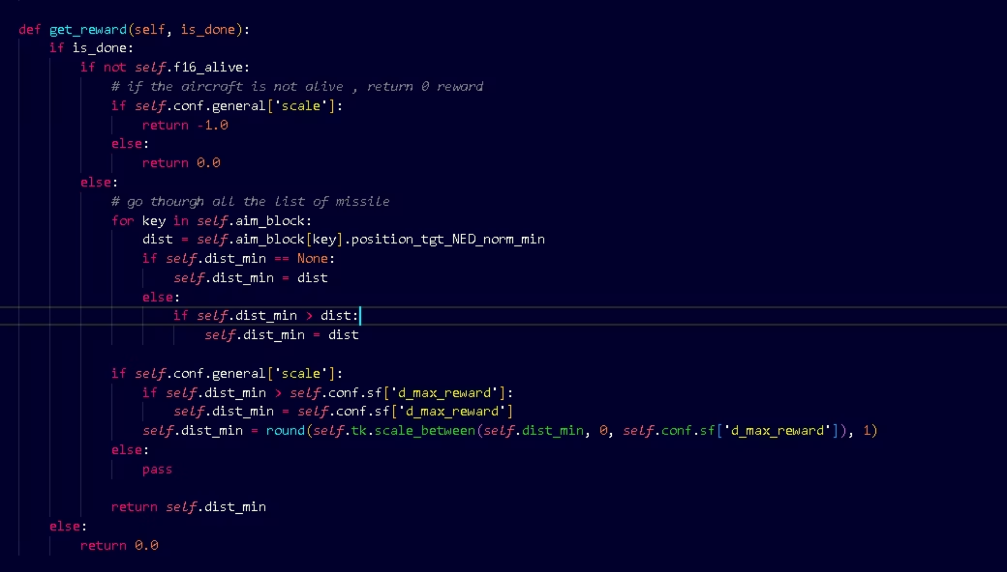
Original code

Slide 9
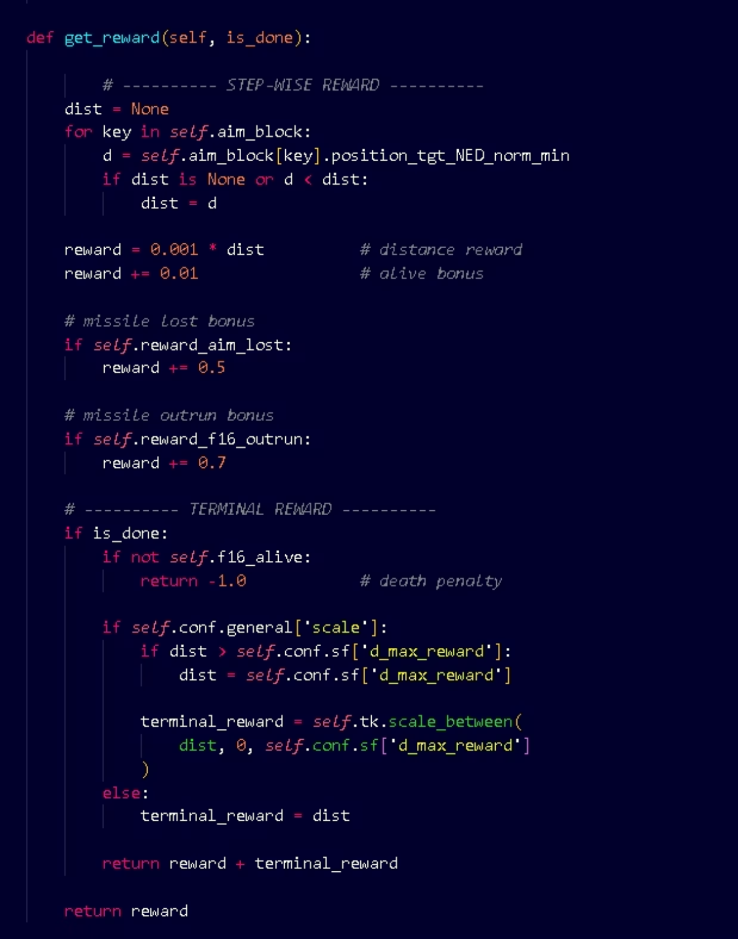
Modified code

Slide 10
Training Process
PPO-Based Training Execution
The agent was trained using Proximal Policy Optimization across multiple experimental phases:
Initial testing: 1,000+ episodes to validate reward structure
Extended training: 5,000 episodes for policy convergence
Key Observations
More stable learning curves with reduced variance
Decreased frequency of random crashes and failures
Increased occurrence of "missile outrun" success events
Generated artifacts: F-16 flight trajectories, missile paths, comprehensive environment statistics

Slide 11

Research Impact
1
Initial State
"Simulation that runs"
2
Evolution
Reward redesign and training improvements
3
Current State
"Simulation that can meaningfully learn"
Key Improvements
Stable Learning Signal
Interpretable Reward Behavior
Research-Ready Environment
Consistent reward feedback enables reliable policy convergence across training runs
Clear correlation between reward components and agent actions simplifies debugging and analysis
Platform now supports policy comparison studies, hyperparameter optimization, and tactical behavior analysis

Slide 12
Next Direction
Building on the stable foundation, the following enhancements will expand BVRGym's research capabilities and analytical depth.
Episode-Level Metrics
Implement comprehensive tracking for survival time, minimum missile distance, and categorized termination reasons
Learning Curve Analysis
Generate visualizations for reward progression and survival time across training episodes
Comparative Experiments
Systematic evaluation of old reward structure versus new reward design to quantify improvements
Reproducible Framework
Establish standardized protocols and documentation for BVR evasion research

