Slide 1
OList Marketing and Retail Analytics
CAPSTONE PROJECT
By : SHRIKANT VISHWAKARMA

Slide 2
AGENDA
Objective
Visualizations
Key Insights
Recommendations
Appendix:
Data sources
Data methodology
Data model assumption
Background

Slide 3
OBJECTIVE
Identify the key products and product categories that account for the majority of revenue using Pareto Analysis.
Enhance our knowledge of customer preferences by analyzing their buying behavior through Market Basket Analysis.
Analyze which items tend to be purchased on their own versus in combination with others.

Slide 4
BACKGROUND
OList is one such e-commerce company that has faced some losses recently and they want to manage their inventory very well so as to reduce any unnecessary costs.
The company needs to store a significant quantity of products in warehouses to satisfy customer orders.
Because storing products increases company expenses, the company must manage its inventory efficiently.

Slide 5
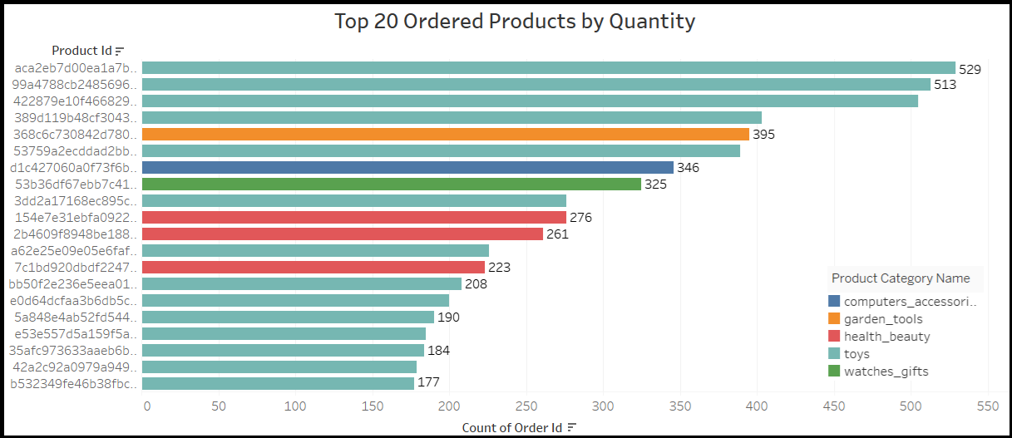
Toys Lead the Pack: Top 20 Ordered Products Overview
The most frequently ordered item comes from the Toys category with 529 orders.
Products from the Toys category dominate the list of the top 20 most ordered items.

Slide 6
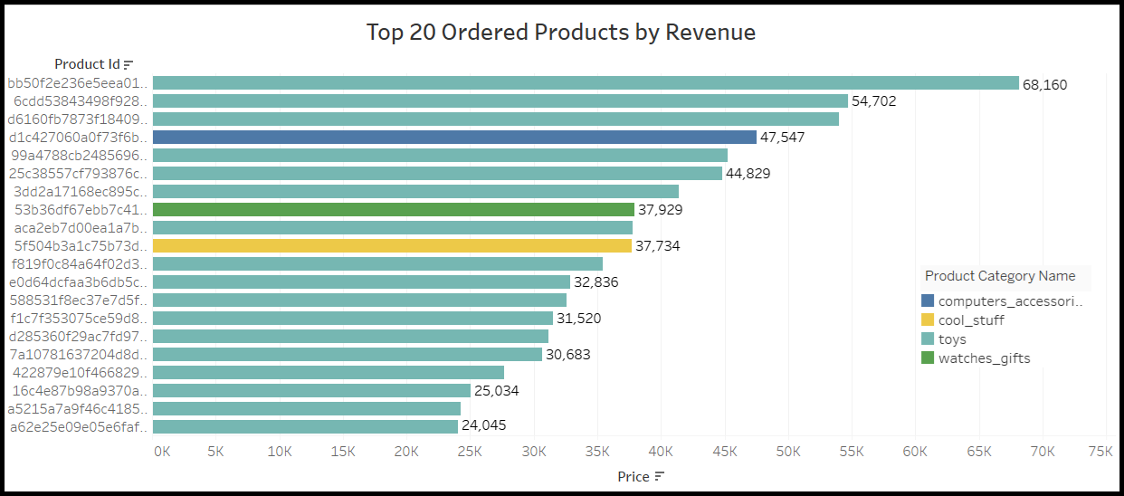
Toys Lead the Sales: Top 20 Revenue-Generating Products
With a revenue of 68,160, the leading product in terms of sales comes from the Toys category.
The majority of the top 20 highest revenue-generating products are from the Toys category.

Slide 7
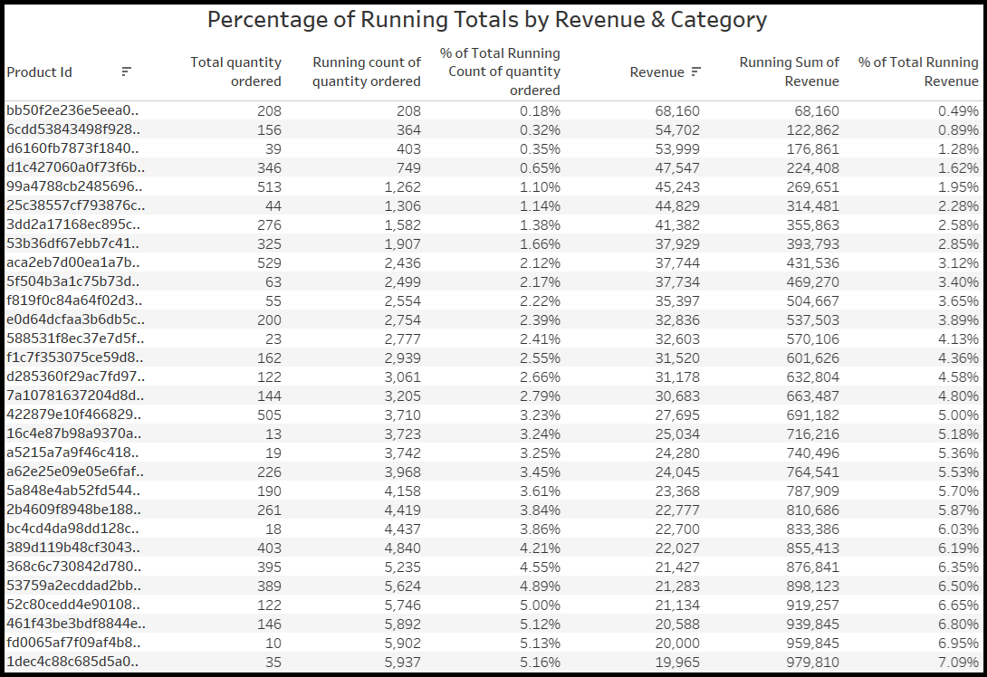
Product-Level Revenue Contribution Analysis
Each Product ID reflects its share of the total running revenue and the quantity ordered.
Each product's impact on the overall revenue can be assessed.

Slide 8
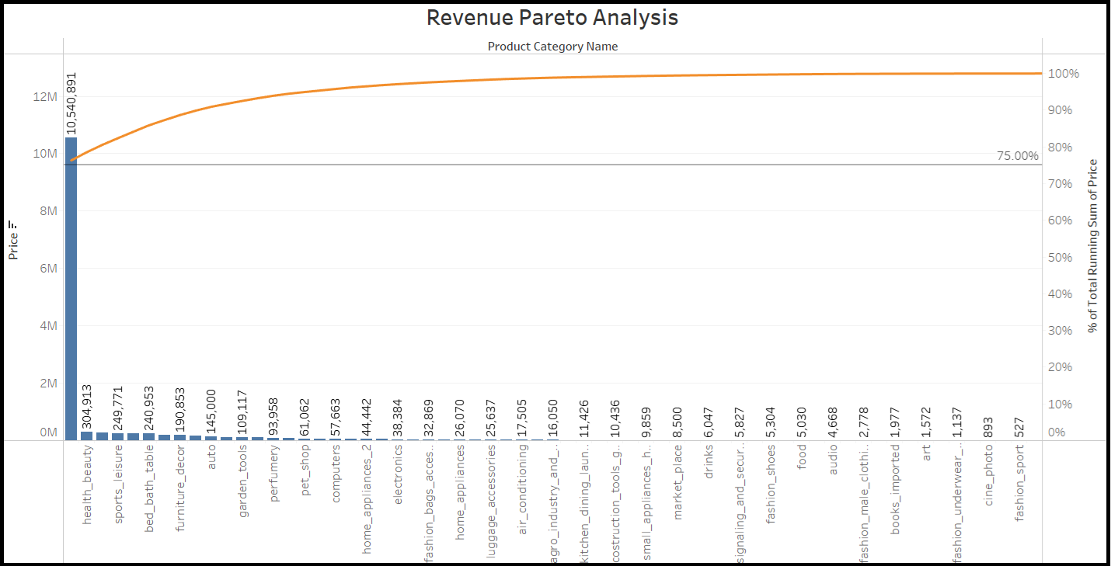
Pareto Analysis: Revenue Driven Primarily by Toys
Toys alone generates more than 75% of Total revenue, 76.31% just to be exact.
The remaining 70+ product categories contribute only 23.69% of the total revenue.

Slide 9
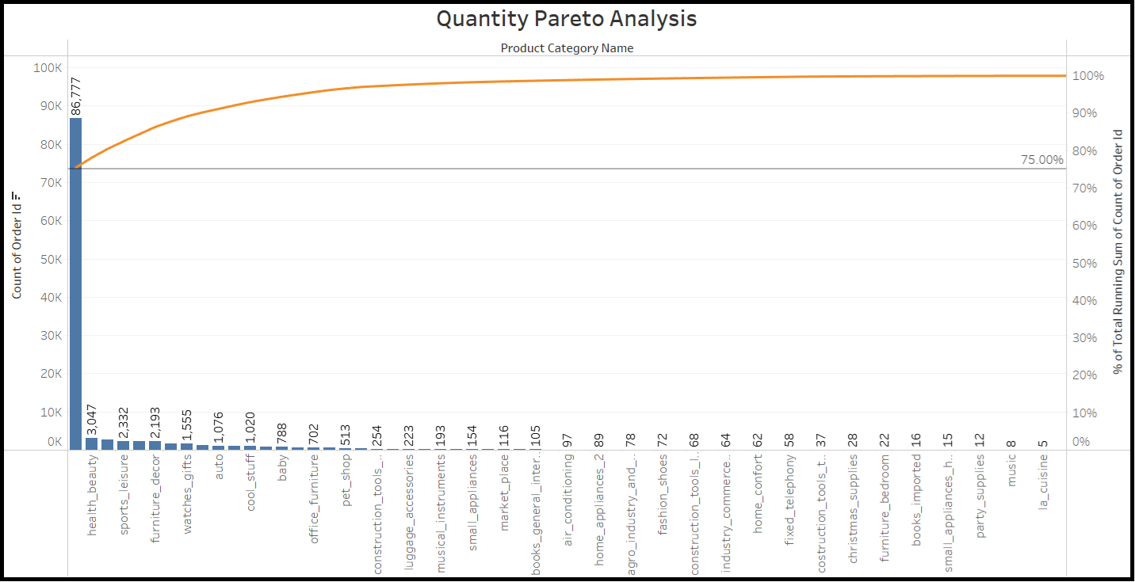
Pareto Insight: One Category Powers Most of Our Volume: Toys
The Toys category contributes 75.44% of the overall order volume.
The remaining 70+ product categories generates only 24.56% of the total orders.

Slide 10
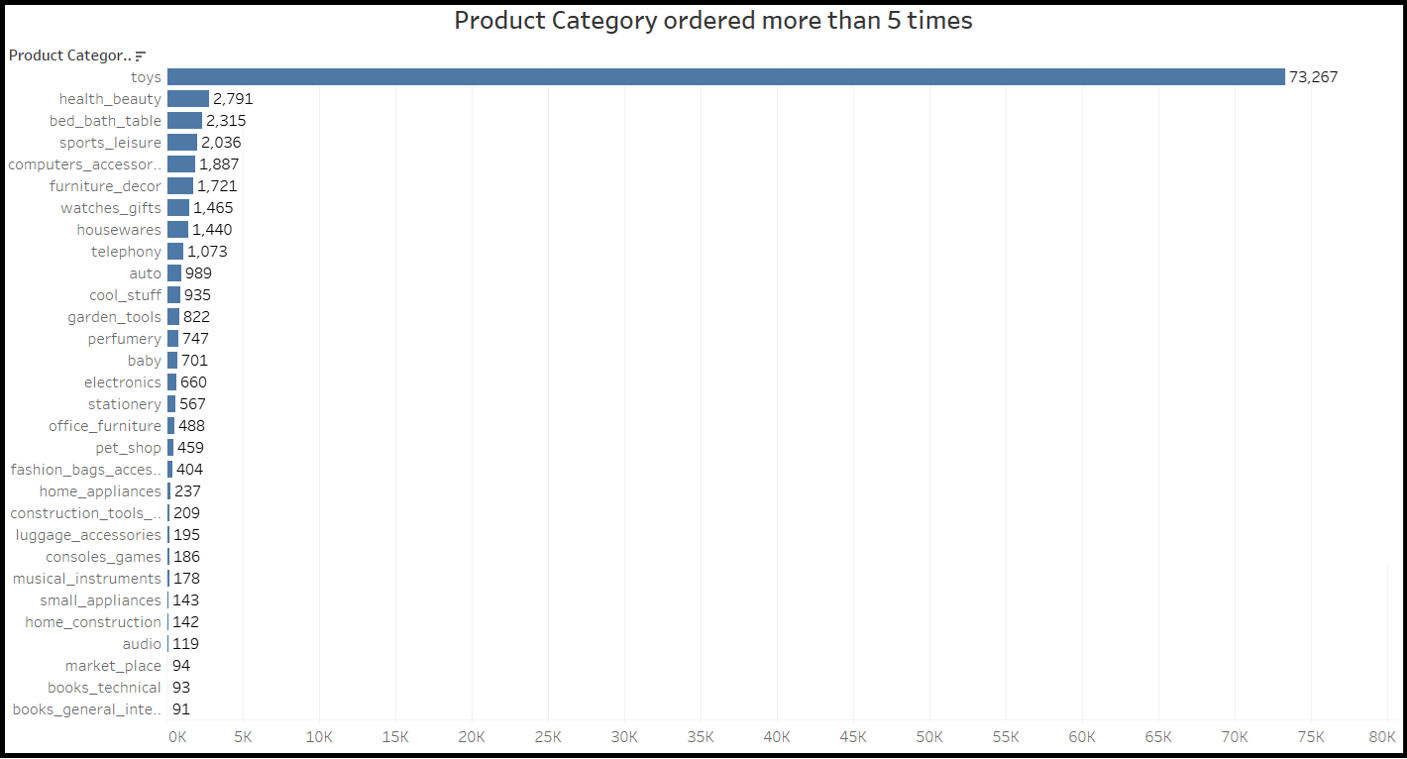
Top Ordered Product Categories: Toys
The Toys category recorded the highest number of orders totaling 73,267, indicating it's the most commonly purchased item.
health_beauty, bed_bath_Table and sports_leisure follow as the next most ordered categories.

Slide 11
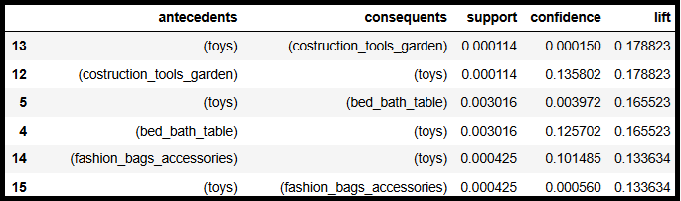
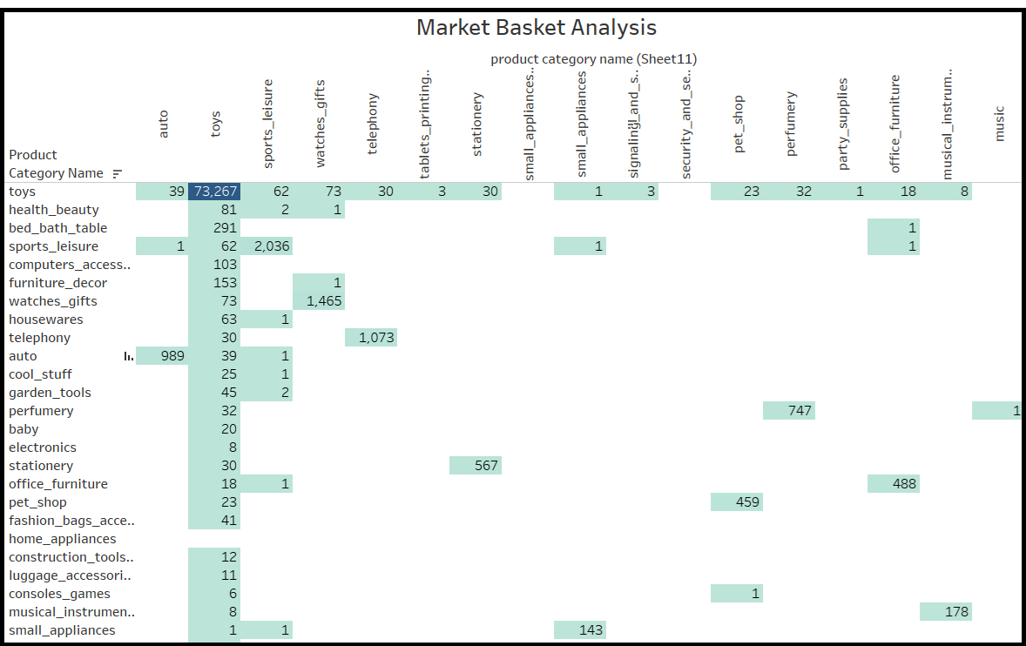
Market Basket Analysis
Rules were derived using the Apriori algorithm.
Lift values < 1: suggest weak cross-category buying behavior.
Customers tend to buy independently.
Implication: Cross-sell opportunities are currently underutilized.

Slide 12
KEY INSIGHTS
The Toys category alone contributes over 75% of both revenue and order volume.
Remaining 70+ categories contribute only 24% to revenue and order volume.
Market Basket Analysis shows weak cross-category associations (lift < 1), indicating that customers tend to purchase products independently.
High dependence on Toys category poses a significant business risk if its sales decline.

Slide 13
RECOMMENDATIONS
Diversify product strategy beyond Toys.
Promote high-potential categories like health_beauty, bed_bath_table, and sports_leisure.
Launch cross-sell campaigns using popular Toys as entry points.
Use targeted marketing and bundling to grow underperforming categories.
NEXT STEPS
Implement A/B testing for cross-category promotions.
Monitor category-level KPIs monthly.
Evaluate warehouse space usage based on evolving product demand.

Slide 14
APPENDIX- Data Sources
The analysis was based on the following dataset:
OList Retail_dataset containing order related information from 2016 to 2018.
Here is a snapshot of dataset which includes multiple linked tables:
orders table: Includes order_id, customer_id, order_status, order_purchase_timestamp etc.
order_items table: Includes order_id, order_item_id, product_id, seller_id etc.
customers table: customer related information includes customer_id, customer_city, customer_zip_code_prefix and customer_state.
payments table: payment related information such as payment_type, payment_installments, payment_value etc.
products table: product related information such as product_id, product_category_name etc.

Slide 15
APPENDIX- Data Methodology
A comprehensive analysis of the OList Retail Dataset was carried out involving the following steps:
The dataset was preprocessed and refined using Python libraries such as Pandas and NumPy within a Jupyter Notebook environment.
Missing data across various columns was handled by imputing the most suitable values.
Duplicate and irrelevant records were removed, retaining only the first instance of each duplicate entry.
Exploratory Data Analysis (EDA) was performed using visualization libraries like Matplotlib and Seaborn.
Market Basket Analysis was implemented using the mlxtend library to identify relationships between product categories, leveraging metrics such as support, confidence, and lift—all executed within Jupyter Notebook.
Additional visualizations and the Market Basket Analysis results were further explored and presented using Tableau.

Slide 16
APPENDIX- Data Model Assumption
Only orders with the order_status marked as "delivered" were included in the analysis.
It was assumed that the current dataset reflects satisfactory revenue performance.
The analysis is based on the assumption that the company has no plans to expand additional warehouses.
Strategic recommendations are made under the assumption of steady, ongoing sales growth.

