Slide 1
Spring Framework - I

Slide 2
Agenda
1
Introduction to Spring
2
Spring Basics and Inversion of Control
3
Spring AOP

Slide 3

Module 1: Introduction to Spring
Notes:
3

Slide 4
Objectives
This module is aimed at :
Introducing Spring as a Framework
Exploring Features of Spring
Understanding Architecture of Spring
Various Modules of Spring

Slide 5
Problems with Traditional Approach to J2EE
J2EE tends to contain excessive amounts of plumbing code like JNDI lookup, try/catch to acquire and release JDBC resources etc.
The EJB Component model is unduly complex.
Ejb is Overused.
J2EE applications are hard to unit test.

Slide 6
Spring Pledge
Good design is more important than technology.
Java Beans loosely coupled through interfaces is good model.
Code should be easy to test.

Slide 7

What is Spring ?
Spring 1.0 – released in March,2004 (by Rod Johnson & Juergen Holler), as a J2EE Application Framework.
The current version is Spring Framework 5.0, which was released in
2017
Is a popular open source application framework that can make J2EE development easier by enabling a POJO-based programming model
Consists of
a container
a framework for managing components
and a set of snap-in services for
web user interfaces
Transactions
and persistence

Slide 8
What is Spring?
Lightweight
Spring is non-intrusive Inversion of control(IOC)
Aspect-Oriented
Container
Notes:
Lightweight:- It is lightweight in terms of both size and overhead.
Spring is non-intrusive: objects in a Spring enabled application typically have no dependencies on spring specific classes.
Inversion of control(IOC):- Spring promotes loose coupling through a technique known as Inversion of Control.
When IOC is applied, objects are passively given dependencies inst
ead of creating or looking for dependencies.
IOC is just like JNDI in reverse where an container gives the dependencies to the object at instantiation without waiting to be asked.
Aspect-Oriented:-- Spring comes with rich support for aspect oriented programming that enables cohesive development by separating application business logic from system services (such as auditing and Transaction Management).
Application objects perform only business logic nothing more.
Container:- Spring is a container in the sense that it contains and manages the life cycle and configuration of application objects.
We can configure how each of our beans should be created and how they should be associated with each other.
Framework:- Spring makes it possible to configure and compose complex applications from simpler components.
In Spring application objects are composed declaratively, typically in an XML file.
Spring also provides much infrastructure functionality( transaction management, persistence framework integration etc.), leaving the application logic to programmer.

Slide 9
Spring Framework
A lightweight framework that addresses each tier in a Web application.
Presentation layer – An MVC framework that is most similar to Struts but is more powerful and easy to use.
Business layer – Lightweight IoC container and AOP support (including built in aspects)
Persistence layer – DAO template support for popular ORMs and JDBC

Slide 10
Why Spring ?
The essence of spring is in providing enterprise services to Plain Old Java Objects (POJO's)
Applications built using Spring are very easy to unit test
Spring can eliminate the need to use a variety of custom properties file formats, by handling configuration in a consistent way throughout applications and projects
Spring can provide an alternative to EJB that's appropriate for many applications
Spring provides a consistent framework for data access, whether using JDBC or an O/R mapping product such as TopLink, Hibernate or a JDO implementation.
Source : http://www.theserverside.com/

Slide 11
Spring == J2EE Application Server ?
Spring is NOT a J2EE Application Server
Spring can nicely integrate with J2EE Application Servers (or any Java Environment)
Spring can elegantly replace the services traditionally provided by J2ee Application Server
Spring provides elegant integration points with :
JDO
EJB
RMI
Web Services
JMS
Hibernate

Slide 12
Features
It is a lightweight framework
There is no dependency on the framework
Spring does not reinvent the wheel. Instead it makes all the existing solutions easier to use
Spring is based on Dependency Injection flavor of Inversion of Control
Spring includes a proxy based AOP (Aspect Oriented Programming) framework
Spring does not provide its own ORM mapping framework.
Spring integrates well with all leading O/R mapping frameworks like hibernate, TopLink, JDP, Apache OJB, etc.
It also integrates with a variety of web frameworks like struts, webwork, Spring MVC, Tapestry, JSP, etc.
Notes:
Spring is a major open source framework that aims to make J2EE development easier.Spring offers services throughout an application and not merely in a single architectural tier. The essence of spring is in providing enterprise services to Plain Old Java Objects (POJO's). It is a lightweight framework (does not have any high startup times, wont involve huge binary dependencies, will run in any environment). Spring provides an abstraction layer over JDBC that is simpler and less error prone to use than JDBC. It provides a transaction abstraction that can sit over JTA (Java Transaction API), global transactions, local transactions using JDBC, Hibernate, JDO or any other data access API's. Spring provides POJO based remoting over a variety of protocols including RMI, IIOP and other web services protocols. Spring provides support for sending and receiving JMS messages.
The best part of using Spring is that the code need not be aware of Spring framework. Hence there is no dependency on the framework.
Spring is based on Dependency Injection flavour of Inversion of Control. This means that the framework code invokes application code, coordinating overall workflow rather than the application code invoking the framework code. Spring includes a proxy based AOP (Aspect Oriented Programming) framework.

Slide 13
Inversion Of Control (IOC) and Dependency Injection
These are the design patterns that are used to remove dependency from the programming code.
They make the code easier to test and maintain.
class Employee{
Address address;
Employee(){
address=new Address();
}
}
There is dependency between the Employee and Address (tight coupling).

Slide 14
Inversion of Control
IOC makes the code loosely coupled.
In such case, there is no need to modify the code if our logic is moved to new environment.
class Employee{
Address address;
Employee(Address address){
this.address=address;
}
}
In Spring framework, IOC container is responsible to inject the dependency.
We provide metadata to the IOC container either by XML file or annotation.

Slide 15
Dependency Injection in Spring
In Spring framework, IOC container is responsible to inject the dependency.
Dependency Injection in Spring can be done through
constructors,
setters
fields.
Advantages
It makes the code loosely coupled so easy to maintain
It makes the code easy to test

Slide 16
Advantages of Spring Framework
Predefined Templates
Spring framework provides templates for JDBC, Hibernate, JPA etc. technologies.
So there is no need to write too much code. It hides the basic steps of these technologies.
Example of JdbcTemplate,
Don't need to write the code for exception handling, creating connection, creating statement, committing transaction, closing connection etc. We need to write the code of executing query only. Thus, it save a lot of JDBC code.
Loose Coupling
The Spring applications are loosely coupled because of dependency injection.

Slide 17
Advantages of Spring Framework
Easy to test
The Dependency Injection makes easier to test the application.
The EJB or Struts application require server to run the application but Spring framework doesn't require server.
Lightweight
Spring framework is lightweight because of its POJO implementation.
The Spring Framework doesn't force the programmer to inherit any class or implement any interface.
That is why it is said non-invasive.
Fast Development
The Dependency Injection feature of Spring Framework and it support to various frameworks makes the easy development of JavaEE application.

Slide 18
Advantages of Spring Framework
Powerful abstraction
It provides powerful abstraction to JavaEE specifications such as JMS, JDBC, JPA and JTA.
Declarative support
It provides declarative support for caching, validation, transactions and formatting.
The Core feature
Spring Framework can be used in developing any Java application.
There are extensions for building web applications on top of the Java EE platform.
Spring framework targets to make J2EE development easier to use and promotes good programming practices by enabling a POJO-based programming model.

Slide 19
We have Business Logic like Servlet why go for Spring?
In servlet for we have servlet objects for each functionality of applications.
If we develop Gmail using servlet, then we need to have
LoginServlet object
ComposeMailServelt object
LogoutServelt object…
And assume there are lots of functionality in Gmail,
So, finally we need to manage and configure each Servlet object of Gmail in Web. xml.
So, here comes the role of Spring java application framework.
Spring has one servlet object for all those no. Of functionalities.

Slide 20
Spring Features
Spring is open source enterprise applications frame work.
Spring is important integration technology.
Spring provide infrastructure for building application.
Spring implements IOC.
It manage components of application. Manage refer to create, initilialize, destroy.
Spring has concept like Dependency Injection. Dependency Injection is implementation of IOC. (IOC is implemented by Spring FW)
Aspect oriented programming language.
We can perform integration between
jdbc and spring,
hibernate and spring,
jdbc and sevelet,
hibernate and servlet.

Slide 21
Architecture of Spring
Spring is well-organized architecture consisting of seven modules.
Modules in the Spring framework are:
Spring AOP
Spring ORM
Spring Web
Spring DAO
Spring Context
Spring Web MVC
Spring Core
Notes:
AOP is used to provide declaration services to objects. It allows us to think about the concerns or aspects of the system like transaction management, logging, failure monitoring, etc. Spring does not provide its own ORM mapping framework. Spring integrates well with all leading O/R mapping frameworks like hibernate, TopLink, JDP, Apache OJB, etc. It also integrates with a variety of web frameworks like struts, webwork, Spring MVC, Tapestry, JSP, etc.
Modules in the Spring framework are:
Spring AOP One of the key components of Spring is the AOP framework.
AOP is used in Spring:
To provide declarative enterprise services, especially as a replacement for EJB declarative services. The most important such service is declarative transaction management, which builds on Spring's transaction abstraction.
To allow users to implement custom aspects, complementing their use of OOP with AOP

Slide 22
Notes:
Spring ORM The ORM package is related to the database access. It provides integration layers for popular object-relational mapping APIs, including JDO, Hibernate and iBatis. Spring Web The Spring Web module is part of Spring’s web application development stack, which includes Spring MVC. Spring DAO The DAO (Data Access Object) support in Spring is primarily for standardizing the dataaccess work using the technologies like JDBC, Hibernate or JDO. Spring Context This package builds on the beans package to add support for message sources and forthe Observer design pattern, and the ability for application objects to obtain resources using a consistent API. Spring Web MVC This is the Module which provides the MVC implementations for the web applications. Spring Core The Core package is the most important component of the Spring Framework. This component provides the Dependency Injection features. The BeanFactory provides a factory pattern which separates the dependencies like initialization, creation and access of the objects from your actual program logic.
The name of the Spring module along with the jar file name (which is available in the SPRING_HOME\dist\modules) is listed below.
Spring Web MVC (spring-webmvc.jar)
Spring Aop (spring-aop.jar)
Spring Beans (spring-beans.jar)
Spring Context (spring-context.jar)
Spring Core (spring-core.jar)
Spring Dao (spring-dao.jar)
Spring Hibernate (spring-hibernate3.jar)
Spring Ibatis (spring-ibatis.jar)
Spring Jca (spring-jca.jar)
Spring Jdbc (spring-jdbc.jar)
Spring Jdo (spring-jdo.jar)
Spring Jms (spring-jms.jar)
Spring Jms (spring-jpa.jar)

Slide 23
Architecture of Spring (Contd.).
Spring ORM
The ORM package is related to the database access.
It provides integration layers for popular object-relational mapping APIs, including JDO, Hibernate and iBatis.
Spring Web
The Spring Web module is part of Spring’s web application development stack, which includes Spring MVC.
Spring DAO
The DAO (Data Access Object) support in Spring is primarily for standardizing the dataaccess work using the technologies like JDBC, Hibernate or JDO.
Spring Context
This package builds on the beans package to add support for message
sources and forthe Observer design pattern, and the ability for application
objects to obtain resources using a consistent API.

Slide 24
Architecture of Spring (Contd.).
Spring Web MVC
This is the Module which provides the MVC implementations for
the web applications.
Spring Core
The Core package is the most important component of the Spring Framework.
This component provides the Dependency Injection features.
The BeanFactory provides a factory pattern which separates the dependencies like initialization, creation and access of the objects from your actual program logic.

Slide 25
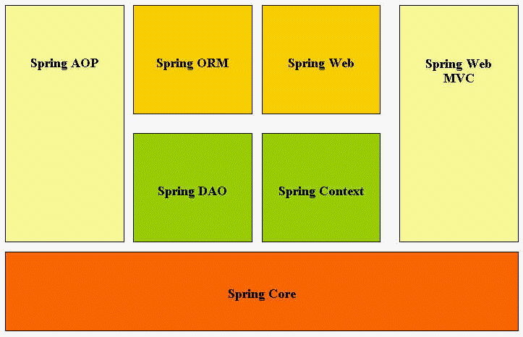
Architecture of Spring (Contd.).
Notes:
Spring Jmx (spring-jmx.jar)
Spring Portlet (spring-portlet.jar)
Spring Remoting (spring-remoting.jar)
Spring Struts (spring-struts.jar)
Spring Support (spring-support.jar)
Spring Toplink (spring-toplink.jar)
Spring Web (spring-web.jar)
Spring Aspects (spring-aspects.jar)
Classpath:
Application requires include any of these jar Files in its classpath, depending on the module(s) which are required. But, what will happen if an Application is in need of the functionality provided by all the various modules. Should it define entries for all the Jar Files in its class-path? Spring provides a smart solution for this need, as it comes with a Jar File called spring.jar which is a combination of all the modules.

Slide 26
Architecture
Spring
Security
(Acegi)
JSP / JSTL
Presentation
Spring MVC
Spring WebFlow
Spring
Context
(DI / IoC
container)
POJO
POJO
POJO
Business
Spring AOP
Spring TX
Spring DAO
Data Access
Spring - Hibernate
Hibernate 3
Database

Slide 27
Know your knowledge …
What is Spring?
J2EE Design pattern
J2EE Application Server
J2EE Web Framework
J2EE Application Framework
Which module of Spring provides integration layer with Hibernate?
Spring DAO
Spring ORM
Spring Context
None
Which module of Spring provides Dependency Injection feature?
Spring Context
Spring Core
Spring DAO

Slide 28
Summary
In this module, we have learnt:
Spring as Framework
Features of Spring
Architecture of Spring
Various Modules of Spring

Slide 29
Module 2- Spring Basics and Inversion of Control

Slide 30
Objectives
This module is aimed at :
Spring Environment Setup
Spring Containers
Bean Configuration File and its content
Inversion of Control methodologies
Setter Injection
Constructor Injection

Slide 31
Spring Environment Setup
Setup Java Development Kit (JDK)
Create the java project
Add spring jar files
Create a Bean class
Create the xml file to provide the values
Create the test class

Slide 32
First Program - Demo
public class Test {
public static void main(String[] args) {
ApplicationContext context = new ClassPathXmlApplicationContext("applicationContext.xml");
HelloWorld obj = (HelloWorld) context.getBean("userbean");
obj.display();}}
Create an application context where we used framework API ClassPathXmlApplicationContext().
This API loads beans configuration file and eventually based on the provided API,
it takes care of creating and initializing all the objects, i.e. beans mentioned in the configuration file.
Get the required bean using getBean() method of the created context.
This method uses bean ID to return a generic object, which finally can be casted to the actual object.
Once you have an object, you can use this object to call any class method.

Slide 33
Core Spring
The Core Spring can be thought of a Framework and a Container for managing Business Objects and their relationship.
The Beauty of the Framework is that, in most of the times we don't need to depend on Spring specific Classes and Interfaces.
This is unlike other Frameworks, where they will force the Client Applications to depend on their propriety Implementations
Business Components in Spring are POJO (Plain Old Java Object) or POJI (Plain Old Java Interface)
Notes:
The Core Spring can be thought of a Framework and a Container for managing Business Objects and their relationship. The Beauty of the Framework is that, in mostof the times we don't need to depend on Spring specific Classes and Interfaces. This is unlike other Frameworks, where they will force the Client Applications to depend on their propriety Implementations. For example, consider the various J2ee Components like Servlets or EJB, if a developer wants to write a Servlet, the class has to depend on HttpServlet, same is the case of creating Enterprise Beans.
The architects of Spring have spent enough time in designing the Framework to keep the coupling between the Clients and the Spring Framework to a bare minimum. In most cases the coupling is often nil. In other terms, whatever Business Components you write in Spring are POJO (Plain Old Java Object) or POJI (Plain Old Java Interface) only. POJO/POJI refers to Classes or Interfaces that doesn't specially extend of implement third-party Implementations. The main advantage of having most of the Classes or Interfaces as POJO/POJI in an Application is that they will facilitate easy Unit Testing in the Application.

Slide 34
BeanFactory Vs ApplicationContext
There are two ways in which clients can use the functionality of the Spring Framework:
BeanFactory
ApplicationContext
Two of the most fundamental and important packages in Spring are:
org.springframework.beans
org.springframework.context
Code in these packages provides the basis for Spring's Inversion of Control – IOC (alternately called Dependency Injection) features.
The BeanFactory provides an advanced configuration mechanism - capable of managing beans (objects) of any nature, using potentially any kind of storage facility.
Notes:
The architects of Spring have spent enough time in designing the Framework to keep the coupling between the Clients and the Spring Framework to a bare minimum. In most cases the coupling is often nil. In other terms, whatever Business Components you write in Spring are POJO (Plain Old Java Object) or POJI (Plain Old Java Interface) only. POJO/POJI refers to Classes or Interfaces that doesn't specially extend of implement third-party Implementations.
The main advantage of having most of the Classes or Interfaces as POJO/POJI in an Application is that they will facilitate easy Unit Testing in the Application.

Slide 35
BeanFactory Vs ApplicationContext
The ApplicationContext builds on top of the BeanFactory and adds other functionality such as :
easier integration with Springs AOP features
message resource handling (for use in internationalization)
event propagation
declarative mechanisms to create the ApplicationContext
application-layer specific contexts such as the WebApplicationContext
In short,
the BeanFactory provides the configuration framework and basic functionality
the ApplicationContext adds enhanced capabilities to it, some of them perhaps more J2EE and enterprise-centric.
Notes:
Users are sometimes unsure whether a BeanFactory or an ApplicationContext are best suited for use in a particular situation. Normally when building most applicationsin a J2EE-environment, the best option is to use the ApplicationContext, since it offers all the features of the BeanFactory and adds on to it in terms of features, while also allowing a more declarative approach to use of some functionality, which is generally desirable. The main usage scenario when you might prefer to use the BeanFactory is when memory usage is the greatest concern (such as in an applet where every last kilobyte counts), and you don't need all the features of the ApplicationContext.

Slide 36
Spring Core API
The Core API in Spring is very limited and it generally involves in:
Configuring
Creating
and Making Associations
between various Business Components.
Spring refers to these Business Components as Beans.
The following are the Core Classes or the Interfaces that are available in the Spring for achieving the goal.
Resource
BeanFactory
Notes:
Resource
A Resource in Spring represents any kind of Information that comes from a File or from a Stream. For example, resources could represent an Xml File containing the various Configuration Information needed for a Spring Application. Or it could represent a Java Class File representing a Bean object. Whatever be the case, it can be represented as a Resource object with the transparent nature of its implementation.
Suppose, we wish a load a Resource that represents the Java Class called MyJavaClass, then we can have,
Resource classRes = new ClassPathResource("PathToClassFile", MyJavaClass.class);
Note that ClassPathResource is the concrete implementation class for loading a Java Class file.
The following code loads an Xml File from the local File System.
String xmlFile = "./resources/myXml.xml");
Resource xmlResource = new FileSystemResource(xmlFile);
Note that FileSystemResource can be used to load any kind of files to make themselves available to the Spring Application, it is not restricted to only Xml Files. Other commonly used Resource in the InputStreamResource that loads content from an Input Stream. Apart from this, there are so many concrete implementations of various Resources are available in the Spring Framework.

Slide 37
Resource
Interface for a resource descriptor that abstracts from the actual type of underlying resource, such as a file or class path resource
Package : org.springframework.core.io
Various classes which provide concrete implementation of ‘Resource’are:
FileSystemResource
ClassPathResource
UrlResource
ByteArrayResource
InputStreamResource
ServletContextResource

Slide 38
Resource – Sample Code
Example
String xmlFile = "./resources/myXml.xml");
Resource xmlResource = new FileSystemResource(xmlFile);

Slide 39
Bean Factory
The BeanFactory provides an advanced configuration mechanism capable of managing beans (objects) of any nature
The BeanFactory is the actual container which instantiates, configures, and manages a number of beans.
These beans typically collaborate with one another, and thus have dependencies between themselves.
These dependencies are reflected in the configuration data used by the BeanFactory
A BeanFactory is represented by the interface org.springframework.beans.factory.BeanFactory, for which there are multiple implementations.
The most commonly used simple BeanFactory implementation is org.springframework.beans.factory.xml.XmlBeanFactory
Notes:
BeanFactory
As mentioned, in Spring terminology a Bean refers to a Business Component in consideration. As such, BeanFactory is the factory class for creating Bean objects. The interesting thing is that how to configure the BeanFactory for creating Business Components. In other words, where the BeanFactory class should look for the Bean definition for creating Bean instances? One important thing to note that all Beans that reside in the Context of Spring Container are highly configurable through external files. It means that your Bean definitions can reside in an Xml File, a Java Property File or even in a database. Although, Bean definitions are not tightly coupledto any format, most developers prefer having their Bean definitions in Xml Format.
Following is the code that will load all Bean definition from an Xml File,
Resource xmlResource = new FileSystemResource("beans.xml");
BeanFactory factory = new XmlBeanFactory(xmlResource);
Note the XmlBeanFactory class which is one of the concrete implementations of BeanFactory class.

Slide 40
BeanFactory and Resource Example
Resource xmlResource = new FileSystemResource ("beans.xml");
BeanFactory factory = new XmlBeanFactory(xmlResource);

Slide 41
Sample Application
In this simple application, which is based on “Spring”, we create the following:
Business Object (Namer.java)
Business Component ‘Namer’, which is used to store the given name
XML Configuration file (namer.xml)
to define and configure the Bean class along with its properties
Client program (SimpleSpringApp.java )
which makes reference to the Xml File using the Resourceobject
and then the contents of the Xml File are read using the XmlBeanFactory class
An instance of the object of type Namer is then retrieved by calling the BeanFactory.getBean(id) method

Slide 42
Sample Application (Contd.).
Namer.java
public class Namer
{
private String name;
public Namer()
{ }
public String getName()
{ return name;
}
public void setName(String name)
{ this.name = name;
}
}

Slide 43
Sample Application (Contd.).
Namer.xml
<?xml version="1.0" encoding="UTF-8"?>
<beans xmlns=“http://www.springframework.org/schema/beans” xmlns:xsi="http://www.w3.org/2001/XMLSchema-instance" xsi:schemaLocation = "http://www.springframework.org/schema/beans http://www.springframework.org/schema/beans/spring-beans-2.0.xsd">
<bean id="namerId“ class=“Namer">
<property name = "name">
<value>Steve</value>
</property>
</bean>
</beans>
Notes:
All the basic definition of the Bean classes along with the Configuration Information, their relationships with other Bean objects can be defined in the Xml Configuration File.

Slide 44
Sample Application (Contd.).
SimpleSpringApp.java (Client code)
import org.springframework.beans.factory.*;
import org.springframework.beans.factory.xml.*;
import org.springframework.core.io.*;
public class SimpleSpringApp {
public static void main(String args[]){
Resource namerXmlFile = new FileSystemResource("src/ namer.xml");
BeanFactory factory = new XmlBeanFactory(namerXmlFile);
Namer namer = (Namer)factory.getBean("namerId");
System.out.println(namer.getName());
} }

Slide 45
Bean Definition Configuration File
All the basic definition of the Bean classes along with the Configuration Information, their relationships with other Bean objects can be defined in the Xml Configuration File
The major configuration features :
Making Associations between Bean Objects
using the 'ref' element through the property bean
Mapping Collection Properties
By including various Collection properties
Importing Configuration Files into a master xml file
E.g.:<beans>
<import resource = “emp.xml"/>
<import resource = “address.xml"/>
</beans>
Notes:
Example for Associations
team-player.xml
<bean id = "india" class = "net.javabeat.articles.spring.complex.Team">
<property name = "name"> <value>India</value>
</property>
</bean>
<bean id = "tendulkar" class = "net.javabeat.articles.spring.complex.Player">
<property name = "name"> <value>Sachin Tendulkar</value> </property>
<property name = "team"> <ref bean = "india"/> </property>
</bean>

Slide 46
Notes:
Example for Collection Mapping
Team.java
import java.util.*;
public class Team {
private String name;
private Set<Player> players;
public Team() { }
public Team(String name)
{ this.name = name; }
public String getName()
{ return name; }
public void setName(String name)
{ this.name = name; }
public Set<Player> getPlayers()
{ return players; }
public void setPlayers(Set<Player> players)
{ this.players = players; } @Override public String toString()
{ return "[Name = " + name + ", Players = " + playersAsString(players) + "]"; }
private String playersAsString(Collection<? extends Object> collection)
{ if(collection == null || collection.isEmpty())
{ return ""; }
StringBuilder result = new StringBuilder();
Iterator<? extends Object> iterator = collection.iterator();
result.append("[");
while (iterator.hasNext())
{ String name = ((Player)iterator.next()).getName();
result.append("{" + name + "}");
}
result.append("]");
return result.toString();
}
}

Slide 47
Notes:
Player.java
import java.util.*;
public class Player {
private String name;
private Team team;
private Map<Team, Integer> runsScored;
public Player() { }
public String getName()
{ return name; }
public void setName(String name)
{ this.name = name; }
public Team getTeam()
{ return team; }
public void setTeam(Team team)
{ this.team = team; }
public Map<Team, Integer> getRunsScored()
{ return runsScored; }
public void setRunsScored(Map<Team, Integer> runsScored)
{ this.runsScored = runsScored; }
@Override public String toString()
{ return "[Name = " + getName() + " , Team Name = " + getTeam().getName() + ", RunsScored = " + runsScoredAsString() + "]";
}
private String runsScoredAsString(){
if (runsScored == null || runsScored.isEmpty()){ return ""; }
StringBuilder result = new StringBuilder();
result.append("[");
Iterator<Map.Entry<Team, Integer>> iterator = runsScored.entrySet().iterator();
while(iterator.hasNext())
{ Map.Entry<Team, Integer> entry = iterator.next();
result.append("{" + entry.getKey().getName() + "," + entry.getValue() + "}");
}
result.append("]");
return result.toString();
} }

Slide 48
Notes:
player-team.xml
<?xml version="1.0" encoding="UTF-8"?>
<beans>
<bean id = "india" class = "net.javabeat.articles.spring.complex.Team">
<property name = "name"> <value>India</value> </property>
<property name = "players">
<set>
<ref bean = "tendulkar"/>
<ref bean = "dravid"/>
<ref bean = "ganguly"/>
</set>
</property>
</bean>
<bean id = "australia" class = "net.javabeat.articles.spring.complex.Team">
<property name = "name">
<value>Australia</value>
</property>
</bean>
<bean id = "south-africa" class = "net.javabeat.articles.spring.complex.Team">
<property name = "name">
<value>South Africa</value>
</property>
</bean>
<bean id = "tendulkar" class = "net.javabeat.articles.spring.complex.Player">
<property name = "name">
<value>Sachin Tendulkar</value>
</property>
<property name = "team">
<ref bean = "india"/>
</property>

Slide 49
Notes:
<property name = "runsScored">
<map>
<entry>
<key><ref bean = "australia"/></key>
<value>5638</value>
</entry>
<entry>
<key><ref bean = "south-africa"/></key>
<value>6383</value>
</entry>
</map>
</property>
</bean>
<bean id = "dravid" class = "net.javabeat.articles.spring.complex.Player">
<property name = "name"> <value>Rahul Dravid</value> </property>
<property name = "team"> <ref bean = "india"/> </property>
<property name = "runsScored">
<map>
<entry>
<key><ref bean = "australia"/></key>
<value>3638</value>
</entry>
<entry> …
</bean>
</beans>

Slide 50
Notes:
Client Application
Resource resource = new FileSystemResource("./src/resources/player-team.xml");
BeanFactory factory = new XmlBeanFactory(resource);
Team india = (Team)factory.getBean("india");
System.out.println(india);
Player tendulkar = (Player)factory.getBean("tendulkar");
System.out.println(tendulkar);
Player dravid = (Player)factory.getBean("dravid");
System.out.println(dravid);
Player ganguly = (Player)factory.getBean("ganguly");
System.out.println(ganguly);

Slide 51
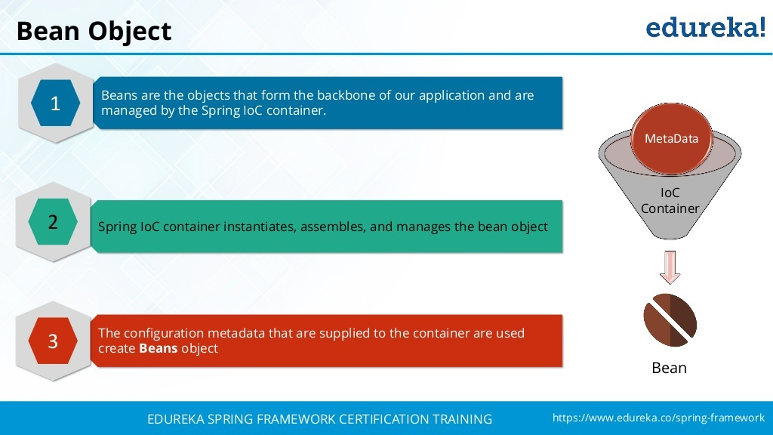

Slide 52
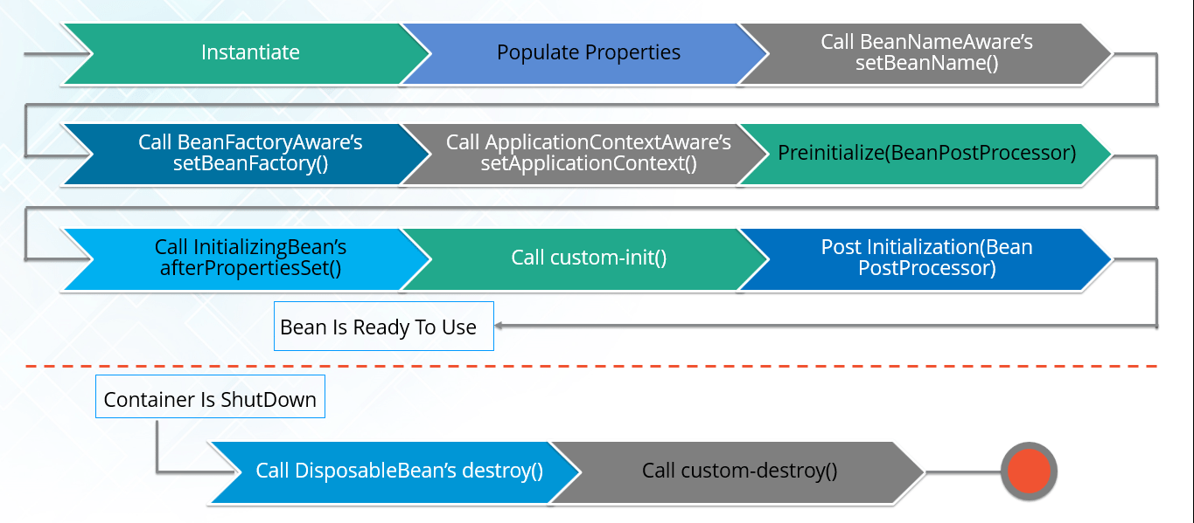
Spring Bean Life Cycle

Slide 53
Bean Definition Configuration File (Contd.).
Bean Life Cycle
The entire Bean objects defined in the Xml Configuration File undergoes a Standard Lifecycle Mechanism
Lifecycle interfaces like InitializingBean and DisposableBean are available to enhance/modify the lifecycle.
The InitializingBean interface has a single method called afterPropertiesSet() which will be called immediately after all the property values that have been defined in the Xml Configuration file is set.
The DisposableBean has a single method called destroy() which will be called during the shut down of the Bean Container
Controlling the Order of Creation of Beans
in a situation where Component A must be created before Component B, we can use the depends-on attribute which takes a list of previously defined Bean Definition identifiers
Source: http://www.javabeat.net/articles
Notes:
Example code illustrating the usage of ‘Life Cycle Interfaces’
import org.springframework.beans.factory.*;
public class Employee implements InitializingBean, DisposableBean
{
private String name;
private String id;
public void afterPropertiesSet() throws Exception { System.out.println("Employee->afterPropertiesSet() method called"); }
public void destroy() throws Exception
{
System.out.println("Employee->destroy() method called");
}
}

Slide 54
Bean Definition Configuration File (Contd.).
Creating Bean Instances through Factory classes
If method in Factory class is a static method, then use ‘factory-method’ attribute
If method is a non-static method, then 'factory-method' and 'factory-bean' attributes must be used
Bean Inheritance
Minimal support of Inheritance is given between the Bean Components in the form of the attribute 'parent' within the 'bean' tag
Notes:
Example code – controlling the order of creation of Beans
<bean id = "joseph" class = "spring.complex.Employee" depends-on = "admin">
</bean>
<bean id = "admin" class = "spring.complex.Department" depends-on = "oracle">
</bean>
<bean id = "oracle" class = "spring.complex.Organisation">
</bean>
Example for “Static” Factory method:
<bean id = "india" class = "spring.complex.TeamFactory" factory-method = "getCountryUsingStaticMethod">
<property name = "name">
<value>India</value>
</property>
</bean>

Slide 55
Notes:
Note: The class attribute must point to the name of the Factory class and the factory-method attribute must be the name of the static method which will return the instance.
Example for “ non-Static” Factory method:
<bean id = "teamFactoryId" class = "spring.complex.TeamFactory">
</bean>
<bean id = "australia" factory-bean = "teamFactoryId" factory-method = "getCountryUsingNormalMethod">
<property name = "name"> <value>Australia</value>
</property>
</bean>
Note: The first thing to note is a Bean definition is made for the Factory class TeamFactory and then in the definition of the bean itself, the 'factory-bean‘ attribute points to the identifier that was previously defined with the factory-method attribute pointing to the name of the instance method that will create Team objects.

Slide 56
Inversion of Control (IoC)
The Framework insists that Associations between Business objects should be externalized
and never the Client Applications should be involved in doing these kinds of activities
Component Wiring is a fancy term given to make associations between various Components
Instead of Clients having the control to establish relationship between Components, now the Framework carries this job
which means that the Control is reversed from the Clients to the Framework
that's why this principle is rightly termed as Inversion of Control

Slide 57
Inversion of Control (Contd.).
Spring is most closely identified with a flavor of Inversion of Control known as Dependency Injection
Dependency Injection is a form of IOC that removes explicit dependence on container APIs
ordinary Java methods are used to inject dependencies such as collaborating objects or configuration values into application object instances.
The two major flavors of Dependency Injection are
Setter Injection (injection via JavaBean setters)
Constructor Injection (injection via constructor arguments).
Notes:
Dependency Injection is a form of IoC that removes explicit dependence on container APIs; ordinary Java methods are used to inject dependencies such as collaborating objects or configuration values into application object instances. Where configuration is concerned this means that while in traditional container architectures such as EJB, a component might call the container to say "where's object X, which I need to do mywork", with Dependency Injection the container figures out that the component needs an X object, and provides it to it at runtime. The container does this figuring out based on method signatures (usually JavaBean properties or constructors) and, possibly, configuration data such as XML.
Dependency Injection in a Software Context Software components (Clients), are often a part of a set of collaborating components which depend upon other components (Services) to successfully complete their intended purpose. In many scenarios, they need to know “which” components to communicate with, “where” to locate them, and “how” to communicate with them. When the way such services can be accessed is changed, such changes can potentially require the source of lot of clients to be changed.

Slide 58
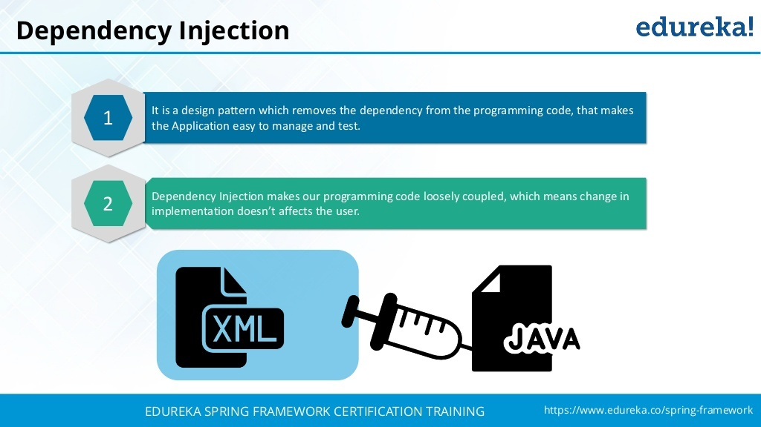

Slide 59
Dependency Injection
The basic concept of the dependency injection (also known as Inversion of Control pattern) is that you do not create your objects but describe how they should be created.
You don’t directly connect your components and services together in code but describe which services are needed by which components in a configuration file.
A container (in the case of the Spring framework, the IOC container) is then responsible for hooking it all up.
Applying IoC, objects are given their dependencies at creation time by some external entity that coordinates each object in the system.
That is, dependencies are injected into objects.
So, IoC means an inversion of responsibility with regard to how an object obtains references to collaborating objects.

Slide 60
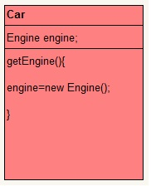
DI - Example
Lets we have two classes-Car and Engine.Car has a object of Engine.
Normal way:
There are many ways to instantiate a object. A simple and common way is with new operator.
so here Car class contain object of Engine and we have it instantiated using new operator.
Without DI

Slide 61
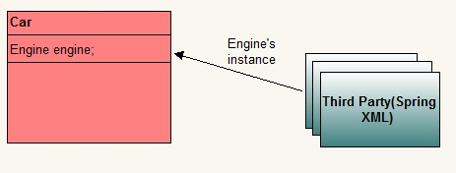
DI- Example
Now we outsource instantiation and supply job of instantiating to third party.
Car needs object of Engine to operate but it outsources that job to some third party.
The designated third party, decides the moment of instantiation and the type to use to create the instance.
The dependency between class Car and class Engine is injected by a third party.
Whole of this agreement involves some configuration information too.
This whole process is called dependency injection.
With DI

Slide 62
Dependency Injection
Dependency Injection has several important benefits :
Because components don't need to look up collaborators at runtime, they're much simpler to write and maintain.
With a Dependency Injection approach, dependencies are explicit, and evident in constructor or JavaBean properties
easy to use objects either inside or outside the IoC container
Spring also provides unique support for instantiating objects from static factory methods or even methods on other objects managed by the IoC container
your business objects can potentially be run in different Dependency Injection frameworks - or outside any framework - without code changes
Notes:
One way of structuring the code is to let the clients embed the logic of locating and / or instantiating the services as a part of their usual logic. Another way to structure the code is to have the clients declare their dependency on services, and have some "external" piece of code assume the responsibility of locating and/or instantiating theservices and simply supplying the relevant service references to the clients when needed. In the latter method, client code typically is not required to be changed when the way to locate an external dependency changes. This type of implementation is considered to be an implementation of Dependency Injection and the "external" piece of code referred to earlier is likely to be either hand coded or implemented using one of a variety of DI frameworks.
Some DI Frameworks
Spring Framework : A substantially large framework which offers a number of other capabilities apart from Dependency Injection.
PicoContainer : A fairly small tightly focused DI container framework.
HiveMind : Another DI container framework.
XWork : Primarily a command pattern framework which very effectively leverages Dependency Injection. While it is an independent framework in its own right, it is often used in conjunction with Webwork

Slide 63
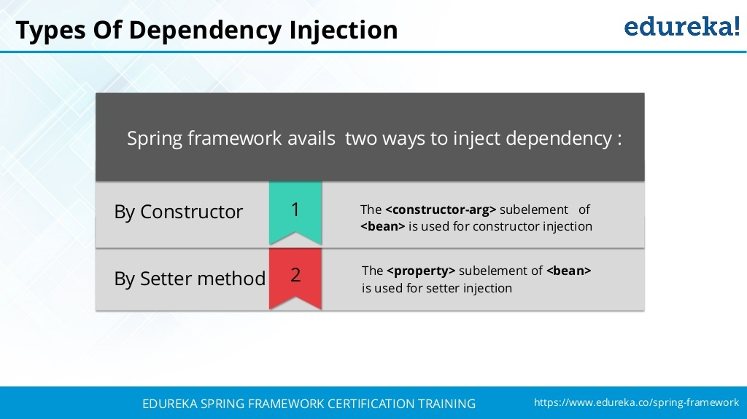

Slide 64
Dependency Injection (Contd.).
There are two types of Dependency Injection(DI) techniques we can use:
Setter Injection
using setter methods in a bean class, the Spring IOC container will inject the dependencies
Constructor Injection
The constructor will take arguments based on number of dependencies required
You don't have option to reconfigure the dependencies at later point of time, since all the dependencies are resolved only at the time of invoking the constructor
Eg.:
<constructor-arg index=“0” type="java.lang.String" value="MyName" />
Notes:
Employee.java
public class Employee { private String name; private String empId; private Address address; public Employee(String name, String empId, Address address){ this.name = name; this.empId = empId; this.address = address; } public Address getAddress() { return address; } public void setAddress(Address address) { this.address = address; }

Slide 65
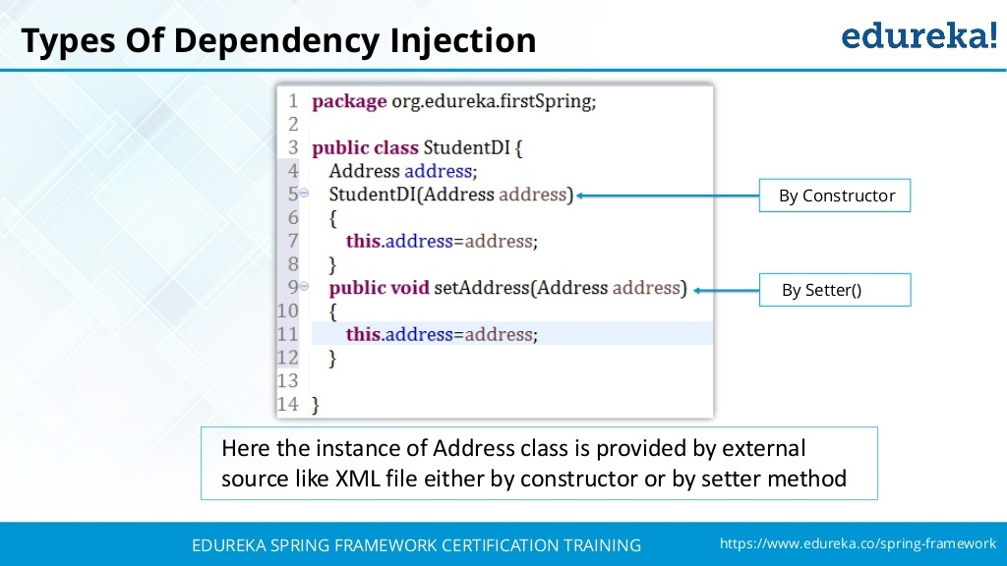

Slide 66
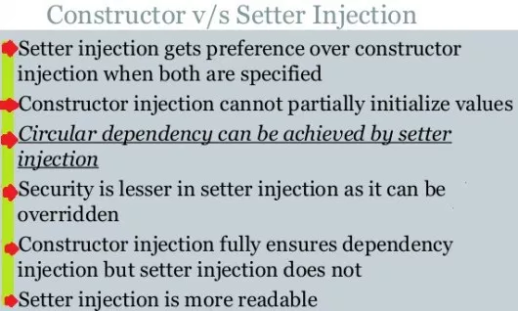
Setter vs Constructor Injection in Spring

Slide 67
Notes:
public String getEmpId() { return empId; } public void setEmpId(String empId) { this.empId = empId; } public String getName() { return name; } public void setName(String name) { this.name = name; } }
Address.java
public class Address { public Address(){ } private String street; private String city; private String pincode; public String getCity() { return city; } public void setCity(String city) { this.city = city; } public String getPincode() { return pincode; } public void setPincode(String pincode) { this.pincode = pincode; }

Slide 68
Notes:
public String getStreet() { return street; } public void setStreet(String street) { this.street = street; } } ConstructorInjection.java
import org.springframework.beans.factory.BeanFactory; import org.springframework.beans.factory.xml.XmlBeanFactory; import org.springframework.core.io.FileSystemResource; import org.springframework.core.io.Resource; public class ConstructorInjection { public static void main(String args[]){ Resource xmlResource = new FileSystemResource("applicationContext.xml"); BeanFactory factory = new XmlBeanFactory(xmlResource); Employee employee = (Employee)factory.getBean("employeeBean"); Address address = employee.getAddress(); System.out.println(employee.getName()); System.out.println(employee.getEmpId()); System.out.println(address.getCity()); System.out.println(address.getStreet()); System.out.println(address.getPincode()); } } applicationContext.xml
<?xml version="1.0" encoding="UTF-8"?> <beans xmlns="http://www.springframework.org/schema/beans" xmlns:xsi="http://www.w3.org/2001/XMLSchema-instance" xmlns:p="http://www.springframework.org/schema/p" xmlns:aop="http://www.springframework.org/schema/aop" xmlns:tx="http://www.springframework.org/schema/tx" xsi:schemaLocation="http://www.springframework.org/schema/beans http://www.springframework.org/schema/beans/spring-beans-2.5.xsd http://www.springframework.org/schema/aop http://www.springframework.org/schema/aop/spring-aop-2.5.xsd http://www.springframework.org/schema/tx http://www.springframework.org/schema/tx/spring-tx-2.5.xsd">

Slide 69
Notes:
<bean id="addressBean" class="Address"> <property name="street"> <value>Street</value> </property> <property name="city"> <value>Bangalore</value> </property> <property name="pincode"> <value>567456</value> </property> </bean> <bean id="employeeBean" class="Employee"> <constructor-arg index="0" type="java.lang.String" value="MyName"/> <constructor-arg index="1" type="java.lang.String" value="001"/> <constructor-arg index="2"> <ref bean="addressBean"/> </constructor-arg> </bean> </beans>
Application.xml (for Setter Injection)
<beans …>
<bean id="addressBean" class="Address"> <property name="street"> <value>Street</value> </property> <property name="city"> <value>Bangalore</value> </property> <property name="pincode"> <value>567456</value> </property> </bean> <bean id="employeeBean" class="Employee"> <property name="name" value="MyName"/> <property name="empId" value="001"/> <property name="address" ref="addressBean"/> </bean>
</beans>
Employee.java (for Setter Injection) : no constructor with ‘address’ as parameter, only setter & getter methods

Slide 70
Spring - Beans Auto-Wiring
You have learnt how to declare beans using the <bean> element and inject <bean> using <constructor-arg> and <property> elements in XML configuration file.
The Spring container can autowire relationships between collaborating beans without using <constructor-arg> and <property> elements.
Autowiring feature of spring framework enables you to inject the object dependency implicitly.
It internally uses setter or constructor injection.
Autowiring can't be used to inject primitive and string values. It works with reference only.
This helps cut down on the amount of XML configuration you write for a big Spring-based application.

Slide 71
Autowiring Modes
The following are the autowiring modes, which can be used to instruct the Spring container to use autowiring for dependency injection.
You use the autowire attribute of the <bean/> element to specify autowire mode for a bean definition.
No
This is default setting which means no autowiring and you should use explicit bean reference for wiring.
You have nothing to do special for this wiring.
byName
Autowiring by property name.
Spring container looks at the properties of the beans on which autowire attribute is set to byName in the XML configuration file.
It then tries to match and wire its properties with the beans defined by the same names in the configuration file.

Slide 72
AutoWiring Modes
byType
Autowiring by property datatype.
Spring container looks at the properties of the beans on which autowire attribute is set to byType in the XML configuration file.
It then tries to match and wire a property if its type matches with exactly one of the beans name in configuration file.
If more than one such beans exists, a fatal exception is thrown.
constructor
Similar to byType, but type applies to constructor arguments.
If there is not exactly one bean of the constructor argument type in the container, a fatal error is raised.
autodetect
Spring first tries to wire using autowire by constructor, if it does not work, Spring tries to autowire by byType.

Slide 73
Autowiring – Pros & Cons
It requires the less code because we don't need to write the code to inject the dependency explicitly.
No control of programmer.
It can't be used for primitive and string values.

Slide 74
Annotations in Spring Based Configuration
Starting from Spring 2.5 it became possible to configure the dependency injection using annotations.
So instead of using XML to describe a bean wiring, you can move the bean configuration into the component class.
It is done by using annotations on the relevant class, method, or field declaration.
Annotation injection is performed before XML injection.
Thus, the latter configuration will override the former for properties wired through both approaches.

Slide 75
Annotation Wiring
Annotation wiring is not turned on in the Spring container by default.
So, before we can use annotation-based wiring, we will need to enable it in our Spring configuration file.
<?xml version = "1.0" encoding = "UTF-8"?>
<beans xmlns = "http://www.springframework.org/schema/beans"
xmlns:xsi = "http://www.w3.org/2001/XMLSchema-instance"
xmlns:context = "http://www.springframework.org/schema/context"
xsi:schemaLocation = "http://www.springframework.org/schema/beans
http://www.springframework.org/schema/beans/spring-beans-4.0.xsd
http://www.springframework.org/schema/context
http://www.springframework.org/schema/context/spring-context-4.0.xsd">
<context:annotation-config/>
<!-- bean definitions go here -->
</beans>

Slide 76
<context:annotation-config/>
The new configurations in the Spring context file(spring.xml).
The <context:annotation-config/> element is used to automatically register all of Spring’s standard post-processors for annotation-based configuration.
Activates various annotations to be detected in bean classes:
@Required The @Required annotation applies to bean property setter methods.
@Autowired The @Autowired annotation can apply to bean property setter methods, non-setter methods, constructor and properties.
@Qualifier The @Qualifier annotation along with @Autowired can be used to remove the confusion by specifiying which exact bean will be wired.
JSR-250 Annotations Spring supports JSR-250 based annotations which include @Resource, @PostConstruct and @PreDestroy annotations.

Slide 77
Annotation @Required
Target:
bean property setter methods
Desrcription-
The @Required annotation is used to specify that the value of a bean property is required to be dependency injected.
That means, an error is caused if a value is not specified for that property.

Slide 78
Annotation @Autowired
Spring Autowiring by using the “autowire” attribute in the bean configuration file we can wire all the properties of the bean class.
Using Spring Autowiring through XML you cannot wire a particular property.
In those cases we can use the Spring @Autowired annotation which allows auto-wiring of setter method, a constructor, a field, or even an arbitrary method.
Target:
bean property setter methods, non-setter methods, constructor and properties.

Slide 79
Annotation @Qualifier
There may be a situation when you create more than one bean of the same type and want to wire only one of them with a property.
In such cases, you can use the @Qualifier annotation along with @Autowired to remove the confusion by specifying which exact bean will be wired.
Target:
bean property setter methods
Description-
There may be a situation when you create more than one bean of the same type and want to wire only one of them with a property.
in such case you can use @Qualifier annotation along with @Autowired to remove the confusion by specifying which exact bean will be wired.

Slide 80
Spring JSR-250 Annotations -@Resource
We can use @Resource annotation on fields or setter methods and it works the same as in Java EE 6.
The @Resource annotation takes a 'name' attribute which will be interpreted as the bean name to be injected.
In other words, it follows by-name semantics.
That's where it differs from other annotations for autowiring like @Autowired and @Inject which are equivalent to autowiring="byType" in autowiring using XML configuration file.
In case no name is provided with @Resource annotation explicitly, the default name is derived from the field name or setter method.
In case of a field, it takes the field name;
In case of a setter method, it takes the bean property name

Slide 81
Spring Dependency Injection With Collections
Spring support injection in the form of the collection as well, it supports the below collections.
List
Set
Map
Properties
Injecting String values to a list and Objects to another list using <list> tag in our configuration file.
<property name="stringList">
<list>
<value>Google</value>
<value>Microsoft</value>
<value>Redhat</value>
</list>
</property>

Slide 82
Spring Bean Life Cycle and Callbacks
Spring Bean Life cycle is managed by the spring container.
The Spring bean life cycle is easy to understand.
When a bean is instantiated, it may be required to perform some initialization to get it into a usable state.
Similarly, when the bean is no longer required and is removed from the container, some cleanup may be required.
Two important bean life cycle callback methods which are required at the time of bean initialization and its destruction.
“myinit” and “cleanUp” are names of instance methods in the bean class.
This is done in XML by specifying attributes init-method=”myinit”, for the initialization callback, and destroy-method=”mydestroy”,

Slide 83
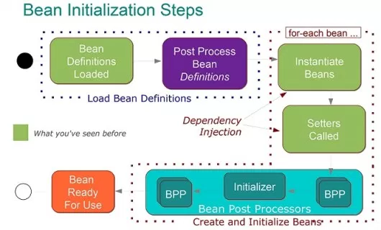

Slide 84
Summary
In this module, we have learnt
Spring Containers
Bean Configuration File and its content
Inversion of Control methodologies
Setter Injection
Constructor Injection

Slide 85
Module 3: Aspect Oriented Programming
(AOP)
Notes:
85

Slide 86
Objectives
This module is aimed at :
Introducing Aspect Oriented Programming(AOP)
AOP Concepts
Join Points
Advice
Point Cuts
Aspects
Weaving
Target
Pointcut Advisor
Proxy

Slide 87
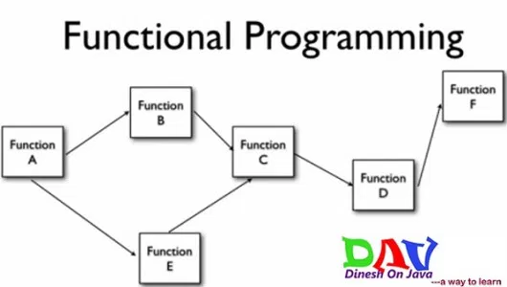
Functional Programming:
In older programming language like C, we have used functional programming style like below in figure.
In this style of programming writing code into couple of functions.
Each function perform unit task and each function call another function.
After last function execution then program is completed.
But in this style of programming the main problem is complexity.
It is very messy style of coding to write big project programming.

Slide 88
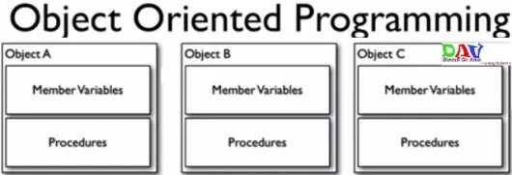
Object Oriented Programming
In this style of programming we would not think about function when we trying to solve problem by writing code.
We would think as individual entities as object when writing the program as below Object A, Object B & Object C…
Here each object contain member variables and methods to perform individual tasks of each individual entity.
This is fine but here is also a problem that not all rectify common procedure in all of the objects as common logging procedure in all as logMessage() method in all.

Slide 89
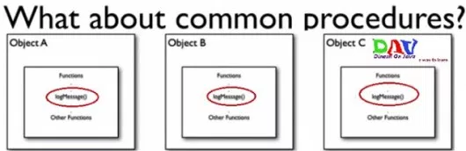
Common Procedures
In above see that logMessage() method in each objects no matter how many objects are there so this is not good design of programming.
Each object has repeating method.
So to solve this type problem we write the separate entity for logger and called in each objects where we want to add read log message as below.

Slide 90
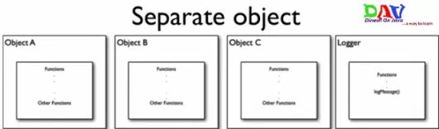
Separate Object
For using this logger entity in each object we have to make dependency injection with each beans of business classes .
Problem is doing the design this type of style there too many dependencies with non business object.
Because logger object does not have any business logic in the project its using just for logging with each objects in the project.
To many relationships with the crosscutting objects.
Code is still required in the all methods
Cannot all be changed at once

Slide 91
ASPECT
Aspects means Aspects are also specific classes with some special methods for particular tasks like logging, security and transactions etc.
A modularized implementation of a software concern that cuts across various objects in a software implementation.
Logging
Security
Transactionality
The core advantage in using Spring AOP is its ability to realize the aspect as a plain Java class.
Aspect is a module which has a set of APIs providing cross-cutting requirements.

Slide 92
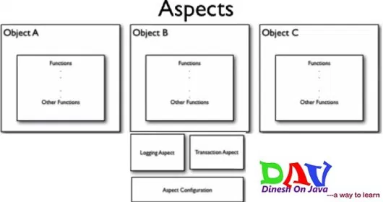
AOP

Slide 93
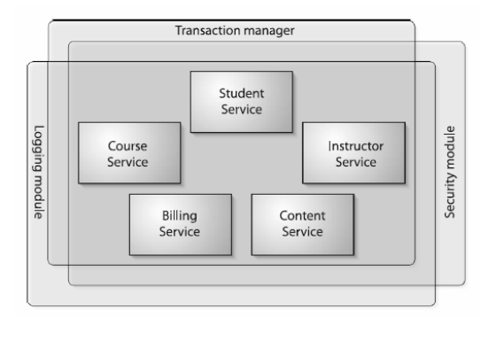
AOP
AOP makes it possible to modularize these services and then apply them declaratively to the components that they should affect.

Slide 94
AOP
Aspect Oriented Programming (AOP) compliments OOPs in the sense that it also provides modularity.
But the key unit of modularity is aspect than class.
AOP breaks the program logic into distinct parts (called concerns).
It is used to increase modularity by cross-cutting concerns.
Examples of cross-cutting concerns
Logging
Transaction management
Security
Auditing
Locking
Event handling

Slide 95
CROSS CUTTING CONCERNS
Generic functionality that is needed in many places in your application.
Means non business idea or non business logic.
A cross-cutting concern is a concern that can affect the whole application and should be centralized in one location in code.
Examples of Cross Cutting Concerns.
Logging and Tracing
Transaction Management
Security
Caching
Error Handling
Performance Monitoring
Custom Business Rules
To solve the above problems in the Object Oriented Programming we can using Aspect Oriented Programming.

Slide 96
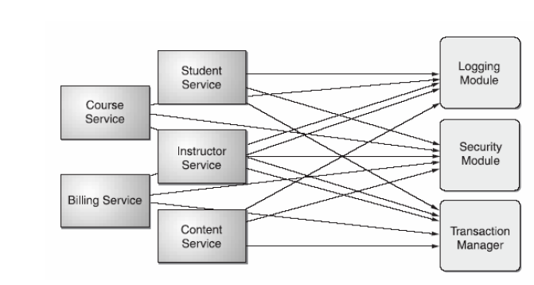
Cross-Cutting Concerns

Slide 97
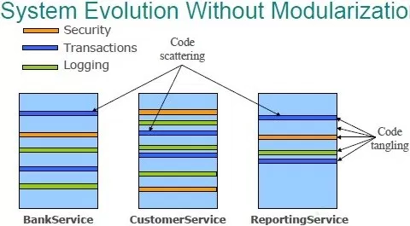
System Without AOP or Modularization
There are two main problems
– Code tangling
• A coupling of concerns
– Code scattering
• The same concern spread across modules

Slide 98
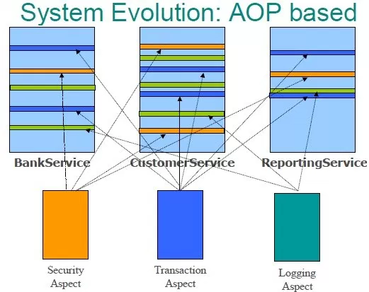
System With AOP or Modularization
Aspect-Oriented Programming (AOP) enables modularization of cross-cutting concerns
– To avoid tangling
– To eliminate scattering

Slide 99
AOP Concepts: Join Points
This represents a point in your application where you can plug-in the AOP aspect.
You can also say, it is the actual place in the application where an action will be taken using Spring AOP framework.
Well-defined point during the execution of your application.
You can insert additional logic at Join points.
A point in the execution of a program.
Examples of Jointpoints
Method invocation
Class initialization
Object initialization
exception thrown
Notes:
AOP Concepts:
Aspect -Think of this as the general feature you want to apply globally to your application (logging, performance monitoring, exception handling, transaction management, etc).
Advice - A chunk of code that is invoked during program execution, and is a piece of the logic for implementing your aspect. This is the first important piece of a Spring AOP aspect implementation! I like to compare advice implementations to the decorator pattern. While an advice doesn't necessarily wrap an entire object in concept, it has the same general effect. We'll learn in a bit that how that advice is applied is more granular / formal than typically defined in the decorator pattern however.
Joinpoint -A *single* location in the code where an advice should be executed (such as field access, method invocation , constructor invocation, etc.). Spring's built-in AOP only supports method invocation currently, so joinpoints aren't particularly important to focus on at this point.
Pointcut -A pointcut is a set of many joinpoints where an advice should be executed. So if, in Spring, a joinpoint is always a method invocation, then a pointcut is just a set of methods that, when called, should have advices invoked around them. This is the second important pieces of a Spring AOP aspect implementation!

Slide 100
AOP Concepts: Advice
Advice: The code that is executed at a particular joinpoint.
This is the actual action to be taken either before or after the method execution.
Types of Advice
‘ before advice’
executes before joinpoint
after advice
Advice to be executed regardless of the means by which a join point exits (normal or exceptional return)
afterReturning advice
Executes after joinpoint returns successfully
afterThrowing advice
Executes after the joinpoint throws exception
‘around advice’
executes around joinpoint
Notes:
Targets/Target Objects - The objects you want to apply an aspect or set of aspects to!
Introduction -This is the ability to add methods to an object. This is closely tied to, and is almost analogous to the term 'mixins'. It's really just a way to make an object of type A also an object of type B. Introduction in Spring is limited to interfaces.

Slide 101
AOP Concepts: Pointcuts
Pointcut: A collection of joinpoints defining as to when/where advice should be executed
Pointcuts can be considered as a subset of Joinpoints.
By creating pointcuts, you gain fine-grained control over how you apply advice to the components and outof the available JoinPoints at which Joinpoints do you want to execute your advice.
Pointcuts can be composed in complex relationships to further constrain when advice is executed (by using regular expression patterns)

Slide 102
AOP Concepts: Aspects ,Weaving, etc.,.
An aspect is a combination of advice and pointcuts
Weaving: Process of actually inserting aspects into the application code at the appropriate point
Target: An object whose execution flow is modified by some AOP process
They are sometimes called advised object
Notes:
Weaving:
Compile Time Weaving
Byte Code Weaving
Dynamic Proxy Based Weaving (Spring Supports only this)

Slide 103
Spring AOP – Infrastructure and Advices
Spring's 'built-in' AOP infrastructure is defined by the org.springframework.aop.* packages
org.springframework.aop.MethodBeforeAdvice
Implementations of this interface have to implement this contract:
void before(Method method, Object[] args, Object target) throws Throwable
org.springframework.aop.AfterReturningAdvice
This interface's method will be called on the return from the invocation of a method
void afterReturning(Object returnValue, Method method, Object[] args, Object target) throws Throwable
org.springframework.aop.ThrowsAdvice
public void afterThrowing(Method method, Object[] args, Object target, Throwable subclass)

Slide 104
Spring – Pointcuts & PointcutAdvisor
A Pointcut object is all about defining all of the joinpoints that an advice should be 'applied to'
In Spring terms, a pointcut defines all of the methods that our interceptor should intercept.
an advice works with is called a JoinPoint .
Joinpoints in Spring are always method invocations
Pointcuts in Spring implement the org.springframework.aop.Pointcut interface
A PointcutAdvisor is nothing more than a pointcut and an advice object combined
The most basic variety of pointcut advisor is the org.springframework.aop.support.DefaultPointcutAdvisor class
Notes:
What seperates AOP from object-oriented design patterns such as the decorator pattern, at least when talking about Spring AOP, is the fact that the *what* is defined seperately from the *where* (or would it be *whom*?). In other words, the 'advice', which is the code to be invoked, is disconnected entirely from the particular item it is 'advising' - which, again, in the Spring case is always a method. In other words, an advice in Spring doesn't have any association, type binding, dependency, or any other form of direct awareness of the method it is working with.
Remember that the thing that an advice works with is called a JoinPoint . Our join points in Spring are always methods, and at runtime resolve to org.aopalliance.aop.Method objects which have made appearances as method arguments to our advices above. To solidify the point, org.aopalliance.aop.Method extends org.aopalliance.aop.JoinPoint .
A Pointcut object is all about defining all of the joinpoints that an advice should be 'applied to' .
Tying Pointcuts with Advisors - PointcutAdvisors (sample xml configuration below)

Slide 105
Custom Aspects Implementation
Spring supports the following two types of approach to implement custom aspects.
@AspectJ annotation style approach
@AspectJ refers to a style of declaring aspects as regular Java classes annotated with Java 5 annotations.
XML schema-based approach
Aspects are implemented using the regular classes along with XML based configuration.

Slide 106
Spring AOP – AspectJ Annotation
One of the key components of Spring is the Aspect-Oriented Programming (AOP) framework.
While the Spring IoC container does not depend on AOP, meaning you do not need to use AOP if you don’t want to.
AOP complements Spring IoC to provide a very capable middleware solution.
Just like the key unit of modularity in OOP is the class, in AOP the unit of modularity is the aspect.
Aspects enable the modularization of concerns (you can read as crosscutting concerns as well) such as transaction management that cut across multiple types and objects.

Slide 107
@AspectJ Based AOP with Spring
@AspectJ refers to a style of declaring aspects as regular Java classes annotated with Java 5 annotations.
AspectJ has grown into a complete and popular AOP framework.
It is a seamless aspect-oriented extension to the Java^{tm} programming language.
Spring supports the use of POJO aspects written with AspectJ annotations in its AOP framework.
Since AspectJ annotations are supported by more and more AOP frameworks.
AspectJ-style aspects are more likely to be reused in other AOP frameworks that support AspectJ.
It enables clean modularization of crosscutting concerns, such as error checking and handling, synchronization, context-sensitive behavior, performance optimizations, monitoring and logging, debugging support, and multi-object protocols

Slide 108
@AspectJ Based AOP Implimentation
The @AspectJ support is enabled by including the following element inside your XML Schema-based configuration file.
<aop:aspectj-autoproxy/>
We will also need the following AspectJ libraries on the classpath of your application.
aspectjrt.jar
aspectjweaver.jar
aspectj.jar
aopalliance.jar

Slide 109
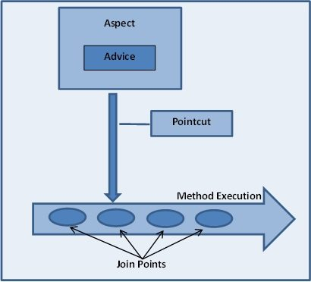
AOP Key Terms

Slide 110
Declaring an aspect
Aspects classes are like any other normal bean.
They may have methods and fields just like any other class, except that they will be annotated with @Aspect as follows −
package org.xyz;
import org.aspectj.lang.annotation.Aspect;
@Aspect
public class AspectModule { }
They will be configured in XML like any other bean as follows −
<bean id = "myAspect" class = "org.xyz.AspectModule">
<!-- configure properties of aspect here as normal -->
</bean>

Slide 111
Declaring a pointcut
A pointcut helps in determining the join points (ie methods) of interest to be executed with different advices. While working with @AspectJ-based configuration, pointcut declaration has two parts −
A pointcut expression that determines exactly which method executions we are interested in.
A pointcut signature comprising a name and any number of parameters. The actual body of the method is irrelevant and in fact should be empty.

Slide 112
Pointcut Declaration
The following example defines a pointcut named 'businessService' that will match the execution of every method available in the classes under the package com.xyz.myapp.service −
The following example defines a pointcut named 'getname' that will match the execution of getName() method available in the Student class under the package com.wipro −
import org.aspectj.lang.annotation.Pointcut;
@Pointcut("execution(* com.xyz.myapp.service.*.*(..))") // expression
private void businessService() {} // signature
import org.aspectj.lang.annotation.Pointcut;
@Pointcut("execution(* com.wipro.Student.getName(..))")
private void getname() {}

Slide 113
Declaring advices
You can declare any of the five advices using @{ADVICE-NAME} annotations as given in the code snippet.
This assumes that you already have defined a pointcut signature method businessService() −
@Before("businessService()")
public void doBeforeTask(){ ... }
@After("businessService()")
public void doAfterTask(){ ... }
@AfterReturning(pointcut = "businessService()", returning = "retVal")
public void doAfterReturnningTask(Object retVal)
{ // you can intercept retVal here. ... }
@AfterThrowing(pointcut = "businessService()", throwing = "ex")
public void doAfterThrowingTask(Exception ex)
{ // you can intercept thrown exception here. ... }
@Around("businessService()")
public void doAroundTask(){ ... }

Slide 114
@AspectJ Based AOP Example
To understand the above-mentioned concepts related to @AspectJ based AOP, let us write an example which will implement few of the advices.
Create Java classes Logging, Student and MainApp.
Create Beans configuration file .
The final step is to create the content of all the Java files and Bean Configuration file and run the application

Slide 115
Spring AOP – Aspects Ordering
Suppose you have multiple aspects in your application and they are can be applied on a certain method.
When there’s more than one aspect applied to the same join point, the precedence/order of the aspects will not be determined.
Unless you have explicitly specified it using either @Order annotation or org.springframework.core.Ordered interface.
@Aspect
@Order(0)
public class LogAspect
{
………
}

Slide 116
XML Schema Based AOP with Spring
To use the AOP namespace tags described in this section, you need to import the springAOP schema as described.
<?xml version = "1.0" encoding = "UTF-8"?>
<beans xmlns = "http://www.springframework.org/schema/beans"
xmlns:xsi = "http://www.w3.org/2001/XMLSchema-instance"
xmlns:aop = "http://www.springframework.org/schema/aop"
xsi:schemaLocation = "http://www.springframework.org/schema/beans
http://www.springframework.org/schema/beans/spring-beans-4.0.xsd
http://www.springframework.org/schema/aop
http://www.springframework.org/schema/aop/spring-aop-4.0.xsd ">
<!-- bean definition & AOP specific configuration -->
</beans>

Slide 117
Declaring an aspect
An aspect is declared using the <aop:aspect> element, and the backing bean is referenced using the ref attribute as follows −
<aop:config>
<aop:aspect id = "myAspect" ref = "aBean">
...
</aop:aspect>
</aop:config>
<bean id = "aBean" class = "...">
...
</bean>
Here "aBean" will be configured and dependency injected just like any other Spring bean

Slide 118
Declaring a pointcut
A pointcut helps in determining the join points (ie methods) of interest to be executed with different advices.
<aop:config>
<aop:aspect id = "myAspect" ref = "aBean">
<aop:pointcut id = "businessService"
expression = "execution(*com.xyz.myapp.service.*.*(..))"/>
...
</aop:aspect>
</aop:config>
<bean id = "aBean" class = "...">
...
</bean>

Slide 119
Declaring advices
You can declare any of the five advices inside an <aop:aspect> using the <aop:{ADVICE NAME}>
<aop:config>
<aop:aspect id = "myAspect" ref = "aBean">
<aop:pointcut id = "businessService"
expression = "execution(* com.xyz.myapp.service.*.*(..))"/>
<!-- a before advice definition -->
<aop:before pointcut-ref = "businessService" method = "doRequiredTask"/>
<!-- an after advice definition -->
<aop:after pointcut-ref = "businessService" method = "doRequiredTask"/>
</aop:aspect>
</aop:config>
<bean id = "aBean" class = "...">
...
</bean>

Slide 121
Spring AOP– ProxyFactoryBean
Required to create a proxy for your bean that executes some advice on method calls when the pointcut says the method is a joinpoint
You typically use ProxyFactoryBean class to provide declarative proxy creation
E.g.:
<bean name="myController“ class = "org.springframework.aop.framework.ProxyFactoryBean">
<property name="proxyInterfaces">
<value>IBusinessLogic</value>
</property>
<property name="target" ref="myRawController"/> <property name="interceptorNames">
<list>
<value>beforeAdviceA</value>
<value>
Notes:
<bean name="interceptorA" class="com.javalobby.tnt.spring.aop.InterceptorA" />
<bean name="pointcut.advisor1" class = "org.springframework.aop.support.NameMatchMethodPointcutAdvisor">
<property name="advice" ref="interceptorA"/>
<property name="mappedName" value="handleRequestInternal"/> </bean>
Example:
Around Advice:
public class MessageDecorator implements MethodInterceptor {
public Object invoke(MethodInvocation invocation) throws Throwable {
System.out.print("Hello ");
Object retVal = invocation.proceed();
System.out.println("!");
return retVal;
}
Proxy set programmatically:
ProxyFactory pf = new ProxyFactory();
ExampleController target = new ExampleController();
pf.setTarget(target);
ExampleController proxy = (ExampleController) pf.getProxy(); …

Slide 122
Spring AOP – Around Advice Infrastructure
Around-Advice‘ implementations in Spring are simply implementations of the org.aopalliance.intercept.MethodInterceptor interface
When you write an advice for intercepting a method, you have to implement one method - the invoke method, and you are given a MethodInvocation object to work with
The MethodInvocation object tells us about the method that we're intercepting, and also gives a hook to tell the method to go ahead and run
Notes:
Basic method performance profiling advice:
import org.aopalliance.intercept.*;
public class PerformanceInterceptor implements MethodInterceptor
{
public Object invoke(MethodInvocation method) throws Throwable
{
long start = System.currentTimeMillis();
try {
Object result = method.proceed();
return result; }
finally {
long end = System.currentTimeMillis();
long timeMs = end - start; System.out.println("Method: " + method.toString() + " took: " + timeMs+"ms.");
}
}
}

Slide 123
Notes:
//Weaving Advice
public static void main(String[] args) {
MessageWriter target = new MessageWriter();
// create the proxy
ProxyFactory pf = new ProxyFactory();
//Add the given AOP Alliance advice to the tail of the advice (interceptor) chain
pf.addAdvice(new MessageDecorator());
//Set the given object as target
pf.setTarget(target);
//Create a new proxy according to the
//settings in this factory
MessageWriter proxy = (MessageWriter) pf.getProxy();
// write the messages
target.writeMessage();
System.out.println("");
// use the proxy
proxy.writeMessage(); }}
Complete Example code on Before & After Advice:
<?xml version="1.0" encoding="UTF-8"?>
<!DOCTYPE beans PUBLIC "-//SPRING//DTD BEAN//EN" "http://www.springframework.org/dtd/spring-beans.dtd">
<beans> <!-- Bean configuration -->
<bean id="businesslogicbean" class = "org.springframework.aop.framework.ProxyFactoryBean"> <property name="proxyInterfaces">
<value>IBusinessLogic</value>
</property>
<property name="target">
<ref local="beanTarget"/>
</property>

Slide 124
Notes:
<property name="interceptorNames">
<list>
<value>theTracingBeforeAdvisor </value>
<value>theTracingAfterAdvisor</value>
</list>
</property>
</bean>
<!-- Bean Classes -->
<bean id="beanTarget" class="BusinessLogic"/>
<!-- Advisor pointcut definition for before advice -->
<bean id="theTracingBeforeAdvisor" class = "org.springframework.aop.support.RegexpMethodPointcutAdvisor">
<property name="advice">
<ref local="theTracingBeforeAdvice"/>
</property>
<property name="pattern"> <value>.*</value>
</property>
</bean>
<!-- Advisor pointcut definition for after advice -->
<bean id="theTracingAfterAdvisor" class = "org.springframework.aop.support.RegexpMethodPointcutAdvisor">
<property name="advice">
<ref local="theTracingAfterAdvice"/>
</property>
<property name="pattern"> <value>.*</value>
</property>
</bean>
<!-- Advice classes -->
<bean id="theTracingBeforeAdvice" class="TracingBeforeAdvice"/>
<bean id="theTracingAfterAdvice" class="TracingAfterAdvice"/>
</beans>

Slide 125
Summary
In this module, we have learnt
Introducing Aspect Oriented Programming(AOP)
AOP Concepts
Join Points
Advice
Point Cuts
Aspects
Weaving
Target
Pointcut Advisor
Proxy

Slide 126
References
http://www.theserverside.com/tt/articles/article.tss?l=SpringFramework
http://static.springframework.org/spring/docs/
http://www.javabeat.net/articles/71-introduction-to-spring-web-framework-3.html
http://www.java2s.com/Code/Java/Hibernate/HibernateSpringHibernateTemplateFind.htm

Slide 127
Thank You

