Slide 1





Zero Effort Spring: An intro to Spring Boot

Slide 2
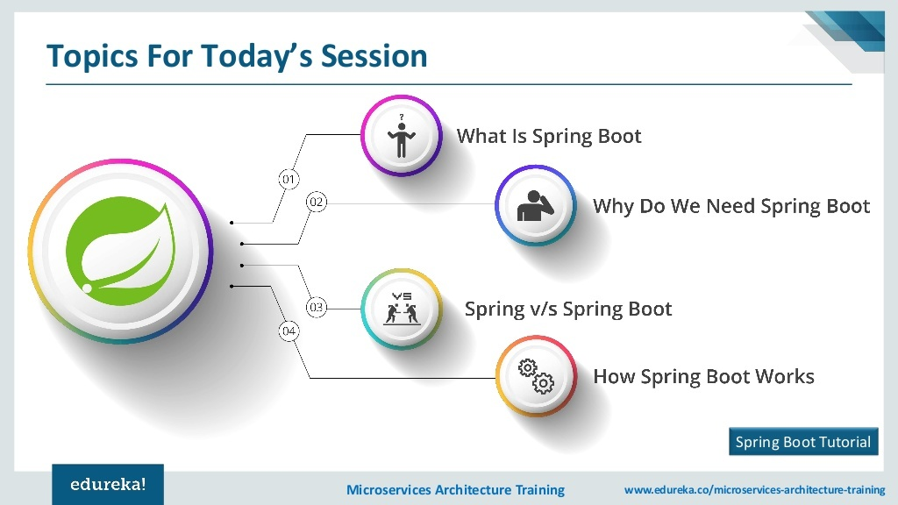

Slide 3
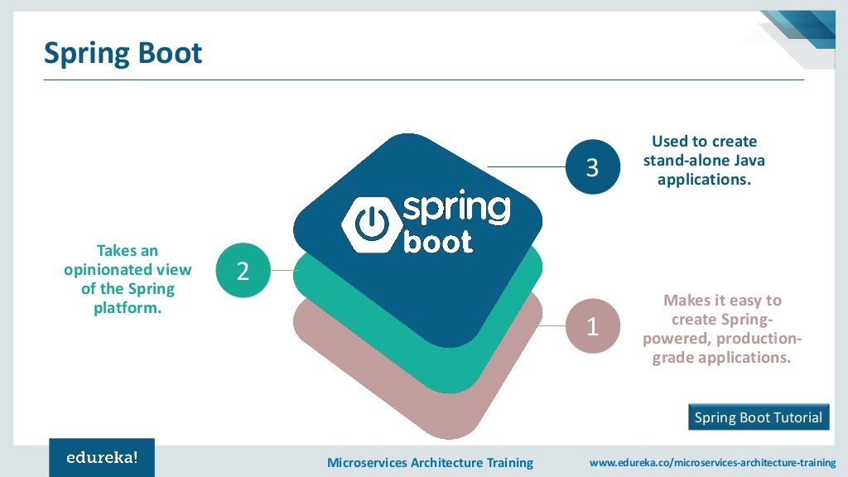

Slide 4
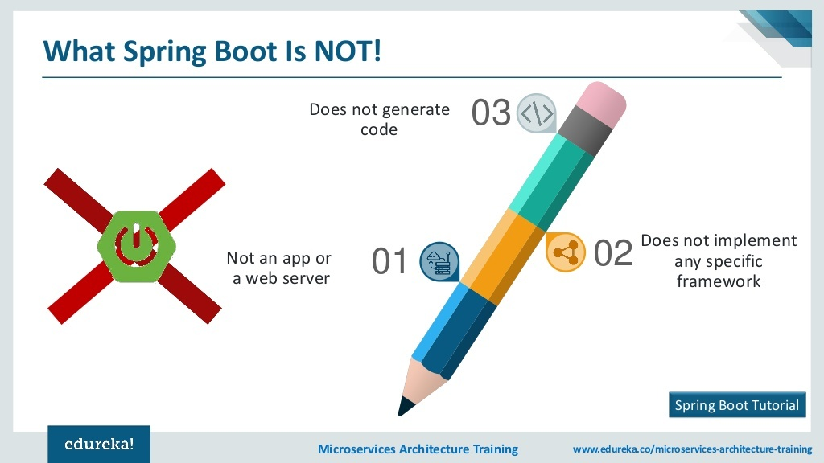

Slide 5
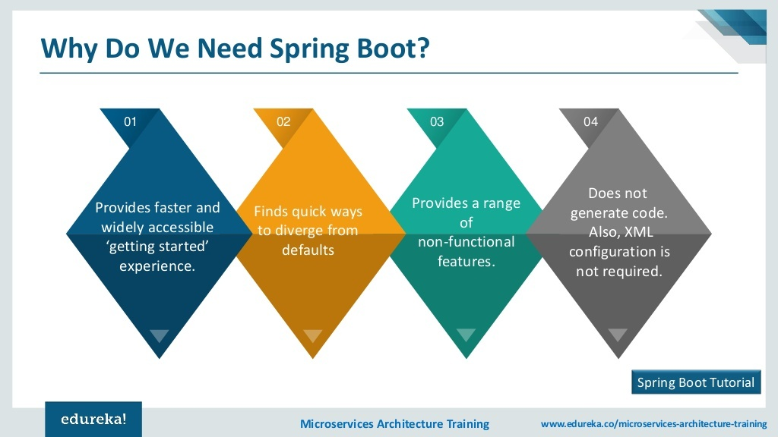

Slide 6
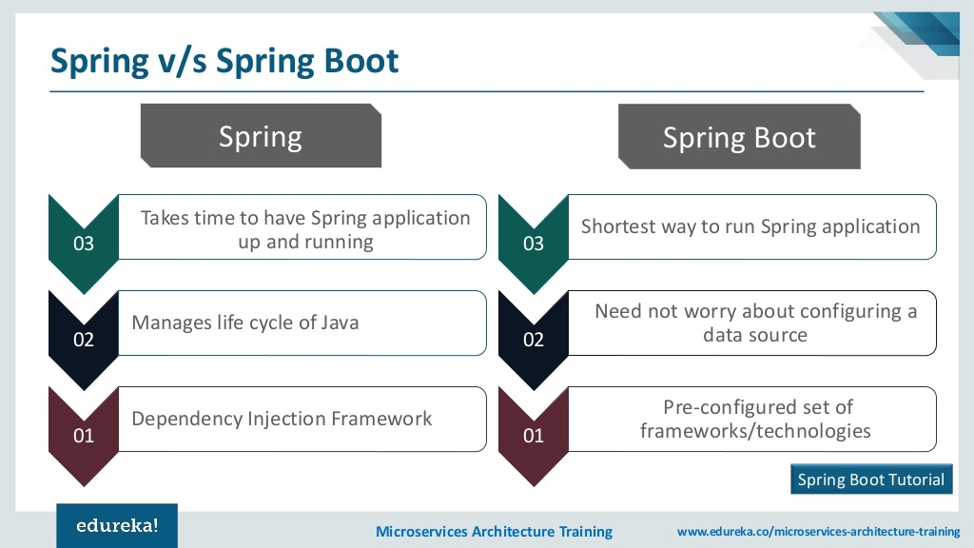

Slide 7
Spring Boot Introduction
Spring Boot is a Spring module which provides RAD (Rapid Application Development) feature to Spring framework.
It is used to create stand alone spring based application that you can just run because it needs very little spring configuration.
Spring Boot does not generate code and there is absolutely no requirement for XML configuration.
It uses convention over configuration software design paradigm that means it decrease the effort of developer.
Spring Boot uses completely new development model to make Java Development very easy by avoiding some tedious development steps and boilerplate code and configuration.
It uses convention over configuration software design paradigm that means it decrease the effort of developer.

Slide 8
Spring Boot Advantages
The main aim of Spring Boot is to let developers to create spring production grade applications and services with very less effort.
Did you remember, what it takes to create real-time spring applications?
It includes writing many XMLconfigurations, server setting, adding dependencies…etc.
But with spring Boot we can avoid all these boilerplate code, writing XML configurations and annotations.
We can create a real-time production ready applications with in minutes.

Slide 9
Spring Boot Advantages
Spring Boot comes with inbuilt server, we no longer have to use any external servers like Tomcat, Glass-fish or anything else, so don’t need to deploy WAR files.
Embed Tomcat, Jetty or Glassfish directly. You don't need to deploy WAR files.
Main advantage of Spring Boot is, we can create spring based applications easily in very less time, without need of any XML configurations.
It provides opinionated 'starter' POMs to simplify your Maven configuration.
We have to use either Maven or Gradle build tool to work with Spring Boot.
The main disadvantage is, it will be little tough to migrate existing spring enterprise applications to Spring Boot.

Slide 10

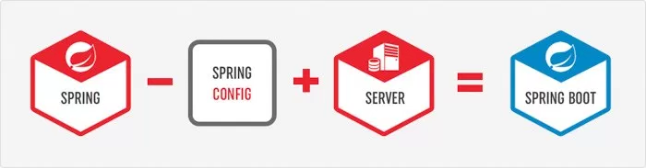
Spring Boot Means
That means Spring Boot is nothing but existing Spring Framework + Some Embedded HTTP Servers (Tomcat/Jetty etc.) – XML or Annotations Configurations.
Here minus means we don’t need to write any XML Configuration and few Annotations only.

Slide 11
Main Goal of Spring Boot
The main goal of Spring Boot Framework is to reduce Development, Unit Test and Integration Test time.
To ease the development of Production ready web applications very easily compared to existing Spring Framework, which really takes more time.
To avoid XML Configuration completely.
To avoid defining more Annotation Configuration(It combined some existing Spring Framework Annotations to a simple and single Annotation).
To avoid writing lots of import statements.
To provide some defaults to quick start new projects within no time.
To provide Opinionated Development approach.

Slide 12

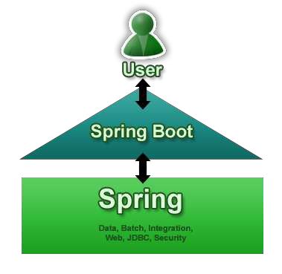
Goals
Provide a radically faster and widely accessible getting started experience
Be opinionated out of the box, but get out of the way quickly as
requirements start to diverge from the defaults
Provide a range of non-functional features that are common to large classes of projects (e.g. embedded servers, security, metrics, health checks, externalized configuration)
Absolutely no code generation and no requirement for XML configuration
10

Slide 13
Spring Boot – why ?
Spring Boot is a brand new framework from the team at Pivotal, designed to simplify the bootstrapping and development of a new Spring application.
The framework takes an opinionated approach to configuration, freeing developers from the need to define a boilerplate configuration.
It provides defaults for code and annotation configuration to quick start new Spring projects within no time.
We can use Spring Boot to create Java applications that can be started by using java -jar or more traditional war deployments.
We also provide a command line tool that runs “spring scripts”.

Slide 14
Primary Goals
Provide a radically faster and widely accessible getting-started experience for all Spring development.
Be opinionated out of the box but get out of the way quickly as requirements start to diverge from the defaults.
Provide a range of non-functional features that are common to large classes of projects (such as embedded servers, security, metrics, health checks, and externalized configuration).
Absolutely no code generation and no requirement for XML configuration.

Slide 15
Opinionated Approach
To Start Opinionated Approach to create Spring Boot Applications, The Spring Team (The Pivotal Team) has provided the following three approaches.
Spring Maven Project
Using Spring Boot CLI Tool
Using Spring STS IDE / Eclipse
Using Spring Initializer Website
We can find Spring Initializer Website at: http://start.spring.io/

Slide 16





Spring Boot Modules
CLI
Starters
Autoconfigure
Boot
Actuator Tools Samples

Slide 17
Spring Boot Core
The base for other modules, but it also provides some functionality that can be used on its own.
eg. using command line arguments and YAML files as Spring Environment property sources and automatically binding environment properties to Spring bean properties (with validation).

Slide 18
Spring Boot Auto Configure
Spring Boot addresses the problem that Spring applications need complex configuration by eliminating the need to manually set up the boilerplate configuration.
Spring Boot takes an opinionated view of the application and configures various components automatically.
Module to auto configure a wide range of Spring projects.
Presence or absence of a Spring bean
It will detect availability of certain frameworks (Spring Batch, Spring Data JPA, Hibernate, JDBC).
When detected it will try to auto configure that framework with some sensible defaults,
Which in general can be overridden by configuration in an application.properties/yml file.

Slide 19
Elegant Configuration Management
Spring supports externalizing configurable properties using the @PropertySource configuration.
Spring Boot takes it even further by using the sensible defaults and powerful type-safe property binding to bean properties.
Spring Boot supports having separate configuration files for different profiles without requiring many configurations.

Slide 20
Spring Boot Actuator
Being able to get the various details of an application running in production is crucial to many applications.
The Spring Boot actuator provides a wide variety of such production-ready features without requiring developers to write much code.
Some of the Spring actuator features are:
Can view the application bean configuration details
Can view the application URL mappings, environment details, and configuration parameter values
Can view the registered health check metrics

Slide 21
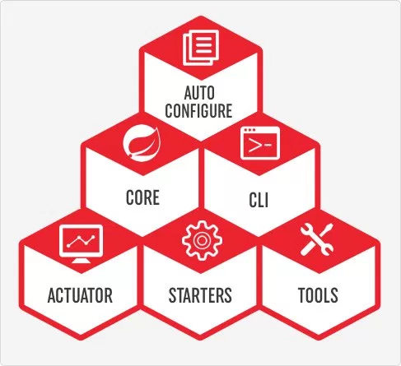
Spring Boot CLI
A command line interface, based on ruby, to start/stop spring boot created applications.

Slide 22
Spring Boot Starters
Different quick start projects to include as a dependency in your maven or gradle build file.
It will have the needed dependencies for that type of application.
Currently there are many starter projects and many more are expected to be added.

Slide 23
Spring Boot Tools
The Maven and Gradle build tool as well as the custom Spring Boot Loader (used in the single executable jar/war) is included in this project.
Traditionally, while building web applications, you need to create WAR type modules and then deploy them on external servers like Tomcat, WildFly, etc.
But by using Spring Boot, you can create a JAR type module and embed the servlet container in the application very easily so that the application will be a self-contained deployment unit.
Also, during development, you can easily run the Spring Boot JAR type module as a Java application from the IDE or from the command-line using a build tool like Maven or Gradle.

Slide 24
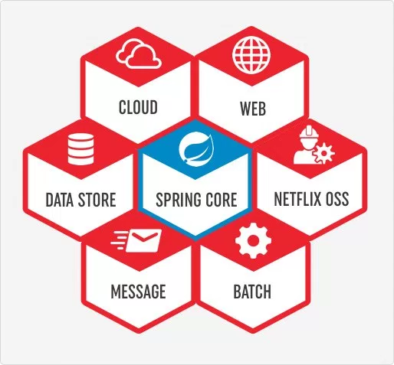
Spring Boot Starters
Spring Boot incorporates many starters packages (in Maven & Gradle) which you can include in order to add appropriate support in your project.
At a high-level there are so far 6 types of starters packages available.
You can find all of them in Spring Boot official WebSite.

Slide 25
Spring Boot Features
Web Development
It is well suited Spring module for web application development.
We can easily create a self-contained HTTP server using embedded Tomcat, Jetty or Undertow.
We can use the spring-boot- starter-web module to start and running application quickly.
Spring Application
It is a class which provides the convenient way to bootstrap a spring application which can be started from main method.
You can call start your application just by calling a static run() method.
public static void main(String[] args){
SpringApplication.run(className.class, args);
}

Slide 26
Spring Boot Features
Application Events and Listeners
Spring Boot uses events to handle variety of tasks. It allows us to create factories file that are used to add listeners. we can refer it by using ApplicationListener key.
Always create factories file in META-INF folder like: META-INF/spring.factories.
Admin Support
Spring Boot provides the facility to enable admin related features for the application.
It is used to access and manage application remotely.
We can enable it by simply using spring.application.admin.enabled property.
Type-safe Configuration
Strong type-safe configuration is provided to govern and validate the configuration of application.
Application configuration is always a crucial task which should be type-safe.
We can also use annotation provided by this library.

Slide 27
Spring Boot Features
Externalized Configuration
Spring Boot allows us to externalize our configuration so that we can work with the same application in different environments.
Application use YAML files to externalize configuration.
Properties Files
Spring Boot provides rich set of Application Properties.
So, we can use that in properties file of our project.
Properties file is used to set properties like: server-port = 8082 and many others.
It helps to organize application properties.
YAML Support
It provides convenient way for specifying hierarchical configuration. It is a superset of JSON. The SpringApplication class automatically support YAML. It is successful alternative of properties.

Slide 28
Spring Boot Features
Logging
Spring Boot uses Common logging for all internal logging.
Logging dependencies are managed by default.
We should not change logging dependencies, if there is no required customization is needed.
Security
Spring Boot applications are spring bases web applications.
So, it is secure by default with basic authentication on all HTTP endpoints.
A rich set of Endpoints are available for develop a secure Spring Boot application.

Slide 29
System Requirements
Spring Boot 2+ requires Java 8 or 9 and Spring Framework 5.1.0.RELEASE or above.
Explicit build support is provided for the following build tools:
Maven 3.2+
Gradle 4.x
Servlet Containers
Tomcat 8.5
Jetty 9.4
You can also deploy Spring Boot applications to any Servlet 3.1+ compatible container.

Slide 30
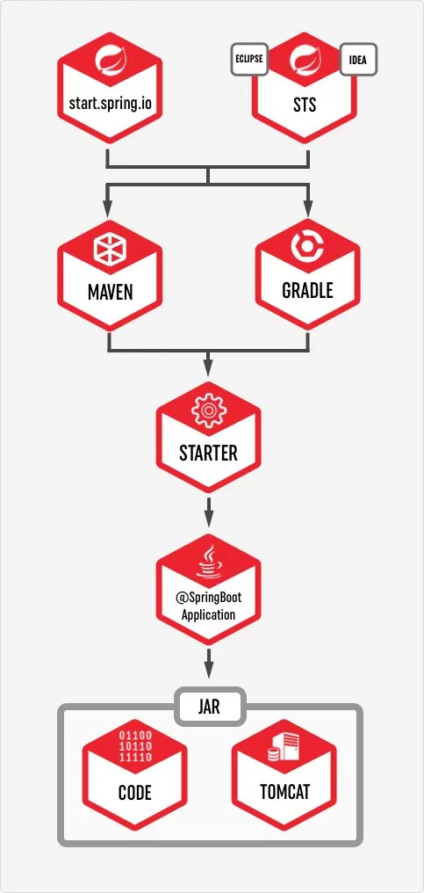
How to use Spring Boot
Use spring initialize to create the initial setup.
You can visit either start.spring.io or use STS (Spring Tool Suite) Support available in IDEA or Eclipse to choose all the Spring Boot Starters
Choose whether to use Maven or Gradle as the build tool.
If you are using start.spring.io, you need to then download the zip and configure your workspace.
Otherwise using your preferred IDE will automatically create the required file in the workspace.
Add your code as required
You can either use mvn clean package or use IDEA or Eclipse to build and create the jar file.
By default the JAR would include integrated Tomcat server, so just by executing the JAR you should be able to use your program.
Notes:
You can use spring initialize to create the initial setup. You can visit either start.spring.io or use STS (Spring Tool Suite) Support available in IDEA or Eclipse to choose all the Spring Boot Starters
You need to also choose whether to use Maven or Gradle as the build tool.
If you are using start.spring.io, you need to then download the zip and configure your workspace. Otherwise using your preferred IDE will automatically create the required file in the workspace.
Add your code as required
You can either use mvn clean package or use IDEA or Eclipse to build and create the jar file.
By default the JAR would include integrated Tomcat server, so just by executing the JAR you should be able to use your program.

Slide 31
Project Structure for Spring Boot Projects
Don't use the “default” Package
Typical Layout
Spring boot team generally recommend that you locate your main application class in a root package above other classes.
The @SpringBootApplication annotation is often placed on your main class, and it implicitly defines a base “search package” for certain items.
For example, if you are writing a JPA application, the package of the @SpringBootApplication annotated class is used to search for @Entity items.
Using a root package also allows the component scan to apply only on your project.

Slide 32
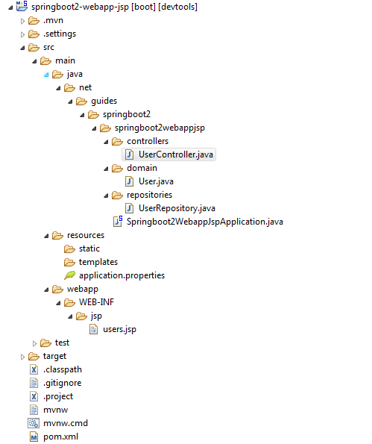
Project Structure - First approach
The Application.java file would declare the main method, along with the basic @SpringBootApplication
@SpringBootApplication
public class Application {
public static void main(String[] args)
{
SpringApplication.run(Application.class, args);
}
}

Slide 33
Static Content
In a spring boot web application, static files like HTML, CSS, JS and IMAGE files can be served directly from any of the following classpath locations out of the box.
No configuration required.
resources/static - contains static resources such as CSS, js, and images.
resources/templates - contains server-side templates which are rendered by Spring.
resources/application.properties - This file is very important. It contains application-wide properties. Spring reads the properties defined in this file to configure your application. You can define a server’s default port, server’s context path, database URLs etc, in this file.

Slide 34
Dynamic web content (Templates)
Spring supports the following template engines by default. These templates can be activated using appropriate spring boot starters.
FreeMarker - spring-boot-starter-freemarker
Groovy - spring-boot-starter-groovy
Thymeleaf - spring-boot-starter-thymeleaf
Mustache - spring-boot-starter-mustache

Slide 35
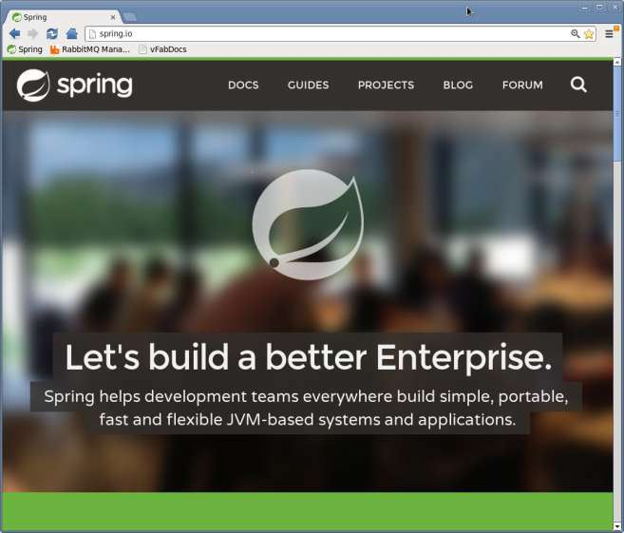
Does Anybody Use This For Real?
We do
Spring Boot app
Thymeleaf
UI
Hosted on Cloud Foundry

Slide 36
pom.xml
In a spring boot project, most of the modules can be enabled or disabled just by adding a set of starters.
All Spring Boot projects typically use spring-boot-starter-parent as the parent in pom.xml.

Slide 37
What is the Spring Boot Starter Parent and How to use it?
<parent>
<groupId>org.springframework.boot</groupId>
<artifactId>spring-boot-starter-parent</artifactId>
<version>2.0.4.RELEASE</version>
</parent>
spring-boot-starter-parent allows us to manage the following things for multiple child projects and modules:
Configuration - Java Version and Other Properties
Dependency Management - Version of dependencies
Default Plugin Configuration

Slide 38
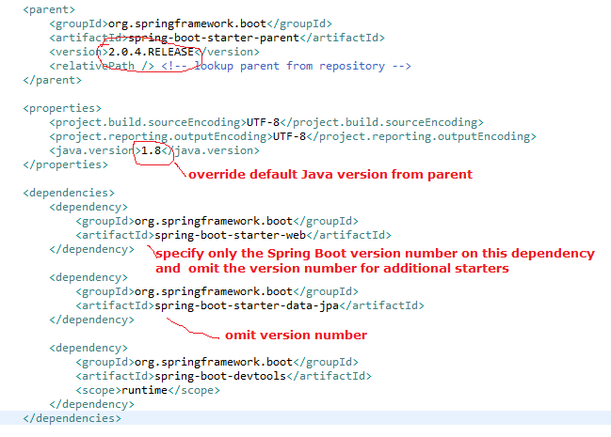
POM.XML
We should need to specify only the Spring Boot version number on this dependency.
If you import additional starters, you can safely omit the version number.

Slide 39
Spring Boot Application Class
@SpringBootApplication. This convenience annotation is a wrapper for the following:
@Configuration – Flags the class as a source of bean definitions for the application context.
@ComponentScan – Searches for beans and components (e.g., Controllers, Services, Repositories, etc.) in the package hierarchy.
@EnableAutoCofiguration – Inspects the application context and classpath and automatically configures the required beans using opinionated assumptions.
@SpringBootApplication
public class HelloWorldApplication {
public static void main(String[] args) {
SpringApplication.run(HelloWorldApplication.class, args);
}
}
HelloWorldApplication class has a main method.
This allows you to run the application as a standalone Java application.
The SpringApplication’s run method bootstraps and launches the HelloWorldApplication.

Slide 40
Controller Annotations
@RestController is another convenience annotation that simply adds @ResponseBody to all request mapping methods of a controller class. RestController is mostly used in REST API programming when no view technology (e.g. JSP, Thymeleaf) is required.
@GetMapping is a specialized RequestMapping. It specifies that HTTP GET requests to “/hello” are mapped to the sayHello() method.
@RestController
public class HelloWorldController {
@GetMapping("/hello")
public String sayHello() {
return "Hello Spring Boot!";
}
}

Slide 41
@SpringBootApplication
@SpringBootApplication annotation, means this is the starting point for our Spring Boot application.
For every spring boot application we have to create a main class and that need to be annotate with @SpringBootApplication and bootstrap it.
The main() method uses Spring Boot’s SpringApplication.run() method to launch an application.
There wasn’t a single line of XML
No web.xml file either.
This web application is 100% pure Java and you didn’t have to deal with configuring any plumbing or infrastructure.

Slide 42
Thymeleaf
Thymeleaf is a HTML 5 Template Engine.
It is a server side Java template engine for web application.
It's main goal is to bring elegant natural templates to your web application.
It can be integrate with Spring Framework and ideal for HTML5 Java web applications.
We are using Thymeleaf as our HTML template and rendering it from controller.
Thymelaef Engine will read a template file and combine with java objects to generate another document.
Thymeleaf can be used to replace JSP on the View layer of Web MVC application.
It is a opensource code software licensed under Apache.

Slide 43
Spring Boot JPA
Spring Boot JPA is a Java specification for managing relational data in Java applications.
It allows us to access and persist data between Java object/ class and relational database.
JPA follows Object-Relation Mapping (ORM). It is a set of interfaces.
It also provides a runtime EntityManager API for processing queries and transactions on the objects against the database.
It uses a platform-independent object-oriented query language JPQL (Java Persistent Query Language).

Slide 44
Spring Boot JPA
In the context of persistence, it covers three areas:
The Java Persistence API
Object-Relational metadata
The API itself, defined in the persistence package
JPA is not a framework. It defines a concept that can be implemented by any framework like Hibernate.

Slide 45
Why should we use JPA?
JPA is simpler, cleaner, and less labor-intensive than JDBC, SQL, and hand-written mapping.
JPA is suitable for non-performance oriented complex applications.
The main advantage of JPA over JDBC is that, in JPA, data is represented by objects and classes.
While in JDBC data is represented by tables and records.
It uses POJO to represent persistent data that simplifies database programming.

Slide 46
JPA Advantages
JPA avoids writing DDL in a database-specific dialect of SQL.
Instead of this, it allows mapping in XML or using Java annotations.
JPA allows us to avoid writing DML in the database-specific dialect of SQL.
JPA allows us to save and load Java objects and graphs without any DML language at all.
When we need to perform queries JPQL, it allows us to express the queries in terms of Java entities rather than the (native) SQL table and columns.

Slide 47
JPA Features
It is a powerful repository and custom object-mapping abstraction.
It supports for cross-store persistence. It means an entity can be partially stored in MySQL and Neo4j (Graph Database Management System).
It dynamically generates queries from queries methods name.
The domain base classes provide basic properties.
It supports transparent auditing.
Possibility to integrate custom repository code.
It is easy to integrate with Spring Framework with the custom namespace.

Slide 48
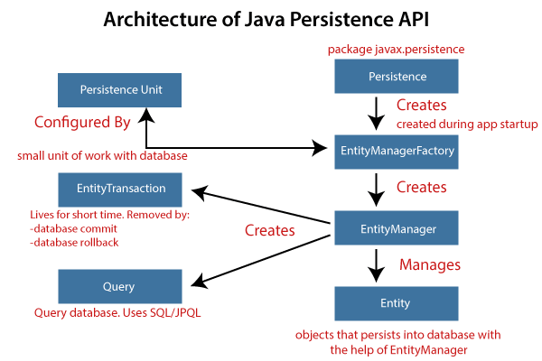
JPA Architecture
JPA is a source to store business entities as relational entities.
It shows how to define a POJO as an entity and how to manage entities with relation.
Figure describes the class-level architecture of JPA.
It describes the core classes and interfaces of JPA that is defined in the javax persistence package.
Persistence: It is a class that contains static methods to obtain an EntityManagerFactory instance.
EntityManagerFactory: It is a factory class of EntityManager. It creates and manages multiple instances of EntityManager.

Slide 49
JPA Architecture
EntityManager: It is an interface. It controls the persistence operations on objects. It works for the Query instance.
Entity: The entities are the persistence objects stores as a record in the database.
Persistence Unit: It defines a set of all entity classes. In an application, EntityManager instances manage it. The set of entity classes represents the data contained within a single data store.
EntityTransaction: It has a one-to-one relationship with the EntityManager class. For each EntityManager, operations are maintained by EntityTransaction class.
Query: It is an interface that is implemented by each JPA vendor to obtain relation objects that meet the criteria.

Slide 50
JPA Implementations
JPA is an open-source API.
There is various enterprises vendor such as Eclipse, RedHat, Oracle, etc. that provides new products by adding the JPA in them.
There are some popular JPA implementations frameworks such as :
Hibernate, EclipseLink, DataNucleus, etc.
It is also known as Object-Relation Mapping (ORM) tool.

Slide 51
JPA Versions
Earlier versions of EJB defines the persistence layer combined with the business logic layer using javax.ejb.EntityBean Interface.
EJB specification includes the definition of JPA.
While introducing EJB 3.0, the persistence layer was separated and specified as JPA 1.0 (Java Persistence API).
The specifications of this API were released along with the specifications of JAVA EE5 on May 11, 2006, using JSR 220.
In 2019, JPA renamed to Jakarta Persistence.
The latest version of JPA is 2.2. It supports the following features:
Java 8, data and time API
CDI Injection in AttributeConvertes
It makes annotations @Repeatable

Slide 52
Spring Boot Starter Data JPA
Spring Boot provides starter dependency spring-boot-starter-data-jpa to connect Spring Boot application with relational database efficiently.
The spring-boot-starter-data-jpa internally uses the spring-boot-jpa dependency.
<dependency>
<groupId>org.springframework.boot</groupId>
<artifactId>spring-boot-starter-data-jpa</artifactId>
<version>2.2.2.RELEASE</version>
</dependency>

Slide 53
In-Memory Databases in Spring Boot
Spring Boot can auto-configure an embedded database such as H2, HSQL, and Apache Derby databases.
We do not need to provide any connection URLs.
We need only include a build dependency on the embedded database that we want to use.
However we can also connect to Real-time Databases like Oracle, My-SQL etc..
<dependency>
<groupId>org.apache.derby</groupId>
<artifactId>derby</artifactId>
<scope>runtime</scope>
</dependency>

Slide 54
Spring Boot CrudRepository
Spring Boot Data enables JPA repository support by default.
CrudRepository provides generic CRUD operation on a repository for a specific type.
CrudRepository is a Spring data interface and to use it we need to create our interface by extending CrudRepository.
Spring provides CrudRepository implementation class automatically at runtime.
It contains methods such as save, findById, delete, count etc.
Spring boot automatically detects our repository if the package of that repository interface is the same or sub-package of the class annotated with @SpringBootApplication.

Slide 55
Spring Boot CrudRepository
Spring Boot provides default database configurations when it scans Spring Data JPA in classpath.
Spring boot uses spring-boot-starter-data-jpa starter to configure spring JPA.
For data source we need to configure data source properties starting with spring.datasource.* in application.properties.

Slide 56
Database connection pooling
Database connection pooling is a method used to keep database connections open so they can be reused by others.
Typically, opening a database connection is an expensive operation, especially if the database is remote.
You have to open up network sessions, authenticate, have authorisation checked, and so on.
Pooling keeps the connections active so that, when a connection is later requested, one of the active ones is used in preference to having to create another one.

Slide 57
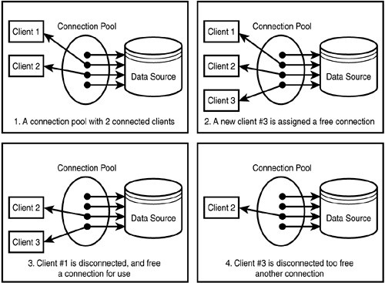
Database connection pooling

Slide 58
Database connection pooling in Spring Boot
In Spring Boot 2.0 release, default database pooling technology has been switched from Tomcat Pool to HikariCP.
Spring boot prefers HikariCP on first place then Tomcat pooling and then Commons DBCP2 on the basis of availability.
<!-- https://mvnrepository.com/artifact/com.zaxxer/HikariCP -->
<dependency>
<groupId>com.zaxxer</groupId>
<artifactId>HikariCP</artifactId>
<version>3.4.1</version>
</dependency>

Slide 59
CrudRepository Interface
CrudRepository is an interface and extends Spring data Repository interface.
CrudRepository provides generic CRUD operation on a repository for a specific type.
It has generic methods for CRUD operation.
To use CrudRepository we have to create our interface and extend CrudRepository.
We need not to implement our interface, its implementation will be created automatically at runtime.

Slide 60
CrudRepository methods
<S extends T> S save(S entity): Saves and updates the current entity and returns that entity.
Optional<T> findById(ID primaryKey): Returns the entity for the given id.
Iterable<T> findAll(): Returns all entities.
long count(): Returns the count.
void delete(T entity): Deletes the given entity.
boolean existsById(ID primaryKey): Checks if the entity for the given id exists or not.
CrudRepository has subinterface as PagingAndSortingRepository.
It provide additional methods to retrieve entities using the pagination and sorting abstraction.

Slide 61
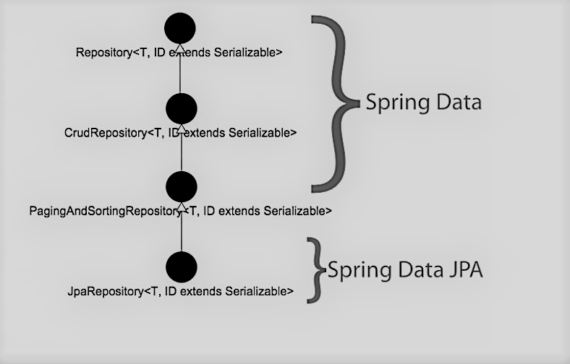
Spring Repository Hierarchy

Slide 62
Steps to Use CrudRepository
Spring boot enables JPA repository support by default.
To use CrudRepository in our Spring data application we need to create an interface implementing CrudRepository .
And then all is done to use it.

Slide 63
Create an Interface extending CrudRepository
public interface ProductRepository extends JpaRepository<Product, Long> {
}
This interface extends the JpaRepository interface from Spring Data JPA.
JpaRepository defines standard CRUD methods, plus JPA-specific operations.
We don’t have to write implementation code because Spring Data JPA will generate necessary code at runtime, in form of proxy instances.
So the purpose of writing the repository interface is to tell Spring Data JPA about the domain type (Product) and ID type (Long) to work with.

Slide 64
Auto-Detection of JPA Repository
Spring boot can automatically detect our repository if the package of that interface is the same or sub-package of the class annotated with @SpringBootApplication.
And if not then we need to use @EnableJpaRepositories annotation with @SpringBootApplication.
@SpringBootApplication
public class MyApplication { ------ }
Now if we have a repository ArticleRepository and it resides in package com.demo or its sub-packages such as com.demo.repository.
Then Spring boot will automatically detect our repository and so no need to use @EnableJpaRepositories annotation.

Slide 65
Instantiate and Use CrudRepository
To instantiate our ProductRepository that has extended CrudRepository, we can use dependency injection
public class ProductService {
@Autowired
private ProductRepository productRepository; ------ }
In this class, we inject an instance of ProductRepository via private field using @Autowired annotation.
At runtime, Spring Data JPA will generate a proxy instance of ProductRepository and inject it to the instance of ProductService class.

Slide 66
Use methods of CrudRepository.
@Service
@Transactional
public class ProductService {
@Autowired
private ProductRepository repo;
public List<Product> listAll() {
return repo.findAll();
}
public void save(Product product) {
repo.save(product);
}
public Product get(long id) {
return repo.findById(id).get();
}
public void delete(long id) {
repo.deleteById(id);
}
}

Slide 67
Custom Repository Methods
CrudRepository provides methods for generic CRUD operation and if we want to add custom methods in our interface that has extended CrudRepository, we can add in following ways.
We can start our query method names with find...By, read...By, query...By, count...By, and get...By.
Before By we can add expression such as Distinct . After By we need to add property names of our entity.
To get data on the basis of more than one property we can concatenate property names using And and Or while creating method names.
If we want to use completely custom name for our method, we can use @Query annotation to write query.

Slide 68
Custom Repository Methods
public interface ArticleRepository extends CrudRepository<Article, Long> {
List<Article> findByTitle(String title);
List<Article> findDistinctByCategory(String category);
List<Article> findByTitleAndCategory(String title, String category);
@Query("SELECT a FROM Article a WHERE a.title=:title and a.category=:category")
List<Article> fetchArticles(@Param("title") String title, @Param("category") String category); }

Slide 69
@Transactional with CrudRepository
CRUD methods of CrudRepository are transactional by default.
They are annotated with @Transactional annotation with default settings in implementation class at runtime.
For reading operation readOnly flag is set to true.
To override default transactional settings of any CrudRepository methods
we need to override that method in our interface and annotate with @Transactional using required configurations.

Slide 70
Configure Properties in application.properties File
spring.datasource.url=jdbc:mysql://localhost:3306/demo
spring.datasource.username=root
spring.datasource.password=cp
spring.datasource.hikari.connection-timeout=20000
spring.datasource.hikari.minimum-idle=5
spring.datasource.hikari.maximum-pool-size=12
spring.datasource.hikari.idle-timeout=300000
spring.datasource.hikari.max-lifetime=1200000
spring.jpa.properties.hibernate.dialect = org.hibernate.dialect.MySQLDialect
spring.jpa.properties.hibernate.id.new_generator_mappings = false
spring.jpa.properties.hibernate.format_sql = true
logging.level.org.hibernate.SQL=DEBUG
logging.level.org.hibernate.type.descriptor.sql.BasicBinder=TRACE

Slide 71
application.properties File
spring.data.jpa.repositories.enabled: It enables JPA repositories. The default value is true.
spring.jpa.database: It targets database to operate on. By default embedded database is auto-detected.
spring.jpa.database-platform: It is used to provide the name of database to operate on. By default it is auto- detected.
spring.jpa.generate-ddl: It is used to initialize schema on startup. By default the value is false.
spring.jpa.hibernate.ddl-auto: It is DDL mode used for embedded database. Default value is create-drop.
spring.jpa.hibernate.naming.implicit-strategy: It is Hibernate 5 implicit naming strategy fully qualified name.
spring.jpa.hibernate.naming.physical-strategy: It is Hibernate 5 physical naming strategy fully qualified name.
spring.jpa.hibernate.use-new-id-generator-mappings: It is used for Hibernate IdentifierGenerator for AUTO, TABLE and SEQUENCE.
spring.jpa.open-in-view: The default value is true. It binds a JPA EntityManager to the thread for the entire processing of the request.
spring.jpa.properties.*: It sets additional native properties to set on the JPA provider.
spring.jpa.show-sql: It enables logging of SQL statements. Default value is false.

Slide 72
Web Services
Web service is an appropriate medium to propagate communication between the client and server applications on the World Wide Web.
It is a software module which is designed to perform a certain set of tasks as follows:
The web services can be searched for over the network and can also be invoked accordingly.
When invoked the web service would be able to provide the functionality to the client which invokes that web service.
For Example, Flipkart provides a web service that provides prices for products sold online via flipkart.com.
The front end or presentation layer can be in .Net or Java but either programming language would have the ability to communicate with the web service.

Slide 73
Advantages of Web Services
Exposing Business Functionality on the network – A web service is a managed code unit that provides some sort of functionality to client applications or end-users.
This functionality can be invoked over the HTTP protocol which means that it can also be invoked over the internet. Web services can be used anywhere on the internet and provide the necessary functionality as required.
Interoperability amongst applications – Web services allow various applications to communicate with each other and share data and services among themselves.
A standardized Protocol which everybody understands – Web services use standardized industry protocol for the communication. All four layers (Service Transport, XML Messaging, Service Description, and Service Discovery layers) uses well-defined protocols in the web services protocol stack.
Reduction in cost of communication – Web services make use of SOAP over HTTP protocol, which lets you use your existing low-cost internet for implementing web services.

Slide 74
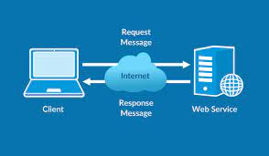
Types of Web Services
Soap Web Services
Simple Object Access Protocol (SOAP) is a standard protocol specification for message exchange based on XML.
Communication between the web service and the client happens using XML messages.
A simple web service architecture has two component: viz. Client and Service provider.
RESTful Web Services

Slide 75
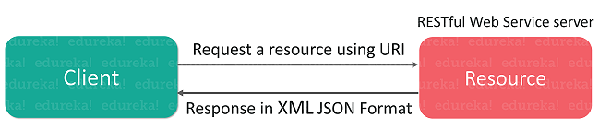
RESTful Web Services
Representational State Transfer (REST) is a stateless client-server architecture in which the web services are viewed as resources and can be identified by their URLs.
It consists of two components REST server which provides access to the resources and a REST client which accesses and modify the REST resources.
Message exchange is based on XML/JSON.

Slide 76
Spring REST
Building REST services with Spring Boot

Slide 77
RESTful Web Services
Web services are used as a medium in World Wide Web for communication between the client application and server application.
It provides one platform for both the applications (client and server) so that multiple application can be built and communication can happen.
REST expanded as REpresentational State Transfer.
REST is basically used for developing Web services which are maintainable, lightweight and scalable.
Restful Web Services uses client-server architecture which is stateless.

Slide 78
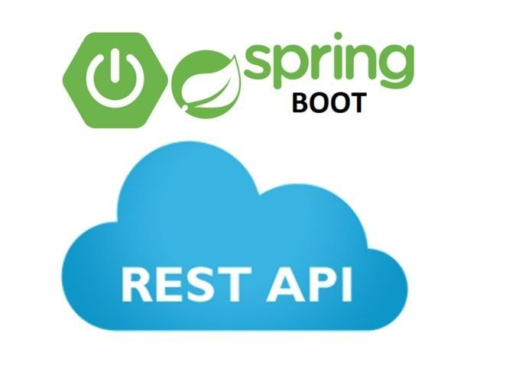
REST has quickly become the de-facto standard for building web services on the web because they’re easy to build and easy to consume.
Http GET and POST both methods can be used by the REST Client applications.
REST Web services are lightweight as compared with the SOAP Web services. Additionally, REST APIs does not follow any standard.
Any type of request and response data like XML, JSON or text etc are supported by the REST API.

Slide 79
REST Benefits
The web and its core protocol, HTTP, provide a stack of features:
Suitable actions (GET, POST, PUT, DELETE, …​)
Caching
Redirection and forwarding
Security (encryption and authentication)

Slide 80
REST Services
Developers are able to draw upon 3rd party toolkits that implement these diverse specs and instantly have both client and server technology at their fingertips.
So building on top of HTTP, REST APIs provide the means to build flexible APIs that can:
Support backward compatibility
Evolvable APIs
Scalable services
Securable services
A spectrum of stateless to stateful services

Slide 81
RESTful Web services
RESTful web services try to define services using the different concepts that are already present in HTTP.
REST is an architectural approach, not a protocol.
It does not define the standard message exchange format.
We can build REST services with both XML and JSON.
JSON is more popular format with REST.
The key abstraction is a resource in REST.
A resource can be anything. It can be accessed through a Uniform Resource Identifier (URI).

Slide 82
REST Resources
The resource has representations like XML, HTML, and JSON.
The current state capture by representational resource.
When we request a resource, we provide the representation of the resource.
The important methods of HTTP are:
GET: It reads a resource.
PUT: It updates an existing resource.
POST: It creates a new resource.
DELETE: It deletes the resource.
.

Slide 83
REST HTTP Methods
To perform the following actions in the social media application, we get the corresponding results.
POST /users: It creates a user.
GET /users/{id}: It retrieves the detail of a user.
GET /users: It retrieves the detail of all users.
DELETE /users: It deletes all users.
DELETE /users/{id}: It deletes a user.
GET /users/{id}/posts/post_id: It retrieve the detail of a specific post.
POST / users/{id}/ posts: It creates a post of the user.

Slide 84
HTTP Status Codes
HTTP also defines the following standard status code:
404: RESOURCE NOT FOUND
200: SUCCESS
201: CREATED
401: UNAUTHORIZED
500: SERVER ERROR

Slide 85
RESTful Service Constraints
There must be a service producer and service consumer.
The service is stateless.
The service result must be cacheable.
The interface is uniform and exposing resources.
The service should assume a layered architecture.

Slide 86
Advantages of RESTful web services
RESTful web services are platform-independent.
It can be written in any programming language and can be executed on any platform.
It provides different data format like JSON, text, HTML, and XML.
It is fast in comparison to SOAP because there is no strict specification like SOAP.
These are reusable.
They are language neutral.

Slide 87
Initializing a RESTful Web Services with Spring Boot
Launch the STS.
Click on File menu -> New -> Spring Starter Project ->
Provide the name, group, and package of the project
Select Spring Boot 2.x, Java Version 8 onwards
Select Spring Web MVC, Spring Boot DevTools, JPA, MySQL and H2 dependencies.
Finish

Slide 88
Creating a Service
Whenever we create a web service, we need to define two things Get method and the URI in the Controller.
If we want to tell the spring MVC that it is going to handle the REST request, we have to add @RestController annotation.
Now it becomes a rest controller which can handle the Rest request.
Add @RequestMapping annotation just above the helloWorld() method.
@RestController
public class HelloWorldController
{
//using get method and hello-world as URI
@RequestMapping(method=RequestMethod.GET, path="/hello")
public String helloWorld()
{
return "Hello World"; } }

Slide 89
Creating a Service
Use @GetMapping annotation instead of @RequestMapping.
Here the method specification is not required.
We can improve the Hello World Service to Return a Bean also.
return new HelloWorldBean("Hello World");
@RestController
public class HelloWorldController
{
//using get method and hello-world as URI
@GetMapping(path="/hello")
public String helloWorld()
{
return "Hello World"; } }

Slide 90
Spring Boot Auto Configuration and Dispatcher Servlet
Spring Boot automatically configures a spring application based on dependencies present or not present in the classpath as a jar, beans, properties, etc.
It makes development easier and faster as there is no need to define certain beans that are included in the auto-configuration classes.
A typical MVC database driven Spring MVC application requires a lot of configuration such as
Dispatcher servlet
View resolver
Jackson
data source
transaction manager etc….

Slide 91
Spring Boot Auto Configuration
Spring Boot auto-configures a Dispatcher Servlet if Spring MVC jar is on the classpath.
Auto-configures the Jackson if Jackson jar is on the classpath.
Auto-configures a Data Source if Hibernate jar is on the classpath.
Auto-configuration can be enabled by adding @SpringBootApplication annotation in startup class.
It indicates that it is a spring context file.
It enables something called auto-configuration.
It enable something called components scan.
It is the features of Spring where it will start automatically scanning classes in the package and sub package for any bean file.

Slide 92
Auto configuration done by Spring Boot
DispatcherServletAutoConfiguration
DataSourceAutoConfiguration
JacksonAutoConfiguration
ErrorMvcAutoConfiguration (#basicErrorController)

Slide 93
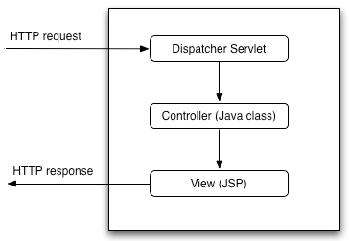
Dispatcher Servlet
In Spring MVC all incoming requests go through a single servlet is called Dispatcher Servlet (front controller).
The front controller is a design pattern in web application development.
A single servlet receives all the request and transfers them to all other components of the application.
The job of DispatcherServlet is to take an incoming URI and find the right combination of handlers (Controller classes) and views (usually JSPs).
When the DispatcherServlet determines the view, it renders it as the response.

Slide 94
Path Variable
The @PathVariable annotation is used to extract the value from the URI.
It is most suitable for the RESTful web service where the URL contains some value.
Spring MVC allows us to use multiple @PathVariable annotations in the same method.
A path variable is a critical part of creating rest resources.
@GetMapping(path="/hello-world/path-variable/{name}") // for method
Type the URL http://localhost:8080///hello-world/path-variable/SpringBoot

Slide 95
POST Method to create User Resource
@RequestBody
The @RequestBody annotation maps body of the web request to the method parameter.
The body of the request is passed through an HttpMessageConverter.
It resolves the method argument depending on the content type of the request.
Optionally, automatic validation can be applied by annotating the argument with @Valid.
We pass the @RequestBody annotation in the createUser() method, it maps to the user parameter.
//method that posts a new user detail
@PostMapping("/users")
public void createUser(@RequestBody User user)
{
User sevedUser=service.save(user); } }

Slide 96
@PathMapping
The @PathMapping annotation is the specialized version of the @RequestMapping annotation which acts as a shortcut for
@RequestMapping(method=RequestMethod=POST).
@PostMapping method handles the Http POST requests matched with the specified URI.

Slide 97
REST API Testing Tools – REST Client
REST Client is a method or a tool to invoke a REST service API that is exposed for communication by any system or service provider.
For example: if an API is exposed to get real time traffic information about a route from Google, the software/tool that invokes the Google traffic API is called the REST client.
REST Client Communicates with the REST Server , which has Web Service developed using Spring, ASP.Net , Java etc…
Examples for REST Client tools:
Postman
SOAP UI
Katalon Studio
Jmeter

Slide 98
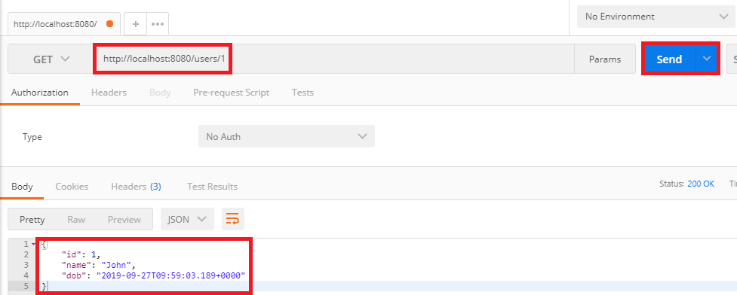
GET request Demo
In Client tool Check for the GET request.
Type the URL http://localhost:8080/users/1 in the address bar and click on the Send button.
It returns the detail of the first user.

Slide 99
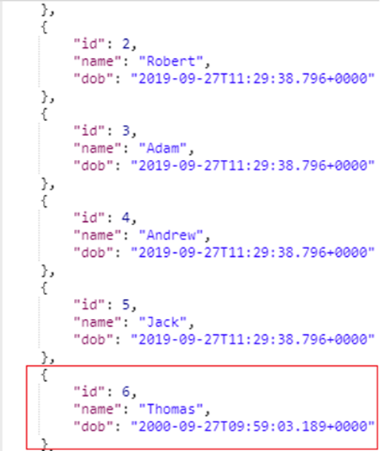
POST request Demo
In Client tool Change the method to the POST.
Copy the body of the response coming from "/users/1".
Click on Body tab. Now we create a body for the POST request.
Choose the raw option. It creates a raw request.
Paste the copied content.
Remove the id because it increments automatically.
Change the "name": “John".
Instead of Text we are sending the data in the JSON format. So select JSON (application/json).
Type the URL http://localhost:8080/users and click on the Send button.
Click on the Get request on the left side of the window.
Now we will send a Get request again, so change the URL http://localhost:8080/users and click on the Send button. It displays all the users, including which we have created

Slide 100
ResponseEntity Class
The ResponseEntity is a class which extends HttpEntity and HttpStatus class.
It is defined in org.springframework.http.RequestEntity.
It is used in RestTemplate and @Controller methods.
It is used as parameter in getForEntity() and exchange() method.
It is also used in Spring MVC, as a parameter in a @Controller method.

Slide 101
created() method of RequestEntity Class
The created() method is the static method of RequestEntity class.
It creates a new builder with a CREATED status and a location header set to the given URI.
Syntax:
public static ResponseEntity.BodyBuilder created(URI location)
Parameter: It accepts the location URI as a parameter.
Returns: It returns the created builder.
All Http status codes are Enum constant, which is defined in the HttpStatus class.

Slide 102
ServletUriComponentsBuilder
The ServletUriComponentsBuilder is a class which is defined in org.springframework.web.servlet.support.ServletUriComponentsBuilder.
It extends UriComponentsBuilder class.
It has additional static factory methods to create a link based on the current HttpServletRequest.

Slide 103
path() method
The path() is the method of UriComponentsBuilder class.
It appends the given path to the existing path of this builder.
The given path may contain URI template variable.
Syntax:
public UriBuilderBuilder path(String path)
Parameter: It accepts a path as a parameter.
Returns: It returns the UriComponentsBuilder.

Slide 104
buildAndExpand() method
It builds UriComponents instance and replaces URI template variables with the values obtained from an array.
It is the shortcut method which combines calls to build() and then UriComponents.expand(Object... uriVariableValues).
Syntax:
public UriComponents buildAndExpand(Object...uriVariableValues)
Parameter: It accepts the URI variable values as a parameter.
Returns: It returns the URI components with extended values.

Slide 105
build() method
It builds UriComponents instance from the various components contained in the builder.
Syntax:
public UriComponents build()
Parameter: It does not accept any parameter.
Returns: It returns the Uri Components.
Let's see how to return the status of the created resource and how to set URI of the created resource in the response.

Slide 106
ResponseEntity Demo
//method that posts a new user detail and returns the status of HTTP and location of the user resource
@PostMapping("/users")
public ResponseEntity<Object> createUser(@RequestBody User user)
{
User sevedUser=service.save(user);
URI location=ServletUriComponentsBuilder.fromCurrentRequest().path("/{id}").buildAndExpand(sevedUser.getId()).toUri();
return ResponseEntity.created(location).build(); } }

Slide 107
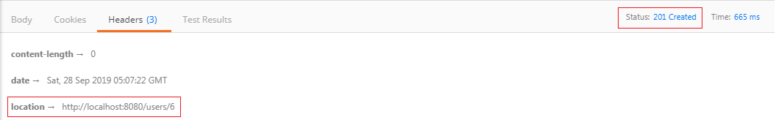
ResponseEntity Demo
Step 2: Now open REST client Postman and create a POST request.
Step 3: Click on the POST request under the History tab.
Step 4: Click on the Body tab and change the user name to James.
Step 5: Ensure that you have selected JSON (application/json) media type.
Step 5: Click on the Send button.
On the right-hand side of the window, we can see the Status: 201 Created. It means resource has been properly created.
Step 6: Now click on the Headers tab to see the location. Location is the URI of the created resource. It shows the location of the created user James that is "/users/6".

Slide 108
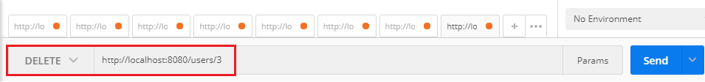
DELETE Method to Delete a User Resource
Method to delete a User
@DeleteMapping("/users/{id}")
public void deleteUser(@PathVariable int id)
{ User user= service.deleteById(id); }
Open Postman, select DELETE request, and specify the user id which you want to delete. Now click on the Send button.

Slide 109
REST Client Software
Developers can integrate the Web services by designing REST Client Software.
It means a consumer Software which consumes JSON/XML data from a Web Service Provider Software.
Web Services can be consumed in Web applications designed using Angular, jQuery,Php, Java, Spring Boot etc..

Slide 110
Consuming a RESTful Web Service in Spring Boot
A RESTful service has been stood up at
https://gturnquist-quoters.cfapps.io/api/random.
It randomly fetches quotations about Spring Boot and returns them as JSON documents.
If you request that URL through a web browser or curl, you receive a JSON document that looks something like this:
{
type: "success",
value: {
id: 10,
quote: "Really loving Spring Boot, makes stand alone Spring apps easy."
}
}

Slide 111
Consuming a RESTful Web Service in Spring Boot
A more useful way to consume a REST web service is programmatically.
To help you with that task, Spring provides a convenient template class called RestTemplate.
RestTemplate makes interacting with most RESTful services a one-line incantation.
And it can even bind that data to custom domain types.

Slide 112



Slide 113
Introduction to Swagger
Swagger is a REST API documentation Tool.
Now a days REST and Microservices have got a lot of momentum.
REST specification does not suggest any standard way to document the REST APIs that we are going to expose [like WSDL for SOAP].
So everybody is documenting their APIs in their own way, resulting a gap in common structure which all can easily follow, understand and use.
So We need to have a common pattern and tool.
Thatz why Swagger !!!

Slide 114
Introduction to Swagger
A Swagger is an open-source tool.
It builds around the OpenAPI Specification that helps developers to design, build, document, and consume RESTful APIs.
It is the most popular API documentation format for RESTful Web Services.
It provides both JSON and UI support.
JSON can be used as a machine-readable format.
Swagger-UI is for visual display, which is easy for humans to understand by just browsing the API documentation.

Slide 115
What is Swagger
Swagger (backed by companies like Google, IBM, Microsoft) does this same job of filling the gap of common documentation style.
Swagger (now the “Open API Initiative”) is a specification and framework for describing REST APIs using a common language that everyone can understand.
It offers both human readable and machine readable format of documentation.
It provides both JSON and UI support. JSON can be used as machine readable format.
Swagger-UI is for visual display which is easy for humans to understand by just browsing the api documentation.

Slide 116
The main Swagger tools
Swagger UI: It creates interactive API documentation.
Swagger Editor: It is a browser-based editor where we can write OpenAPI specifications.
Swagger Codegen: It generates server stubs (API implementation stub), and client libraries form an OpenAPI specification.

Slide 117
OpenAPI Specification
An OpenAPI Specification (formerly known as Swagger Specification) is an API documentation format for REST APIs.
An Open API file allows us to describe our entire API, including:
Available endpoints (/users) and operations on each endpoint (GET /users, POST /users).
Operation parameters for each operation.
Authentication methods.
Contact information, license, the term of use and other information

Slide 118
Setting Up Swagger 2 with a Spring REST API
Nowadays, front-end and back-end components often separate a web application.
Usually, we expose APIs as a back-end component for the front-end component or third-party app integrations.
In such a scenario, it is essential to have proper specifications for the back-end APIs.
At the same time, the API documentation should be informative, readable, and easy to follow.
Moreover, reference documentation should simultaneously describe every change in the API.

Slide 119
Generate Swagger documentation for our RESTful services.
Swagger 2 for a Spring REST web service, is done using the Springfox implementation of the Swagger 2 specification.
To generate a Swagger documentation we need to include Springfox-Swagger Dependencies.
Enabling Springfox's Swagger
Enabling Springfox's Swagger UI
<dependency>
<groupId>io.springfox</groupId>
<artifactId>springfox-swagger2</artifactId>
<version>2.9.2</version>
</dependency>
<dependency>
<groupId>io.springfox</groupId>
<artifactId>springfox-swagger-ui</artifactId>
<version>2.9.2</version>
</dependency>

Slide 120
Integrating Swagger 2 into the Project
The configuration of Swagger mainly centre's around the Docket bean.
Docket: A builder that is intended to be the primary interface into the swagger-Spring MVC Framework.
Docket provides sensible defaults and convenience methods for configuration.
Swagger 2 is enabled through the @EnableSwagger2 annotation.
@Configuration annotation is part of the spring core framework.
Spring Configuration annotation indicates that the class has @Bean definition methods.
So Spring container can process the class and generate Spring Beans to be used in the application.

Slide 121
Integrating Swagger 2 into the Project
@Configuration
//Enable Swagger
@EnableSwagger2
public class SwaggerConfig
{
//creating bean
@Bean
public Docket api()
{
//creating constructor of Docket class that accepts parameter DocumentationType
return new Docket(DocumentationType.SWAGGER_2);
}}

Slide 122
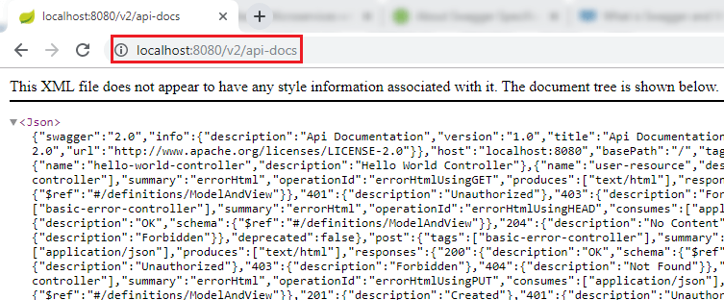
Integrating Swagger 2 into the Project
Open the browser and type the URI
http://localhost:8080/v2/api-docs
It shows the complete documentation in JSON format.
Swagger has provided it to be used in other systems like API management tools that offer functionality like API gateways, API caching, API documentation, etc.

Slide 123
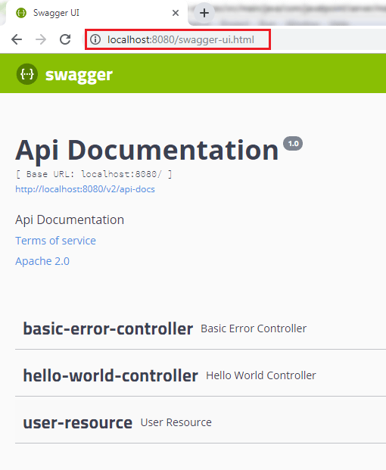
Integrating Swagger 2 into the Project
If we want to share the documentation of web service with customers, we can share this JSON file.
But its very difficult to understand.
So now type the URI http://localhost:8080/swagger-ui.html in the browser.
It shows the documentation of the services that we have created.

Slide 124
Swagger2 Annotations
The default generated API docs are good but they lack detailed API level information.
Swagger has provided few annotations to add this detailed information to the APIs.
@Api | Marks a class as a Swagger resource.
@ApiModel | Provides additional information about Swagger models.
@ApiModelProperty | Adds and manipulates data of a model property.
@ApiOperation | Describes an operation or typically an HTTP method against a specific path.
@ApiParam | Adds additional meta-data for operation parameters.
@ApiResponse | Describes a possible response of an operation.
@ApiResponses | A wrapper to allow a list of multiple ApiResponse objects.

Slide 125
Swagger2 Annotations
@Api – We can add this Annotation to the controller to add basic information regarding the controller.
@Api(value = "Swagger2DemoRestController", description = "REST APIs related to Student Entity!!!!")
@RestController
public class Swagger2DemoRestController {
...
}

Slide 126
Swagger2 Annotations
@ApiOperation and @ApiResponses – We can add these annotations to any rest method in the controller to add basic information related to that method. e.g.
@ApiOperation(value = "Get list of Students in the System ", response = Iterable.class, tags = "getStudents")
@ApiResponses(value = {
@ApiResponse(code = 200, message = "Success|OK"),
@ApiResponse(code = 401, message = "not authorized!"),
@ApiResponse(code = 403, message = "forbidden!!!"),
@ApiResponse(code = 404, message = "not found!!!") })
@RequestMapping(value = "/getStudents")
public List<Student> getStudents() {
return

Slide 127
Swagger2 Annotations
@ApiModelProperty – This annotation is used in the Model property to add some description to the Swagger output for that model attribute. e.g.
@ApiModelProperty(notes = "Name of the Student",name="name",required=true,value="test name")
private String name;

Slide 128

Thanks!
© 2013 Spring, by Pivotal

Slide 129

Learn More. Stay Connected.
Download now:
springsource.org/spring-tool-suite-download (eclipse plugin)
springsource.org/download/community (zip)
springsource.org/spring-framework#maven (maven)
Monthly Newsletter: springsource.org/news-events
Twitter: twitter.com/springsource
YouTube: youtube.com/user/SpringSourceDev
RSS Feed: feeds.feedburner.com/springsource/OEVE LinkedIn: springsource.org/linkedin
28

