Slide 1
Spring Framework - II

Slide 2
Agenda
1
Spring MVC -Web
2
Spring Database Interaction

Slide 3

Module 1: Spring - MVC

Slide 4
Objectives
This module is aimed at :
Core Components of Spring MVC
Flow of Request in Spring MVC based Web Application
How to develop a Web Application using Spring MVC

Slide 5
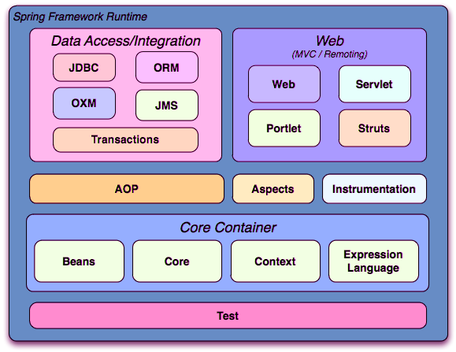
Spring Modules

Slide 6
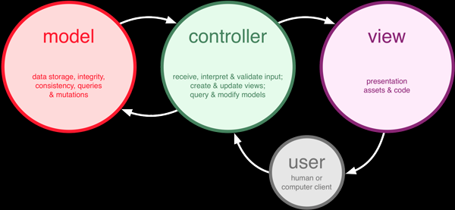
What is MVC?
The Model-View-Controller (MVC) is an architectural pattern that separates an application into three main logical components: the model, the view, and the controller.
MVC is a software design pattern for developing Web Applications.
Each of these components are built to handle specific development aspects of an application.
MVC is one of the most frequently used industry-standard web development framework to create scalable and extensible projects.

Slide 7

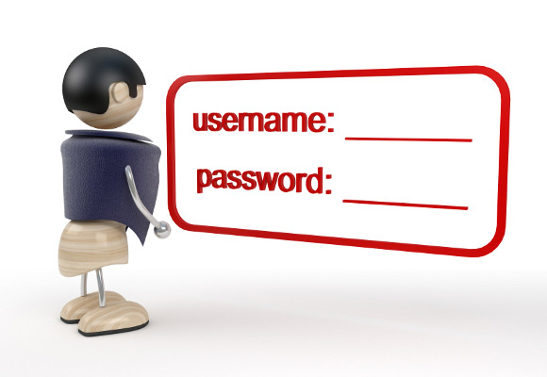
Model
The Model component corresponds to all the data-related logic that the user works with.
This can represent either the data that is being transferred between the View and Controller components or any other business logic-related data.
For example, a Customer object will retrieve the customer information from the database, manipulate it and update it data back to the database or use it to render data.

Slide 8
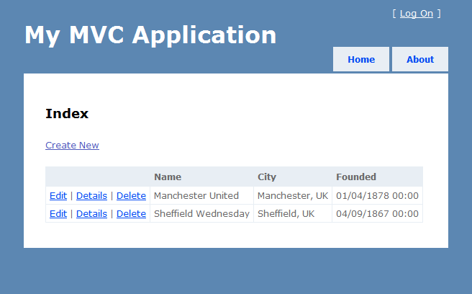
View
The View component is used for all the UI logic of the application.
For example, the Customer view will include all the UI components such as text boxes, dropdowns, etc. that the final user interacts with.

Slide 9
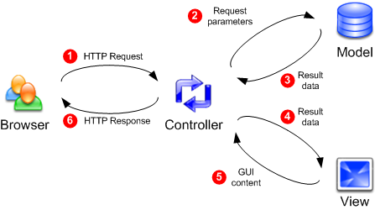
Controller
Controllers act as an interface between Model and View components.
It processes all the business logic and incoming requests, manipulate data using the Model component and interact with the Views to render the final output.
For example, the Customer controller will handle all the interactions and inputs from the Customer View and update the database using the Customer Model. The same controller will be used to view the Customer data.

Slide 10
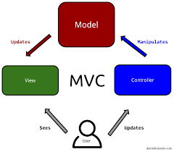
Spring – MVC Framework
The Spring Web MVC framework provides Model-View-Controller (MVC) architecture.
It creates ready components that can be used to develop flexible and loosely coupled web applications.
The MVC pattern results in separating the different aspects of the application :
(input logic, business logic, and UI logic),
While providing a loose coupling between these elements.

Slide 11
MVC Overview
MVC => Model-View-Controller
Pattern helps to clearly separates business, navigation and presentation logic
Proven mechanism for building a thin & clean web-tier
Three core collaborating components
Controller
Handles navigation logic and interacts with the service tier for business logic
Model
Handles the business logic and data
View
Renders the response to the request
Pulls data from the model
Notes:
“ ”
“ “

Slide 12
MVC Components
The Model encapsulates the application data and in general, they will consist of POJO.
A model contains the data of the application. A data can be a single object or a collection of objects.
The View is responsible for rendering the model data and in general, it generates HTML output that the client's browser can interpret.
A view represents the provided information in a particular format. Generally, JSP+JSTL is used to create a view page.
Although spring also supports other view technologies such as Apache Velocity, Thymeleaf and FreeMarker.
The Controller is responsible for processing User Requests and Building Appropriate Model and passes it to the view for rendering.
A controller contains the business logic of an application. Here, the @Controller annotation is used to mark the class as the controller.

Slide 13
Motivation for MVC
Eases maintenance burden
Changes to business logic are less likely to break the presentation logic
Vice versa
Facilitates multi-disciplined team development
Developers can focus on creating robust business code without having to worry about breaking the UI
Designers can focus on building usable and engaging UIs without worrying about Java
Use the best tool for the job
Java is especially suited to creating business logic code
Markup languages are more suited to creating HTML layouts
Ease testability
Business and navigation logic are separated from presentation logic meaning they can be tested separately
Practically: you can test more code outside the servlet container

Slide 14
MVC in Spring
A single Front Controller servlet that dispatches requests to individual Controllers
Proven pattern shown in Struts and Core J2EE Patterns
Front Controller - In Spring Web MVC, the DispatcherServlet class works as the front controller. It is responsible to manage the flow of the Spring MVC application.
Request routing is completely controlled by the Front Controller
Individual Controllers can be used to handle many different URLs
Controllers are Classes of Java
Controllers are managed exactly like any other bean in the Spring ApplicationContext

Slide 15
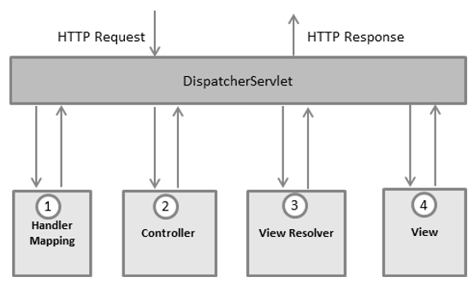
The DispatcherServlet
The Spring Web model-view-controller (MVC) framework is designed around a DispatcherServlet that handles all the HTTP requests and responses.
The request processing workflow of the Spring Web MVC DispatcherServlet is illustrated in the following diagram −

Slide 16
HTTP DispatcherServlet Events
After receiving an HTTP request, DispatcherServlet consults the HandlerMapping to call the appropriate Controller.
The Controller takes the request and calls the appropriate service methods based on used GET or POST method. The service method will set model data based on defined business logic and returns view name to the DispatcherServlet.
The DispatcherServlet will take help from ViewResolver to pickup the defined view for the request.
Once view is finalized, The DispatcherServlet passes the model data to the view which is finally rendered on the browser.
All above components are parts of WebApplicationContext which is an extension of the plainApplicationContext with some extra features necessary for web applications.

Slide 17
Core Components of Spring MVC
DispatcherServlet
Spring’s Front Controller implementation
Controller
User created component for handling requests
Encapsulates navigation logic
Delegates to the service objects for business logic
The default handler is a very simple Controller interface with method:
ModelAndView handleRequest(request, response).
View
Responsible for rendering output

Slide 18
Core Components of Spring MVC (Contd.).
ModelAndView
Created by the Controller
Stores the Model data
Associates a View to the request (usually a logical view names)
The ModelAndView class is simply a container by which the model may be transported to and exposed by the view.
ViewResolver
Used to map logical View names to actual View implementations
HandlerMapping
Strategy interface used by DispatcherServlet
for mapping incoming requests to individual Controllers

Slide 19
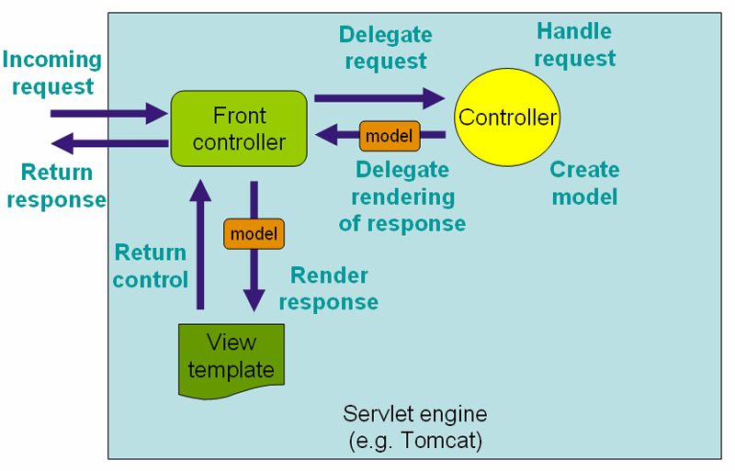
Work Flow in Spring MVC (High Level)

Slide 20
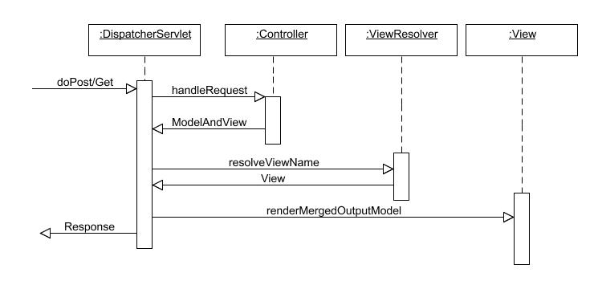
Sequence Diagram of Spring MVC
Source: http://www.theserverside.com/

Slide 21
Lifecycle of a request in Spring MVC
A request leaves the browser asking for a URL and optionally with request parameters.
The request is first examined by DispatcherServlet.
DispatcherServlet consults handler-mappings defined in a configuration file
It selects an appropriate controller and delegates to it to handle therequest.
The controller applies appropriate logic to process the request which results in some information (i.e. model).

Slide 22
Lifecycle of a request in Spring MVC (Contd.).
This information is associated with the logical name of a result rendering entity (i.e. view)
And the whole is returned as a ModelAndView object along with the request back to DispatcherServlet.
DispatcherServlet then consults the logical view name with a view resolving object to determine the actual view implementation to use.
DispatcherServlet delivers the model and request to the view implementation which renders an output and sends it back to the browser.

Slide 23
The Deployment Descriptor: web.xml
A web application's deployment descriptor describes the classes, resources and configuration of the application and how the web server uses them to serve web requests.
When the web server receives a request for the application, it uses the deployment descriptor to map the URL of the request to the code that ought to handle the request.
Java web applications use a deployment descriptor file to determine how URLs map to servlets, which URLs require authentication, and other information.
This file is named web.xml, and resides in the app's WAR under the WEB-INF/ directory.
web.xml is part of the servlet standard for web applications.

Slide 24
Web.xml
The deployment descriptor is a file named web.xml.
It resides in the app's WAR under the WEB-INF/ directory.
The file is an XML file whose root element is <web-app>.
Here is a simple web.xml example that maps all URL paths (/*) to the servlet class .
<web-app xmlns="http://java.sun.com/xml/ns/javaee" version="2.5"> <servlet> <servlet-name>comingsoon</servlet-name> <servlet-class>mysite.server.ComingSoonServlet</servlet-class> </servlet> <servlet-mapping> <servlet-name>comingsoon</servlet-name> <url-pattern>/*</url-pattern> </servlet-mapping> </web-app>

Slide 25
Servlets and URL paths
web.xml defines mappings between URL paths and the servlets that handle requests with those paths.
The web server uses this configuration to identify the servlet to handle a given request and call the class method that corresponds to the request method.
For example: the doGet() method for HTTP GET requests.
To map a URL to a servlet, you declare the servlet with the <servlet> element, then define a mapping from a URL path to a servlet declaration with the <servlet-mapping> element.

Slide 26
Servlet Mapping
The <servlet-mapping> element specifies a URL pattern and the name of a declared servlet to use for requests whose URL matches the pattern.
The URL pattern can use an asterisk (*) at the beginning or end of the pattern to indicate zero or more of any character.
The standard does not support wildcards in the middle of a string, and does not allow multiple wildcards in one pattern.
The pattern matches the full path of the URL, starting with and including the forward slash (/) following the domain name.
<servlet-mapping> <servlet-name>redteam</servlet-name> <url-pattern>/red/*</url-pattern> </servlet-mapping> <servlet-mapping> <servlet-name>blueteam</servlet-name> <url-pattern>/blue/*</url-pattern> </servlet-mapping>

Slide 27
JSP in Web.xml
An app can use JavaServer Pages (JSPs) to implement web pages. JSPs are servlets defined using static content, such as HTML, mixed with Java code.
For example, if an app has a JSP file named start.jsp in a subdirectory named register/ in its WAR, App Engine compiles it and maps it to the URL path /register/start.jsp.
<servlet> <servlet-name>register</servlet-name> <jsp-file>/register/start.jsp</jsp-file> </servlet> <servlet-mapping> <servlet-name>register</servlet-name> <url-pattern>/register/*</url-pattern> </servlet-mapping>

Slide 28
The welcome file list
The welcome-file-list element of web-app, is used to define a list of welcome files. Its sub element is welcome-file that is used to define the welcome file.
A welcome file is the file that is invoked automatically by the server, if you don't specify any file name.
By default server looks for the welcome file in following order:
welcome-file-list in web.xml
index.html
index.htm
index.jsp
If none of these files are found, server renders 404 error.

Slide 29
The welcome file list
<welcome-file-list> <welcome-file>index.jsp</welcome-file> <welcome-file>index.html</welcome-file> </welcome-file-list>
Now, index.jsp and index.html will be the welcome files.
If you have the welcome file, you can directory invoke the project as given below:
http://localhost:8888/myproject

Slide 30
Configuring Spring-MVC Application
Configure DispatcherServlet in web.xml and establish URL mappings for it.
E.g.:
<servlet>
<servlet-name>springweb</servlet-name>
<servlet-class>org.springframework.web.servlet.DispatcherServlet
</servlet-class> …
Spring configuration metadata in a configuration file named [servlet-name]-servlet.xml in the WEB-INF directory of your web application
E.g.: the DispatcherServlet defined in web.xml with name as springweb, will look for the configuration file /WEB-INF/springweb-servlet.xml
Notes:
Controller Basics
Write a controller and map it to a URL in springweb-servlet.xml
Write the view rendering JSP and map it through a view resolver in
springweb-servlet.xml
The controller class extends AbstractController that deals with the intricacies of Java Servlets. The only method required due to extending AbstractController is handleRequestInternal. You put your controller logic in this method. After setting up some data for the view to render, a ModelAndView object is used to pack the data and specify the logical view name. The data objects are tagged with names that the view can use to pull them out.
The controller completes it work by returning the created ModelAndView object thatDispatcherServlet will use to select a view renderer.
you need to tell Spring MVC in springweb-servlet.xml to use the Controller:
<bean name="/home.htm" class="org.himu.springweb.co.HomePageController"/>

Slide 31
Configuring Spring-MVC Application (Contd.).
When a request is submitted to the server, DispatcherServlet looks in springweb-servlet.xml for a mapping of the specified URL to some controller bean.
This is done by using a BeanNameUrlHandlerMapping class by default.
There are other mapping handlers that you can specify instead of the default. (SimpleUrlHandlerMapping class)
The default handler looks for a bean that has the URL as its name and gives it to DispatcherServlet.
DispatcherServlet looks for a view resolver to resolve the view name that it got from the ModelAndView object - (InternalResourceViewResolver class)
Notes:
Mapping a View :
E.g.:
<bean id="viewResolver"
class="org.springframework.web.servlet.view.InternalResourceViewResolver">
<property name="prefix" value="/jsp/"/>
<property name="suffix" value=".jsp"/>
</bean>
What this resolver does is take the view name, prepend the prefix and append the suffix, and look for a resource with the produced name. So, if you put all your JSP files in the /jsp directory and use their main filename as logical view names then you have got an automatic mapping.

Slide 32
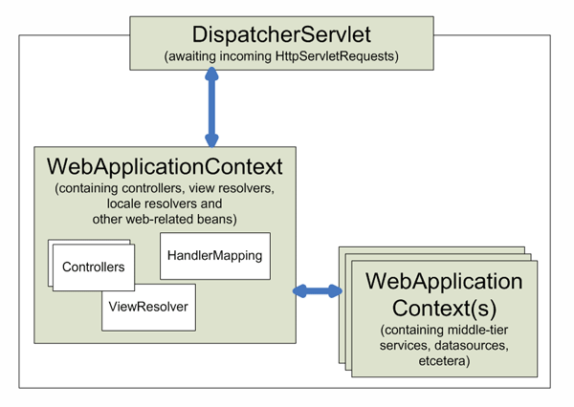
Context hierarchy in Spring Web MVC
Notes:
Web Application Context
The WebApplicationContext is an extension of the plain ApplicationContext that has some extra features necessary for web applications. It differs from a normal ApplicationContext in that it is capable of resolving themes and that it knows which servlet it is associated with (by having a link to the ServletContext). The WebApplicationContext is bound in the ServletContext, and by using static methods on the RequestContextUtils class you can always lookup the WebApplicationContext in case you need access to it.

Slide 33
Controller(s) in Spring-MVC
Spring's Web MVC framework is designed around a DispatcherServlet that dispatches requests to handlers (Controllers)
The default handler is a very simple Controller interface, just offeringthe below method :
ModelAndView handleRequest(request,response)
Application Controllers are typically sub-classes of the included implementation hierarchy, consisting of:
AbstractController
AbstractCommandController
SimpleFormController
Notes:
Controllers provide access to the application behavior which is typically defined by a service interface.
Controllers interpret user input and transform such input into a sensible model which will be represented to the user by the view. Spring has implemented the notion of a controller in a very abstract way enabling a wide variety of different kinds of controllers to be created. Spring contains form-specific controllers, command-based controllers, and controllers that execute wizard-style logic, to name but a few.
Spring's basis for the controller architecture is the org.springframework.web.servlet.mvc.Controller interface.
The Controller interface defines a single method that is responsible for handling a request and returning an appropriate model and view. These three concepts are the basis for the Spring MVC implementation - ModelAndView and Controller. While the Controller interface is quite abstract, Spring offers a lot of Controller implementations out of the box that already contain a lot of the functionality you might need. The Controller interface just defines the most basic responsibility required of every controller; namely handling a request and returning a model and a view.

Slide 34
Command controllers
Spring's command controllers are a fundamental part of the Spring Web MVC package.
Command controllers provide a way to interact with data objects and dynamically bind parameters from the HttpServletRequest to the data object specified.
They perform a somewhat similar role to the Struts ActionForm, but in Spring, your data objects don't have to implement a framework-specific interface.
Built-in Classes:
AbstractCommandController
AbstractFormController
SimpleFormController
AbstractWizardFormController
Notes:
The list of classes of type – Command Controllers:
AbstractCommandController -a command controller you can use to create your own command controller, capable of binding request parameters to a data object you specify. This class does not offer form functionality; it does however offer validation features and lets you specify in the controller itself what to do with the command object that has been populated with request parameter values.
BaseCommandController
● Controller implementation which–Creates an object (the command object) on receipt of a request & Populates command object with request parameters
AbstractFormController -an abstract controller offering form submission support. Using this controller you can model forms and populate them using a command object you retrieve in the controller. After a user has filled the form, the AbstractFormController binds the fields, validates the command object, and hands the object back to the controller to take the appropriate action. Supported features are: invalid form submission (resubmission), validation, and normal form workflow. You implement methods to determine which views are used for form presentation and success. Use this controller if you need forms, but don't want to specify what views you're going to show the user in the application context.

Slide 35
Command controllers (Contd.).
AbstractController
BaseCommandController
AbstractCommandController
AbstractFormController
SimpleFormController
AbstractWizardController
MultiActionController
ParameterizableViewController
Notes:
SimpleFormController -a form controller that provides even more support when creating a form with a corresponding command object. The SimpleFormController let's you specify a command object, a viewname for the form, a viewname for page you want to show the user when form submission has succeeded, and more.
AbstractWizardFormController - as the class name suggests, this is an abstract class -your wizard controller should extend it. This means you have to implement the validatePage(), processFinish() and processCancel() methods.

Slide 36
Handler Mapping
Using a handler mapping you can map incoming web requests to appropriate handlers
When a request comes in, the DispatcherServlet will hand it over to the handler mapping
It lets the HandlerMapping inspect the request and come up with an appropriate HandlerExecutionChain.
Then the DispatcherServlet will execute the handler and interceptors in the chain (if any).
There are some handler mappings you can use out of the box:
SimpleUrlHandlerMapping
BeanNameUrlHandlerMapping (default)
Notes:
BeanNameUrlHandlerMapping
A very simple, but very powerful handler mapping is the BeanNameUrlHandlerMapping, which maps incoming HTTP requests to names of beans, defined in the web application context.
<beans>
<bean id="handlerMapping" class = "org.springframework.web.servlet.handler.BeanNameUrlHandlerMapping"/>
<bean name="/editaccount.form" class = "org.springframework.web.servlet.mvc.SimpleFormController">
<property name="formView" value="account"/>
<property name="successView" value="account-created"/>
<property name="commandName" value="account"/>
<property name="commandClass" value="samples.Account"/>
</bean>
<beans>
All incoming requests for the URL /editaccount.form will now be handled by the form Controller.

Slide 37
Mapping Handler
<mvc:annotation-driven />
<context:component-scan base-package="com.rps.controller" />
<mvc:default-servlet-handler />
<bean id="viewResolver"
class="org.springframework.web.servlet.view.UrlBasedViewResolver">
<property name="viewClass"
value="org.springframework.web.servlet.view.JstlView" />
<property name="prefix" value="/WEB-INF/views/" />
<property name="suffix" value=".jsp" />
</bean>

Slide 38
Mapping Handler
This is the important configuration file where we need to specify the ViewResolver and View components.
<mvc:annotation-driven /> declares explicit support for annotation-driven MVC controllers
(i.e. @RequestMapping, @Controller, although support for those is the default behaviour),
As well as adding support for declarative validation via @Valid and message body marshalling with @RequestBody/ResponseBody.
The <context:component-scan> element defines the base-package where DispatcherServlet will search the controller class.
This xml file should be located inside the WEB-INF directory.

Slide 39
Mapping Handler-View Resolver
The InternalResourceViewResolver class is used for the ViewResolver.
The prefix+string returned by controller+suffix page will be invoked for the view component.
<context:component-scan base-package="com.rps" />
<bean class="org.springframework.web.servlet.view.InternalResourceViewResolver"> <property name="prefix" value="/WEB-INF/jsp/" />
<property name="suffix" value=".jsp" /> </bean>

Slide 40
Notes:
SimpleUrlHandlerMapping
A further - and much more powerful handler mapping - is the SimpleUrlHandlerMapping. This mapping is configurable in the application context and has Ant-style path matching capabilities.
Example:
<beans>
<!-- no 'id' required, HandlerMapping beans are automatically detected by the DispatcherServlet -->
<bean class="org.springframework.web.servlet.handler.SimpleUrlHandlerMapping">
<property name="mappings">
<value>
/*/account.form=editAccountFormController
/*/editaccount.form=editAccountFormController /ex/view*.html = helpController
/**/help.html=helpController
</value>
</property>
</bean>
<bean id="helpController" class = "org.springframework.web.servlet.mvc.UrlFilenameViewController"/>
<bean id="editAccountFormController" class = "org.springframework.web.servlet.mvc.SimpleFormController">
<property name="formView" value="account"/>
<property name="successView" value="account-created"/>
<property name="commandName" value="Account"/> <property name="commandClass" value="samples.Account"/>
</bean>
<beans>
This handler mapping routes requests for 'help.html' in any directory to the 'helpController', which is a UrlFilenameViewController. Requests for a resource beginning with 'view', and ending with '.html' in the directory 'ex' will be routed to the 'helpController'.

Slide 41
Notes:
Another Example configuration file, using InternalResourceViewResolver:
<?xml version="1.0" encoding="UTF-8"?> <!DOCTYPE beans PUBLIC "-//SPRING//DTD BEAN//EN" "http://www.springframework.org/dtd/spring-beans.dtd">
<beans>
<bean id="simpleUrlMapping"
class="org.springframework.web.servlet.handler.SimpleUrlHandlerMapping">
<property name="mappings">
<props>
<prop key="/login.html">loginBankController</prop>
</props>
</property>
</bean>
<bean id="logonValidator" class="springexample.commands.LogonValidator"/>
<!-- LoginBankController is a SimpleFormController -->
<bean id="loginBankController"
class="springexample.contoller.LoginBankController">
<property name="sessionForm">
<value>true</value>
</property>
<!-- This is Command object. The command object can be
accessed in a view through <spring:bind path="loginCommand"> -->
<property name="commandName">
<value>loginCommand</value>
</property>
<property name="commandClass">
<value>springexample.commands.LoginCommand</value>
</property>
<property name="validator">
<ref bean="logonValidator"/>
</property>

Slide 42
Notes:
<!-- Indicates what view to use when the user asks for a new form
or when validation errors have occurred on form submission. -->
<property name="formView">
<value>login</value>
</property>
<!-- Indicates what view to use when successful form submissions
have occurred. Such a success view could e.g. display a submission
summary. More sophisticated actions can be implemented by
overriding one of the onSubmit() methods.-->
<property name="successView">
<value>accountdetail</value>
</property>
<property name="authenticationService">
<ref bean="authenticationService" />
</property>
<property name="accountServices">
<ref bean="accountServices" />
</property>
</bean>
<bean id="viewResolver"
class="org.springframework.web.servlet.view.InternalResourceViewResolver">
<property name="viewClass">
<value>org.springframework.web.servlet.view.JstlView</value>
</property>
<property name="prefix">
<value>/jsp/</value>
</property>
<property name="suffix">
<value>.jsp</value>
</property>
</bean>
</beans>

Slide 43
Intercepting requests
Spring's handler mapping mechanism has the notion of handler interceptors
Interceptors located in the handler mapping must implement HandlerInterceptor from the org.springframework.web.servlet package.
This interface defines three methods:
boolean preHandle(HttpServletRequest request, HttpServletResponse response, Object handler) throws Exception;
void postHandle( HttpServletRequest request, HttpServletResponse response, Object handler, ModelAndView modelAndView) throws Exception;
void afterCompletion( HttpServletRequest request, HttpServletResponse response, Object handler, Exception ex) throws Exception;
Spring has an adapter class - named HandlerInterceptorAdapter, to make it easier to extend the HandlerInterceptor interface.
Notes:
HandlerInterceptor
This interface defines three methods, one that will be called before the actual handlerwill be executed, one that will be called after the handler is executed, and one that is called after the complete request has finished. These three methods should provide enough flexibility to do all kinds of pre- and post-processing.
The preHandle(..) method returns a boolean value. You can use this method to break or continue the processing of the execution chain. When this method returns true, the handler execution chain will continue, when it returns false, the DispatcherServletassumes the interceptor itself has taken care of requests (and, for example, rendered an appropriate view) and does not continue executing the other interceptors and the actual handler in the execution chain.
Example:
The following example provides an interceptor that intercepts all requests and reroutes the user to a specific page if the time is not between 9 a.m. and 6 p.m.

Slide 44
Notes:
.java file:
package samples;
public class TimeBasedAccessInterceptor extends HandlerInterceptorAdapter
{
private int openingTime;
private int closingTime;
public void setOpeningTime(int openingTime)
{ this.openingTime = openingTime; }
public void setClosingTime(int closingTime) { this.closingTime = closingTime; }
public boolean preHandle( HttpServletRequest request, HttpServletResponse response, Object handler) throws Exception
{
Calendar cal = Calendar.getInstance();
int hour = cal.get(HOUR_OF_DAY);
if (openingTime <= hour < closingTime) { return true; }
else
{ response.sendRedirect("http://host.com/outsideOfficeHours.html"); return false;
}
}
}
Any request coming in, will be intercepted by the TimeBasedAccessInterceptor, and if the current time is outside office hours, the user will be redirected to a static html file, saying, for example, he can only access the website during office hours.

Slide 45
Spring MVC - Page Redirection
In Spring MVC there is a class which is used to transfer an http request to another page. org.springframework.web.servlet.view.RedirectView,
As name indicated, a view is redirect to another absolute, context relative, or current request relative URL.
There is attribute “redirect” which can be prefixed to the view name to indicate that the new request should be a redirected one.

Slide 46
Summary
In this module, we have learnt :
Core Components of Spring MVC
Flow of Request in Spring MVC based Web Application
How to develop a Web Application using Spring MVC

Slide 47
The View
All the data, we place within these models, is used by a view .
In general, a templated view to render the web page.

Slide 48
MVC Form Tag Library
The Spring MVC form tags are the configurable and reusable building blocks for a web page.
These tags provide JSP, an easy way to develop, read and maintain.
The Spring MVC form tags can be seen as data binding-aware tags that can automatically set data to Java object/bean and also retrieve from it.
Here, each tag provides support for the set of attributes of its corresponding HTML tag counterpart, making the tags familiar and easy to use.

Slide 49
Configuration of Spring MVC Form Tag
The form tag library comes under the spring-webmvc.jar.
To enable the support for form tag library, it is required to reference some configuration.
So, add the following directive at the beginning of the JSP page:
<%@ taglib prefix="form" uri="http://www.springframework.org/tags/form" %>

Slide 50
Spring MVC Form Tags
Form Tag | Description
form:form | It is a container tag that contains all other form tags.
form:input | This tag is used to generate the text field.
form:radiobutton | This tag is used to generate the radio buttons.
form:checkbox | This tag is used to generate the checkboxes.
form:password | This tag is used to generate the password input field.
form:select | This tag is used to generate the drop-down list.
form:textarea | This tag is used to generate the multi-line text field.
form:hidden | This tag is used to generate the hidden input field.

Slide 51
Spring’s Form Tag Library
The form tag
The input tag
The checkbox tag
The checkboxes tag
The radiobutton tag
The radiobuttons tag
The password tag
The option tag
The select tag
The options tag
The textarea tag
The hidden tag
The errors tag
HTML5 tags

Slide 52
The form tag
The Spring MVC form tag is a container tag.
It is a parent tag that contains all the other tags of the tag library.
This tag generates an HTML form tag and exposes a binding path to the inner tags for binding.
<form:form action=“mapPath" modelAttribute=“cust”>
modelAttribute attribute is the key which specifies a name of the model object that backs
This will correspond to the @ModelAttribute later on in the controller.

Slide 53
Spring MVC Form Text Field
The Spring MVC form text field tag generates an HTML input tag using the bound value.
By default, the type of the input tag is text.
<form:input path="name" />
Here, path attribute binds the form field to the bean property.
The Spring MVC form tag library also provides other input types such as email, date, tel, etc.

Slide 54
path attribute
Each input fields specifies a path attribute.
This must correspond to a getter/setter of the model attribute (Eg: the Employee class).
When the page is loaded, the input fields are populated by Spring, which calls the getter of each field bound to an input field.
When the form is submitted, the setters are called to save the values of the form to the object.
When the form is submitted, the POST handler in the controller is invoked and the form is automatically bound to the employee argument that we passed in
<form:input path="name" />

Slide 55
Spring MVC Form Radio Button, CheckBox
The Spring MVC form radio button allows us to choose only one option at a time.
This tag renders an HTML input tag of type radio.
<form:radiobutton path="abc" value="xyz"/>
<form:checkbox path="abc" value="element"/>
The Spring MVC form checkbox facilitates to choose multiple options at the same time.

Slide 56
Spring MVC Form Drop-Down List
The Spring MVC form drop-down list contains the list of elements.
This tag generates an HTML select element.
It allows data binding to the selected element.
<form:select path=“city">
option tag
This tag generates an HTML option tag.
Each tag contains a value that can be selected by the user.
<form:option value=“Bangalore" label=“Bangalore"/>

Slide 57
@ModelAttribute Annotation
@ModelAttribute annotation is used to bind a method parameter or a method return value to a named model attribute.
It can be used either on methods or on method parameters in controller.
Spring invokes all methods that have @ModelAttribute annotation before handler methods (i.e. methods annotated with the @RequestMapping) in a same controller.

Slide 58
@ModelAttribute annotation at Parameter level
When using the @ModelAttribute annotation as a method parameter, it binds the form data with a POJO bean.
It has a value attribute which acts as a name of the model attribute to bind.
@RequestMapping(value="/handleRequest", method=RequestMethod.GET)
public String saveCustomer(@ModelAttribute("cust") Customer custObj)
{
custObj.setName("John");
return “listView”
}
In this case, a new instance of the Customer is created and then passed to the handler method for further processing.

Slide 59
@ModelAttribute annotation at Method level
When using the @ModelAttribute annotation at the method level, developers can add the values in the Model at a global level.
It means for every request, a default value will be there in the controller for every response.
@ModelAttribute
public void addAttributes(Model model) {
model.addAttribute("welcome_text", "Welcome to my Web Site");
}

Slide 60
Model Interface
In Spring MVC, the model works a container that contains the data of the application.
Here, a data can be in any form such as objects, strings, information from the database, etc.
The model can supply attributes used for rendering views.
To provide a view with usable data, we simply add this data to its Model object.
Additionally, maps with attributes can be merged with Model instances.
It contains four addAttribute() and one mergeAttribute() method.

Slide 61
ModelMap Interface
Just like the Model interface above, ModelMap is also used to pass values to render a view.
The advantage of ModelMap is it gives us the ability to pass a collection of values and treat these values as if they were within a Map
@GetMapping("/printViewPage")
public String passParametersWithModelMap(ModelMap map) {
map.addAttribute("welcomeMessage", "welcome");
map.addAttribute("message", “Spring MVC");
return "viewPage";
}

Slide 62
JSTL (JSP Standard Tag Library)
The JSP Standard Tag Library (JSTL) represents a set of tags to simplify the JSP development.
Advantages:
Fast Development JSTL provides many tags that simplify the JSP.
Code Reusability We can use the JSTL tags on various pages.
No need to use scriptlet tag It avoids the use of scriptlet tag.

Slide 63
JSTL Tags
Tag Name | Description
Core tags | The JSTL core tag provide variable support, URL management, flow control, etc. The URL for the core tag is http://java.sun.com/jsp/jstl/core. The prefix of core tag is c.
Function tags | The functions tags provide support for string manipulation and string length. The URL for the functions tags is http://java.sun.com/jsp/jstl/functions and prefix is fn.
Formatting tags | The Formatting tags provide support for message formatting, number and date formatting, etc. The URL for the Formatting tags is http://java.sun.com/jsp/jstl/fmt and prefix is fmt.
XML tags | The XML tags provide flow control, transformation, etc. The URL for the XML tags is http://java.sun.com/jsp/jstl/xml and prefix is x.
SQL tags | The JSTL SQL tags provide SQL support. The URL for the SQL tags is http://java.sun.com/jsp/jstl/sql and prefix is sql.

Slide 64
JSTL Core Tags
The JSTL core tag provides variable support, URL management, flow control etc.
The syntax used for including JSTL core library in your JSP is:
<%@ taglib uri="http://java.sun.com/jsp/jstl/core" prefix="c" %>

Slide 65
JSTL Core Tags List
Tags | Description
c:out | It display the result of an expression, similar to the way <%=...%> tag work.
c:import | It Retrives relative or an absolute URL and display the contents to either a String in 'var',a Reader in 'varReader' or the page.
c:set | It sets the result of an expression under evaluation in a 'scope' variable.
c:remove | It is used for removing the specified scoped variable from a particular scope.
c:catch | It is used for Catches any Throwable exceptions that occurs in the body.
c:if | It is conditional tag used for testing the condition and display the body content only if the expression evaluates is true.
c:choose, c:when, c:otherwise | It is the simple conditional tag that includes its body content if the evaluated condition is true.
c:forEach | It is the basic iteration tag. It repeats the nested body content for fixed number of times or over collection.
c:forTokens | It iterates over tokens which is separated by the supplied delimeters.
c:param | It adds a parameter in a containing 'import' tag's URL.
c:redirect | It redirects the browser to a new URL and supports the context-relative URLs.
c:url | It creates a URL with optional query parameters.

Slide 66
Expression Language (EL) in JSP
The Expression Language (EL) simplifies the accessibility of data stored in the Java Bean component, and other objects like request, session, application etc.`
There are many implicit objects, operators and reserve words in EL.
It is the newly added feature in JSP technology version 2.0.
Syntax for Expression Language (EL): ${ expression }

Slide 67


Introduction to EL 4-1
EL stands for Expression Language
Developed by two groups
JSP Standard Tag Library expert group
JSP 2.0 expert group
Syntax for JSP expression language
${EL Expression}
JSP EL expressions are used in
Static text
Standard and Custom tags
Request
JSP page
Response
Response
Static
Content
Dynamic
Content
Client
Server
Request
${ EL Expression }

Slide 68
Introduction to EL 4-2
<tr>
<td>Or</td>
<td>${'${'}true or true}</td>
<td>${true or true}</td>
</tr>
<tr>
<td>Or</td>
<td>${'${'}true || false}</td>
<td>${true || false}</td>
</tr>
<tr>
<td>Not</td>
<td>${'${'}not true}</td>
<td>${not true}</td>
</tr>
<tr>
<td>Not</td>
<td>${'${'}'!false}</td>
<td>${!false}</td>
</tr>
</table>
</body>
</html>
<html>
<head>
<title>Expression Language</title>
</head>
<body>
<h1>EL operations</h1>
<table border="1">
<tr>
<td><b>Concept</b></td>
<td><b>EL Expression</b></td>
<td><b>Result</b></td>
</tr>
<tr>
<td>And</td>
<td>${'${'}true and true}</td>
<td>${true and true}</td>
</tr>
<tr>
<td>And</td>
<td>${'${'}true && false}</td>
<td>${true && false}</td>
</tr>
EL expressions in
<table> tags
EL expressions in
<table> tags
Demonstration: Example 1

Slide 69
Introduction to EL 4-3
<html>
<head>
<meta http-equiv="Content-Type" content="text/html; charset=UTF-8">
<title>Article Expression</title>
</head>
<body>
<h1>Article Expression</h1>
<h2>Price of the article is ${84.5E4}.</h2>
</body>
</html>
EL expressions in
<h2> tags (Static text)
Demonstration: Example 2

Slide 70
Introduction to EL 4-4
<html>
<head>
<meta http-equiv="Content-Type" content="text/html; charset=UTF-8">
<title>EL Example</title>
</head>
<%
pageContext.setAttribute("color","#FFFFCC");
%>
<body bgcolor='${pageScope.color}'>
<h1>
Background color changed
</h1>
</body>
</html>
EL passed as a
value of bgcolor attribute
Demonstration: Example 3

Slide 71
Disabling the EL 2-1
Disable evaluation to ignore the execution of EL expression in JSP
Syntax to disable EL evaluation
<%@ page isELIgnored ="true|false" %>
<html>
<%@ page isELIgnored = "true" %>
<head>
<title>Using the JSP Expression
Language</title>
</head>
<body>
<h1>The Expression Language</h1>
<b>The User Agent is </b>
${header["User-Agent"]}
</body>
</html>
<html>
<%@ page isELIgnored = "false" %>
<head>
<title>Using the JSP Expression
Language</title>
</head>
<body>
<h1>The Expression Language</h1>
<b>The User Agent is</b>
${header["User-Agent"]}.
</body>
</html>
true
false
EL is not evaluated
EL is evaluated

Slide 72
Disabling the EL 2-2
isELIgnored
set to true
<%@page isELIgnored="true" %>
<html>
<head>
<title>ELDisabled</title>
</head>
<body bgcolor="#ffffff">
<h1>
Enabling/Disabling Expression Language
</h1>
<form method="post" action="ELDisabled.jsp">
<b> ${'First Name: '}<input type="text"
value="${'Enter your first name'}"/> </b><br />
<b> ${'Last Name: '}<input type="text"
value="${'Enter your last name'}"/> </b><br />
<hr/>
<input type="submit" name="Submit" value="${'Submit'}">
<input type="reset" value="${'Reset'}">
</form>
</body>
</html>
JSP Engine ignores
EL expressions
Demonstration: Example 4

Slide 73
Module 2: Spring Database Interaction

Slide 74
Objectives
This module is aimed at:
Understanding Spring interaction with database using
JDBC
ORM (Hibernate)

Slide 75
Spring JDBCTemplate
JDBCTemplate class is the central class in the JDBC core package.
It simplifies the use of JDBC in Spring applications by handlingthe creation and release of resources.
This class performs basic tasks of core JDBC workflow like SQL statement creation and execution.
This class executes SQL queries, update statements and stored procedure calls, performs iteration over ResultSets and extraction of returned parameter values and catch and handle JDBC exceptions.

Slide 76
Spring JdbcTemplate
Spring JdbcTemplate is a powerful mechanism to connect to the database and execute SQL queries.
It internally uses JDBC api, but eliminates a lot of problems of JDBC API.

Slide 77
JDBC API – Cons
We need to write a lot of code before and after executing the query, such as:
creating connection,
statement,
closing resultset,
connection etc.
We need to perform exception handling code on the database logic.
We need to handle transaction.
Repetition of all these codes from one to another database logic is a time consuming task.

Slide 78
Advantage of Spring JdbcTemplate
Spring JdbcTemplate eliminates all the above mentioned problems of JDBC API.
It provides you methods to write the queries directly, so it saves a lot of work and time.

Slide 79
Spring Jdbc Approaches
Spring framework provides following approaches for JDBC database access:
JdbcTemplate
NamedParameterJdbcTemplate
SimpleJdbcTemplate
SimpleJdbcInsert and SimpleJdbcCall

Slide 80
JdbcTemplate class
It is the central class in the Spring JDBC support classes.
It takes care of creation and release of resources such as creating and closing of connection object etc.
So it will not lead to any problem if you forget to close the connection.
It handles the exception and provides the informative exception messages by the help of excepion classes defined in the org.springframework.dao package.
We can perform all the database operations by the help of JdbcTemplate class such as insertion, updation, deletion and retrieval of the data from the database.

Slide 81
JdbcTemplate class - Methods
Method | Description
public int update(String query) | is used to insert, update and delete records.
public int update(String query,Object... args) | is used to insert, update and delete records using PreparedStatement using given arguments.
public void execute(String query) | is used to execute DDL query.
public T execute(String sql, PreparedStatementCallback action) | executes the query by using PreparedStatement callback.
public T query(String sql, ResultSetExtractorrse) | is used to fetch records using ResultSetExtractor.
public List query(String sql, RowMapper rse) | is used to fetch records using RowMapper.

Slide 82
DriverManagerDataSource - *.xml
It is used to contain the information about the database such as driver class name, connnection URL, username and password.
There are a property named datasource in the JdbcTemplate class of DriverManagerDataSource type.
We need to provide the reference of DriverManagerDataSource object in the JdbcTemplate class for the datasource property.
We are using the JdbcTemplate object in the Dao class, so we are passing it by the setter method but you can use constructor also.

Slide 83
applicationContext.xml
<bean id="ds" class="org.springframework.jdbc.datasource.DriverManagerDataSource">
<property name="driverClassName" value="oracle.jdbc.driver.OracleDriver" />
<property name="url" value="jdbc:oracle:thin:@localhost:1521:xe" />
<property name="username" value="system" />
<property name="password" value="oracle" />
</bean>
<bean id="jdbcTemplate" class="org.springframework.jdbc.core.JdbcTemplate">
<property name="dataSource" ref="ds"></property>
</bean>
<bean id="edao" class="com.lti.EmployeeDao">
<property name="jdbcTemplate" ref="jdbcTemplate"></property>
</bean>

Slide 84
PreparedStatement in Spring JdbcTemplate
We can execute parameterized query using Spring JdbcTemplate by the help of execute() method of JdbcTemplate class.
To use parameterized query, we pass the instance of PreparedStatementCallback in the execute method.
public T execute(String sql,PreparedStatementCallback<T>);

Slide 85
PreparedStatementCallback interface
It processes the input parameters and output results.
In such case, you don't need to care about single and double quotes.
Method of PreparedStatementCallback interface
It has only one method doInPreparedStatement.
public T doInPreparedStatement(PreparedStatement ps)throws SQLException, DataAccessException

Slide 86
RowMapper -Fetching records by Spring JdbcTemplate
RowMapper interface to fetch the records from the database using query() method of JdbcTemplate class.
RowMapper interface allows to map a row of the relations with the instance of user-defined class.
It iterates the ResultSet internally and adds it into the collection.
RowMapper saves a lot of code becuase it internally adds the data of ResultSet into the collection.
It defines only one method mapRow that accepts ResultSet instance and int as the parameter list.
public T mapRow(ResultSet rs, int rowNumber)throws SQLException

Slide 87
Model
The model can supply attributes used for rendering views.
To provide a view with usable data, we simply add this data to its Model object.
Additionally, maps with attributes can be merged with Model instances:
public String passParametersWithModel(Model model) {
Map<String, String> map = new HashMap<>();
map.put("spring", "mvc");
model.addAttribute("message", “SpringMVC");
model.mergeAttributes(map);
return "viewPage";
}

Slide 88
ModelMap
Just like the Model interface above, ModelMap is also used to pass values to render a view.
The advantage of ModelMap is it gives us the ability to pass a collection of values and treat these values as if they were within a Map:
@GetMapping("/printViewPage")
public String passParametersWithModelMap(ModelMap map) {
map.addAttribute("welcomeMessage", "welcome");
map.addAttribute("message", “SpringMVC");
return "viewPage";
}

Slide 89
ModelAndView in Spring MVC
ModelAndView is an object that holds both the model and view.
The handler returns the ModelAndView object and DispatcherServlet resolves the view using View Resolvers and View.
The View is an object which contains view name in the form of the String and model is a map to add multiple objects.
The final interface to pass values to a view is the ModelAndView.
@GetMapping("/goToViewPage")
public ModelAndView passParametersWithModelAndView() {
ModelAndView modelAndView = new ModelAndView("viewPage");
modelAndView.addObject("message", “SpringMVC");
return modelAndView;
}

Slide 90
RequestParam Annotation
In Spring MVC, the @RequestParam annotation is used to read the form data and bind it automatically to the parameter present in the provided method.
So, it ignores the requirement of HttpServletRequest object to read the provided data.
Including form data, it also maps the request parameter to query parameter and parts in multipart requests.
If the method parameter type is Map and a request parameter name is specified, then
the request parameter value is converted to a Map else
the map parameter is populated with all request parameter names and values.

Slide 91
@RequestParam
The @RequestParam is used to read the HTML form data provided by a user and bind it to the request parameter.
The Model contains the request data and provides it to view page.
@RequestMapping("/hello")
//read the provided form data
public String display(@RequestParam("name") String name,@RequestParam("pass") String pass,Model m)
{
if(pass.equals("admin"))
{
String msg="Hello "+ name;
//add a message to the model
m.addAttribute("message", msg);
return "viewpage"; }}

Slide 92
Spring with ORM Frameworks
Spring provides API to easily integrate Spring with ORM frameworks such as :
Hibernate,
JPA(Java Persistence API),
JDO(Java Data Objects),
Oracle Toplink and
iBATIS.

Slide 93
Advantages of ORM Frameworks with Spring
Less coding is required: By the help of Spring framework, you don't need to write extra codes before and after the actual database logic such as getting the connection, starting transaction, commiting transaction, closing connection etc.
Easy to test: Spring's IoC approach makes it easy to test the application.
Better exception handling: Spring framework provides its own API for exception handling with ORM framework.
Integrated transaction management: By the help of Spring framework, we can wrap our mapping code with an explicit template wrapper class or AOP style method interceptor.

Slide 94
Integrating Hibernate with Spring
The Spring Framework provides integration with Hibernate, in terms of:
Resource management
DAO implementation support
transaction strategies
There are usually two integration styles:
using Spring's DAO 'templates' (helper classes)
or coding DAOs against plain Hibernate/JDO/TopLink/etc APIs.
In both cases, DAOs can be configured through Dependency Injection and participate in Spring's resource and transaction management.
Notes:
Some of the benefits of using the Spring Framework to create your ORM DAOs include:
Ease of testing. Spring's IoC approach makes it easy to swap the implementations and config locations of Hibernate SessionFactory instances, JDBC DataSource instances, transaction managers, and mapper object implementations (if needed). This makes it much easier to isolate and test each piece of persistence-related code in isolation.
Common data access exceptions. Spring can wrap exceptions from your O/R mapping tool of choice, converting them from proprietary (potentially checked) exceptions to acommon runtime DataAccessException hierarchy. This allows you to handle most persistence exceptions, which are non-recoverable, only in the appropriate layers, without annoying boilerplate catches/throws, and exception declarations. You can still trap and handle exceptions anywhere you need to. Remember that JDBC exceptions (including DB specific dialects) are also converted to the same hierarchy, meaning that you can perform some operations with JDBC within a consistent programming model.

Slide 95
Integrating Hibernate with Spring
Spring is the leading enterprise application framework.
Hibernate is the leading ORM framework.
So combination of these two technologies would be a preferable choice in order to develop robust enterprise applications.
The DAO implementation uses Hibernate’s SessionFactory to query against the database.
The following configuration approaches can be used :
Spring MVC: Annotations for controller and XML for bean definitions.
Hibernate: XML mapping for model class.
Web Application: using web.xml deployment descriptor file.

Slide 96
Hibernate and Spring Integration
We can simply integrate hibernate application with spring application.
In hibernate framework, we provide all the database information hibernate.cfg.xml file.
But if we are going to integrate the hibernate application with spring, we don't need to create the hibernate.cfg.xml file.
We can provide all the information in the applicationContext.xml file.

Slide 97
Advantages of Spring framework with hibernate
The Spring framework provides HibernateTemplate class, so you don't need to follow so many steps like:
Create Configuration,
BuildSessionFactory,
Session,
beginning and committing transaction etc.
So it saves a lot of code.
Solution by using HibernateTemplate class of Spring Framework:
Employee e1=new Employee(111,“John",40000);
hibernateTemplate.save(e1);

Slide 98
Methods of HibernateTemplate class
Method | Description
void persist(Object entity) | persists the given object.
Serializable save(Object entity) | persists the given object and returns id.
void saveOrUpdate(Object entity) | persists or updates the given object. If id is found, it updates the record otherwise saves the record.
void update(Object entity) | updates the given object.
void delete(Object entity) | deletes the given object on the basis of id.
Object get(Class entityClass, Serializable id) | returns the persistent object on the basis of given id.
Object load(Class entityClass, Serializable id) | returns the persistent object on the basis of given id.
List loadAll(Class entityClass) | returns the all the persistent objects.

Slide 99
Notes:
General resource management. Spring application contexts can handle the location and configuration of Hibernate SessionFactory instances, JDBC DataSource instances, iBATIS SQL Maps configuration objects, and other related resources. This makes these values easy to manage and change. Spring offers efficient, easy and safe handling of persistence resources.
For example: related code using Hibernate generally needs to use the same Hibernate Session for efficiency and proper transaction handling. Spring makes it easy to transparently create and bind a Session to the current thread, either by using an explicit 'template' wrapper class at the Java code level or by exposing a current Session through the Hibernate SessionFactory (for DAOs based on plain Hibernate API). Thus Spring solves many of the issues that repeatedly arise from typical Hibernate usage, for any transaction environment (local or JTA).
Integrated transaction management. Spring allows you to wrap your O/R mapping code with either a declarative, AOP style method interceptor, or an explicit 'template' wrapper class at the Java code level. In either case, transaction semantics are handled for you, and proper transaction handling (rollback, etc) in case of exceptions is taken care of. As discussed below, you also get the benefit of being able to use and swap various transaction managers, without your Hibernate/JDO related code being affected:
for example, between local transactions and JTA, with the same full services (such as declarative transactions) available in both scenarios.
As an additional benefit, JDBC-related code can fully integrate transactionally with the code you use to do O/R mapping. This is useful for data access that's not suitable for O/R mapping, such as batch processing or streaming of BLOBs, which still needs toshare common transactions with ORM operations.

Slide 100
Spring support for Hibernate
Basically, in order to support Hibernate integration, Spring provides two key beans available in the org.springframework.orm.hibernate5 package
LocalSessionFactoryBean:
Creates a Hibernate’s SessionFactory which is injected into Hibernate-based DAO classes.
HibernateTransactionManager:
Provides transaction support code for a SessionFactory.
Programmers can use @Transactional annotation in DAO methods to avoid writing boiler-plate transaction code explicitly.
Notes:
JDBC DataSource and HibernateSessionFactory wiring <!-- DataSource Property -->
<bean id="exampleDataSource" class="org.apache.commons.dbcp.BasicDataSource">
<property name="driverClassName">
<value>org.apache.derby.jdbc.EmbeddedDriver</value>
</property>
<property name="url">
<value>jdbc:derby:springexample;create=true</value>
</property>
</bean> <!-- Database Property -->
<bean id="exampleHibernateProperties" class = "org.springframework.beans.factory.config.PropertiesFactoryBean"> <property name="properties">
<props>
<prop key="hibernate.hbm2ddl.auto">update</prop>

Slide 101
Spring JpaTemplate
Spring Data JPA API provides JpaTemplate class to integrate spring application with JPA.
JPA (Java Persistent API) is the sun specification for persisting objects in the enterprise application.
It is currently used as the replacement for complex entity beans.
It is basically used to integrate Hibernate with Spring

Slide 102
JPA Spring Annotations
@Entity -Annotate all your entity beans with @Entity.
@Entity
public class Company {
...
}
@Service - Annotate all your service classes with @Service.
All your business logic should be in Service classes.
@Service
public class CompanyServiceImpl implements CompanyService {
...
}

Slide 103
JPA Spring Annotations
@Repository
Annotate all your DAO classes with @Repository.
All your database access logic should be in DAO classes.
@Transactional
Configure your transactions with @Transactional spring annotation.
@Repository
public class CompanyDAOImpl implements CompanyDAO {
...
}
@Transactional
public Company findByName(String name) {
Company company = companyDAO.findByName(name);
return company;
}

Slide 104
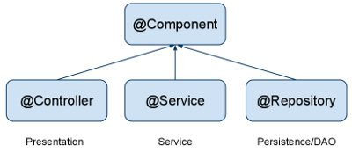
JPA Spring Annotations
@Component
Annotate your other components (for example REST resource classes) with @Component.
@Component is a generic stereotype for any Spring-managed component.
@Repository, @Service, and @Controller are specializations of @Component for more specific use cases,
for example, in the persistence, service, and presentation layers, respectively.
@Component
public class ContactResource {
...
}

Slide 105
JPA Spring Annotations
@Autowired
Let Spring auto-wire other beans into your classes using @Autowired annotation.
@Autowire by default is a type driven injection.
@Autowired
private CompanyDAO companyDAO;

Slide 106
Summary
In this module, we have learnt:
Understanding Spring interaction with database using
JDBC
ORM (Hibernate)

Slide 107
References
http://www.theserverside.com/tt/articles/article.tss?l=SpringFramework
http://static.springframework.org/spring/docs/
http://www.javabeat.net/articles/71-introduction-to-spring-web-framework-3.html
http://www.java2s.com/Code/Java/Hibernate/HibernateSpringHibernateTemplateFind.htm

Slide 108
Thank You

