Slide 1
Claims Vertical Support Process
Notes:
---

Slide 2
Table of Contents :
Customers in Claims Vertical
Applications/Services
Incident Management levels
Ticket assignment groups
Minimum Information to be provided in SNOW ticket

Slide 3
Overview of Claims Vertical

Slide 4

Customers in Claims Vertical
International Customer Base
  Claims vertical serves customers from following region:
  • Italy
  • Australia
  • Germany
  • Switzerland

Slide 5

Applications and Services in Claims Vertical
Specialized Claims Applications
  Claims Vertical uses apps/Softwares like :
  • Claimnet
  • POI
  • SPP (GCPP)
  • CTR ( Claim Task Routing )
  • Claims tracker
  • FNOL
  These applications enhance operational efficiency and customer experience in claims processing.

Slide 6
Incident Management Support Levels

Slide 7
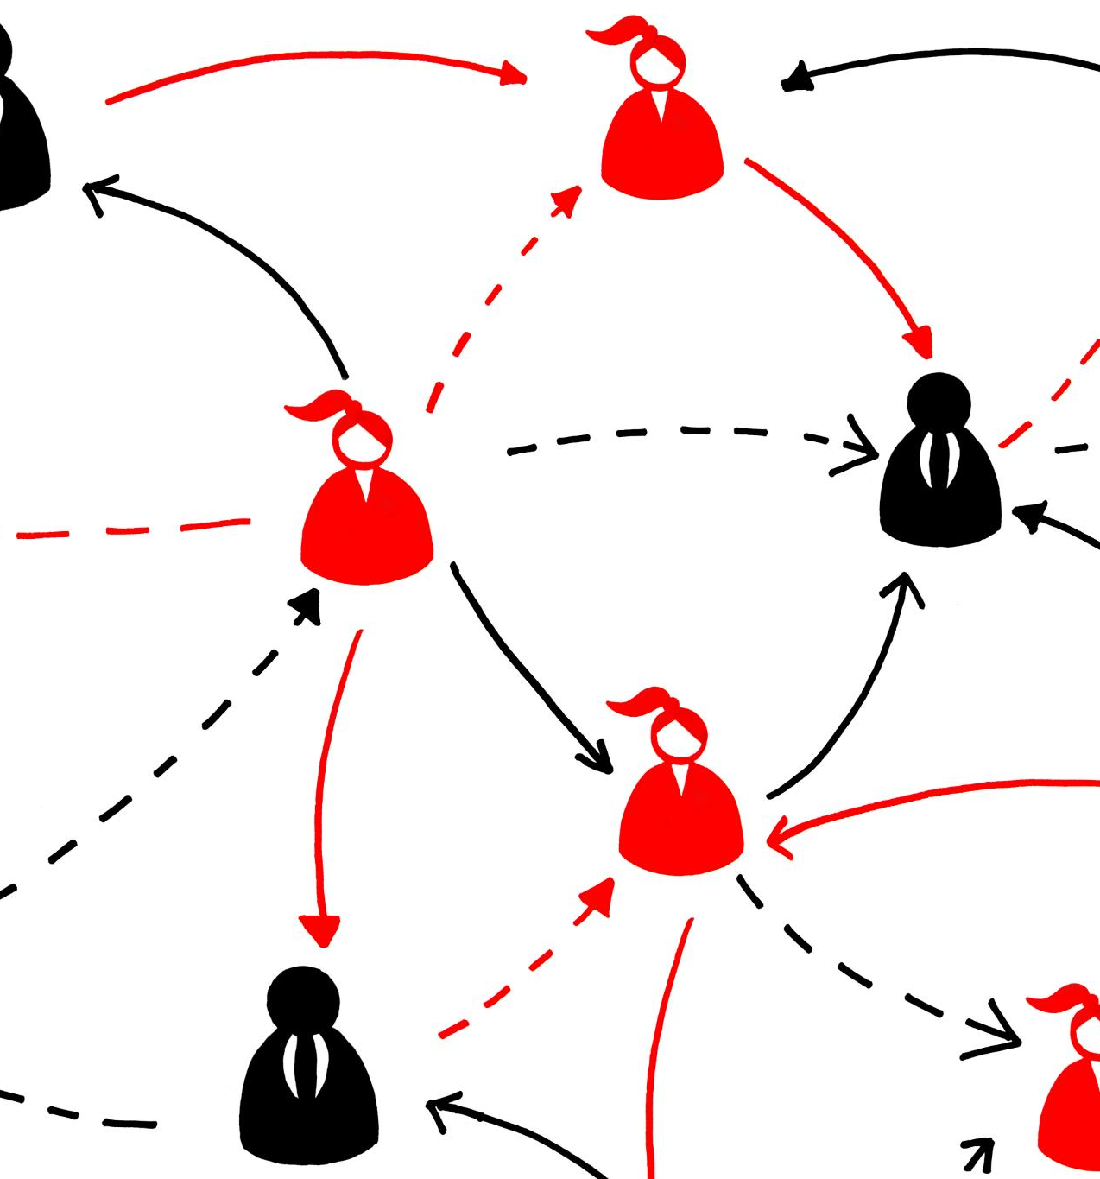
Support Levels in Incident Management
First Level Support- L1
  Depending on the customer, 1st Level support is done by local IT or My-Allicia who is supporting 24/7 all over the globe
Second Level Support –L2
  The task of the 2nd Level User Support is to examine tickets that have been forwarded and to decide: the priority of the issue, to forward it with the right assignment group.
  Third Level Support – L3
  Developers fix bugs, rewrite programs, and plan long-term solutions for incidents.

Slide 8
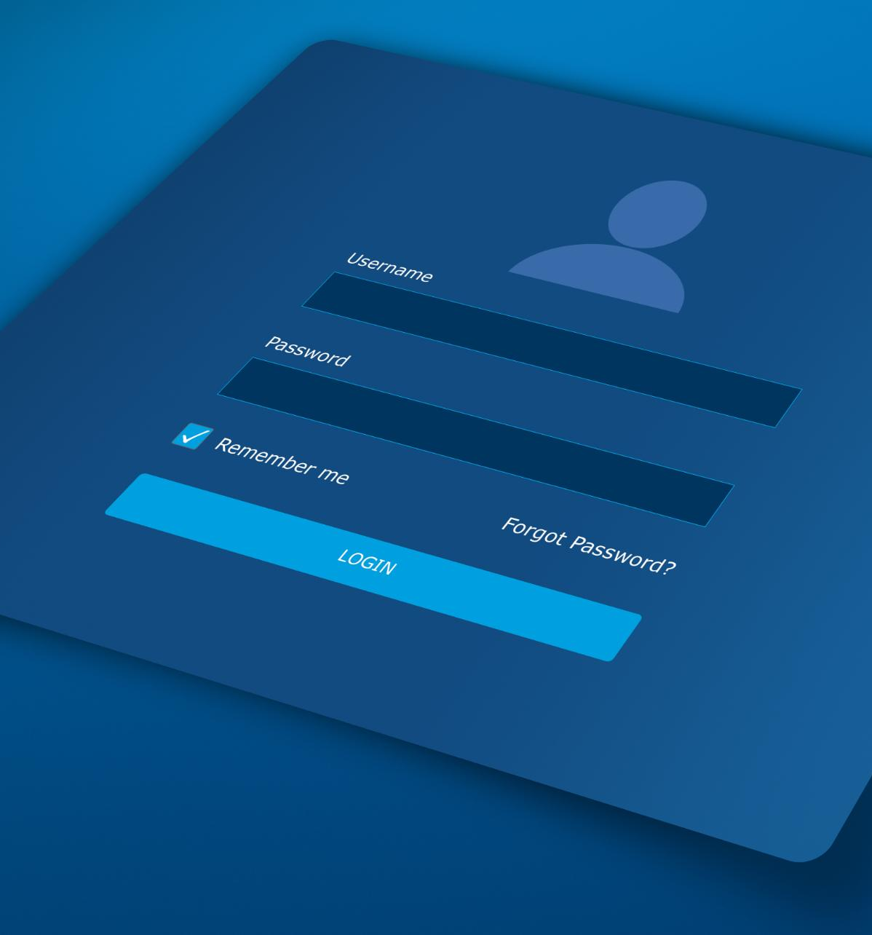
Ticket Assignment
Importance of Ticket Assignment
  Proper ticket assignment directs issues to correct local and global teams for faster resolution.
Mandatory SNOW Ticket Fields
  Tickets require detailed info including description, business unit, priority, and user details.
Benefits of Structured Ticketing
  Structured tickets support efficient issue handling, tracking, auditing, and process improvement.
  Whom must we assign this tickets
  Add F group link here

Slide 9
Minimum information to be provided in SNOW ticket
Notes:
Incident Management Flowchart, Interactive Questions for KT Session

Slide 10
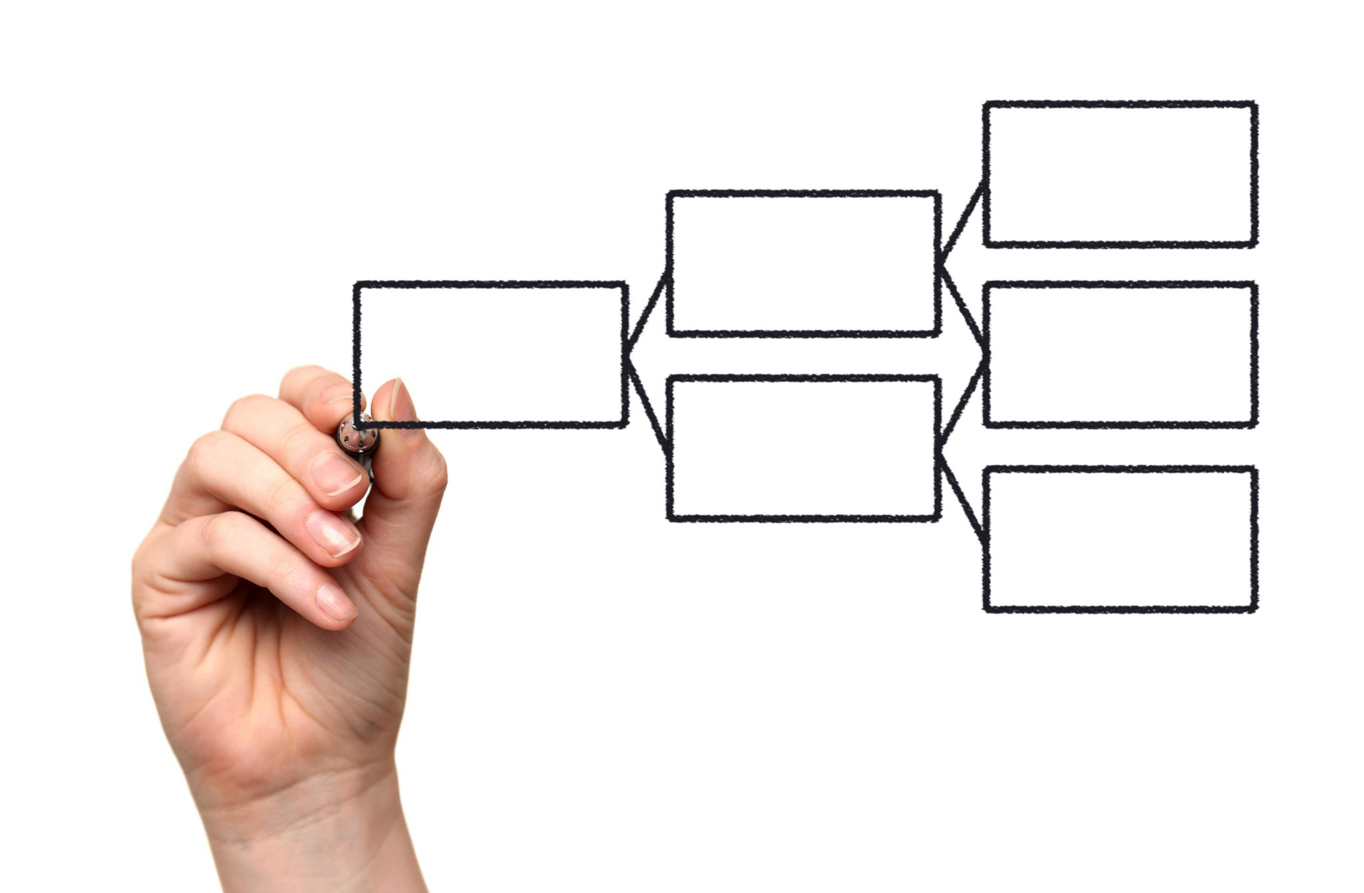
Dear team,
Please be so kind and look into below issue
ITMP AUS | (Usually we add short description here )
Business unit (Country): BMP Australia
Priority of this issue : Regular
Incident date and time : [Insert Date/Time]
Affected GIAM users and ABS user ID’s : JDBB
Affected User : [ Name ]
Affected User Email: [ Email ]
Affected User Phone : [ Phone Number ]
Problem: [ Describe the issue ]
Steps Taken : [ List steps already tried ]
Attachments :
Best Regards
Your Name
team name

Slide 11

Thank You
Thank you for your attention ! Any questions ?

