Slide 1
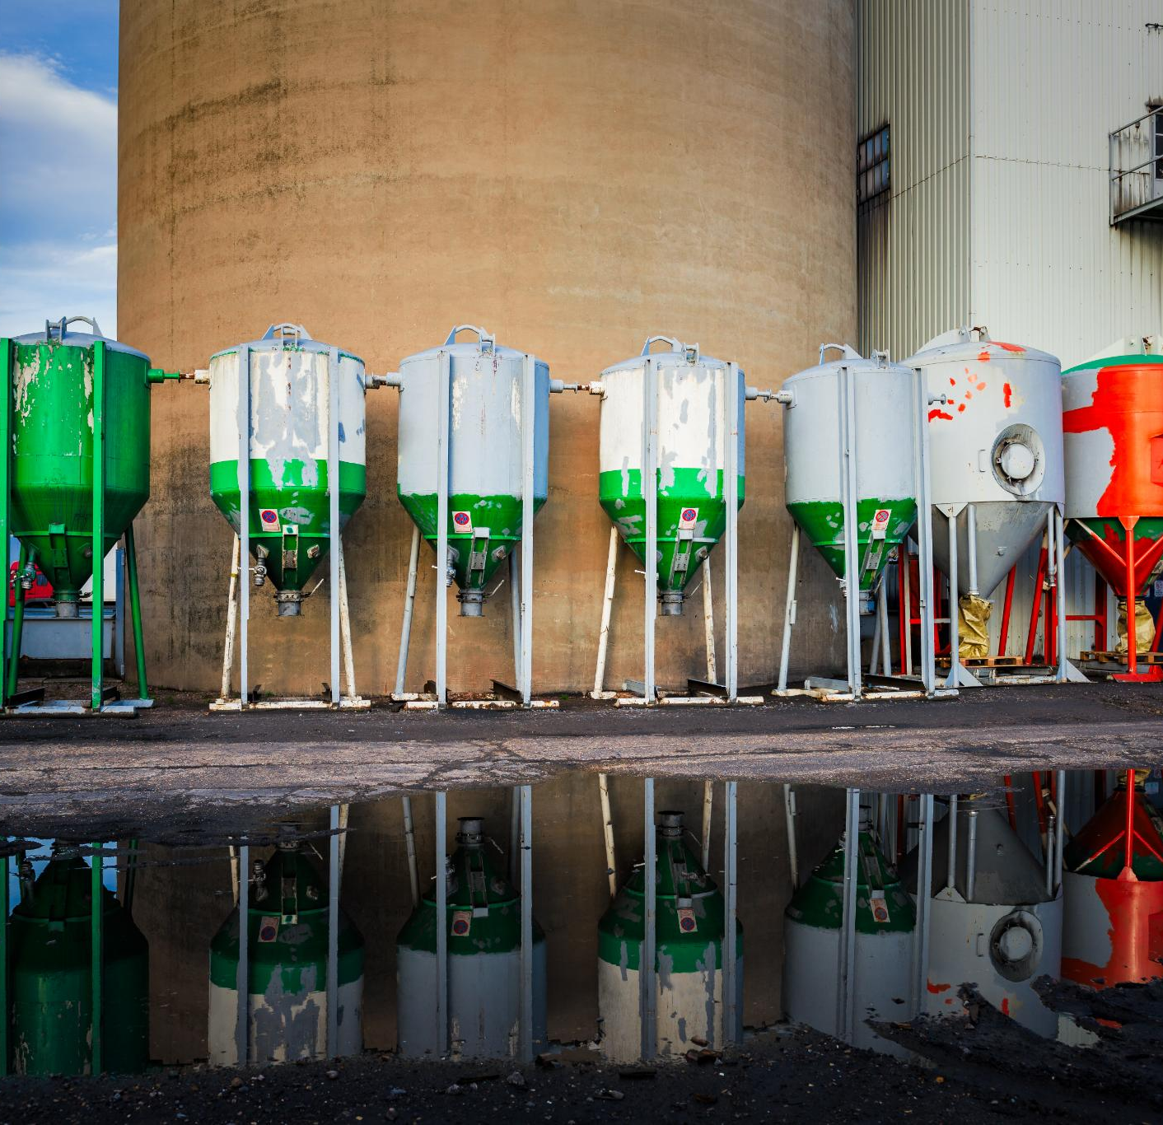
Alternative Fuels: Properties, Advantages, Disadvantages, and Types
Exploring various fuels and their impacts on energy use
Notes:
---

Slide 2
Introduction to Alternative Fuels
Notes:
Overview of Alternative Fuels

Slide 3

Overview of Alternative Fuels
Definition and Purpose
  Alternative fuels replace conventional fossil fuels to reduce environmental impact and improve energy security globally.
Types of Alternative Fuels
  Common alternative fuels include biodiesel, ethanol, hydrogen, and others derived from renewable resources.
Environmental Benefits
  Alternative fuels help reduce greenhouse gases and mitigate climate change by lowering fossil fuel use.
Global Adoption Efforts
  Governments and industries invest in research and infrastructure to support alternative fuel use in transport and industry.
Notes:
Alternative fuels are energy sources that serve as substitutes for conventional fossil fuels like petrol and diesel. They are developed to address environmental concerns, reduce greenhouse gas emissions, and enhance energy security. These fuels include biodiesel, ethanol (power alcohol), hydrogen, and others derived from renewable resources. Unlike traditional fuels, alternative fuels often have distinct chemical properties, combustion characteristics, and environmental impacts. Their adoption is driven by the need to mitigate climate change, reduce dependency on finite fossil reserves, and promote sustainable energy practices. Governments and industries worldwide are investing in research and infrastructure to make these fuels viable for transportation and industrial applications. Understanding their properties, benefits, and limitations is crucial for informed decision-making and policy development.

Slide 4
Properties of Alternative Fuels
Notes:
Key Characteristics

Slide 5
Key Characteristics
Fuel | Energy Density (MJ/kg) | Emission Profile | State
Diesel | 45.5 | High CO2 | Liquid
Biodiesel | 37.8 | Lower CO2, biodegradable | Liquid
Ethanol | 26.8 | Lower CO, renewable | Liquid
Hydrogen | 120.0 | Zero CO2, water vapor only | Gas
Notes:
Alternative fuels exhibit unique properties that influence their performance and suitability for different applications. Key characteristics include energy density, which determines how much energy is stored per unit mass or volume; combustion efficiency, which affects engine performance; and emissions profile, which impacts environmental sustainability. For instance, hydrogen has an exceptionally high energy density per kilogram but requires specialized storage due to its gaseous state. Biodiesel, derived from vegetable oils or animal fats, is biodegradable and produces fewer pollutants compared to diesel, but it has slightly lower energy content. Ethanol, commonly blended with petrol, improves octane rating and reduces carbon monoxide emissions, though its lower energy density means higher fuel consumption. These properties dictate infrastructure requirements, engine compatibility, and overall feasibility for widespread adoption.

Slide 6
Advantages and Disadvantages
Notes:
Advantages of Alternative Fuels, Disadvantages of Alternative Fuels

Slide 7
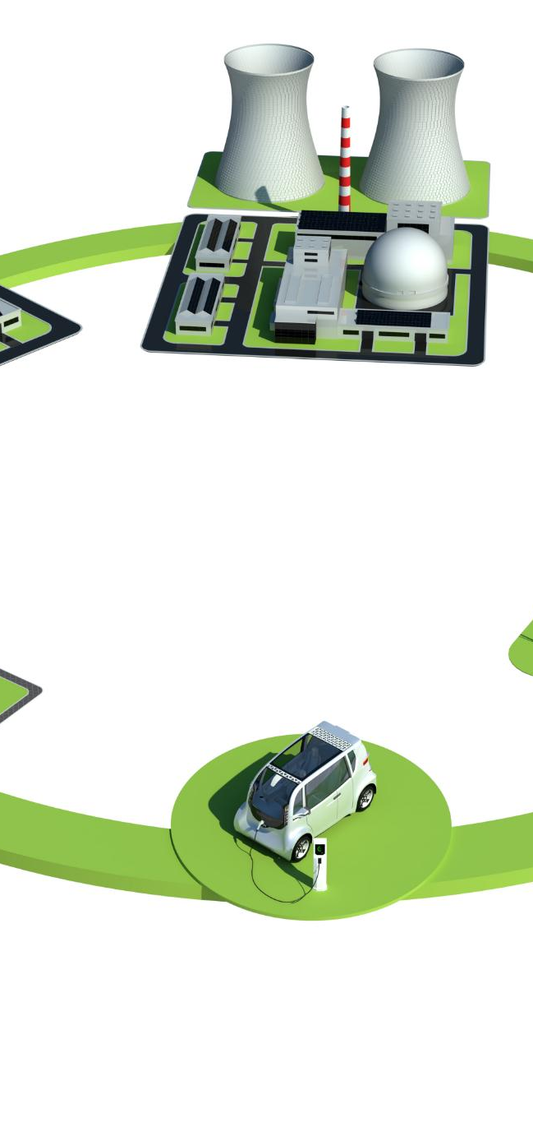
Advantages of Alternative Fuels
Reduced Greenhouse Emissions
  Alternative fuels reduce greenhouse gas emissions, helping to mitigate climate change and protect the environment.
Renewable Resource Base
  Many alternative fuels come from renewable sources, ensuring sustainable energy supply and less reliance on fossil fuels.
Lower Environmental Impact
  Alternative fuels are often biodegradable and produce fewer harmful pollutants, minimizing ecological damage.
Enhanced Energy Security
  Using alternative fuels diversifies energy sources and reduces dependence on imported oil, boosting energy security.
Notes:
Alternative fuels offer several advantages that make them attractive for sustainable energy strategies. Firstly, they significantly reduce greenhouse gas emissions compared to conventional fossil fuels, contributing to climate change mitigation. Secondly, many alternative fuels are derived from renewable resources, ensuring long-term availability and reducing reliance on finite petroleum reserves. Thirdly, they often have a lower environmental impact, as some are biodegradable and produce fewer harmful pollutants. Additionally, promoting alternative fuels enhances energy security by diversifying energy sources and reducing dependence on imported oil. These benefits align with global efforts to transition toward cleaner energy systems and meet international environmental targets.

Slide 8

Disadvantages of Alternative Fuels
High Production Costs
  Alternative fuels often have higher production costs, reducing their economic competitiveness without financial support.
Infrastructure Limitations
  Limited fueling stations and storage facilities hinder widespread adoption of alternative fuels.
Lower Energy Density
  Alternative fuels usually have lower energy density, causing reduced mileage and increased consumption.
Technological Challenges
  Engine compatibility and need for specialized equipment complicate the implementation of alternative fuels.
Notes:
Despite their benefits, alternative fuels face several challenges. Production costs are often higher than those of conventional fuels, making them less economically competitive without subsidies or incentives. Infrastructure limitations, such as the lack of fueling stations and storage facilities, hinder widespread adoption. Many alternative fuels have lower energy density compared to fossil fuels, resulting in reduced mileage and higher consumption rates. Technological challenges, including engine compatibility and the need for specialized equipment, further complicate implementation. These drawbacks must be addressed through research, policy support, and technological innovation to make alternative fuels a practical and cost-effective solution.

Slide 9
Types of Alternative Fuels
Notes:
Biodiesel, Power Alcohol (Ethanol), Hydrogen

Slide 10
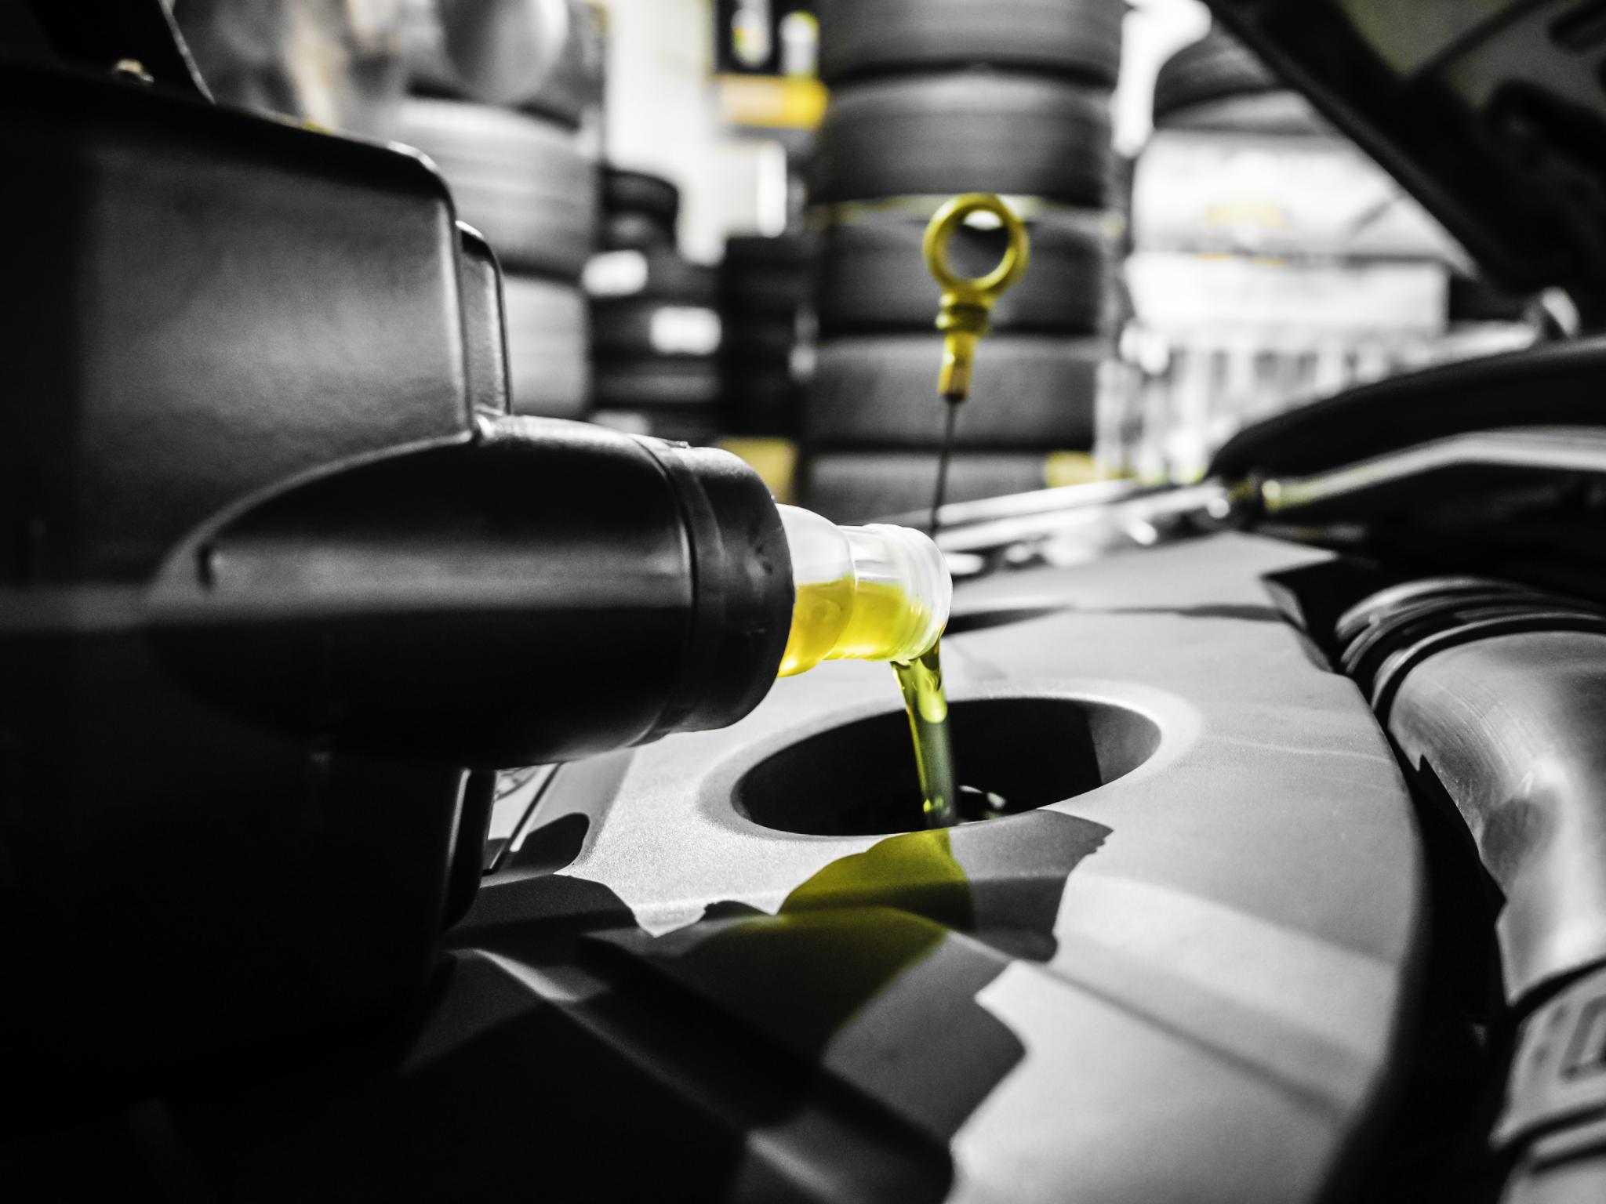
Biodiesel
Renewable Fuel Source
  Biodiesel is made from renewable resources like vegetable oils, animal fats, and recycled cooking grease.
Environmental Benefits
  Biodiesel is biodegradable and produces fewer pollutants, reducing carbon dioxide emissions significantly.
Engine Compatibility
  Biodiesel works in existing diesel engines with minimal modifications, making it a practical fuel alternative.
Sustainability Concerns
  Large-scale biodiesel production may compete with food supply and require significant land, raising sustainability issues.
Notes:
Biodiesel is a renewable fuel produced from vegetable oils, animal fats, or recycled cooking grease. It is biodegradable and emits fewer pollutants compared to petroleum diesel. Biodiesel can be used in existing diesel engines with minimal modifications, making it a practical alternative. It reduces carbon dioxide emissions and supports agricultural economies by utilizing crops like soybean and rapeseed. However, biodiesel has a slightly lower energy content than diesel, which can affect fuel efficiency. Additionally, large-scale production may compete with food supply and require significant land resources, raising sustainability concerns.

Slide 11
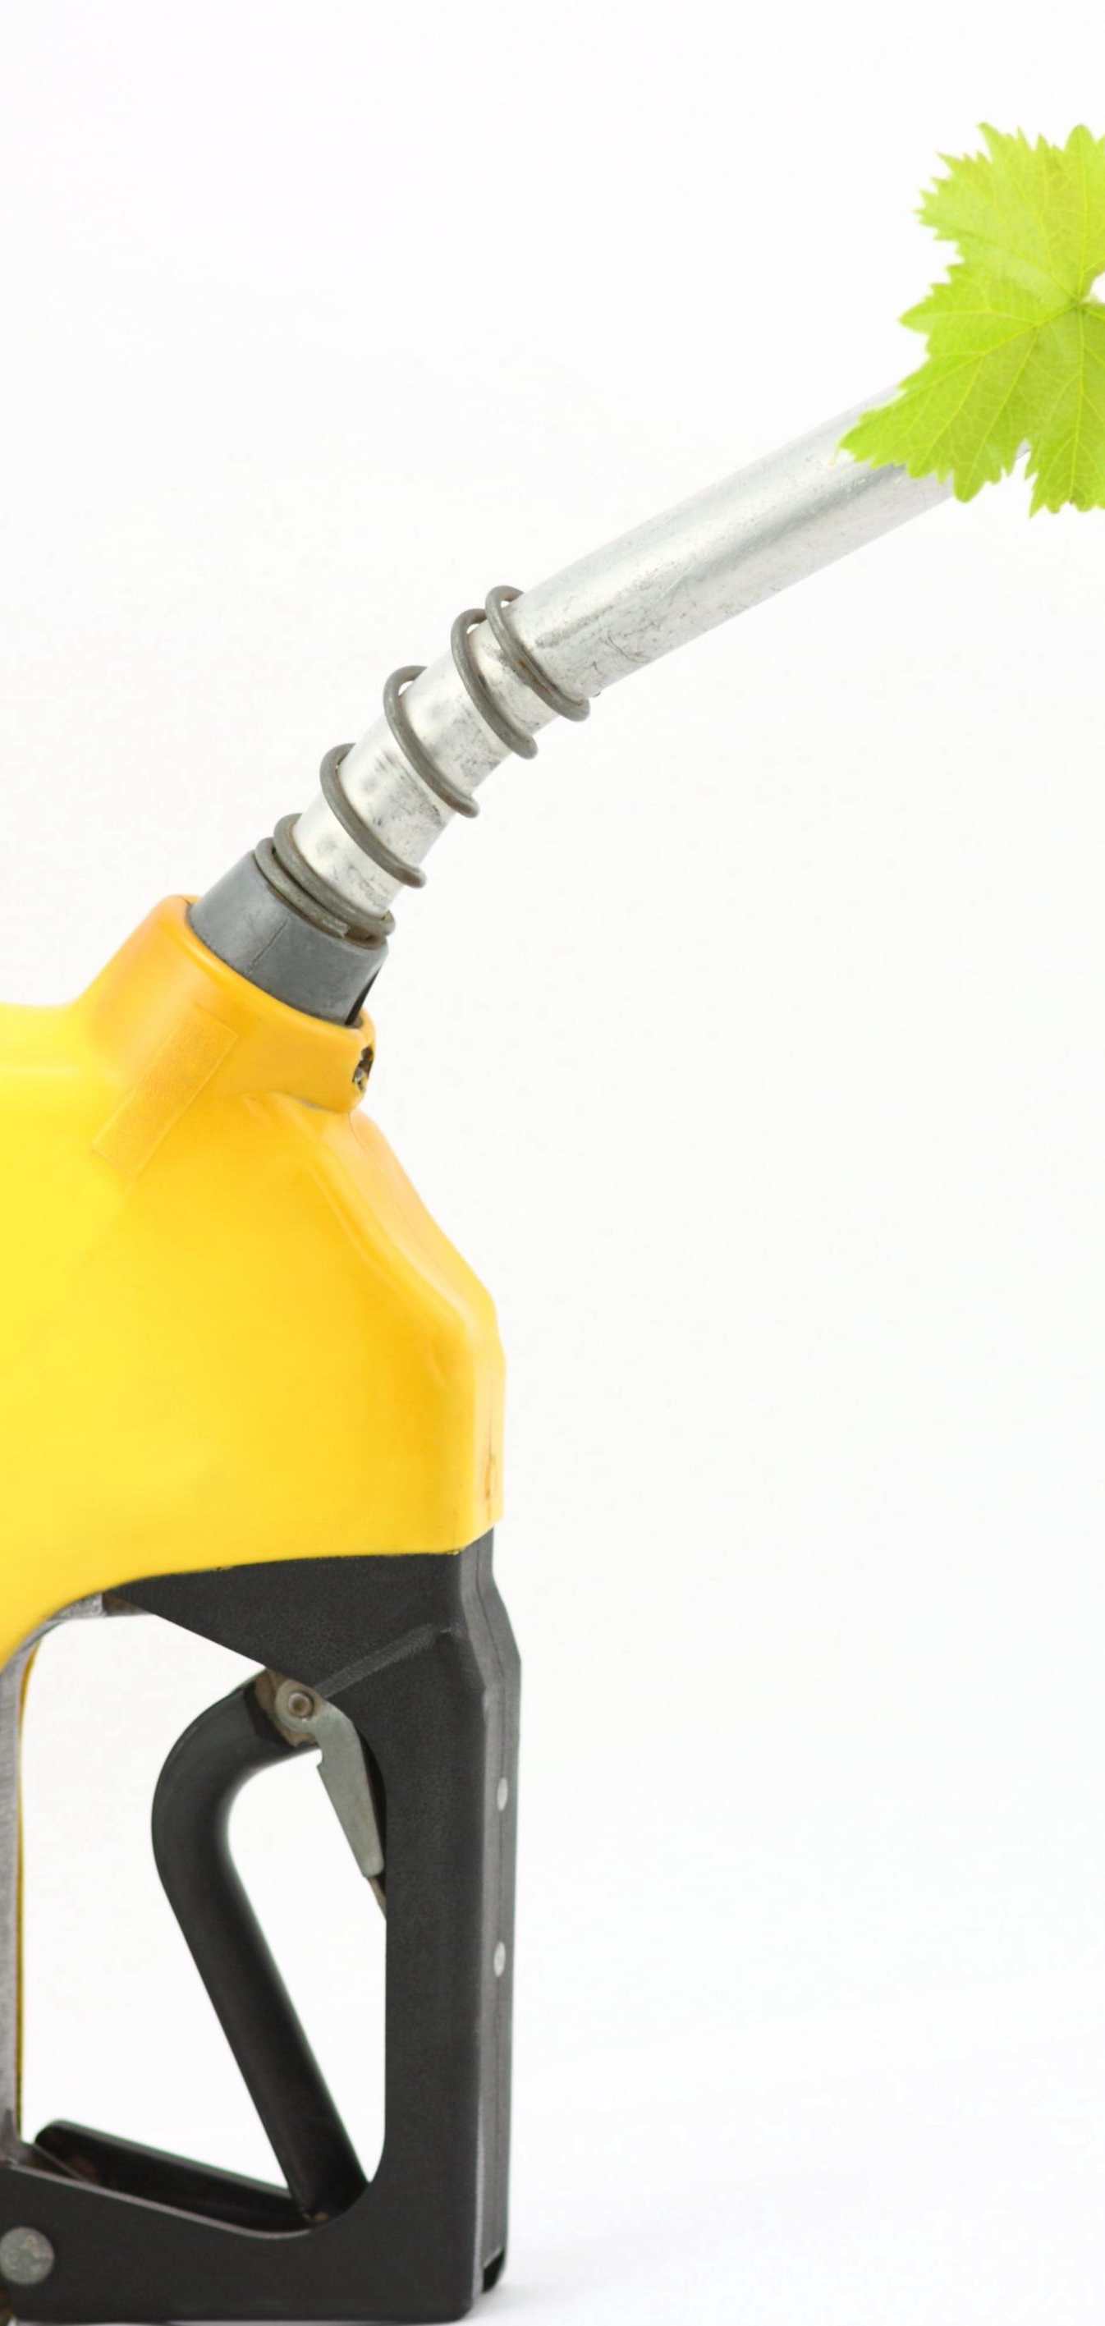
Power Alcohol (Ethanol)
Ethanol as Biofuel
  Ethanol is blended with petrol to improve octane rating and enhance engine performance.
Renewable Production Sources
  Ethanol is produced from renewable biomass sources like sugarcane and corn crops.
Environmental Benefits
  Ethanol reduces carbon monoxide emissions contributing to cleaner combustion in engines.
Challenges of Ethanol Use
  Lower energy density increases fuel consumption and large-scale production may impact water and food resources.
Notes:
Power alcohol refers to ethanol blended with petrol, commonly used as a biofuel in transportation. Ethanol improves the octane rating of fuel, leading to better engine performance and reduced knocking. It is produced from biomass sources such as sugarcane, corn, and other crops, making it renewable. Ethanol reduces carbon monoxide emissions and contributes to cleaner combustion. However, its lower energy density compared to petrol means vehicles consume more fuel for the same distance. Additionally, large-scale ethanol production can strain water resources and compete with food crops, posing environmental and economic challenges.

Slide 12

Hydrogen
Clean Fuel Benefits
  Hydrogen combustion produces only water vapor, making it an environmentally friendly energy source.
High Energy Efficiency
  Hydrogen has a high energy content per kilogram, enabling efficient energy storage and use.
Storage and Distribution Challenges
  Hydrogen's low density requires high-pressure or cryogenic systems for safe storage and transport.
Future Energy Role
  Hydrogen's zero-emission potential positions it as a key player in sustainable transportation and energy strategies.
Notes:
Hydrogen is considered a clean fuel because its combustion produces only water vapor as a byproduct. It has an extremely high energy content per kilogram, making it efficient in terms of energy storage. Hydrogen can be used in fuel cells to generate electricity or in modified internal combustion engines. Despite its advantages, hydrogen poses significant challenges in storage and distribution due to its low density and requirement for high-pressure or cryogenic systems. Infrastructure development and cost reduction are critical for hydrogen to become a mainstream fuel option. Its potential for zero-emission transportation makes it a key player in future energy strategies.

Slide 13
Energy Density Comparison
Notes:
Chart Analysis

Slide 14
Chart Analysis
Fuel | Energy Density (MJ/kg)
Diesel | 45.5
Biodiesel | 37.8
Ethanol | 26.8
Hydrogen | 120.0
Notes:
Energy density is a crucial factor in determining the practicality of a fuel for transportation and industrial use. Higher energy density means more energy can be stored in a smaller volume or mass, which is essential for vehicle range and efficiency. Conventional diesel has an energy density of about 45.5 MJ/kg, while biodiesel is slightly lower at 37.8 MJ/kg. Ethanol, commonly used as a biofuel, has an energy density of 26.8 MJ/kg, which is significantly lower than diesel, leading to higher consumption rates. Hydrogen stands out with an energy density of 120 MJ/kg, making it highly efficient in terms of energy content per unit mass. However, its gaseous state and storage challenges offset this advantage. Understanding these differences helps in evaluating trade-offs between performance, cost, and infrastructure requirements.

