Slide 1
AUTOMOBILE DATA EDA by Shrikant Kolte

Slide 2
Contents
1. Problem Statement
2. About data
3. Pre-post profiling
4. Exploratory Data Analysis (EDA)
5. Observations and Insights

Slide 3
Problem Statement(s)
🔑
Determine the prices of vehicles with multiple makes using various features like make, fuel-type, mileage, engine-type, engine-size, body-style, horsepower and many more.
Which are the highest number of vehicles based on brand, body style and price slab?
Do the Body Style and Engine Specification determine the vehicle price?

Slide 4
About the Data
This data gives detailed information about the vehicles using total 25 different features.
These features contains make, Fuel-type, prices, mileage, engine-size, horsepower etc.

Slide 5
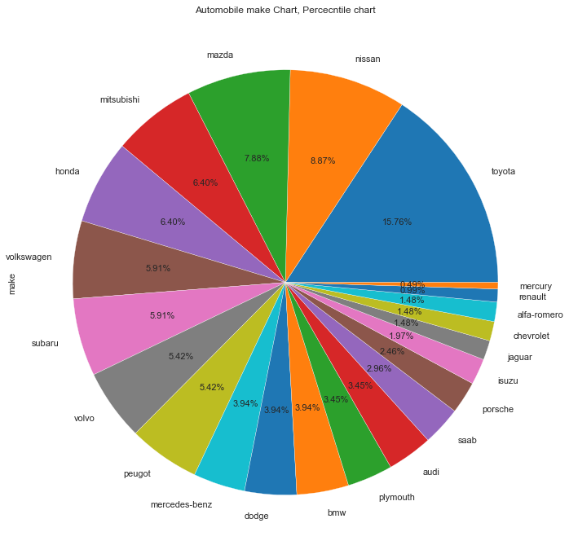
Which make of vehicles has the highest percentage in provided data?
Toyota make vehicles are having the highest percentage, which is more than 15% in the given data set.
Mercury and Renault make vehicles have the lowest percentage which is less than 1.5% together.

Slide 6
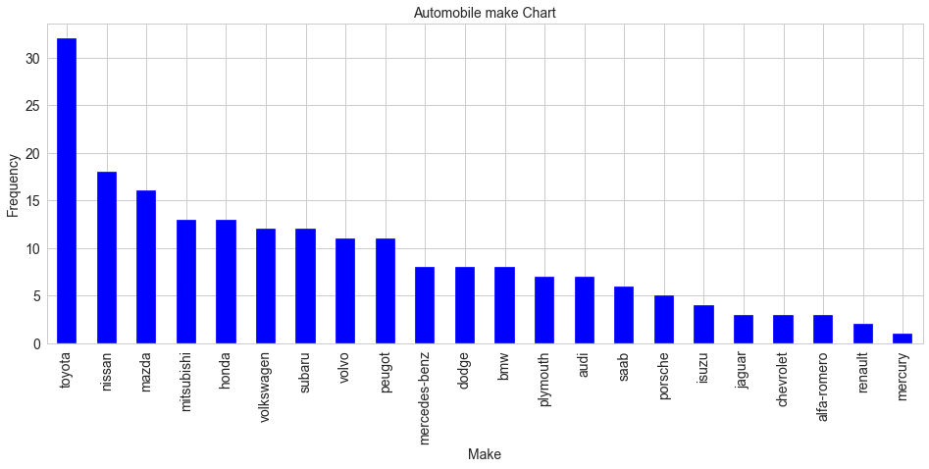
How many vehicles are there with respect to their make?
Highest number of vehicles are of make Toyota, which are near about 32, which is approximately double than the second highest make Nissan.

Slide 7
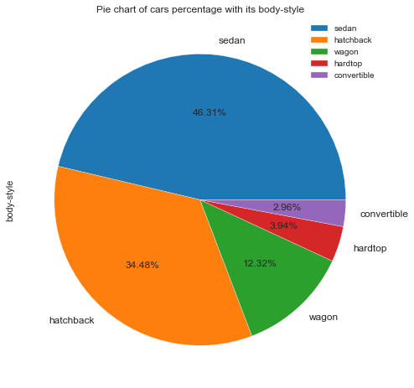
Which body-style vehicles are more popular?
Sedan vehicles are more popular, which are 46.31% of total.
Below Sedan, the hatchback vehicles are more popular, which are 34.48%.
Convertible vehicles are very less, which are 2.96% only.

Slide 8
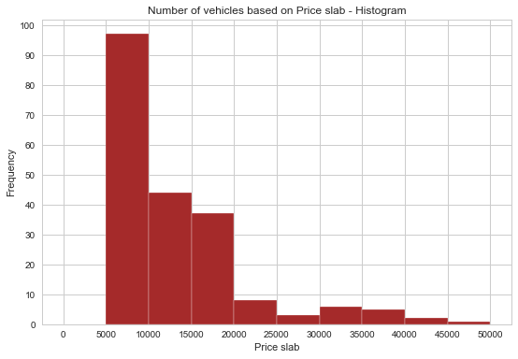
Number of vehicles with respect to price slab.
There are more number of vehicles in the price range of 5K to 10K. Approx. 96 to 98 vehicles in this range.
Most of the vehicles having the prices below 20K.
Very less number of vehicles (Only 1 or 2) with the price range of 45K to 50K.

Slide 9
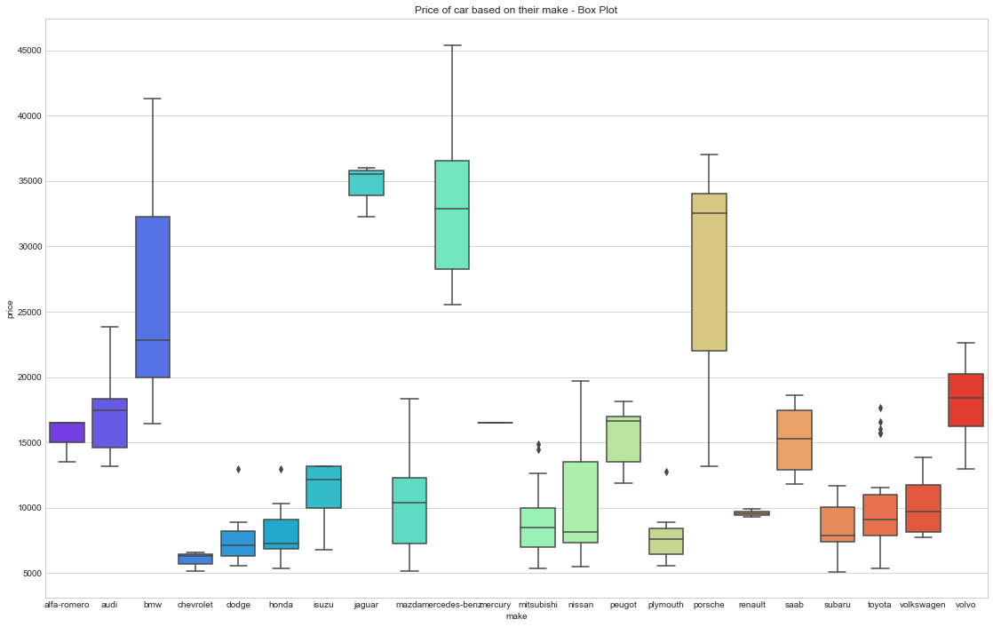
What is the price range of vehicles based on their make?
Jaguar, Mercedes-Benz and Porche vehicles are having highest prices.
Companies with the lowest price range are Chevrolet, Dodge, Plymouth and Honda.
The 50% of Toyota vehicles price are below 10K.

Slide 10
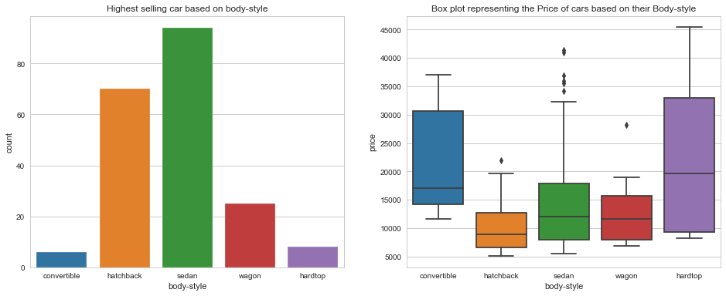
Which body-style vehicles has more in number and what is the price range of that body-style?
Sedan vehicles are high in numbers and Hatchback vehicles are the second highest
50% of the sedan vehicles has price below 12K And More than 50% hatchback vehicles has the priced below 10K.
The body-style as 'hardtop' having the price distribution higher than the other body-style vehicles.

Slide 11
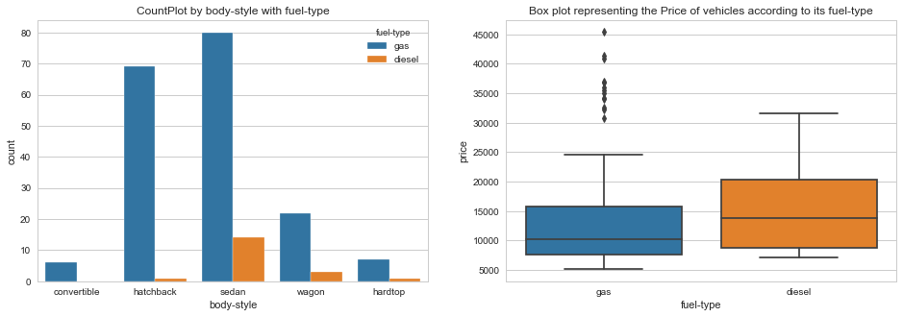
Which body-style and fuel-type vehicles are more and what are their average prices?
Most of the vehicles are with fuel-type as gas in all the body-styles.
50% of the gas vehicles are below 10K and Diesel vehicles are costly than the gas cars.

Slide 12
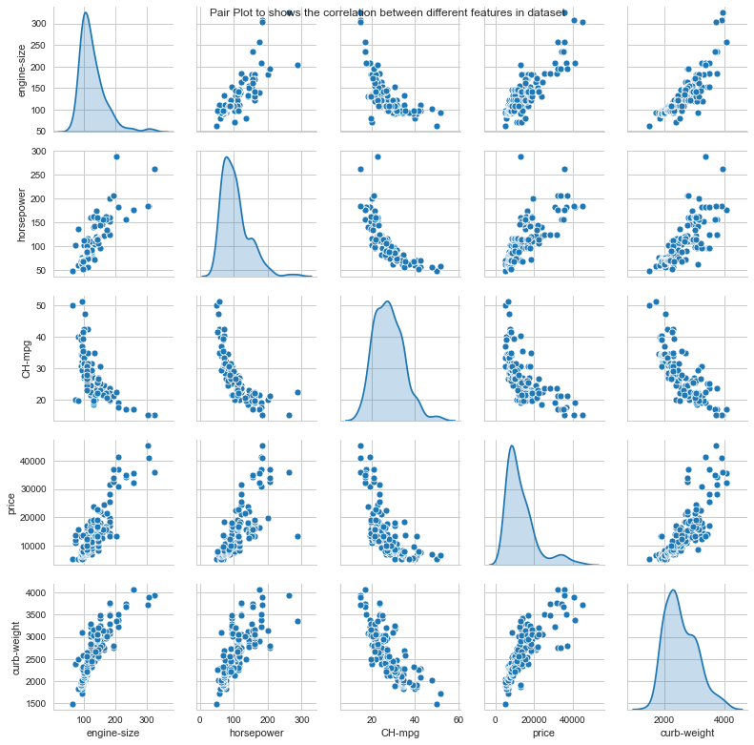
Which body-style and fuel-type vehicles are more and what are their average prices?
Engine-size, horsepower, CH-mpg, curb-weight and price are highly correlated to each other in the given dataset.
Have below observations
Price is positively correlated with the engine-size and horsepower whereas negatively correlated with the CH-mpg (City/highway mileage)

Slide 13
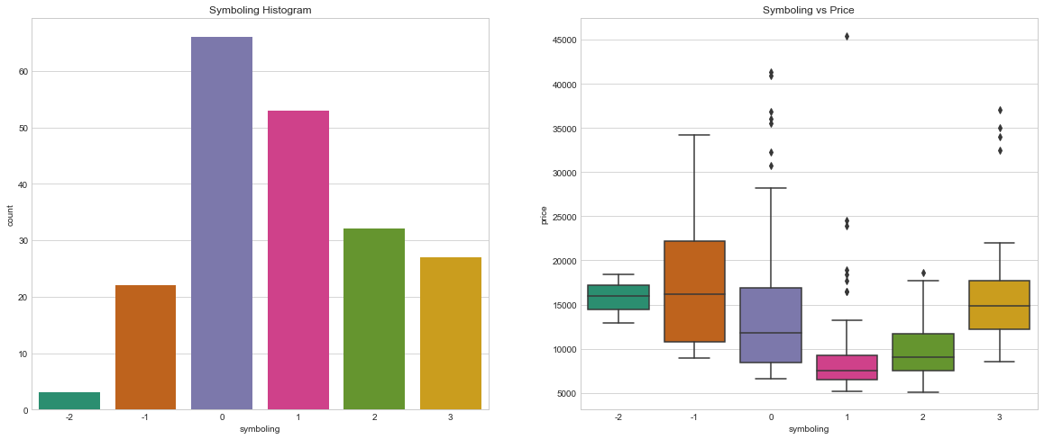
What symboling category have the more number of vehicles and what is the relation between symboling and price?
Symboling is the risk rating of vehicles. More number of cars are in the range of 0 and 1 for symboling/risk.
Histogram - Symboling with 0 and 1 have the more number of vehicles.
Vehicles with symboling value -1 are the high priced vehicles.
Vehicles with symboling value 1 are the low priced vehicles

Slide 14
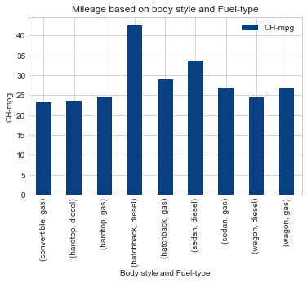
Which body-style and fuel-type vehicles are better in terms of the mileage?
Hatchback diesel vehicles gives the more mileage (more than 40) compared to all other diesel and gas vehicles.
Convertible gas and hardtop diesel vehicles gives the low mileage.

Slide 15
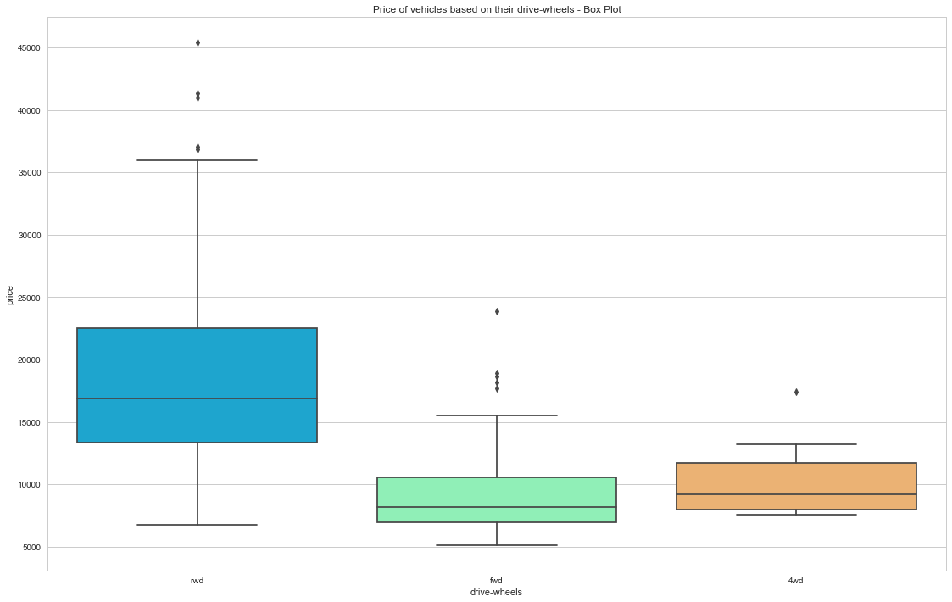
Prices of vehicles based on wheel-drive.
Front wheel drive and 4wd vehicles are having small price range compared to rwd and fwd. But FWD vehicles are having some outliers in price range.

Slide 16
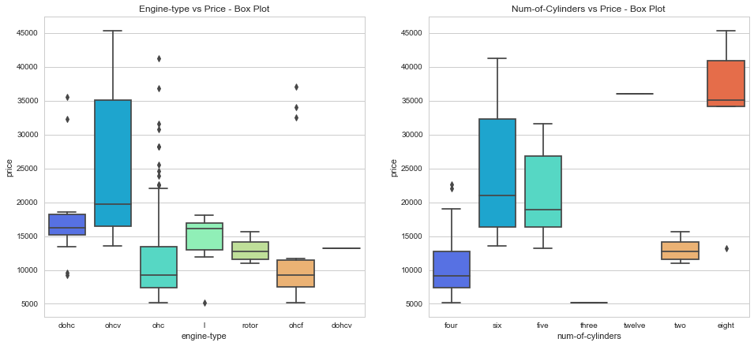
Engine-type and Number of cylinders vs. Prices of vehicles.
Vehicles with engine type as chcf are low priced range vehicles followed by chc with outliers.
3 cylinder vehicles are low priced followed by 4 and 2 cylinder vehicles.

Slide 17
OBSERVATIONS….
Observed that the Toyota make vehicles are more popular.
Sedan and hatchback vehicles sell is more than other type of vehicles.
Sedan and hatchback vehicles prices are bit lower compared to other type of vehicles, sedan vehicles has some outliers in price slab.
Most of the gas fuel vehicles are in the low price range with some high price outliers.
4 wheel drive vehicles are with the price towards lower range.
Vehicles with engine-type “ohcf” are low priced.
3 cylinder vehicles are low priced followed by 4 and 2 cylinder vehicles.

Slide 18
ACTIONABLE INSIGHTS
To increase the sell of cars, price range should be less than 15K.
Company can increase production of Sedan with gas fuel type vehicles which are having more demand.
To lower the prices of cars company can use low power engines.
Similarly the use of two, three and four cylinders in cars can decrease the prices.
OHCF engine types can be used to decrease the prices of cars.

Slide 19
THANK YOU! ☺

