Slide 1
Communication
Module 1

Slide 2
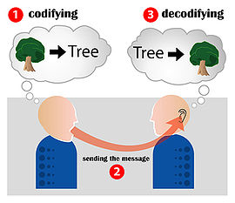

Communication
Latin word ‘communis’ which means ‘to share’. Communication means the meaningful exchange of information between two or more participants.

Slide 3
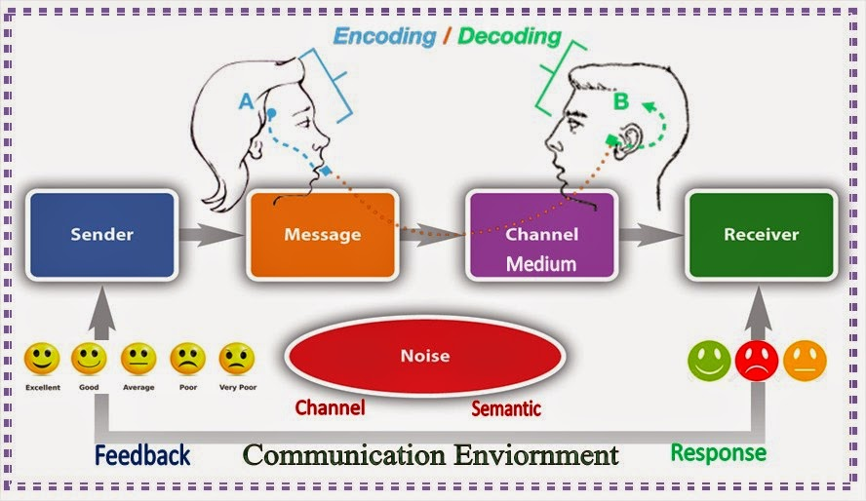
Process of Communication
It consists of 7 elements:
  Sender- idea to be shared
  Encoding- ideas and facts into words, symbols, pictures or gestures
  Message-what is being communicated, may be verbal or non-verbal
  Channel- medium through which message is transmitted to the sender
  Receiver- any person who notices and attaches some to a message/ destination for the message. He may be a listener, a reader or a viewer
  Decoding-receiver translates and interprets it to attain meaning
  Feedback- receiver reacts or responds to the communication sent by the sender

Slide 4
Importance of Communication
Growing specialization
Technological advancements
Competition
Human relations
Public relations
Personal asset

Slide 5
Features of successful Professional Communication
Communication is a non-verbal process by which information is transmitted between individuals and / or organizations so that an understanding may develop among them.
Communication is a continuous process of meaningful interactions among persons in an organization that results in meanings being perceived and understood in a desired way.
The role of the sender and receiver keeps changing in the entire communication activity.
Communication broadly includes both verbal and non-verbal forms. It is an art or technique of persuasion through the use of oral, written and non-verbal features.
It is a process which transmits and disseminates important ideas, thoughts, feelings, plans etc.

Slide 6
Types of Communication
Verbal Communication
Non verbal Communication

Slide 7
Verbal communication- 2 Types
  Oral Communication: a face to face interaction between the sender and the receiver. Ex: Presentations, deliver speeches, participate in group discussions, appear for interviews or simply interact with somebody.
  Written Communication: The sender uses the written mode to transmit his/her messages. Ex: Reports, proposals, books, handbooks, letters, emails etc. It is routinely used for documentation purposes in business and government organizations.

Slide 8
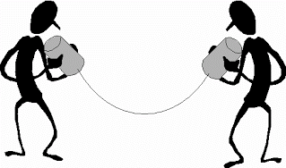
Advantages of Oral Communication
  immediate feedback
  time saving
  economical
  personal touch
  flexibility
  secrecy
  group communication

Slide 9
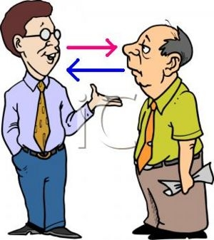
VERBAL COMMUNICATION:
For good oral communication the following factors are considered:
  Preparation for speaking
  the message must be chosen
  should be understandable
  enable to spread enthusiasm to the listeners
  preparation will help to achieve a clear and simple message and drives for systematic approach

Slide 10

Written Communication
Can be printed or hand written
Can be transmitted by email, letter, report, memo

Slide 11
Non Verbal Communication

Slide 12
Meharbian’s Communication Model

Slide 13
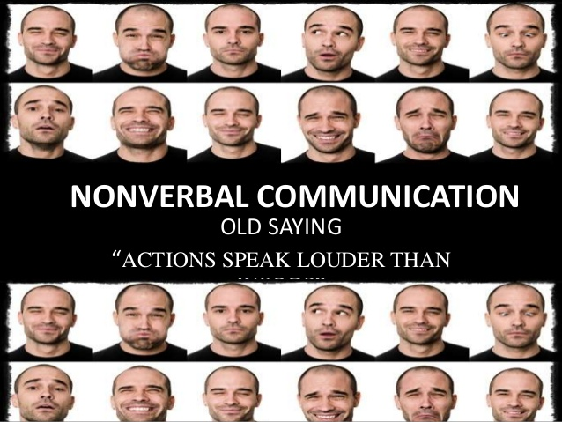
Non-Verbal communication
Kinesics or Body Language
  Nodding of our head, blinking of our eyes, waving of our hands, shrugging of our shoulders are our expressions of our thoughts and feelings.
  Nervousness, anger, fear, determination, horror, sympathy, pity, lack of understanding, disinterestedness can be expressed through the body language than through words.

Slide 14
Non Verbal communication
Artifactual communication – clothing, accessories, dressing
Vocalics/ Paralanguage- Rate, pitch, tone, volume, intensity, pausing ,word stress and silence
Proxemics- Closeness or space while communicating
Haptics – Sense of touch
Oculesics – Eye movement, eye behaviour, gaze

Slide 15
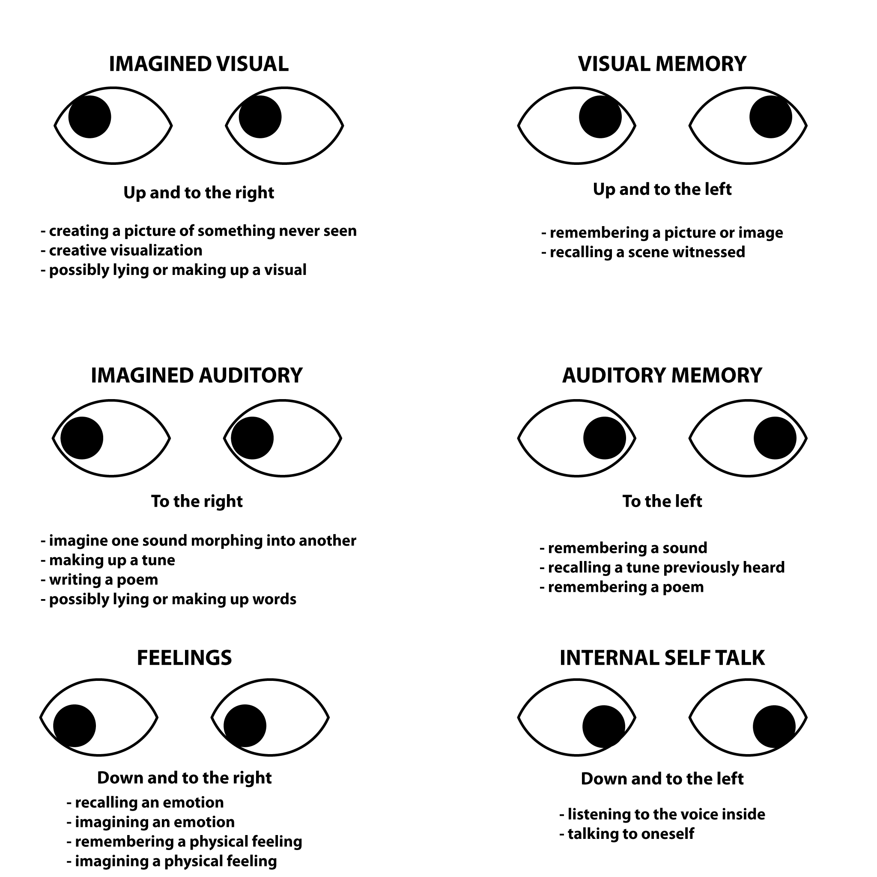
Oculesics:

Slide 16

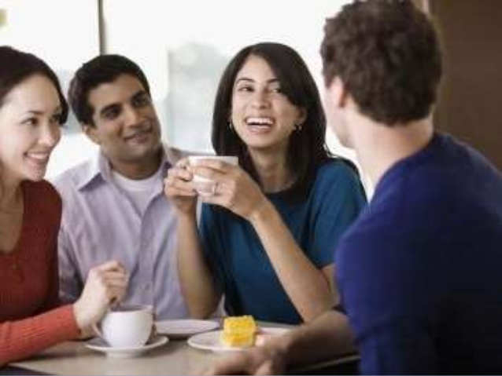
FORMS OF COMMUNICATION
Depending on the way the messages or the information is sent, is classified as:
Formal
Informal

Slide 17
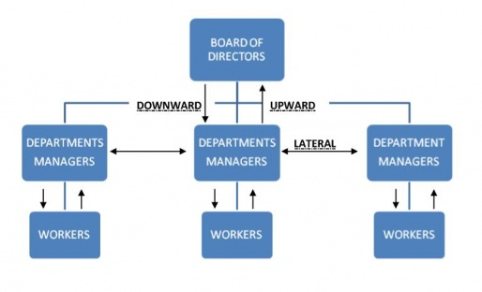
Formal Communication
Downward communication- Superior to subordinate
Upward communication- subordinate to superior
Horizontal/ Lateral communication- in the same level
Crosswise/Diagonal communication- Across any levels

Slide 18
Informal Communication
Grapevine
  word of mouth transmission of secret information, rumor and gossip
  Very useful particularly in decision making / critical issue
  Experimental or tentative announcement
  Gives management an opportunity to observe reaction of the employees

Slide 19
Barriers to Effective Communication
Physical
Language barrier
Cultural
Interpersonal
Organisational
Perceptual
Gender
Psychological

Slide 20
Barriers to Effective Communication- Physical Barriers:
Physical barriers are those that arise due to certain factors like faulty equipment, noise, closed doors and cabins that cause the information sent from sender to receiver to become distorted, which results in improper communication.

Slide 21
Barriers to Effective Communication -Semantic (language)
Semantic barriers are also known as language barriers. These barriers are caused due to improper communication between the sender and the receiver. Some instances of semantic barriers are:
Mother tongue influence
Poor quality of message
Difference in language
Difference in level of proficiency
Using technical language

Slide 22
Barriers to Effective Communication – Psychological Barriers:
Psychological barriers play an important role in interpersonal communication as the state of the mind of the sender or the receiver can make it difficult to understand the information that is conveyed, which often leads to misunderstanding.
Distrust, threat or Fear
Apathetic listening
Assumptions
Prejudices
Information overload
Rigid attitude

Slide 23
Barriers to Effective Communication – Cultural Barriers:
Cultural barriers arise due to lack of similarities among the different cultures across the world.
Language
Stereotypes and Prejudices
Signs and Symbols
Behaviours and Beliefs

Slide 24
Barriers to Effective Communication – Organizational Barriers:
Organizational barriers are caused due to the structure, rules and regulations present in the organization. Sometimes it is caused due to
Superior subordinate relationships
Complexity of Organisational structure
Hierarchical positions

Slide 25
Barriers to Effective Communication – Perceptual Barriers
Perceptual barriers exist in people’s minds based on how they perceive the world around them. They can be caused by the many cognitive biases of the human mind that prevent us from perceiving people and situations accurately. Individuals may also have their own unique biases based on previous experience and the influence of others.

Slide 26
Barriers to Effective Communication – Gender Barriers:
Gender barriers occur due to disparities in how different genders interact and are expected to communicate by society. Communication is also hampered by gender prejudices and assumptions that favor one gender over the other.
Each gender has a different communication pattern and usually assumes that the other gender thinks and acts similarly.

Slide 27
Barriers to Effective Communication – Interpersonal Barriers:
Interpersonal barriers are any negative patterns of behavior that hinder from communicating or discourage others from communicating with you. Poor self esteem, social anxiety, arrogance makes it difficult for people to feel comfortable opening up to others.
Lack of participation
Lack of open-mindedness
Lack of trust and transparency
Lack of patience and organization

Slide 28
Steps to overcome the different types of Barriers:
Ensure clarity in message and look for genuine feedback
Understand others’ emotions
Understand other cultures and language variations and use the appropriate variety in the given context.
Make sure that information overload does not affect the communication environment adversely.
Maintain openness and acknowledge that people have different perceptions and views regarding things.
Listen attentively to others.
Speak with clarity and conviction.
Encourage innovative ideas and views so that people do not live in fears.

Slide 29
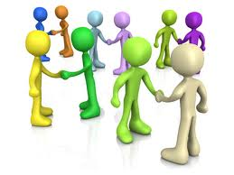
INTERPERSONAL SKILLS
The ability which enables a person to understand others and to make others understand him.
They are also known as ‘people skills’, soft skills and Human skills
Very essential for interpersonal communication.
Trust and cooperation can be generated
can be motivated to share information in the right spirit

Slide 30
Importance of Interpersonal skills
Brings in the good image
You show self awareness
They make you relatable
Helps to be empathetic and a better person
Helps to express ideas and thoughts/feelings
Builds confidence
Value diversity, individual respect and different customs

Slide 31
Intrapersonal Skills
It implies individual reflection, contemplation, and meditation. The ability to enable you to effectively control your :
  Emotions
  Create objectives
  Self motivate
  Dealing with distractions
  Strategize and modify your approach

Slide 32
THANK YOU

