Slide 1
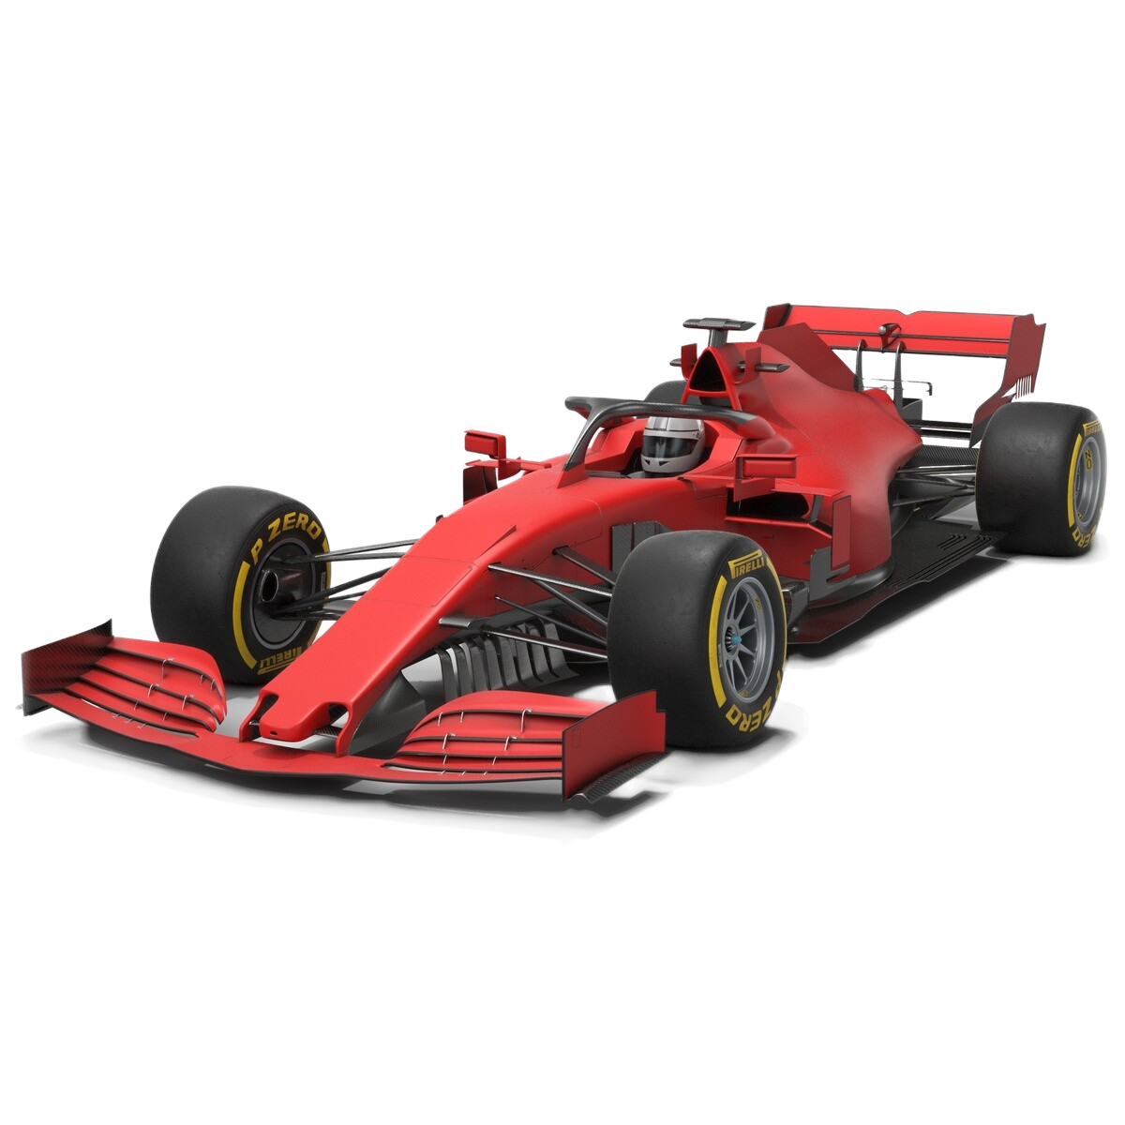
F1 RACE STRATEGY
INTELLIGENCE PLATFORM
A Product & Operations Personal Project
Shrikanth Roopesh
MS Engineering Management | Northeastern University | 2026

Slide 2
PHASE 1
THE PROBLEM
F1 is at the center of data and speed. Analyzing huge loads of data in a matter of split seconds can win you the race or lose it.
The Pit Stops, Compound choice, Temperatures – everything plays a huge role.
Casual viewers have no way to access or understand this data without deep technical knowledge.

Slide 3
The Users & Success Metrics
Primary Users: F1 enthusiasts who want to understand tire strategy without reading the raw telemetry.
Secondary Users: Aspiring F1 analysts, content creators and hobbyists data people.
Success Metrics:
  Can a non technical user understand degradation patterns from the dashboard?
  Does the AI chatbot return the data backed answer and say it doesn’t know when it can’t.
  Strategy prediction accuracy vs actual race results.

Slide 4
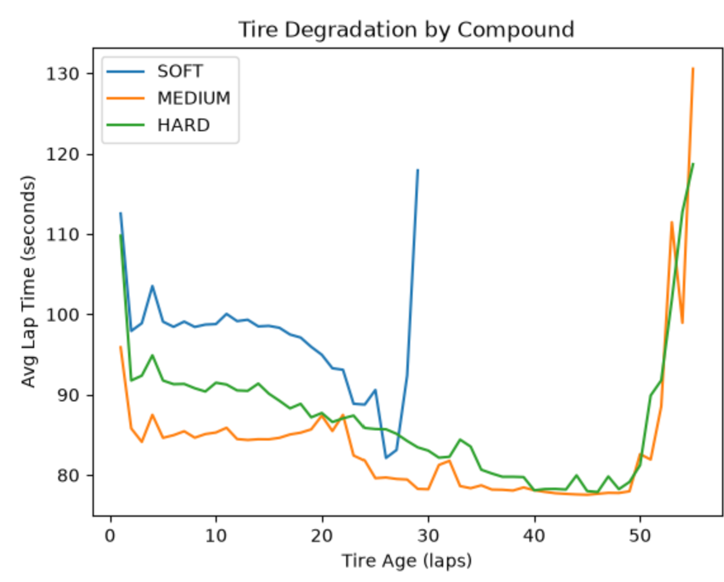
Tire Degradation by Compound
Key Insight
SOFT compound cliffs around lap 28
MEDIUM holds until around lap 45
HARD shows the least degradation
The first cliff detection attempt gave a false positive from yellow flags, so we corrected it with a rolling average.

Slide 5
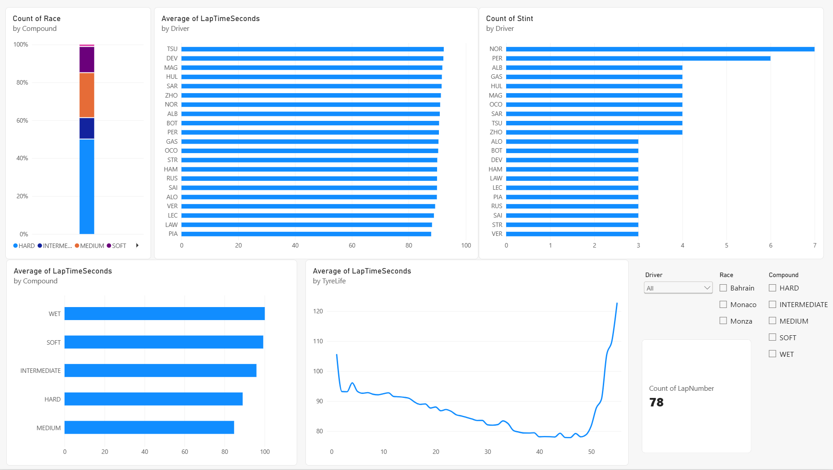
The Product - Race Strategy Explorer
Race Strategy Explorer – Filter by Race, Driver, Compound to see the tire degradation, stint analysis and driver consistency.
Final Vision: An interactive dashboard with an AI chatbot for layman end users.
[Insert Dashboard Screenshot Here]

Slide 6
Key Insight: Why the Iteration Mattered?
First Pass: Raw lap deltas flagged the cliff laps too early. These were the false positives from yellow flags, safety cars and lockups.
Fix: We applied a rolling average with a minimum lap filter before recomputing the degradation.
The corrected analysis told us a completely different story about when each compound actually falls off.
Why this matters? Getting the right answers matters less than knowing when you have the wrong one. The iteration was more valuable than the result.

Slide 7
RICE Prioritization
Rank | Feature | RICE
1 | Driver Leaderboard | 23.8
2 | Multi-Season Benchmarking | 8.0
3 | Strategy Comparison | 7.8
4 | Weather Integration | 5.6
5 | Undercut Simulator | 3.2
6 | Real-Time Mode | 1.4
7 | ML Pit Predictor | 1.1
The Takeaway
The two features that sound most exciting are Real Time Mode and ML Predictor. But they are scored the lowest. It’s not because they're bad, but because they carry the highest uncertainty and cost. The Driver Leaderboard scored the highest because the analytical work was already de-risked. This was the point of doing RICE.

Slide 8
Process: DMAIC Pit Stop Analysis
Define: Pit Stop time variation costs track position. All the pre race strategy calculations depend on consistent stop times.
Measure: Pulled Pit Stop timing data across 3 races via FastF1. I found significant variation within races (Eg: Albon’s 119s to 128s in Bahrain)
Analyze: Highest standard variation was for Esteban Ocon (22.38) followed by Logan Sargeant (18.31) and Lewis Hamilton (17.03). Monaco showed the most variation for a circuit across all drivers. Monza had the least.
Improve: Standardize the crew procedures, regular machinery checks, flag any outlier stops for review.
Control: Insert a rolling average monitor along with post race feedback protocol for stops which exceed a target threshold.

Slide 9
ROADMAP
PHASE 5
Now / Next / Later

Slide 10
Now / Next / Later
NOW
NEXT
LATER
Driver Leaderboard
Multi-Season Benchmarking
Competitor Strategy
Comparison
Weather Integration
Undercut Simulator
Real-Time Mode
ML Pit Predictor
Phase 10: F1 Knowledge Chatbot – a text to SQL over the database, designed for a casual fan to ask questions and get data backed answers.

Slide 11
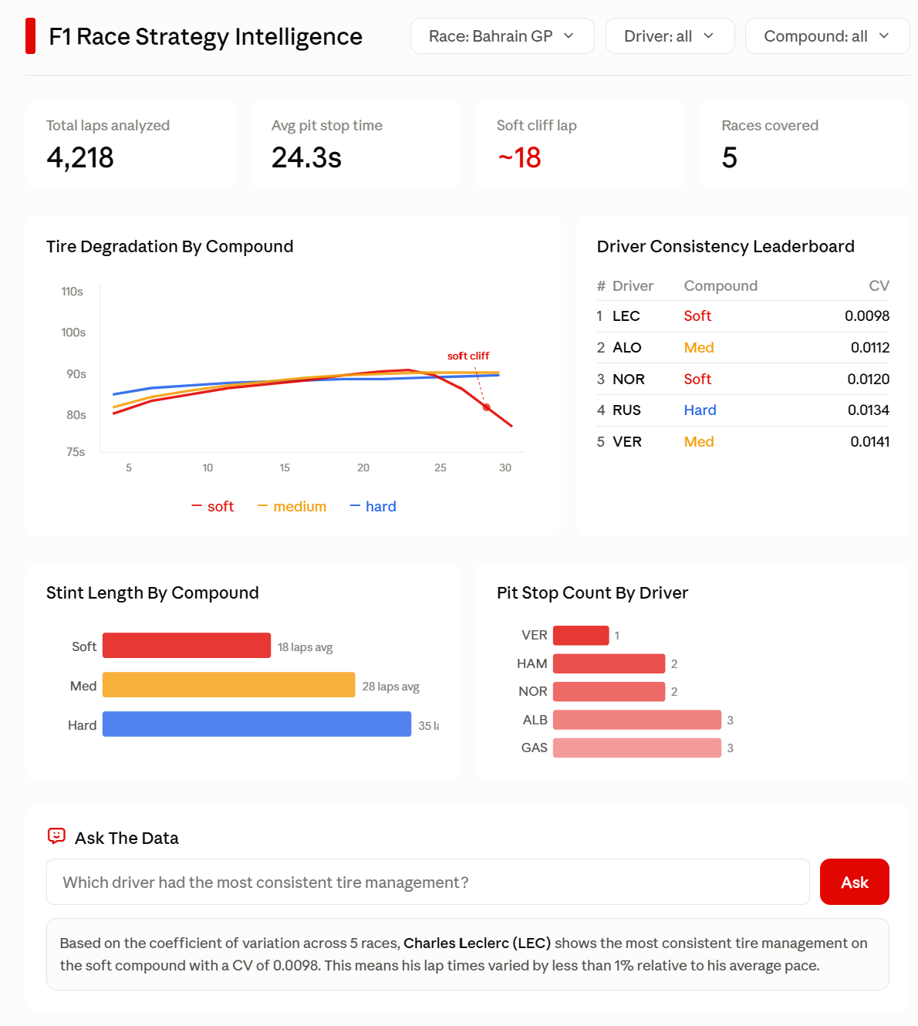
Recommendation
Start with what’s de-risked. Ship the leaderboard and multi-season benchmarking first. Keep the Real Time Mode and ML Predictor for when the data access and validation uncertainty is resolved.
Next Step: Build the interactive dashboard with the AI chatbot, making this accessible to any F1 fan, not just for data people.

Slide 12
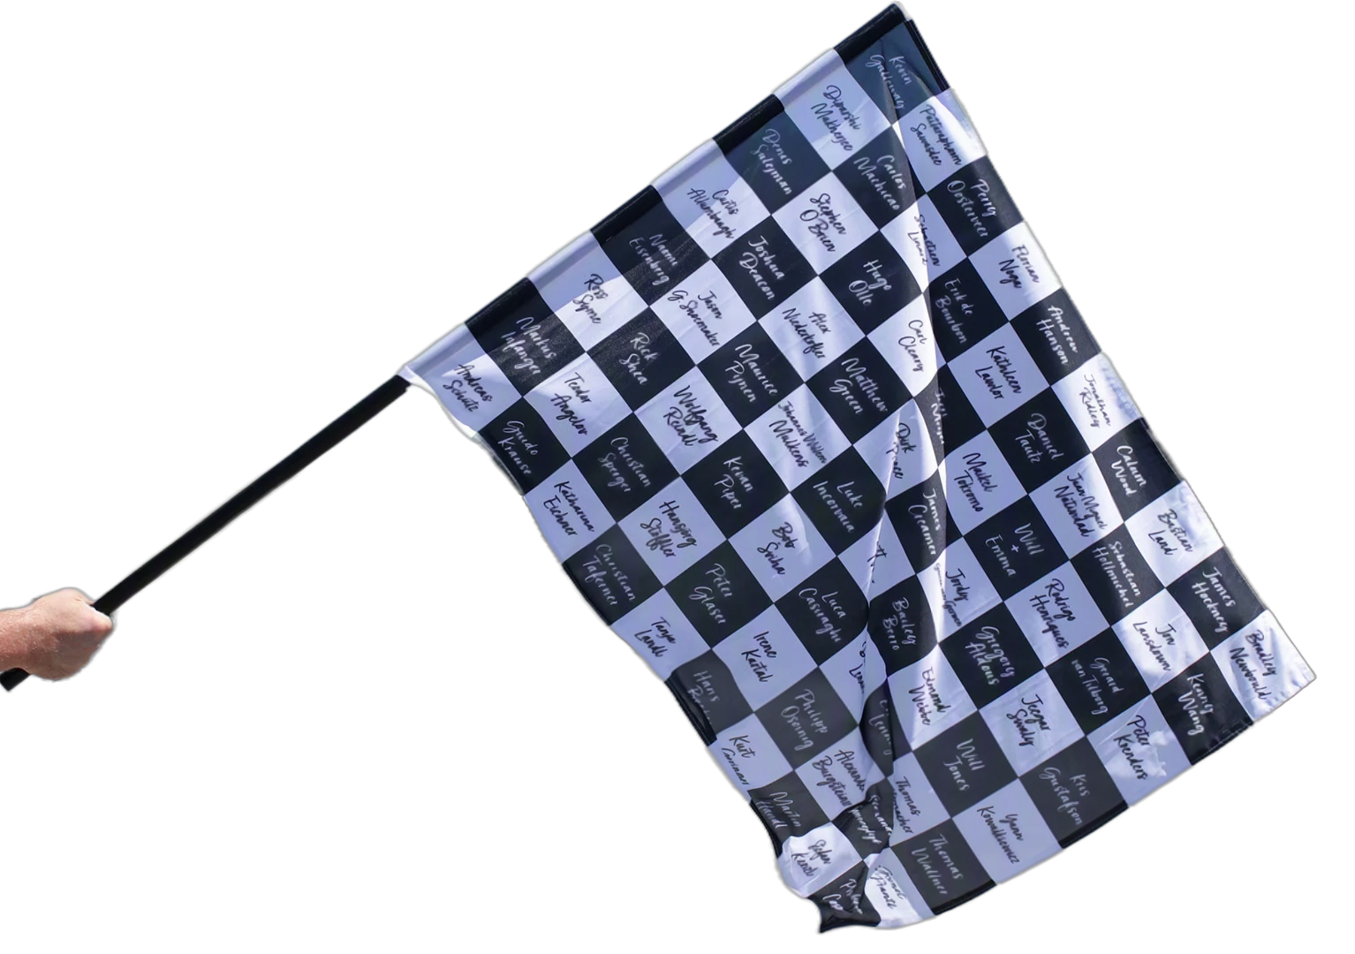
THANK YOU
Shrikanth Roopesh
Contact Me
LinkedIn
GitHub
Portfolio

