Slide 1
Capstone Project
Extraction/identification of major topics & themes discussed in news articles. -Shrikanth Ravi - Ankit Raj

Slide 2
Problem Statement
Based on given BBC news articles
Identify major themes/topics
Using LDA Clustering Algorithm

Slide 3

Information Available
The dataset contains a set of news articles for each major segment consisting of business, entertainment, politics, sports and technology. Need to create an aggregate dataset of all the news articles and perform topic modeling on this dataset. Verify whether these topics correspond to the different tags available.

Slide 4
Steps Performed
Data
Data Preprocessing
TF- IDF
Latent Dirichlet Allocation (LDA)

Slide 5

Data
The data was downloaded from repository.
For the corpus of our dataset, we will read all the downloaded articles into one list corpus.
We will use the folder name as a list of labels - this will be handy later for validation of LDA effectiveness.

Slide 6
Data Preprocessing
Tokenization
Stopwords
Stemming

Slide 7
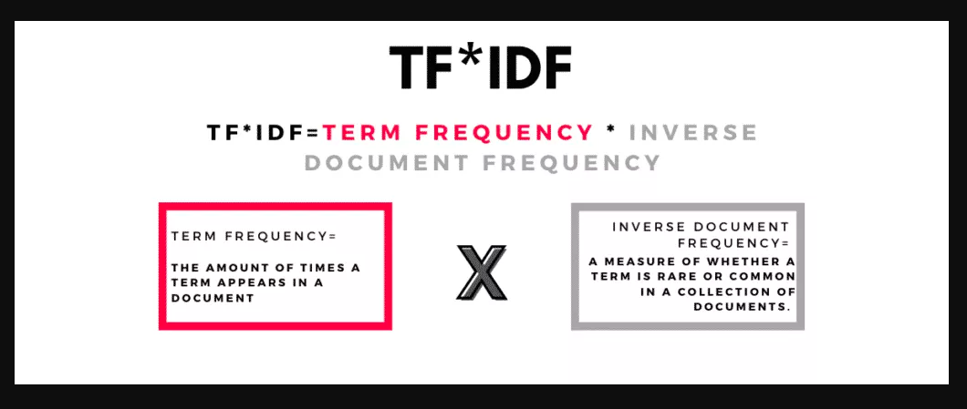
Term Frequency - Inverse Document (TF-IDF)
The idea of TF-IDF is to penalize the common words assigning them lower weights while giving importance to words that are rare in the entire corpus but appear frequently in few documents.

Slide 8
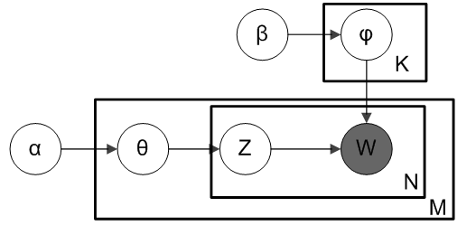
Latent Dirichlet Allocation - model description
Latent Dirichlet Allocation is a generative probability model that is constructed along Bayes Inference. It provides distribution of outputs and inputs based on latent variables, whereas the only observed values (grayed out in the graph below) are words. This approach requires only a few assumptions to be made. One of them is the number of topics 𝐾 we want to distinguish.
LDA has its pythonic implementation in sklearn package (sklearn.decomposition.LatentDirichletAllocation).

Slide 9
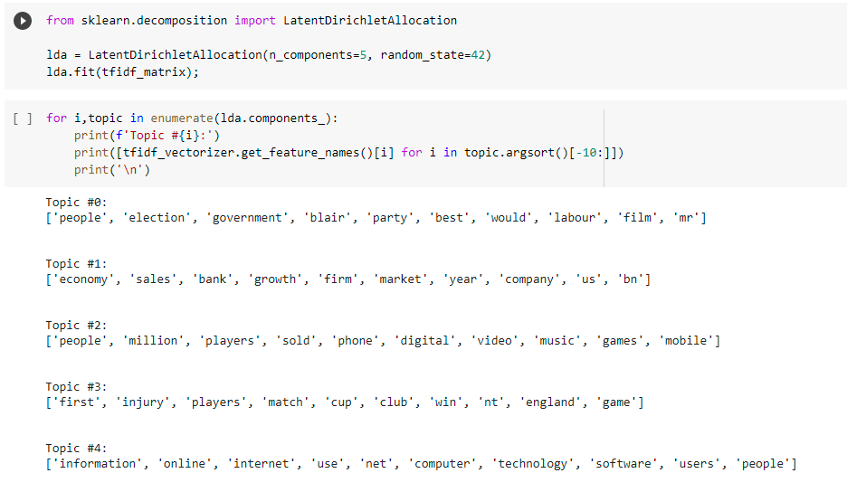
LDA Practical Implementation
By using LDA we were able to cluster words according to the topics.

Slide 10
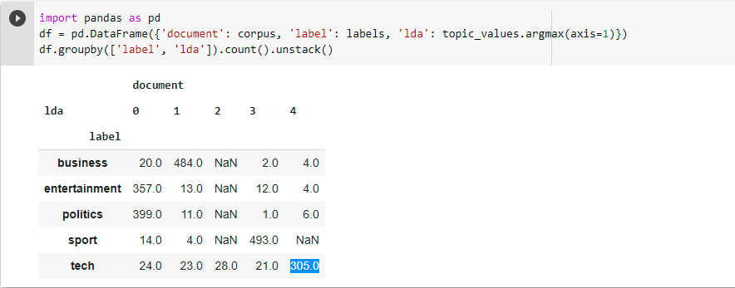
Conclusion
By using Topic Modeling we were able to identify frequently used words in each genre of topics provided in problem statement.

