Slide 1
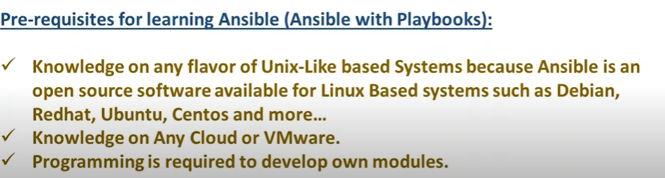
Ansible
Ansible is a Configuration Management Tool
Other Tools are like Chef, Puppet, Saltstack

Slide 2
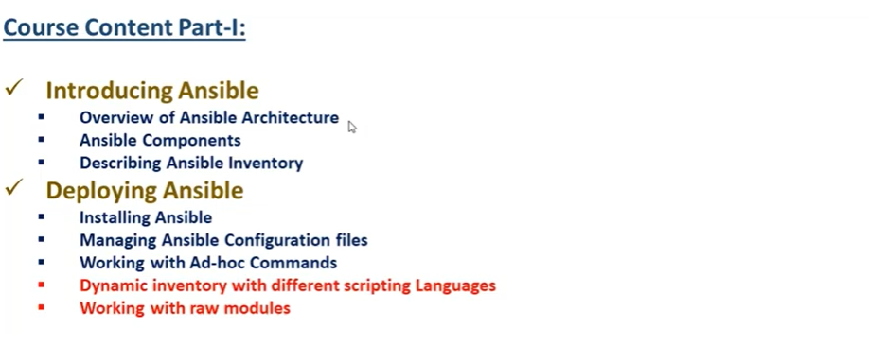
Ansible

Slide 3
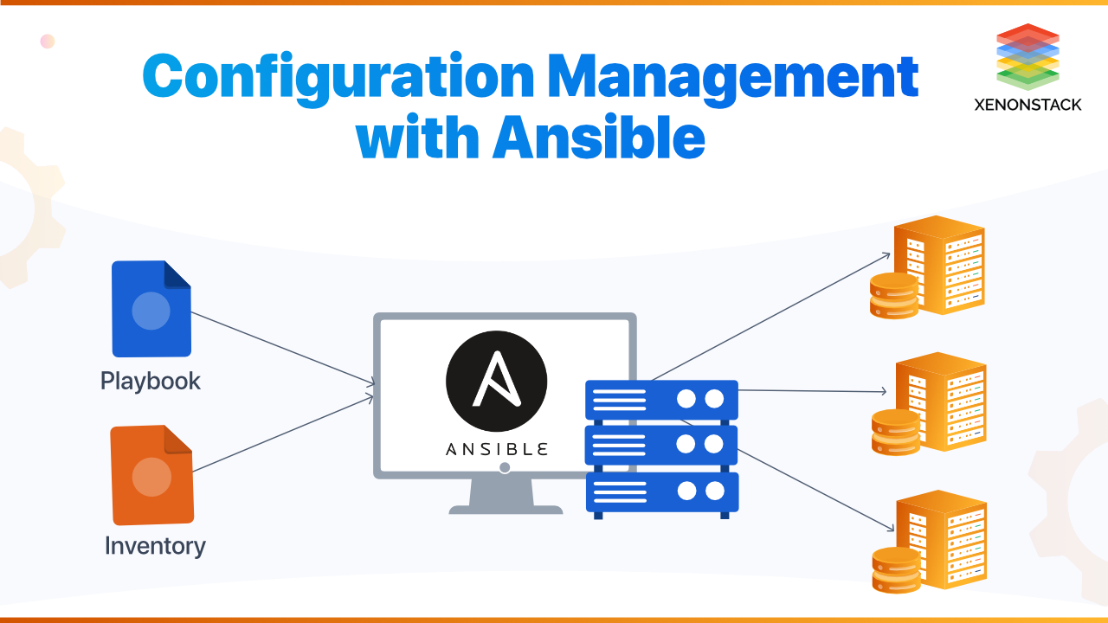

Slide 4
Ansible
How to use the password less authentication
ssh-keygen
(This will generate the id_rsa and id_rsa.pub under .ssh/id_rsa)
We need to copy the id_rsa.pub key to the machine which need to be connected
- cd .ssh
- vi autenticatedkeys
Insert the public key here on the desired machine
And id_rsa private key in the machine from where we need to connect
- ssh -i id_rsa user@ipaddress to connect to that machine,

Slide 5
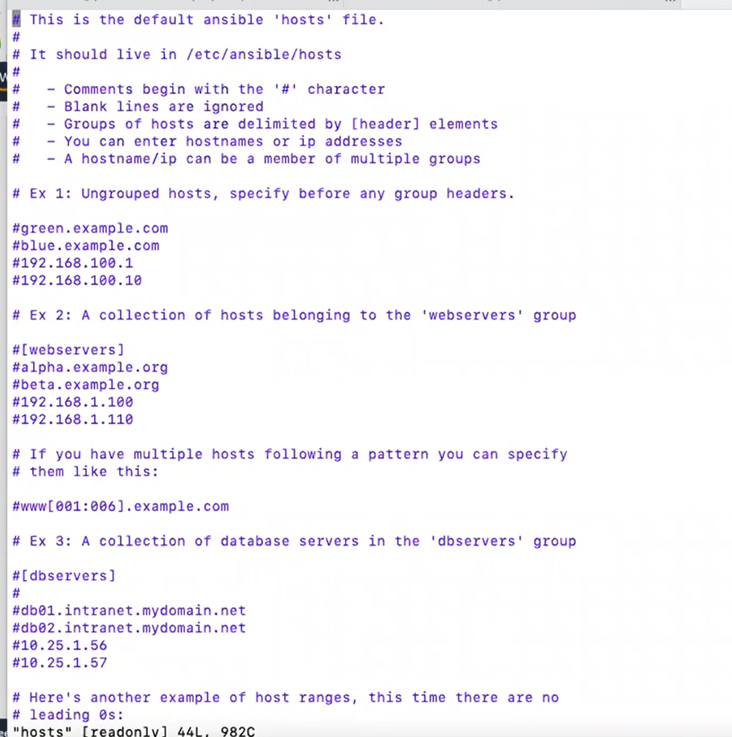
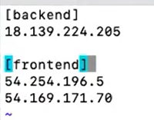
Ansible – How to install Ansible
sudo apt-get update
sudo apt install ansible
How will ansible know the hosts
vi /etc/ansible/hosts
Add the hosts inside the hosts file

Slide 6
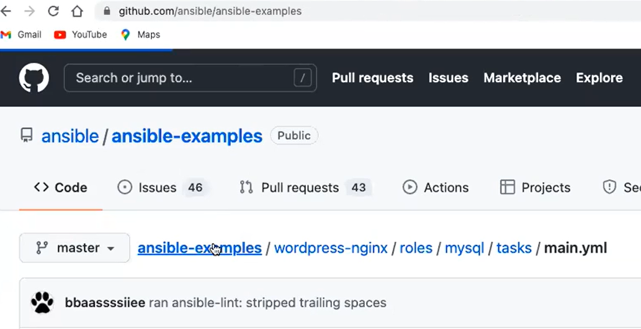
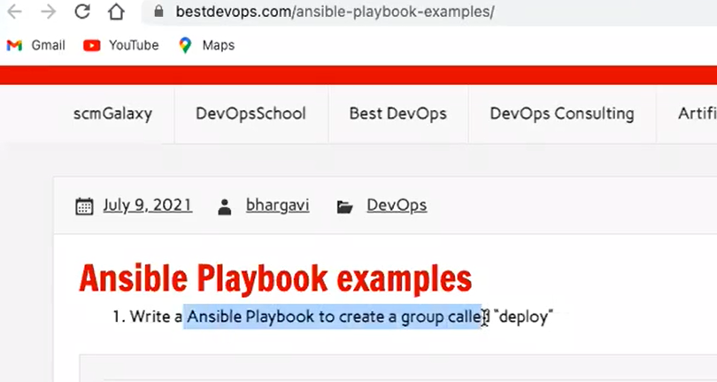
For Ansible Examples

