Slide 1
Online Electronic shopping
BCA - III
3121 – Mahesh Kamtam
3138 – Shrikant Mergu

Slide 2
USER
Signup/Login
Online Electronic shopping
Signup/Login
View Product
Manage Product Catalog
Add to shopping cart
Manage Orders
Order Product
Order Deatils
Generates Repots
ADMIN

Slide 3
Modules (First Level Dfd)
Customer
1.0
Register/Login
User Details
users
Admin
2.0
Manage Products catalog
Product details
Admin
Product
3.0
View Product
Customer
4.0
Place Order
Order Details
Orders
Customer
5.0
View Order Details
Admin

Slide 4
ERD
id
User_id
id
name
Pur_date
email
1
can
m
Pro_id
Users
Orders
1
password
id
can
name
m
Products
Product_type
Product_img
details
stock
price

Slide 5
Table Design
User
Id | bigInt(20)
Name | Varchar(121)
Email | Varchar(121)
Password | Varchar(121)
Product
Id | bigInt(20)
Name | Varchar(65)
Product_type | Varchar(65)
Product_image | Varchar(110)
category | bigInt(35)
subcategory | int(9)
Price | bigInt(45)
Order
id | bigInt(20)
User_id | bigInt(20)
Purchase_date | date
Payment_Method | Varchar(100)
Purchase_id | bigInt(15)

Slide 6
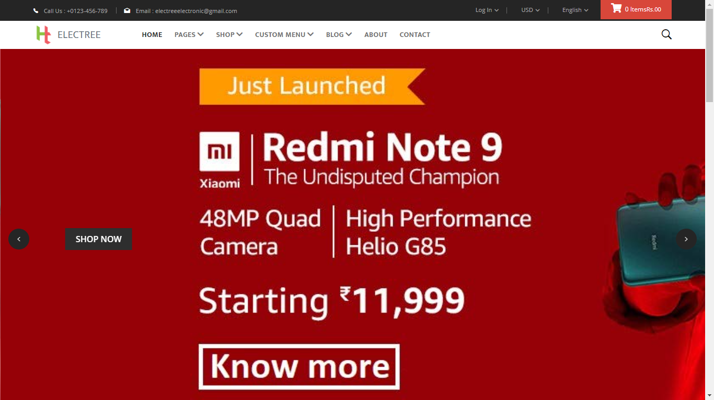

Slide 7
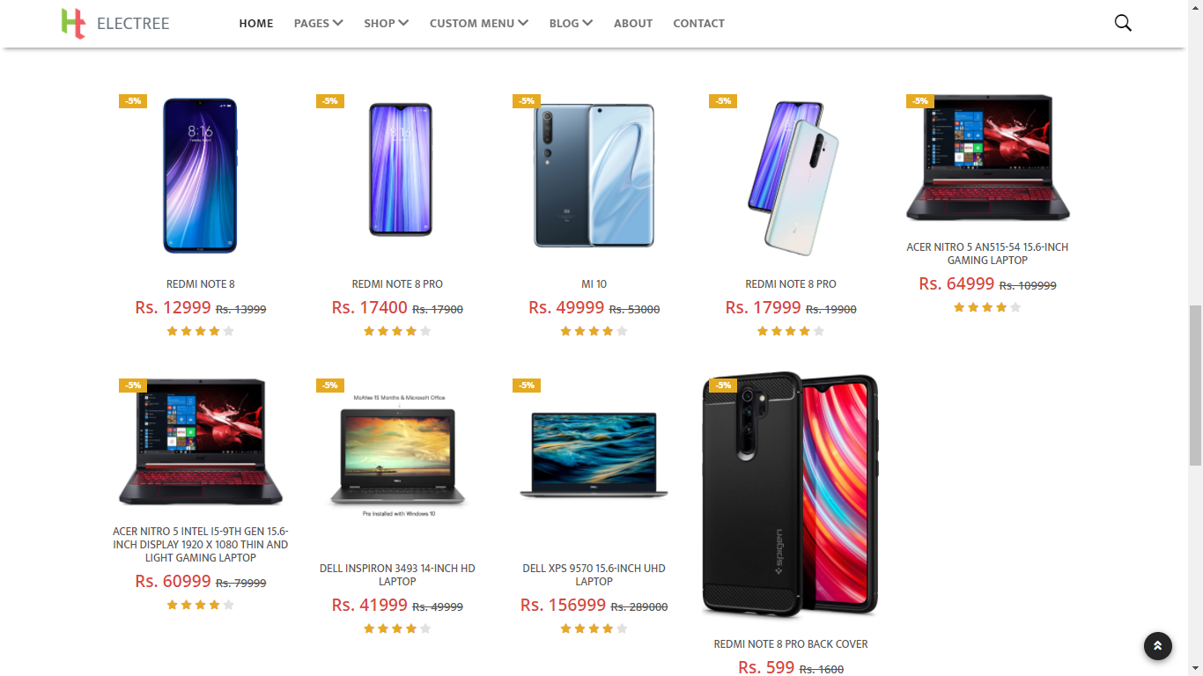

Slide 8
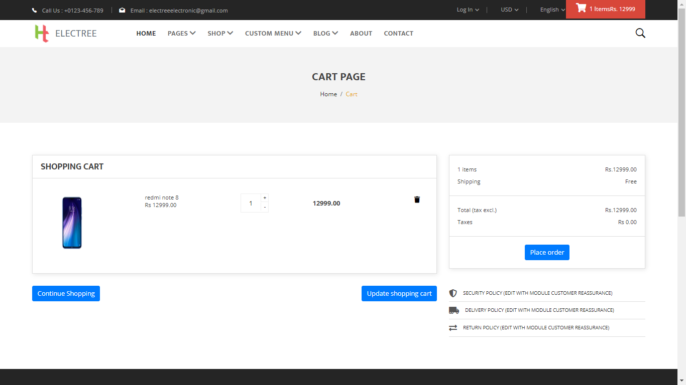

Slide 9
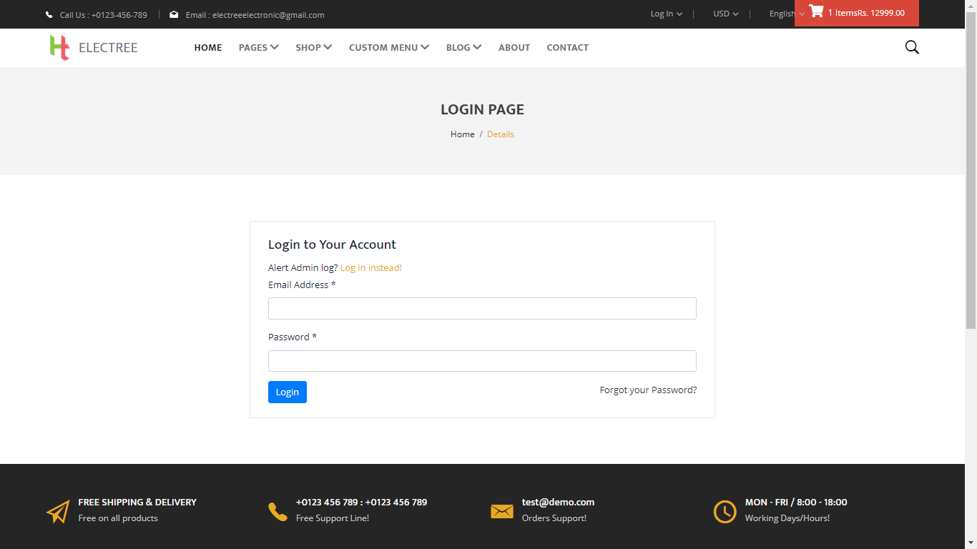

Slide 10
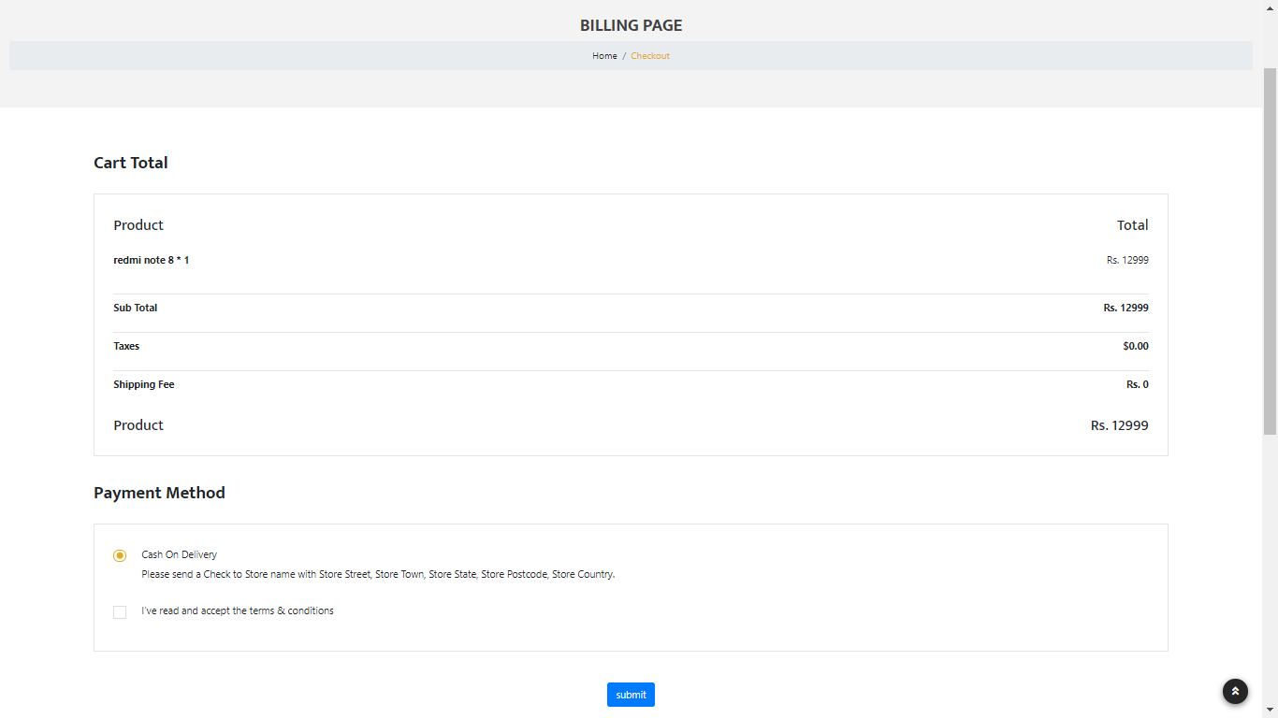

Slide 11
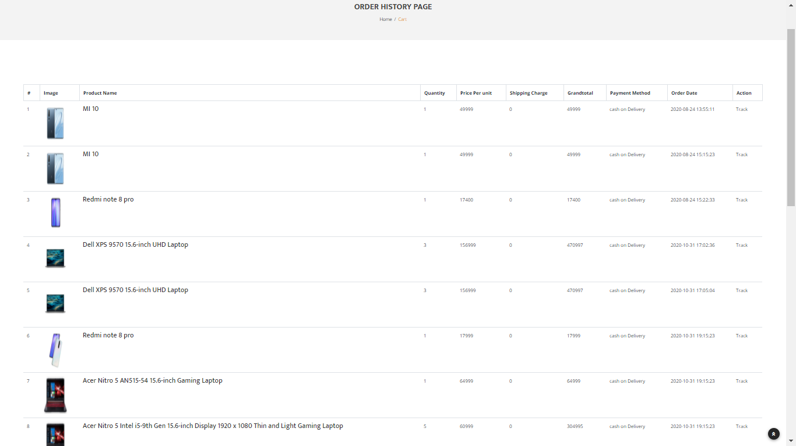

Slide 12
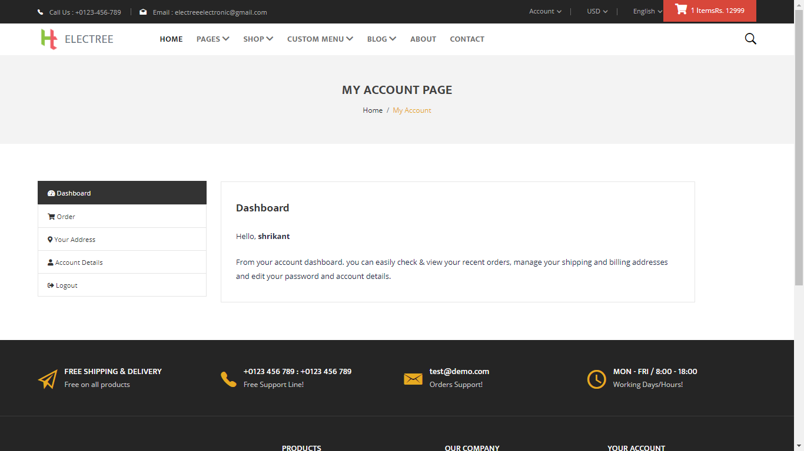

Slide 13
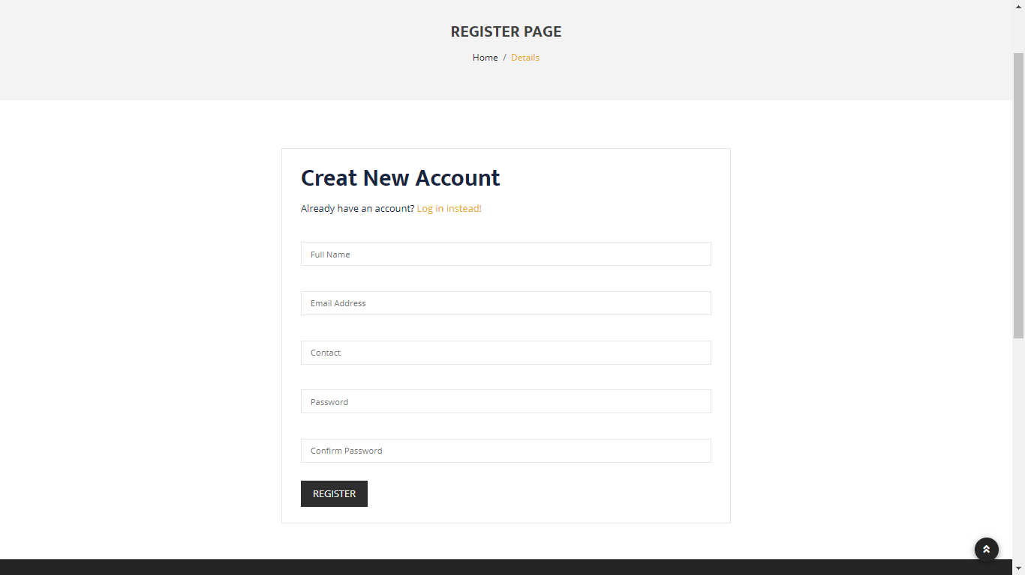

Slide 14
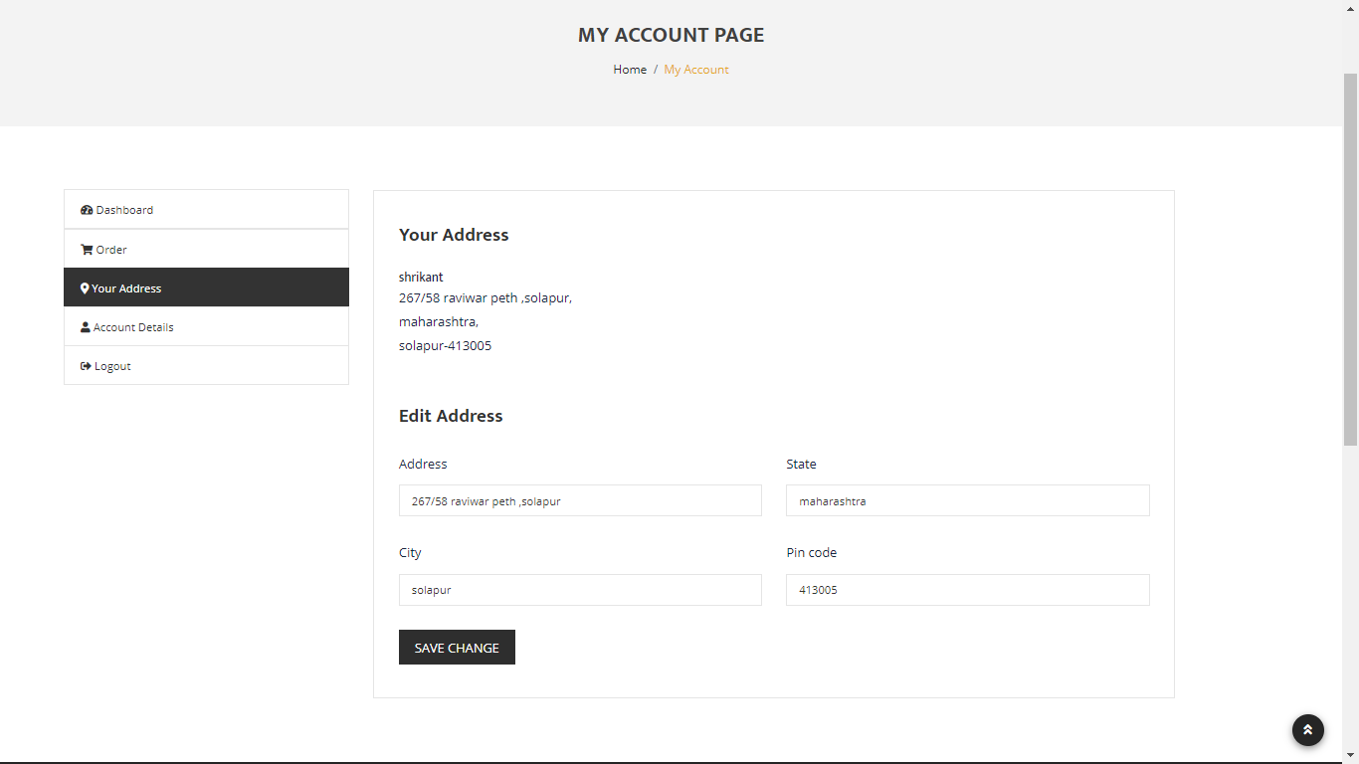

Slide 15
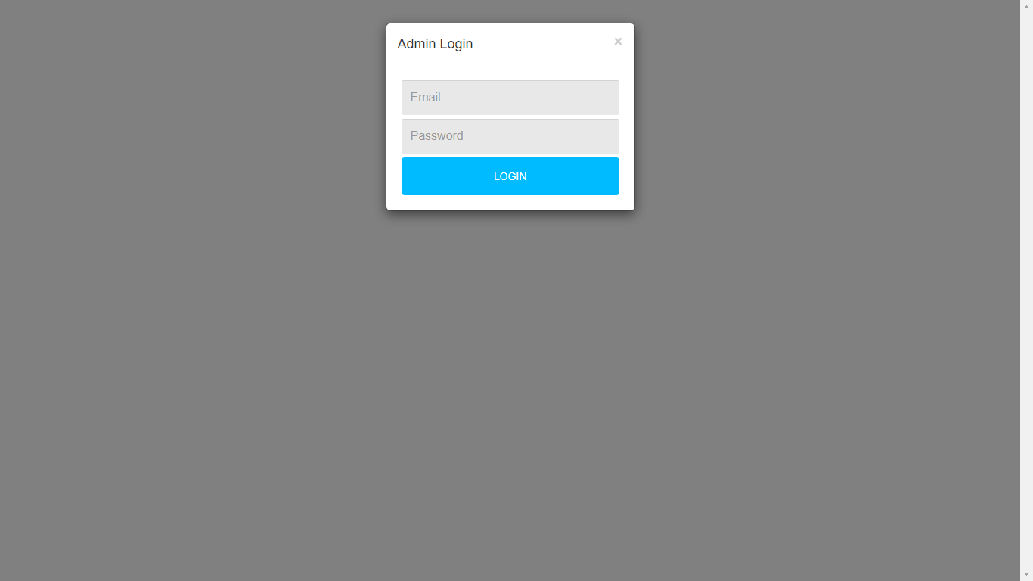

Slide 16
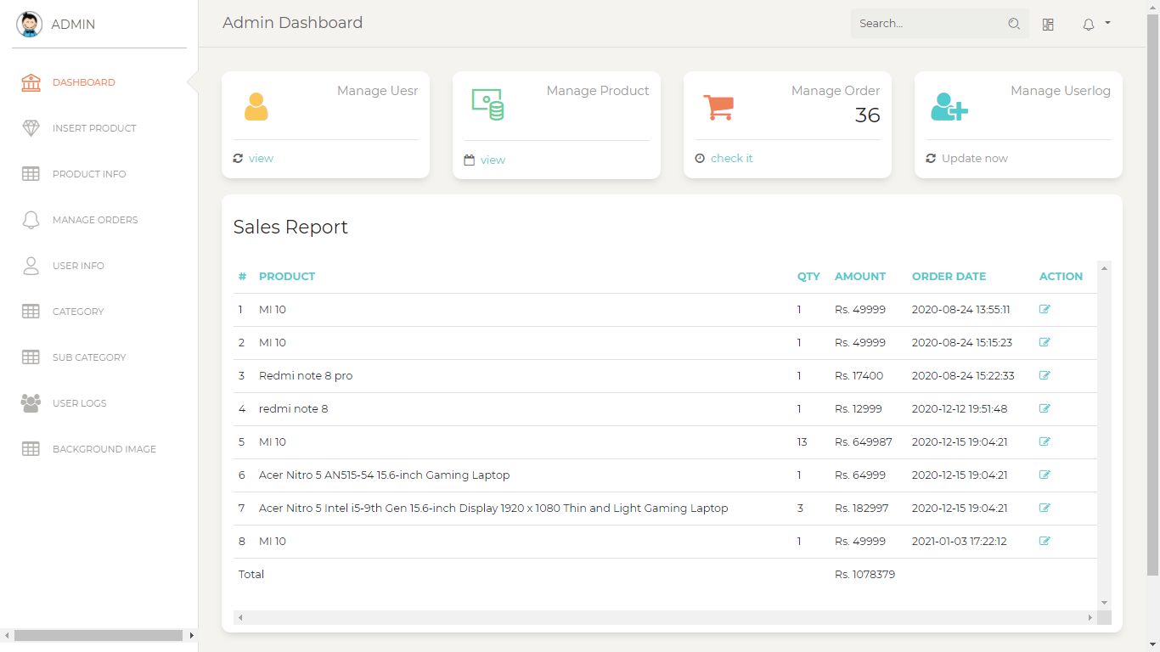

Slide 17
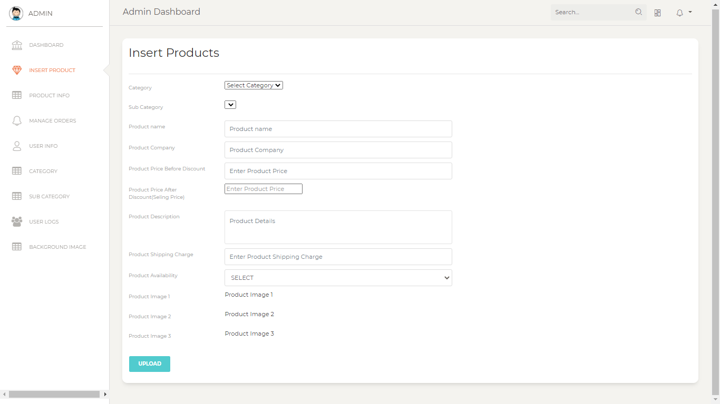

Slide 18
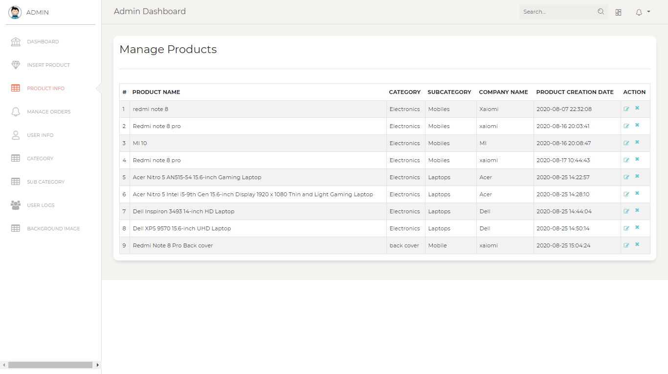

Slide 19
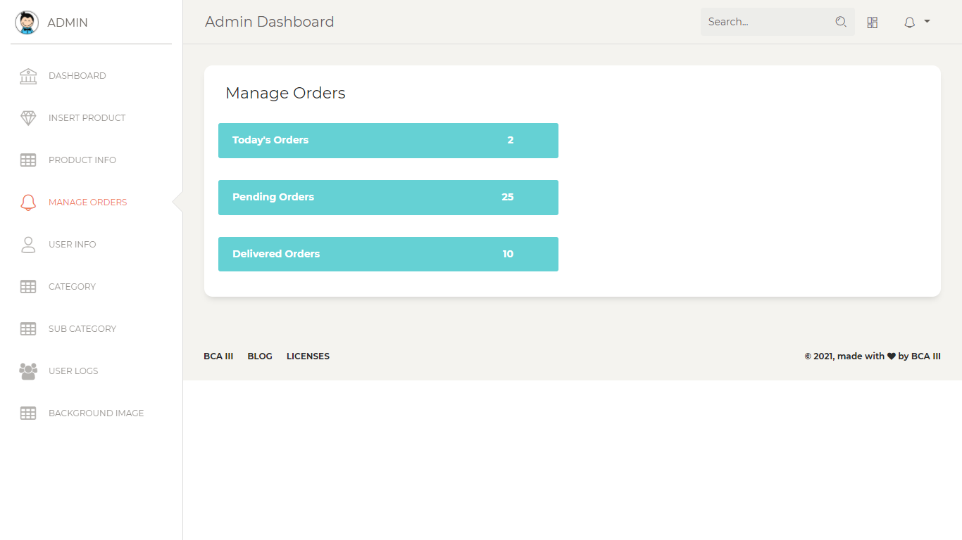

Slide 20
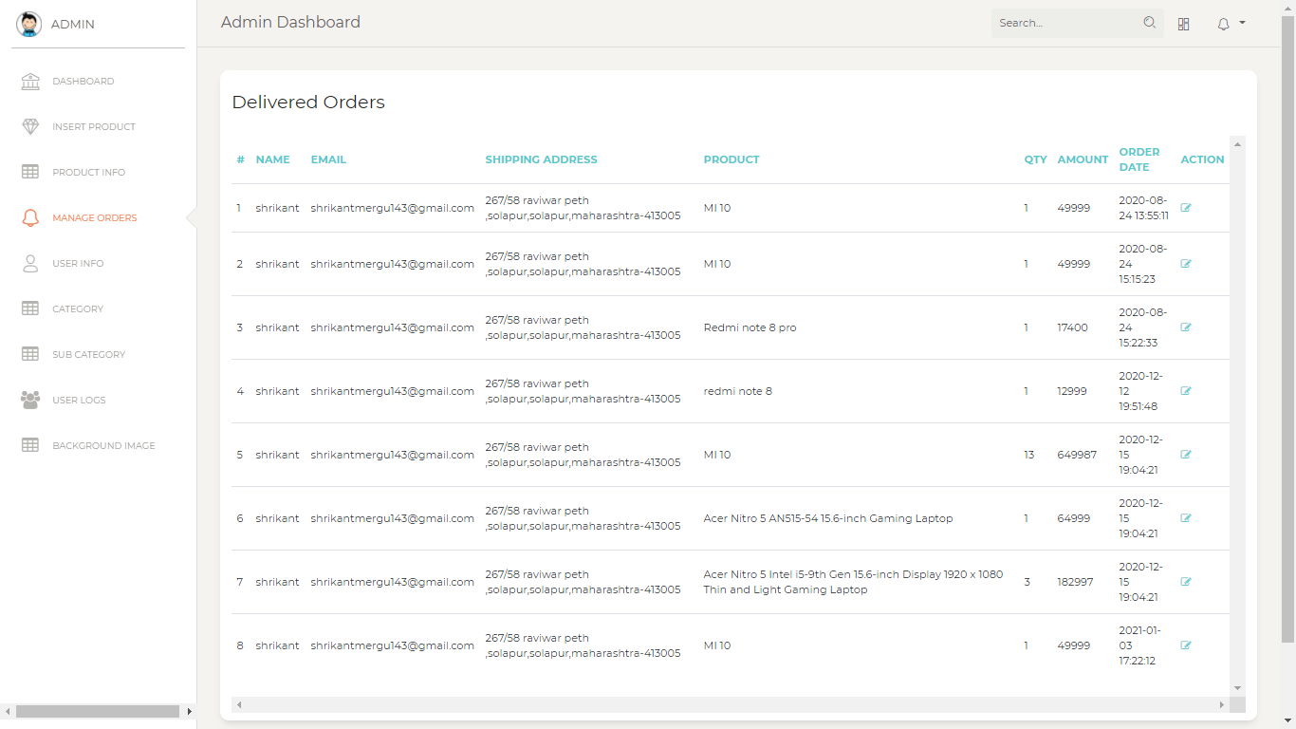

Slide 21
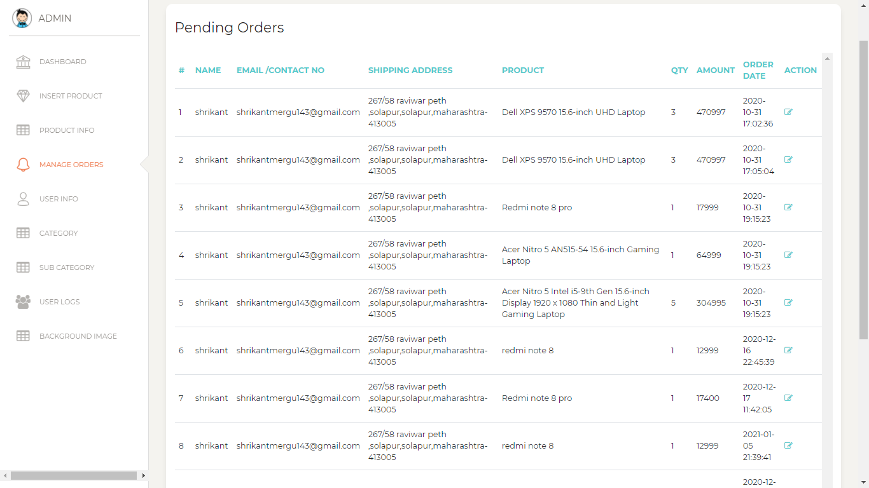

Slide 22
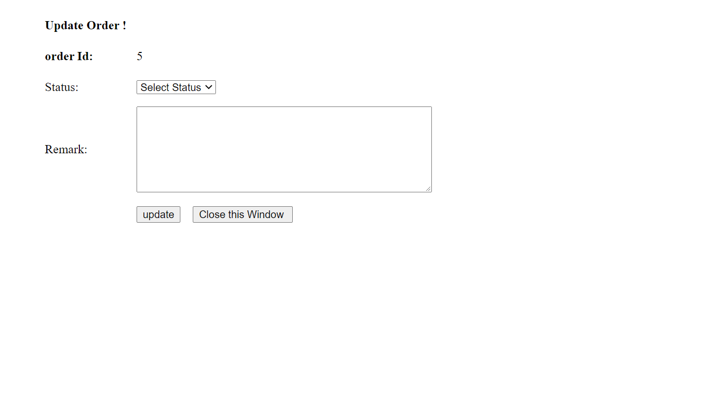

Slide 23
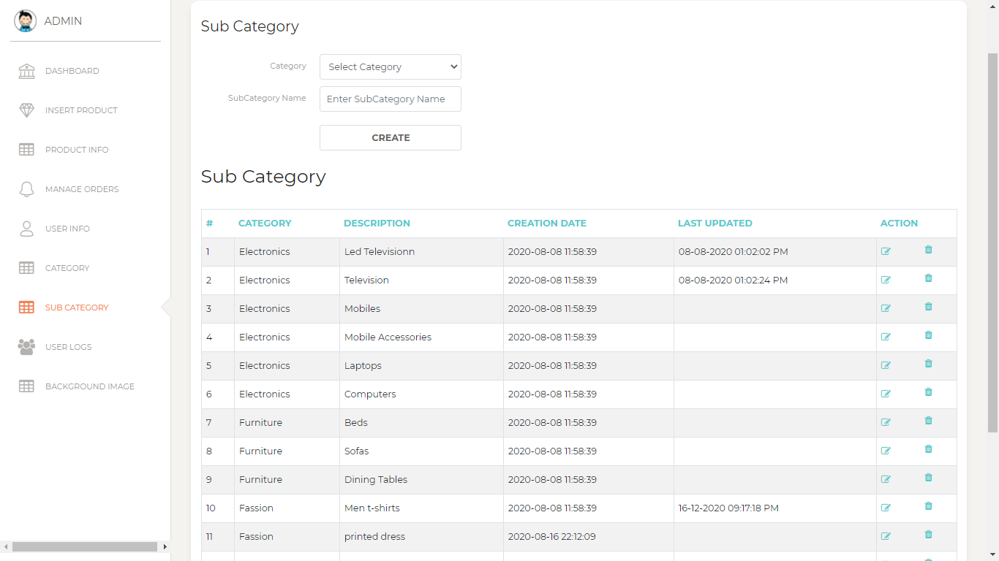

Slide 24
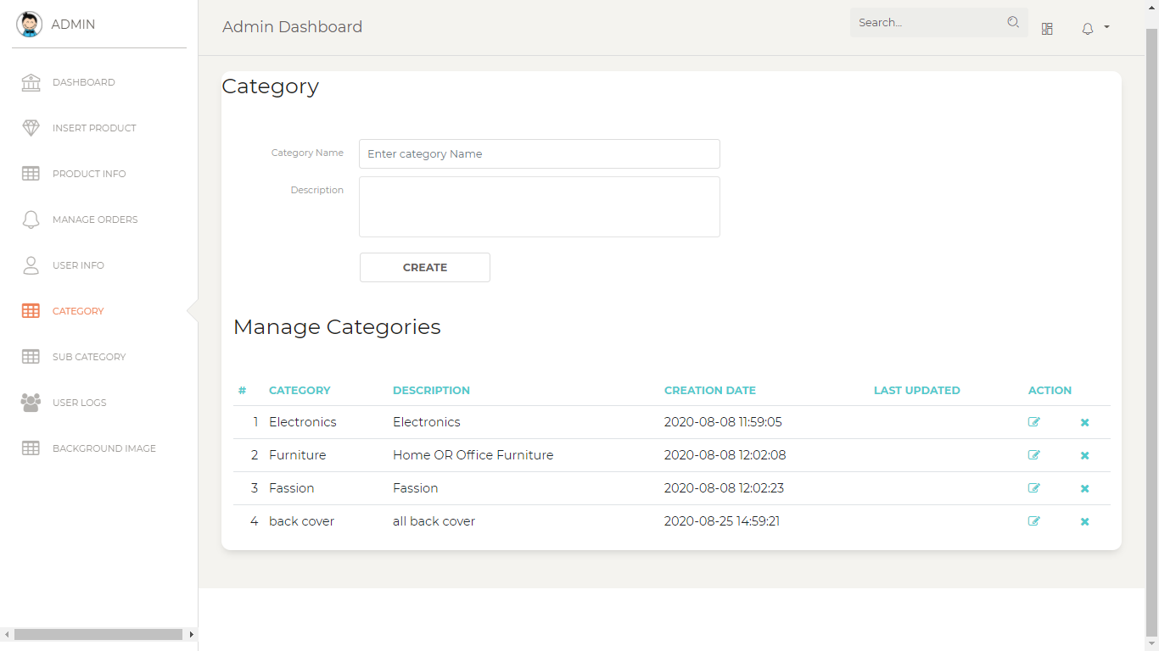

Slide 25
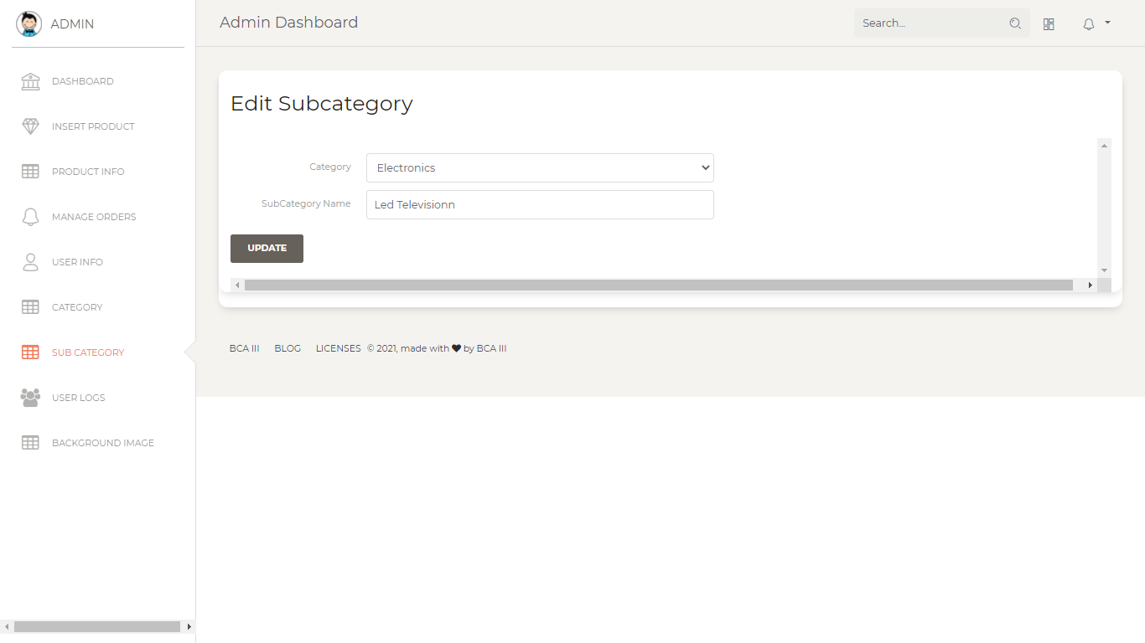

Slide 26
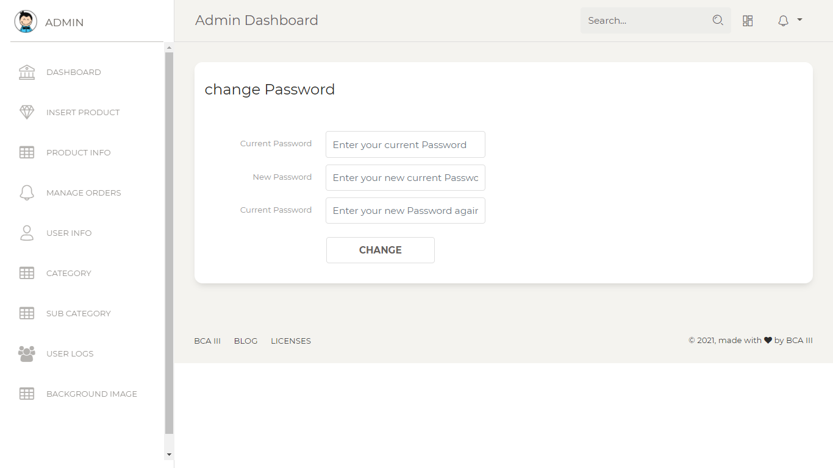

Slide 27
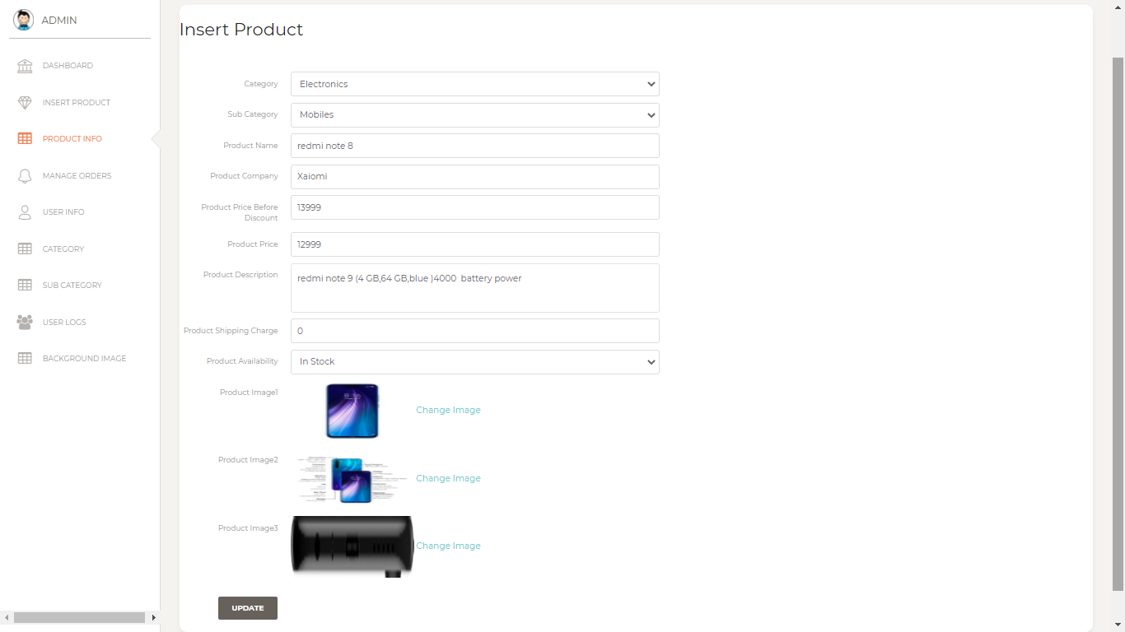

Slide 28
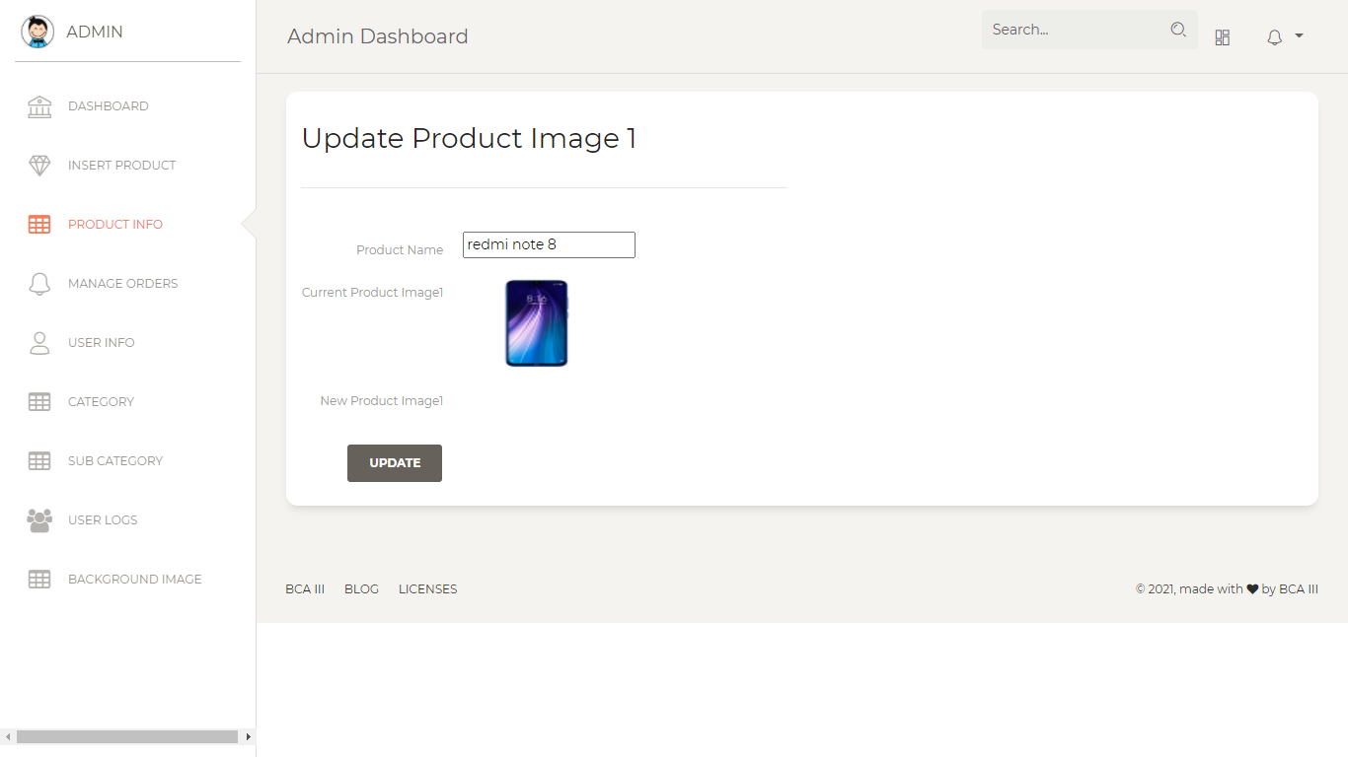

Slide 29
LIMITATIONS
In this Project security is not strong.
User Password format is not set.
Forgot password is not declared for user. But can be change password using old password.
Otp Verification is NOT available .

Slide 30
Thank You

