Slide 1
DATA PROVENANCE USING QUERY INVERSION
Kiran VS-2013H103092P
Shrikant Jagtap-2013H112176P

Slide 2
Introduction
Provenance information describes the origins and the history of data in its life cycle
Data Provenance – Origin of a piece of data and the process by which it arrived in database.
Two Approaches
1.Annotation Based Approach
2.Query Inversion

Slide 3
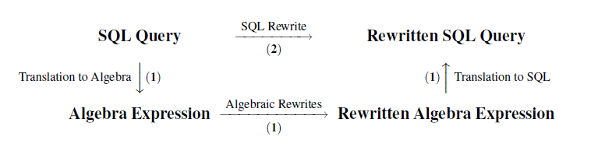
Query Inversion
Process of finding source tuples from output table with the help of rewrite rules.

Slide 4
Implementation Steps
Store fired query in Query Table with the help of Time Stamp.
Create output table and link Query table and Output table.
Select Output table for Data Provenance.
Get the corresponding tuple (Query String ,Time Stamp).

Slide 5
Implementation Steps cond.
Parse the source query string with the help of Sql Parser.
Query Metadata as the output of Sql Parser.
Use Query Metadata and according to query type rewrite the source query.
Use TimeStamp constraint in the rewritten query to get correct input tuples.

Slide 6
SQL PARSER
Pass the input source query to the sql parser.
Using the parser find the sql statements present in the query string.
For each sql statement divide the query into different parts like
Select Part, From Part, Join Part, OnCondition Part, Group by part etc.
Each part contains its associated list of table details and column details.
Finally we obtain the query metadata which will be the input for query rewriting model.

Slide 7
Rewrite Rule Translation
Translating it into relational algebra, applying the algebraic rewrites, and translating it back to SQL
OR
Using the mapping between relational algebra and SQL to translate the rewrite rules to SQL

Slide 8
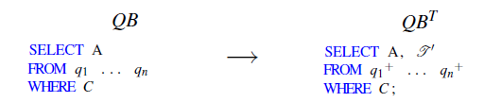
Rewrite of SPJ Query Block
Algebraic rewrite rule to SQL
SIMPLE SELECT FORMAT

Slide 9
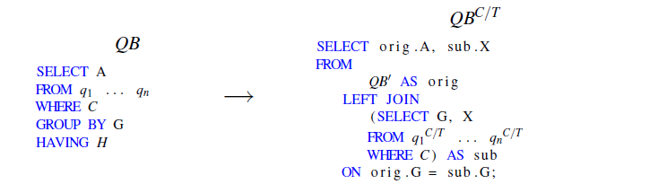
Rewrite of SPJ Query Block cond.
SELECT-GROUP BY- HAVING FORMAT

Slide 10
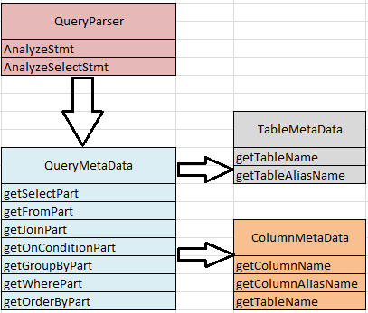
SQL PARSER
Used to analyze and get all the SQL statement details which are used for Query Rewriting.

Slide 11
SQL PARSER cond.
ALGORITHM :
Get the input query to parse.
Get the list of SQL statements from input query.
Analyze statement to get the type of query.
Call AnalyzeSelectStmt if Query type is SELECT.
Get the TABLE LIST from the sql statement and store it in QueryMetadata.
Get the COLUMN LIST from the Select part of the sql statement.
Get the Tables used for JOIN.
Get the Columns used for OnCondition of JOIN.
Get the Columns from the Where Clause of the sql statement.
Get the Columns from the Group by Clause.
Return the QueryMetadata Object details to the Provenance Model.

Slide 12
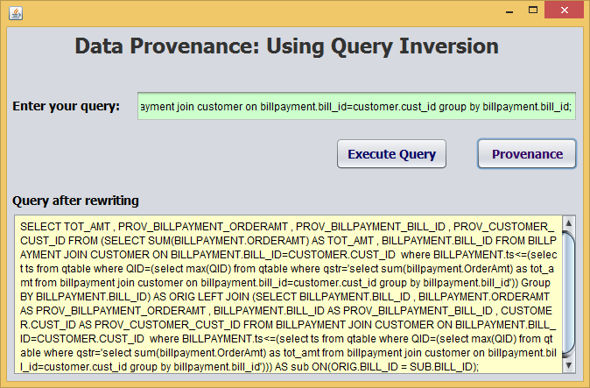
PROVENANCE RESULT GUI

Slide 13
Conclusion
Implemented Data Provenance using a new query inversion approach.
Storing only the user queries, unlike annotation approach
SQL Parser is used to analyze the user query.
Parser speeds up the query rewriting process to get the correct result for queries like ASPJ ,Simple where ,Union and Nested Select

Slide 14
THANK YOU

