Slide 1
S5- CalculatedFieldsAcrossBlends
File created on: 5/6/20 10:39:28 PM EDT

Slide 2
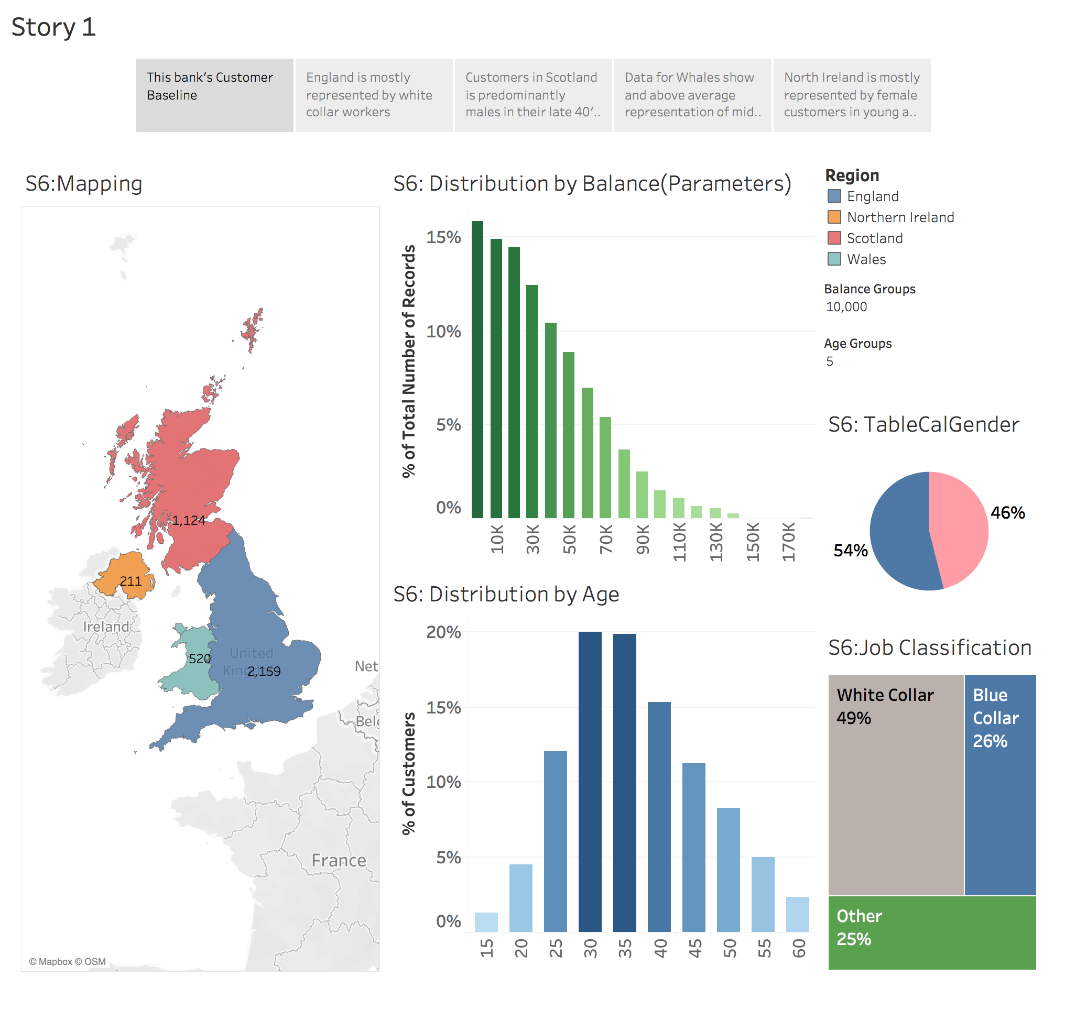

Slide 3
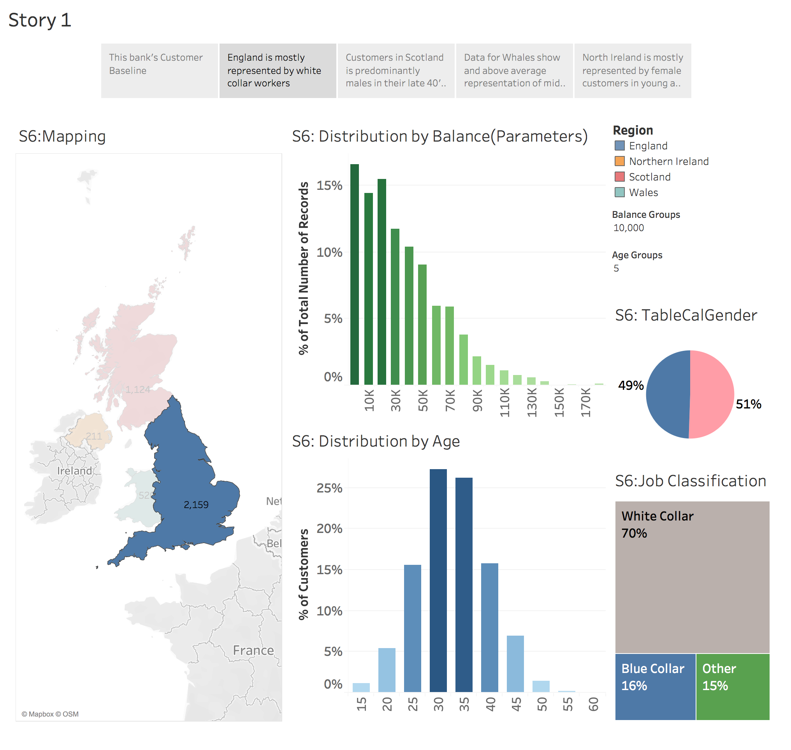

Slide 4
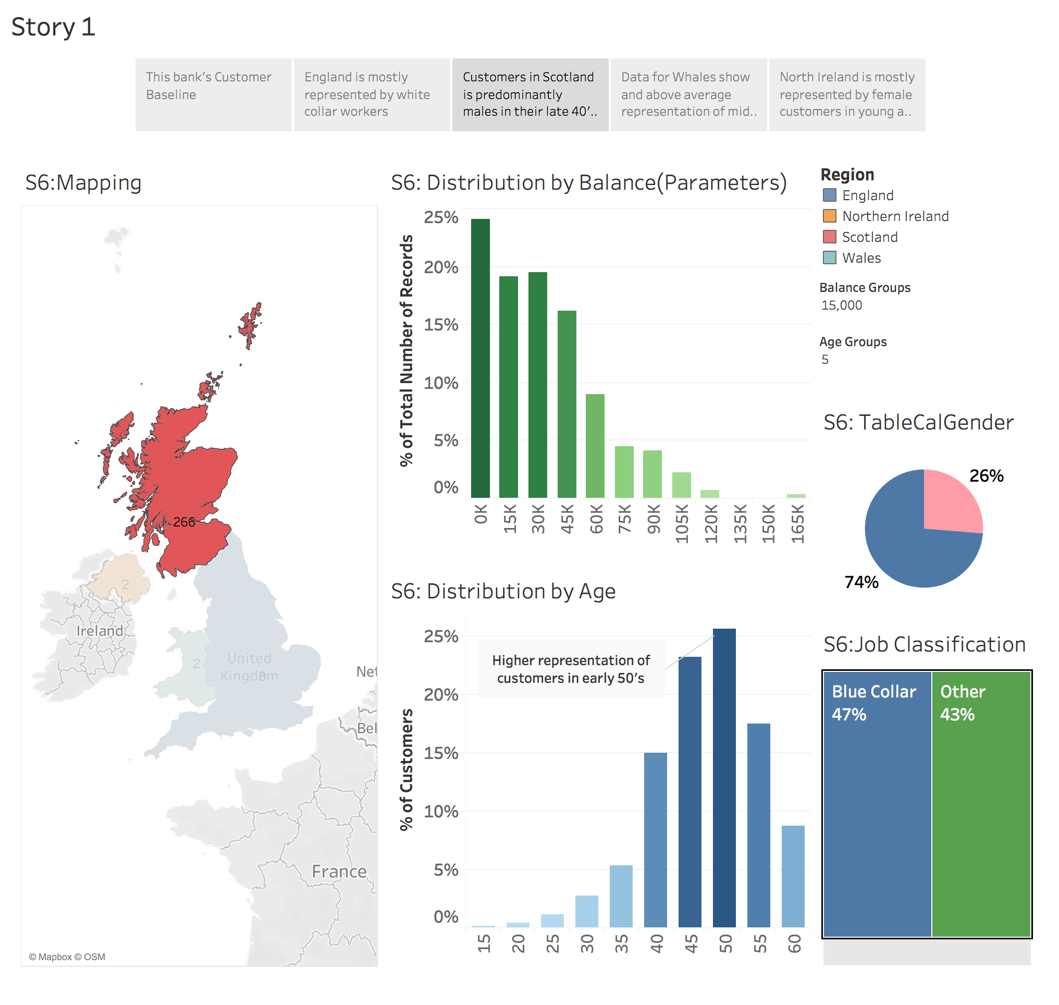

Slide 5
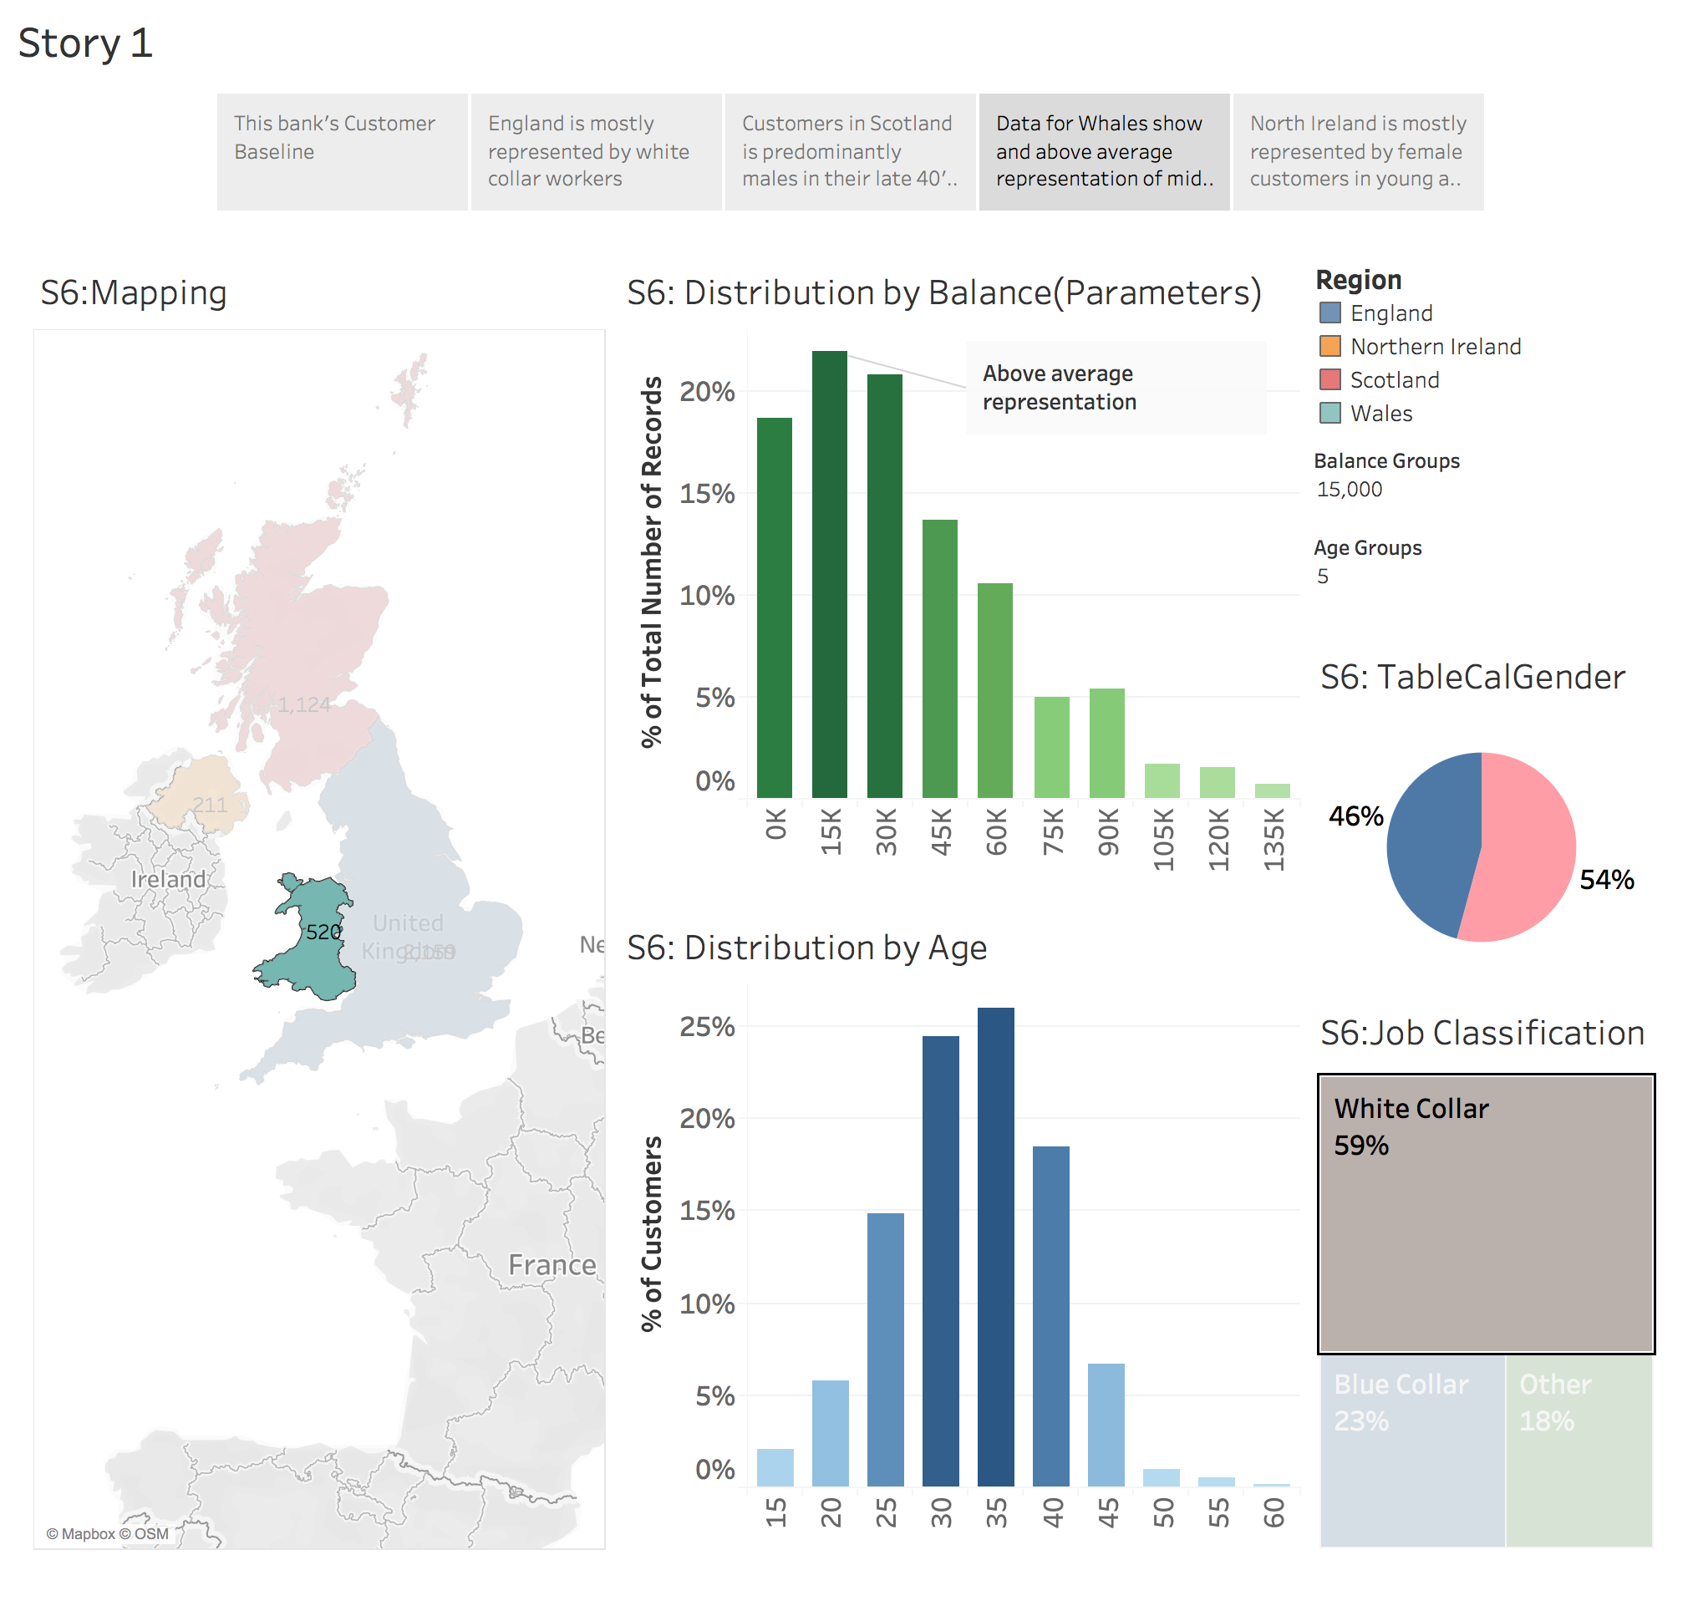

Slide 6
